Slide 1
Data Science Summit
March Madness Challenge

Slide 2
March Madness Challenge
Background: Every year, the college basketball national champion is crowned by winning the NCAA Tournament. The Tournament is a 68-team single-elimination competition known for random and chaotic outcomes, resulting in this time being known as March Madness. Despite the mayhem, can we provide insight into which teams are most likely to win?
Objective: Create a model that, given Team A and Team B, calculates the likelihood of Team A defeating Team B. We will evaluate the performance of the model using the actual games from a past year’s tournament.

Slide 3
More Background
NCAA DI
350+ teams
32 Conferences
After the regular season, each conference holds a tournament
Each conference tournament winner advances to the national tournament
A selection committee selects *36 “at-large” teams to join the 32 automatic qualifiers in the national tournament
The selection committee ranks all 68 teams

Slide 4
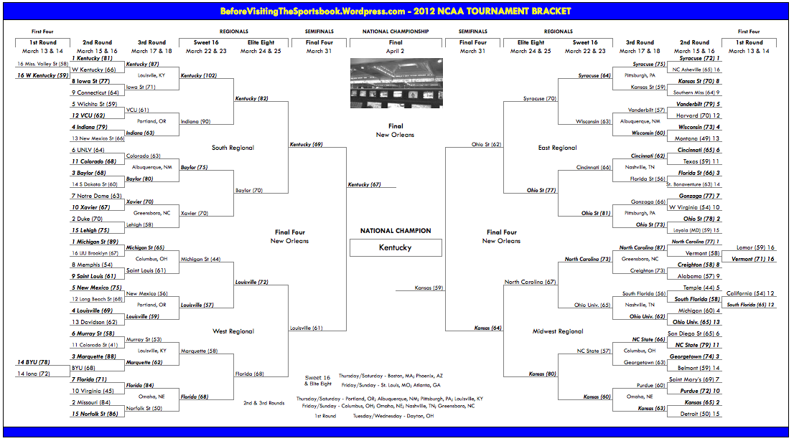
The NCAA Tournament

Slide 5
Submission File
Rename it according to your team name – e.g., ‘Team1.csv’
Fields
TeamA
TeamB
TeamA_Win_Prob
Update TeamA_Win_Prob with results from your model

Slide 6
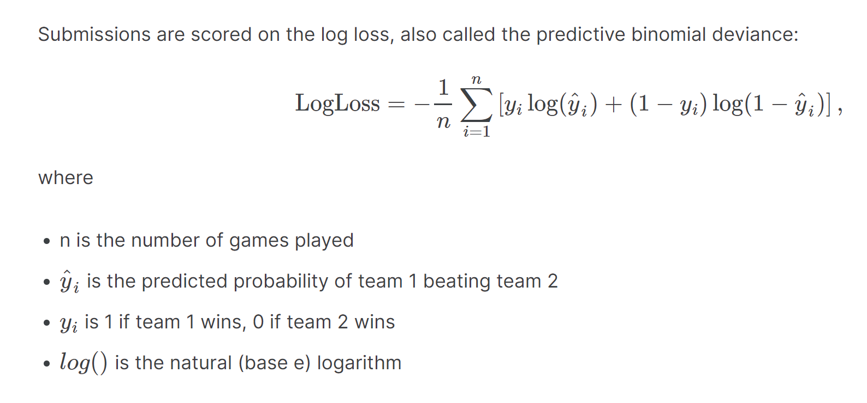
Evaluation

Slide 7
The Data
Teams - This file identifies the different college teams present in the dataset. Each team has a 4 digit id number.
Seasons - This file identifies the different seasons included in the historical data, along with certain season-level properties
"season" - indicates the year in which the tournament was played
"dayzero" - tells you the date corresponding to daynum=0 during that season. All game dates have been aligned upon a common scale so that the championship game of the final tournament is on daynum=154. Working backward, the national semifinals are always on daynum=152, the "play-in" games are on days 134/135, Selection Sunday is on day 132, and so on.
"regionW/X/Y/Z" - by convention, the four regions in the final tournament are always named W, X, Y, and Z.

Slide 8
The Data
RegularSeasonCompactResults - This file identifies the game-by-game results for 31 seasons of historical data, from 1985 to 2015. Each year, it includes all games played from daynum 0 through 132 (which by definition is "Selection Sunday," the day that tournament pairings are announced). Each row in the file represents a single game played.

Slide 9
The Data
RegularSeasonDetailedResults - This file is a more detailed set of game results, covering seasons 2003-2015. This includes team-level total statistics for each game (total field goals attempted, offensive rebounds, etc.) The column names should be self-explanatory to basketball fans (as above, "w" or "l" refers to the winning or losing team)
wfgm - field goals made
wfga - field goals attempted
wfgm3 - three pointers made
wfga3 - three pointers attempted
wftm - free throws made
wfta - free throws attempted
wor - offensive rebounds
wdr - defensive rebounds
wast - assists
wto - turnovers
wstl - steals
wblk - blocks
wpf - personal fouls

Slide 10
The Data
TourneyCompactResults - This file identifies the game-by-game NCAA tournament results for all seasons of historical data. Note that these games also include the play-in games (which always occurred on day 134/135) for those years that had play-in games.
TourneyDetailedResults - This file contains the more detailed results for tournament games from 2003 onward.

Slide 11
The Data
TourneySeeds - This file identifies the seeds for all teams in each NCAA tournament, for all seasons of historical data. Thus, there are between 64-68 rows for each year, depending on the bracket structure.
"season" - the year
"seed" - this is a 3/4-character identifier of the seed, where the first character is either W, X, Y, or Z (identifying the region the team was in) and the next two digits (either 01, 02, ..., 15, or 16) tells you the seed within the region. For play-in teams, there is a fourth character (a or b) to further distinguish the seeds, since teams that face each other in the play-in games will have the same first three characters. For example, the first record in the file is seed W01, which means we are looking at the #1 seed in the W region (which we can see from the "seasons.csv" file was the East region). This seed is also referenced in the "tourney_slots.csv" file that tells us which bracket slots face which other bracket slots in which rounds.
"team" - this identifies the id number of the team, as specified in the teams.csv file

