Slide 1
Azure Kubernetes Service
Global Azure Bootcamp 2019, Jena, 27-April-201
Mark Blume
Principal Software Engineer

Slide 2
Containers in Azure
# container instance
az container create --name $CI_NAME –image nginx --dns-name-label $LABEL \
--ports 80 --query ipAddress.fqdn
# web application
SP_ID=`az appservice plan create --name $SP_NAME --is-linux \
--sku P1V2 -o tsv --query id`
az webapp create --name $APP_NAME --plan $SP_ID \
--deployment-container-image-name nginx

Slide 3
container based applications
elements of
container orchestration
scheduling
scaling
node (anti)affinity
health monitoring
failover
networking
service discovery
coordinate app upgrades
Env_02
Services
Environments
Env_01
Env_03
Nodes
…

Slide 4
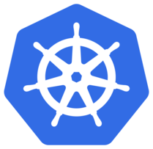
Kubernetes
de-facto standard for container orchestration
graduated project of cncf.io
Supported by Azure, AWS, Google Cloud, IBM, …

Slide 5
Kubernetes - Pods
Pods
… are an environment for containers
environment variables
storage assignment
IP address
… are organized by lables
… specify resource requirements, the containers need
cpu, memory, …
node affinity
… defines health checks
readiness probe
liveness probe
… will be accessed over Services
Service
10.0.37.57
10.24.1.66
app: myapp
10.24.1.65
app: myapp

Slide 6
Kubernetes - Manifests
deployment.yaml
service.yaml
apiVersion: apps/v1
kind: Deployment
metadata:
name: mydeployment
spec:
replicas: 2
selector:
matchLabels:
app: myapp
template:
metadata:
labels:
app: myapp
spec:
containers:
- name: myctnr
image: nginx
ports:
- containerPort: 80
apiVersion: v1
kind: Service
metadata:
name: myservice
spec:
selector:
app: myapp
ports:
- port: 80
targetPort: 80

Slide 7
Kubernetes Manifest - apply
localhorst@notebook:/mnt/d/BootCamp$ kubectl apply -f deployment.yaml
localhorst@notebook:/mnt/d/BootCamp$ kubectl apply -f service.yaml
localhorst@notebook:/mnt/d/BootCamp$ kubectl get –o wide
NAME READY STATUS RESTARTS AGE IP NODE
pod/myapp-5769ff78fc-4sjr7 1/1 Running 0 1m 10.244.1.66 aks-agentpool-35064155-0
pod/myapp-5769ff78fc-9qxln 1/1 Running 0 1m 10.244.1.65 aks-agentpool-35064155-1
NAME TYPE CLUSTER-IP EXTERNAL-IP PORT(S) AGE SELECTOR
service/myapp ClusterIP 10.0.37.57 <none> 80/TCP 4m app=myapp
NAME DESIRED CURRENT UP-TO-DATE AVAILABLE AGE CONTAINERS IMAGES SELECTOR
deployment.apps/myapp 2 2 2 2 1m myctnr nginx app=myapp
NAME DESIRED CURRENT READY AGE CONTAINERS IMAGES SELECTOR
replicaset.apps/myapp-5769ff78fc 2 2 2 1m myctnr nginx app=myapp, …

Slide 8
Kubernetes Deployment Rollout
service.yaml
name: myapp
replicas: 2
Image: myimg:v1
deployment.yaml
Service
10.0.37.57
create
replicas: 2
Image: myimg:v1
aks-agentpool-35064155-0
Deployment
ReplicaSet
create
Rollout
Rollout
v1
kubelet
proxy
v1
2 | 1 | 0
0 | 1 | 2
create
v2
v1
ReplicaSet
aks-agentpool-35064155-1
update
replicas: 0
Image: myimg:v2
kubelet
proxy
deployment.yaml
name: myapp
replicas: 2
Image: myimg:v2

Slide 9
Kubernetes Deployment Rollout
service.yaml
Service
10.0.37.57
aks-agentpool-35064155-0
Deployment
v2
kubelet
proxy
create
ReplicaSet
v2
aks-agentpool-35064155-1
update
replicas: 2
Image: myimg:v2
kubelet
proxy
deployment.yaml
name: myapp
replicas: 2
Image: myimg:v2

Slide 10
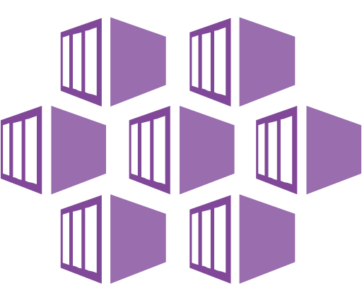
Azure Kubernetes Service (AKS)
A fully managed Kubernetes Service

Slide 11
AKS Setup
# AKS installation
az aks create --name myaks --node-count 2 --node-vm-size Standard_D2_v3
# coffee break (10min)
# kubernetes client (optional)
az aks install-cli
# create/adapt kube kube config (~/.kube/config)
az aks get-credentials --name myaks
# ready
kubectl get nodes

Slide 12
AKS - Advanced Networking
… with using Azure Container Networking Interface (CNI)
use an preconfigured subnet for
use the subnet IP range for Pod IP adresses
# advanced networking
az aks create ... \
--network-plugin azure \
--max-pods 30 \
--vnet-subnet-id <subnet-id> \
--docker-bridge-address … \
--dns-service-ip … \
--service-cidr …

Slide 13


AKS – Storage
apiVersion: v1
kind: PersistentVolumeClaim
metadata:
name: azure-managed-disk
spec:
accessModes:
- ReadWriteOnce
storageClassName: managed-premium
resources:
requests:
storage: 5Gi
---
kind: Pod
spec:
containers:
- name: myapp
volumeMounts:
- mountPath: "/mnt/azure"
name: myvolume
volumes:
- name: myvolume
persistentVolumeClaim:
claimName: azure-managed-disk
standard K8s volume types: azureDisk and azureFile
predefined StorageClasses for providing Azure ManageDisks as PersistentVolumeClaim
StorageClasses for Azure Files can be created.
StorageClass
Admin
PVClaim
Pod
Developer

Slide 14
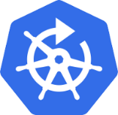
AKS – Security Patches
Kured
(Kubernetes Reboot Daemon)
watches for presence of a reboot sentinel: /var/run/reboot-required
Utilise a lock in the API server to ensure only one node reboots at a time
Block reboots for dedicated Pods
Block reboots view Prometheus alerts
https://github.com/weaveworks/kured
Patches are installed automatically.
But nodes will not rebooted !

Slide 15

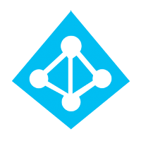
AKS – Authentication
use AAD authentication
enable RBAC for users
define RoleBindings for AD users and groups
client app
# Active Directory Authentication
az aks create ... \
--aad-server-app-id ...\
--aad-server-app-secret ...\
--aad-client-app-id ...\
--aad-tenant-id ...
server app

Slide 16
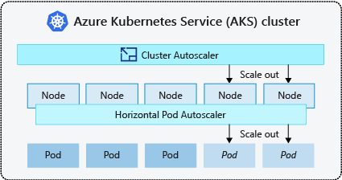
AKS – Cluster Autoscaler (Preview)
# horizontal pod autoscaler
apiVersion: autoscaling/v2beta2
kind: HorizontalPodAutoscaler
metadata:
name: myapp-autoscaler
spec:
scaleTargetRef:
apiVersion: apps/v1
kind: Deployment
name: myapp
minReplicas: 1
maxReplicas: 10
metrics:
- type: Resource
resource:
name: cpu
target:
type: Utilization
averageUtilization: 50
# cluster autoscaler
az extension add --name aks-preview
az aks create ... \
--kubernetes-version 1.12.6 \
--enable-vmss \
--enable-cluster-autoscaler \
--min-count 1 \
--max-count 3
https://github.com/kubernetes/autoscaler/blob/master/cluster-autoscaler/FAQ.md#what-are-the-parameters-to-ca

Slide 17
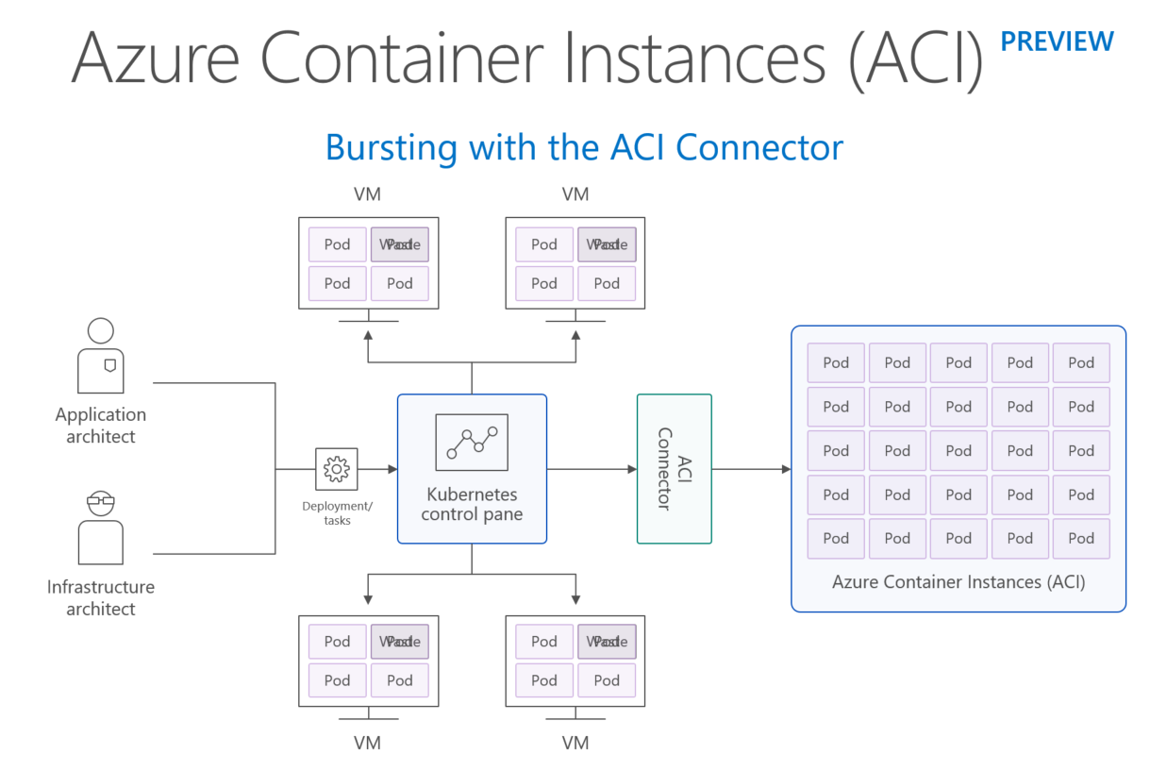
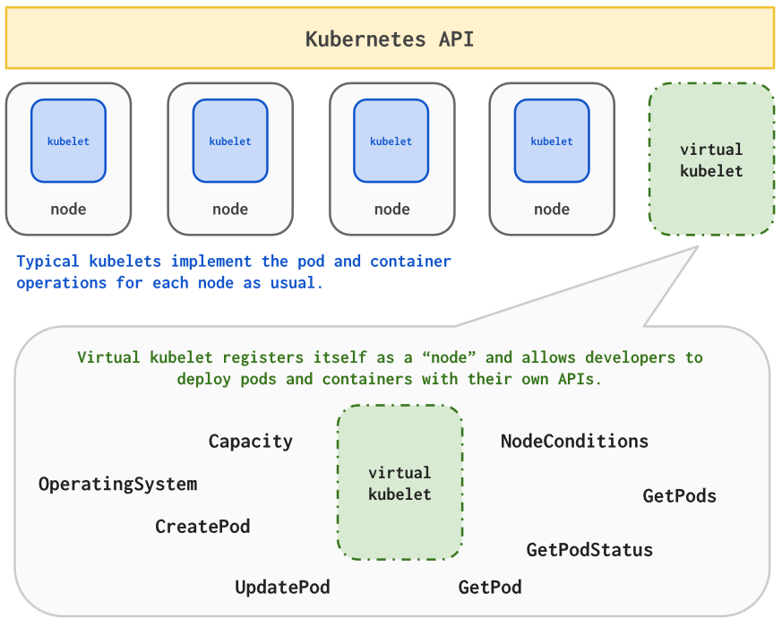
AKS – Virtual Kubelets (Preview)
https://github.com/virtual-kubelet

Slide 18
Azure Devops

Slide 19

Azure Dev Ops – Continuos Delivery
v5
v6
v4
v3
DEV
OPS
v4
v7
v5

Slide 20
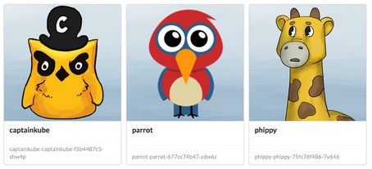
Phippy and Friends
https://github.com/Azure/phippyandfriends

Slide 21
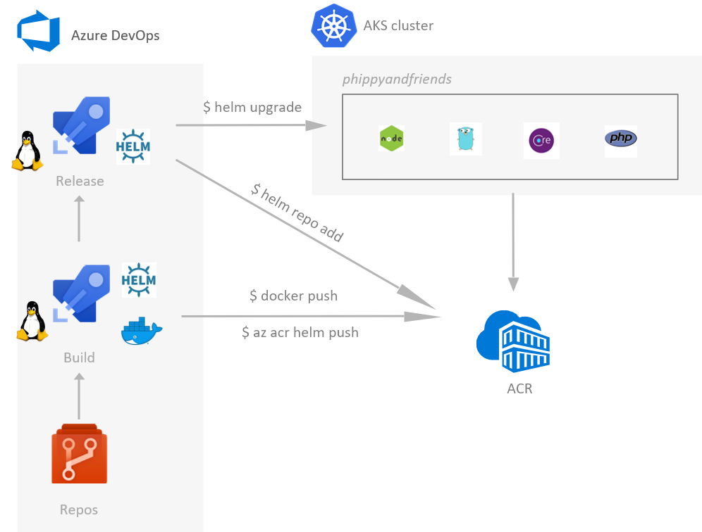
https://github.com/Azure/phippyandfriends

Slide 22
Q & A

