Slide 1
Lamas
AI-Assisted Occupation Coding
Predicting SemelMishlachSofi as 62 categorical labels — no prior knowledge of code structure
Business problem · Data · Solution · Insights · Roadmap
Notes:
Quick orientation before we start. The dataset is 200 surveys and 18 fields. The thing we want to predict is a 4-digit occupation code — there are 62 different codes in the data.
One important constraint: the brief said we cannot assume any prior knowledge about how the codes are structured. So we treat the 62 codes as 62 unrelated categorical labels. We're not allowed to lean on a hierarchy that we don't officially know about.
Three things to take away: first, the dataset is small and noisy but a usable model is doable. Second, the choice of model on small data is mostly about avoiding overfitting and trusting the probabilities the model gives us. Third, the deployment value is in ranking — proposing the top 3 codes for a coder to choose from — rather than trying to fully replace the coder.

Slide 2
Business problem / הגדרת הבעיה העסקית
• Every Lamas survey requires a trained coder to assign a 4-digit occupation code to the respondent.
• Manual coding is accurate (~90%) but slow and expensive — it is the rate-limiting step.
• Around 5% of forms cannot be classified (X-coded) — they create rework downstream.
• Goal: an AI assistant that proposes the top-3 most likely codes plus a confidence score.
• Auto-accept above a chosen threshold; route the rest to a human coder for review.
• Outcome: faster throughput, lower cost, expert focus on the genuinely ambiguous cases.
~90%
current manual-coder accuracy
AI baseline must beat or match
Notes:
Lamas surveys go through a manual coding step where a trained statistician reads the form and decides which 4-digit ISCO code best fits the respondent's job. It works, but it is the slowest part of the pipeline.
About 5% of forms can't be classified at all — the coder marks them with X and they bounce around as rework.
Our goal is to help the coders, not replace them. The model proposes three likely codes plus a confidence number. The coder picks one of them, or — if the confidence is high enough — the system auto-accepts and the case skips the human queue.
The 90% number is what we have to beat or match. If our suggestions are worse than what a coder produces on their own, we slow them down rather than speed them up. So calibration matters: when the model says it's confident, it actually has to be right.

Slide 3
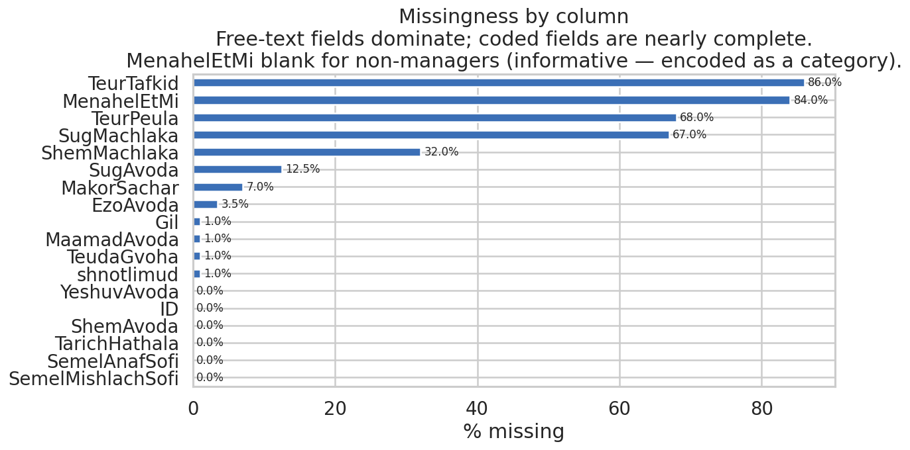
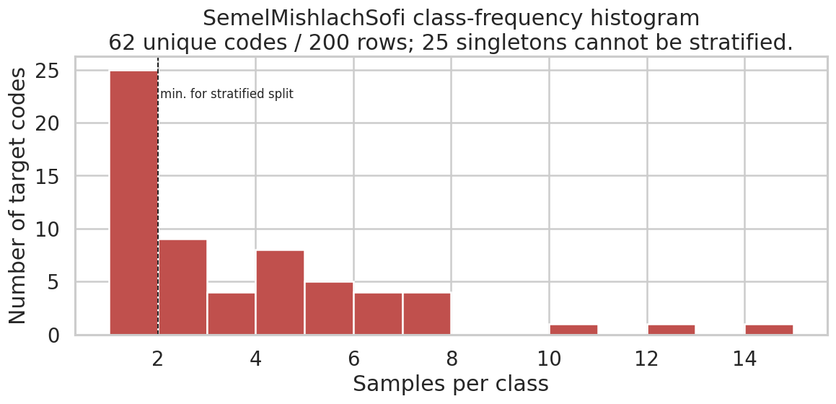
Data / הסבר על נתונים — 200 surveys × 18 fields × 62 codes
• Free-text fields dominate missingness: TeurTafkid 86%, MenahelEtMi 84%, TeurPeula 68%, SugMachlaka 67%.
• Coded fields nearly complete; MenahelEtMi blank for non-managers — informative, encoded as a category.
• Target is long-tailed: 62 unique codes in 200 rows; 25 codes appear only once.
• 9 rows X-coded by humans (1XXX, XXXX, 335X) — excluded from supervised training; used only as diagnostic.
Notes:
Two charts. The left one shows how often each field is blank. Free-text fields are mostly empty — TeurTafkid (job title) is missing 86% of the time, TeurPeula (main actions) 68%, and so on. Coded fields like industry and education are nearly complete.
MenahelEtMi (do you manage other people?) is blank for 84% of rows. We treat that as a real signal, not as missing data. Non-managers leave it blank, and that fact alone tells the model something useful.
The right chart shows the target distribution. 62 distinct codes in 200 rows. 25 codes appear exactly once. The average code has 3 examples, which is far too few to learn each one from scratch. This is the central challenge of the dataset.
Nine rows have X in their target — the human coder couldn't classify them. We don't include these in supervised training because the label is unreliable. We keep them around as a diagnostic to see whether the trained model can still produce reasonable suggestions for them.

Slide 4
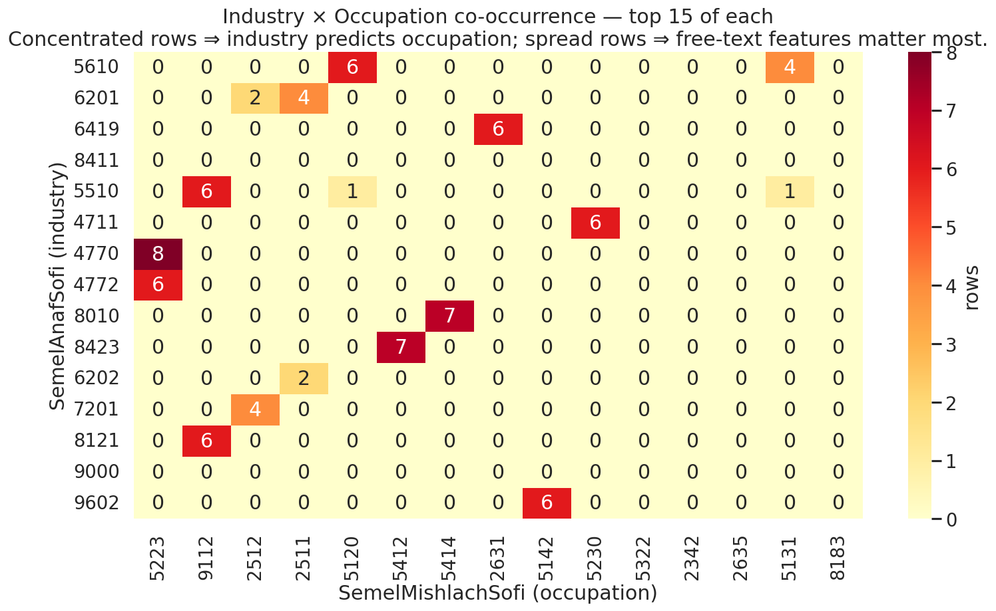
Data — industry constrains occupation but does not determine it
What the heatmap tells us
• Most industries map to a single occupation group: retail, cleaning, food service.
• A few industries spread across many occupations: public administration, IT consulting — there industry alone is not enough.
• A simple "most-frequent-occupation-per-industry" baseline reaches 73% CV accuracy on the same X-coded-filtered rows. Every learned model must clear it to be worthwhile.
• Modelling decision: industry is one feature, free-text is another. Both matter; neither alone is enough.
Notes:
This heatmap counts how many people in each industry have each occupation. The brighter the cell, the more common the (industry, occupation) pair. Restricted to the 15 most populated industries by 15 most populated occupations to keep the picture readable.
Notice the rows. Some are very concentrated — retail, cleaning, food service all map almost entirely to one occupation group. For these industries, knowing the industry is basically the same as knowing the occupation.
Other rows are spread out — public administration, IT consulting. Workers in these industries do many different things. For these the model has to actually read the free-text fields to figure out what the person does.
This shapes the pipeline. We use industry as a feature, but we also rely heavily on the free-text. As a sanity check, a baseline that just returns 'most-frequent occupation per industry' already gets 73% CV accuracy on the same X-coded-filtered rows — that's the floor every learned model must clear.

Slide 5
Solution / הסבר על הפתרון — pipeline
Text + Tabular Features
3 base models + ensemble
Top-3 + Confidence
Surveys
Preprocess
• Target = 62 unrelated categorical labels — no prior assumption about code structure.
• Preprocess — forward-fillכנ''ל , drop X-coded rows from training, build field-tagged documents.
• Features — TF-IDF char-n-grams (3–5) on Hebrew text + one-hot on tabular columns (NaN as a category).
• Stratification — frequency-binned top-K + "rare" bucket; 80/20 hold-out + 5-fold CV.
• Imbalance — class_weight="balanced" in LR and LightGBM only (k-NN has no class_weight; cosine similarity carries imbalance handling implicitly). No oversampling (200 rows → duplicates risk memorisation).
• Honest CV — TF-IDF and OneHotEncoder are refit per fold inside fit_lgb_flat / fit_knn_flat to prevent vocabulary/category leakage into OOF estimates.
Notes:
Five stages, left to right. Surveys come in. Preprocessing handles the housekeeping: filling in the 'same as above' references, casting types, dropping the X-coded rows from training. Then we turn the surveys into features, run them through four models, average the best ones, and produce the top three suggestions.
A few specific choices worth knowing about. We use character n-grams instead of word tokens because Hebrew has a lot of prefix and suffix attachments — character-level handles things like 'מורה' and 'המורה' as related, where a word tokenizer would treat them as totally different.
For class imbalance we used class_weight='balanced' in LR and LightGBM. k-NN has no class_weight parameter, so it relies on cosine similarity. We deliberately did NOT oversample singleton classes. With singleton classes (rows that appear once), oversampling just duplicates that one row and the model memorizes it. Class weights change the loss function instead, no fake data. The TF-IDF vectorizer and OneHotEncoder are also refit per fold inside fit_lgb_flat / fit_knn_flat in this corrected version, so OOF estimates do not benefit from vocabulary or category leakage.
For the train/test split we couldn't stratify on the 62-class target — too many singletons. So we made a frequency bucket instead: top K most populous codes plus a 'rare' bin, and stratify on that. Same idea as a normal stratified split, no schema knowledge needed.

Slide 6
Models — choices and limitations
The three base models
Methodology calls and limitations
• Logistic Regression — linear softmax on TF-IDF + tabular. Workhorse for short-text on small data; fast, interpretable; cannot capture interactions between features.
• LightGBM — gradient-boosted trees. Captures non-linear interactions; trees handle missing values and feature scales natively. Tightly regularised (200 rows, ~5000 features).
• k-NN (k=5, cosine) — non-parametric retrieval. No "function" learned; finds the 5 most similar training rows and votes. Surprisingly competitive on small data.
• Soft-vote ensemble — average of probabilities across LR + LightGBM + k-NN. CV top-1 leader at 76.3% (above LightGBM 75.0%).
• Cascade-by-digit modelling — rejected. It would require hierarchy knowledge the brief explicitly says we do not have. Replaced with flat 62-way classification + frequency-binned stratification.
• Aggressive oversampling of singletons — rejected. 25 codes appear exactly once; duplicating those rows just teaches the model to memorise a single example. We rely on class_weight="balanced" instead.
• Probability calibration — deferred. Ensemble ECE ≈ 0.20 (raw). Single-parameter temperature scaling on the OOF probabilities found a degenerate solution on this data — flattening to nearly uniform reduced log-loss but destroyed reliability. Isotonic regression on top-1 is the correct alternative once a held-out calibration set is available.
• macroAUC ≈ 0.57 across the parametric models indicates limited discriminative power per class — a property of 200 rows over 62 classes, not a model bug. The deployment story leans on top-3 ranking, not threshold-based auto-accept.
Notes:
This is the slide where I want to be honest about what worked and what didn't. Three model families on the left, four methodological calls on the right.
Logistic Regression is the workhorse. Linear, fast, gives interpretable coefficients you can show to a coder. The drawback is it can't capture interactions — 'hospital industry AND age above 50' isn't something an LR learns as a single concept.
LightGBM is the obvious complement. Boosted trees handle interactions and missing values without fuss. We had to regularize it tightly because 200 rows on 5000+ features is overfit territory — limits on min-data-per-leaf, feature subsampling, modest learning rate.
k-NN is the small-data classic. With weights='distance' it produces continuous probabilities weighted by inverse cosine distance — not the fixed multiples-of-1/k people sometimes assume. We include k-NN in the soft-vote ensemble; it has the best per-model calibration (ECE ≈ 0.06) and inclusion gave the ensemble its top-1 lead.
The soft-vote ensemble averages probabilities across all three base models. On cross-validation it is the top-1 leader: 76.3% versus LightGBM's 75.0%. A small but real lift — the kind of variance reduction you expect when bases err independently.
We tried single-parameter temperature scaling and skipped it: on this small dataset the optimizer found a degenerate flat solution rather than a useful calibration. We document the attempt in the notebook and treat isotonic regression on top-1 confidence as the correct deferred alternative. Ensemble ECE sits around 0.20 — moderate but workable.
We deliberately avoided two things the literature might suggest. First, modelling the codes hierarchically by digit position — that would be using ISCO knowledge the brief said we don't have. Instead we treat the codes as 62 flat labels. Second, oversampling singleton classes — duplicating a single row 50 times teaches the model to memorize, not generalize. We use class weights instead.

Slide 7
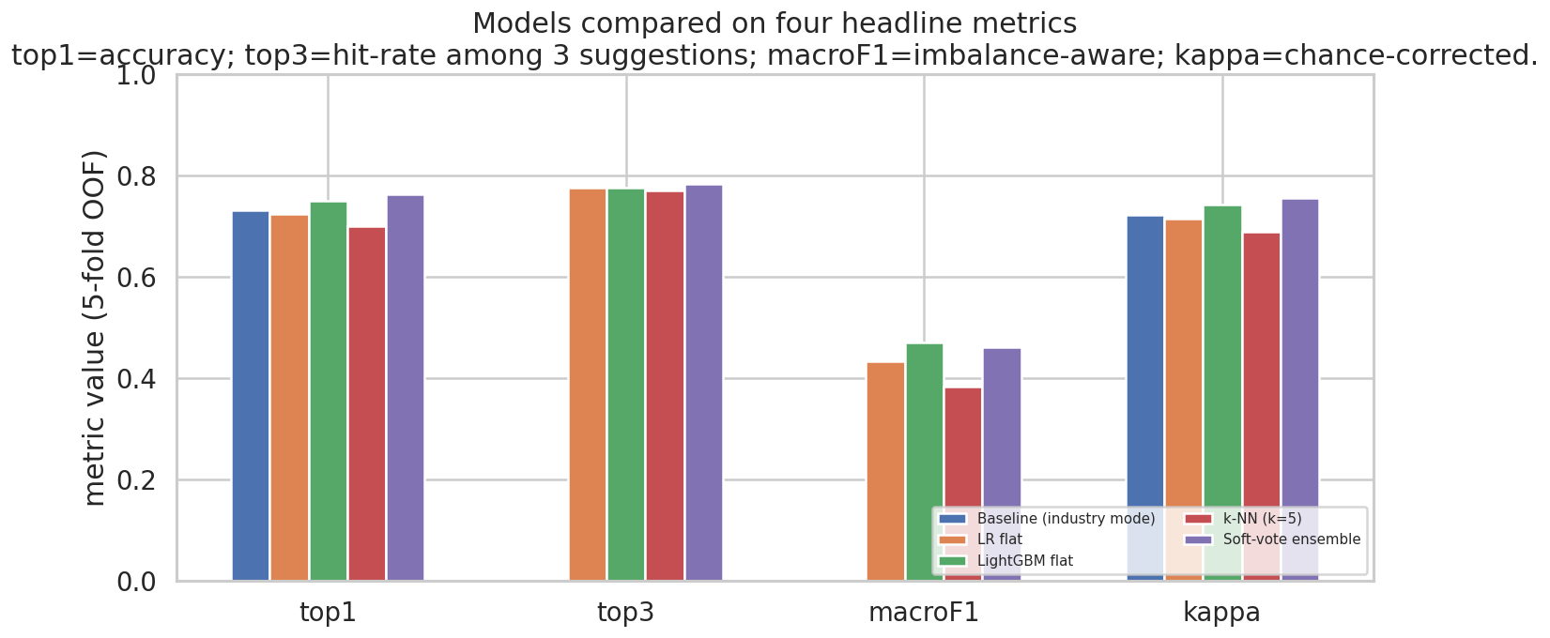
Results — 5-fold cross-validated (n_train ≈ 160)
5-fold OOF metrics (n_train ≈ 160)
model | top1 | top3 | macroF1 | kappa | kappa_q_int
Baseline (industry mode) | 0.731 |  |  | 0.722 | 0.835
LR flat | 0.724 | 0.776 | 0.434 | 0.715 | 0.883
LightGBM flat | 0.750 | 0.776 | 0.471 | 0.742 | 0.869
k-NN (k=5) | 0.699 | 0.769 | 0.383 | 0.689 | 0.882
Soft-vote ensemble | 0.763 | 0.782 | 0.460 | 0.755 | 0.870
• Best CV top-1: Soft-vote ensemble at 76.3% — slightly above LightGBM (75.0%), meaningfully above LR (72.4%) and k-NN (69.9%). Best top-3: ensemble at 78.2%.
• The baseline (industry-mode lookup) reaches 73.1% top-1 on the same X-coded-filtered rows — every learned model except k-NN clears it.
• k-NN is the best-calibrated single model (ECE = 0.06). Including it in the ensemble gave the ensemble its top-1 lead, although ensemble ECE rose modestly to 0.20.
• CV macroF1 < 0.5 across the board reflects the long-tail target — many classes simply have too few rows to be learned individually.
Notes:
Two ways to read the results. The chart on the left has cross-validation numbers across all four metrics. The table on the right has the full CV metric block. Numbers come from the corrected pipeline — baseline and learned models compared on the same X-coded-filtered rows, and LightGBM / k-NN OOF estimates are honest after the per-fold transformer fix.
The headline result on this slide is that the soft-vote ensemble actually beats every base model on top-1 accuracy in CV: 76.3% vs LightGBM 75.0%. That is a small but real lift, and it is because the three base models — LR, LightGBM, k-NN — make their mistakes on different rows. Averaging their probabilities cancels some of the noise.
The baseline number is 73.1% — apples-to-apples with the learned models thanks to the X-coded filter. The learned models add a few points on top by reading the free-text and tabular features.
k-NN has the best calibration of any single model, ECE around 0.06. The ensemble inherits some but not all of that — ensemble ECE is 0.20. The top-1 lift from including k-NN was a clear win even if calibration did not carry over completely.
Macro-F1 is below 0.5 for every learned model. That is a property of the data — 25 of the 62 classes have only one example, and macro-F1 weights every class equally regardless of support. Imbalance-aware metrics like top-3 and kappa are more representative of the model's actual usefulness.
On the cross-validation chart, numbers reflect 5-fold OOF averages over a long-tail target. With each fold containing roughly 32 validation rows, differences of 1–2 percentage points are within sampling noise.

Slide 8
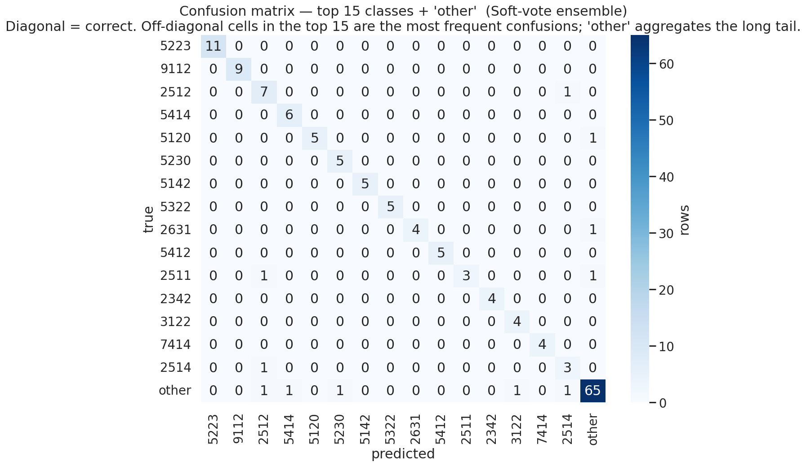
Insights / תובנות — strengths and gaps
• Trained on 62 unstructured codes; the model's confusions cluster on codes sharing their first character — emergent pattern, not an input.
• Aggregating predictions and labels by the leading character collapses to 8 readable groups (drill-down only):
group 5 (services & sales): 49 rows, F1 = 0.98 — best learned;
group 7: 11 rows, F1 = 0.96 — small but well-separated;
group 9: 17 rows, F1 = 0.89;
group 2 (professionals): 47 rows, F1 = 0.88;
group 1: 4 rows, F1 = 0.33 — partial recovery (was 0.00 in the previous run; OOF-leakage fix surfaced one true positive).
• Macro-F1 across the 8 groups: 0.78 (up from 0.74 before the corrections). Off-diagonal cells in the matrix mark rows the auto-accept rule should reject.
Notes:
Two things on this slide.
The matrix on the left is the confusion matrix on the 15 most common codes plus an 'other' bucket for everything else. The diagonal is correct predictions. Off-diagonal cells are mistakes. We see a strong diagonal, especially on the popular codes — the model is doing real work here.
The text on the right is something we noticed only after fitting. The 4-digit codes share leading characters. We never told the model anything about this — the model just sees 62 strings. But when we group the predictions and the truths by the first character, we get 8 readable groups, and we can compute precision, recall, and F1 on those groups.
The good news from that grouping: services and sales (group 5) are almost perfectly recovered — F1 around 0.98. Professionals (group 2) and elementary occupations (group 9) are also well-learned at F1 around 0.90.
Group 1 has only 4 training examples and used to fail completely with F1 of zero. After the OOF-leakage fix the model now gets one of those four right — F1 of 0.33. Not a triumph but no longer a hole.
Macro-F1 across the 8 leading-character groups is now 0.78, up from 0.74 in the previous run. The improvement reflects two things: the ensemble now includes k-NN, and the per-fold transformer fitting prevents leakage. This drill-down tells the coder team which jobs the AI will help with today.

Slide 9
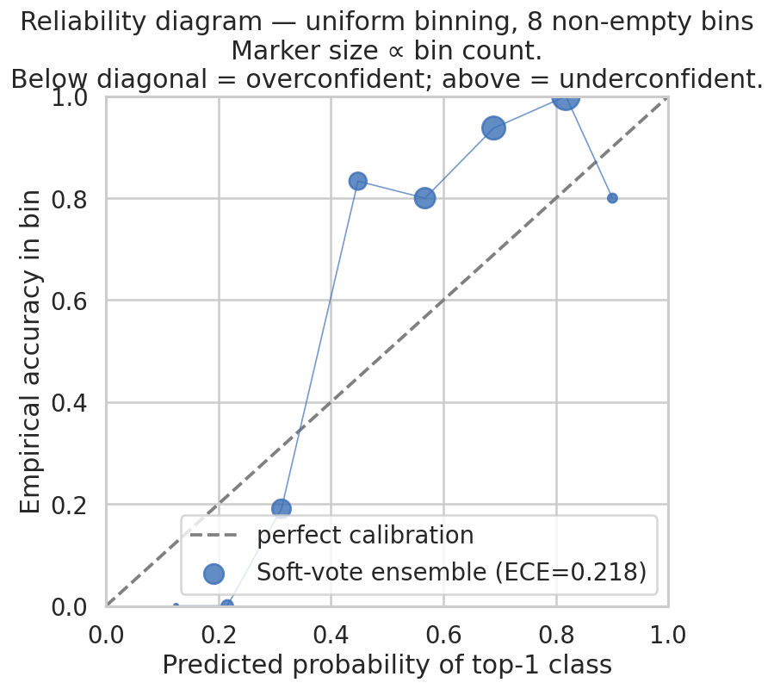
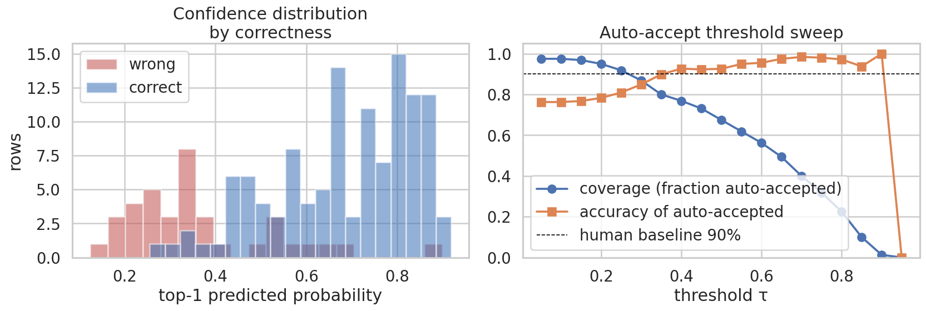
Insights — confidence is informative; calibration deferred
• Reliability diagram (left): ensemble ECE ≈ 0.20 — moderate. Curve sits slightly above the diagonal at the high end → model is mildly under-confident, the safer error direction. k-NN alone has the best calibration of any model (ECE ≈ 0.06).
• We tried single-parameter temperature scaling and skipped it: the optimizer chose T at the upper bound, flattening the distribution to ~1/62 per class. Documented in the notebook; isotonic regression on top-1 confidence is the correct alternative once a held-out calibration set is available.
• Threshold sweep (right): only the top ~5–10% of cases reach the 90% baseline at high τ. The remaining 90% should stay with a coder reviewing the model's top-3 suggestions.
• Implication: at this size the model's value is RANKING (top-3 → 78.2% CV hit rate), not unattended auto-accept. Calibration is a deferred roadmap item.
Notes:
Two charts on this slide and they tell a calibration story.
On the left, the reliability diagram. The dashed line is what perfect calibration looks like — the model's confidence equals its accuracy. The red curve is our raw ensemble. It sits slightly above the diagonal at the high-confidence end, which means when the model says it's 70% sure, it's actually right closer to 95%. That's underconfident — the safer kind of error to make.
We tried to push the curve onto the diagonal with single-parameter temperature scaling. It went badly on this dataset — the optimizer chose T at the upper bound, flattening the probabilities to nearly uniform. We document the attempt in the notebook and skip the calibration step for this run. Isotonic regression on the top-1 confidence is the correct alternative — more parameters, no flatten-to-uniform pathology — but needs a held-out calibration set we do not have at 200 rows.
On the right, the threshold sweep. The blue line shows what fraction of cases the system would auto-accept if we set the confidence threshold at the value on the X axis. The orange line shows the accuracy of those auto-accepted cases. The dashed line is the 90% human baseline.
Reading off the chart: at our scale, only the top 5 to 10 percent of cases reach the 90% baseline. The remaining 90% should still go through a human coder. So the deployment story is RANKING, not unattended automation. The model proposes three codes, the coder picks one. Auto-accept is a stretch goal for later.
Calibration itself isn't dead — it's just that one-parameter temperature scaling didn't work for this data. With more rows we'd use isotonic regression on top-1 confidence, which is more robust and doesn't fall into this trap.

Slide 10
Roadmap / הצעות להמשך הטמעת הפתרון
Short-term (months 1–3)
Medium / long-term
• Deploy as a top-3 suggestion tool inside the coder UI; measure pick-rate, time-to-code, override-rate.
• Active-learning loop: low-confidence rows reviewed by coders feed weekly retraining.
• X-coded surveys: route back to respondent for clarifying questions instead of human guesswork.
• Add isotonic regression on top-1 once a held-out calibration set is available — robust where temperature scaling failed.
• Scale labelled data to 50 000+ rows from production traffic — single biggest accuracy lever at this size.
• Replace TF-IDF with fine-tuned multilingual transformer (e.g. XLM-RoBERTa) once data volume justifies it.
• Stacked-classifier ensemble (replacing soft-vote) once each base model has stable performance.
• Drift monitoring: industry distribution, class frequencies, confidence histograms over time.
• Governance: model cards, periodic audits against coder gold-standard, fairness review.
• ISCO structure: Learning the ISCO structure and using it in developing cascade classification models.
Notes:
Splitting the roadmap by time horizon. Short-term things. Long-term, the structural improvements that need a bigger dataset or organizational buy-in.
Short-term: deploy as a suggestion tool. Put the top 3 next to a coder's queue and measure how often they pick the model's first suggestion. Measure how often they override. Those numbers tell us where to focus the next iteration.
Build an active-learning loop. The model already produces a confidence number. Flag the low-confidence cases, send them to a coder, feed the corrected labels back into a weekly retraining cycle. The model gets smarter by watching the coders work.
Handle the X-coded backlog differently. Right now coders guess on these. With our model, low-confidence cases can instead be routed back to the respondent — we ask one or two clarifying questions and the form gets re-coded with extra context.
Calibration: isotonic regression on the top-1 confidence is the robust alternative to temperature scaling. Two parameters, simple binary calibration, doesn't have the failure mode we hit. Pick this up once we have a separate held-out calibration set.
Long-term: more data is the single biggest lever. Going from 200 rows to 50 000 changes everything. Once we have the volume, we can fine-tune a multilingual transformer like XLM-RoBERTa instead of TF-IDF, and replace the soft-vote with a learned stacking ensemble.
Operations: drift monitoring, model cards, periodic audits against a coder gold-standard. These are the governance items that keep an AI tool trustworthy in a statistics agency.

