Slide 1
Clash of the Titans - MapReduce Versus Spark For Large Scale Data Analytics
One of the first efforts to measure how efficient MapReduce (MR) and Spark perform typical analytical and machine learning workloads.
Enterprise sized data sets are used.
4 typical use cases are evaluated.
Emphasis placed on
Measuring how efficient these frameworks shuffle and cache data.
How these programs use system resources (e.g., CPU, memory and disk).
Authored in 2015.
How do these findings hold up today?
Notes:
Ice Breaker: Millennial child not realizing their parents had fun back in the day partying up a storm and listening to wild music. Same view that I had prior to reviewing this article. I am like the Millennial when it comes to data science in a big date environment. It impossible to believe that data science with large dataset was performed back in the day – circa 2014 – 2015 – in many cases with Hadoop MR. That I thought about it some more, and realized that Social Media giants like Google and Twitter were using MR on massive data sets to do serious data science that core to business. As it turns out 2015 tuns out to be an inflection point in data science using large volume data sets. MR was still mature and going strong and this framwork called Spark was starting to get a lot of buzz.
The Clash of the Titans: Mapreduce Versus Spark for Large Scale Data Analytic – the paper I am reviewing today -- was one of the first quantitative evaluations of MR and Spark from the perspective of industrial strength Data Science.
The Paper focuses on 4 typical ML use cases – with the authors anticipating that their findings will generalize acorss the spectrum of data science work loads as a whole.
The authors place emphasis on measuring how efficient both frameworks are in terms of shuffle operations and data caching. The authors also take a deep dive into compare how both of these frameworks utilize resources across each of the four use case
Finally, I provide commentary on how well the author’s assertions hold up today – especially as it relates to sorting and shuffling data. I conclude with where my company, US Bank, is today and where it will be in a couple of years from now on the MR/Spark spectrum.

Slide 2
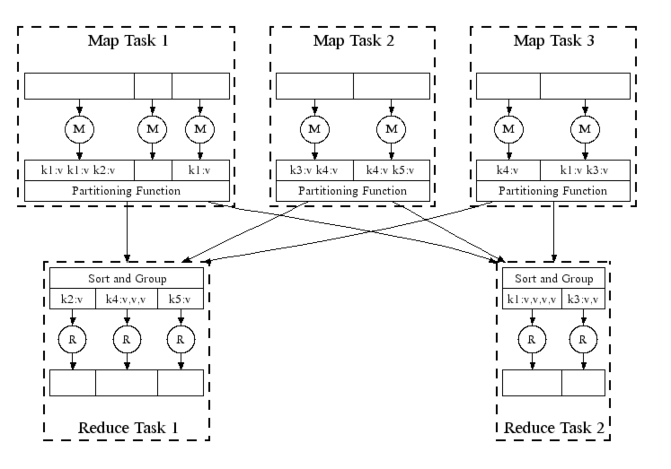
MapReduce (MR) Logical View
[1]

Slide 3
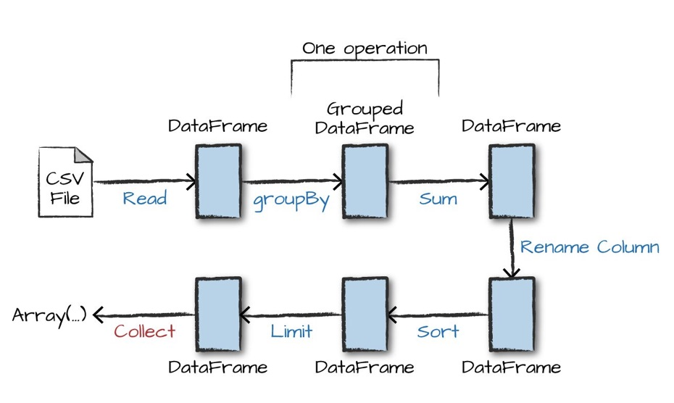
Spark Logical View
[2]

Slide 4
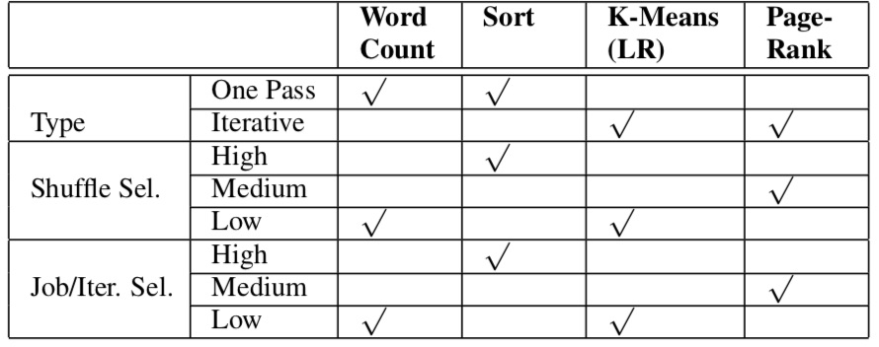
The 4 Use Cases And Their Characteristics
Execution Mode
One pass versus iterative.
Shuffle selectivity
Map output size / Job input size.
Proxy for amount of disk & network I/O for a shuffle.
Job selectivity
Reduce output size / Job input size
Proxy for amount of HDFS writes.
Iteration selectivity
Job output size / Iteration input size
Proxy for intermediate data exchanged across iterations.
[3]

Slide 5
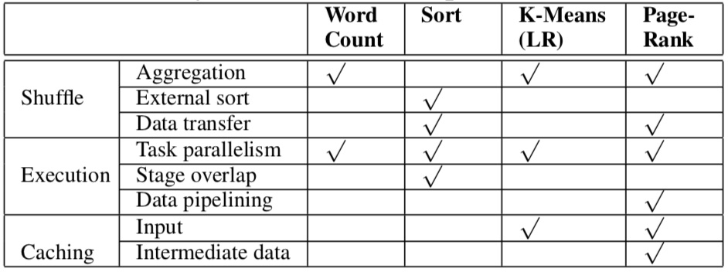
How Use Cases Map To Key Architectural Components of Interest
[4]

Slide 6
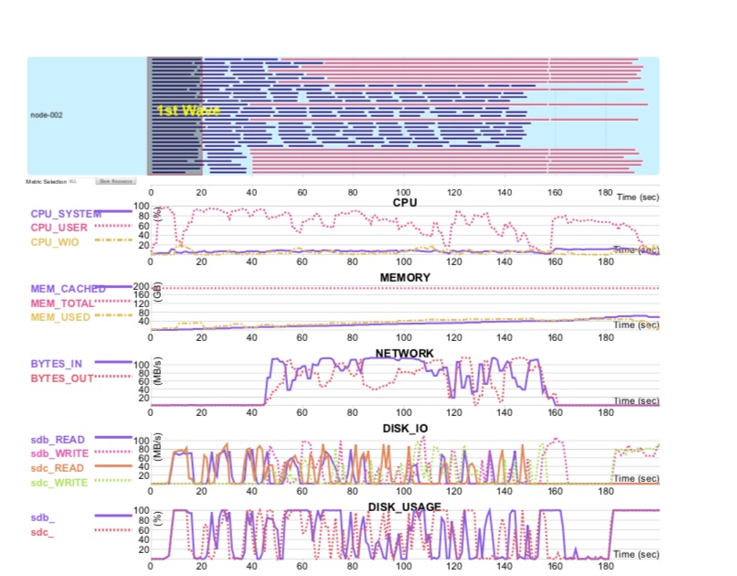
Custom Built Execution Plan Visualization Tool
Tasks
Visual aid for understanding how M-R and Spark impact system resources.
Each task is a horizontal line.
Line length proportional to execution time of task
Tasks in different stages have different colors
visually correlated to CPU, memory and disk utilization.
[5]

Slide 7
Use Case 1: Word Count (WC)
Proxy for analytic jobs that have low shuffle selectivity
Descriptive statistics (e.g., count, min, max, mean, var, sd).
Test uses WC programs that come with Apache Hadoop and Spark Distributions. Spark and MR use the same input dataset.
Spark is faster than MR for at 40GB and 200 GB sized datasets.
2.6X and 2.7, respectively.
Spark is 3 times faster than MR in the map phase.
Spark and MR have similar execution times in reduce phase.
Amount of data to shuffle is similar for Spark and MR

Slide 8
Why Is Spark Faster Than MR in the Map Phase?
MR Task initialization slow.
Spark is more efficient than MR at map and combiner operations
2.9x faster for map operations.
6.2x faster for combiner operations.
Spark uses hash-based combine. More efficient MR sort-based combine.

Slide 9
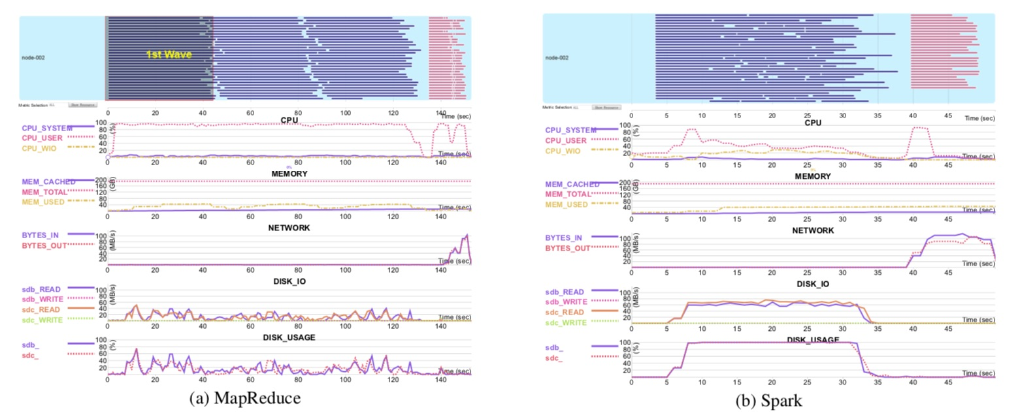
MR & Spark Execution Plans For Word Count
:CPU Bound
[6]

Slide 10
Use Case 2: Sort
Proxy for measuring the efficiency of MR and Spark shuffle operations.
Sort operation has a shuffle selectivity equal to 1.
Spark is marginally faster than MR for a 1 GB dataset.
Due to M-R’s longer task initialization.
MR out performs Spark for 100 GB and 500 GB datasets
1.5X and 1.8X, respectively.

Slide 11
Inside the Performance Difference
Sampling
MR reads a small subset of the file
Takes 1 second for both 100 GB and 500 GB files.
Spark reads the entire file during sampling.
Takes 1.1 minutes and 5.2 minutes for a 100 GB file and 500 GB file, respectively.
Reduce Phase
MR faster by 105 seconds for a 100 GB file.
MR faster by 16 minutes and 48 seconds for a 500 GB file.

Slide 12
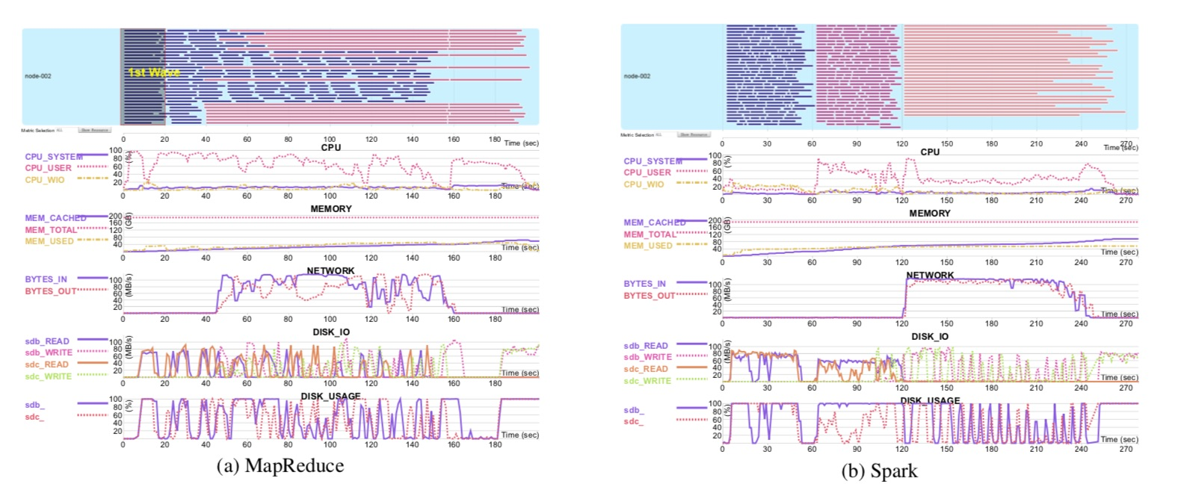
Why Is MR Faster Than Spark’s At Reduce?
MR:
Shuffle data is pre-fetched by reducers during the map phase
Map tasks write one shuffle file for each partition.
1000s of shuffle files.
Spark
Shuffle occurs after all map tasks are complete
Map tasks write one file for each reduce task.
Millions of shuffle files.
Overlapping Phases
[7]

Slide 13
Do the Author’s Insights About Sort Hold Up?
Spark out performs MR when a 10 Gbps Ethernet backbone is used with the Dayton Gray Benchmark Sort benchmark .
Researchers from University of California @ Berkley have reduced the number of shuffle files by 3 orders of magnitude.
Results in Spark out performing M-R when it comes to Spark
Hortonworks is planning on dropping support for MR in a future release. Spark will be the go to framework for processing large volumes of data. This suggests that Spark sort efficiency will be on par with MR’s sort efficiency.

Slide 14
Use Case 3: K-Means
Proxy for iterative machine learning algorithms that exhibit low iteration selectivity and low shuffle selectivity.
N input records > > K map output records for each iteration
Logistic Regression, Linear Regression, Hidden Markov Models, E-M, etc.
Spark out performs MR by 1.5X on the initial iteration at all sizes of input.
Spark out performs MR by 5X on subsequent iterations at all sizes of input
Faster by 42 seconds for each subsequent iteration on a 100 million record dataset.
Faster by 44 seconds for each subsequent iteration on a 1 billion record dataset..

Slide 15
Caching, Caching Caching
MR outputs updated centroids as text to HDFS from the reduce phase for each iteration.
Each iteration must transform text objects back to Point objects
Spark’s caches the output from the first iteration onward to RDDs
There is no disk i/o after the first iteration.
Writing results to an RDD reduces CPU overhead.
Point objects from K-means are stored in memory.
No need to transform the output data from each iteration back to Point objects.

Slide 16
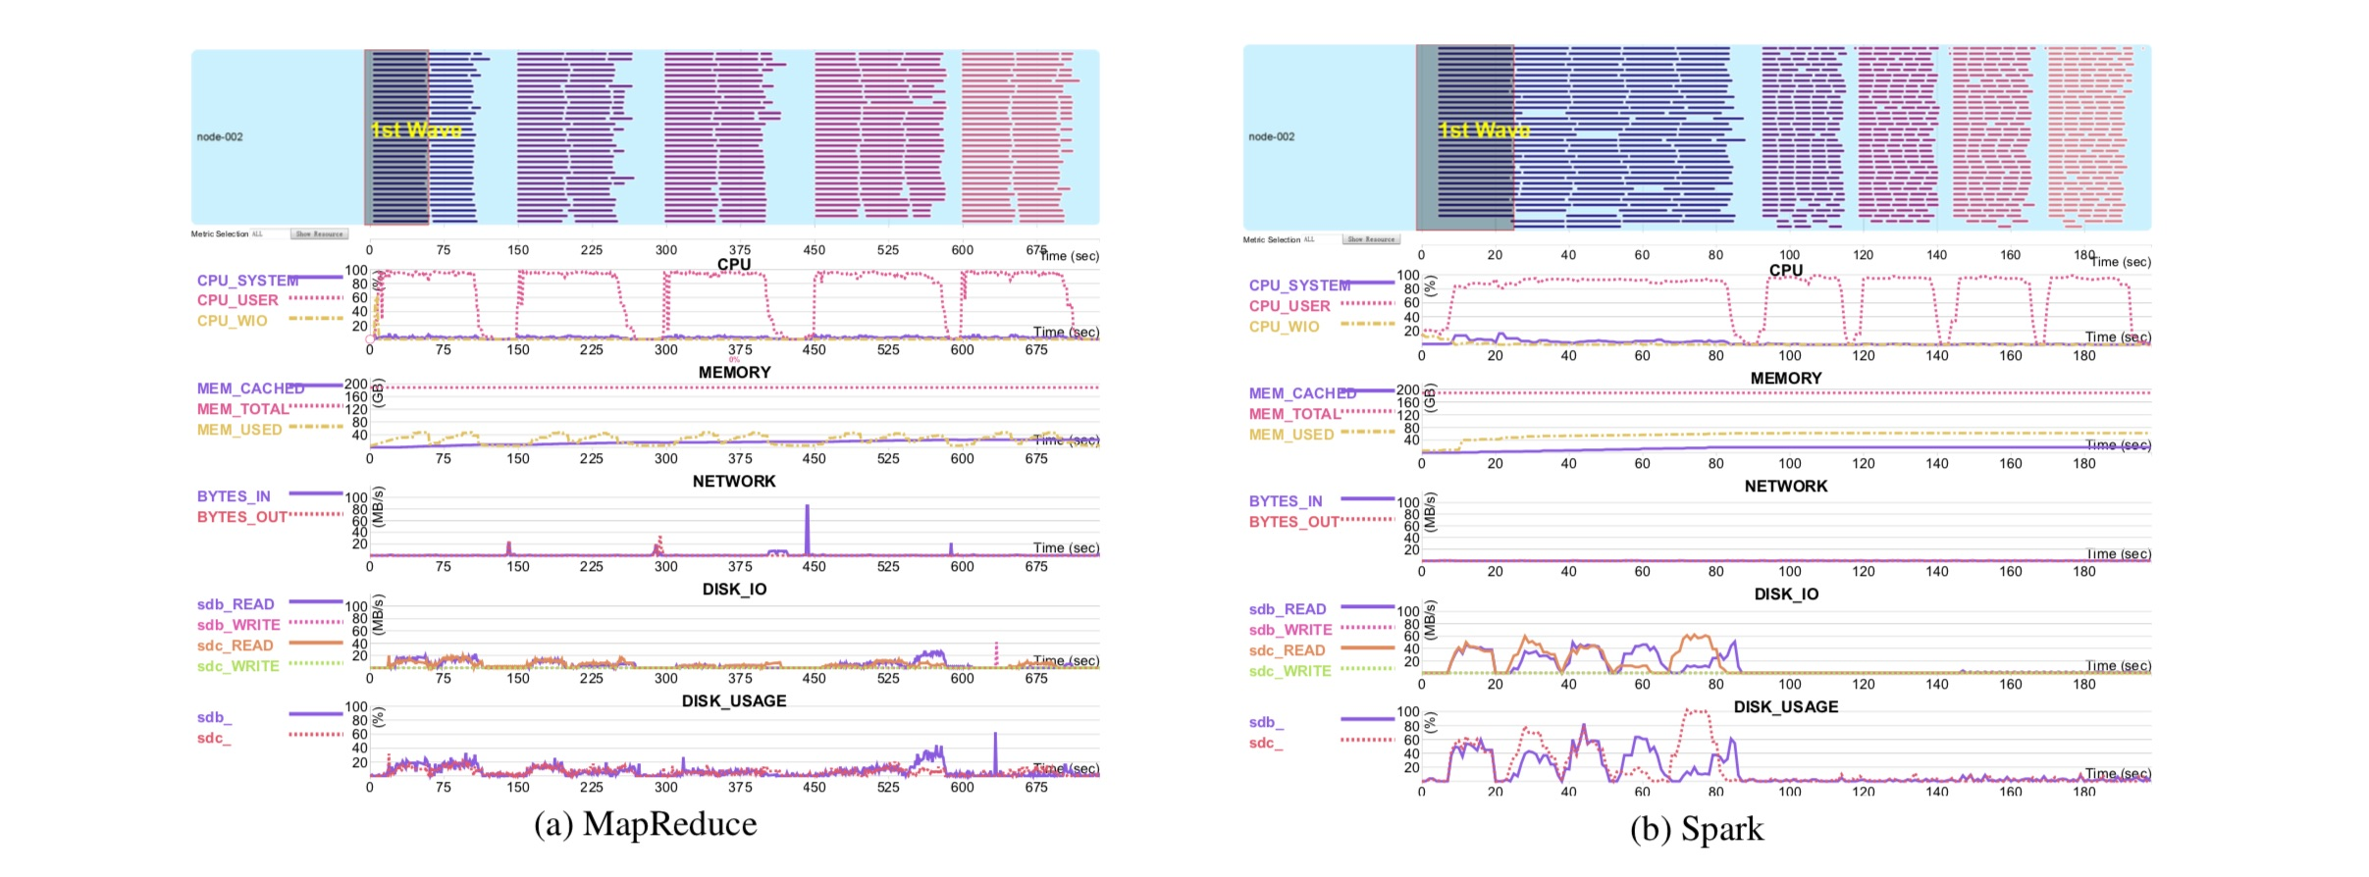
MR & Spark Execution Plan for K-means
5 Iterations
5 Iterations
Map stage takes 99% of execution time for MR & Spark
No disk usage for Spark after the 1st iteration.
Output cached to memory based RDDs.
[8]

Slide 17
Use Case 4: Page Rank
Proxy for iterative machine learning algorithms that are iterative in nature and exhibit high high shuffle selectivity and iteration selectivity.
Neighboring vertices exchanges their ranks via shuffle operations
Graph structures are exchanged across iterations
Test harness:
Twitter dataset: 41.7M vertices and 1.47B directed edges
X-RIME PageRank for M-R
Sample Spark GraphX program for Spark
Spark out performs MR on the first iteration by 521 seconds (8.68 minutes).
Spark out performs MR on subsequent iterations by 529 seconds (8.81 minutes).

Slide 18
Spark RDDs Again Win the Day
Spark stores the graph in an RDD at the end of each iteration and it reads the graph from the same RDD at the start of the next iteration.
No CPU cycles required seed subsequent iterations with the input graph object.
MR must serialize the graph and write it to HDFS at the end of each iteration.
With the exception of the first iteration, MR must read the graph from from HDFS and then de-serialize (e.g., materialize) the graph.
Extra disk I/O and CPU cycles required to seed subsequent iterations with the input graph object.

Slide 19
Key Takeaways From The Paper
Spark’s hash based aggregation operation is more efficient that MR’s sort based aggregation operation.
One pass workloads that calculate descriptive statistics are more efficient when run as Spark jobs.
Spark’s RDD feature significantly reduces the execution time of iterative analytical workloads compared to MR.
RDDs reduce CPU cycles and disk I/O.
M-R has an advantage over Spark when it comes to sort heavy workloads. This is attributed to M-R’s more efficient shuffle implementation.
MR’s sort advantage is open to debate and with may no longer be the valid.

Slide 20
How Relevant Are the Paper’s Conclusions Today?
US Bank as a case study [9]
MR will continue to be used for large scale data ingestion long as it is supported by the Hortonworks.
A Spark data ingestion framework has been implemented for by self service customers for small to medium sized data ingestion jobs.
Observation: Small to medium size data ingestion jobs execute faster in Spark than MR.
Spark based tools are being on-boarded for self service data consumption.
Spark-SQL based queries execute 16X.
Will continue to use R and Python based ML libraries for non-real time modeling.
Spark ML and Spark-R and other vendor ML engines are being evaluated for use in real time model execution.

Slide 21
References
[1] Jeffrey Dean and Sanjay Gemawat, MapReduce: Simplified Data Processing on Large Clusters, OSDI, 2004
[2] Petar Zecevic and Marko Bonaci, Spark In Action, Manning Publications, 2017
[3],[4],[5],[6],[7],[8] Juwei Shi, Umar Farooq Minhas, et al, Clash of the Titans: MapReduce vs Spark For Large Scale Data Analytics, Proceedings of the VLDB Endowment, Vol 8, Issue 13, 2015
[9] Vijaya Jasti, Nagender Bethy, US Bank, Enterprise Data Management, 2019

