Slide 1
Data Engineering
Final Project
Chan En Ching

Slide 2
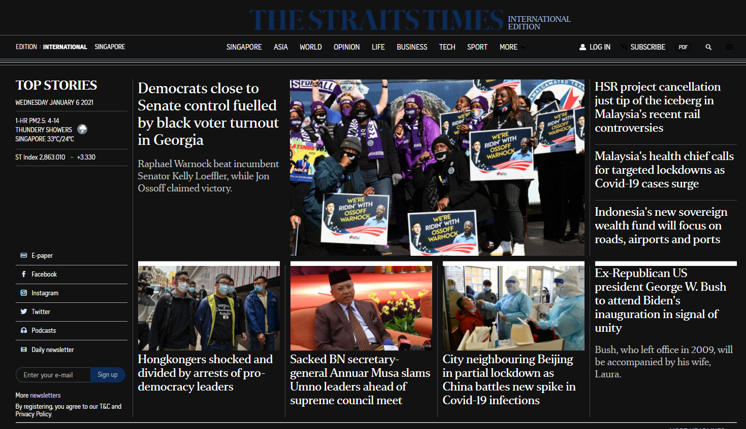
News Website
https://www.straitstimes.com/global
Use requests to connect

Slide 3
News Website
Title
https://www.straitstimes.com/global
Contents parsed via Beautiful Soup 4 using HTML parser

Slide 4
News Website
1 H1
https://www.straitstimes.com/global
Results stored in list
206 links

Slide 5

Web scraping
67 headline
https://www.straitstimes.com/global
6 Jan 2021
Results stored in list
13 sub-headline

Slide 6
MySQL schema
STHeadlines
STSubHeadlines
links
ValueList VARCHAR(1024)
ValueList VARCHAR(1024)
ValueList VARCHAR(1024)
ValueList VARCHAR(1024)
Header1
Simple example pushing scrapped data to MySQL
Each list item is saved individually as a record

Slide 7
Q & A

