Slide 1
The Beginner’s Guide to
Bad Engineering Presentations
Mark L. Chang
v1.10-ASME October 28, 2006

Slide 2
Outline
Title Slide
Introduction
Outline
Meat of my presentation
Results
Conclusions

Slide 3
Outline
Just start the presentation!
Everyone knows what ends up in a presentation
  You don’t have to remind us
Surprising the audience is not a bad thing

Slide 4
Bad Presentations
Audience won’t see your work is great
Will make fun of you from back row
Those are some NASTY colors…
What does that slide say?
Dunno, I’m playing minesweeper
Hey – it matches my tie.
Please let it be OVER…
zzz

Slide 5
Good Presentations
Interesting topic, explained at the right level
Slides are understandable and easy to see
I wonder if this technique would work for my problem
I understood this one!
Well, you do have a PhD…
Let’s talk to them at the break
It’s a bit outside my area
I never thought of that!
Interesting

Slide 6
Know Your Topic
Be prepared to get questions!
Know WHEN to say “I don’t know”
Know HOW to say “I don’t know”
Don’t just stand there uncomfortably
Be able to recover from interruptions
Know what to skip if you’re running late
  Don’t just talk faster!

Slide 7
Know Your Audience
Do they have a background like yours?
How much hand-holding?
Can you jump right in to specifics?
How much motivation for your work?
How detailed should you get?

Slide 8

Know Your Location
Need to bring a laptop?
Need to bring a CD, or email
a PPT in advance?
Need to print transparencies?
How far is audience from screen?
Can you point with your hand,
or do you need a laser pointer?

Slide 9
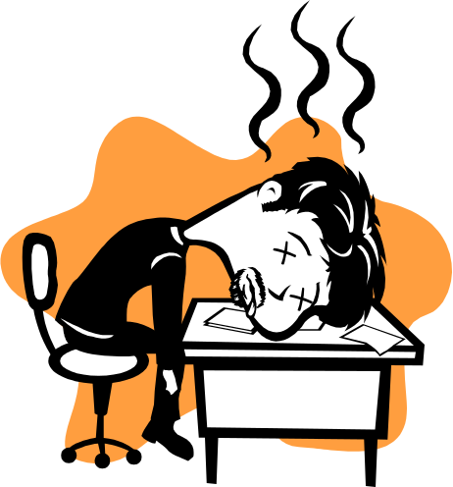
Attitude. (Yours)
Are you INTERESTED in your topic?
  If no, get a different one!
  If yes, ACT LIKE IT.
If YOU aren’t excited…
  Can’t expect OTHER people to be!
Don’t talk down to audience
  You know more than them about THIS…
  They know more than you about other stuff

Slide 10
Dead Man Talking
Are you hiding behind the podium?
Are you engaging your audience?
Are you staring at your advisor/boss?
Are you staring at your laptop?
Are you staring at the screen?
Is your back to the audience?

Slide 11
I took some Meth this morning
Calm down. E-nun-see-ate.
It’s not a race
Take a bottle of water up to the podium with you
  Bottles if you can work a cap (better for spillage)
  Glass if you don’t have a free hand

Slide 12
I’ve got two turntables and a microphone
Feedback kills people
Most PA systems are tuned so that the microphone can be down in the middle of your chest
  Not 2mm from your mouth
Modulate your voice evenly

Slide 13

Where are your hands?
You have a set of “moves”
that you will repeat
Make sure they aren’t silly looking
Don’t point with your middle finger
Record your presentation if possible
Practice in front of mean friends

Slide 14
Look Ma, I have a L-A-S-E-R!
If necessary, get a laser pointer
Get it a few weeks before your talk
  Get all the silly laser-pointer play time out of your system now
Get a second one for backup

Slide 15
Common Laser Pointer Moves
The circle
The underline
The back-handed flick
The epileptic-seizure inducer
DO NOT POINT AT EVERYTHING

Slide 16
Right Here. See?
Don’t point at your laptop screen

Slide 17
Ummmm, yeah
Practice makes perfect
Do not read your slides like a script
You lose 20 IQ points in front of an audience

Slide 18
Time Check!
Keep track of the time
Learn to adjust your pace to accommodate questions (and answers)
Make your talk fit into the alloted time
  Don’t assume your 45 minute talk will “just work” in a 15 minute time slot
  It won’t -- customize it!
Know where you can trim to save time
  Don’t make haste, don’t trim the “meat”

Slide 19
This is not pretty
Everyone uses PowerPoint
Don’t drive home the point by using the stock templates
Spend 5 minutes and make your own
Please don’t use this one

Slide 20
This is a really long title for this single slide, I should have just summarized
Most people don’t read the title

Slide 21
README.TXT
Do not attempt to put all the text, code, or explanation of what you are talking about directly onto the slide, especially if it consists of full, long sentences
If you do that, you will have too much stuff to read on the slide, which isn’t always a good thing.
Like the previous slide, people do not really read all the stuff on the slides.
  That’s why it’s called a “presentation” and not “a reading” of your work
Practice makes perfect, which is what gets you away from having to have all of your “notes” in textual form on the screen in front of you.
Utilize the Notes function of PowerPoint, have them printed out for your reference.
  The audience doesn’t need to hear the exact same thing that they can read themselves.
  The bullet points are simply talking points and should attempt to summarize the big ideas that you are trying to convey
If you’ve reached anything less than 18 point font, for Pete’s sake, please:
  Remove some of the text
  Split up the text and put it on separate slides
  Perhaps you are trying to do much in this one slide?
Reading a slide is annoying. We can do that (even if we don’t).
Pictures are worth a thousand words.
  Do not attempt to make up for your lack of pictures by putting, oh, say 500-750 words on a single slide
If your audience is squinting, something is wrong.

Slide 22
Font Size
You are close to your monitor
Your audience is far from the screen
Tahoma
32 pt
28 pt
24 pt
20 pt
18 pt
16 pt
14 pt
12 pt
10 pt
TNR
32 pt
28 pt
24 pt
20 pt
18 pt
16 pt
14 pt
12 pt
10 pt
Courier
32 pt
28 pt
24 pt
20 pt
18 pt
16 pt
14 pt
12 pt
10 pt
Comic
32 pt
28 pt
24 pt
20 pt
18 pt
16 pt
14 pt
12 pt
10 pt
Lucida Sans
32 pt
28 pt
24 pt
20 pt
18 pt
16 pt
14 pt
12 pt
10 pt

Slide 23
Slide Numbers Are Your Friend
See this thing down here?
Number your slides!

Slide 24
Know Slide Boundaries
People can’t read text that runs off the side of the slide

Slide 25
Speelchick
You sohlud selpl cechk yuor decuomnt to aovid spuidtd eorrrs
Raed yuor dnmeucot aluod in oerdr to cehck ervey sgninle wrod
Aoccdrnig to rscheearch at an Elingsh uinervtisy, it deosn't mttaer in waht oredr the ltteers in a wrod are, olny taht the frist and lsat ltteres are at the rghit pcleas. The rset can be a toatl mses and you can sitll raed it wouthit a porbelm. Tihs is bcuseae we do not raed ervey lteter by ilstef, but the wrod as a wlohe.

Slide 26
Line ‘em Up
This is a bad drawing
Put in some effort
FPGA
CPU

Slide 27
HOWTO: Mind Control Implants
Smart machines
Tiny robots
Swarm machine
Future:
Implantable, self-replicating mind control devices in every American
Cognitive Science
Food
Nanotech
Tiny computers
Smart chips everywhere
Eyes and ears everywhere
Implantable monitors
Understanding mind, brain
Brain prosthesis
True AI Improved decision making
Man/Machine simulation
Psychology
Cosmetics
TOP SECRET - Pentagon “Mind’s Eye” Briefing - Dec ‘03

Slide 28
Oops, wrong presentation
Be careful with cut and paste
Best case: you look dumb
Worst case: international crisis
Don’t get caught hacking together your slides!
Each talk is unique, and the audience deserves your best

Slide 30
The Art of Suspense

Slide 31
The Art of Suspense
Don’t

Slide 32
The Art of Suspense
Don’t
Be

Slide 33
The Art of Suspense
Don’t
Be
A

Slide 34
The Art of Suspense
Don’t
Be
A
Tease

Slide 35
Anticipatory Lecturing
Don’t Be A Tease
Rarely, does it accomplish anything
Let the audience think at their own pace

Slide 36
You are not Pixar Studios
Animation
Can
Use it sparingly
Be Very
Distracting

Slide 37
Mommy, my eyes are burning!
Can you look at this for 45 minutes?
Colors look different on every LCD projector
Colors look different between transparencies and projector

Slide 38
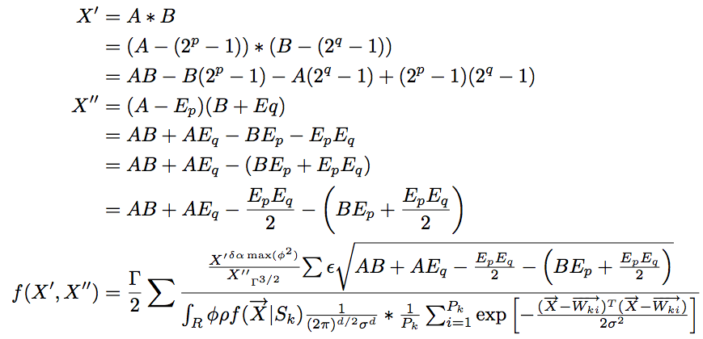
Formulae
WTF?
Notes:
Do you really need all those equations?
This is very instance-dependent!
Depends on what you’re discussing
Depends on your audience
Sometimes you may need them
Explain the variables and what they mean
Give a “plain-text” description of it
If you don’t need them, don’t use them!

Slide 39
Results

Slide 40
Interstitial Slides
They are very segregating and distracting
Use sparingly

Slide 41
Use Simple Examples
This isn’t one. It doesn’t help.
BB
D
N
l
g
h
B
A
a
FF
EE
HH
q
V
o
c
GG
F
E
H
n
DD
VV
YY
R
p
II
m
NN
h
K
KK
JJ
Y
OO
k
CC
L
I
t
J
O
TT
QQ
C
X
LL
f
Q
PP
ZZ
M
MM
P
Z
RR
XX
x
r
y
T
u
SS
d
z
G
WW
w
UU
S
W
s
v
b
AA
U
e
j

Slide 42
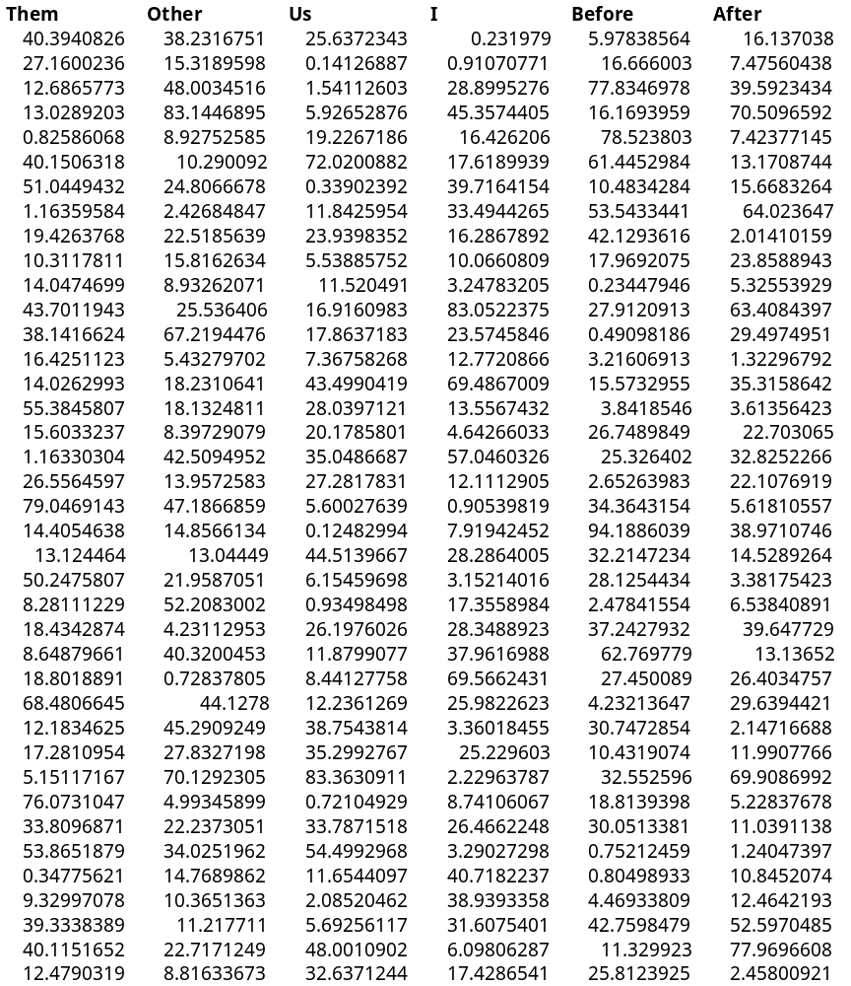
Results
We get it
You have
lots of cool
results
No one can
read this
Show us!

Slide 43
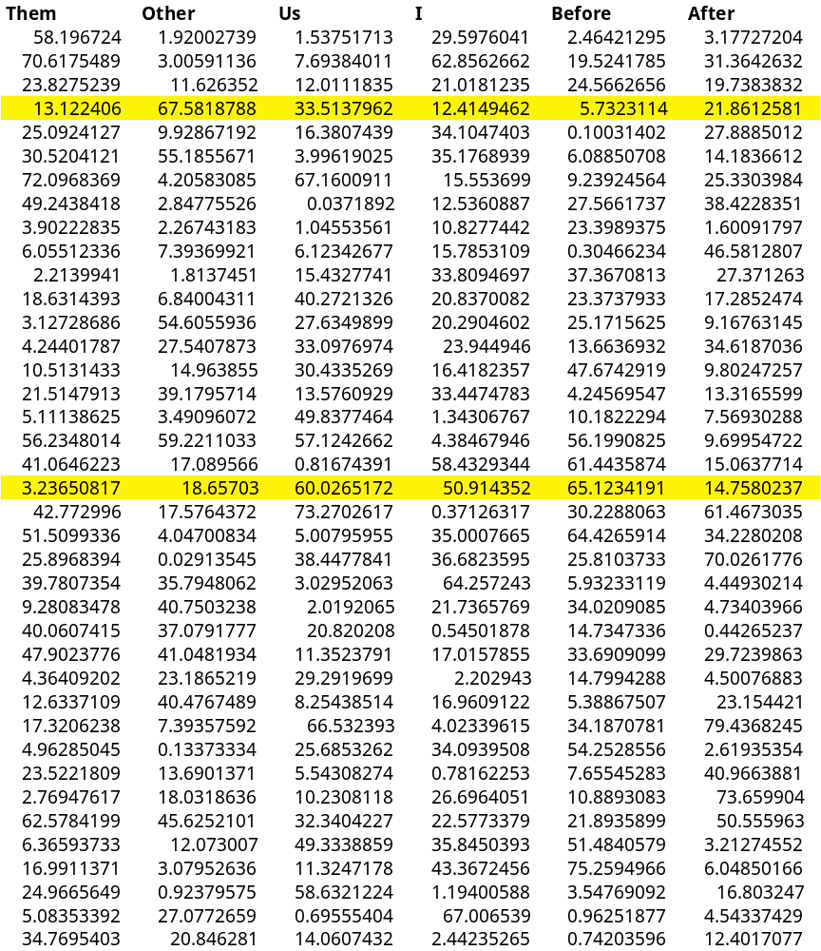
Highlights
Highlighting
your results
makes it
easier to
be impressed
Often, graphs
are your best
option

Slide 44
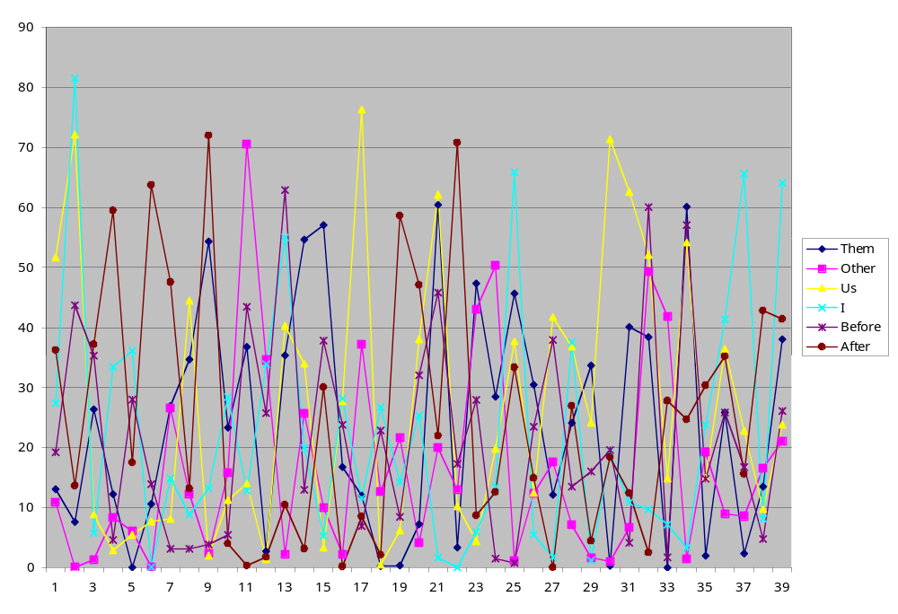
Information Overload

Slide 45
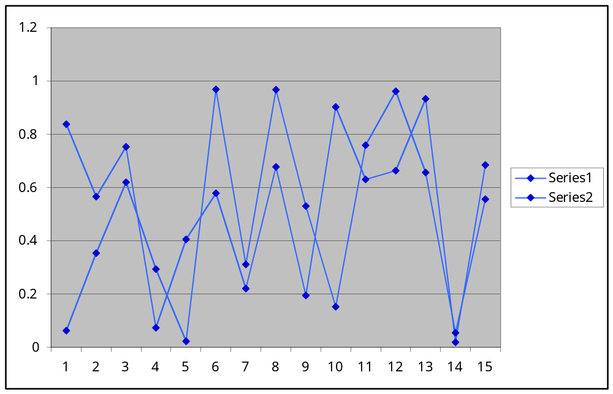
Pick a Line, Any Line

Slide 46
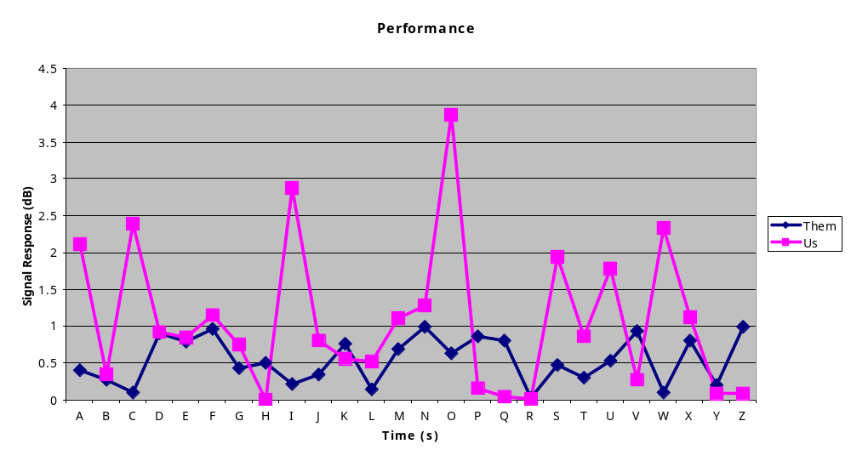
Simplify Your Life
Give us the “big picture”
Thicker lines
Speak the axis labels and legend

Slide 47
Ummm…That’s All I Have
You’ve come this far, go the distance!
Don’t just fizzle out in the end
SUMMARIZE! Give us the big finish!
30x speedup / 10% area penalty

Slide 48
Conclusion
A little prep goes a long way
Your audience:
  Is smarter than you think
  Gets bored easily
  Will ask questions
  Deserves your best effort
Make it easy for them to understand your work!

