Slide 1
Photoshop Plug-ins with Reconfigurable Logic
Implementing a Skeletonization algorithm on the VCC Hotworks Development System (Xilinx XC6200)
Mark L. Chang <mchang@ece.nwu.edu>

Slide 2
What are we trying to do?
Create an Adobe Photoshop plug-in to perform Zhang-Suen skeletonization on bi-level images
Modify the plug-in to support calculations on reconfigurable logic (FPGA)

Slide 3
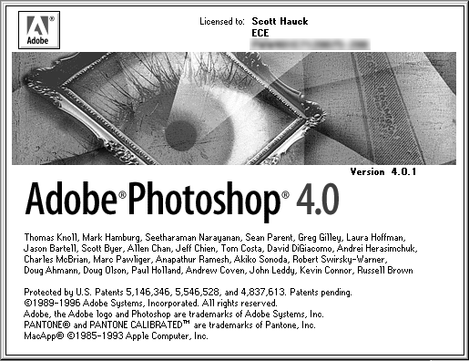
The Software

Slide 4
What is a Plug-In module?
Software programs designed to extend the capabilities of Photoshop
Adobe provides a toolkit, Adobe Photoshop SDK, for plug-in development
Written primarily in C/C++ using Microsoft Visual Studio 97
  We are using the Filter plug-in module type
Notes:
Types of plug-ins:
Color Picker: when user request a custom color
Import: imports an image into a new window
Export: exports the image window into a user-defined file format
Extension: session-start/session-end features (initialization of devices)
Filter: filter an existing image
Format: reading/writing additional formats
Parser: manipulation of images between different image file formats
Selection: modifies which pixels are selected (fade/feathering)

Slide 5
How does a Plug-In work?
Generally a “stateless” process
Plug-in host makes calls to the plug-in to perform specific tasks
  Initialization of flags and parameters (and possibly hardware devices)
  Calculate and allocate memory
  Show User Interface for user-tunable parameters
  Repeatedly filter portions of the image
  Clean up (if necessary)

Slide 6
Plug-In Host⇔Plug-in communication
All communication passes through a large data structure: the parameter block
The parameter block can contain persistent user-defined parameters
Some provided information:
  imageSize, planes, filterRect, inData, outData
We supply:
  inRect, outRect
Notes:
Persistent in bullet two means between calls in the same filter.
imageSize -> size of image to be filtered
planes -> number of color planes
filterRect -> a structure containing the dimensions of the bounding box to be filtered
inRect/outRect -> may be portions of the entire image, according to memory constraints

Slide 7
Filtering a region
Use pointers to memory regions to manipulate image data
  inRect / outRect
Get pointers to next image rectangles [AdvanceStateProc()]
Final image should reside entirely in outRect memory buffer
Notes:
When we are done, we the plug-in set inRect = outRect = 0;

Slide 8
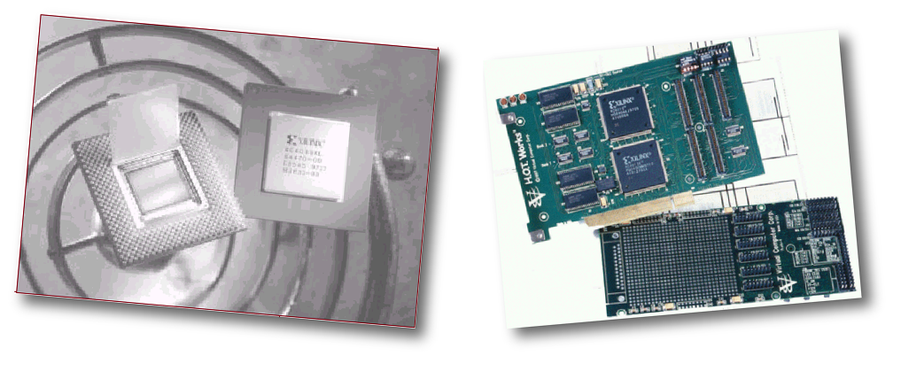
The Hardware
Xilinx XC6200 RPU
VCC H.O.T. Works Development System

Slide 9
What is an FPGA?
Field Programmable Gate Array
Fully programmable alternative to a customized chip
Used to implement functions in hardware
Also called a Reconfigurable Processing Unit (RPU)
Notes:
XC6200 is a family of fine-grain, sea-of-gates FPGAs.
These devices are designed to operate in close cooperation
with a microprocessor or microcontroller to provide an
implementation of functions normally placed on an ASIC.
These include interfaces to external hardware and peripherals,
glue logic and custom coprocessors, including bit-level
and systolic operations unsuited to standard processors.
task.
This is not a strict definition!

Slide 10
Why use an FPGA?
Hardwired logic is very fast
Can interface to outside world
  Custom hardware/peripherals
  “Glue logic” to custom co/processors
Can perform bit-level and systolic operations not suited for traditional CPU/MPU
Notes:
Systolic is anything rhythmically pulsing -- like data flowing through a network.

Slide 11
XC6200 Architecture
Large array of simple, configurable cells (sea of gates)
Each cell:
  D-Type register
  Logic function
  Nearest-neighbor interconnections
  Grouped in 4x4, 16x16, and 64x64 blocks
Notes:
Information on each cell comes later (slide 10)

Slide 12
XC6200 Routing
Each level of hierarchy has its own associated routing resources
  Unit cells, 4x4, 16x16, 64x64 cell blocks
Routing does not use a unit cell’s resources
Switches at the edge of the blocks provide for connections between the levels of interconnect
Notes:
Edge switches connect various levels of interconnect at the same position in the array (e.g. connecting length 4 wires to neighbor wires)
All routing wires are directional (not bi-directional)
Benefits are that wiring delays scale logarithmically with distance in cell units rather than linearly.

Slide 13
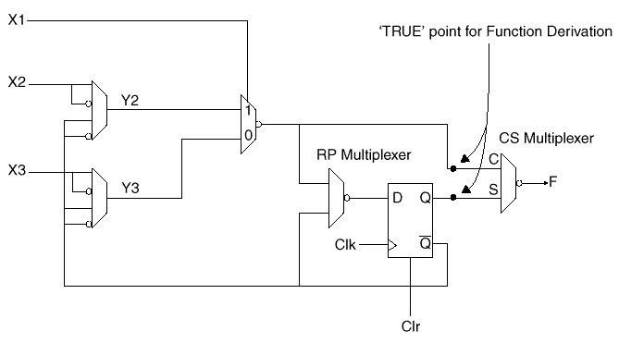
XC6200 Functional Unit
Design based on the fact that any function of two Boolean variables can be computed by a 2:1 MUX.
Notes:
Need to choose suitable values for inputs
Y2 and Y3 multiplexers provide for conditional inversion of inputs.
CS multiplexer selects combinatorial or sequential output
RP multiplexer allows the contents of the register to be ‘protected’
- protected = only programming interface (uP) can write to the reg
- unprot = otherwise

Slide 14
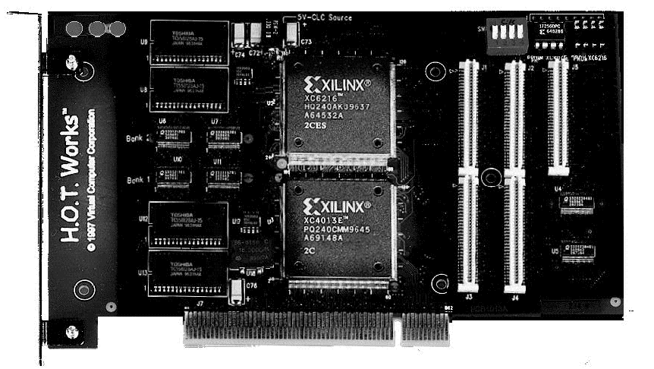
H.O.T. Works
Development system based on the Xilinx XC6200-series RPU
Includes:
  H.O.T. Works Configurable Computer Board
  H.O.T. Works Development System Software

Slide 15
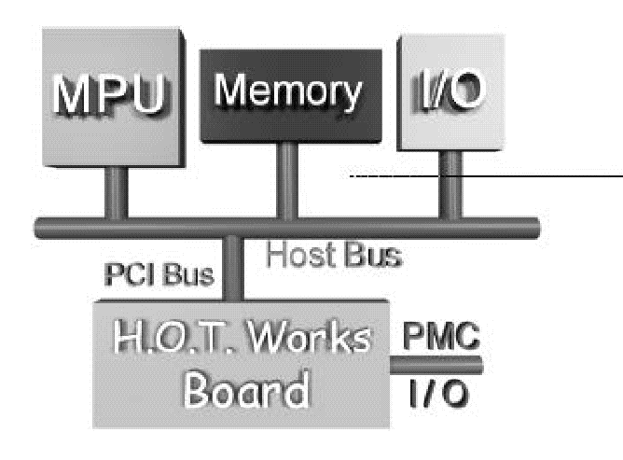
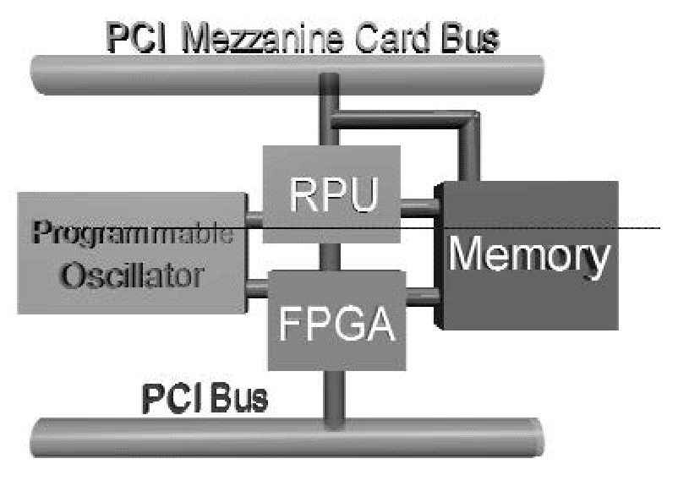
H.O.T. Works Board
Interfaces with a host system (Windows95-based PC) on PCI bus
  2MB SRAM (memory)
  XC6200 (RPU)
  PCI controller on XC4000 (FPGA)
  Expansion through Mezzanine connector
Notes:
FPGA is an XC4000 FPGA which has the PCI core logic loaded from PROM.
Programmable Oscillator (360KHz to 100MHz)
PCI Mezzanine Card (PMC) Standard interface connectors for the addition of optional development daughter cards.

Slide 16
H.O.T. Works Software
Xilinx XACTStep 6000
  Map, Place and Router for XC6200
Velab
  Freeware structural VHDL elaborator
WebScope
  Java-based debugging tool
H.O.T. Works Development System
  C++-based API for board interfacing
Notes:
Also has LOLA Programming system (buggy but interesting)
XactSTEP takes EDIF formatted input from a design capture system. Also provides timing analysis and constraint editing.
Velab elaborates only structural VHDL. Outputs EDIF file formats.

Slide 17
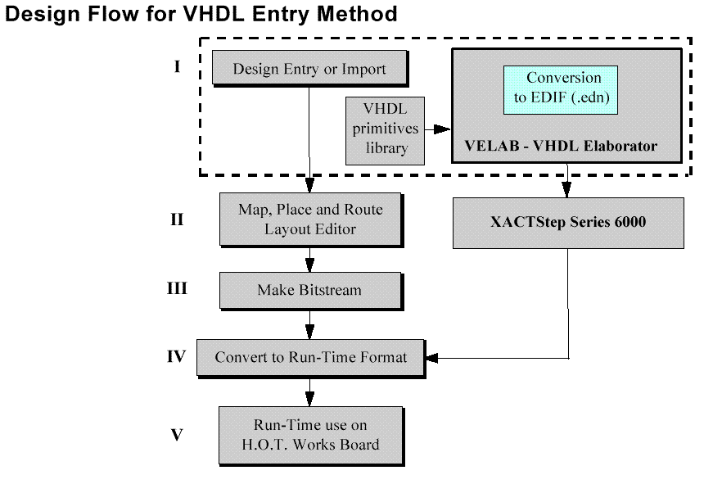
Design Flow

Slide 18
Run-Time Programming
C++ support software is provided for low-level board interface and device configuration
Digital design is downloaded to the board at execution time
User-level routines must be written to conduct data input/output and control

Slide 19

The Algorithm

Slide 20
Generic Thinning
Iteratively thins/skeletonizes a bi-level (1-bit) image, maintaining three properties:
  The skeleton should be a thinned region, one pixel wide
  The skeleton’s pixels should be near the center of a cross-section of the original region
  Skeletal pixels must be connected in a fashion preserving the original shape and direction

Slide 21
Zhang-Suen (1984) Thinning
Three basic rules to decide whether a pixel may be removed
  Neighbor count
  Crossing index
  Pass requirements
All rules must be satisfied to erode the pixel in question

Slide 22
Neighbor Count
Can only delete a pixel if it has more than one and fewer than seven neighbors
Ensures that end points are not eroded and that pixels are eroded from the boundary of the region
Can’t erode, too few neighbors
Erode OK three neighbors
Can’t erode, too many neighbors

Slide 23
Crossing Index
Can only delete a pixel if it is connected to only one other region
Ensures that the pixel in question is at an edge of a region rather than at an intersection of two regions
Can’t delete, intersection of two regions
Erode OK, one region
Can’t erode, connects two regions

Slide 24
Pass requirements
Scanning top to bottom, left to right, we bias the selection of pixels to erode
Solution: make two passes, looking at different regions
Keeps thinned object “centered”
Pass 1
Both dark grey are background OR either light grey are background
Pass 2

Slide 25
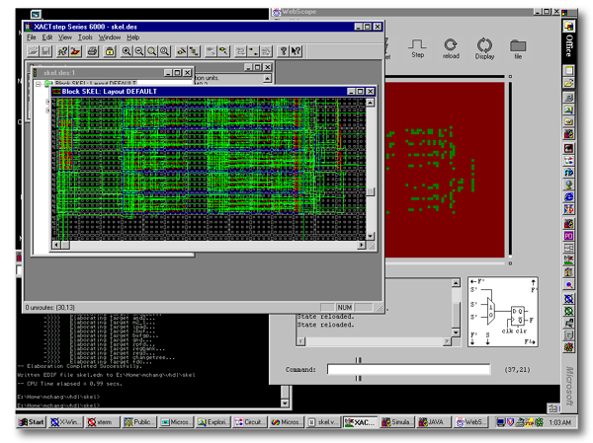
Mapping to Hotworks

Slide 26
Basic Blocks
We want to implement on the FPGA:
  Neighbor count
  Crossing index
  Pass requirement
Create simple logic blocks in VHDL to handle each test

Slide 27
Neighbor Count
0
1
2
In
Out
7
3
0
6
5
4
+
1
S0
Input order
S1
2
To NAY8LOGIC
+
S2
3
S3
+
4
5
6
NAY8TREE
7

Slide 28
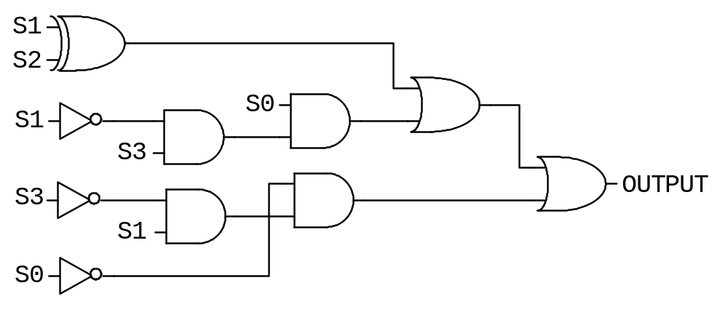
Neighbor Count
Implements (S1 XOR S2) + (S0*!S1*S3) + (!S0*S1*!S3)

Slide 29
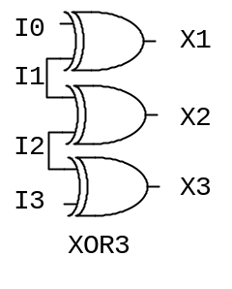
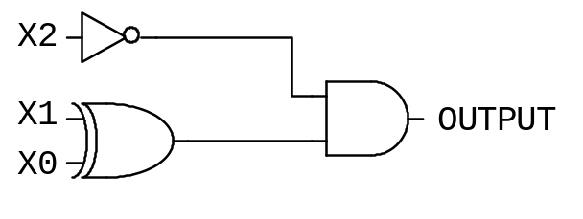
Crossing Index
In
Out
0
1
2
0
7
3
1
6
5
4
XOR3
+
X0
2
3
X1
Input order
+
X2
4
5
XOR3
+
6
7
3
4
XOR
Looks for level changes between all pairs, 1 or 2 valid

Slide 30
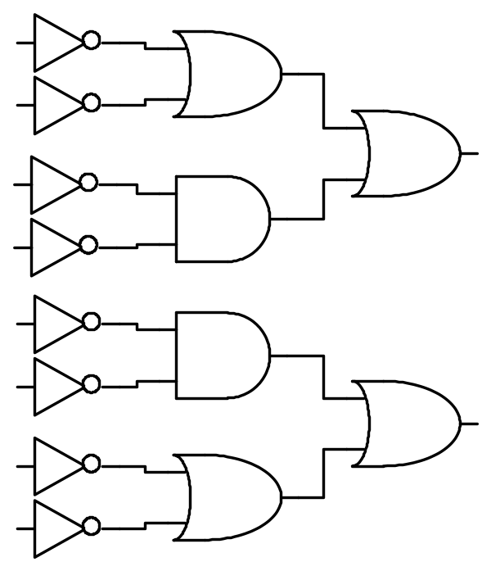
Pass Requirement
3
1
2
0
1
3
PASS
Input order
0
2
0
OUT
1
1
3
0
2

Slide 31
One “SKELSLICE”
6
7
8
3
4
5
NAY8TREE
NAY8LOGIC
0
1
2
XTREE
Input order
0:8
PASS
ERODE
[4]
“CHANGE”
“NEXTPIXEL”
“0”

Slide 32
10-bit Skeletonizer
Output Registers
SKELSLICE
SKELSLICE
SKELSLICE
SKELSLICE
SKELSLICE
SKELSLICE
SKELSLICE
SKELSLICE
OR_TREE
CHANGE
Register
Input Registers

Slide 33
Hardware Results
On an XC6216 (64x64 cells):
  Limited to 8 computational bit-slices due to routing resource congestion
  Maximum delay = 70.12ns
  Maximum clock speed = 14MHz
  Input size is 30 bits
  Output size is 8 bits

Slide 34
Software Results
Adobe Photoshop SDK and HOTWorks SDK modified and merged by Douglas Wilson
  Created static objects to use HOTWorks board from within a plug-in module
  Created a template Visual Studio workspace
Filter code: ~300 lines
FPGA interface code: ~100 lines

Slide 35
Preliminary Performance Results
Working software and hardware versions of Photoshop Plug-in completed
Speedups on large (>1K x 1K pixels) images: ~1.5-1.8
  Note: wall-clock time speedups

Slide 36
Future Work
Pipeline the computations on the FPGA
Optimize the layout to obtain higher densities and more bit-level parallelism
Utilize the on-board SRAM to amortize PCI transfer bottlenecks over larger block transfers
Interleave host PC and FPGA calculations to decrease idle time

Slide 37
Conclusions
Adobe Photoshop acceleration using reconfigurable logic is attainable using this development platform
VCC provides a useable set of tools to perform hardware design at the structural level

