Slide 1
FPGA Basics
The Xilinx XC6200 and the
H.O.T. Works Development System
11 February, 1998
Mark L. Chang <mchang@ece.nwu.edu>
Notes:
Stuff is stolen from Xilinx documentation and HOT Works documentation. Will check to see if I can put up on my web site.
PDF format for tech sheets.
Presentation will also be available

Slide 2
What is an FPGA?
Field Programmable Gate Array
Fully programmable alternative to a customized chip
Used to implement functions in hardware
Also called a Reconfigurable Processing Unit (RPU)
Notes:
XC6200 is a family of fine-grain, sea-of-gates FPGAs.
These devices are designed to operate in close cooperation
with a microprocessor or microcontroller to provide an
implementation of functions normally placed on an ASIC.
These include interfaces to external hardware and peripherals,
glue logic and custom coprocessors, including bit-level
and systolic operations unsuited to standard processors.
task.
This is not a strict definition!

Slide 3
Reasons to use an FPGA
Hardwired logic is very fast
Can interface to outside world
  Custom hardware/peripherals
  “Glue logic” to custom co/processors
Can perform bit-level and systolic operations not suited for traditional CPU/MPU
Notes:
Systolic is anything rhythmically pulsing -- like data flowing through a network.

Slide 4
The Xilinx XC6200 RPU
SRAM-based FPGA
  Fast, unlimited reconfiguration
  Dynamic and partially reconfigurable logic
Microprocessor interface
Symmetrical, hierarchical and regular structure
Notes:
We’re talking about this because we have one in the HOTWORKS board and it may be used in MATCH.

Slide 5
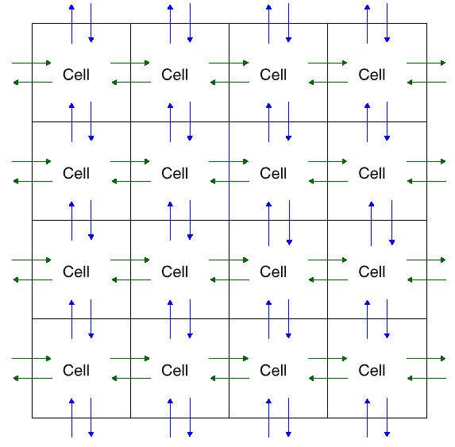
XC6200 Architecture
Large array of simple, configurable cells (sea of gates)
Each cell:
  D-Type register
  Logic function
  Nearest-neighbor interconnection
  Grouped in 4x4 block
Notes:
Information on each cell comes later (slide 10)

Slide 6
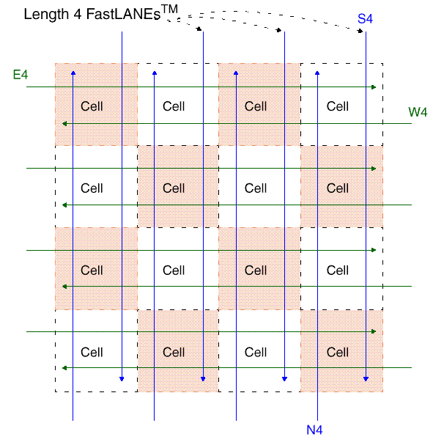
XC6200 Architecture
16 (4x4) neighbor-connected cells are grouped together to form a larger cellular array
Communication “lanes” available between neighboring 4x4 cell blocks

Slide 7
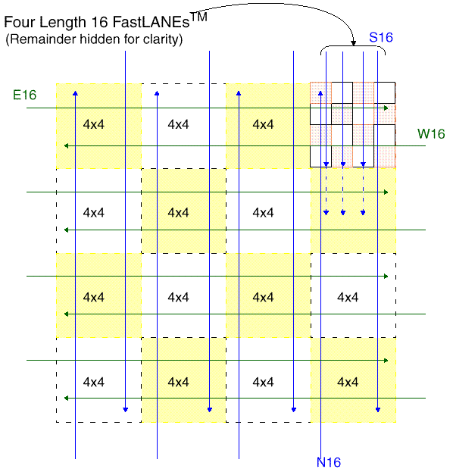
XC6200 Architecture
A 4x4 array of the previously shown 4x4 blocks forms a 16x16 block
Length 16 FastLANEs connect these larger arrays

Slide 8
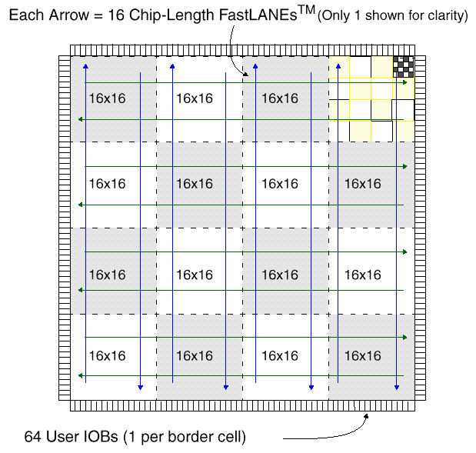
XC6200 Architecture
A 4x4 array of the 16x16 blocks forms the central 64x64 cell array
Chip-Length FastLANEs connect
Central block surrounded by I/O pads

Slide 9
XC6200 Routing
Each level of hierarchy has its own associated routing resources
  Unit cells, 4x4, 16x16, 64x64 cell blocks
Routing does not use a unit cell’s resources
Switches at the edge of the blocks provide for connections between the levels of interconnect
Notes:
Edge switches connect various levels of interconnect at the same position in the array (e.g. connecting length 4 wires to neighbor wires)
All routing wires are directional (not bi-directional)
Benefits are that wiring delays scale logarithmically with distance in cell units rather than linearly.

Slide 10
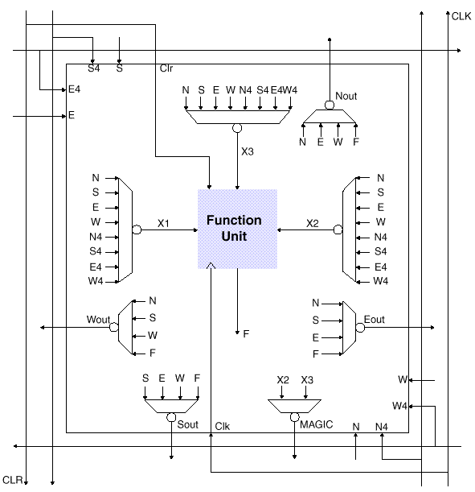
XC6200 Unit Cell
Each unit cell contains a computation unit:
  D-type register
  2-input logic function
  Nearest neighbor interconnection
  Individually programmable from host interface (uP)
Notes:
Can be configured to implement a purely combinatorial function, with no register.
As can be seen, basic cells in the array have inputs from the length 4 wires associated with 4x4 cell blocks as well as their nearest neighbors (Magic wire routing)

Slide 11
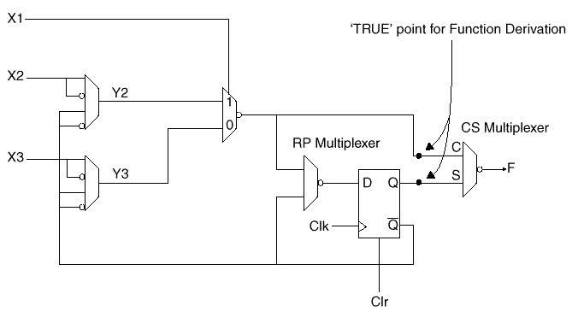
XC6200 Functional Unit
Design based on the fact that any function of two Boolean variables can be computed by a 2:1 MUX.
Notes:
Need to choose suitable values for inputs
Y2 and Y3 multiplexers provide for conditional inversion of inputs.
CS multiplexer selects combinatorial or sequential output
RP multiplexer allows the contents of the register to be ‘protected’
- protected = only programming interface (uP) can write to the reg
- unprot = otherwise

Slide 12
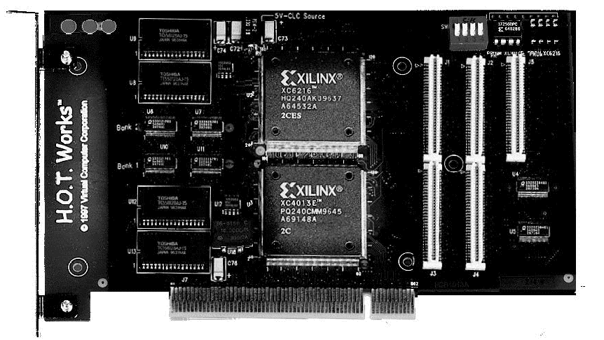
H.O.T. Works
Development system based on the Xilinx XC6200-series RPU
Includes:
  H.O.T. Works Configurable Computer Board
  H.O.T. Works Development System Software

Slide 13
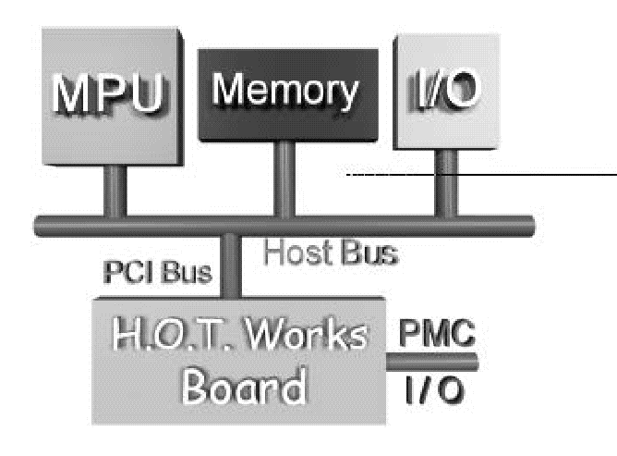
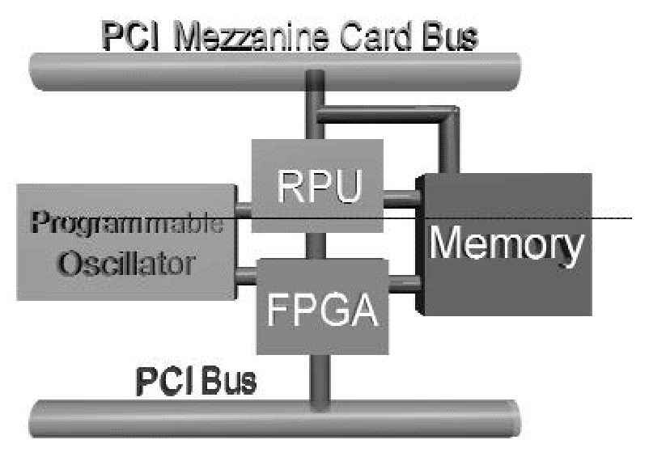
H.O.T. Works Board
Interfaces with a host system (Windows95-based PC) on PCI bus
  2MB SRAM (memory)
  XC6200 (RPU)
  PCI controller on XC4000 (FPGA)
  Expansion through Mezzanine connector
Notes:
FPGA is an XC4000 FPGA which has the PCI core logic loaded from PROM.
Programmable Oscillator (360KHz to 100MHz)
PCI Mezzanine Card (PMC) Standard interface connectors for the addition of optional development daughter cards.

Slide 14
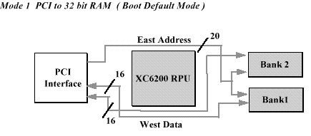
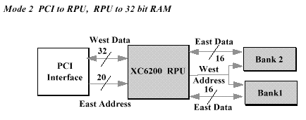
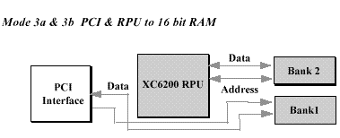
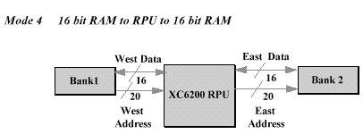
Memory Access Modes
Notes:
On board local memory is organized into two banks. Each bank is 512K x 8 SRAMs Each bank can be accessed from either the PCI interface or the RPU. Mode 1-PCI to 32 bit RAM
Single or Burst 32-bit read or write to local memory from the PCI. One address to both banks of memory.
Mode 2-PCI to RPU, RPU to 32 bit RAM
32-bit read or write to local memory from RPU
One address to both banks of memory
Concurrent PCI and local memory accesses
Can reconfigure logic in RPU while still processing data from local memories
Can store data into RPU registers and access data from local memories
Mode 3a & 3b PCI & RPU to 16 bit RAM
One bank of memory can be filled by the PCI interface and the other bank can be read from the RPU so that: Real time image processing
Mode 4 16 bit RAM to RPU to 16 bit RAM
Read or Write both banks simultaneously, 2 addresses, only communication to RPU through interrupts

Slide 15
H.O.T. Works Software
Xilinx XACTStep
  Map, Place and Router for XC6200
Velab
  Structural VHDL elaborator
WebScope
  Java-based debug tool
H.O.T. Works Development System
  C++-based API for board interfacing
Notes:
Also has LOLA Programming system (buggy but interesting)
XactSTEP takes EDIF formatted input from a design capture system. Also provides timing analysis and constraint editing.
Velab elaborates only structural VHDL. Outputs EDIF file formats.

Slide 16
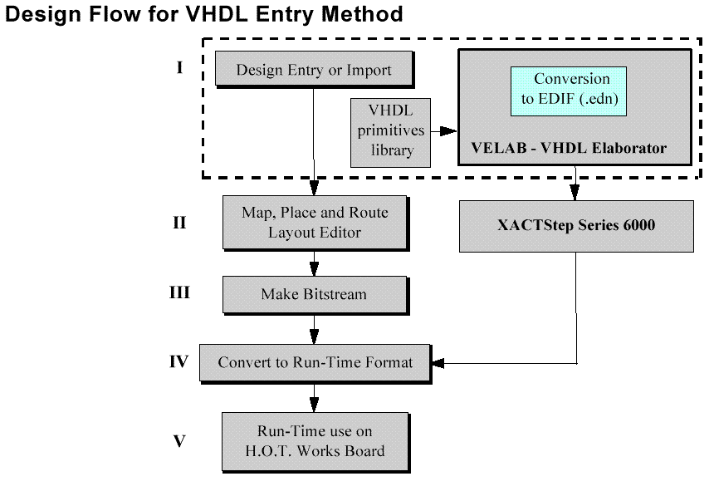
Design Flow

Slide 17
Run-Time Programming
C++ support software is provided for low-level board interface and device configuration
Digital design is downloaded to the board at execution time
User-level routines must be written to conduct data input/output and control

Slide 18
Conclusions
Xilinx XC6200 provides a fast and inexpensive method to obtain great speedups in certain classes of algorithms
H.O.T. Works provides a useable development platform to go from structural VHDL to digital design, and a programmable run-time interface in C++.

Slide 19
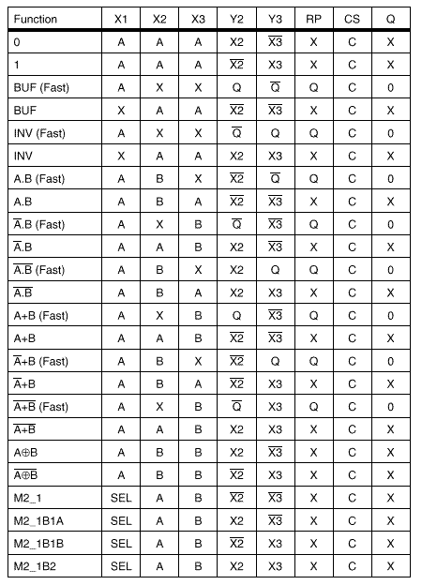
Addendum:
Cell logic function table
Refer to Slide 11

