Slide 1
Alternative Reconfigurable Architectures
ACME Seminar
Mark L. Chang
September 15, 2003

Slide 2
Life Beyond Virtex
Added functionality
  Virtex-II Pro, Altera Excalibur
Increased granularity
  QuickSilver ACM
  PicoChip
  PACT XPP
  Morpho Technologies MS1
Reduced granularity
  Cell Matrix

Slide 3
QuickSilver ACM
Targeting cellular handsets
  W-CDMA, CDMA-2000, MPEG-4
Diverse computational requirements are not good for “standard” homogenous FPGAs
Uses a heterogeneous array of nodes instead

Slide 4
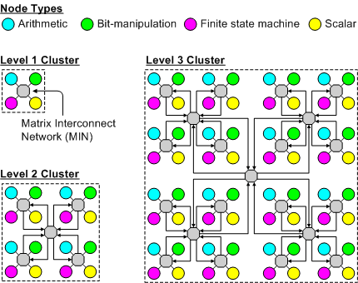
QuickSilver Architecture
Notes:
Not shown – configurable I/O, local memories, configuration memory.
Dedicated configuration bus is 128-bit or 256-bit
Arithmetic node can perform basic algorithmic task: FFT, DCT, FIR
Bit-manipulation: linear feedback shift register, etc.
Performs 2.3x faster on CDMA2000 than dedicated ASIC
Utilizing SilverC to implement algorithms

Slide 5
PicoChip
Again, targeting W-CDMA
Utilizes array of 430 processors on a single chip
13mm x 13mm die size, 160M transistors 0.13um TSMC
160MHz operation

Slide 6
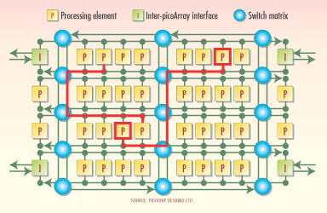
PicoChip Architecture
Notes:
430 ARM9-capable processors
Four types of processing elements:
Forward error correction, Viterbi and Turbo coding
Dedicated MAC units for filtering
Similar to #1, but 4x the memory for block (vs. stream) processing
Device controller, 4x more than #3 for scheduling

Slide 7
PACT XPP
Xtreme Processing Platform
Developed as a synthesizable Verilog IP core
Configurable
  Word size (16/24/32-bit)
  Routing and event channels
  RAM size
  I/O elements
XPP64-A1 released as prototype

Slide 8
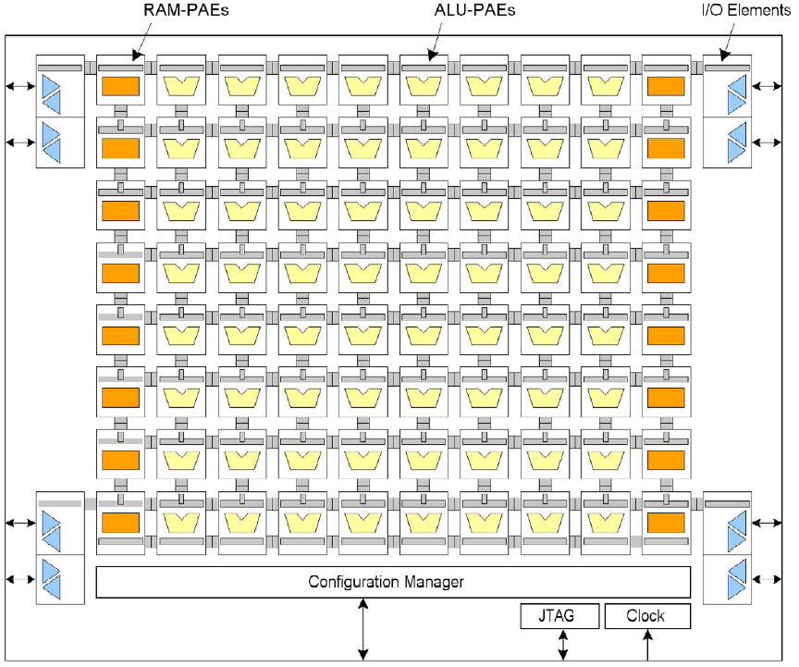
Notes:
64 ALU-PAEs in an 8x8 array
16 RAM-PAEs, each with 512 x 24 bit capacity
2 x 8 horizontal data routing channels per row
2 x 6 horizontal event routing channels per row

Slide 9
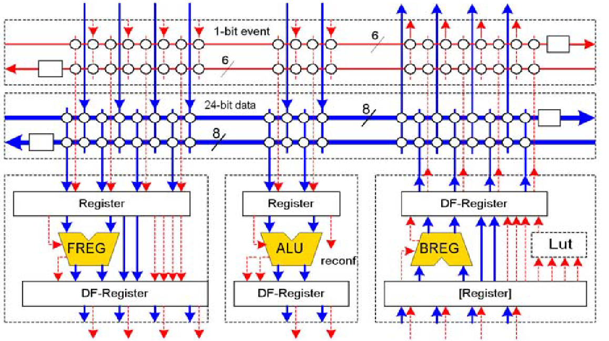
ALU-PAE

Slide 10
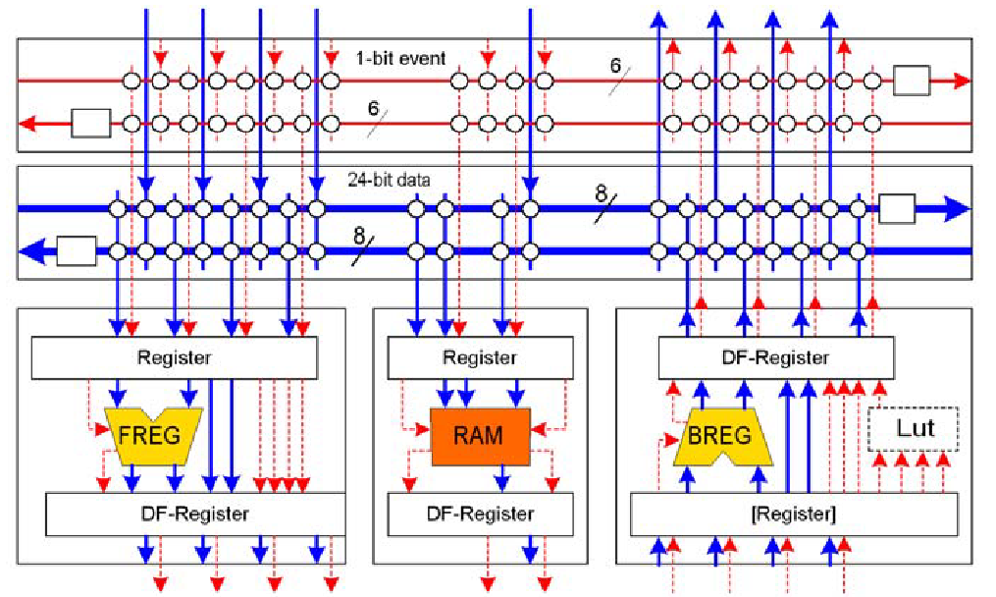
RAM-PAE

Slide 11
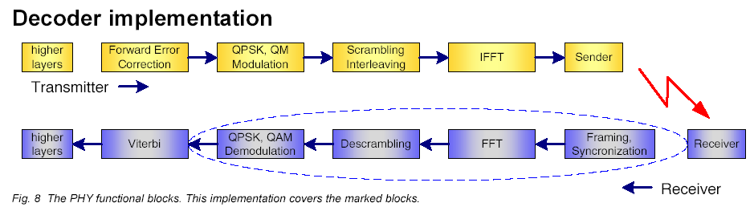
Results: OFDM Decoder
Burst rate: 40Mbit/s
Raw rate: 24Mbit/s
Power: 19.1mW
Design clocked at 40MHz

Slide 12
The Cell Matrix
Given nano-scale switches, how do we organize them to perform computation?
  Self-(re)onfiguration
  Parallel confugration
  Fault tolerance
  Scalability
  Easy to nano-fabricate

Slide 13
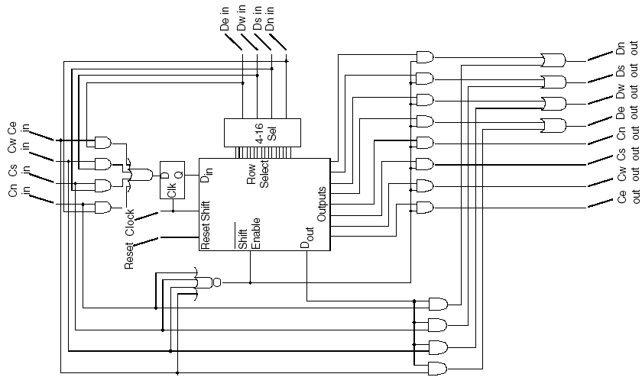
Single Cell Schematic
Notes:
Middle block is the configuration memory as a 128-bit shift register.
Shift register can become 16 x 8 random access memory.
A few dozen simple gate (NAND, OR, etc.) plus a few multiplexors and flip-flops (memories).
Requires about 1000 transistors.

Slide 14
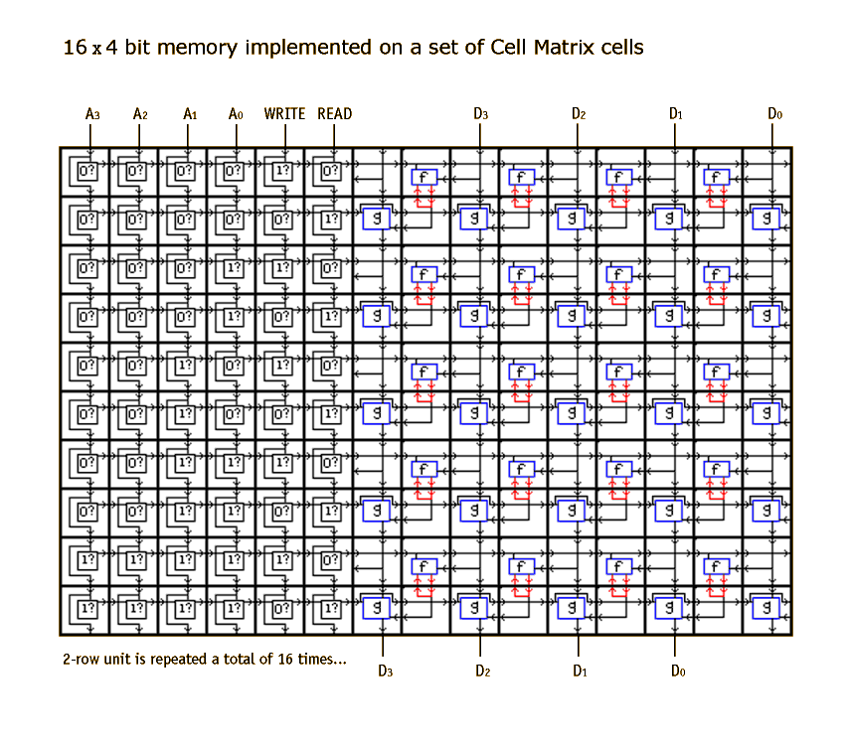

Slide 15
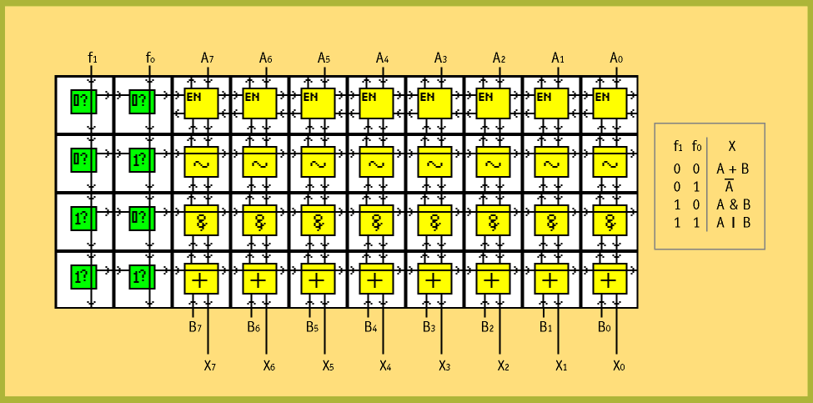
8-bit ALU

Slide 16
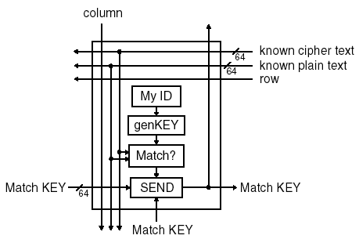
56-bit DES Decryption Processor

Slide 17
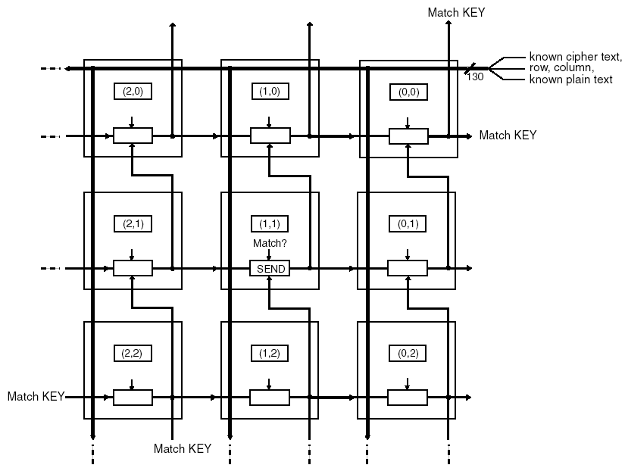
Communication Design

Slide 18
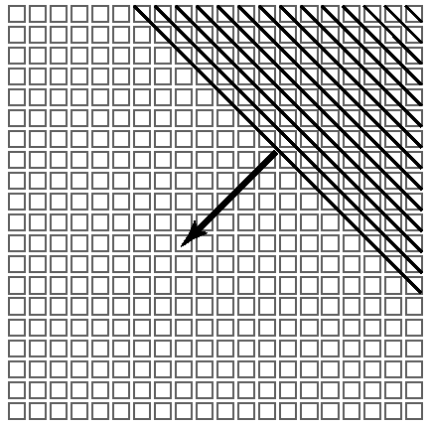
Parallel Self Configuration

Slide 19
Implementation Results
Implemented four-bit DES cracker in simulation
  Each processor is about 2500 cells
For full 56-bit decryption
  10^17 processors
  4 million cells per processor
  Assuming 1ps cell delay time, 200ms total propagation time across the cube = 40k characters/s decrypted

