Slide 1
Evolvable Hardware:
Evolution in FPGAs
Adrian Thompson
Evolutionary & Adaptive Systems Group,
University of Sussex, Brighton UK
Mark L. Chang
ACME Seminar
December 3, 2002
ACME LAB

Slide 2

Evolution
A theory that the various types of animals and plants have their origin in other preexisting types and that the distinguishable differences are due to modifications in successive generations

Slide 3
Traditional Design
Conventional digital design is just an abstraction for humans
Simplifies designs by allowing reality to be ignored
  Properties of real hardware are suppressed
  Analog behavior of transistors reduced to ON/OFF switches
  Transients suppressed by using a synchronous design
  Modules are compartmentalized
  Communicate only on clock edges
  Transients are localized to modules and don’t influence other modules
Spatial and dynamical behavior is constrained
In any design methodology, we can’t get far without help from abstraction!

Slide 4
Why Evolvable Circuits?
We can’t understand everything, so let Mother Nature do the tough stuff
Increase the search space by eliminating constraints
Let evolution organize the circuit spatially and dynamically
There is a possibility for better solutions than in constrained designs

Slide 5
Why “In Silicon” Evolution?
Evolution normally takes place in software simulations
  Easy to manipulate
  Usually an Artificial Neural Network (ANN)—a constrained system
  Not too slow that we need to accelerate using hardware
Evolution in hardware gives us unique opportunities
  Can exploit real-world physics that are often difficult or impossible to analyze or model in simulations—let’s us drop simplifying constraints.
  Physical components have a size, shape and location, which are critical in determining the interactions between them. No longer artificial point-to-point interconnections as in simulations.
  Characteristics of the components and their interactions are not exactly predictable or constant over time. Evolution must cope with this.

Slide 6
Artificial Evolution Basics
Chromosome/Genotype
  Bit string that represents a possible solution
Population
  Collection of chromosomes
Fitness
  The goodness of the solution expressed by a particular chromosome
Crossover
  A method of creating a child chromosome by taking sections from one parent or the other
Mutation
  Random inversion of bits in a chromosome

Slide 7
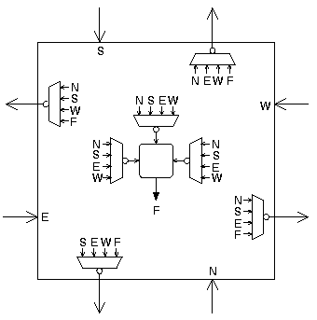
The Evolvable Hardware
Xilinx XC6216 FPGA
  64x64 array of reconfigurable cells
  NEWS connectivity
  Functional block or route-through
  2-input Boolean / 3-input MUX
  No illegal configurations possible
Only nearest neighbor connections used
Constrained to 10x10 corner
One input and one output on IOBs
18 configuration bits per cell

Slide 8
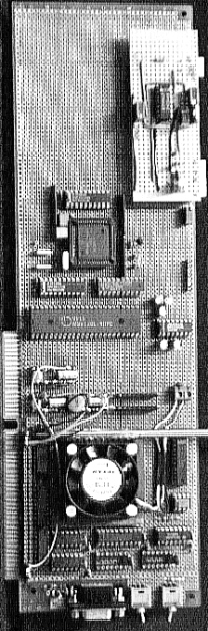
The Experiment
Each cell has an 18-bit chromosome
  Grouped into a linear bit-string genotype 1800 bits long
Evolve a circuit to discriminate between square waves of 1kHz and 10kHz
  Output +5V at one frequency, 0V at the other
Genetic Algorithm (GA) parameters
  Population size = 50 (randomly generated)
  Elitism (single fittest individual survives)
  Fittest individual expected twice the offspring as the median-ranked individual
  Mutation rate = 2.7 mutations/genotype
Configure and run on real hardware

Slide 9
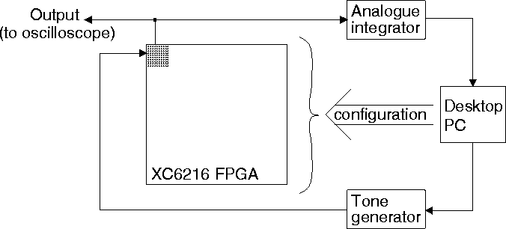
Fitness Evaluation
Five 500ms bursts of 1kHz square wave, five 500ms bursts of 10kHz square wave (random order, no gap)
Reset integrator at beginning of each test tone
Integrate output voltage over each test tone duration

Slide 10
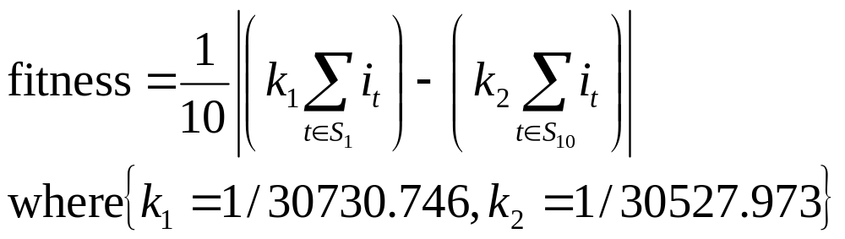
Fitness Evaluation
i_{t} = integrator value at end of test tone t
S₁ = set of five 1kHz test tones
S₁₀ = set of five 10kHz test tones
Maximizes difference between the average output voltage during the two input test tones
  Constants determined such that circuits that directly map input to output get zero fitness

Slide 11
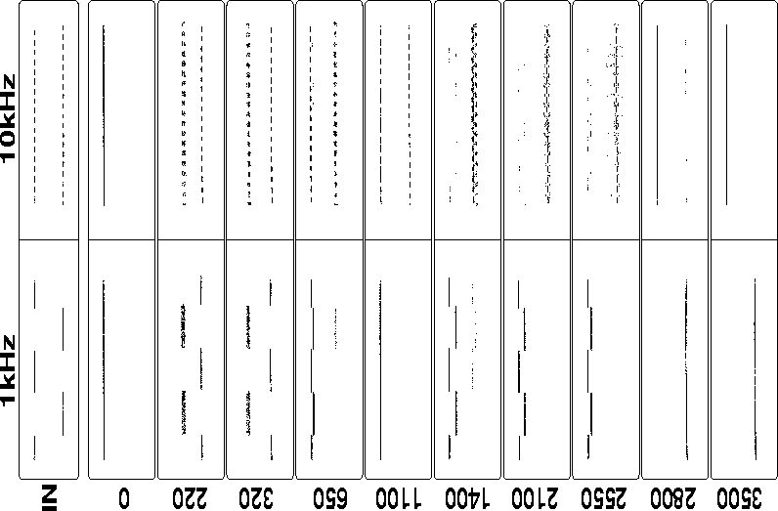
Results

Slide 12
Caveats
Analysis
  No clear functional decomposition
  Long-term stability is hard to prove
  Possible that intermittent behavior has a long time-scale
  Unknown failure modes
Application
  Must be insensitive to certain variations in implementation and environment
    Thermal drift
    Noise
    Aging effects at the semiconductor level
    Variations at the semiconductor level

Slide 13
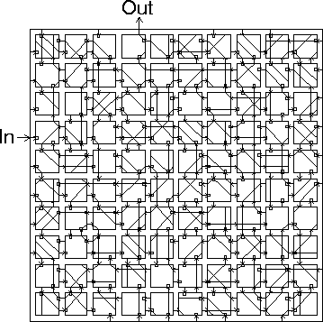
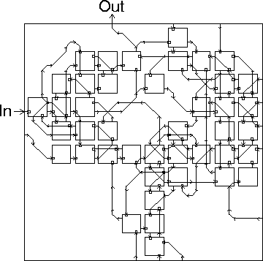
Resulting Circuit
Full evolved circuit
Pruned circuit
Notes:
Functional unit outputs indicated by arrows.
Inputs used in the functional unit indicated by squares.
Prune_1:
Tracing all possible paths through the circuit from input to output. Assumed that all functional unit inputs could affect functional unit output. Done because we don’t always know how the functional unit works in continuous time.

Slide 14
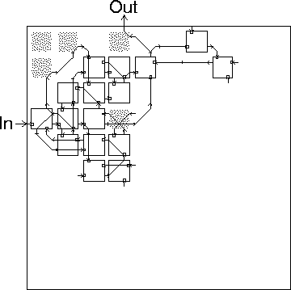
Functional Circuit
Random “unused” cells were clamped to random constant values
Fitness was re-evaluated
  Cell unclamped if performance degraded
  Cell left clamped otherwise
Iterated to build a maximal set of clamped cells without altering fitness
Grey cells cannot be clamped even though there is no path to the output!

Slide 15
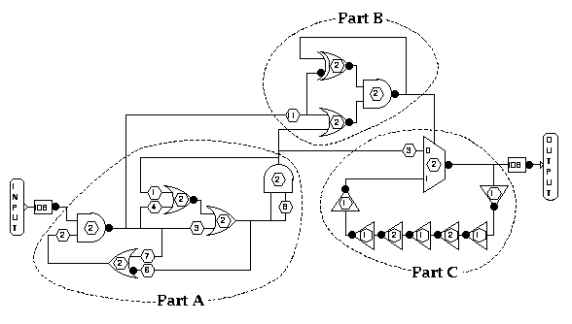
Circuit Diagram
Within 20ns of an input ‘1’, gates in A and B switch to fixed states until input goes to ‘0’
Part C has 9ns inversion delay

Slide 16
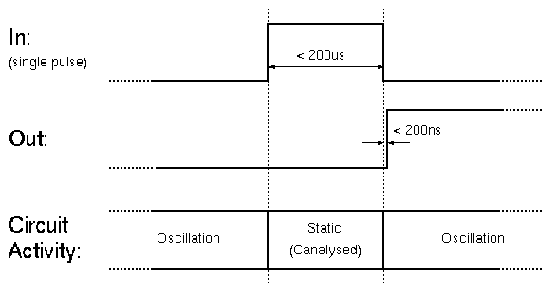
Circuit Behavior
During pulse A and B parts are static within 20ns
Part C is also static (through observation), yet “knows” within 200ns of the end of the pulse, how long the pulse was
Short pulses keep output high, longer pulses change output low

Slide 17
Analysis
Probing
  Power consumption at quiescent levels during pulse
  Observed signals are in a stable state
Simulation
  PSPICE simulation verified transient upon entering static state
Synthesis
  Built circuit out of separate CMOS multiplexer chips--failed

Slide 18
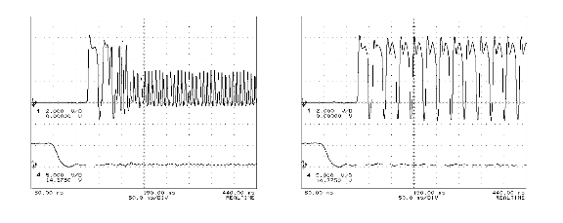
Analysis
Evolutionary history
  After pulse, output oscillates at one of two frequencies, depending on the length of the pulse (left: long, right: short)
  Bistable oscillations present in Part A of final circuit
  These oscillations are used by Parts B &C to derive a steady output according to the pulse width
  Maybe due to charging/discharging of unknown parasitic capacitance?

Slide 19
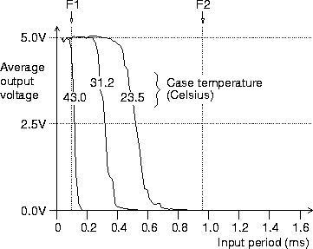
Robustness
Discriminate between >4.5kHz and <1.6kHz
Vary frequency from 31.25kHz to .625kHz
Vary temperature
Can discriminate well at nominal temperature
Temperature has adverse effect on performance

Slide 20
Evolving Robustness
Can we evolve a circuit to work within a defined operational envelope?
The Experimental Operational Envelope
  Use five FPGAs in similar configuration to last experiment
  Electronic surroundings
    Shielding, pin connectivity
    Circuit position
    FPGA fabrication variations (Yamaha vs. Seiko)
    FPGA Packaging
    Temperature (ambient, constant cold, constant hot, gradient)
    Power supply
    Output pin resistive loading
Notes:
Packaging:
3x: 299-pin ceramic pin-grid-array (PG299)
1x: Plastic 84-pin PLCC (PC84)
1x: Surface mounted 240-pin plastic PQFP (HQ240) w/heatsink
Temperature
Ambient: 17-25C
Hot: 60C
Cold: 12C
Gradient: 15C/cm (30-15C)
Power supply:
1x: PC 5V
2x: 5V switching w/12v fans
2x: Regulated @4.80V and 5.20V

Slide 21
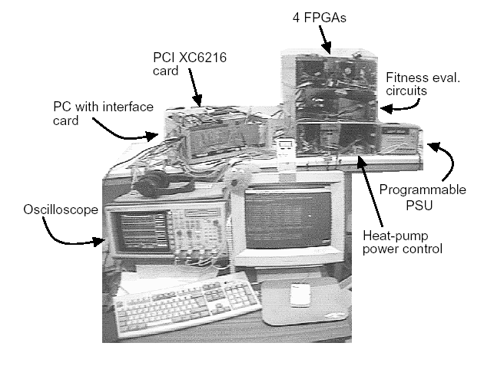
The Evolvatron Mk. I

Slide 22
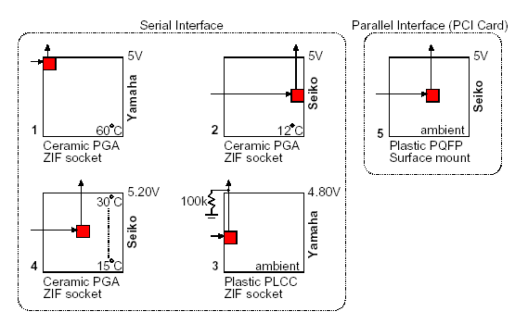
Per FPGA Variations

Slide 23
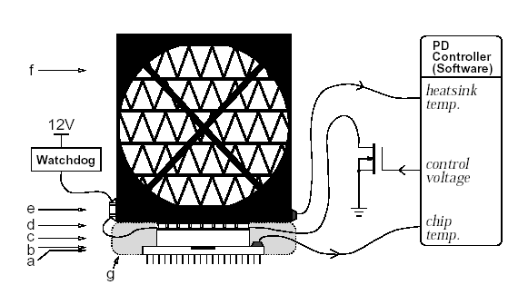
Hot and Cold FPGAs

Slide 24
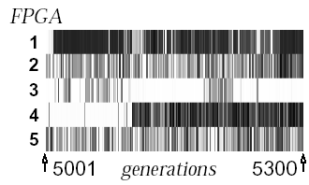
Results Mk. I
Take generation 5000 population from previous experiment
Continue evolution with overall fitness now being the mean of the individual fitnesses measured on the five different FPGAs
This measures the population subject to new selection pressures
Trying to find a single individual scoring well in all conditions

Slide 25

Evolvatron Mk. II
Uses similar hardware setup, but different evolutionary algorithm
Clock supplied as an environmental resource
Randomly pick cell and randomly select mux within cell to reconfigure with mutation – do three times per parent

Slide 26
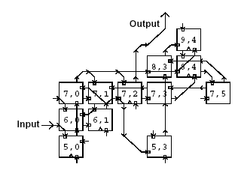
Results Mk. II
Final circuit works near-perfectly on all of the FPGAs in all conditions
Tested on six new FPGAs first frozen to –50C – worked perfectly all the way to room temperature
Simulated perfectly in PSPICE
  Does not rely on analog effects
  Much more robust than earlier
  experiements

Slide 27
Conclusions
Pros
  Evolved circuits can be much more compact and power-efficient than human-created circuits
  Intrinsic evolution allows us to explore and exploit physical dynamics of hardware without the need to understand the exact dynamic behavior
  Evolving circuits can be exposed to robustness parameters and can evolve tolerances and adaptability
  Evolution can take place without human intervention
  Evolved circuits can teach designers new tricks
Cons
  Fitness function creation can be a non-trivial task
  Intrinsic fitness evaluation can be time consuming
  Very little understanding of fundamentals

