Slide 1
Survey of Nanoscale
Digital System Technology
Mark L. Chang
ACME Seminar
May 10, 2002
ACME LAB

Slide 2
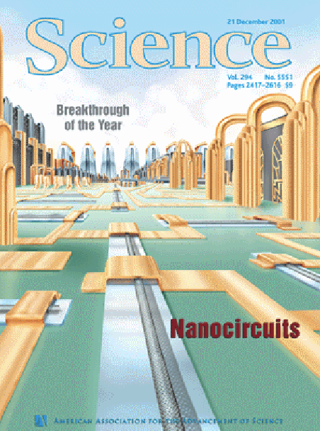
Where did I get this info?
Evening workshop at FCCM’02
Mike Butts – moderator
Panelists
  Andre DeHon – Caltech
  Phil Keukes – HP Labs

Slide 3
Nanoelectronics is T.N.B.T.™©®
The Next Big Thing
Molecular-scale devices
  Programmable only
  Good for FPGA and NVRAM architectures
  Up to 1 trillion devices/sq. cm.
  1 million times smaller than today’s “micro-scale” devices
Mass fabricated cheaply
Have some lab results right now
Timeline
  16 Kbit RAM: 2005
  Niche products: 2008
  Equivalent to CMOS density: 2011

Slide 4
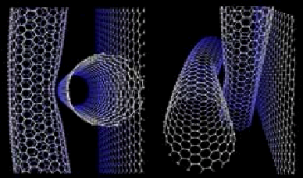
Carbon Nanotubes (NTs)
Carbon sheet one atom thick, wrapped around like a tube
Variant of the BuckyBall carbon molecule
1-5 nm wide, several mm long
It is a single molecule
  Extremely strong
  Flexible
Both a metal and
semiconductor
  Depends on lattice
  geometry
  No way to synthesize pure batch of either yet

Slide 5
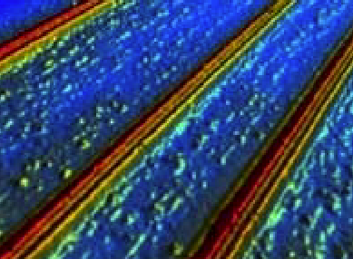
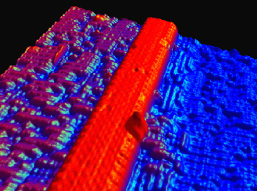
Silicon Nanowires (NWs)
Single-crystal of silicon
  6-20 nm diameter, 1-30 um long
Fabricated in bulk by laser-assisted growth
Ge, Au, GaP, GaN, InP NWs have also been made
p-type and n-type NWs
  Doped with phosphorus
  and boron
Can be wire or
semiconductor

Slide 6
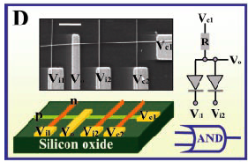
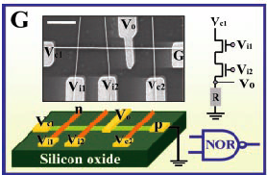
Transistors and Diodes
Diode: cross two doped NWs
  90% yield
  1V up to 5V turn-on adjustable
  via oxidation
FET: oxide between NWs
  p: Si NW channel
  n: GaN NW gate
  Voltage gain = 5

Slide 7
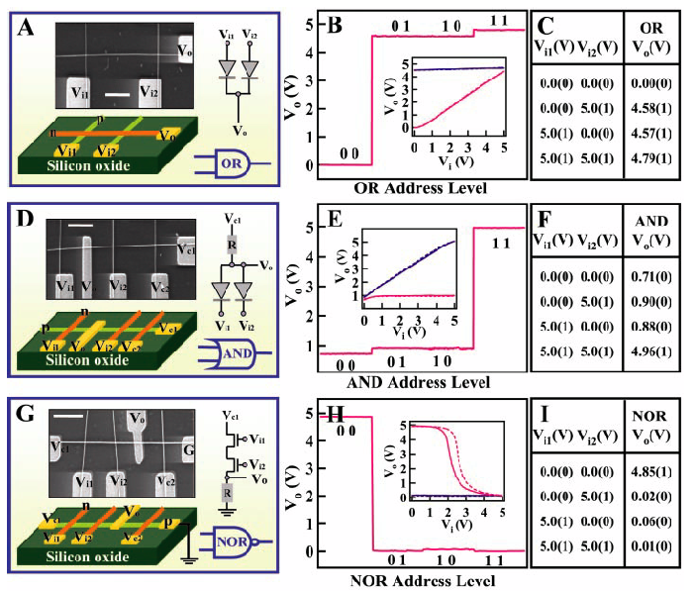
More Logic

Slide 8
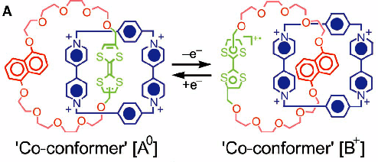
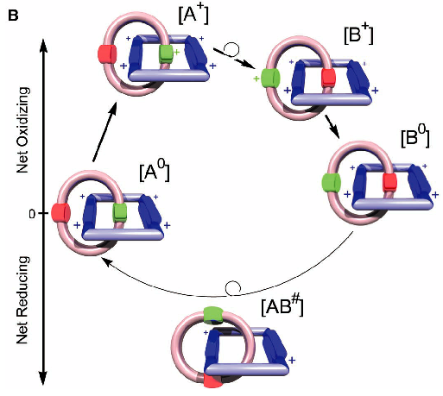
Molecular Switches
Organic molecules with two parts
Interlocking rings
Applying voltage oxidizes the molecules and shifts the rings
  2v opens, -2v closes
Non-volatile programmable switch

Slide 9
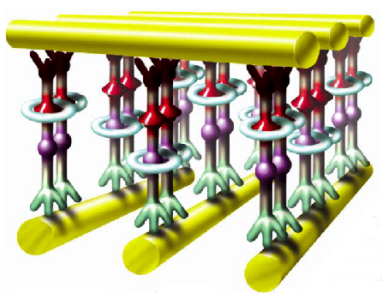
Molecular Switches

Slide 10
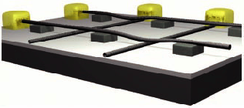
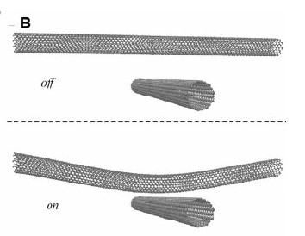
Mechanical Switches
NW/NT crossbar
Programmable array of non-volatile bistable switches
  Charge attracts wires to touch
  Van der Waals force sticks them together
  Opposite charge repels and opens the junction
Diode array
  Semiconducting lower half should make diodes at the junctions

Slide 11
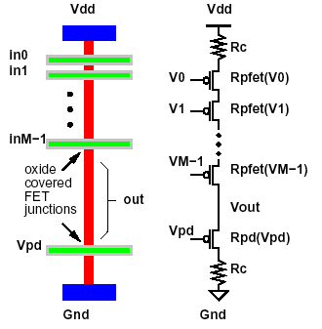
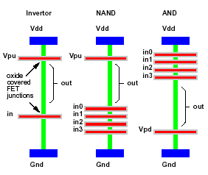
Logic Gates
Build NOR from NW-FET crossbar arrays
  Grow oxide over NW bottom wire to form FET
  One time programmable
  Static power dissipation

Slide 12
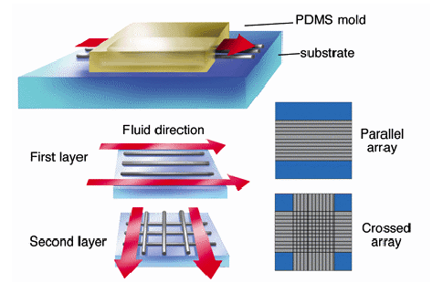
Bottom-Up Self-Assembly
We can’t make nano-circuits top-down
  Lithography can’t get to the nano scale
Make them bottom-up with chemical self-assembly
  Their own physical properties keep them in regular order, much like crystals do when they grow
Fluid flow
self-assembly
  Flow rate and duration
  controls wire separation
  Higher flow, more
  alignment
  Longer duration, more
  density
  Crossbar generated in
  two passes

Slide 13
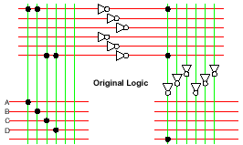
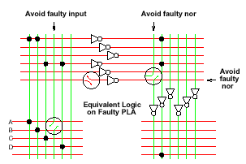
Implications
Defect tolerance is necessary
  Nature of chemical process is uncertain
  Alignment imperfect at single molecule level
Programmable designs
  FPGA with lots of spares
  Test and program around defects
Cheap fab, cheap gates
  Batch chemical process makes regular materials
  Fabrication cost per device practically zero

Slide 14

Crosspoint Density
CMOS crosspoint costs about 8 transistors
  SRAM cell, big n-channel pass transistor
  Far larger than minimum feature size
NW or NT crosspoint fits iniside the wire crossover
Area difference is 625x
Makes NanoFPGAs very attractive

Slide 15
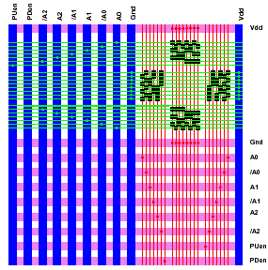
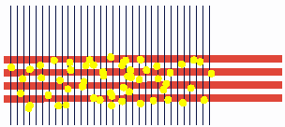
Interface to Microelectronics
Need to get out to the micro world
Can’t position any features at the nano scale
Connect log(n) microwires to a set of N nanowires to make decoders

Slide 16
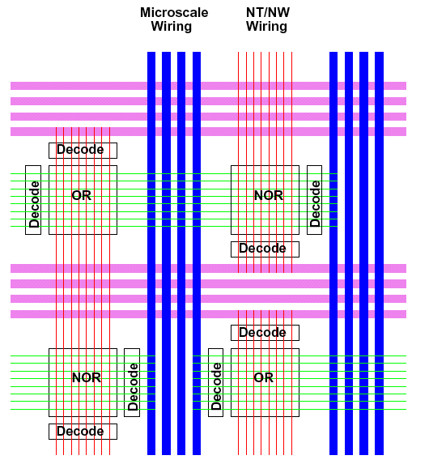
System Level Interconnect
Programmable OR/NOR, NVRAM nanoarrays
Interconnect arrays through
  Extending NWs across multiple arrays
  Through fully populated interconnect crossbars
  NW-FET buffer/registers in-between when needed
Interface to microwires with N-log(N) decoders

Slide 17
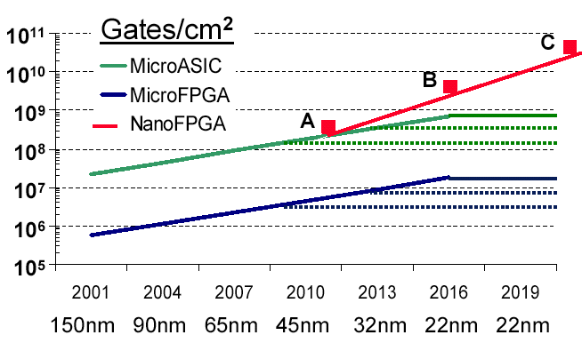
Logic Density Projections
A: 50nm/20%/400M, B: 25nm/50%/4B, C: 10nm/80%/40B

Slide 18
No free lunch™
Power:
  10¹¹ devices/cm² * 1 nanowatt/device = 100 watts/cm²
  That’s a lot of juice!
Signal integrity/crosstalk not addressed
Quantum effects?
  Electrons can act like waves too…
Reliability
  Creeping defects after fab?
  Cosmic ray damage or hardness?
Programming effort
  Work around defects to get a defect-free generic array
  OR place & route a billion gates!

Slide 19
What do we get for Gigagates?
Macro-scale computing
  Massive massive massive parallel machines
  Simulations (ASCI red/white/blue)
  Weather
Micro-scale computing
  100 MIPS in 10 sq. um.
  Powered by ambient light
  Biosensors

Slide 20
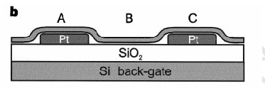

Slide 21
