Slide 1
Perturbation Analysis for
Word-length Optimization
George A. Constantinides
Imperial College, London
May 20, 2003

Slide 2
Word-length Optimization
It’s hard.
  For linear time-invariant (LTI) systems, it’s proven NP-hard
It’s necessary.
  Infinite-precision datapaths do not exist
  Changing representation can drastically affect area, power, speed, quality of output
It’s not supported in the vendor toolchains.
  Someone has to do it by hand
It’s just not fun.

Slide 3
Contributions
Uses a high-level design tool (Simulink) for input specification
Eliminates specifying bit-true hardware in the design process
Semi-automatic tradeoff of area, power, and speed against user-specified SNR
  Tool called Right-Size
Extends previous work on LTI system modeling to non-linear systems

Slide 4
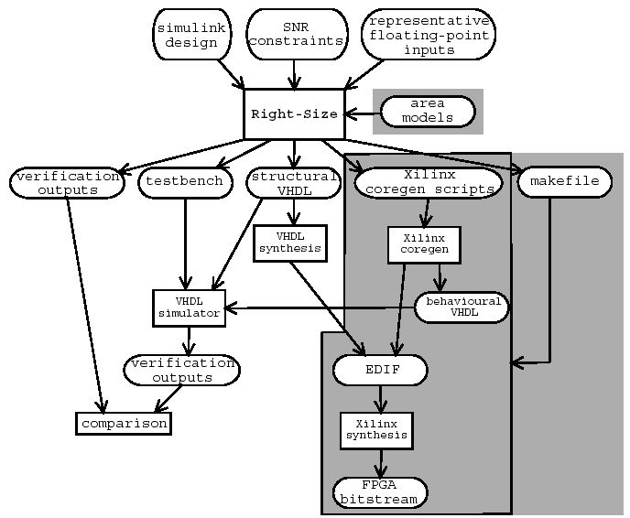
Design Flow

Slide 5
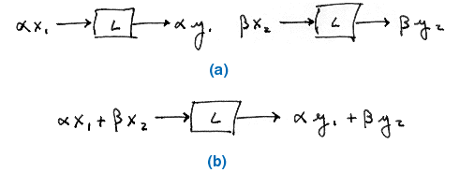

LTI Systems

Slide 6
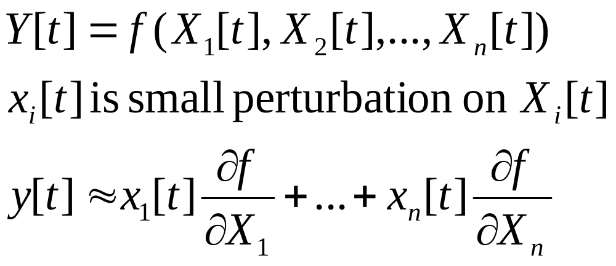
Linearizing Systems
Assumption:
  Quantization errors induced by rounding or truncation are sufficiently small to not affect the macroscopic behavior of the system
Thus, each non-linear component can be locally linearized
  Replaced by its “small-signal equivalent”
  Now, output can be predicted as a linear, time-varying system

Slide 7
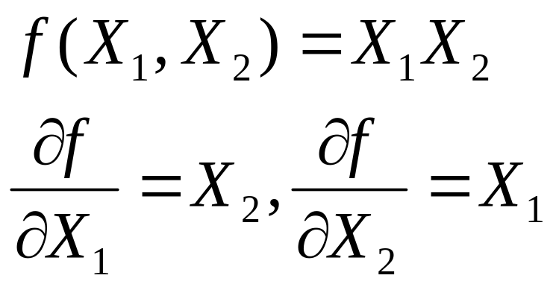
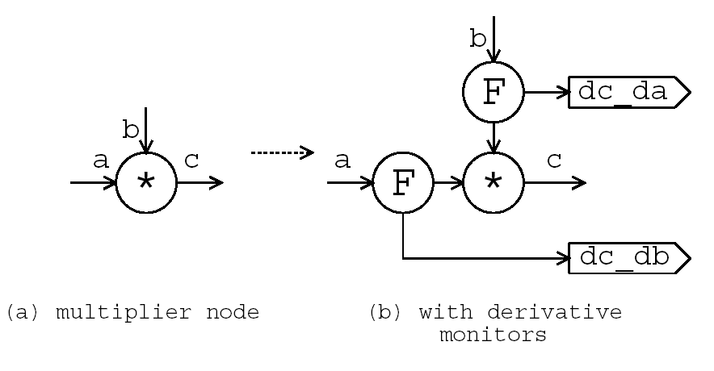
Multiply: Derivative Monitors
Evaluate the differential coefficients of the Taylor series model during simulation
Coefficients written out to file

Slide 8
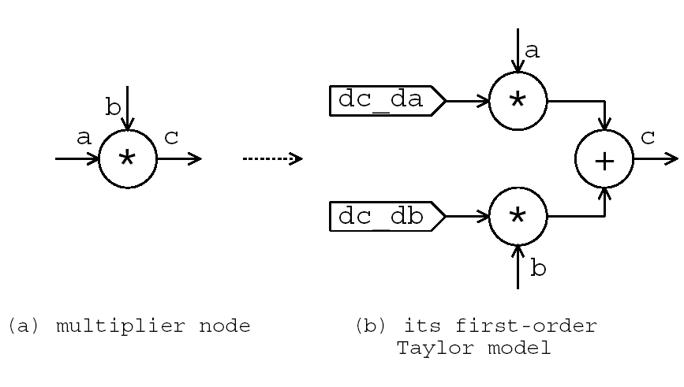
Multiply: Linearization
Replace nonlinear component with Taylor model
Read Taylor coefficients from previous step

Slide 9
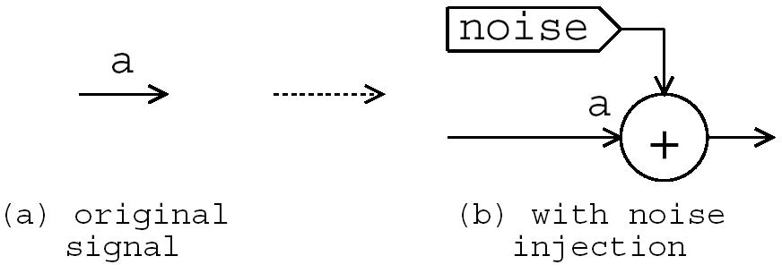
Multiply: Noise Injection
Noise is the quantization error
We can predict the sensitivity of a linear system to this additive noise (perturbation)
Apply this transformation to each signal, propagating zeros from primary inputs

Slide 10
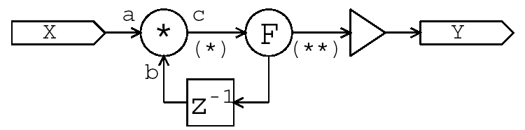
Example

Slide 11
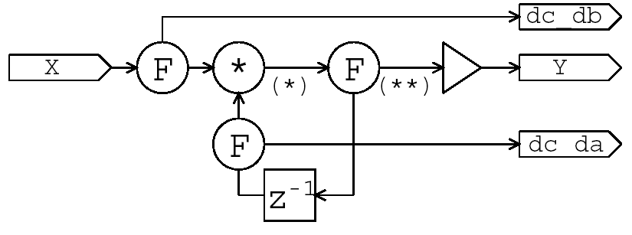
Insert Derivative Monitors

Slide 12
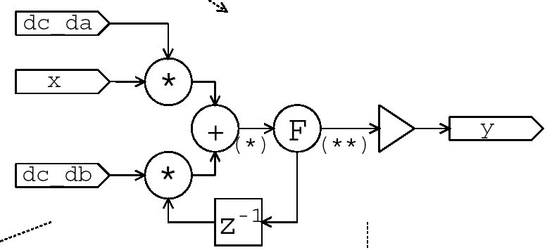
Linearized DFG

Slide 13
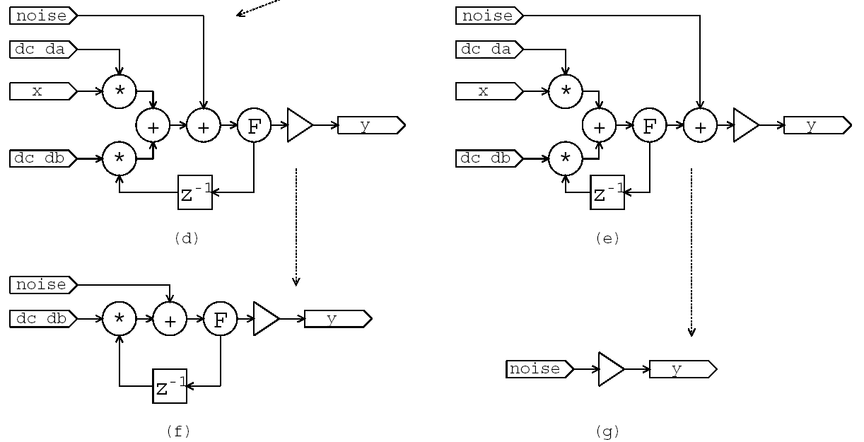
Adding Noise (Quantization)

Slide 14
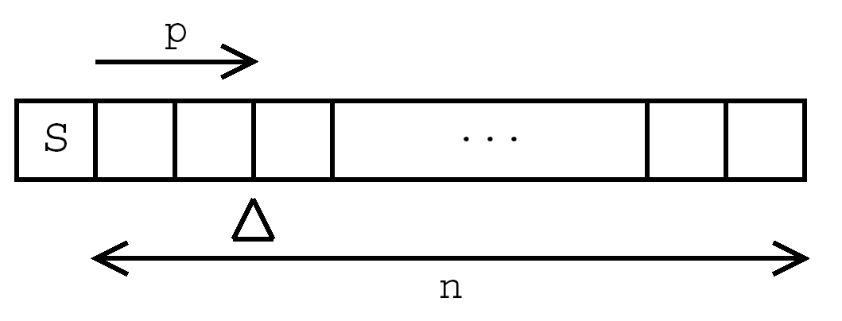
Scaling Analysis
Each signal in a multiple word-length system has two parameters
  Word-length (n)
  Scaling (p)
Perform simulation to find peak signal value reached by each signal
Scale up by a safety factor (guard bits)

Slide 15
Word-length Optimization
Two-stage algorithm
  Compute an optimal uniform wordlength
    Minimize area under user-defined maximum allowable error
  Use heuristic to find smaller wordlengths for individual signals
    Scale up optimal uniform wordlength by a fixed factor
    Greedily reduce wordlength of individual signals bit by bit according to area pay-off
All built using area models of Xilinx Coregen arithmetic units

Slide 16
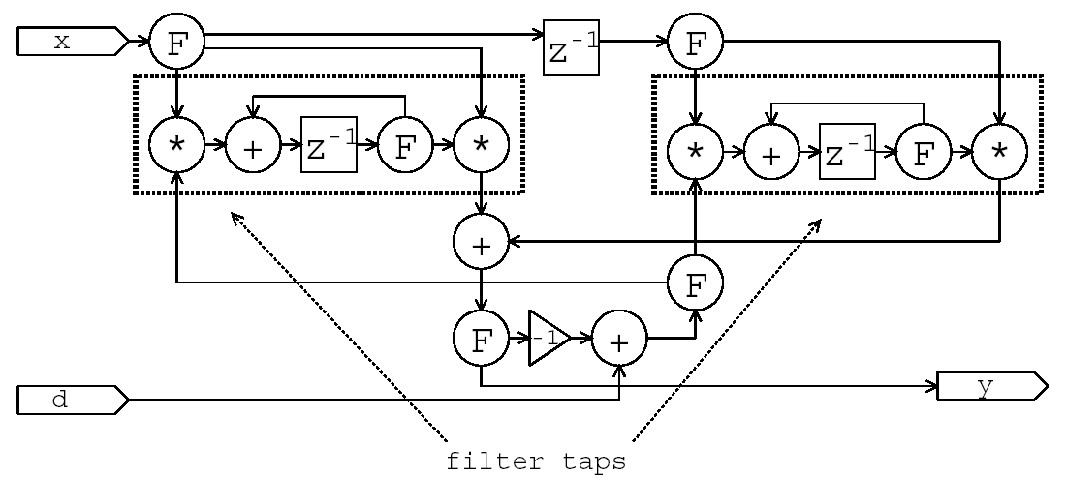
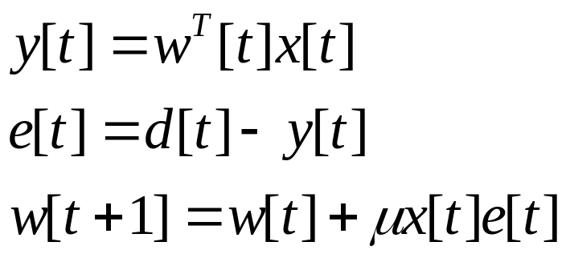
Case Study: Adaptive Filtering
Least-mean-square (LMS) filter
Adapts filter coefficients for system identification

Slide 17
Results
90 filters between 1st and 10th order constructed
Three designs synthesized
  Uniform scaling and optimum uniform word-length
  Scaling individually optimized for each signal and optimum uniform word-length
  Individually optimized scaling and word-length
Lower bound of output fixed at 34dB

Slide 18
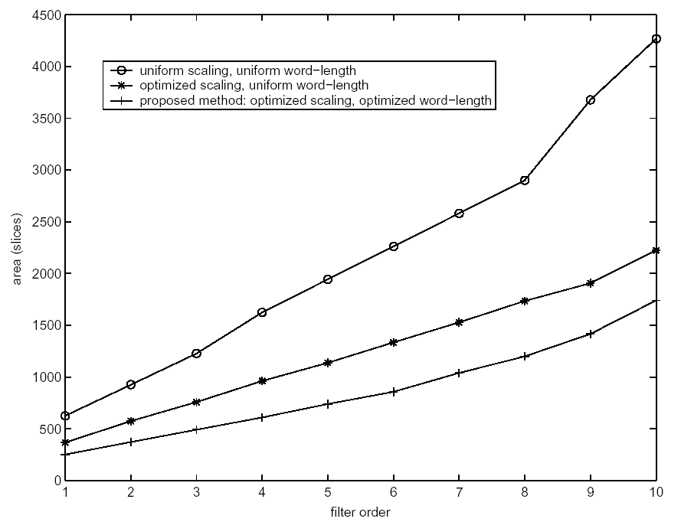
Area vs. filter order

Slide 19
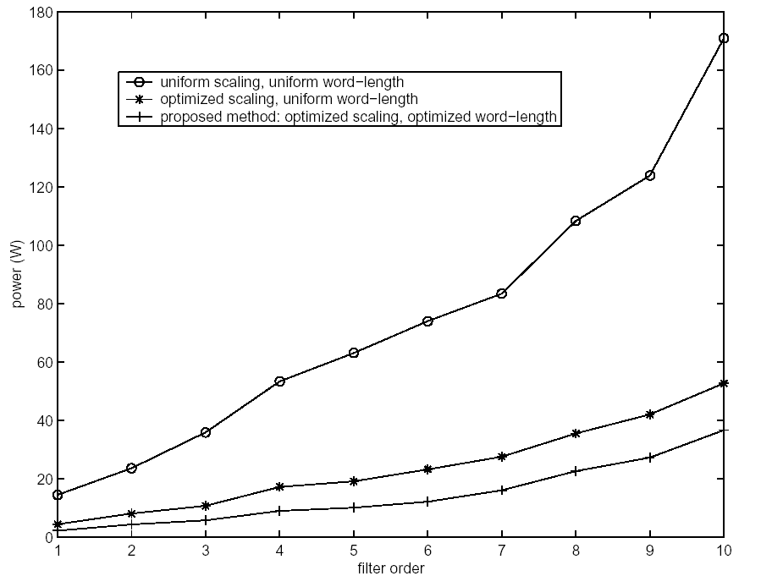
Power vs. filter order

Slide 20
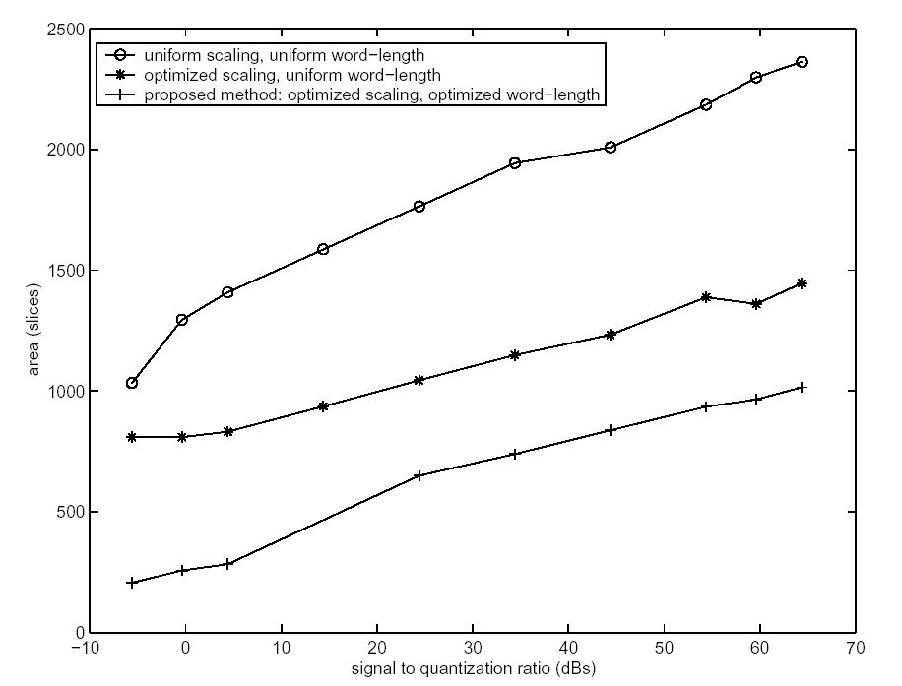
Area vs. SNR bound

Slide 21
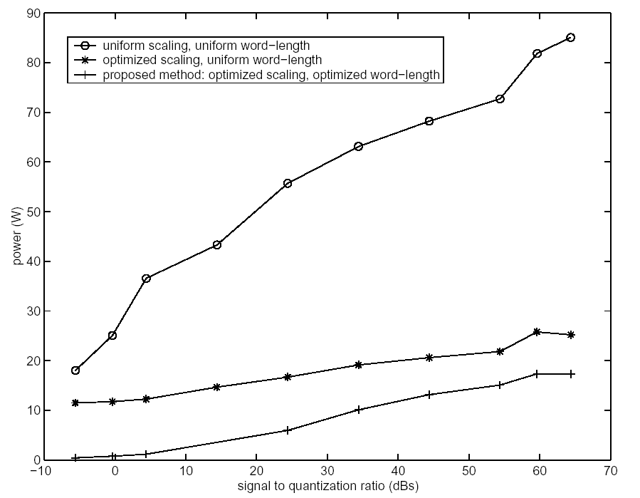
Power vs. SNR bound

