Slide 1
The SFRA: A Corner-Turn FPGA Architecture
Nicholas Weaver, John Hauser, John Wawrzynek
Berkeley CS | FPGA’04
ACME Seminar
January 23, 2004
Mark L. Chang

Slide 2
Fixed Frequency FPGAs
Conventional FPGAs do not pre-determine clock frequency
  Interfacing with microprocessor requires compatible clocking schemes
How about a fixed-frequency FPGA?
  Operates at a set clock rate regardless of configuration
  Easier to integrate, higher clock rates
  Good for computations that can be pipelined!

Slide 3
Interconnect and Routing
Interconnect delay dominates conventional FPGAs
Fixed-frequency generally requires pipelined interconnect and routing structures
Previous fixed-frequency arrays:
  Difficult placement problems
  Highly restrictive interconnect topologies limit their applicability

Slide 4
Other Fixed-Frequency FPGAs
Garp
  MIPS processor with reconfigurable coprocessor
  Interconnect fabric supported only limited connectivity
RaPiD / PipeRench
  Coarse-grained array of functional units
  Explicitly pipelined interconnect

Slide 5
More Fixed-Frequency Stuff
HSRA
  Pipelined H-tree for the routing structure
  Retiming chains, programmable delay shift registers on all inputs to balance delay
  Introduces a significant placement problem
    Not Manhattan
    Recursive bipartitioning
    Bad for datapath-oriented circuits

Slide 6
The Problem
Want to leverage conventional placement and synthesis tools and techniques
Interconnect must be pipelined
But adding pipelined switches to a conventional FPGA would be impractical
  Too many registers
  Could complicate the routing problem if switches are not fully registered

Slide 7
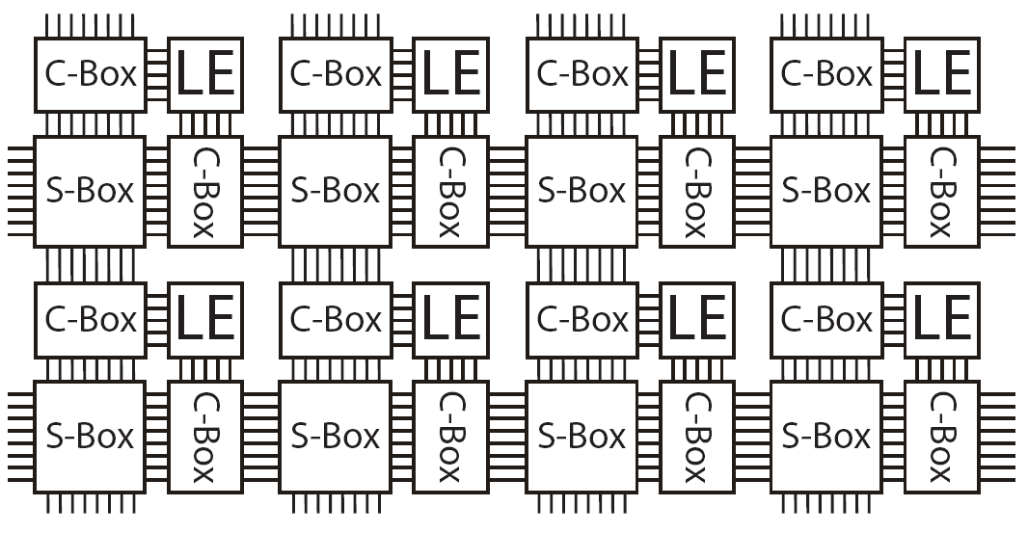
The FPGA Landscape

Slide 8
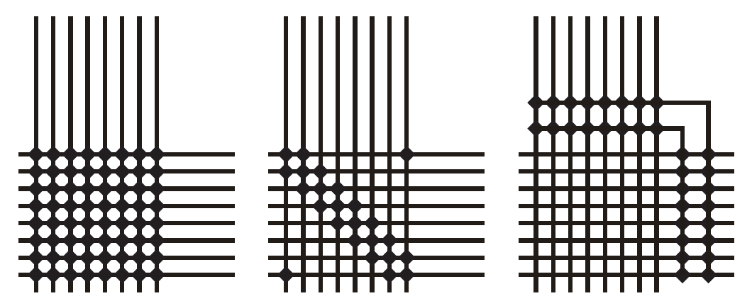
Corner-Turn Interconnect
Any-to-any connectivity for very few signals
Maintains Manhattan placement
Can be efficiently pipelined

Slide 9
Routing Corner-Turn FPGAs
Global Routing
  Assigns signals to particular channels and turns
  Attempts to minimize the number of turns taken by each signal
  Done in 5 stages
Detailed routing
  Performs wire assignment within each channel
  Greedy channel-packing technique
  O(N log N)

Slide 10
5-Stage Global Routing
1 – Direct routing
  All nets which can be routed without using turns are routed
2 – Fanout routing
  Attempt to route large fanout nets to maximize sharing of turns
  Sort all remaining nets by degree of fanout
  Starting with highest, route all nets fanout > 4

Slide 11
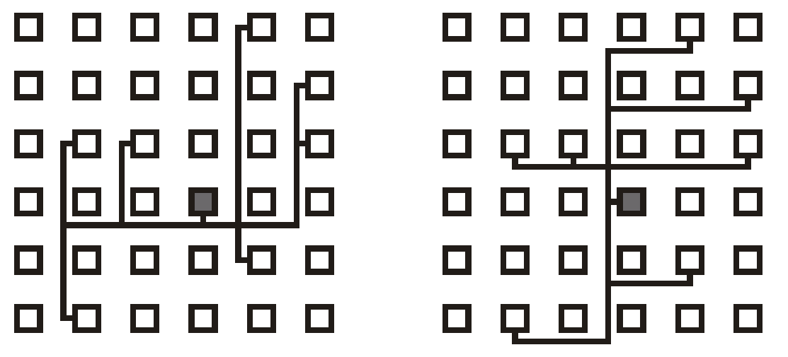
Fanout Routing
Start horizontally or vertically
Use orientation that uses fewer turns
Leave unroutable nets to later routing stages
Lock down routed nets

Slide 12
5-Stage Global Routing
3 – Pushrouting
  Consider all nets as individual point-to-point signals
  Prioritize shorter nets and nets on the critical path
  For each net, only two possible one-turn routes
  If either route is free, assign the turn
  If not free, depth-first search routed nets that use the two turns to see if an adjustment can be made to allow routing of the net

Slide 13
5-Stage Global Routing
4 – Zig-zag routing
  Remaining nets are examined to find possible two-turn routes
  Prioritize longer nets, as they have more possible turns along their route

Slide 14
5-Stage Global Routing
5 – Rip-up-and-reroute
  We want to route any remaining unrouted nets
  For each net, determine if it can be pushrouted or zig-zag routed
  If not, examine the two one-turn route switches
  Breath [sic] first search on all nets using these turns
  Select one randomly (weighted toward longer nets), rip up and reroute.

Slide 15
Retiming
In a fixed-frequency FPGA we must either
  Restrict the user’s designs to meet the array’s pipeline requirements
  Automatically transform designs to meet the array’s constraints
Feed-forward designs can be repipelined
Feed-backward designs must use C-slow retiming

Slide 16
The SFRA Architecture
Generally compatible with Xilinx Virtex
Designs must use a single global clock
Resets and clock enables must be expressed as combinational logic rather than using primitives
Cannot use LUTs as RAMs or SRL16s

Slide 17
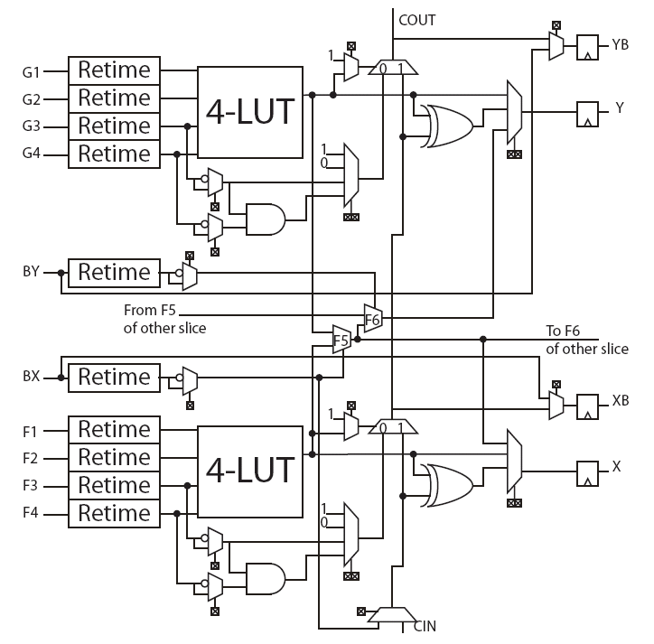
The SFRA Slice

Slide 18
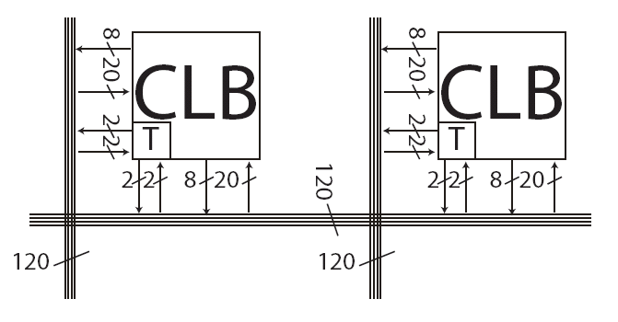
The SFRA Interconnect
I/O on any horizontal and vertical wire
Every three CLBs bidirectional buffer break
Every nine CLBs bidirectional register break

Slide 19
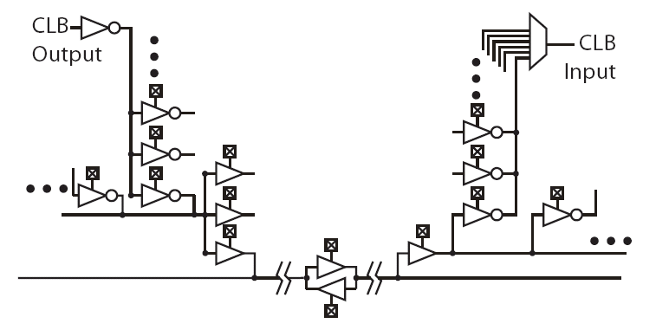
The SFRA Interconnect

Slide 20
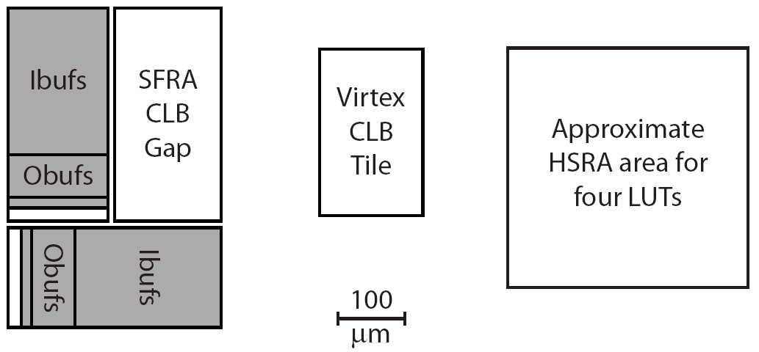
The SFRA Tile
180nm process, 160,000 square microns
3.9x larger than Xilinx Virtex E, 1.5x HSRA
300MHz simulation

Slide 21
The SFRA Tool Flow
Begins with Xilinx toolset
  Design entry
  Placement
  Mapping
Custom tools
  Initial retiming to find critical path
  Global routing
  Detailed routing
  Retiming

Slide 22
Evaluating the SFRA
Benchmarks
  AES encryption
  Smith/Waterman sequence matching
  Synthetic datapath (core of 32-bit CPU)
  LEON 1 microprocessor core (SPARC)
Xilinx benchmarks done on a Spartan II @ 250nm. Clock rates scaled by 1.4.

Slide 23
Evaluating the SFRA
Benchmarks placed using Xilinx tools
Maximum effort for all tools
C-Slow retimed Xilinx implementations
Used hand- and automatically-placed versions

Slide 24
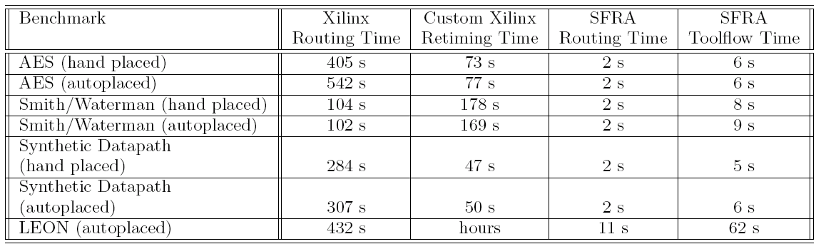
Tool Runtime Results

Slide 25
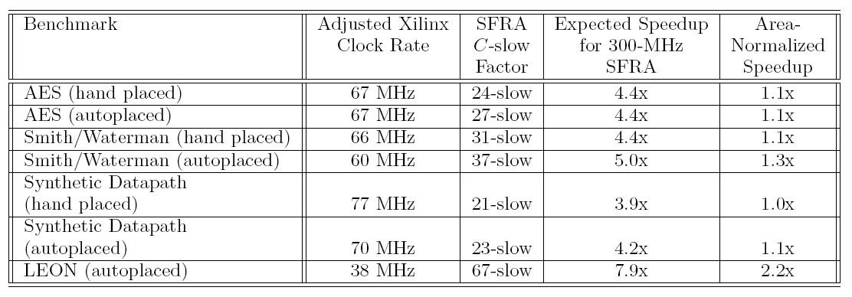
SFRA Performance Results
Unretimed Xilinx

Slide 26
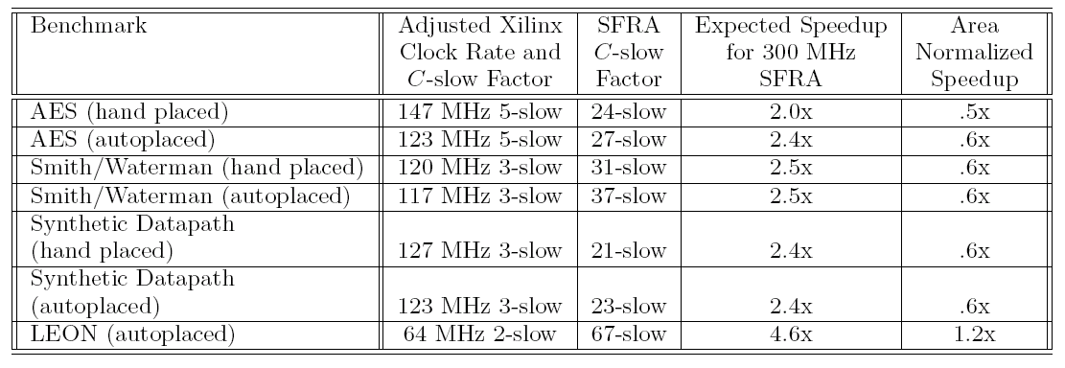
SFRA Performance Results
C-Slow Xilinx

