Slide 1
State of the Art Architectures
Xilinx and Altera
Mark L. Chang
ACME Seminar
June 30, 2003
ACME LAB

Slide 2
The Timeline
1998 – Xilinx Virtex
1999 – Xilinx Virtex-E
2000 – Xilinx Virtex-II
June 2000
  Altera Nios soft-core processor ships
  Excalibur announced

Slide 3
The Timeline
Sept. 2000
  Excalibur architecture unveiled
April 2001
  Xilinx MicroBlaze soft-core processor ships
October 2001
  Excalibur ships

Slide 4
The Timeline
February 2002
  Altera Stratix announced
March 2002
  Xilinx Virtex-II Pro ships
June 2002
  Stratix ships

Slide 5
Head-to-Head
Xilinx Virtex-II Pro
  1.5v 130nm copper
  125,136 logic cells
  10Mb RAM
  556 18x18 multipliers
  Up to four PowerPC 405 cores
Altera Stratix
  1.5v 130nm copper
  114,140 logic elements
  10Mb RAM
  224 9x9 multipliers
  No hard processor cores (Excalibur, based on Apex 20k)

Slide 6
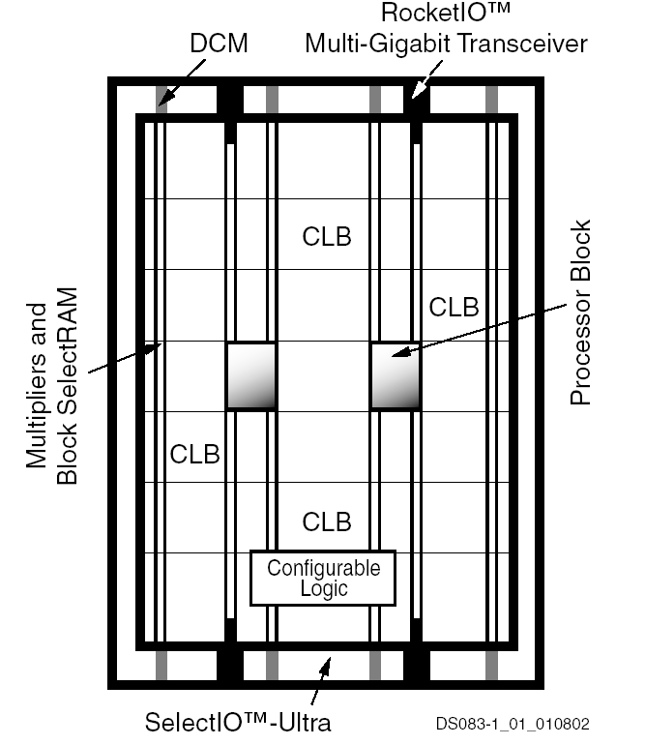
Xilinx Virtex-II Pro

Slide 7
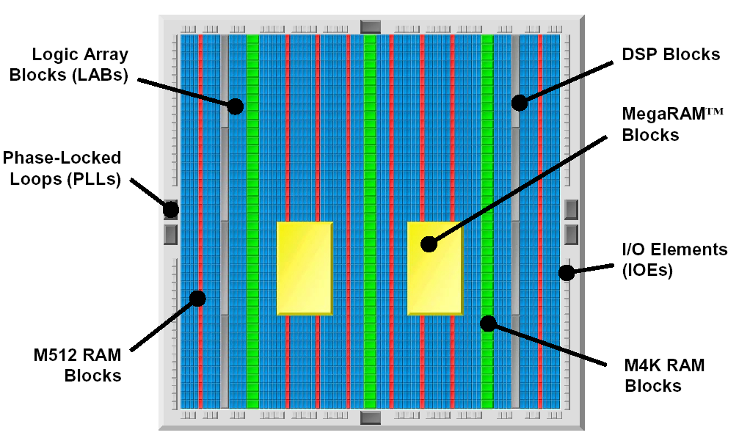
Altera Stratix

Slide 8
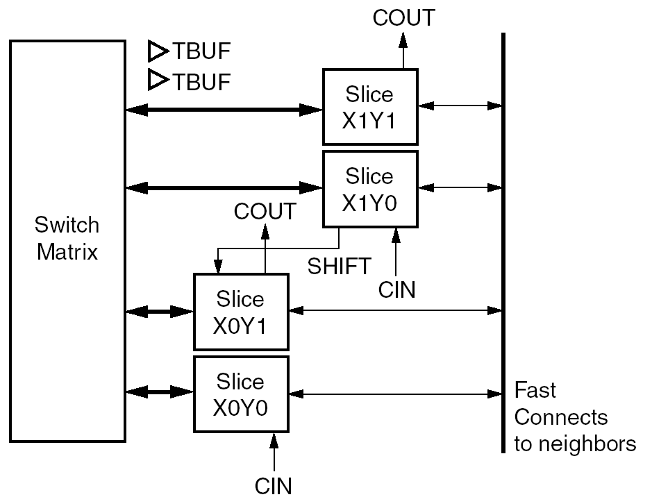
Xilinx Virtex CLB

Slide 9
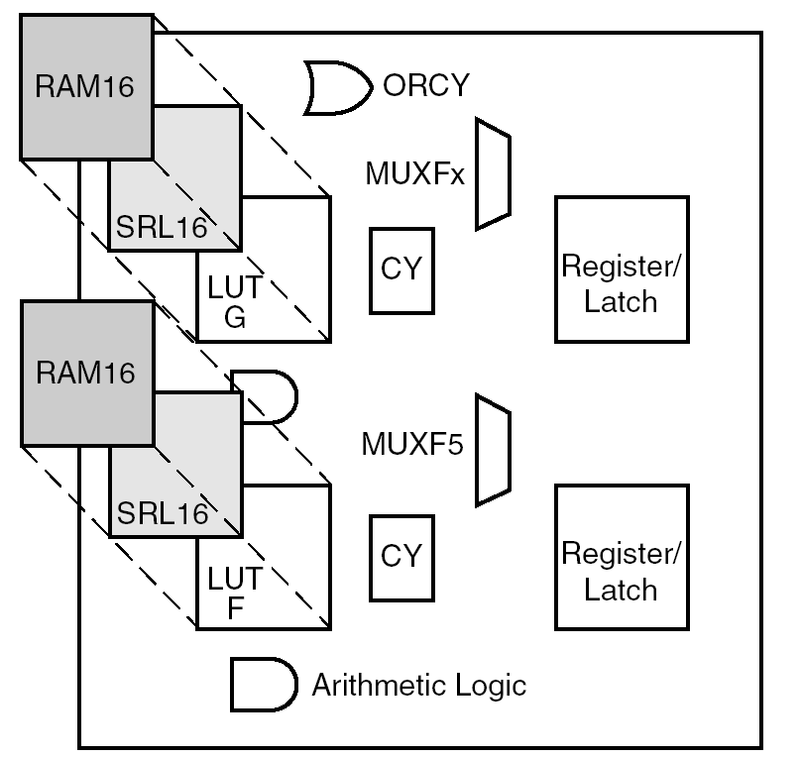
Virtex Slice

Slide 10
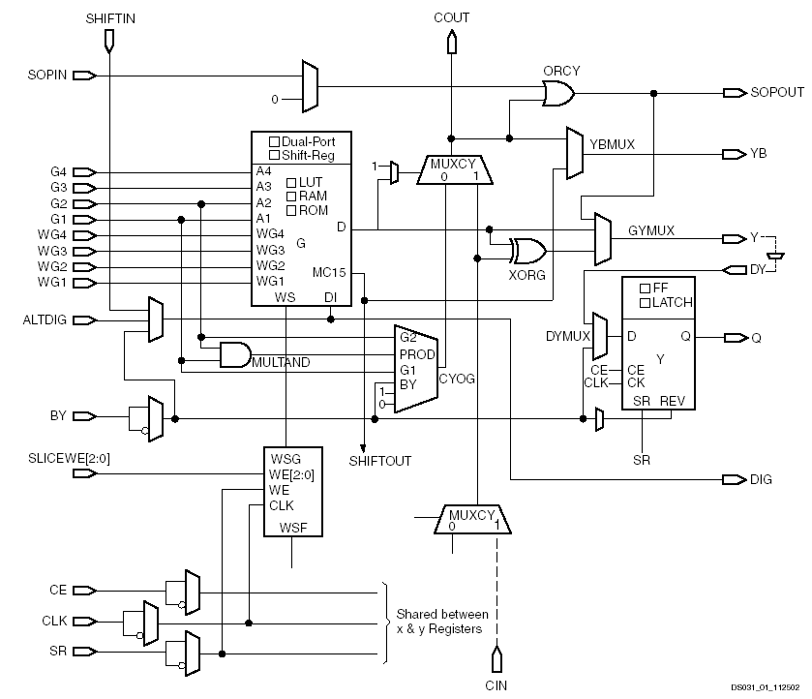
Half Slice

Slide 11
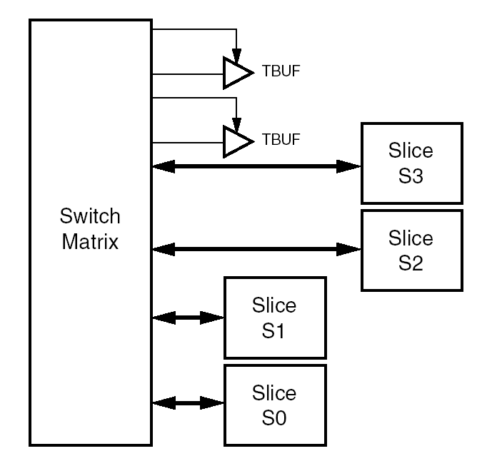
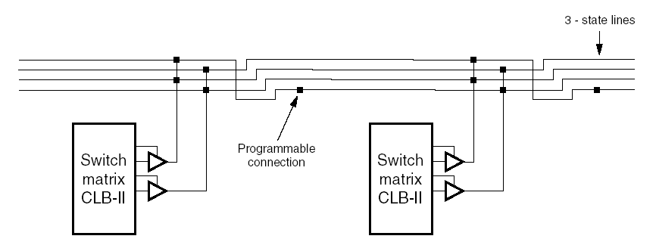
3-State Buffers

Slide 12
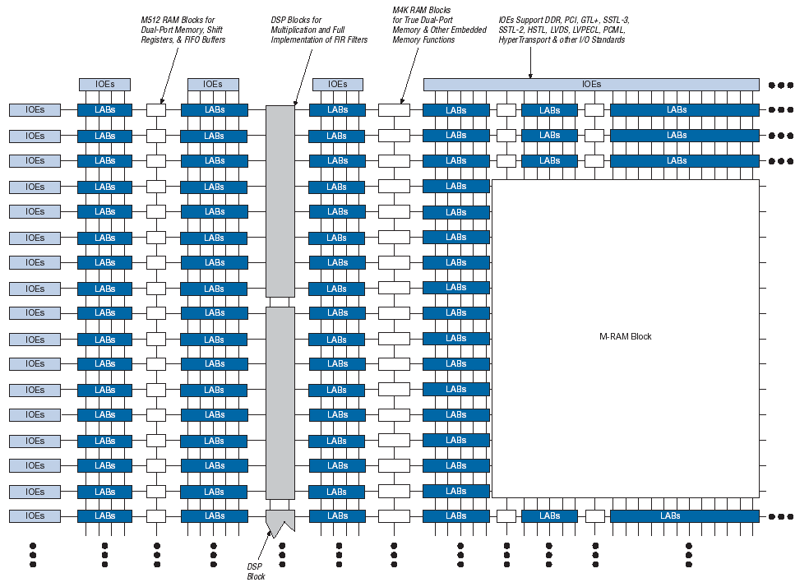
Altera Stratix

Slide 13
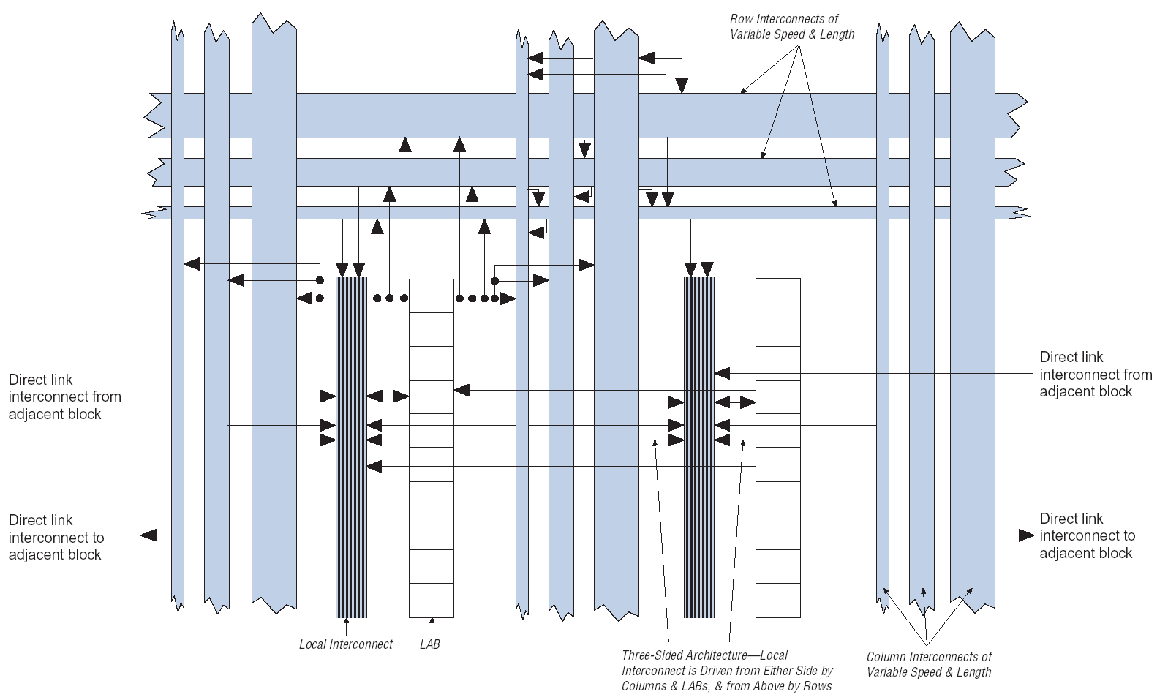
Logic Array Blocks (LABs)

Slide 14
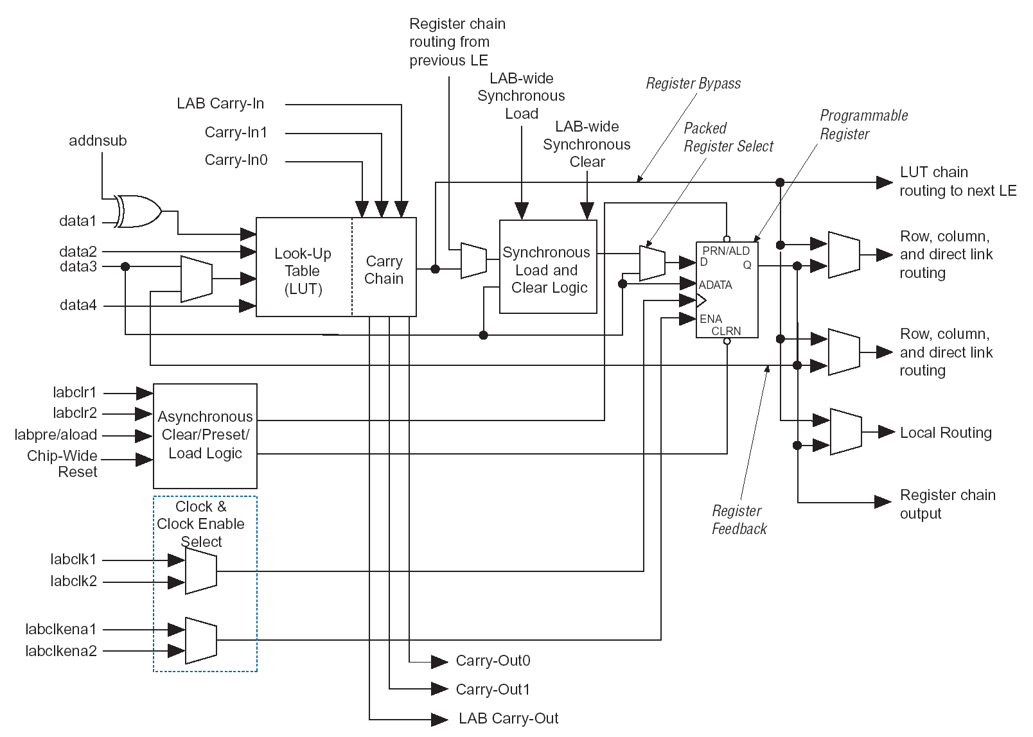
Logic Element

Slide 15
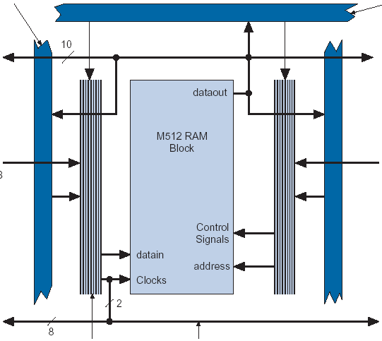
Embedded RAM
Xilinx – Block SelectRAM
  18Kb dual-port RAM arranged in columns
Altera – TriMatrix Dual-Port RAM
  M512 – 512 x 1
  M4K – 4096 x 1
  M-RAM – 64K x 8

Slide 16
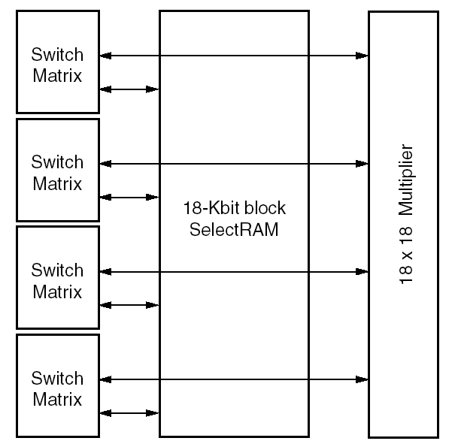
Xilinx: Embedded Multipliers

Slide 17
Altera: Embedded DSP Blocks
Two DSP Block columns per device
Number varies by height of column
Can implement:
  Eight 9x9 multipliers
  Four 18x18 multipliers
  One 36x36 multiplier
Contains adder/subtracter/accumulator
Registered inputs can become shift register

Slide 18
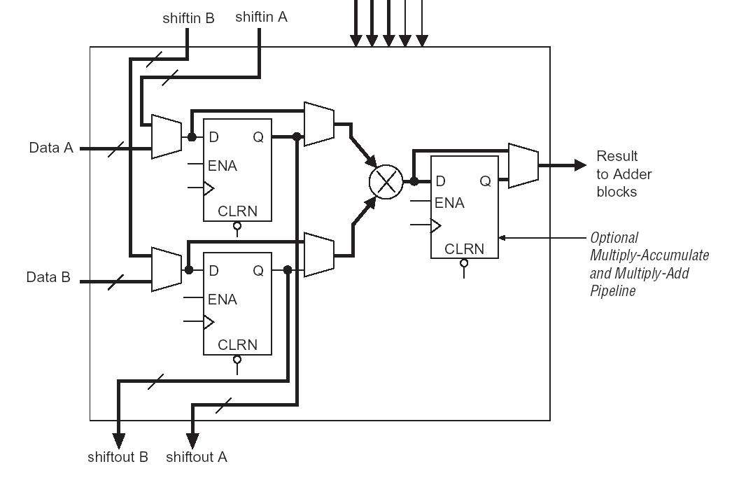
Altera Multiplier Sub-block

Slide 19
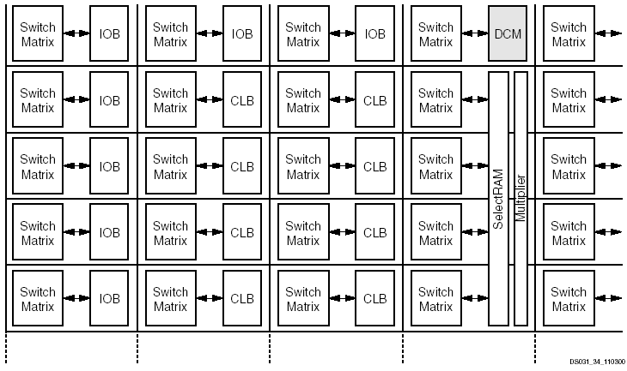
Virtex: Active Interconnect

Slide 20
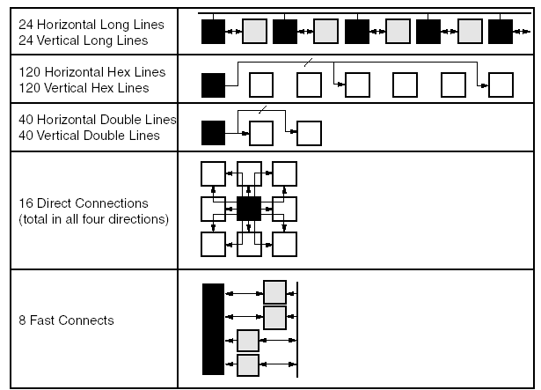
Virtex Hierarchical Interconnect

Slide 21
Altera: MultiTrack Interconnect
Direct link between LABs and adjacent blocks
Row interconnects
  4, 8, and 24 blocks left or right
Column interconnects
  4, 8, and 16 blocks up or down

Slide 22
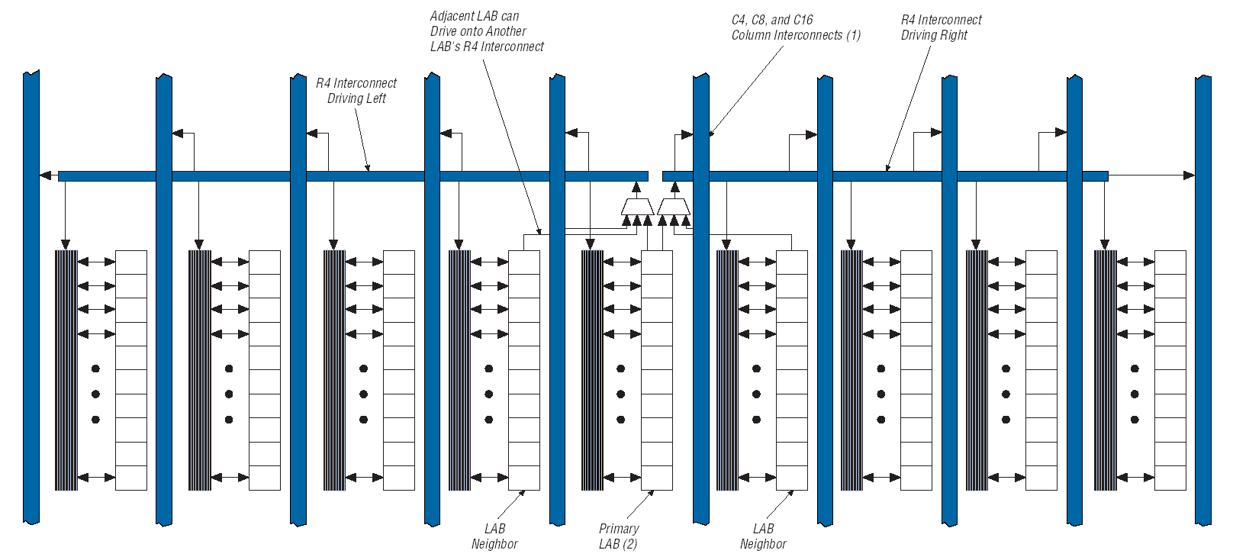
Stratix: R4 Interconnect

Slide 23
Big Differences
Xilinx
  3DES bitstream decrypter on-board
  RocketIO serial transceivers
  Partial reconfiguration
Altera
  Documented self-reconfiguration in Excalibur

Slide 24
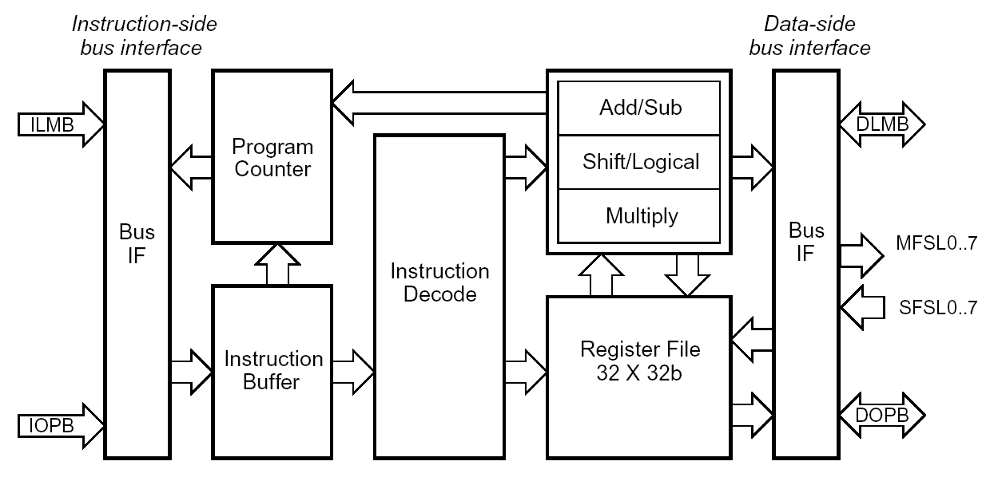
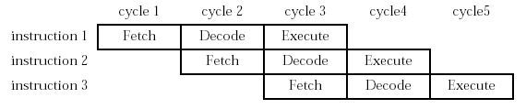
Xilinx MicroBlaze
Notes:
32 32-bit registers
32-bit instructions
Big Endian
I/D Cache
I/D Buses go to BRAMs
Hardware multiplier uses Virtex 18x18 multiplier
Assume not-taken branches
One branch delay slot + history buffer
Caches are configurable between 4kb and 64kb Direct-Mapped (write-through for dcache)
82 MIPS @ 150MHz
Fast Simplex Link interfaces to custom logic (read/write 32-bit values)
Can fit over 100 on the largest Virtex-II parts (900 LUTs)

Slide 25
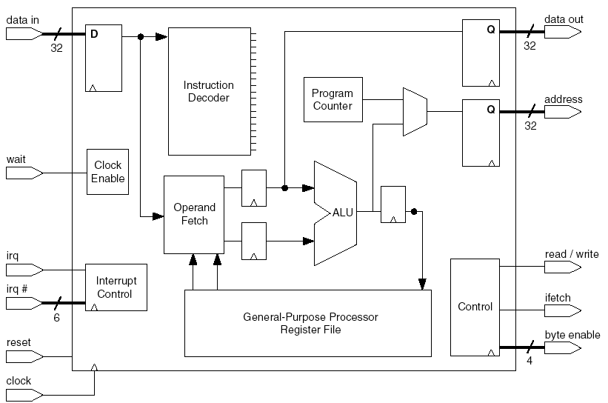
Altera Nios
Notes:
16 or 32 bit processor
126, 256, or 512 32-bit registers
Uses a 32-register sliding window register file
Little endian
Five custom instruction opcodes
50 MIPS on old FPGA (Cyclone). Could get 150MHz on Stratix and probably 80-100 MIPS
Consumes 2,000 - 3,000 LEs

Slide 26
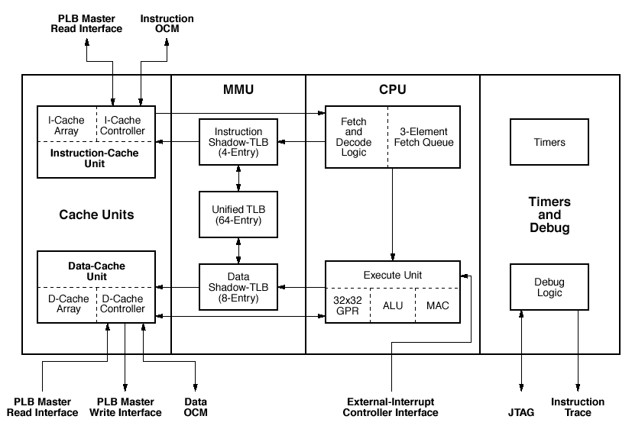
Virtex PowerPC Core

Slide 27
PowerPC 405
Five-stage pipeline
Independent instruction and data caches
  16KB two-way set associative (256 x 32B)
  Write-back or write-through data cache
Static branch prediction
Real memory management unit
  TLB, memory protection
300MHz+, 420 MIPS
Notes:
P4 1.5GHz = 2800 MIPS
Big endian core, little endian capable

Slide 28
Interface to Virtex
On-Chip Memory Controller (OCM)
  Interface between PowerPC core and BRAM
  Separate data and instruction OCMs
  Scratch-pad memory
  Bi-directional data transfer to FPGA blocks
  Storage is interrupt service routines
Processor Local Bus

Slide 29
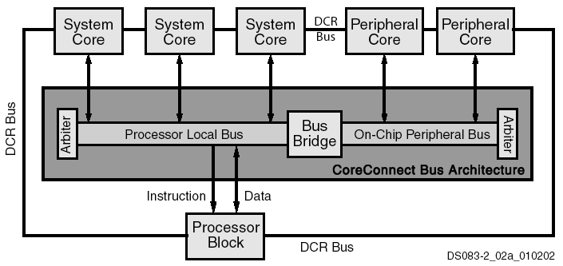
Processor Local Bus

Slide 30
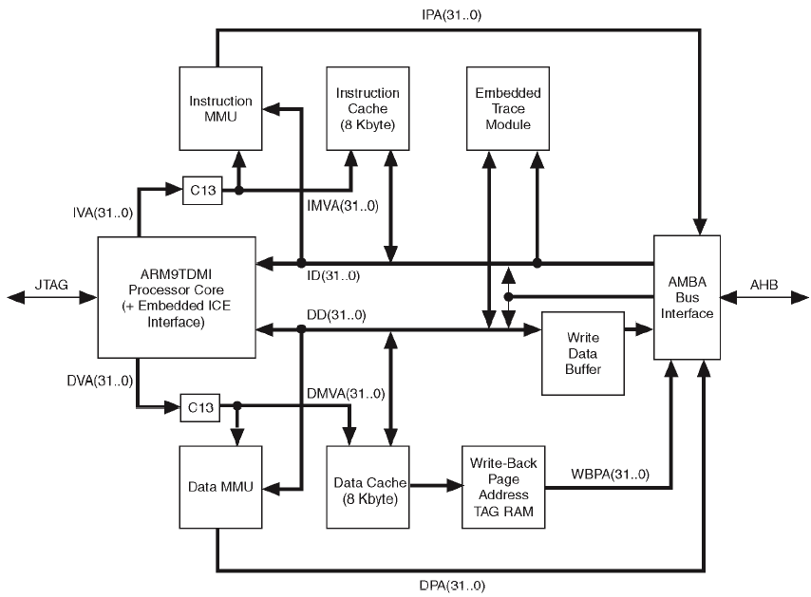
Excalibur ARM Core

Slide 31
ARM 922T
Single “stripe” embedded in Apex 20K
Five-stage pipeline
8KB 64-way set-associative instruction and data caches
256KB internal single-port SRAM
128KB internal dual-port SRAM
All FPGA interface through ABMA buses
Notes:
Little endian core, big-endian capable.
ABMA = Advanced Microcontroller Bus Architecture

Slide 32
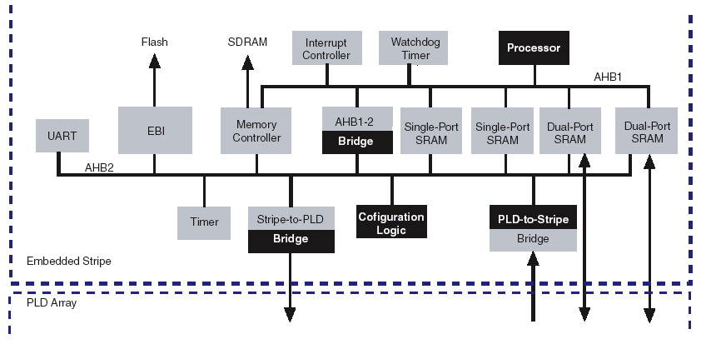
ARM922T Stripe

Slide 33
Head-to-Head
Implement 97 customer designs
Sizes up to 61,000 LEs
Basic unit of comparison: LE
  4-LUT, register, and anything else associated
80% are more efficient on Altera
Uses on average 9% fewer LEs
41% are >10% more efficient

Slide 34
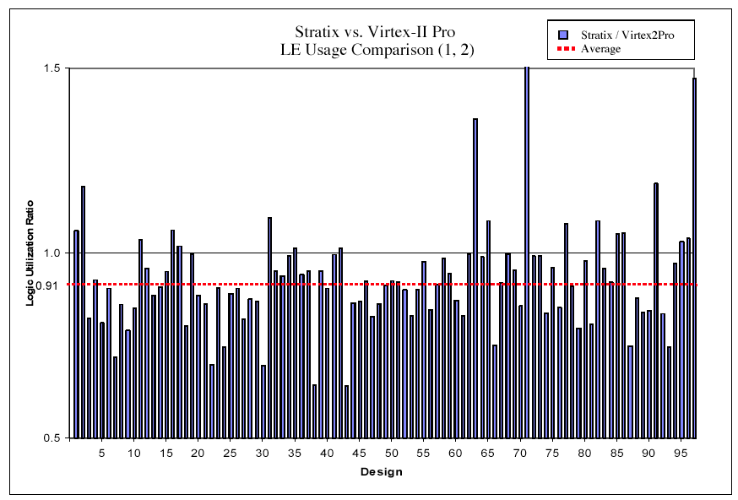
Logic Utilization

Slide 35
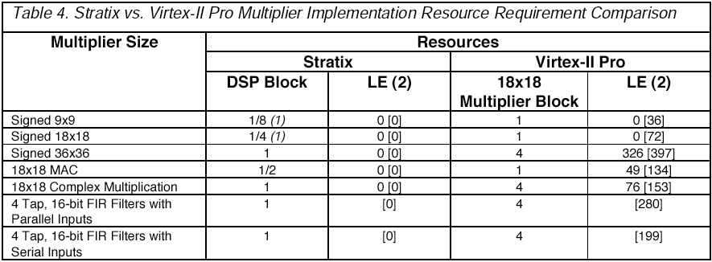
DSP Block vs. 18x18 MUL

Slide 36
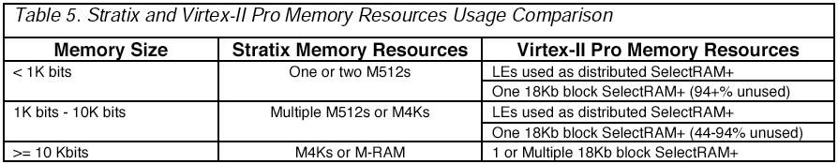
Memory Comparison

Slide 37
Lattice Semiconductor ispXPGA
E²CMOS built-in to FPGA die stores configurations
Non-volatile, but still SRAM-based for infinite reconfigurability
Four 4-LUTs per block
Two flip-flops per 4-LUT
Small embedded RAMs

Slide 38
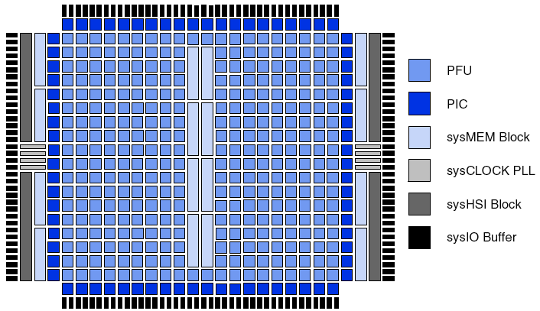
ispXPGA

Slide 39
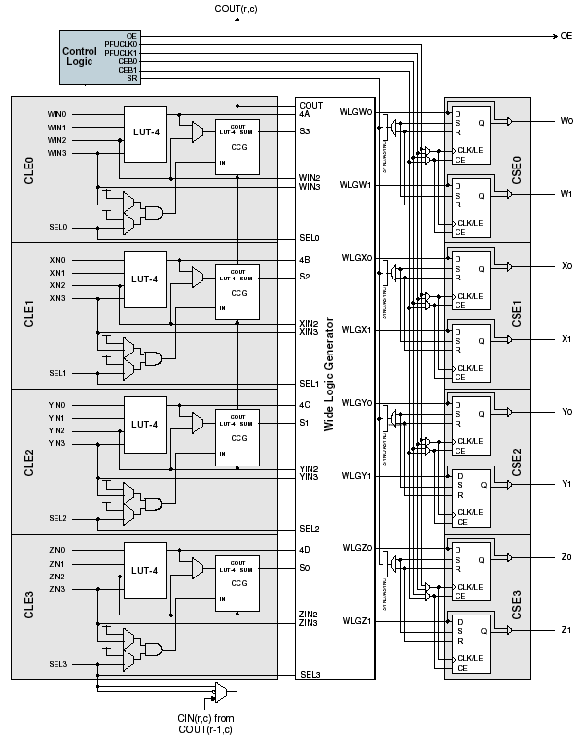

Slide 40
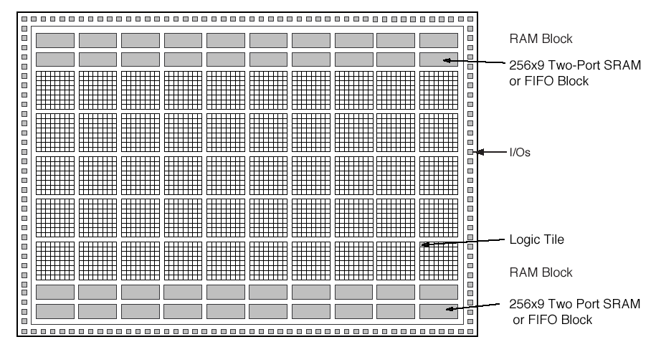
Actel ProASIC

Slide 41
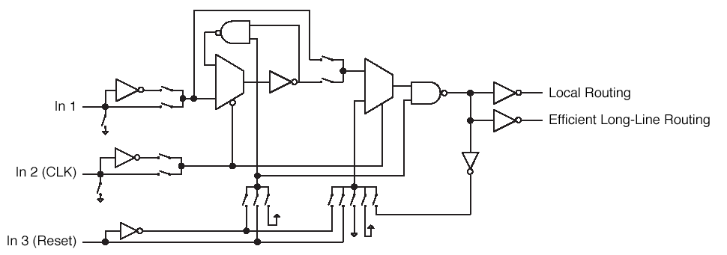
Actel ProASIC

