Slide 1
Adaptive Computing for NASA Applications
Mark L. Chang
Northwestern University ECE Department
ACME Labs
18 November, 1998

Slide 2
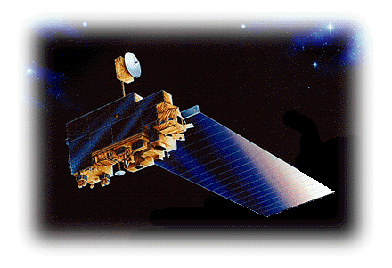
Background
(1991) Initiative by NASA to study Earth as an environmental system—Earth Science Enterprise (ESE)
(1999) Launch of the first Earth Observation System (EOS) satellite, the AM-1
Notes:
ESE consists of three parts:
1) Earth observing satellites
2) Advanced data system to process and distribute data
3) Scientists to study the data
Key areas of study include clouds; water and energy cycles; oceans; chemistry of the atmosphere; land surface; water and ecosystem processes; glaciers and polar ice sheets; and the solid Earth.
Phase I of the Earth Science Enterprise has been comprised of focused, free-flying satellites, Space Shuttle missions, and various airborne and ground-based studies.
Phase II Begins with EOS AM-1
Instruments on board:
ASTER - Advanced Spacebourne Thermal Emission and Reflection Radiometer
CERES - Clouds and Earth's Radiant Energy System
MISR - Multi-angle Imaging Spectro Radiometer
MODIS - Moderate Resolution Imaging Spectro-Radiometer
MOPITT - Measurements of Pollution in the Troposphere

Slide 3
The Data Flow
EOS divides telemetry processing into five levels with the following flow:
L2
L4
L1
L3
Receiver
Level 0
Instrument 1
Instrument 2
Instrument 3
Instrument n
Notes:
Level 0: Reconstructed, unprocessed instrument payload data at full resolution; any and all communications artifacts, e.g., synchronization frames, communications headers, duplicate data removed.
Level 1A: Reconstructed, unprocessed instrument data at full resolution, time-referenced and annotated with ancillary information, including radiometric and geometric calibration coefficients and georeferencing parameters, e.g., platform ephemeris, compute and appended but not applied to the Level 0 data.
Level 1B: Level 1A data that has been processed to sensor units (not all instruments will have a Level 1B equivalent). Takes calibration coefficients and recalculates the digital data payload to get at-aperture measurements. Also could include ancillary data, e.g., quality flags, error estimates, and on-board calibration data.
Level 2: Derived geophysical variables at the same resolution and location as the Level 1 source data.
Level 3: Variables mapped on uniform space-time grid scales, usually with some completeness and consistency.
Level 4: Model output or results from analyses of lower level data, e.g., variables derived from multiple measurements.

Slide 4
The Processing Problem
I/O intensive
  EOS AM-1 satellite averages ~918 Gbytes of data per day
  Current NASA-supported data holdings total ~125,000 Gbytes
Processing intensive
  Average processing load ~12,000 MFLOPs per day
Notes:
In 6 months, EOS AM-1 will downlink more data than entire NASA holdings. Too much data!

Slide 5
The Expensive Solution
Several Distributed Active Archive Centers (DAACs) around the country
  Distributed, so each DAAC gets only a subset of all the data
  Utilize many high-end compute engines to process the data
Full-custom VLSI for Level 0 processing
Notes:
Goddard’s Microelectronics System Branch has developed a Level 0 processing ASIC. Integrated into a PCI card that fits into a workstation, it is dubbed the Desktop Satellite Data Processing (DSDP) system. Allows installations with an appropriate antenna to receive and decode Level 0 data for their own private use.

Slide 6
Motivation for Adaptive
Level 1 processing is instrument dependent. ASICs not cost-effective
Level 2 and up data products involve many different algorithms. Could use same adaptive compute engine to accelerate many algorithms
Algorithms are very mutable

Slide 7
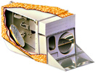
MODIS
Moderate Resolution Imaging Spectroradiometer
Accounts for over half of the average daily data and processing load
Scans at three resolutions and 36 bands @ 12 bits of sensitivity
  250m, 500m, 1000m
  0.4μm - 14.4μm
Notes:
We look at three different algorithms that have to do with the MODIS instrument that will fly on EOS AM-1.
These algorithms are representative of three different levels of processing and data products.
1) Level 1B: MODIS calibration
2) Level 2: Cloud mask creation
3) Level 3: Multispectral image classification

Slide 8
Level 1: Calibration
Digital counts need to be scaled by some calibration factors that are determined by
  Temperature
  Instrument Degradation
  Damage
  Orbit changes
Applied to every “granule” of data off-line
Notes:
Level Gbytes MFLOPs
1A 115,099 99.917
1B 193.6 1339.854
2 161.859 1293.981
3 66.312 3005.218
4 0.230 0.050
TOTAL 537.1 5739.02

Slide 9
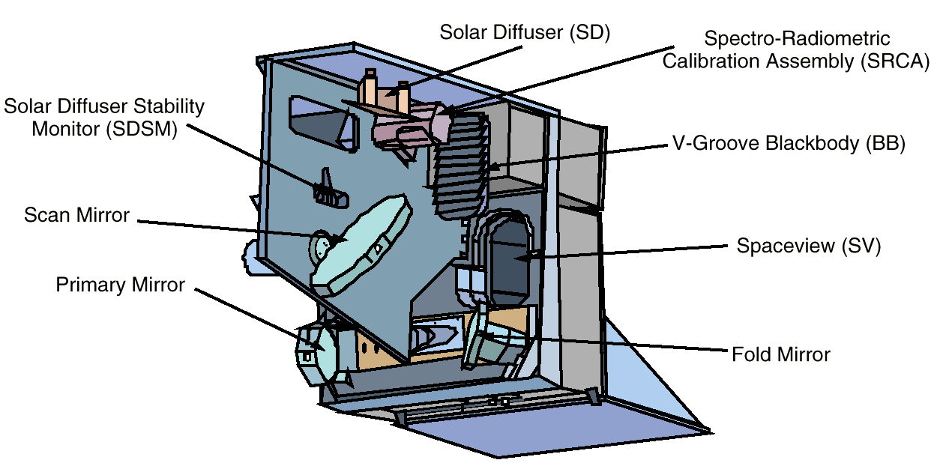
Level 1B Calibration
Notes:
The Level 1B product generation was selected for implementation on the FPGA reconfigurable computer. Its data set contains calibrated and geolocated at-aperture radiances for all spectral bands plus additional data including quality flags, error estimates and on-board calibration data. The Level 1B data is the input "fuel" used to generate every remaining MODIS product - it is "plugged in" to theoretical models that use radiance as a starting point to make useful statements concerning atmospheric and geophysical properties.
Uses the above viewports to define dynamic calibration values to be applied to the digital data stream.
SD: Near north pole it opens and views the sun for 2 minutes to track the radiance calibration stability of the reflected solar bands.
SRCA: Track changes in radiometric calibration. Find limits of changes to responsivity, find center wavelengths, track along-scan shift in Earth location for each detector and each band. 3 modes of operation: spectral, radiometric, spatial. Spatial: scan-shift tracked by reticules (fixed points). Radiometric: uses lamps to calibrate reference levels.
BB: Isothermal w.r.t. scan cavity. Used in emissive bands to get “zero”.
SV: Looks at cold space to determine “black”. Used to establish gain and zero offset. Occasionally looks at the moon as a radiance source.

Slide 10
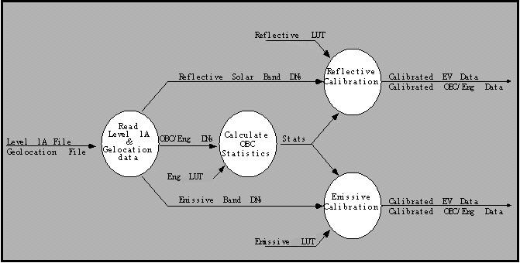
L1B Data Flow
Notes:
Reflective calibration was profiled to be the most processing-intensive part of the L1B calibration algorithm.

Slide 11
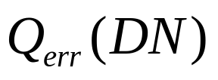
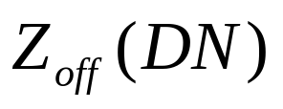
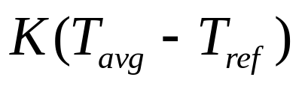

Effective Digital Counts
Correct digital numbers for A/D nonlinearity
Filter and average zero radiance offset
Correct for focal plane temperature effects
Correct for scan angle effects
Notes:
A/D: Fourteen A/D conmverters to generate the digital numbers (DN) from the focal planes. Ground tests measure deviations from linearity for each A/D converter. Then, we correct for quantization effects with a table lookup.
Zero: Use SV port
Temperature: Temperature coefficient (K) determined for each detector on ground. MODIS will warm up over time because the thermal blanket loose efficiency.
Scan angle: Reflectance depends on the angle at which the mirror is viewed. Use the normal to the scan mirror surface. SRCA and SD data are mapped into the normal.

Slide 12
Effective Digital Counts
Apply to the digital numbers (DN) to get effective digital counts, DN*

Slide 13
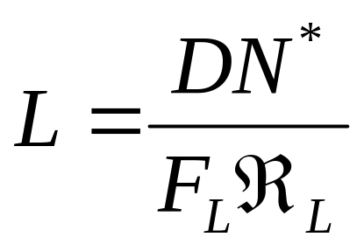
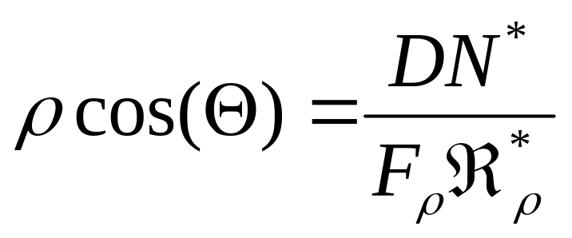
Calculate Radiance & Reflectance
Use the correct digital counts in calculations of radiance and reflectance
Notes:
All lookups in tables
Fl and Fp are correction factors additionally applied to R
Rl is the radiance reponsivity
Rp is the reflective reponsivity
Both calibrated from lookups into ancillary calibration data.

Slide 14
The Loop
for R = 1 to #resolutions
for B = 1 to #bands
for D = 1 to #detectors per band(B)
for F = 1 to #frames
Calculate DN*
Calculate Radiances & Reflectances
Use an FPGA-based coprocessor board to accelerate innermost loop

Slide 15
Hardware
Host
  SGI Origin 200
    180MHz R10000
    128MB RAM
    Identical to the DAAC configuration
FPGA Co-Processor
  Annapolis Wildforce PCI
    Five Xilinx 4036EX

Slide 16
Results
Software only
  16.51 seconds
Software + FPGA Co-Processor
  1.78 seconds
Speedup
  9.28x

Slide 17
Level 2: Cloud Mask
For each pixel, provide a confidence flag that indicates how certain we are that a pixel is clear (not covered by a cloud)
Restrictions
  Near real-time
  Low output data volume
  Simplicity

Slide 18
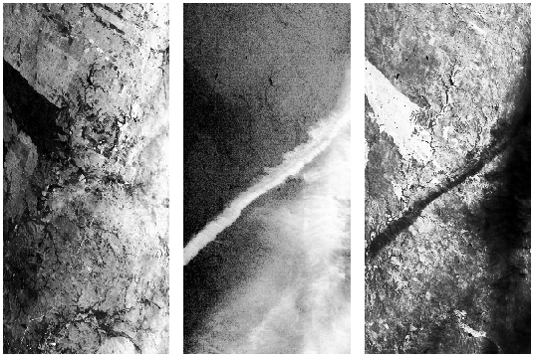
Approach: Spectral Analysis
Notes:
Three spectral images of the same coordinates at the same time. Histogram normalized for viewing. These pictures are of a subvisual contrail.
Left:
0.66um channel. Typical for many satellites and commonly used today for land surface classifications. Not visible.
Right:
11um channel. Dark is cold, light is warm. You can see the contrail, but it would be difficult to fully define its extent without the middle panel.
Middle:
1.88um channel. Near a strong water vapor absorption band, and, during the day, is extremely sensitive to the presence of high level clouds.
Used together, we can get a decent cloud mask.

Slide 19
Approach
Per pixel:
  Choose appropriate tests to perform
  Run threshold tests to determine if the pixel is clear [11] or clouded [00]
  Group similar tests together into one of five domains
  Determine final cloud mask, Q, from results of each group
Notes:
Picking tests:
land/water
ecosystem (vegetation, urban, desert, etc.)
Sun glint?
Day or night
Get snow cover information and mask appropriately
Several means about 1 dozen different tests per pixel. Each test has four levels of confidence.
Domains:
I: Simple IR threshold test
II: Brightness temperature difference
III: Solar reflectance tests
IV:NIR thin cirrus
V: IR thin cirrus

Slide 20
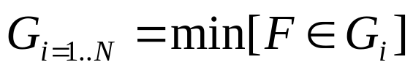
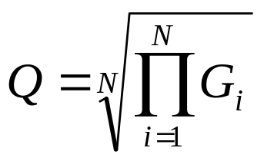
Approach
To determine final cloud mask
  Minimum confidence is determined for each group:
  Final mask result is the product of the results from each group:
Notes:
F_i is the confidence level of the i-th test
Note: this method is clear-sky-conservative .. E.g. if any test finds the pixel cloudy (0), the resulting mask will be cloudy.

Slide 21
Approach (cont’d)
Per pixel
  If final confidence level is still uncertain (0.05 < Q < 0.95), use spatial uniformity tests on 3-by-3 pixel regions
  Check for temporal consistency
  Update final cloud mask confidence

Slide 22
Applicability for FPGAs
Simple threshold tests
Threshold values do not change
Can perform threshold tests in parallel
Can operate on multiple pixels in parallel
Easy to add new tests if needed
Easy to change threshold constants if needed

Slide 23
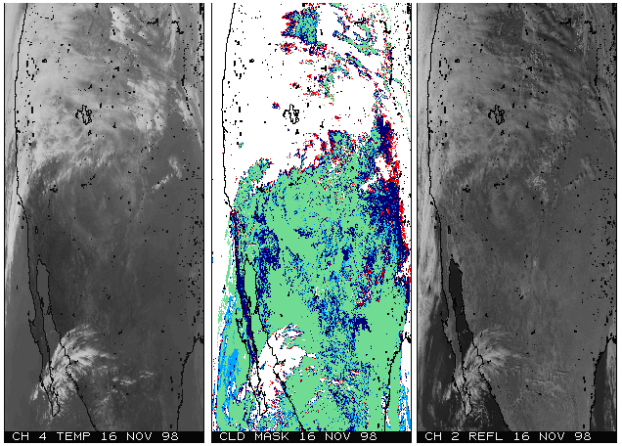
Sample Results
Notes:
November 16, 1998
Shot of somewhere in North America
Left: Near-infrared
Middle Cloud mask
Right: Infrared
Confidence of CLEAR SKY
Most -> Least
Green
Light blue
dark blue
red
white

Slide 24
Level 3: Multi-spectral Image Classification
Want to classify a multi-spectral image in order to make it more useful for analysis by humans
  Used to determine type of terrain being represented
  Similar to data compression
  Similar to clustering analysis

Slide 25
PNN Algorithm
Use a Probabilistic Neural Network (PNN) classifier
  Given an input image pixel represented as a vector
  Compare against sets of training vectors (weights) which are known to belong to a certain class (water, forest, urban, etc.)

Slide 26
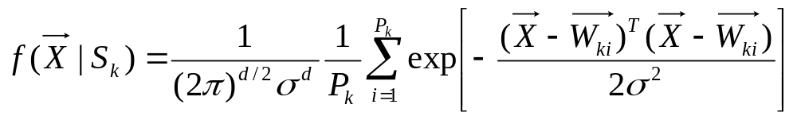
PNN Calculation
For each class, we derive a probability that the pixel belongs to that particular class
The highest value indicates which class the pixel most likely belongs to
Notes:
X is the pixel vector
Sk is the class K
Wki is the weight vector I of class k
Pk is the number of weight vectors for class k
d is the number bands (depth of the multispectral image)
k number of classes
sigma = smoothing parameter determined by the training set

Slide 27
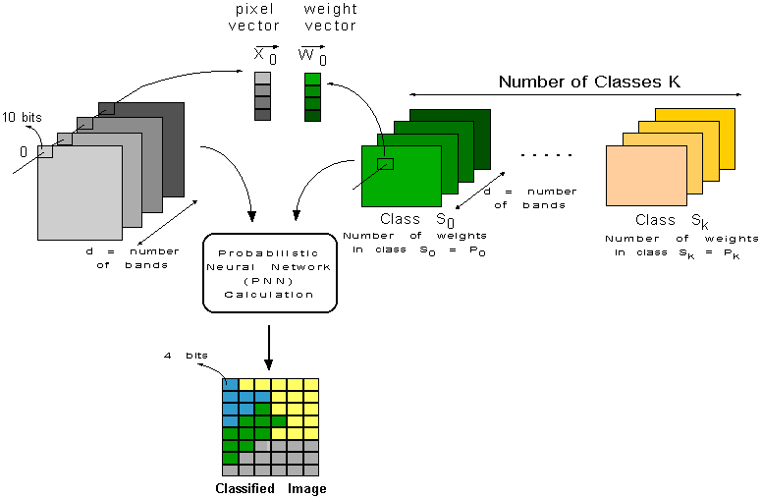
PNN Illustration

Slide 28
FPGA Mapping
Put the entire PNN calculation onto the FPGA
  Load training data into local memories
  Load training data constants into memories
  Use lookup tables to perform the exponentiation
If enough space, work on multiple pixels in parallel

Slide 29
Hardware
Host
  Pentium PC (166MHz)
FPGA Co-Processor
  GigaOperations Spectrum System G-900
    (2) X213 Modules
      Each equivalent to Xilinx 4013E (13,000 gates)
    128Kbytes of SRAM

Slide 30
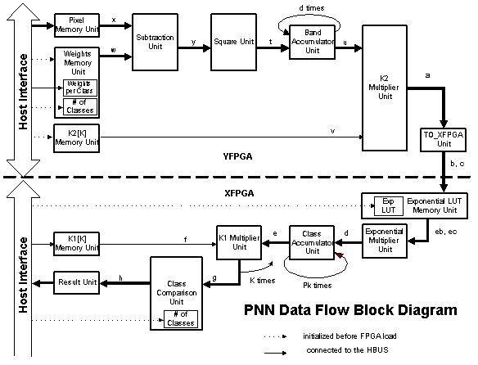
PNN FPGA Data Flow

Slide 31
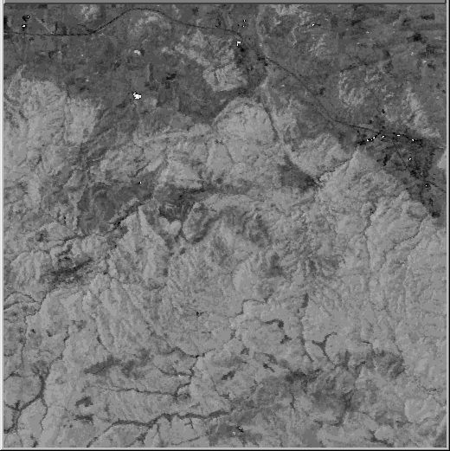
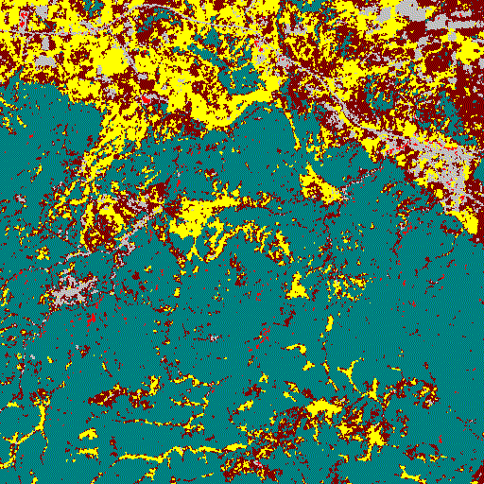
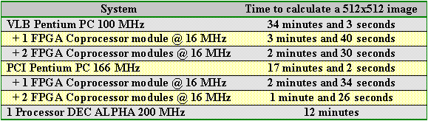
Results
Notes:
Speedups:
1 X213 = 6.63 x PCI P166 / 4.67 x DEC Alpha
2 X213 = 11.88 x PCI P166 / 8.37 x DEC Alpha
Legend:
grey = urban yellow = fields brown = range dark green = forest
blue = water black = wetland red = barren purple = tundra
white = perennial snow and ice pink = unclassified
Image of Blackhills South Dakota
4 spectral bands (0.5-0.6, 0.6-0.7, 0.7-0.8, 0.8-1.1)um
512x512 image
each pixel represents a 76m x 76m patch of ground

Slide 32
Why work with NASA?
Most of NASA’s holdings are not classified or sensitive
  Easy to get cooperation from scientists and engineers
  Easy to get data sets and code samples
Plethora of algorithms and problems to choose from

Slide 33
Conclusions
EOS will provide the scientific community with lots of data to process
  Need faster and cheaper solutions
  Very interested in Adaptive Computing
NASA has started an initiative to investigate Adaptive Computing, and they would love some help

