Slide 1
TSTT Mesh Adaptation Service
M. S. Shephard and X. J. Luo
Rensselaer Polytechnic Institute

Slide 2
Outline
Overview of TSTT adaptive loop
Mesh adaptation using TSTT interfaces
Implementation of TSTT mesh adaptation
Application of TSTT mesh adaptation service
Examples
Closing remark

Slide 3
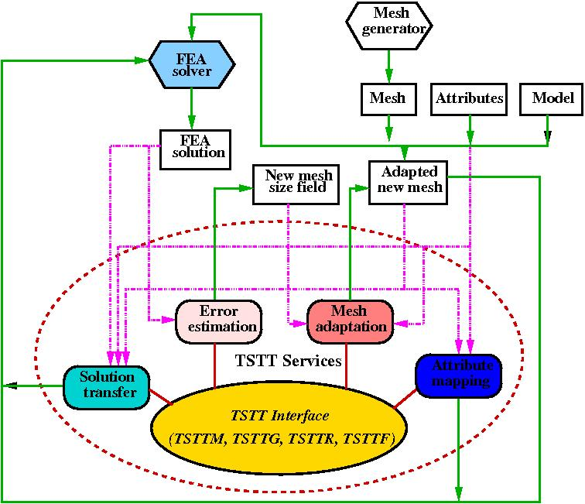
Overview of TSTT Adaptive Loop
Operational components for an adaptive loop
  FEA solver
  Error estimation
  Mesh adaptation
  Solution transfer
  Attributes mapping
TSTT adaptive loop
  The services obtain information through TSTTM, TSTTG, TSTTR and TSTTF interface

Slide 4
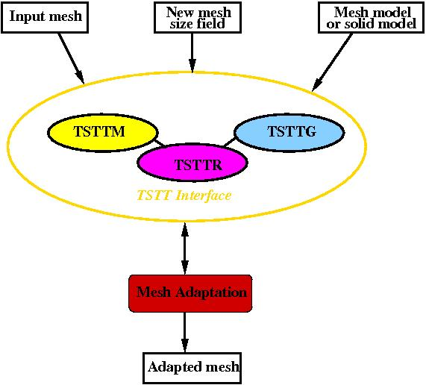
TSTT Mesh Adaptation Service
Capabilities
  Modify the input mesh to satisfy the specified size field
  Provide interoperability between different TSTT implementation
Implementations
  Deal with mesh with/without
  solid model
  Different size specification
    Isotropic
    Anisotropic

Slide 5
TSTT Mesh Adaptation Service
TSTT mesh adaptation without solid model
  Load the mesh through TSTTM interface
  Create a mesh model based on the TSTTM mesh
  Specify the size field against the TSTTM mesh
  Apply mesh adaptation procedure to modify the mesh
  Output the adapted mesh through TSTTM interface
TSTT mesh adaptation with solid model
  Load the solid model through TSTTG/TSTTR
Replace

Slide 6
Implementation of TSTT Mesh Adaptation
Class of TSTT_meshAdapt
  Constructor
    TSTT_meshAdapt(Implementation_class *tstt_mesh, int sizefieldType, int modelType)
      Implementation_class: the different TSTTM implementation
      sizefieldType:
        0 - uniform refinement
        1 - isotropic
        2 - anisotropic
      modelType:
        0 - without solid model
        1 - with solid model
  Member functions
    run(): execute the mesh adaptation

Slide 7
Implementation of TSTT Mesh Adaptation
Size field definition - provide by user
  Specified size field w.r.t TSTTM mesh
    mesh_sizefield (Implementation_class *tstt_mesh)
      Traverse each mesh vertex and compute the size field tensor
      Attach the size field tensor to each vertex
  Analytical size field
    xyz_sizefield (double *input_xyz, double *output_size, double (*output_dir)[3])
      Input_xyz: the input xyz location
      Output_size: the defined size
      Output_dir: the defined size field directions (3x3 matrix)

Slide 8
Application of TSTT Mesh Adaptation
Load the mesh through TSTTM
  Implementation_Class tstt_mesh = Implementation_class::_create();
  tstt_mesh.load(tstt_mesh.getRootSet(), mesh_file);
Define the TSTT_meshAdapt object
  TSTT_meshAdapt adpt(&tstt_mesh, 0, 0); // No model
  TSTT_meshAdapt adpt(&tstt_mesh, 1, 1); // with model
Adapt the mesh
  adpt.run();
Output the mesh
  adpt.output(&tstt_mesh);

Slide 9
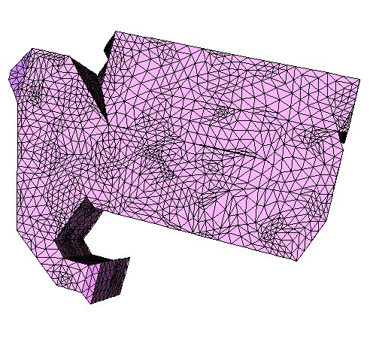
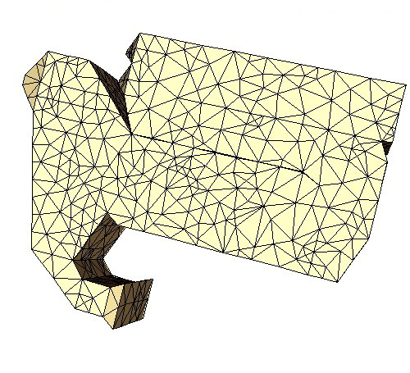
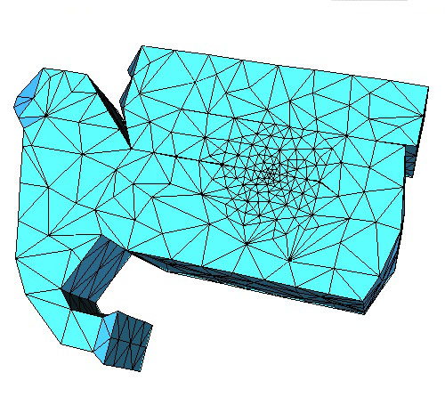
Examples with GRUMMP
Define Implementation_class TSTTM_GRUMMP::Volume
  Without solid model
  Uniform refine the mesh
  Define cylindrical size field
88748 Regions
11098 Regions
14455 Regions

Slide 10
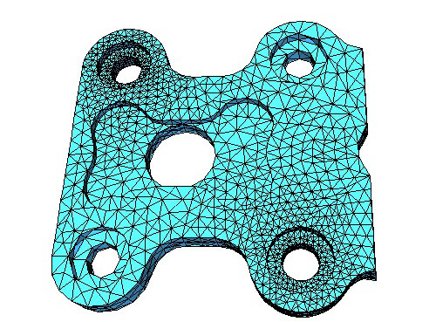
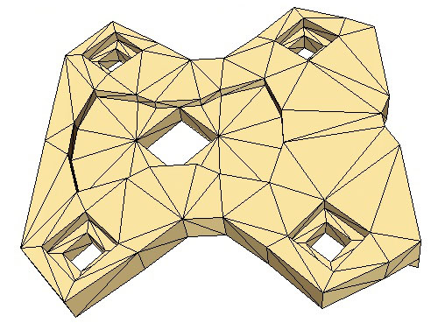
Examples with FMDB
Define Implementation_class FMDB_TSTTM::Mesh
  With Solid model
  Define cylindrical isotropic size field
408 Regions
36261 Regions

Slide 11
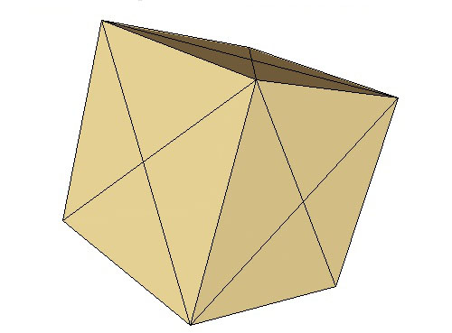
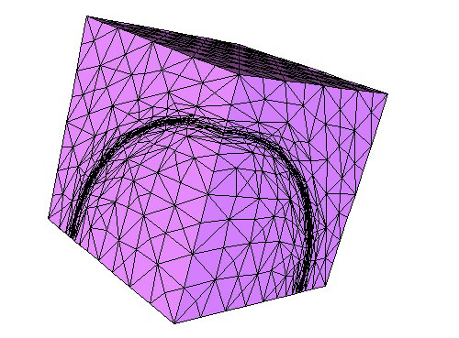
Examples with FMDB
Define spherical anisotropic size field
24 Regions
30524 Regions

Slide 12
Closing Remark
Overview the construction of adaptive loop using the TSTT interoperable components
The implementation and application of TSTT mesh adaptation service
  Support different TSTTM implementations
  Deal with meshes with/without solid model
  Flexible size field specification

