Slide 1
TSTT Mesh Adaptation Service
M. S. Shephard and X. J. Luo
Rensselaer Polytechnic Institute

Slide 2
Outline
Overview of TSTT adaptive loop
Mesh adaptation using TSTT interfaces
Implementation of TSTT mesh adaptation
Application of TSTT mesh adaptation service
Examples
Closing remarks

Slide 3
Overview of TSTT Adaptive Loop
Operational components for an adaptive loop
  FEA solver
  Error estimation
  Mesh adaptation
  Field solution transfer
  Attributes mapping
TSTT adaptive loop
  The services obtain information through TSTTM, TSTTG, TSTTR and TSTTF interface

Slide 4
TSTT Mesh Adaptation Service
Capabilities
  Modify the input mesh to satisfy the specified size field
  Provide interoperability between different TSTT implementations
Implementations
  Deal with mesh with or
  without solid model
  Different size specification
    Isotropic
    Anisotropic
Input mesh
New size field
Mesh model
Solid model
TSTT Interface
TSTTM
TSTTG
TSTTR
Adapted mesh
MeshAdapt

Slide 5
TSTT Mesh Adaptation Service
TSTT mesh adaptation without solid model
  Load the mesh through TSTTM interface
  Create a mesh model based on the TSTTM mesh
  Specify the size field against the TSTTM mesh
  Apply mesh adaptation procedure to modify the mesh
  Output the adapted mesh through TSTTM interface
TSTT mesh adaptation with solid model
  Load the solid model through TSTTG/TSTTR
Replace

Slide 6
Implementation of TSTT Mesh Adaptation
Class of TSTT_meshAdapt
  Constructor
    TSTT_meshAdapt(Implementation_class *tstt_mesh, int sizefieldType, int modelType)
      Implementation_class: the different TSTTM implementation
      sizefieldType:
        0 - uniform refinement
        1 - anisotropic size field
        2 - isotropic size field
      modelType:
        0 - without solid model
        1 - with solid model
  Member functions
    run(): execute the mesh adaptation

Slide 7
Application of TSTT Mesh Adaptation
Size field definition
  Anisotropic size field
    sizeTensor defines anisotropic size field tensor at each mesh vertex
      struct sizeTensor {
      double dirs[3][3], // size field direction tensor
      double h[3] }; // mesh size at the directions
  Isotropic size field
    Use a double value to define the edge length at each mesh vertex

Slide 8
Application of TSTT Mesh Adaptation
Define the size field over the input TSTTM mesh
  tsttm_sizefield (Implementation_class *tstt_mesh)
    Create attachable tag with name “SF”
      Ainsotropic: general tag type for pointer to sizeField
      Isotropic: double tag type
    Traverse each vertex of the TSTTM mesh using the TSTTM iteration interfaces
      Compute the size field at each vertex based either on error estimation or analytic function
      Attach the computed size field to each vertex using the attachable mechanism of TSTTM interfaces

Slide 9
Application of TSTT Mesh Adaptation
Load the mesh through TSTTM
  Implementation_Class tstt_mesh = Implementation_class::_create();
  tstt_mesh.load(tstt_mesh.getRootSet(), mesh_file);
Define the TSTT_meshAdapt object
  TSTT_meshAdapt adpt(&tstt_mesh, 0, 0); // No model
  TSTT_meshAdapt adpt(&tstt_mesh, 1, 1); // with model
Adapt the mesh
  adpt.run();
Output the mesh
  adpt.output(&tstt_mesh);

Slide 10
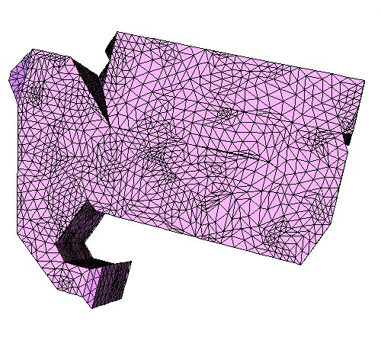
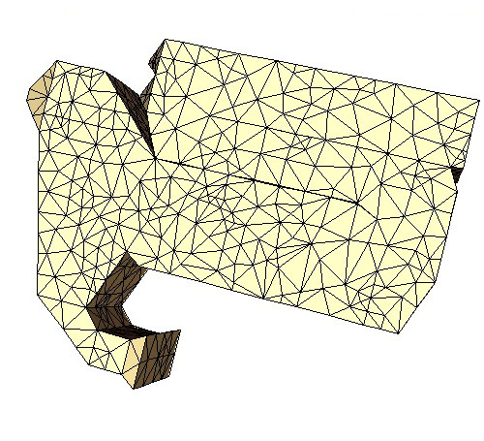
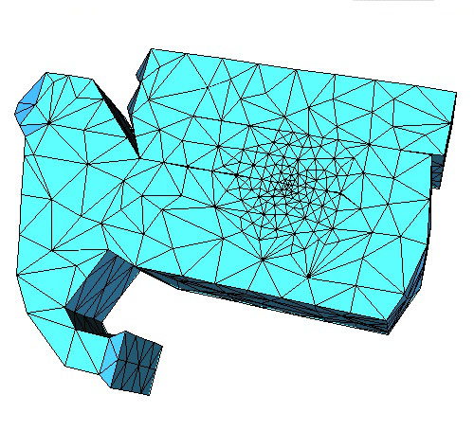
Examples with GRUMMP
Define Implementation_class TSTTM_GRUMMP::Volume
  Without solid model
  Uniform refine the mesh
  Analytic cylindrical size field
88,748 Regions
11,098 Regions
14,455 Regions

Slide 11
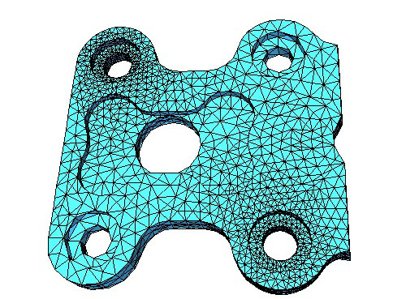
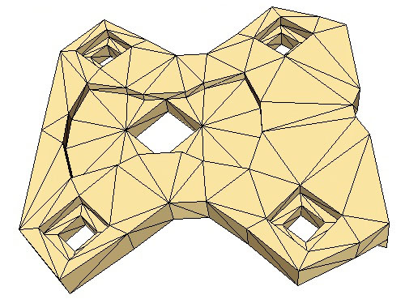
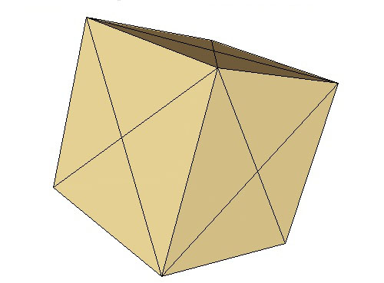
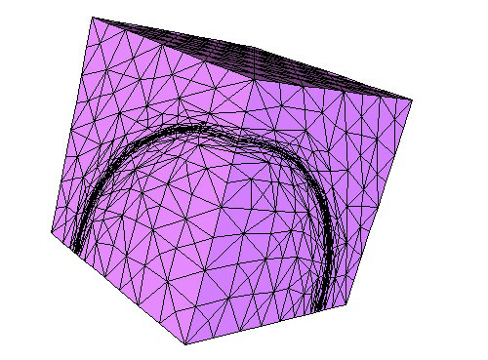
Examples with FMDB
Define Implementation_class FMDB_TSTTM::Mesh
  Analytic cylindrical isotropic and anisotropic size field
36,261 Regions
408 Regions
30,524 Regions
24 Regions

Slide 12
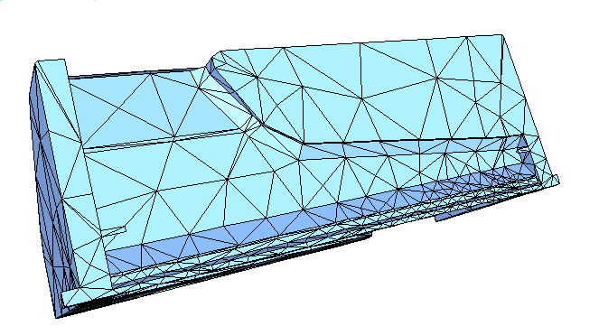
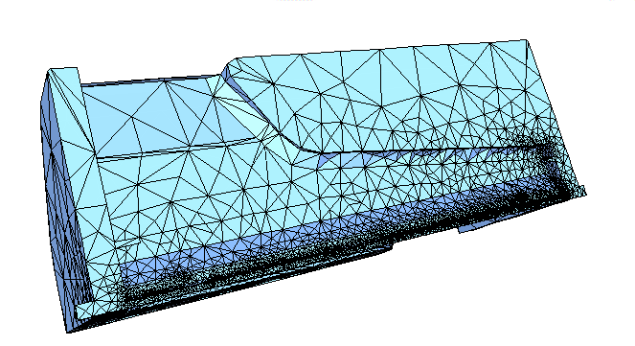
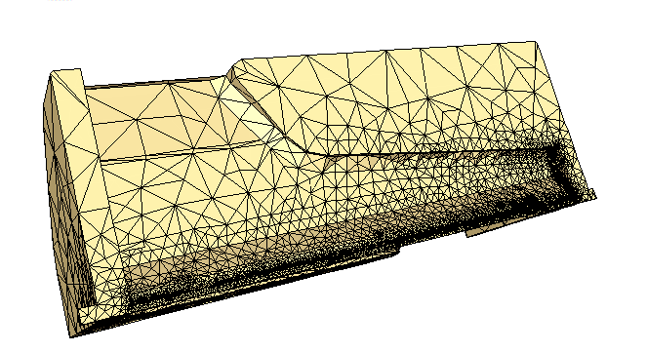
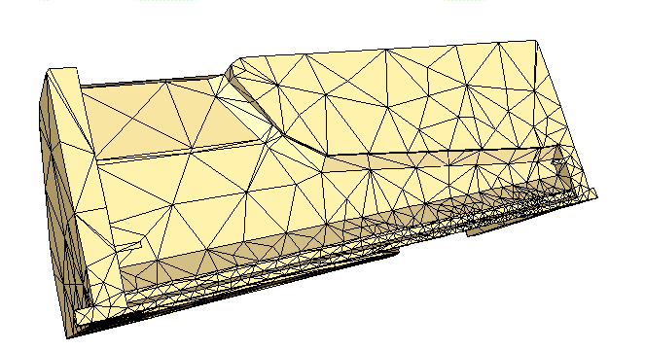
Examples with FMDB
Finite element solver - SLAC
Isotropic size field defined by error estimation
Step 5
Step 9
73,825 Regions
2,635 Regions
111,337 Regions
4,866 Regions

Slide 13
Closing Remarks
Overview the construction of adaptive loop using the TSTT interoperable components
The implementation and application of TSTT mesh adaptation service
  Support different TSTTM implementations
  Deal with meshes with or without solid model
  Flexible size field specification

