Slide 1
The Mesquite Mesh Quality Improvement Toolkit
Lori Diachin
LLNL

Slide 2
Mesh quality has many meanings
“The characteristics of a mesh that permit a numerical PDE simulation to be performed with fidelity to the underlying physics, accuracy, and efficiency.”
Fidelity: Preservation of equation type, and solution symmetry
Accuracy: ‘Small’ discretization error
Efficiency: Mesh results in best possible matrix conditioning
The quality of a mesh depends on the discretization scheme, the solver, the PDE, and the physical solution.

Slide 3
Mesquite provides advanced mesh quality improvement
Mesquite is a comprehensive, stand-alone toolkit for mesh quality improvement with the following capabilities
  Shape Quality Improvement
  Mesh Untangling
  Alignment with Scalar or Vector Fields
  R-type adaptivity to solution features or error estimates
    Maintain quality of deforming meshes
    Anisotropic smoothing
    Control skew on mesh boundaries
Uses node point repositioning schemes

Slide 4
Mesquite is based on sound mathematical principles
Pose the mesh quality improvement problem as an optimization problem
Element Quality: q_{i}(x) i=1,…,<n,k>
  A function of the vertex locations
  Can be vertex or element based
Mesh quality objective function
F = f(q_{i}(x)) i=1,…,<n_{s},k_{s}>
  A function of element quality metrics defined on some subset of the free vertices
Optimization problem
min F subject to c_{j}(x)
Element shape, s_{i}
0 = degenerate
1 = ideal
F = 1/n ∑ 1/s_{i}
min F

Slide 5
The Mesquite infrastructure provides advanced solution techniques
State-of-the-art algorithms and metrics
  Simple (Laplace) to complex (optimization) smoothers
  Untangle, smooth, size, shape metrics
    Feasible Newton techniques
    Active set solvers
  Single-vertex and all-vertex solvers
  Mesh culling to eliminate un-needed operations
  Some metrics permit anisotropic smoothing
Combined approaches
  Increase effectiveness and efficiency
Efficient to run
  Kernels written with inline functions and array-based access
  Light-weight mesh data structure

Slide 6
Mesquite is designed for use in a wide variety of applications
Mesh Types
  Structured, Unstructured, Hybrid
  2D, 3D
Element Types
  Triangular, Tetrahedral, Quadrilateral, Hexahedral, Pyramidal currently
  Prismatic planned, Polyhedral easily added
  Linear currently, higher-order planned
Customizable
  User-defined metrics, objective functions, and algorithms
Callable as a library
  Mesh and geometry information obtained through TSTTB and TSTTM accessor functions

Slide 7
TSTT interfaces necessary for using Mesquite
Entity sets specify which elements to improve, entity access functions, vertex coordinates, geom dim
Adjacency information
  Build sets of vertices from an input set of elements
  Get elements from a vertex
  Get element connectivity
Iterators over entity sets to populate local mesh information in Mesquite
  Avoids large array copies
Tags
  indicate which vertices are fixed
  saving state information
  setting reference ideal element information

Slide 8
TSTTG interfaces for surface smoothing
Relax node positions to geometric domain
Get surface normals
  Avoids large array copies
Get the geometric entity type to determine how many normals to cache

Slide 9
Mesquite Architecture
Closely follows mathematical abstractions used to define optimization problem
Core classes
  Quality Metric
  Objective Function (takes a quality metric as input)
  Quality Improver (takes an objective function as input)
Additional classes
  Quality Assessor
  Termination Criterion
  Instruction Queue
  MeshSet and PatchData

Slide 10
MESQUITE User Interface
Multi-level API
  Simple to use wrapper interface
    Access Mesquite functionality in a minimal number of calls
    Uses default algorithms, settings, stopping criterial
  Low level interface for customization
    User chooses the combination of metric, objective function, solver
    User determines the instruction queue
Assessment Tools
  Diagnostics
  Statistics
  A priori and a posteriori quality assessment
Users’ Manual and Documentation

Slide 11
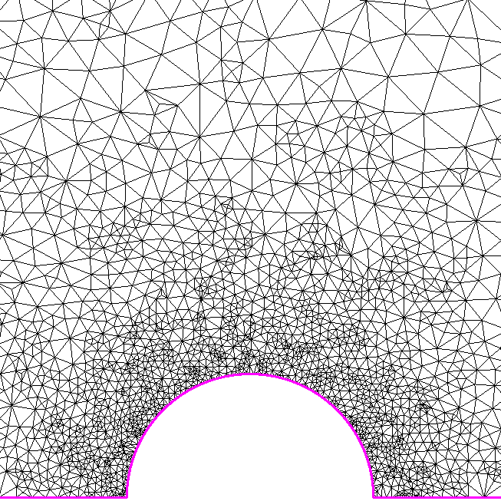
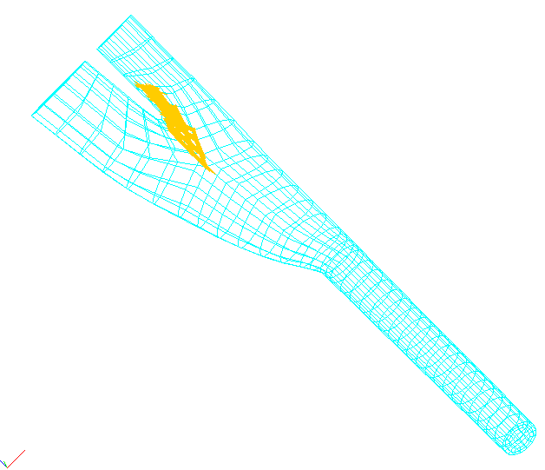
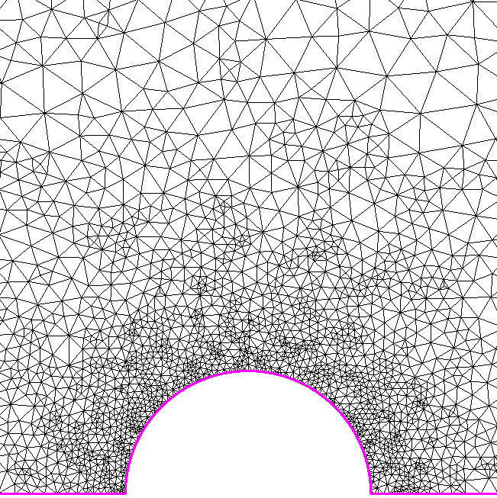
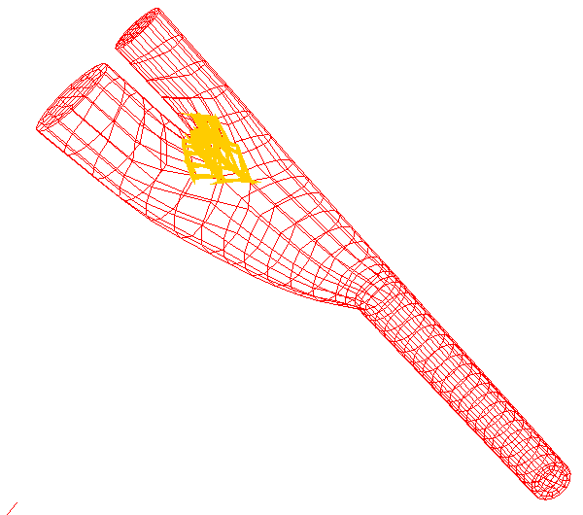
Improving mesh quality can dramatically affect time to solution
Arteriovenous Graft Turbulent Flow Simulation
Compute maximum shear stress with high order spectral methods
  Poorly-shaped Elements Increase CG Solver Iterations
Mesh Optimized by Condition Number
  reduced maximum number of solver iterations from 169 to 150
  reduced the average condition number from 18.06 to 15.46
  (about a 17% savings).
Four hours of applications solver time was traded for 19 minutes of mesh smoothing time.
Compressible Flow
Mesh Optimized w/ Active set solver
  Improved the convergence rate by 25%
Mesh improvement cost less than one multigrid iteration
Knupp and
Fischer, 2000
Freitag and
Ollivier-Gooch, 1998

Slide 12
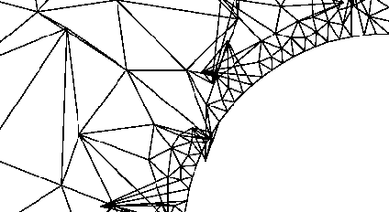
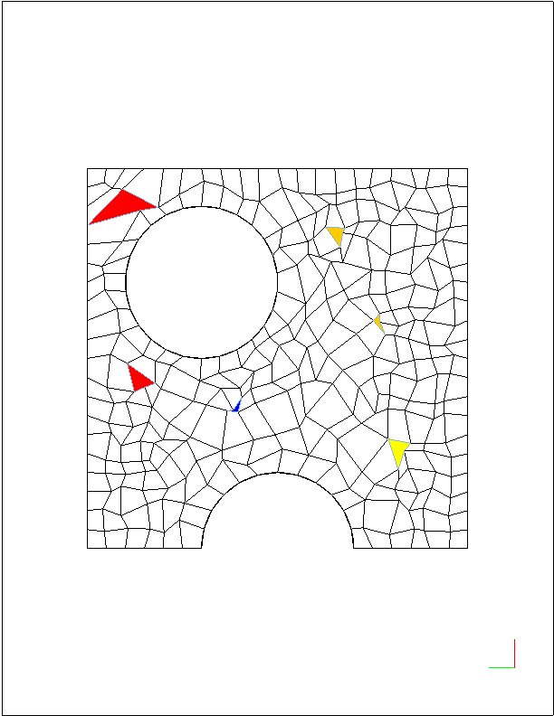
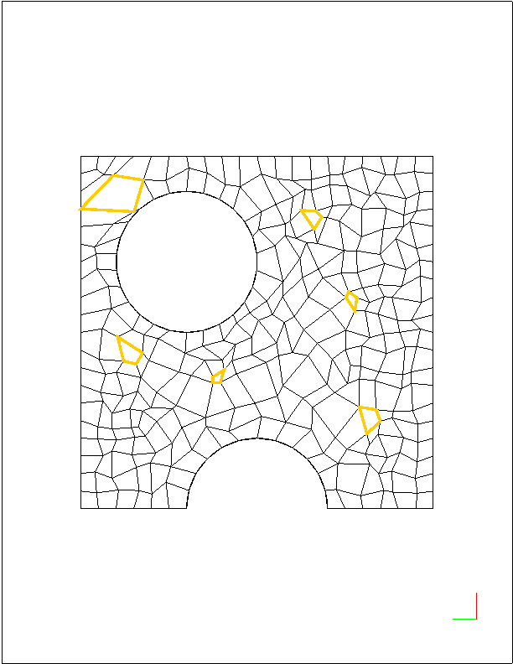
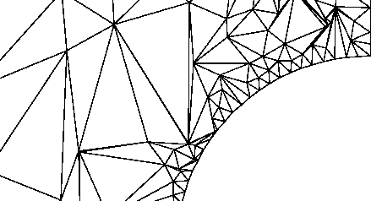
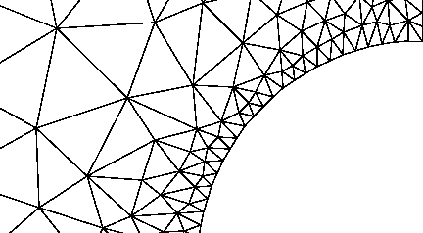
Mesh untangling algorithms reduce unnecessary effort
Few hex-meshing algorithms guarantee the quality of the mesh
  Inverted elements are produced
Mesh untangling algorithms can remove inverted elements quickly
  Eliminates the need to remesh
  Eliminates the need to decompose the geometry
Improved
mesh
Knupp
Freitag

Slide 13
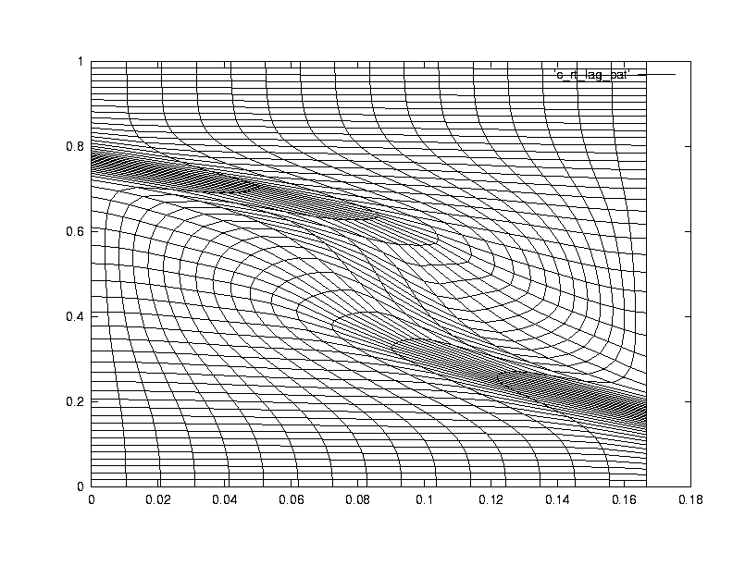
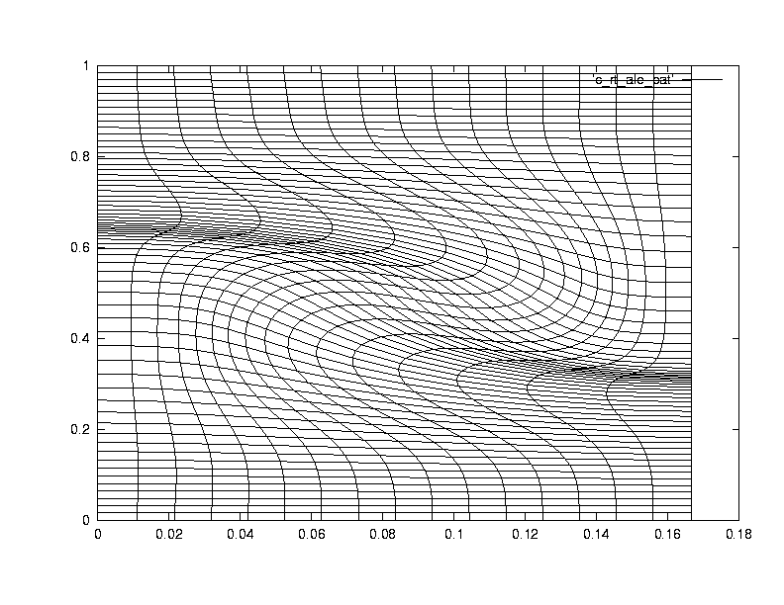
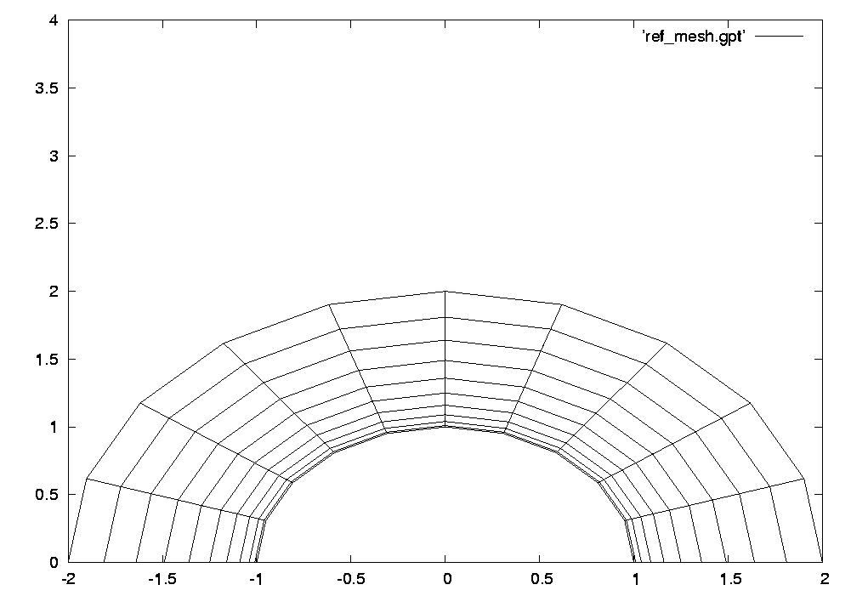
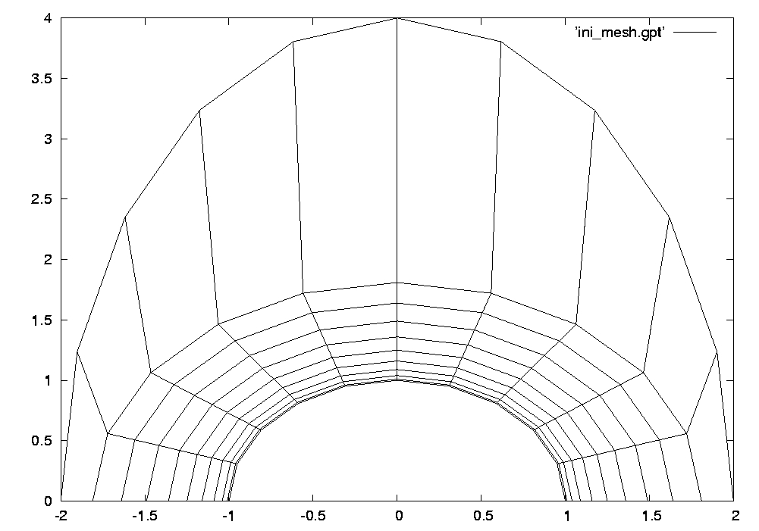
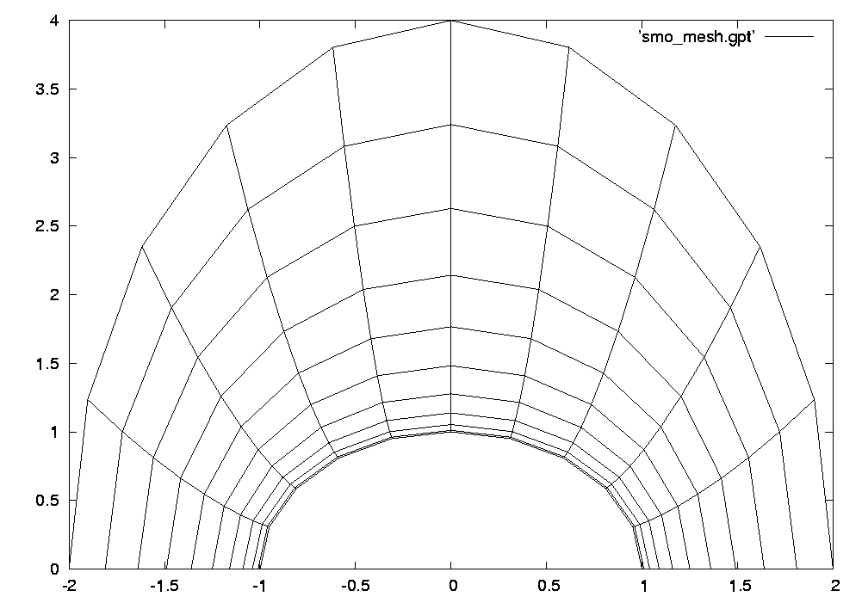
Mesh alignment can improve simulation results
Moving vertex positions to match a vector or scalar field
Improving ALE mesh quality while preserving flow characteristics
Deforming a mesh to match a perturbed geometrical domain
Knupp,
Shashkov,
Garimella 2000
Original Mesh
Deformed Mesh
Smoothed Mesh

Slide 14
Contact Information
Lori Freitag Diachin
Center for Applied Scientific Computing
L-561
Lawrence Livermore National Laboratory
Livermore, CA 94551
diachin2@llnl.gov
Patrick Knupp
Optimization and Uncertainty Estimation Department
MS 1111
Sandia National Laboratories
Albuquerque, NM 87185
pknupp@sandia.gov

Slide 15
Acknowledgments
The Mesquite team
  Michael Brewer (SNL)
  Lori Freitag Diachin (LLNL)
  Patrick Knupp (SNL)
  Jason Kraftcheck (Wisconsin)
  Thomas Leurent (ANL)
  Darryl Melander (SNL)
  Craig Kapfer (LLNL)

Slide 16
LLNL Disclaimer and Auspices
This document was prepared as an account of work sponsored by an agency of the United States Government. Neither the United States Government nor the University of California nor any of their employees, makes any warranty, express or implied, or assumes any legal liability or responsibility for the accuracy, completeness, or usefulness of any information, apparatus, product, or process disclosed, or represents that its use would not infringe privately owned rights. Reference herein to any specific commercial products, process, or service by trade name, trademark, manufacturer, or otherwise, does not necessarily constitute or imply its endorsement, recommendation, or favoring by the United States Government or the University of California. The views and opinions of authors expressed herein do not necessarily state or reflect those of the United States Government or the University of California, and shall not be used for advertising or product endorsement purposes.
This work was performed under the auspices of the U.S. Department of Energy by University of California Lawrence Livermore National Laboratory under contract No. W-7405-Eng-48.
UCRL-PRES-216694

