Slide 1
Triangular and Tetrahedral Mesh Swapping Using TSTT
Carl Ollivier-Gooch
University of British Columbia

Slide 2
Bird's Eye View
2D / 3D swapping with variety of criteria
Single edge/face, mesh subset, or entire mesh
Recursive swapping available
User-defined swapping criteria
Boundary modification optional in 3D
Most typical usage will look like:
  setMesh
  setModel
  setCriterion
  swapAll

Slide 3
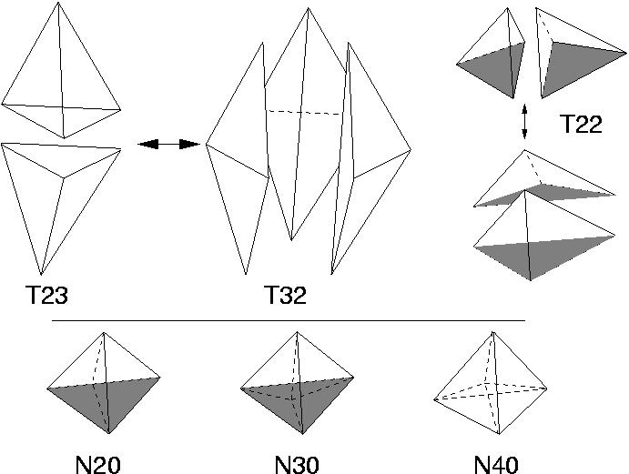
Swapping Operations
Face Swapping in 3D
Swappable
Unswappable
Notes:
Shaded faces are coplanar.
Also a T44 swappable combination: two T22 combinations with same coplanar faces.
In 2D, just have the equivalent of the coplanar faces in the T22 configuration.

Slide 4
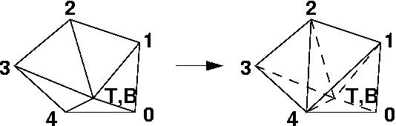
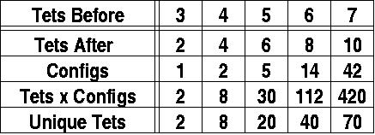
Swapping Operations
Edge Swapping in 3D
Notes:
Basically, remove tets incident on an edge; triangulate the “equatorial” (but non-coplanar) points; replace original tets with two per equatorial triangle.
Don't bother with 8 -> 12 or higher swaps, because the number of successful swaps drops rapidly, and there are only a few successes at 7 -> 10.
For efficiency, don't compute quality for every tet in every configuration. Instead, compute quality for every -unique- tet, and assemble quality for configurations based on the tets in it.

Slide 5
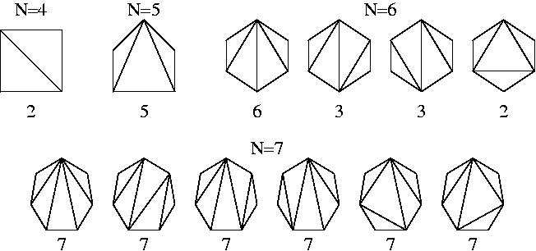
Swapping Operations
Canonical Configurations for Edge Swapping
Notes:
N is number of “equatorial” points; number below each diagram is the number of unique rotations.

Slide 6
Swapping Criteria
Built-in criteria
  Delaunay, maxmin (dihedral) angle, minmax sine (dihedral) angle
User-defined criteria
  Any single-valued criterion depending only on vertex coordinates
    double calcQuality(array<double> coords, int coords_size);
  Can be minimized or maximized
    bool shouldMinimize();
Notes:
In 3D, built-in criteria are also implemented as models of user-defined criteria, for use with edge swapping. (Special hard-coded versions of these for face swapping save several quality calculations.)

Slide 7
Driver for Swapping Entire Mesh
Initialize:
      create iterator (initEntIter), set counters
Iterate: while swaps still occuring ...
    Iterate over mesh:
        get next d-1-dimensional entity (getEntNextIter)
        swap that entity, if appropriate
    Reset:
        prepare for next pass(resetEntIter)
Finalize: delete iterator (endEntIter)
Notes:
By far the hardest part of getting an implementation ready to use this service is getting iterators to work right in the presence of added / deleted entities!

Slide 8
Identifying Cells to Swap
1. Identify adjacent cells: getEntAdj (d-1  d dimensions)
2. (3D) Find any other tets with same vertices: getEntAdj (tet  vertex, tet  tri, tri  tet)
3. Identify all faces and vertices in old configuration
Along the way, must use getEntType / getEntTopo to make sure that only tri/tet elements are being swapped.

Slide 9
Deciding Whether to Actually Swap
A Geometric Decision
  Based on orientation and quality of entities
Getting Coordinate Data
  Could fetch one vertex at a time (getVtxCoords)
    Too many calls through Babel interlayers
    Packing/unpacking too many SIDL arrays
  Instead, use a block call(getVtxArrCoords)

Slide 10
Changing Mesh Topology
Out with the Old
  Remove interior of old configuration
  Delete d-dimensional entities first
  Then d-1-dimensional entities
In with the New
  Create new d-1-dimensional entities from vertices
  Create new d-dimensional entities from d-1-dimensional entities
Notes:
These calls (and the adjacency calls above) should be blocked, but I was thinking in terms of using Mesh, Entity, and Modify -only-.

Slide 11
Specifying What Can and Can't Be Swapped
Currently
  swapAll is passed an entity set
  All d-dimensional entities must be in set
Future Plan
  Use tags to specify swappability
  Integer-valued tag:
    Unswappable, check for swapping, can be swapped
  Tags will remain optional; current set functionality retained as well

Slide 12
TSTT Calls Outside the Mesh Interface
Classification onto Geometry
  Identify non-swappable cases (TSTTR.getEntEntAssociation)
  Set classification for new entities (TSTTR.setEntEntAssociation)
Error Handling
  Uses TSTTB.Error
Notes:
Or whatever the current names for these functions are....

Slide 13
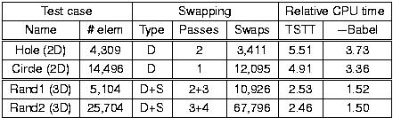
Sample Results
Notes:
No statistical difference in output meshes; trivial differences in detail because of order of operations.
Swap type: D = Delaunay, S = maxmin sine of dihedral angles. These choices are in accordance with the recommendations Lori and I make in the infamous “How to improve your mesh by swapping and smoothing paper” (IJNME 97).
Timings are compared to the GRUMMP native implementation, which uses exactly the same algorithm.
Last column: involves some dirty tricks to avoid much of the Babel interlayer overhead; probably comparable to what you'd get with macros.
Timings will be better once I get block adjacency and modification calls in place.
Finally, this is the worst case for performance: TSTT calls are basically doing a very simplequery, and there aren't many calculations per TSTT call. I'm confident that (without dirty tricks) I can get the 3D overhead down to 75% or so (maybe 25% with dirty tricks?)

Slide 14
Summary
Full swapping implementation is non-trivial
Service using standard interface can handle all the tricky bits
Implementation of approx ten functions can allow anyone, with any mesh data structure, to take advantage of this
  Most difficult is correct implementation of iterators
Performance is a bit slow compared with native implementation, but not disastrously so
Notes:
Yes, the performance is a little sad, but still faster than trying to write your own from scratch, and get it all right. :-)

