Slide 1
Front Tracking
Tutorial Lectures by James Glimm
with thanks to the Front Tracking team
S. Dutta, E. George, J. Grove, H. Jin, Y. Kang, M.-N. Kim,T. Lee, X.-L. Li, T. Liu, X.-F. Liu, A. Marchese, W. Oh, A. Pamgemanan, R. Samulyak, D. S. Sharp, Z. Xu, Y. Yu,Y. Zhang, M. Zhao, N. Zhao
at BNL, LANL, Univ. Stony Brook

Slide 2
Outline of Presentation
Overview
  Basic idea of Front Tracking
  Advantages and disadvantages of Front Tracking
  Modular software design
  Use and availability of software
Technical Description
  Geometry: interfaces and the description of free surface
    Grid free and grid based formulations
  Physics: fronts and the propagation of states and points
Advanced Topics
  Conservative and nonconservative formulations
Ongoing Research

Slide 3
Part I:
Overview -- The Basic Ideas
Front is a lower dimensional grid, moving through the volume filling grid
Key ideas are
  the geometrical description of the front
  the algorithm to propagate it
  the modification of the finite difference stencils which cross the front so that the stencils see only states on one side of the front
Front tracking is the ultimate ALE code as it is pure Eulerian except for a lower dimensional Lagrangian surface grid
Beyond ALE: front tracking has built in slide surfaces for interfaces (shear discontinuity allowed)

Slide 4
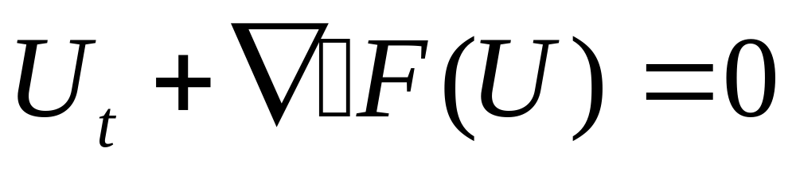
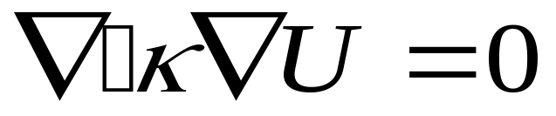

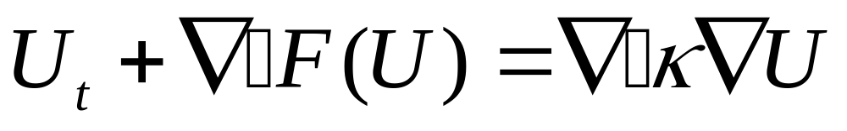
Conservative Equations for Front Tracking
Hyperbolic:
Track discontinuities in U
Elliptic:
Track discontinuities in
Parabolic:
Mixed: any or all of the above in different
subsystems of equations

Slide 5
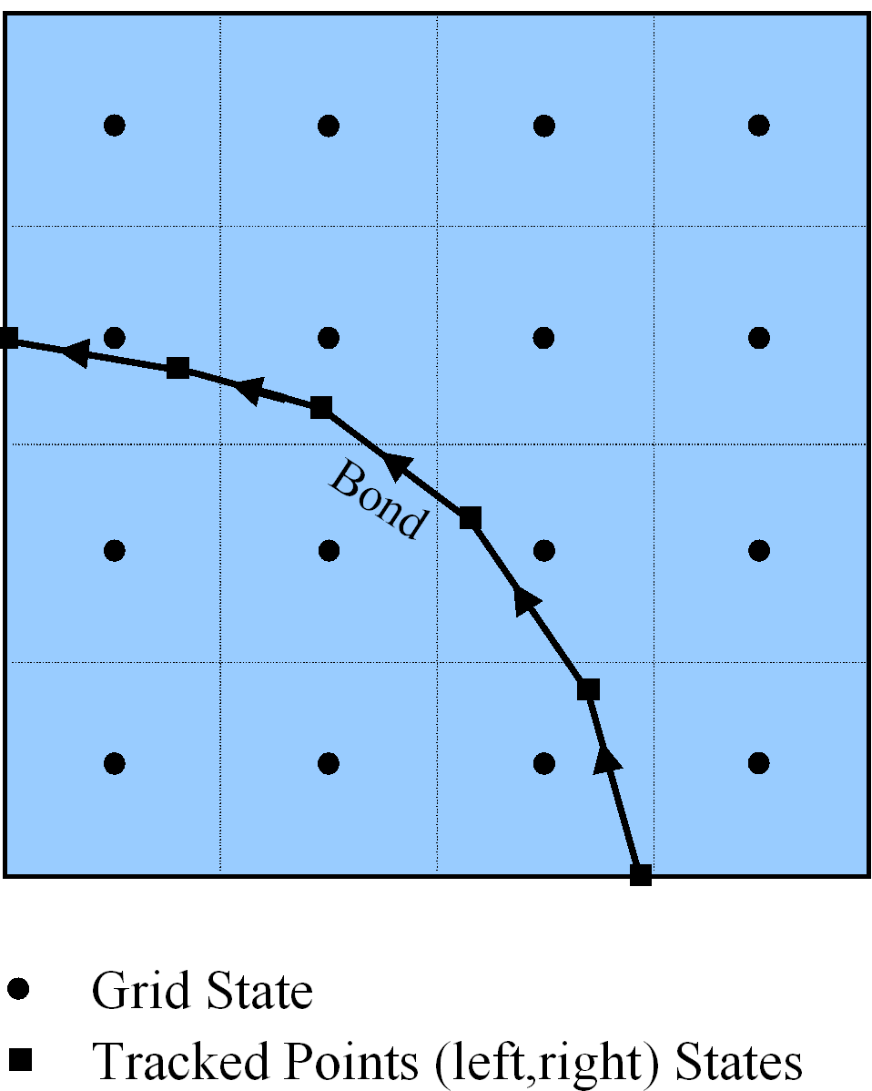
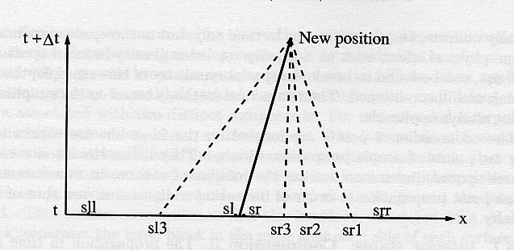
Schematic for Front Tracking
R
R

Slide 6
Front Tracking:
Advantages and Disadvantages
Advantages:
  Often gives the best solutions on coarser grids compared to other methods for problems with important discontinuity interfaces
  Solves interface problems not solvable by other methods
Disadvantages:
  For shocks: too complex relative to benefits
  Not well suited to diffused or spread out fronts
  Software complexity implies learning period for use

Slide 7
Three Examples
Code comparison and grid convergence study for spherical implosions and explosions: shock passage through an interface (the spherical Richtmyer-Meshkov problem)
Code comparisons for a single mode accelerated interface (the planar 2D Rayleigh-Taylor problem)
Code comparison for 3D steady acceleration of a density discontinuity interface (the planar Rayleigh-Taylor problem)

Slide 8
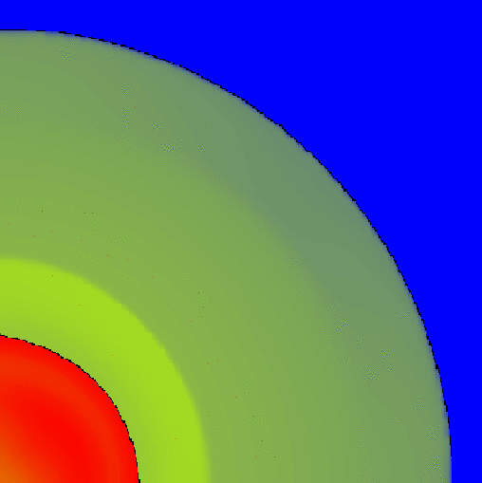
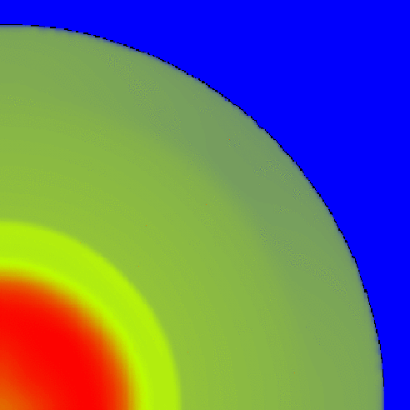
Tracked (left) and untracked (right) spherical implosions, 200x200 grids

Slide 9
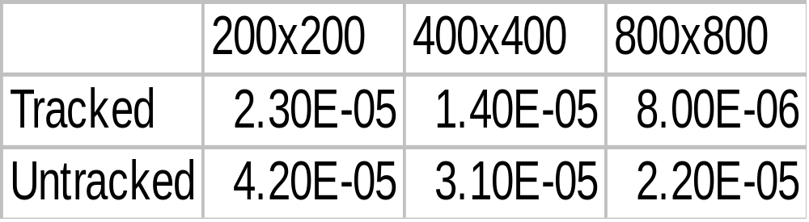
Comparison of L₁ error for contact for tracked and untracked simulations

Slide 10



Single mode Rayleigh-Taylor instability comparison
(20 cells across): Frontier, Tracked TVD, TVD

Slide 11



Comparison (40 cells across);
FronTier, TVD Tracked, TVD

Slide 12
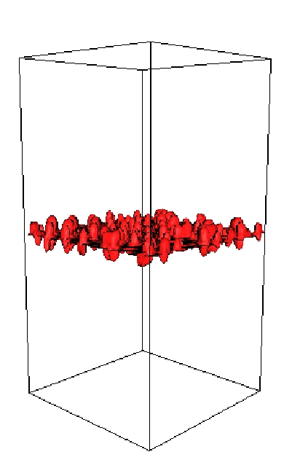
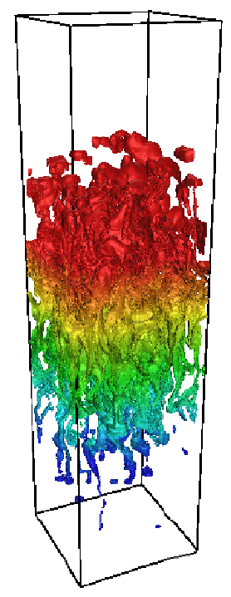
Fluid Mixing Simulation
Early time FronTier simulation of Late time FronTier simulation of a
3D RT mixing layer. 3D RT mixing layer.

Slide 13
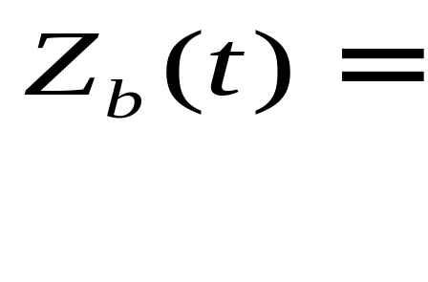
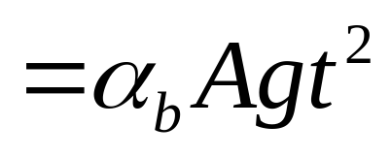
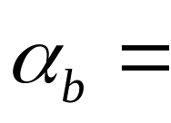
Comparison of Simulation, Theory, Experiments
penetration distance of light fluid into heavy
^{0.05 -- 0.077 (Experiment)}
^{0.05 -- 0.06 (Theory)}
0.07 (Simulation - tracked)
0.035 (Simulation - TVD untracked)
0.06 (Simulation - TVD untracked, diffusion renormalized)

Slide 14
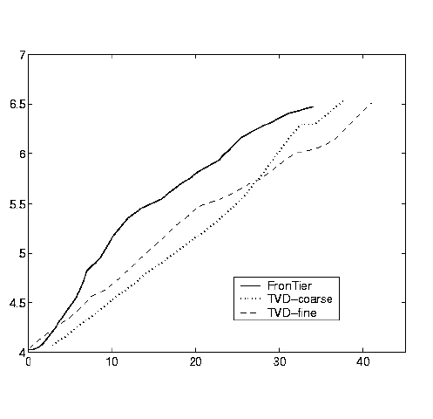
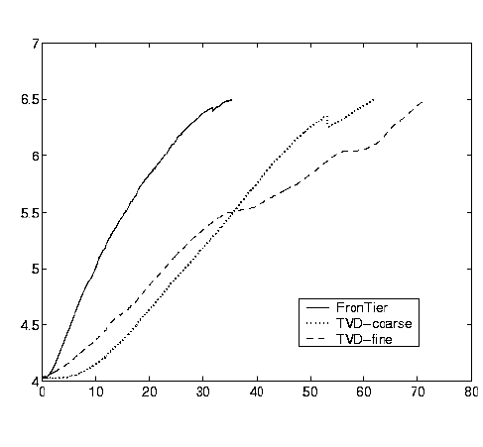
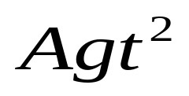
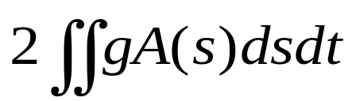
FronTier and TVD Simulations without / with diffusion remormalization

Slide 15
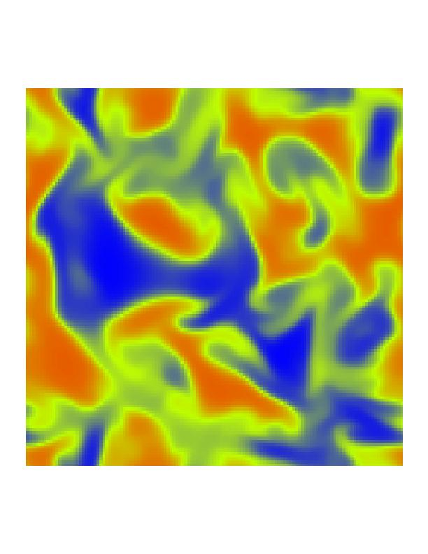
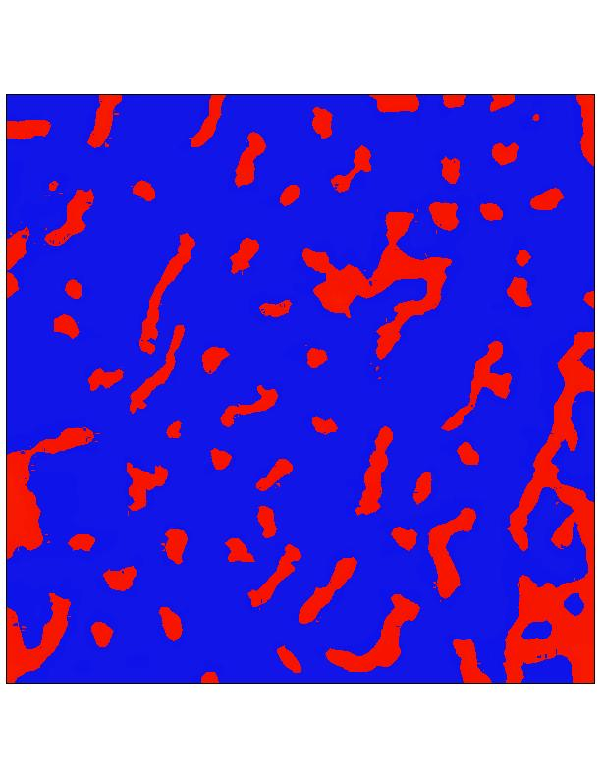
Density at Z = const. Cross section.
Comparison of FronTier (left) and TVD (right)

Slide 16
Modular Code Design
Interface library: Describes geometry of an interface. This is at the level of nonmanifold geometry, meaning that the interface surfaces can intersect on curves, which can meet at points.
  Typical support routines: make_object, print, read_print, copy, delete, modify where object = point, bond, curve, triangle, surface, interface
  Higher level support routines: test for intersections, find side or closest interface point or component from a general position in space, glue pieces for parallel communication

Slide 17
Modular Code Design
Front Library: Describes Interface with physical states (at this level, a unit of storage)
  Typical support routines: Propagation of interface points; re-meshing of interface points
Hyp Library: Assembles stencils for explicit solution of hyperbolic equations.
Gas: Provides Riemann solvers to Front and finite difference stencil operators to Hyp.
EOS: Contains constitutive laws to close equations
Reference: J. Glimm, J. Grove, X.-L. Li, K-M. Shyue, Q. Zhang,
Y. Zeng. “Three Dimnsionslal Front Tracking.” SISC 19
(1998), 703-707

Slide 18
Software Availability
Interface -- geometrical routines
  Freely available
Hyperbolic tracking -- finite difference for fronts and for interior states near fronts
  Available by request
  Plans to make this portion into freely available library
Elliptic and parabolic tracking -- finite elements for elliptic operators with discontinuous coefficients
  Available by request
Physics libraries -- Gas, MHD, Solid, Porous media
http://www.ams.sunysb.edu/~FronTier.Ftmain.html

Slide 19
Part II: Technical Description
Geometry: interfaces and the description of free surfaces
  Grid free and grid based formulations
  Conservative, higher order formulation
  Interface operations and support
  Untangle, remesh
Dynamics: fronts and the propagation of states and points
  Local and nonlocal Riemann solvers
  Interior difference solvers near a tracked front
Parallel communication (and AMR)
  repatch pieces of fronts after parallel communication

Slide 20
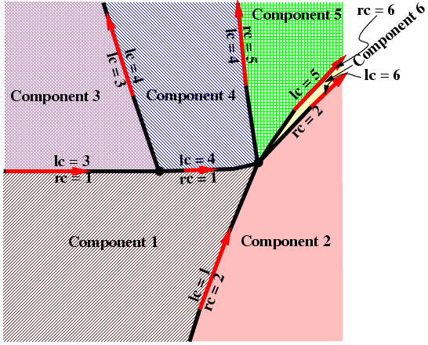
II.1: Geometry
The front separates space into connected components, each with possibly different physics

Slide 21
Interface data structures
Coords: (pointer to) three numbers in a 3D space
Point: coords, left state, right state
Bond: point for each end, and pointers to next, prev bond
Node: beginning/end of curve. This is a curve with a list of
incoming and outgoing curves
Curve: doubly linked list of bonds, starting and ending at a node,
pointers to first/last bond, start/end node
Tri: three points for vertices and pointers to neighbors

Slide 22
Interface data structures
Surface: defined by bounding curves and by linked tris
Hypersurface element: tri in 3D, bond in 2D
Hypersurface: surface in 3D, curve in 2D. Left/right
component index
Interface: has all of the above

Slide 23
Elementary Interface Operations
For each object (POINT, BOND, CURVE, TRI, SURFACE, INTERFACE):
  allocate, install, copy, print, read_print, delete, next (iterators)
For parallel communication:
  communicate in blocks
  reset all pointers in communicated blocks
  reconnect interface patches communicated near edges or over buffer zones at edges

Slide 24
Advanced Interface Operations
Test for intersections
Resolve intersections (untangle)
Locate relative to interface
  which side, or connected component
  closest interface point
Determine crossings of interface with lines
  to define finite difference stencil
  to define grid based reconstruction
Precomputation (hash tables) for efficiency

Slide 25
Grid free vs. Grid based
Grid free: interface and interior (volume) grid share a comon length scale but are otherwise unrelated
Grid based: the interface is directly tied to the volume grid.
  The interface is defined by its intersections with the grid cell edges.
  It is assumed that each grid cell edge has at most one intersection with the interface.
  In the interior of the cell, the interface is reconstructed from its cell edge crossings.

Slide 26
Grid free vs. Grid based
Grid free
  can be more accurate
  is less robust
Grid based
  highly robust
  Lorensen and Cline. “Marching Cubes”. Computer Graphics, 21 (1987), 163-169.
Hybrid: alternate grid free and grid based at some frequency
  robust since grid based is used as a backup
  improved interface description
  best of three algorithms

Slide 27
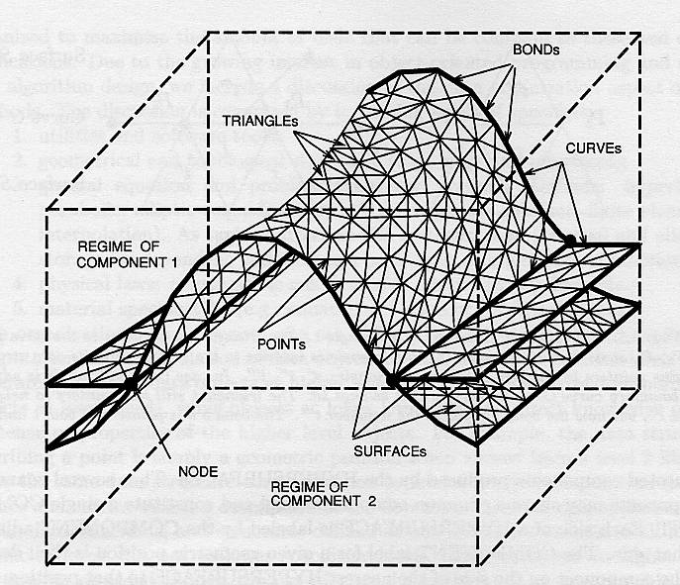
The 3D interface: Grid free

Slide 28
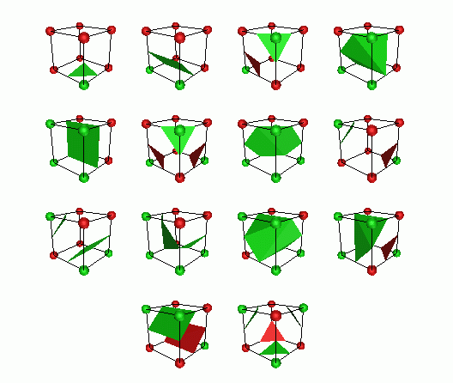
Grid-based interface reconstruction:
14 nonisomorphic cases in 3D

Slide 29
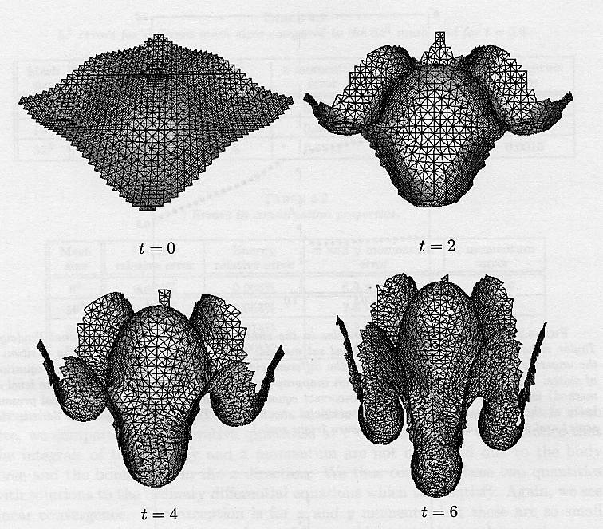
Grid-free interface evolution

Slide 30
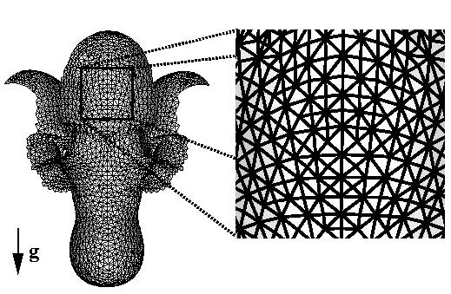
Grid-free surface

Slide 31
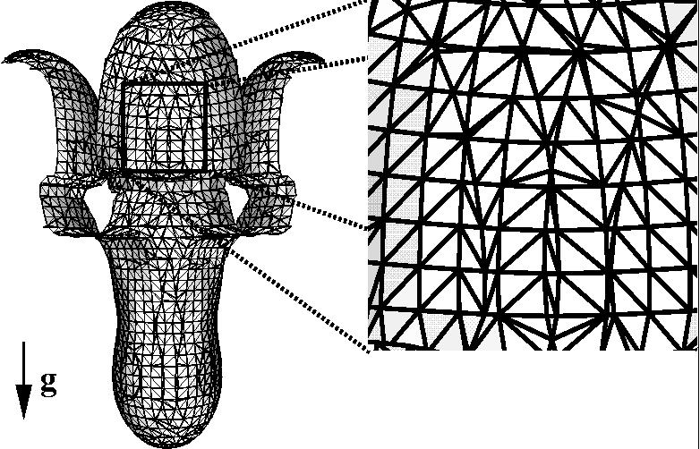
Grid-based surface

Slide 32
References for Interface Construction
J. Glimm and O. McBryan, “A Computational Model for
Interfaces”, Adv. Appl. Math. 6 (1985), 422-435
J. Glimm, J. W. Grove, X.-L. Li, K.-M. Shyue, Q. Zhang
snd Y. Zeng, “Three Dimensional Front Tracking”, SIAM
J. Sci. Comp. 19 (1998), 703-727.
J. Glimm, J. W. Grove, X.-L. Li and D. Tan, “A Robust
Computational Algorithm for Dymanic Interface Tracking in
Three Dimensions”, SIAM J. Sci. Comp. 21 (2000), 2240-
2256.
J. Glimm, J. W. Grove, X. L.Li and D. C. Tan “Robust Computational Algorithms for Dymanic Interface Tracking in Three Dimaneions”, SIAM J. Sci. Comp. 21 (2000) 2240-2256.

Slide 33
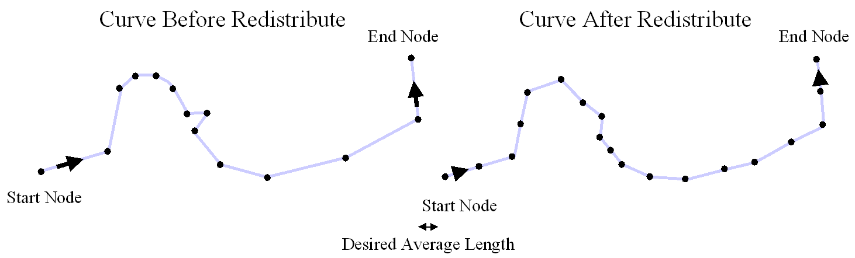
Redistribution of points on a curve will ensure equal spacing and provide some smoothing

Slide 34
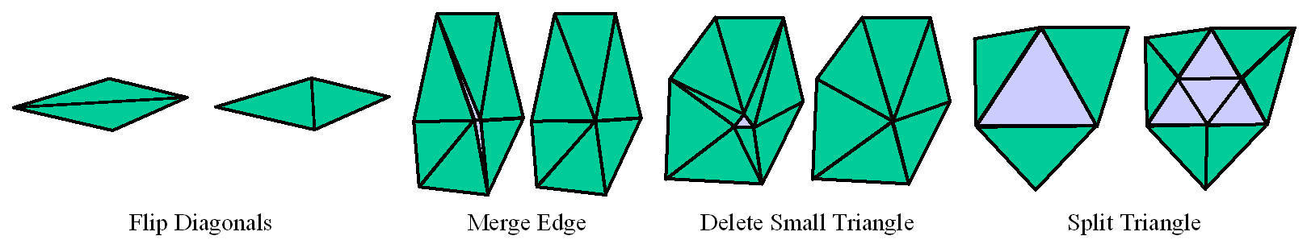
Grid free redistribute in 3D is based on elementary triangle operations

Slide 35
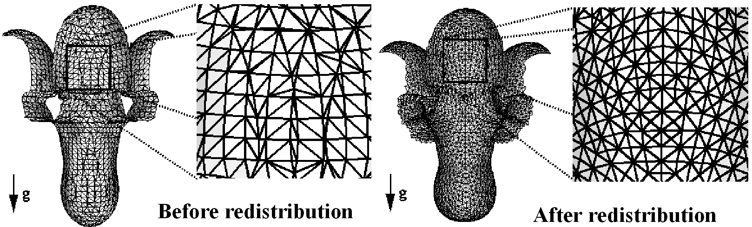
3D redistribution improves the triangle quality for the surface

Slide 36
Grid based redistribution
The grid based algorithm is automatically redistributed
every step.
The algorithm is based on reconstruction of the interface
from the crossings of the interface with the grid cell edges.
The reconstruction can be viewed as a special type of
redistribution.

Slide 37
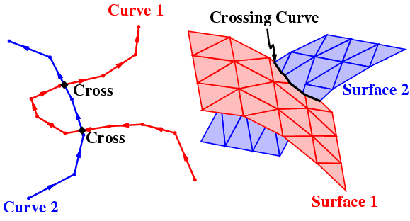
Tangles:
Self-intersecting curves and surfaces

Slide 38
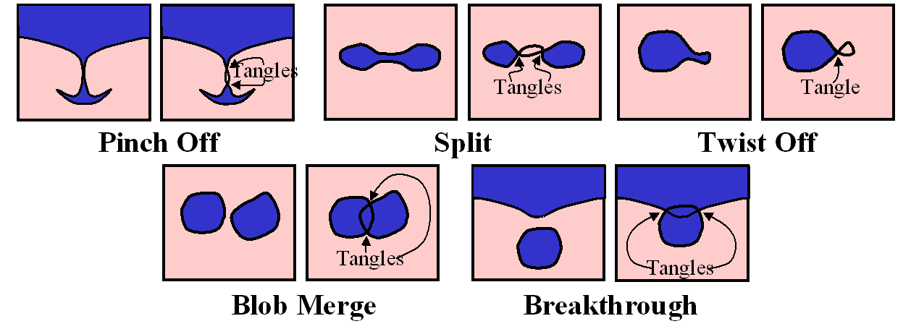
Typical 2D interface tangles, resolved within a time step

Slide 39
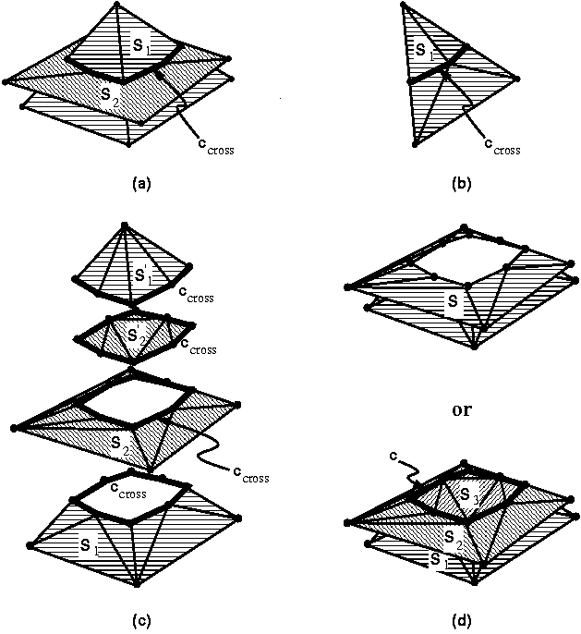
Grid-free untangling (3D)

Slide 40
Grid free untangle
1. Test all triangle pairs for intersections (use hash table)
2. Find (cross) bonds defined by intersecting trinagles
3. Link cross bonds to form cross curves
4. Install cross curves into interface, cutting surfaces along
line of intersection
5. Test for and remove unphysical surfaces
6. Remove unneeded cross curves
2D algorithm: just the analogues of 1+2+6 needed

Slide 41
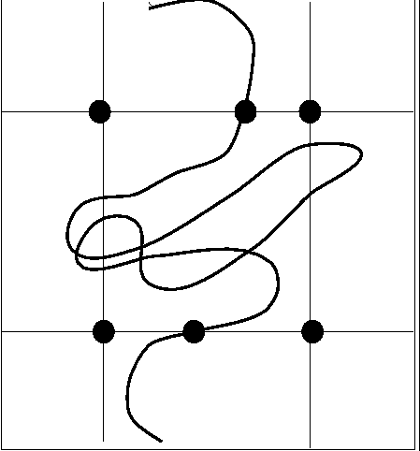
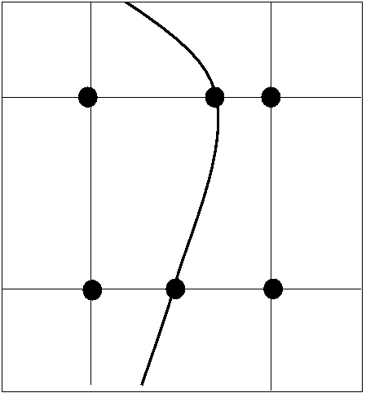
The idea of grid-based untangling

Slide 42
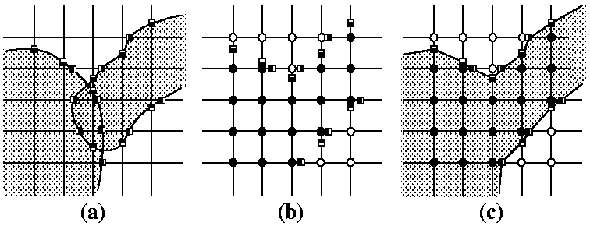
Grid-based topological correction
The same construction works for 3D. Untangle is an elementary step for grid based tracking.

Slide 43
Grid based reconstruction (includes redistribute and untangle)
1 Determine the crossings of the interface with the cell block
edges
2. Determine the components at the corners of the cell block.
This is done, starting with a point not swept by the interface
(thus with the same component as the previous time step), and
followed by a walk through all mesh block squares. Double
crossings and other unphysical crossings are eliminated at this
step.
3. Reconstruct the interface, using the one of the 14
nonisomorphic templates which matches the give cell
4. Check for and resolve any possible inconsistency at each
cell face

Slide 44
Grid based matching at cell faces
On cell faces, the interface is also grid based, in the
sense that it is determined by reconstruction with the
intersections of the interface with the edges of that face.
Thus two cells with a common face share a boundary
with common data (edge intersections) and a common
solution (the reconstruction). Thus the interface is
consistent across adjacent cells after reconstruction
(it is watertight).
Exception: 4 edge crossings for a single face allow a nonunique
reconstruction, and an explicit watertight patch is needed.
Uniqueness of reconstruction matching is important for
parallel communication.

Slide 45
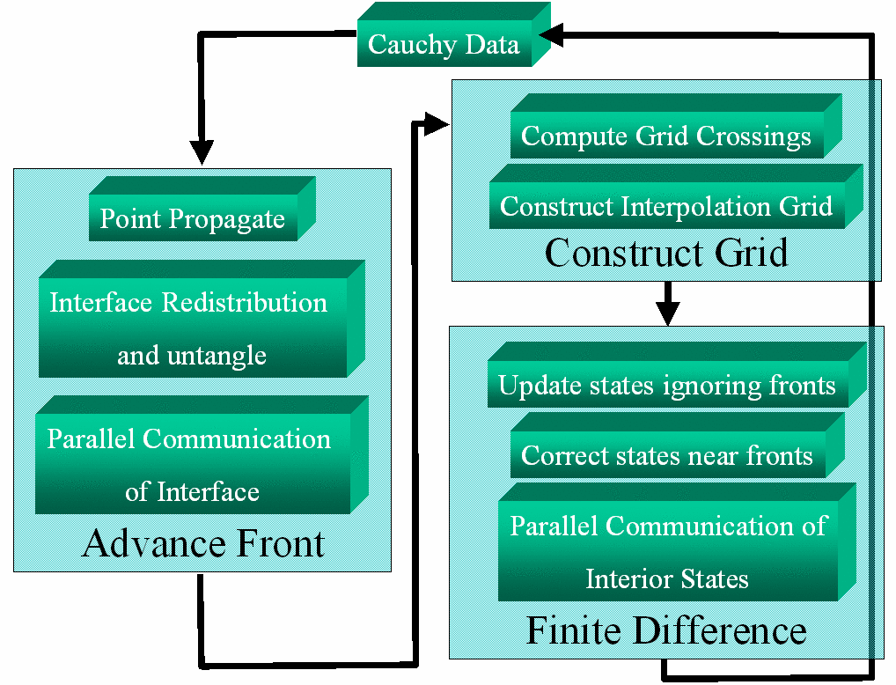
II.2: Dynamics
Flow Chart for Front Tracking

Slide 46
Propagation of Points and States
Front points (each point has a left and right side state)
  Normal propagate: solution of a nonlocal Riemann problem in one dimension
  Tangential propagate: project surface onto tangent plane and apply finite differences there
Interior points
  Many different finite difference methods supported. No modification in case the stencil does not cross the front
  Use of ghost cells to reconstruct stencil states in case the stencil crosses the front

Slide 47
Algorithms for differencing with multi-components defined by fronts
The only routine which sees multicomponents is the
Riemann solver. The Riemann solver will accept left
and right states describing possibly different physics
(e.g. a different Equation of State). Its solution defines
the coupling or boundary conditions between these two
regimes.
All other routines (finite differences, interpolation, finite
elements, tangential front update) see only states from
one component at a time.
In this way there is no numerical mass diffusion across a
front.

Slide 48
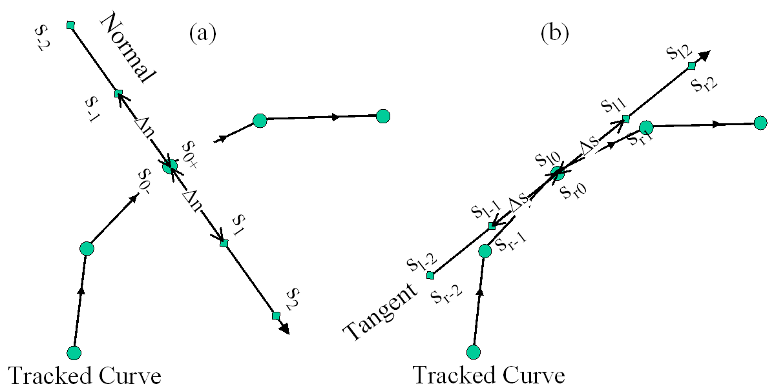
The interface motion is split into normal and tangential steps

Slide 49
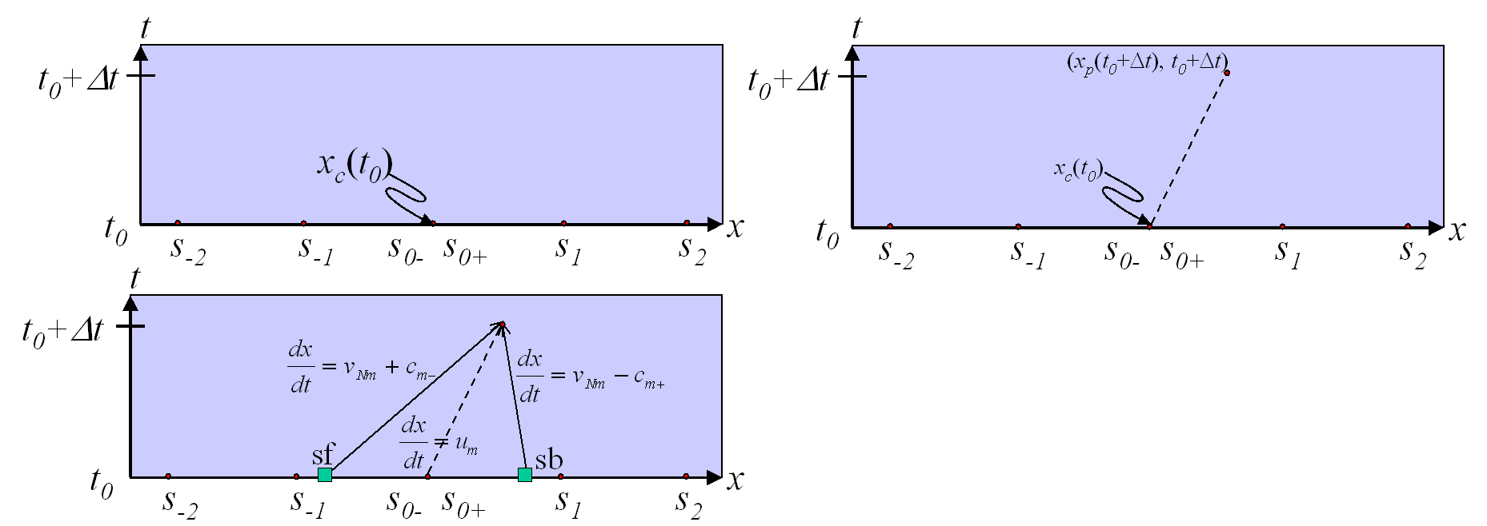

Three steps in the normal propagation algorithm
Determine states at new point via
characteristic equations.
Solve RP at new point to get left
and right states.
Repropagate point using average of t₀
and t ₀+ t velocities to achieve higher
order accuracy

Slide 50
A Solution Function
Evaluation of the solution at the foot of a backwards
characteristic will fall at an arbitrary point relative to
the grid.
A solution function is provided to evaluate the solution
at an arbitrary point.
It is based on interpolation from (regular) grid data points
using bilinear interpolation and from front points using
linear interpolation on triangles

Slide 51
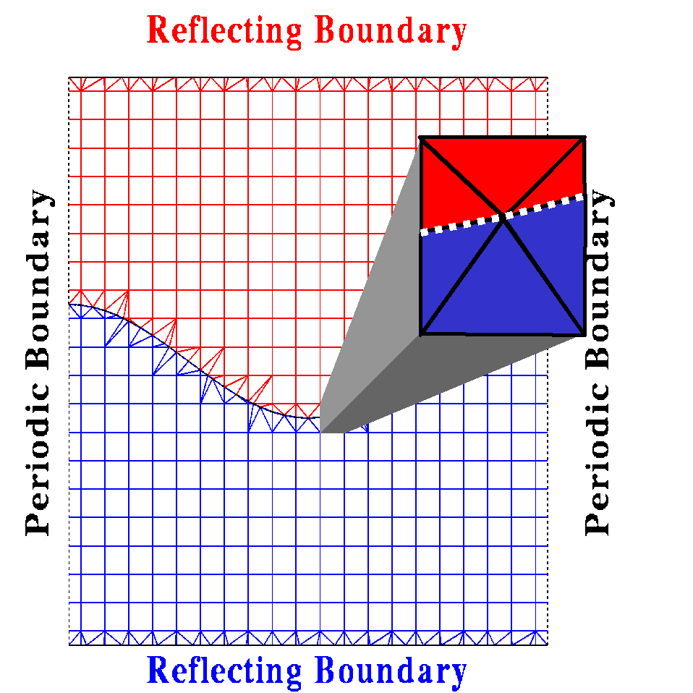
Interpolation grid used to define solution function: Interpolation of states from a single component only

Slide 52
Tangential propagation
Tangential propagation applies to front states.
States on each side of the front are propagated
separately, by a conventional finite difference algorithm.
Motion of points is optional. Propagation (normal
and tangential) can occur in any Galilean frame,
as the equations are frame invariant. Choice of frame
affects the tangential component of point propagation.
Tangential motion is an isomorphism of the interface,
and has no dynamical significance.

Slide 53
Grid base front propagation
The front propagation algorithm will yield a general
interface even if it starts from a grid based one.
For grid based front propagation, the final step in the
propagation algorithm is to reconstruct the propagated
front to be grid based.
As indicated before, we determine the intersections of’
the front with the grid cell edges and use these
intersections to give a new grid based propagated front.

Slide 54
Propagation of interior states
The problem: irregular stencils which cross the front.
The solution: ghost cells and extrapolation.
This method is nonconservative.
Locally conservative tracking requires a space time
tracked grid.
The locally conservative construction gains one and
potentially two additional orders of accuracy.

Slide 55
Interior states (continued)
For efficiency, the interior solution consists of two
passes.
The first pass ignores the front and solves for all points,
regular or irregular in a uniform manner.
This pass is vectorized.
The second pass returns to the cells with an irregular
stencil and solves taking the front into account, in effect
overwriting the answer of the first pass for those cells.

Slide 56
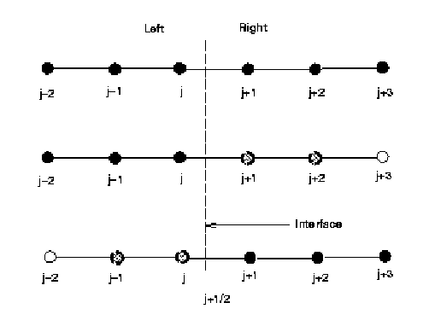
Stencil states for the ghost cell method: extrapolate states across the interface

Slide 57
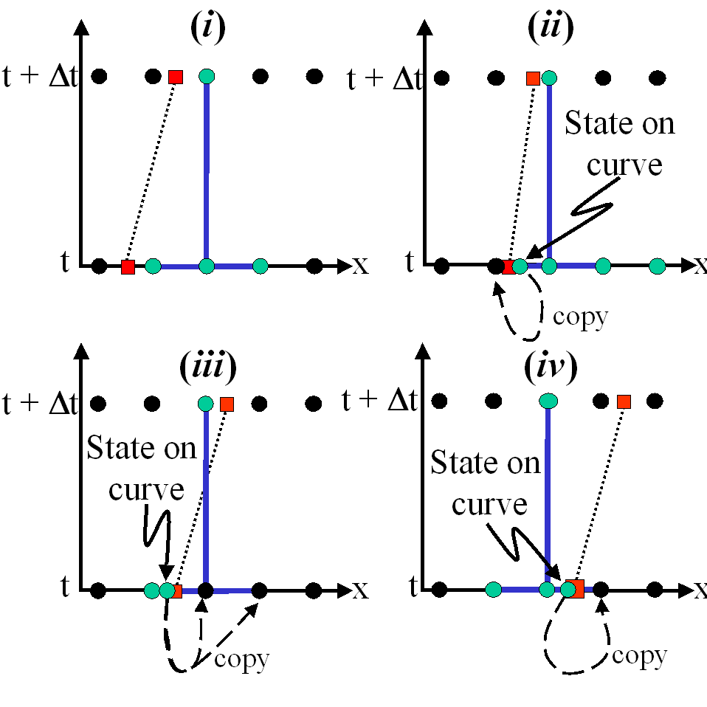
Ghost cell extrapolation copies a state on a curve to a ghost cell regular stencil point. The completed stencil always has states from a single component

Slide 58
Ghost Cells
For stencils to the left, left side states are
extrapolated to right to fill states at the
locations where they are needed on the
right.
Similarly on the right.
Thus the finite difference scheme sees only
states from a single side.

Slide 59
The ghost cell extrapolation method
Original reference
  J. Glimm, D. Marchesin, O. McBryan. “A Numerical Method for Two Phase Flow with an Unstable Interface.” J. Comp. Phys. 39 (1981), 179-200
Used without attribution by Fedkiw et al.
  R. Fedkiw, T. Aslam, B. Merriman, S. Osher. “A Non-Oscillatory Eulerian Approach to Interfaces in Multiphase Flow.” J. Comp. Phys. 152 (1999), 452-492.

Slide 60
Parallel Communication
For interior states, use ghost cells. Communicate after
interior sweeps
For the front: cut a patch to extend beyond ghost cell region.
Communicate patch. Install patch in image domain.
Installation requires a matching condition, defined by
floating point comparison of points, with redundancy
through use of the coordinates of the (2 or 3) points
defining a bond or triangle.
Grid based matching depends on cell face data, and is easier.

Slide 61
General Reference for Front Tracking: geometry and dynamics
J. Glimm, J. W. Grove and Y. Zhang, “Interface Tracking for Axisymmetric Flows”, SIAM J. SciComp 24 (2002), 208-236.

Slide 62
Part III: Introduction to Advanced Topics
Conservative tracking
  conservation
  higher order accuracy
  simpler numerical methods; all difficulty transferred to the space time geometry
Parabolic and elliptic problems with free surfaces
  Free surface MHD
  Porous media with sharp fronts
  Navier-Stokes with two fluids (distinct viscosities)

Slide 63
Locally Conservative Tracking
Ghost cells are not conservative
Ghost cells are locally zero order accurate, as is the case with other finite difference methods at discontinuities
A locally conservative higher order method requires a space time interface
All difficulty is transferred to the geometrical issues of interface construction
Finite differencing is standard

Slide 64
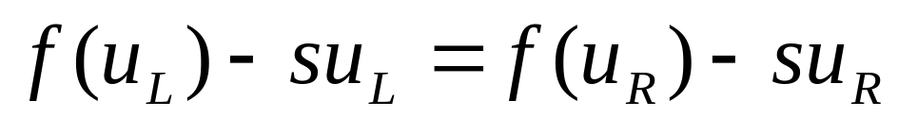
Locally Conservative Front Tracking
Lax-Wendroff theorem[1960]: A conservative consistent scheme “converges” to a function u, the limit u is a weak solution.
The Key: Utilization of the dynamic flux, which not only satisfies Rankine-Hugoniot condition but also gives equal numerical flux on both sides of cell boundary.
The Rankine-Hugoniot condition:

Slide 65
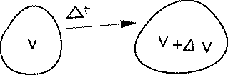


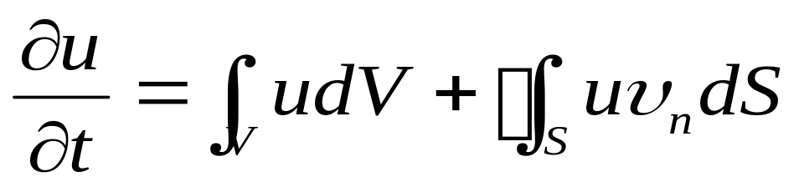
Conservation laws in Integral Form
Figure 1: The changes of volume V inside the flow
For the right hand side, omitting the higher order term, dividing both sides by and taking the limit of , we have

Slide 66
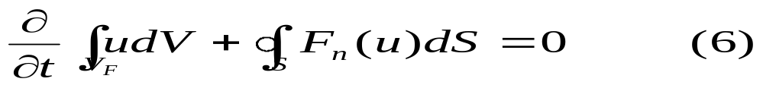
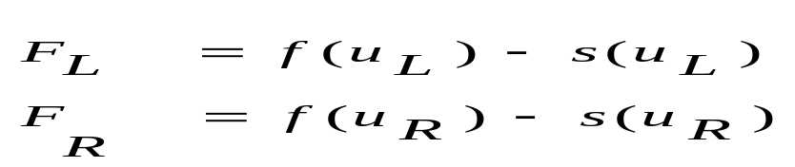
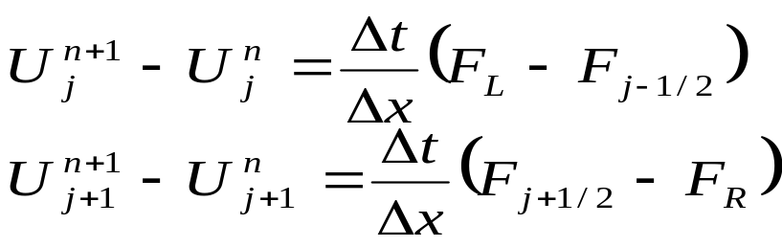
Conservation laws in Integral Form
The space integral form of the conservation law for a cell with moving boundary
For a fixed cell such as a rectangular cell in an Eulerian grid,
Define dynamic flux with moving boundary:
Difference function near boundary

Slide 67
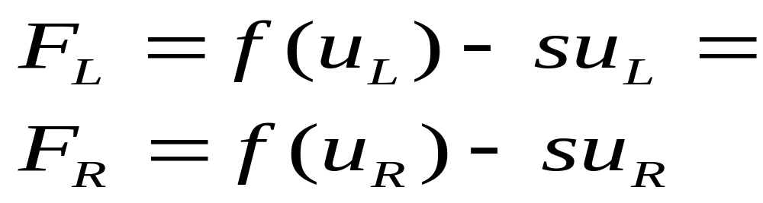
The conservation property
due to the Rankine-Hugoniot relations for the
conservation law. Thus the method is conservative.

Slide 68
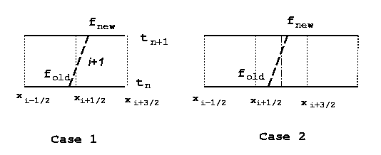


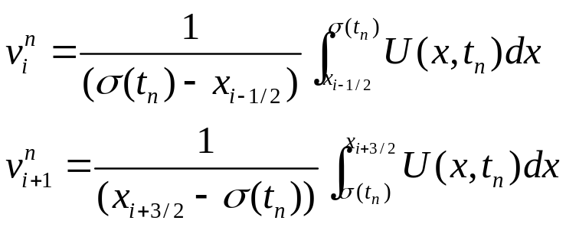
1D Conservative Front Tracking Geometry
Two cases
Fronts do not cross the cell center in one time step.
Fronts do cross the cell center in one time step.
New cell average and :

Slide 69
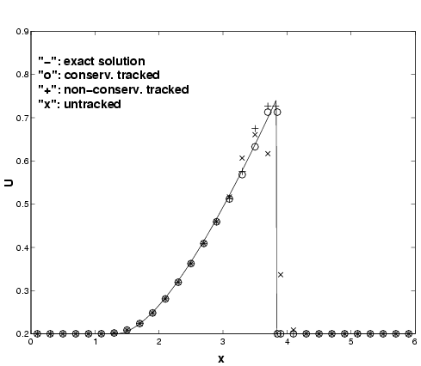
4-way comparison: exact vs. untracked (x), conserv. tracked (o), nonconserv. tracked (+)

Slide 70

L₁ convergence order for shock interacting with rarefaction wave (having smooth edges): comparison of conservative and nonconservative tracking
Grid Conservative Nonconservative

Slide 71
Accuracy Order of
Locally Conservative Tracking
1D locally conservative algorithm is also locally 2nd order accurate at the tracked front
  Front propagation is 2nd order accurate in position. Uses a predictor corrector.
2D locally conservative algorithm is 1st order accurate at tracked front
  Implementation is1st order accurate at present.
  2nd order requires curvature corrections in 2D
2D space time grid uses 3D grid based interface

Slide 72
Major Steps in 2D Algorithm
Propagate 2D spatial interface
Connect old, new 2D grids to form 3D space time grid, and reconstruct this to be grid based
Merge cells with small tops to ensure CFL stability
Conservative differencing in 3D space time cells using dynamic flux, and piecewise linear state reconstruction

Slide 73

2D Space time interface

Slide 74

Irregular cells cut by 2D space time interface

Slide 75

Irregular volume grid after merger of small cells
After cell merger

Slide 76



Conservative tracking: single mode
Richtmyer-Meshkov instability, 40 cells across

Slide 77



Conservative tracking (40 cells) vs. Nonconservative tracking, 40, 80, 160 cells
C 40
NC 40
NC 80
NC 160

Slide 78

Comparison of growth rates:
40, 160 cell Cons. Tracked and 160 noncons. Tracked are similar; 40 cell Noncons. Tracked has slower growth

Slide 79
Conservative Front Tracking
J. Glimm, X. L. Li, and Y.-J. Liu, “Conservative Front Tracking with Improved Accuracy”, Siam J. Num. Analys. Submitted (2003).
J. Glimm, X.-L. Li and Y.-J. Liu, “Conservative Front Tracking in Higher Space Dimensions”, Transactions of Nanjing University of Aeronautics and Astronautics 18, Suppl. 1-15.
J. Glimm, X.-L. Li, Y.-J. Liu and N. Zhao, “Conservative Front Tracking and Level Set Algorithms”, Proc. Nat. Acad. Sci. 98 (2001) 14196-14201.

Slide 80
Parabolic and Elliptic Problems:
Discontinuous Coefficients in the Elliptic Operator
Multiple applications (transport properties with discontinuities in the materials)
Shift grid lines or surfaces to the discontinuity interface
Preserve well conditioned mesh elements for numerical stability
Rectangular index structure desirable but not essential, for fast solvers

Slide 81
Point-Shifted Triangular Grid
1. Irregular
Rectangular Grid
Density Function

Slide 82
Point-Shifted Triangular Grid
2. Point-Shifting
a. intersections

Slide 83
Point-Shifted Triangular Grid
2. Point-Shifting
a. intersections
b. redistribution
3. Error Handling
local mesh refinement

Slide 84

Point-Shifted Triangular Grid
2. Point-Shifting
a. intersections
b. redistribution

Slide 85
Point-Shifted Triangular Grid
2. Point-Shifting
a. intersections
b. redistribution
c. shift grid nodes

Slide 86
Point-Shifted Triangular Grid
3. Triangulation

Slide 87
3D Construction of Surface Constrained Grid for Elliptic Finite Element Solver
Find intersections of triangle edges with the grid block surfaces; add new points to the triangle there
Split resulting polygons to get triangles again
Collapse small triangles, remove some points
Record all grid block surface and volume diagonals enforced by surface
Add new grid lines if topology is too complex to resolve
Shift grid points to interface or vica versa
Tetrahedralize (breadth first)
Introduce Steiner points if needed (rarely)

Slide 88

Simulation Results
Conformity

Slide 89
Part IV: Ongoing Research
Algorithms
  Locally Conservative tracking
  Automatic Mesh Refinement
Applications: Engineering and physics
  Axisymmetric spherical flows
  Laser accelerated targets
  Jet breakup and spray
  Late stage fluid mixing
Packaging and usability
  Uniform calling interface (TSTT)
  Merge with other code frameworks (Overature)
  Library formulation

Slide 90
Automatic Mesh Refinement for FT
Merge with Overature (LLNL) code; acquire AMR from Overature.
Patch based AMR as with M. Berger
Assume that the front occurs on the finest grid level only
Assume that each patch lies in a single parallel processor domain

Slide 91


AMR: A shock-contact interaction
Initial data

Slide 92


Level 4 AMR
After shock passage through contact

Slide 93
Applications of FronTier-Gas
Acceleration driven mixing
  E. George, J. Glimm, X.-L. Li, A. Marchese and Z. L. Xu “A comparison of Experimental, Theoretical, and Numerical Simulation of Rayleigh-Taylor Mixing Rates”, Proc. National Academy of Sci. 99 (2002) 2587-2592
  R. L.Holmes, B. Fryxell, M. Gittings, J. W. Grove, G. Dimonte, M. Schneider, D. H. Sharp, A. Velikovich, R. P. Weaver, and Q. Zhang “Richtmyer-Meshkov Instability Growth: Experiment, Simulation, and Theory”, J. Fluid Mech. 389 (1999) 55-79.
  S. Dutta,, E. George, J. Glimm, X. L. Li, A. Marchese, Z. L. Xu, Y. M. Zhang, J. W. Grove and D. H. Sharp, “Numerical Methods for the Determination of Mioxing”, Laser and Particle Beams, submitted (2003).

Slide 94
Applications of FronTier-gas
Breakup of a diesel jet into spray
  J. Glimm, X.-L. Li, W. Oh, A. Marchese, M.-N. Kim, R. Samulyak and C. Tzanos, “Jet breakup and spray formation in a diesel engine”, Proceedings of Second MIT conference on Computational Flluid and Solid Mechanics, 2003.
Laser Induced Fluid Mixing
  R. P. Drake, H. F. Robey, O. A. Hurricane, B. A. Remington, J. Knauer, J. Glimm, Y. Zhang, D. Arnett, D. D. Ryutov, J. O. Kane, K. S. Budil and J. W. Grove, “Experiments to produce a hydrodynamically unstable spherical divergine system of relevance to instabilities in supernovae”, Astrophysics Journal 546 (2002), 896-906.
Axisymmetric Fluid Flows
  J. Glimm, J. W. Grove, Y. Zhang and S. Dutta “Numerical Study of Axisymmetric Richtmyer-Meshkov Instability and Azimuthal Effect on Spherical Mixing”, J. Stat. Phys. 107 (2002) 241-260.
Target and Detector Design for High Energy Particle Accelerator
  R. Samulyak, “Numerical Simulation of hydro- and magnetohydrodynamic processes in the Muon Collider target”, Lecture Notes in Computer Science, 2002 (submitted).
  R. Samulyak, L. Lu, J. Glimm, X. L. Li, and P. Spentzouris,“Numerical Simulation of PMT Implosion Effects in MiniBooNE”, BNL Technical Report, 2003.

Slide 95




Diesel injection:
Four time steps in jet breakup
Fuel injector (liquid-gas EOS)

Slide 96

Pressure vs. Density (EOS): The phase change EOS is one of several difficulties in this problem

Slide 97



FronTier Simulation of
NLUF 2 Experiment
CHGe capsule surrounded by CRF foam. The RM instability is driven by strong shock of Mach number 300 by the Omega laser

Slide 98

Comparison of the FronTier and CALE
Simulations with Experiment

Slide 99

Shock imploding randomly perturbed initial contact surface (light Imploding heavy)

Slide 100


Application: Cracking of PMT detector.
Simulation of accident at Super K detector

Slide 101
Other Extensions of FronTier
FronTier-res
  P. Daripa, J. Glimm, W. B.Lindquist and O. McBryan, “Ploymer floods: A case study of nonlinear wave analysis and of instability control in tertiary oil recovery”, Siam J. Appl. Math. 48 (1988) 353-373
FronTier-MHD
  R. Samulyak, “Numerical Simulation of hydro- and magnetohydrodynamic processes in the Muon Collider target”, Lecture Notes in Computer Science, 2002 (submitted).
FronTier-solid
  F. Wang, J. Glimm, J. W. Grove, B. Plohr and D. H. Sharp, “A conservative Eulertian Numerical Scheme for Elasto-Plasticity and Application to Plate Impace Problems”, Impact Comput. Sci. Engrg 5 (1993) 285-308..
FronTier-mphase
  J. Glimm, H. Jin, M. Laforest, and F. Tangerman, “A
  two pressure numerical model of two fluid mixtures”, J. Multiscale Modeling and Simulation. Accepted for publication.:

Slide 102

MHD: Pure hydo energy deposition into jet. Successive time steps in instability development

Slide 103

MHD: Energy deposition into jet with increasing strength of magnetic field

Slide 104
Packaging and usability of FronTier
Plans for an externally callable library
Merger with other codes (Overature) and library systems underway
  J. Glimm, J. Grove, X. L. Li, Y. Liu, and Z. Xu “Unstructured grids in 3D and 4D for a time dependent interface in front tracking with improved accuracy”, Proceedings of the 8th International Conference on Numerical Grid Generation in Computational Field Simulations, June 2-6, 2002, Honolulu Hawaii,

Slide 105
Related Lectures at this Conference
MS24, Monday Feb 10, 4:15-4:40PM, Garden Room F. High resolution algorithms for fluid mixing. J. Glimm, M. Kim, X. LI, A. Marchese, Z. Xu, and N. Zhao.
MS 41,Tuesday Feb. 11, 3:15-3:40 PM, Mission Ballroom B, Uncertainty Quantification for Numerical Simulaitons, J. Glimm
MS 51 Wednesday Feb 12, 10:30-10:55, Regency Ballroom C, Simplifying the Front Tracking Method to Track Complex Interfaces in High Dimensions, X. Li.
MS 75 Thursday Feb 13, Regency Ballroom C. Error Distribution Models for Strong Shock Interactions, J. Grove.

Slide 106
Thank you for your attention

