Slide 1
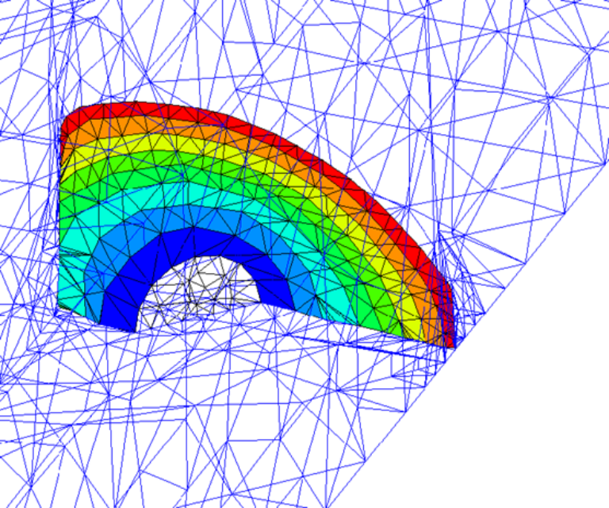
Terascale Simulation Tools and Technologies Center
Jim Glimm (BNL/SB),
David Brown (LLNL), Lori Freitag (ANL), PIs
Ed D’Azevedo (ORNL), Joe Flaherty (RPI),
Patrick Knupp (SNL), Mark Shephard (RPI),
Harold Trease (PNNL), Co-PIs
TSTT

Slide 2
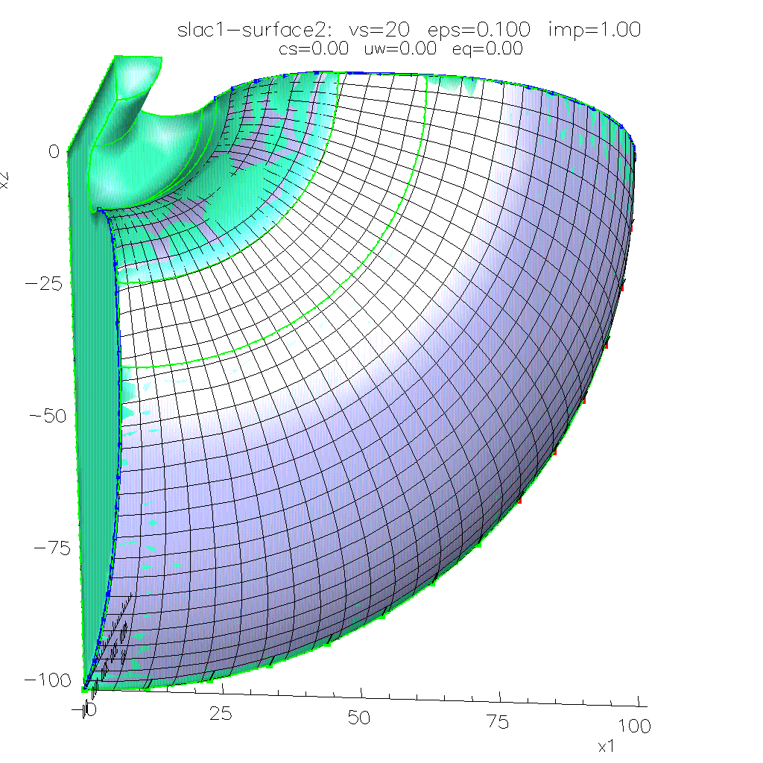
TSTT will bring sophisticated meshing and discretization technology to DOE application scientists
TRISPAL Cavity
Surface Mesh

Slide 3
TSTT will bring sophisticated meshing and discretization technology to DOE application scientists
DOE has supported the development of sophisticated tools for
  structured, unstructured, hybrid mesh generation
  front-tracking, local mesh refinement
  high-order PDE discretization methods
In general, however, the technology requires too much software expertise from application scientists
TSTT will address the technical and human barriers impeding the use of this technology by developing
  uniform software interfaces to multiple technologies
  interoperable software tools

Slide 4
TSTT will develop interoperable meshing and discretization technology supporting DOE/SC applications
Software interoperability is a pervading theme
  interoperability allows different software tools to work together
  encapsulate research into software components
  define interfaces for plug-and-play experimentation
Application deployment and testing is paramount
  near-term benefit to SciDAC applications by providing latest meshing and discretization technology
  understanding SciDAC application needs will help TSTT to develop application-appropriate software components

Slide 5
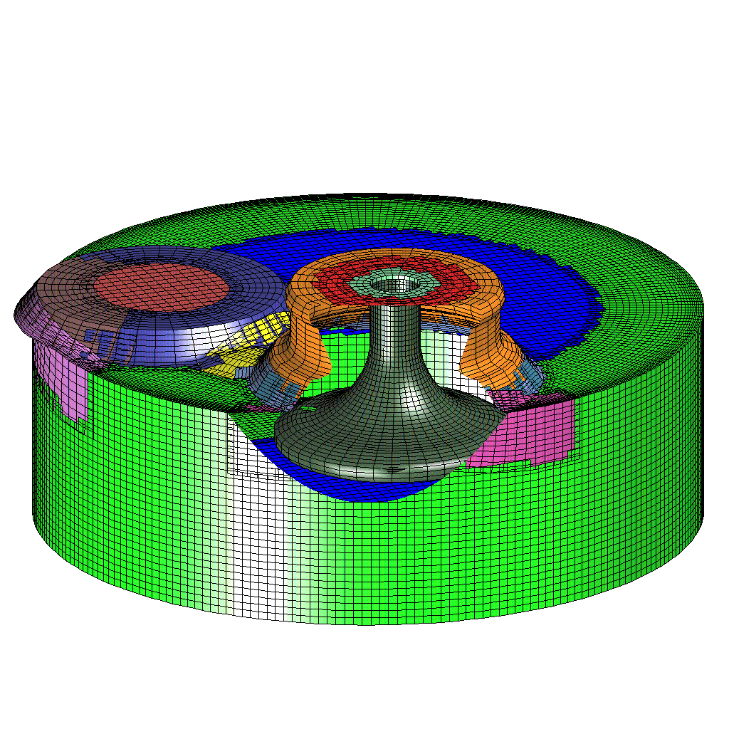
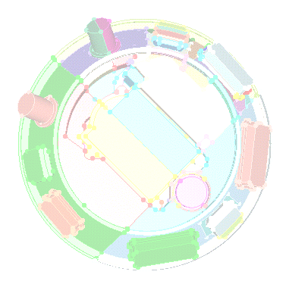
TSTT brings together existing meshing expertise from DOE Labs and Universities
Structured and hybrid meshes
  Overture - high quality predominantly structured meshes on complex CAD geometries, mesh refinement (LLNL)
  Variational and Elliptic Grid Generators (ORNL, SNL)
Unstructured meshes
  MEGA (RPI) - primarily tetrahedral meshes, boundary layer mesh generation, curved elements, mesh refinement
  CUBIT (SNL) - primarily hexahedral meshes, automatic decomposition tools, common geometry module
  NWGrid (PNNL) - hybrid meshes using combined Delaunay, mesh refinement and block structured
Front-tracking
  FronTier (SUNY-SB) - tracking of complex interfaces
Overture Mesh (LLNL)
CUBIT Mesh (Sandia)

Slide 6
Our long-term goal is to develop a common interface specification for all mesh types
Initially focus on low level access to static mesh components
  Data: mesh geometry, topology, field data
  Efficiency though
    Access patterns appropriate for each mesh type
    Caching strategies and agglomerated access
  Appropriateness through working with
    Application scientists
    TOPS and CCA SciDAC ISICs
  “Plug-and-play”: Application scientists program to the common interface and can than use any conforming tool without changing their code
High level interfaces
  to entire grid hierarchy which allows interoperable meshing by creating a common view of geometry
  mesh refinement including error estimators and curved elements
All TSTT tools will be interface compliant

Slide 7
CUBIT, TSTT, and Accelerator Design
SLAC already uses CUBIT, what does TSTT add?
  SciDAC provides formal funding mechanism for direct support of SLAC meshing needs
  TSTT plug-and-play interfaces
    leverage on-going CUBIT componentization
      Common Geometry Module
      MESQUITE
    permits interoperable use of CUBIT with other packages

Slide 8
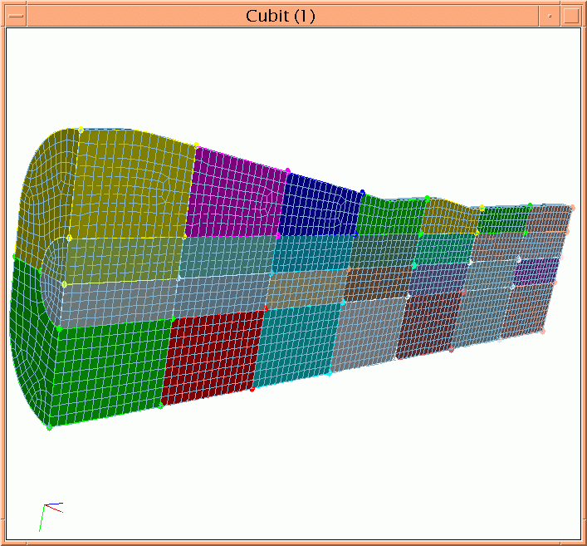
TSTT provides a formal funding mechanism for support of SLAC Meshing Needs
Cubit/Meshing Consultants:
Patrick Knupp
- Mesh Quality & Improvement,
- Structured Grids
Tim Tautges - Geometry
CUBIT Meshing Research:
Accelerator meshing needs can now influence the development of algorithms and components
New CUBIT Mesh maintains cell aspect
ratio along entire tapered geometry

Slide 9
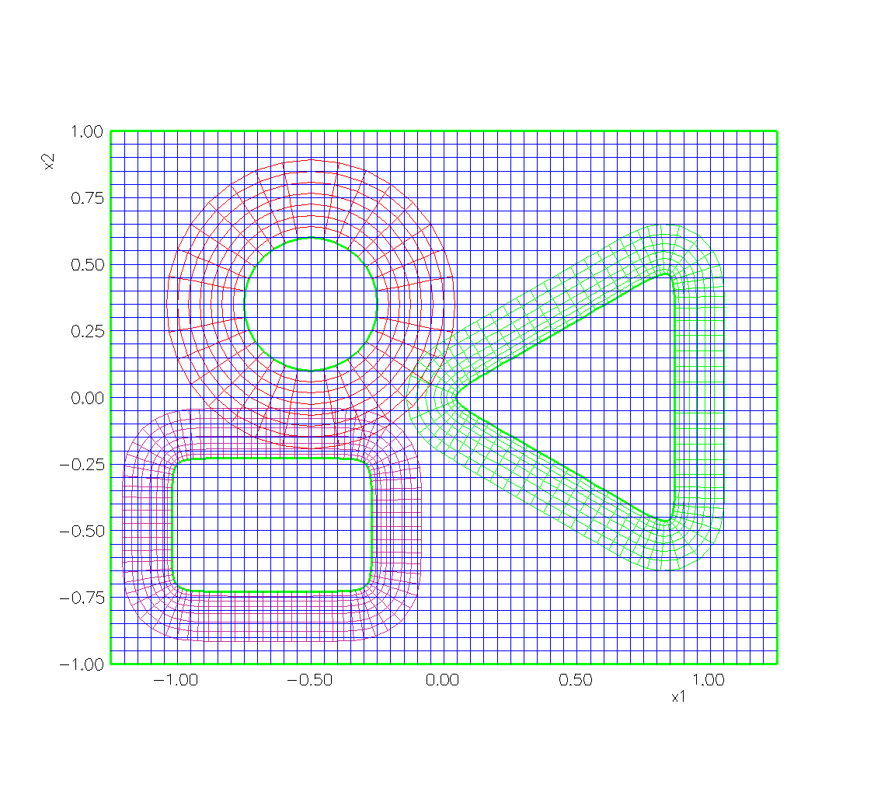
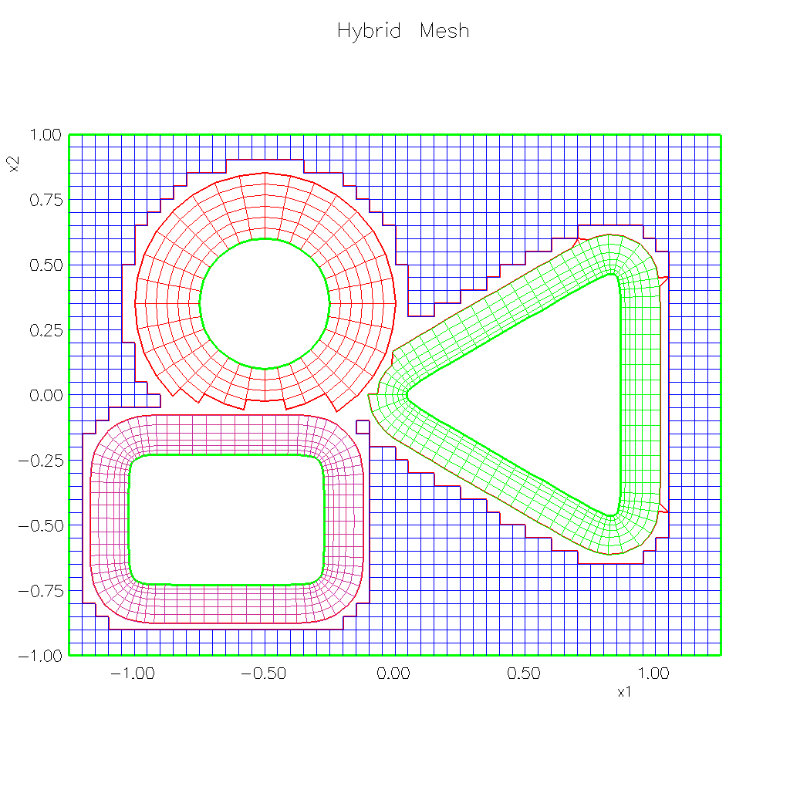
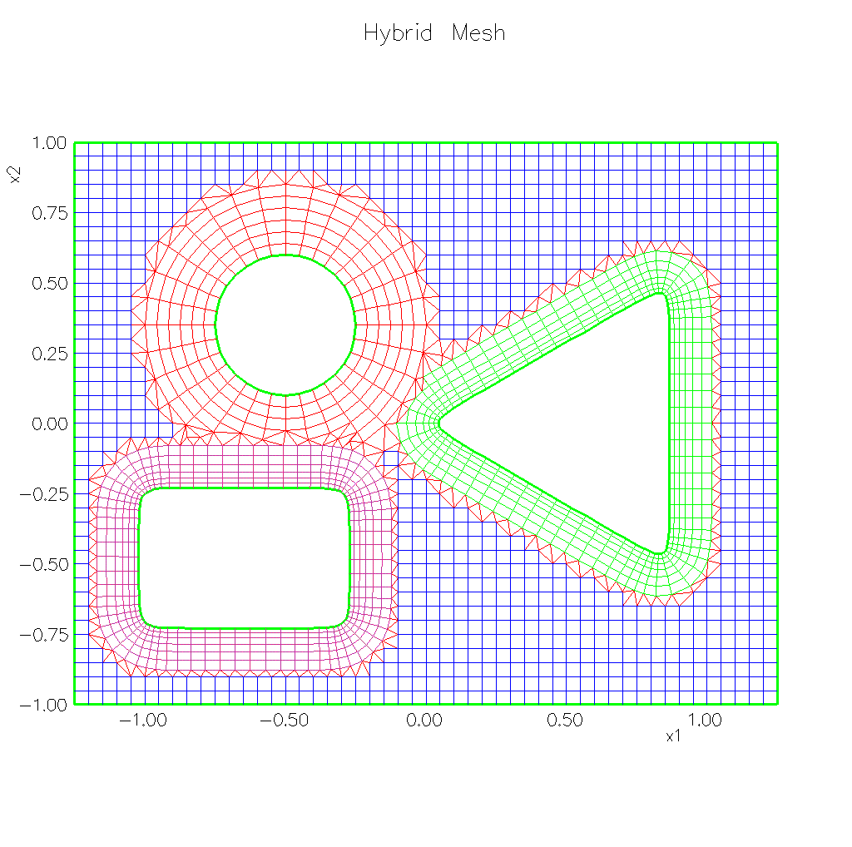
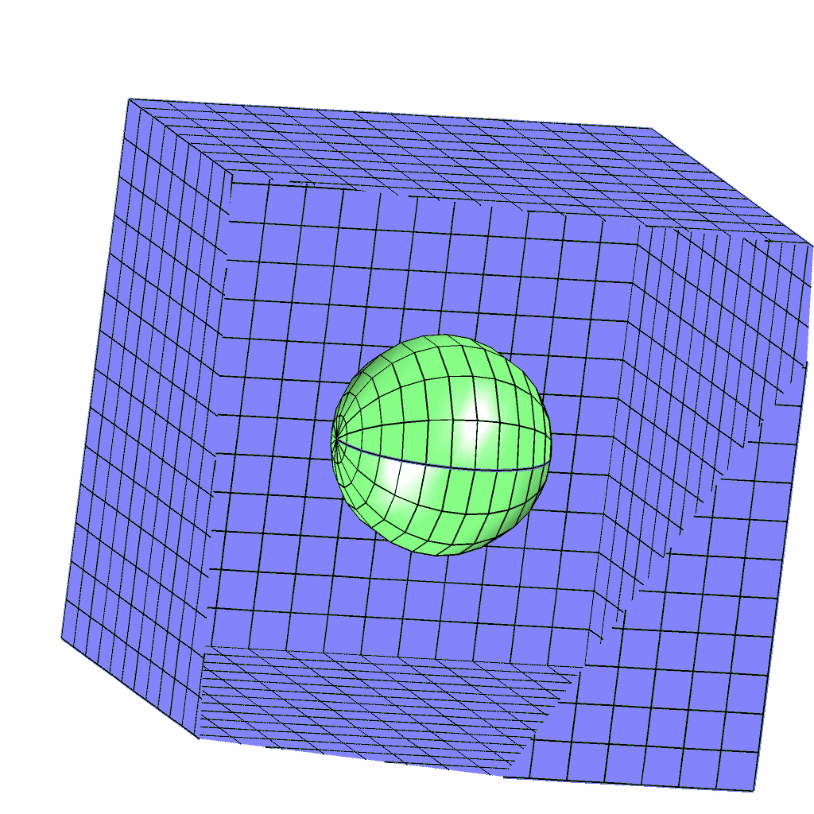
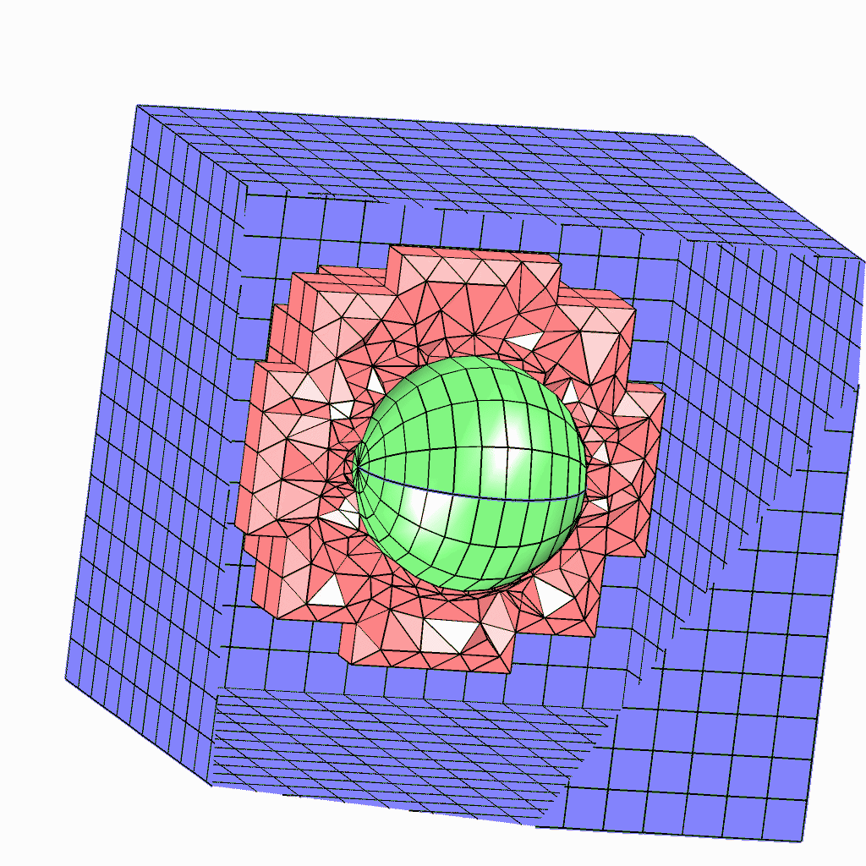
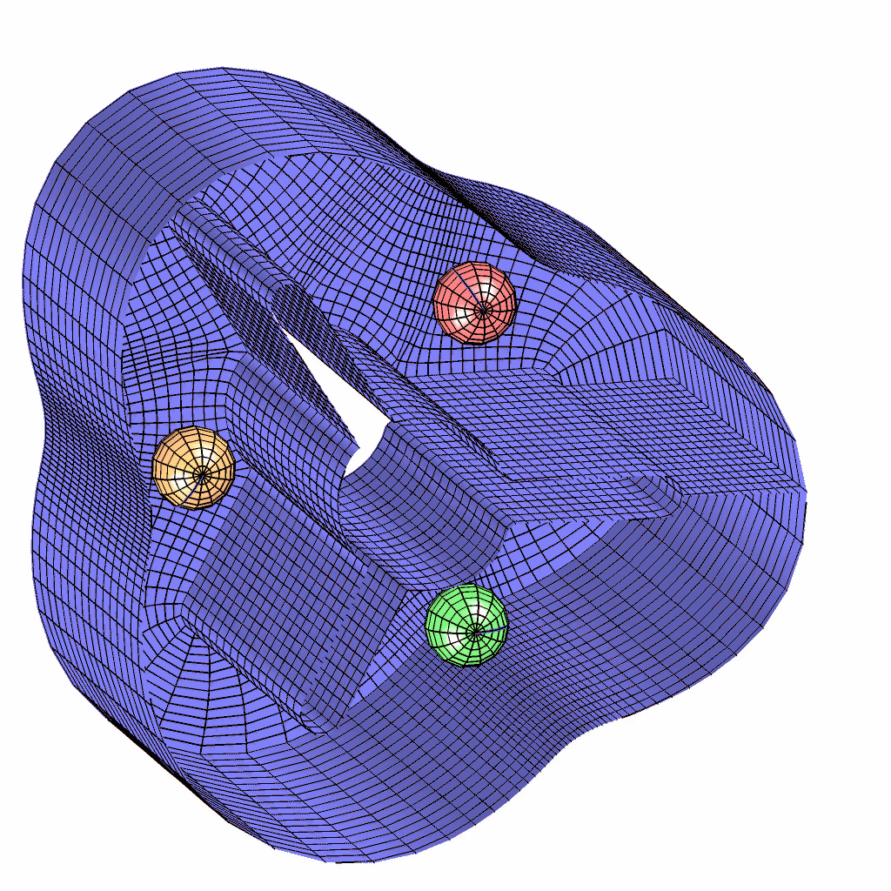
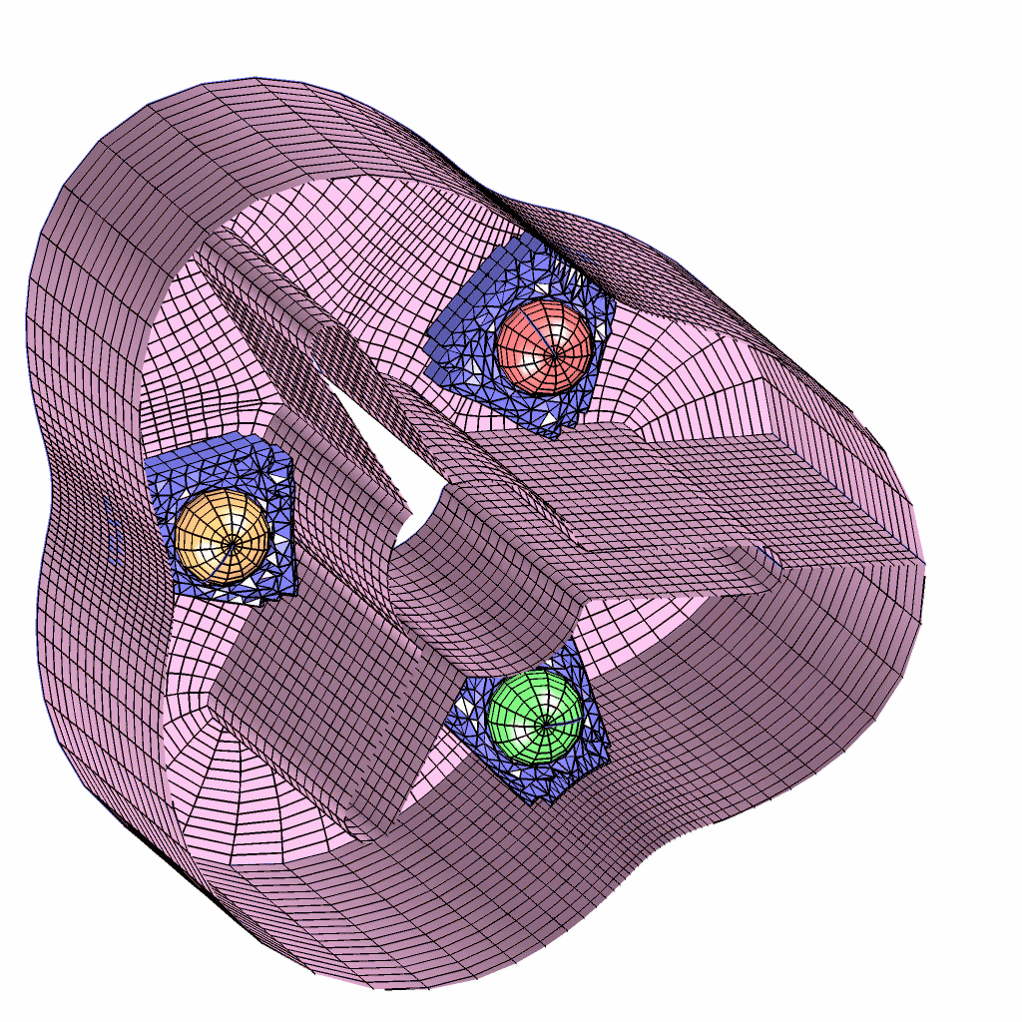
A new approach at LLNL stitches together high-quality structured grids with unstructured elements
Overture Stitching Algorithm (LLNL)
Start with a set of
component meshes...
… Stitch together
to form a hybrid mesh
… Cut holes...

Slide 10
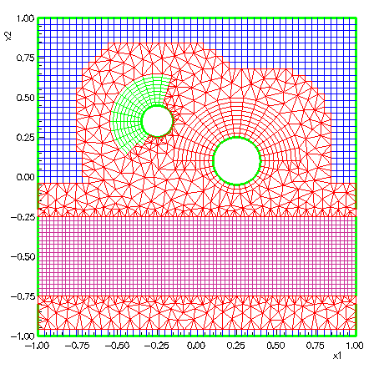
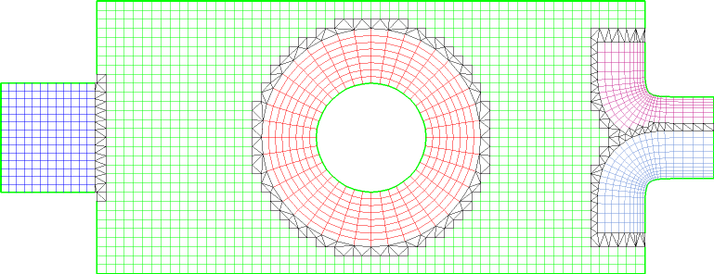
Unstructured mesh connection algorithm can also be used to represent complex geometry
Contact:
Kyle Chand, LLNL

Slide 11
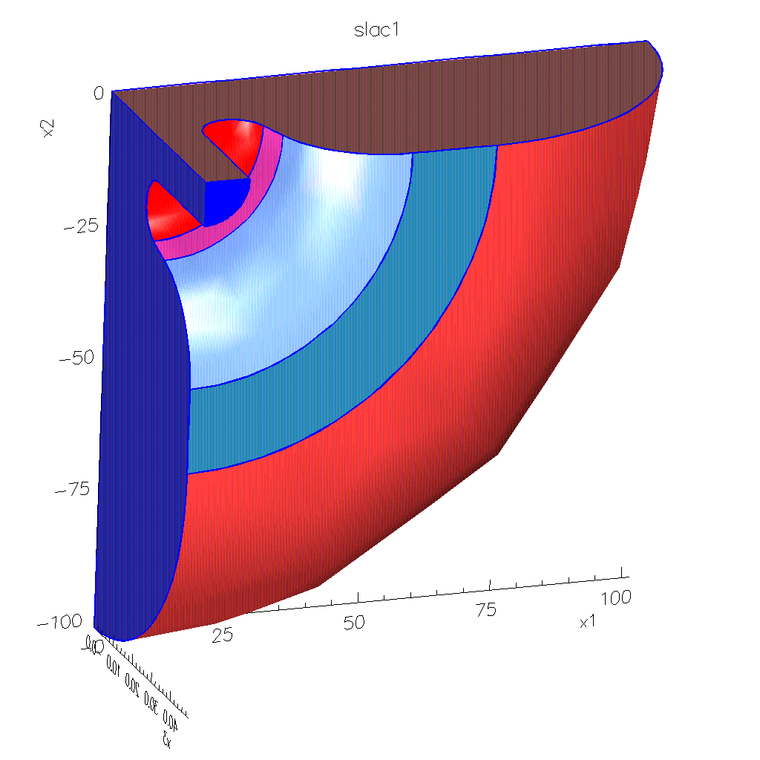
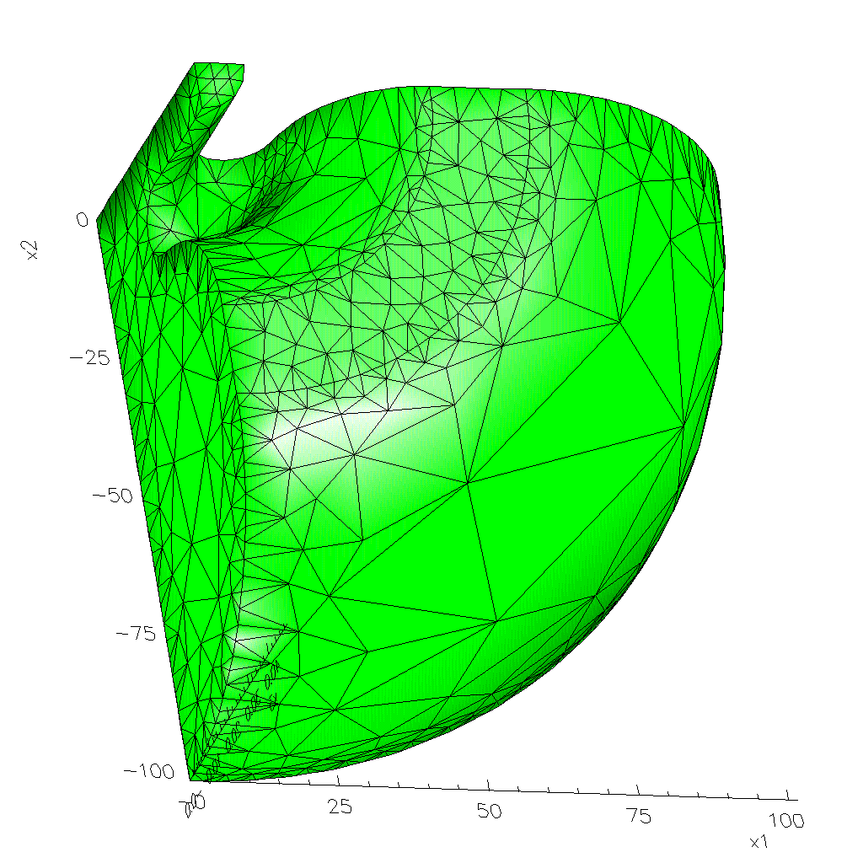
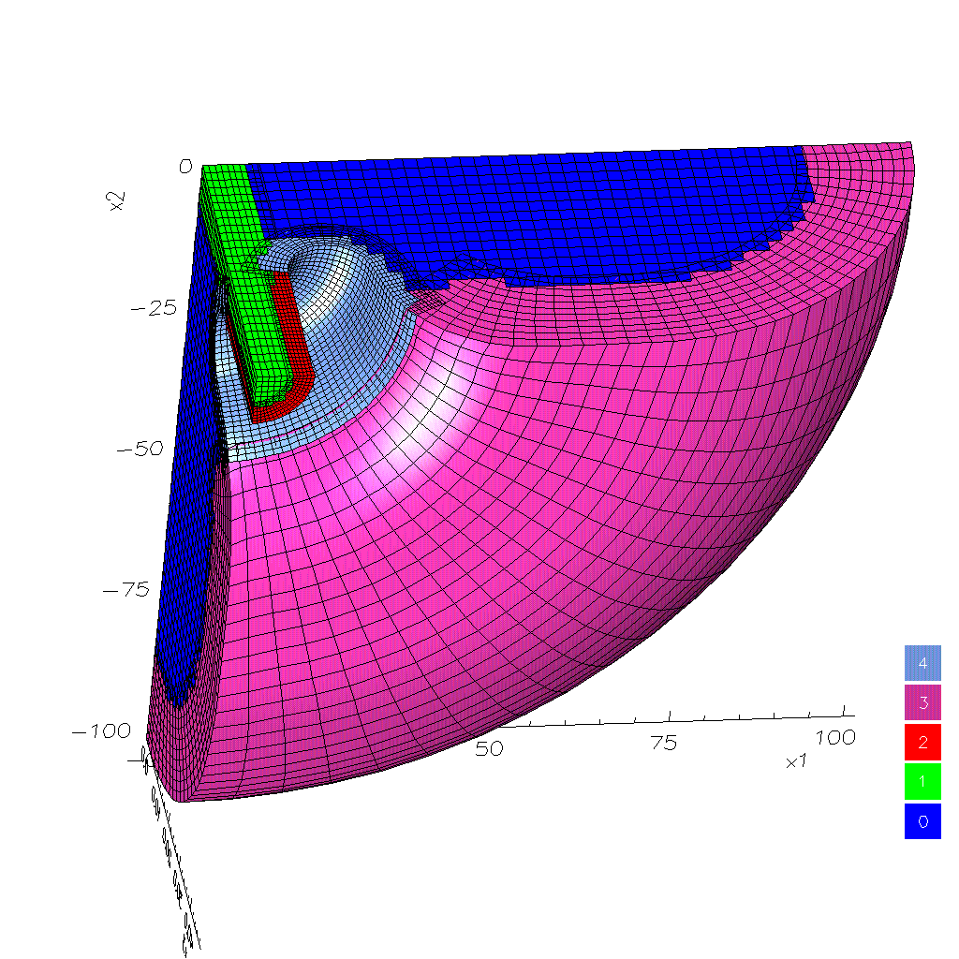
TRISPAL Cavity geometry meshed with Overture
CAD geometry
Reference triangulation
Surface Mesh
Volume Mesh

Slide 12
Final mesh is structured and rectangular along the beam axis, high quality body-fitted elsewhere
Contact:
Bill Henshaw, LLNL

Slide 13
MESQUITE will provide tools for mesh quality improvement
Objective: “Create software library of first-class mesh quality optimization tools for meshing and applications codes”
Goals: Automatic, Guaranteed Quality Improvement, Invertibility Guarantees, Comprehensive, Robust, Efficient, Portable
Components:
Node Movement & Swapping Techniques,
L2 & L-infinity Optimization Techniques,
Constrained & Unconstrained,
Smoothers,
Algebraic Quality Metrics (Shape, Size, Orientation),
Support All Element & Mesh Types,
Isotropic & Anisotropic Objective Functions
Contact:
Pat Knupp, SNLA

Slide 14
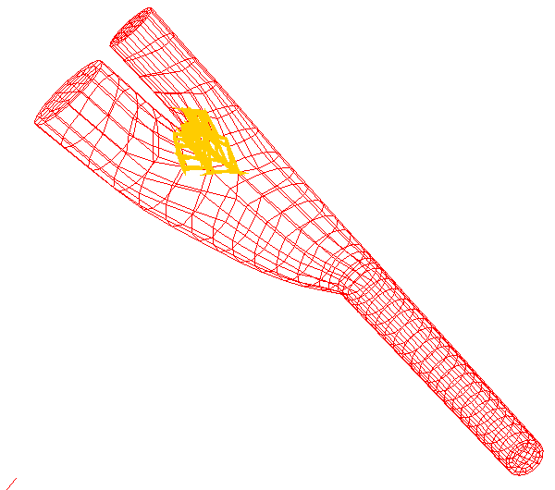
Improved mesh quality can reduce solver time
Method: Mesh Condition Number Optimization (MICS Research)
RESULTS:
17% reduction in number of solver iterations
20 minutes of smoothing saved 4 hours application run-time
Improved elliptic solvers can also
help: TSTT-TOPS interaction
Arteriovenous Graft Mesh
Convergence rates can also
depend on discretization methods
Paul Fisher/TSTT/ANL:
Turbulent flow simulation
Could not smooth unstructured
hexahedral effectively.

Slide 15
High-order discretization methods can deliver improved accuracy with fewer degrees of freedom
However, complexities of using high-order methods on adaptively evolving grids has hampered their widespread use
  Tedious low level dependence on grid infrastructure
  A source of subtle bugs during development
  Bottleneck to interoperability of applications with different discretization strategies
  Difficult to implement in general way while maintaining optimal performance
Result has been a use of sub-optimal strategies or lengthy implementation periods
TSTT will eliminate these barriers by developing a Discretization Library

Slide 16
The TSTT discretization library will leverage similar work by the Overture and Trellis projects
Mathematical operators will be implemented
  Start with +, -, *, /, interpolation, prologation
  Move to div, grad, curl, etc.
  Both strong and weak (variational) forms of operators when applicable
Many discretization strategies will be available
  Finite Difference, Finite Volume, Finite Element, Discontinuous Galerkin, Spectral Element, Partition of Unity
  Emphasize high-order and variable-order methods
  various boundary condition operators
The interface will be independent of the underlying mesh
  Utilizes the common low-level mesh interfaces
  All TSTT mesh tools will be available
Interface will be extensible, allowing user-defined operators and boundary conditions

Slide 17
TSTT Institutional Roles and Contacts for Accelerator Physics
LLNL David Brown dlb@llnl.gov 925 424 3557
Bill Henshaw henshaw@llnl.gov
Kyle Chand kylechand@llnl.gov
  Co-leads design and implementation of mesh hierarchy and component design. Contributes performance optimization tools to discretization library and is liaison to the accelerator design app
SNL Pat Knupp pknupp@sandia.gov 505 284 4565
Tim Tautges tjtautg@sandia.gov 608 263-8485
  Co-leads efforts on mesh quality optimization, contributes to interoperable meshing, domain decomposition and load balancing. Liaison with accelerator application.

Slide 18
TSTT Institutional Roles and Contacts
ANL Lori Freitag 630 252 7246 freitag@mcs.anl.gov
  Co-lead mesh quality and optimization, contribute to discretization library, interoperable meshing and terascale computing. Liaison with CCA, climate, reacting flows, and biology applications
BNL Jim Glimm 631 632 8355 glimm@bnl.gov
  Leads the application effort and is liaison for climate and accelerator design. Leads efforts to create interoperability between Frontier and TSTT mesh generators, contributes to discretization library
ORNL Ed D’Azevedo 865 576 7925 ed6@ornl.gov
  Contributes to mesh quality optimization, enhancement and interoperability. Contributes to climate and chemically reacting flow applications

Slide 19
TSTT Institutional Roles and Contacts
RPI Mark Shephard 518 276 6795 shephard@scorec.rpi.edu
  Co-leads the development of meshing and discretization technologies for mesh hierarchy and discretization libraries. Contributes to the load balancing work and serves as liaison to the fusion application.
PNNL Harold Trease 509 375 2602 het@pnl.gov
  Contributes to interoperable meshing and terascale computing areas, liaison for the biology applications.
SUNY SB Jim Glimm 631 632 8355 glimm@bnl.gov
  Leads the interoperability of FronTier with meshing technologies and development of high-order versions. Liaison in spray simulations and oil reservoir applications.

Slide 20
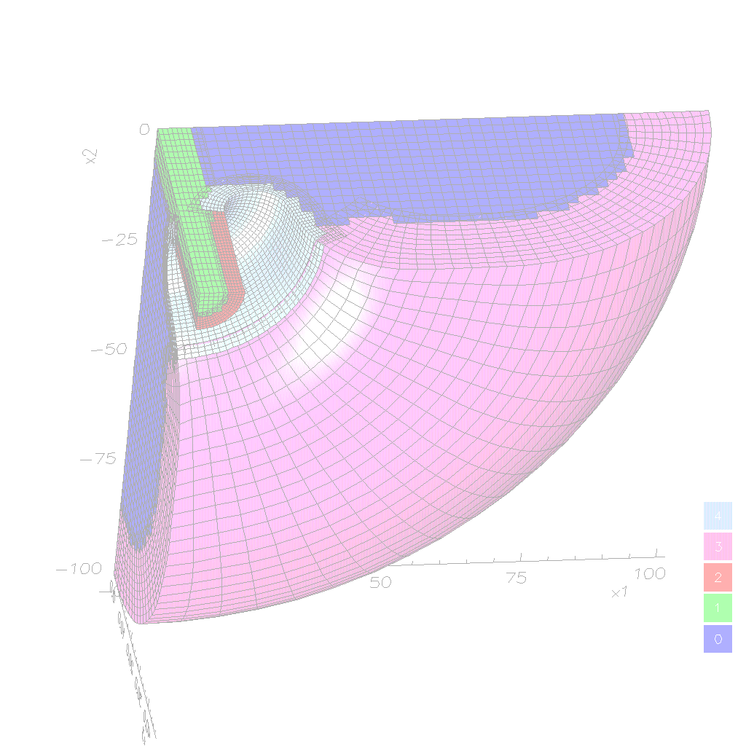
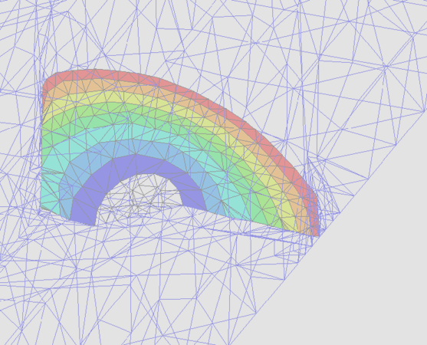
We look forward to a productive partnership between TSTT and Accelerator SciDAC Initiative
Support for accelerator technology geometry and discretization needs
TSTT interaction with accelerator SciDAC will help develop better meshing and discretization software components for all DOE Office of Science applications
TSTT

Slide 21
We look forward to a productive partnership between TSTT and Accelerator SciDAC Initiative
Support for accelerator technology geometry and discretization needs
TSTT interaction with accelerator SciDAC will help develop better meshing and discretization software components for all DOE Office of Science applications
TSTT

