Slide 1

Source Control, Git, GitHub
.net

Slide 2
Version Control is a component of software configuration management. It is the management of all changes to documents, computer programs, large web sites, and other collections of information, over time.
https://en.wikipedia.org/wiki/Version_control

Slide 3
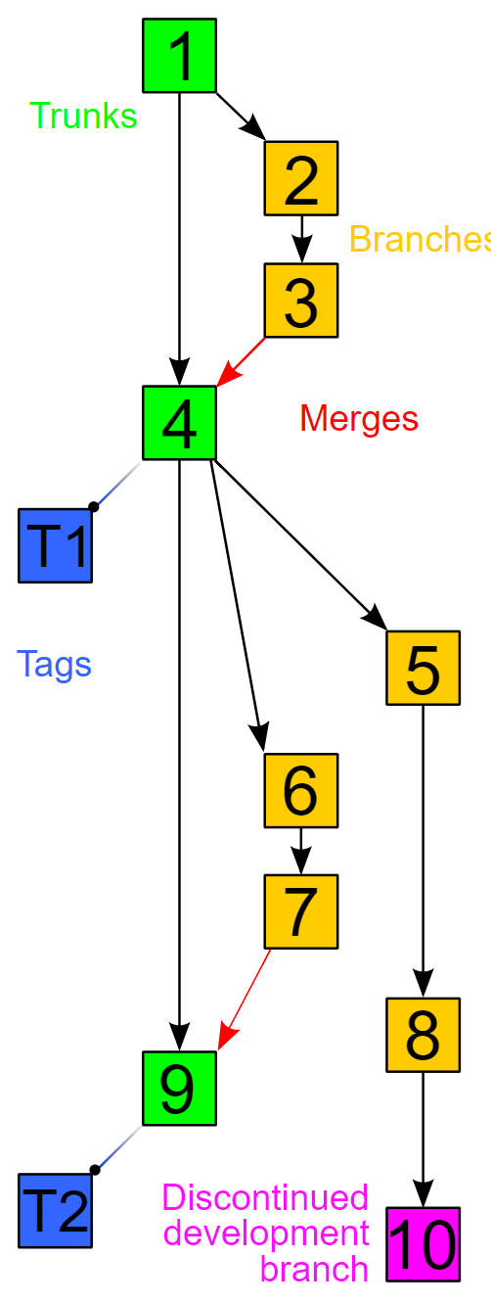
VCS (Version Control Management) https://en.wikipedia.org/wiki/Version_control
Version Control Systems (VCS) have seen great improvements over the past few decades.
VCSs are sometimes known as:
SCM (Source Code Management) tools or
RCS (Revision Control System).
One of the most popular VCS tools used today is called Git.

Slide 4
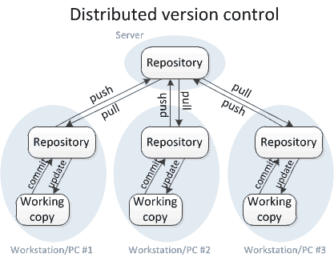
DVCS (Distributed VCS) https://www.teamstudio.com/blog/distributed-vs-centralized-version-control-systems-for-lotus-notes https://homes.cs.washington.edu/~mernst/advice/version-control.html
Work on a peer-to-peer model.
The code base is distributed amongst the individual developers’ computers.
The entire history of the code is mirrored on each system.
There is still a master copy of the code base kept on a client machine rather than a server.
There are no locking of parts of the code;
Developers make changes in their local copy. When they’re ready to integrate their changes into the main branch, they issue a request to the owner of the remote main branch to merge their changes into the remote main branch.

Slide 5
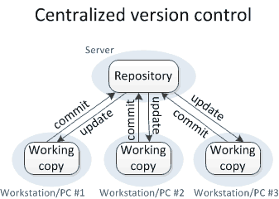
CVCS (Centralized Version Control System) https://www.teamstudio.com/blog/distributed-vs-centralized-version-control-systems-for-lotus-notes https://homes.cs.washington.edu/~mernst/advice/version-control.html
A Centralized Version Control system works on a client-server model. There is a single, (centralized) master copy of the code base, and pieces of the code that are being worked on are typically locked (“checked out”), so that only one developer is allowed to work on that part of the code at any one time.
Access to the code base and locking is controlled by the server. When the Software Developer checks their code back in, the lock is released so it’s available for others to check out.

Slide 6


Git - A History https://git-scm.com/ https://git-scm.com/book/en/v2/Getting-Started-A-Short-History-of-Git
Git officially began in 2005 but is the result of 15 years of experience with another VCM application. Linus Torvalds (creator of Linux) was instrumental in creating a new VCM tool that was distributed, fast and simple, supported branching, and could handle large projects. Out of those goals came Git.
Git is a free, open-source, distributed Version Control System designed to handle small and large projects with speed and efficiency.
Many different VCS websites leverage Git. The primary and most popular is www.github.com. Most open-source software is hosted, for free, on GitHub.

Slide 7
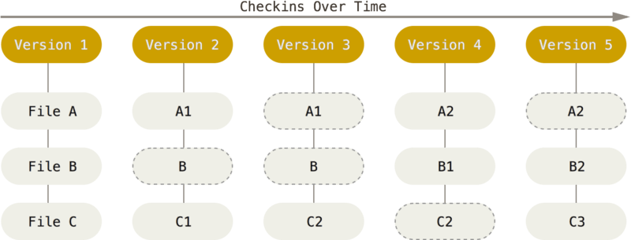
How Git works https://git-scm.com/book/en/v2/Getting-Started-What-is-Git%3F
Git thinks of its data like a series of snapshots of a filesystem. Every time you commit (save the state of your project), Git snapshots (documents) what your files look like and stores a reference to that snapshot. Only changed files are re-snapshotted.
Most operations in Git need only local files and resources to operate.
For example, Git doesn’t need to go out to the server to get the history of a file and display it. All that data is kept locally.
Git can look up the state of a file a month ago and do a local difference calculation to show the differences.

Slide 8
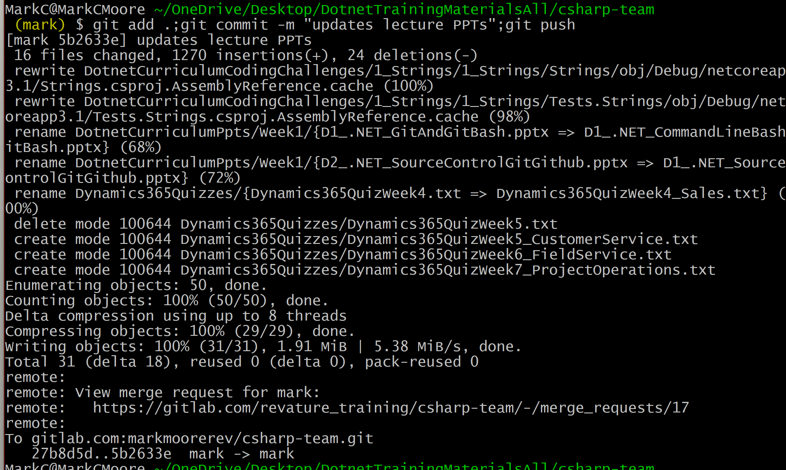
How Git works https://git-scm.com/book/en/v2/Getting-Started-What-is-Git%3F
Every time you commit, each changed file is checksummed before it is stored. That moment in its individual history is then referred to by that 40-character checksum hash.
In the future, that file can be reverted to that point in its history using the assigned hash.
Git stores everything in its own database by the hash value. This functionality is built into Git at the lowest levels, so you’ll never get file corruption without Git being able to detect it.
Hash!

Slide 9
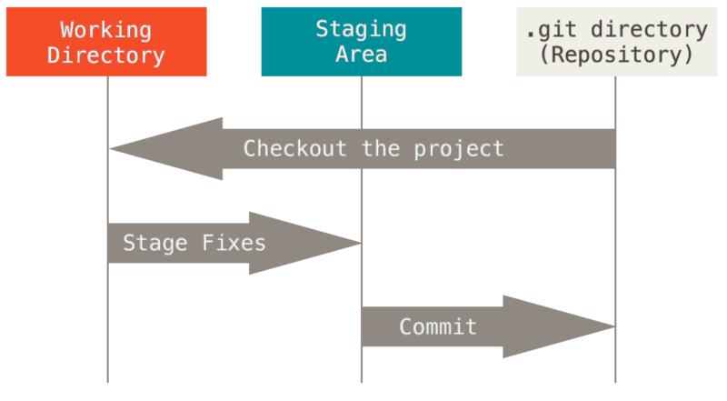
How Git works https://git-scm.com/book/en/v2/Getting-Started-What-is-Git%3F
The Git lifecycle has three main stages that a file could be in:
Modified - you have changed a file but have not committed it yet.
Staged - you have marked a modified file in its current version to go into your next commit.
Committed – the data is safely stored in your local database.
A Git project has three main sections:
working tree - a single checkout of one version of the project.
staging area - a file contained in your Git directory that stores what will go into your next commit.
Git directory - where Git stores the metadata and object database for your project.
The three Git stages and three Git project sections correlate.

Slide 10
Git and bash Basic Commands https://git-scm.com/book/en/v2/Getting-Started-First-Time-Git-Setup
Git command | Purpose
git clone <url> | Clone a remote repo.
git add . | Add changes to the git tracking system.
git commit –m “msg” | Move a branch into staging status and get a commit hash.
git push | Push code to the remote version of this branch
git merge <src> <dest> | Merge one branch into another branch
git
Bash Command | Purpose
echo | Print to console
cat | Print to a file
nano
grep
mkdir | Create a new directory
touch | Create or open a file.
cd | Move into a folder
ls | List what’s in this folder.
which
find
pwd | Print the path to the current working directory

Slide 11


No-Conflicts Github LifeCycle
Open Source Repository
Upstream version of local branch
Make a Pull Request
cloud
Feature Branch
(with committed changes)
local
git clone <repoUrl>
- git pull origin main
- git push
git checkout –b <featureBranchName>
git commit –m “message”
Local Copy
Main Branch
Feature Branch
(copy of Main)
Feature Branch
(with “untracked changes”)
Feature Branch
(with “tracked changes”)
Add code.
git add .

