Slide 1

Box Model
.net

Slide 2
A browser's rendering engine represents each element as a rectangular box according to the standard CSS basic box model. CSS determines the size, position, and properties of these boxes.
https://developer.mozilla.org/en-US/docs/Web/CSS/CSS_Box_Model/Introduction_to_the_CSS_box_model

Slide 3
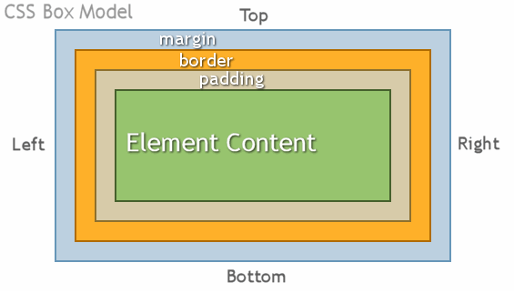
CSS - Box Model https://www.w3schools.com/css/css_boxmodel.asp
The CSS ‘Box Model’ is the way that all HTML elements are defined. The Box Model is made up of 4 different concentric boxes.
Content - this is the actual text or image
Padding - space between content and border
Border - space between the padding and the margin. The border width, style, and color properties may be set
Margin – the invisible space between the end of one element and the start of another
Remember:
C.P.B.M. => Create Pretty Box Models!

Slide 4
Box Model elements.
Box Element | Additional Information
Content | This is the content that the user sees. The actual content of an element can be changed based on factors like hover, etc
Border | The border doesn’t exist if there’s no style and size for it.
Margin | Creates space around elements, outside of any defined borders. Cannot be colored and is the only element that can have a negative value.
Padding | Padding is used to create space around an element's content, inside of any defined borders.

Slide 5
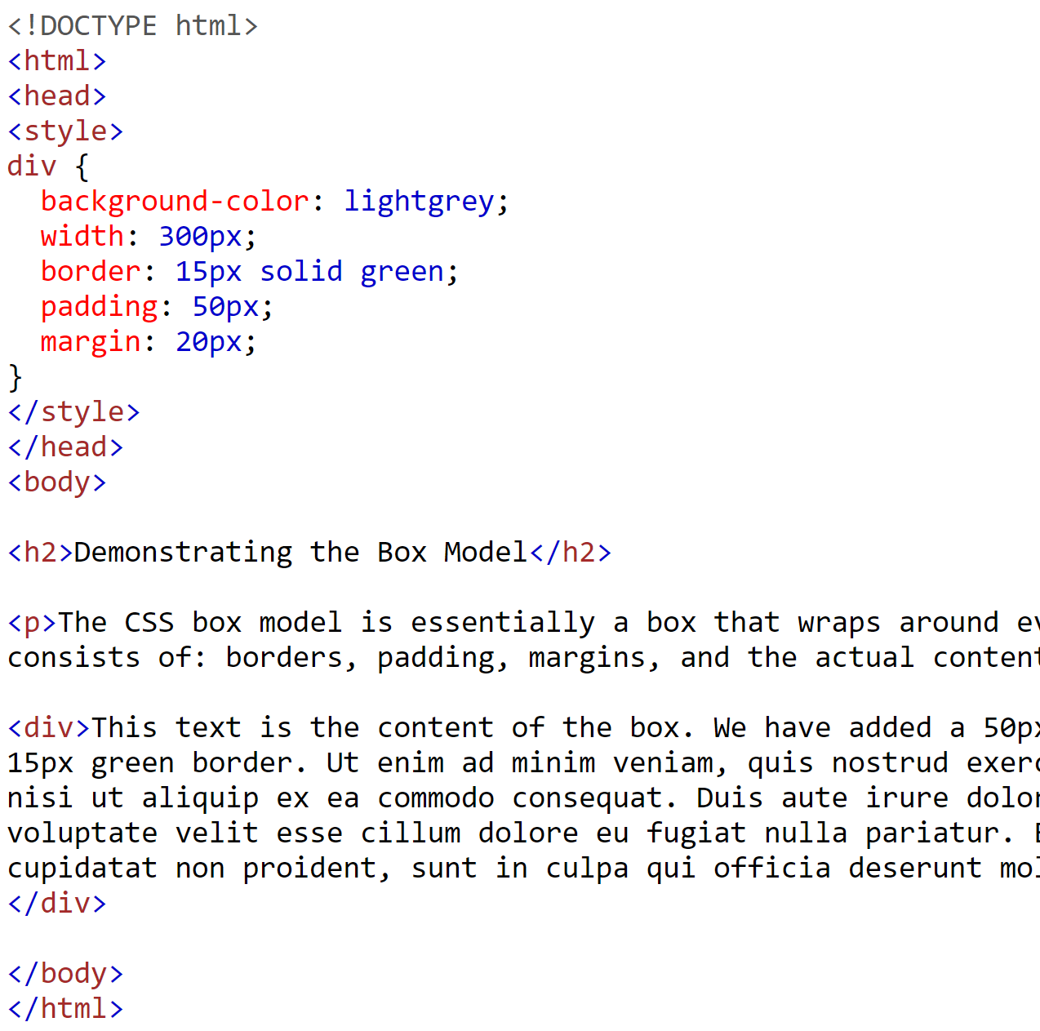
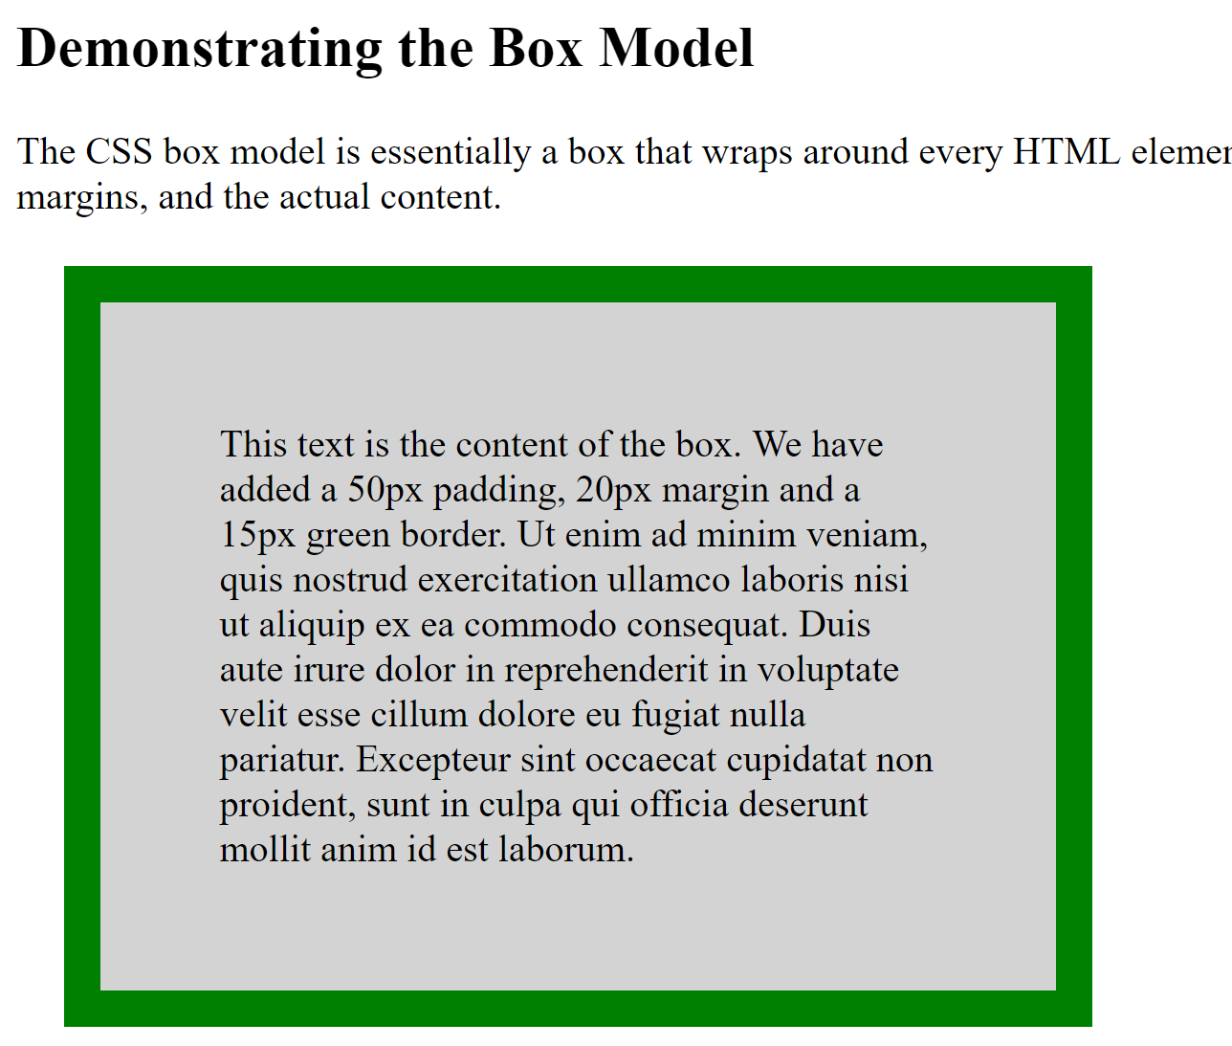
CSS - Box Model Example https://www.w3schools.com/css/css_boxmodel.asp

Slide 6
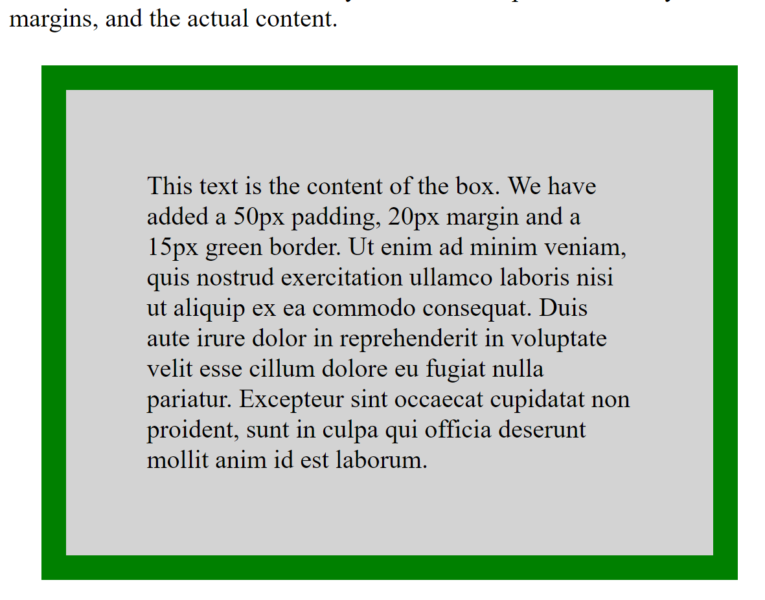
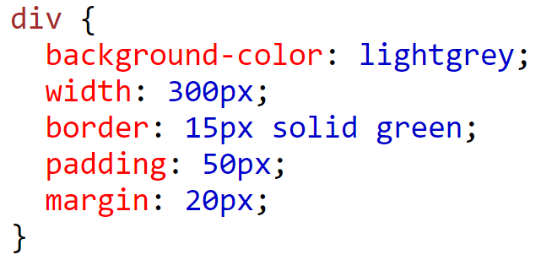
CSS Box Model – Example https://developer.mozilla.org/en-US/docs/Web/CSS/Shorthand_properties
In order to correctly set the width and height of an element, you must know how the box model works.
margin
border
padding
width
300px (width)
+ 30px (left + right border)
+ 100px (left + right padding)
+ 40px (left + right margin)
= 470px total element width
Margin is the only part if the Box Model that can display a negative value.

Slide 7
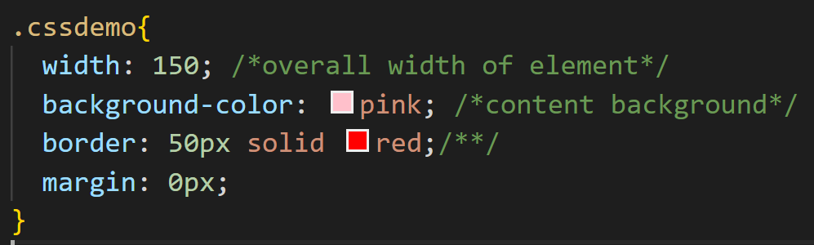
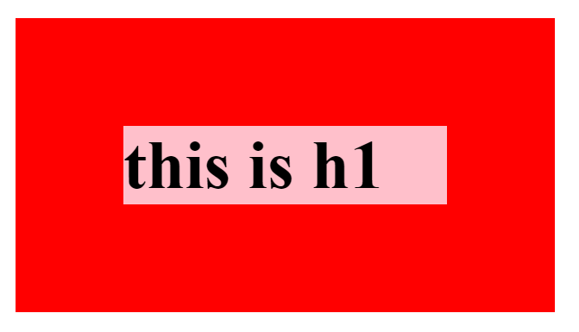
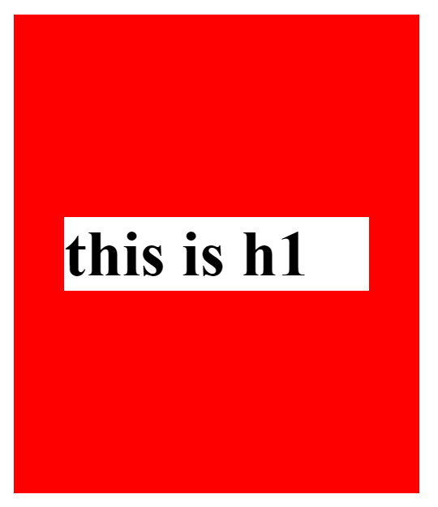
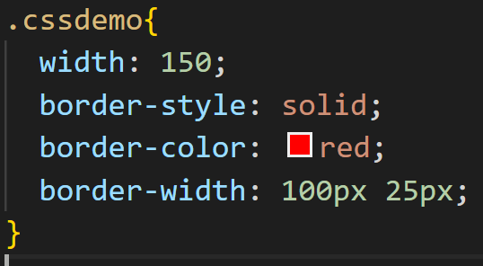
CSS Box Model – Sizing Explained https://developer.mozilla.org/en-US/docs/Web/CSS/Shorthand_properties
In CSS, the sides of an element can be sized and styled individually.
If there is only one value, that value applies to all sides.
If there are two values, the Top and Bottom margins are set to the first value and the Right and Left margins are set to the second.

Slide 8
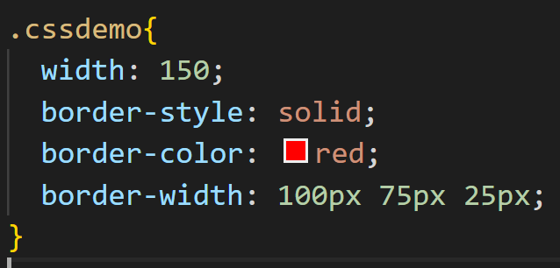
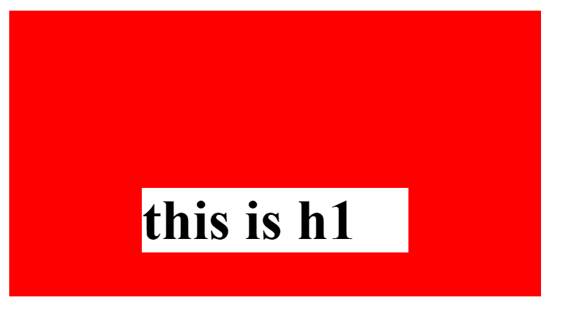
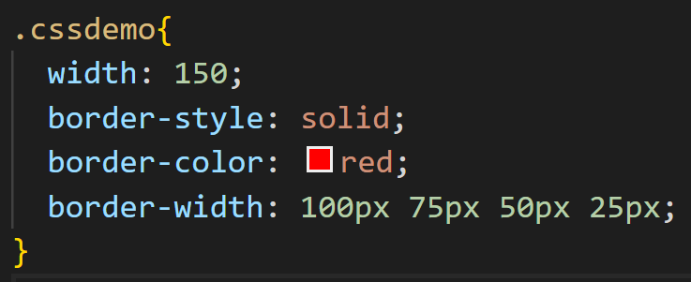
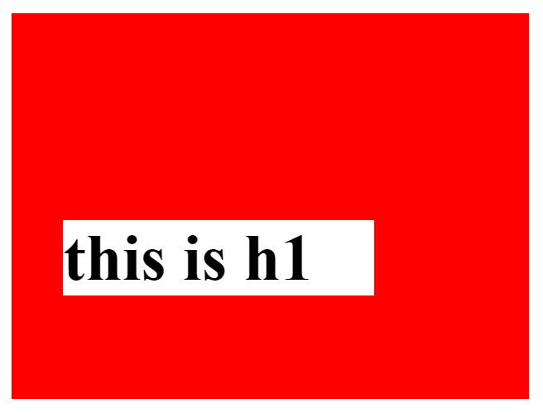
CSS Box Model – Sizing Explained https://developer.mozilla.org/en-US/docs/Web/CSS/Shorthand_properties
If there are three values, the first value sets Top, the second value sets the Left and Right, and the third sets the Bottom.
If there are four values, they apply to the Top, Right, Bottom, and Left, respectively.

