Slide 1

HTTP DNS and Content Negotiation
.NET

Slide 2
The Domain Name System (DNS) is the system that converts a website domain name (hostname) into numerical values (IP address) so they can be found and loaded into your web browser.
https://www.pcmag.com/how-to/what-is-dns-how-it-works-domain-name-system

Slide 3
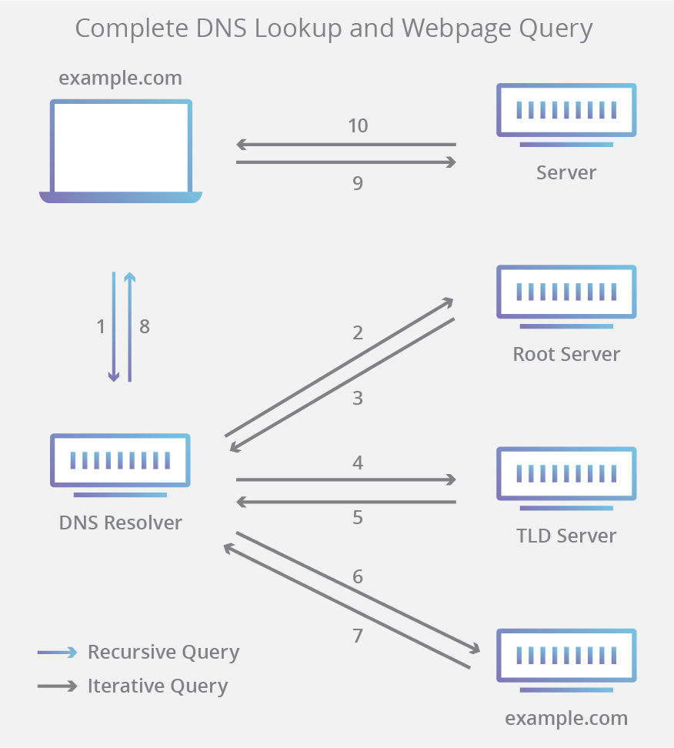
DNS (Domain Name System) https://en.wikipedia.org/wiki/Domain_Name_System https://docs.microsoft.com/en-us/windows-server/networking/dns/dns-top?source=docs
Domain Name System (DNS) is an industry-standard protocol that makes up TCP/IP.
Together the DNS Client and DNS Server provide computer name-to-IP address mapping name resolution services to computers and users.
The DNS translates domain names (www.revature.com) to numerical IP addresses (255.255.255) for locating and identifying computer services and devices over the web.
The DNS also associates identifying data with the unique domain names assigned to each connected entity.

Slide 4
DNS: A History https://www.cloudns.net/blog/dns-history-creation-first/
The technology progress was going so fast, but people were starting to have a severe problem with the bookkeeping. There was no one united network, but rather a system of networks. The need of global solution was strong and here comes the DNS!

Slide 5
Domain Name System https://www.cloudflare.com/learning/dns/what-is-dns/
Domain Name System (DNS) is one of the industry-standard suite of protocols that comprise TCP/IP, and together the DNS Client and DNS Server provide computer name-to-IP address mapping name resolution services to computers and users.
There are 4 DNS servers used to look up a domain name.
Name | Purpose | Analogy
DNS Recursor | A server that receives queries from client machines through a web browser. It then makes additional requests to satisfy the client’s DNS query. | A librarian that shows you the card catalog of books.
Root Nameserver | The first step in translating human-readable hostnames into IP addresses. It serves as a reference to other more specific locations. | The card catalog.
TLD Nameserver | The Top-Level Domain server hosts the last portion of a hostname. For example, in Revature.com, the TLD server is “com”). | A specific shelf of books in the library.
Authoritative Nameserver | The last stop in the nameserver query. If it has access to the requested record, it will return the IP address for the requested hostname back to the DNS Recursor (the librarian) that made the initial request. | The number on the book spine.

Slide 6
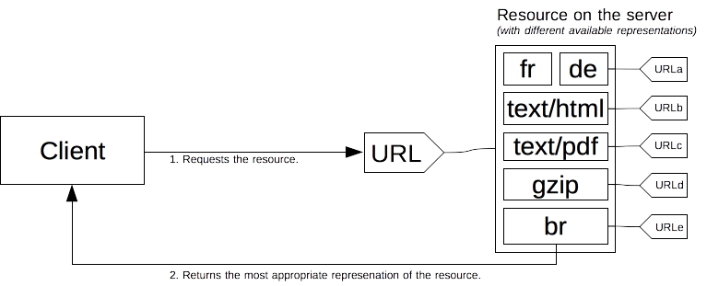
Content negotiation https://developer.mozilla.org/en-US/docs/Web/HTTP/Content_negotiation
In HTTP, content negotiation is the mechanism that is used for serving different representations of a resource at the same URI so that the user agent can specify which is best suited for the user (which language, which image format, or which content encoding).
The client requests a resource using its URL. The server uses this URL to choose one of the variants (representations) it provides to return. The overall resource and each representation have a specific URL. How a specific representation is chosen when the resource is called is determined by content negotiation.

Slide 7
Types of Content Negotiation https://developer.mozilla.org/en-US/docs/Web/HTTP/Content_negotiation
HTTP headers provide “Proactive” content negotiation. This is the standard method, is server-driven, and has many types.
The browser sends several HTTP headers along with the URL with every request. Headers describe the preferences of the user. The server chooses the best content to serve to the client. If it cannot provide a suitable resource, as a fallback it might respond with 406 (Not Acceptable) or 415 (Unsupported Media Type) and set headers for the types of media that it supports.
Header | Purpose
Accept | Negotiation by format. A comma-separated list of MIME types the client can process.
Accept-Charset | Negotiation by character encoding. Tells what char characters are supported by the browser.
Accept-Language | Negotiation by natural language. Indicates users’ language preference.
Accept-Encoding | Negotiation by compression. Defines the acceptable content-encoding compressions. This is for optimization. Ex. br, gzip;q=0.8

Slide 8
Drawbacks of Content Negotiation https://wiki.whatwg.org/wiki/Why_not_conneg https://developer.mozilla.org/en-US/docs/Web/HTTP/Content_negotiation
Server-driven content negotiation is the most common way to agree on a specific representation of a resource, but it has several drawbacks:
It doesn’t scale well. With more specificity more and more headers must be sent with every request.
The server doesn't have total knowledge of the browser. Even with the Client Hints extension, it has an incomplete knowledge of the capabilities of the browser. Unlike Reactive Content Negotiation where the client makes the choice, the server choice is always somewhat arbitrary.
The information sent by the client is quite verbose (HTTP/2 header compression mitigates this problem) and a privacy risk (HTTP fingerprinting)
As several representations of a given resource are sent, shared caches are less efficient and server implementations are more complex.
HTTP-based negotiation in general is worse than letting the browser choose from alternative URLs. HTTP-based codec negotiation solution is often worse than the actual browser-side codec negotiation solution.

Slide 9
Additional Resources
https://developer.mozilla.org/en-US/docs/Web/HTTP/Overview#HTTP_Messages
https://docs.microsoft.com/en-us/azure/architecture/best-practices/api-design

