Slide 1

HTTP Verbs
.NET

Slide 2
HTTP defines a set of request methods to indicate the desired action to be performed for a given resource. Although they can also be nouns, these request methods are sometimes referred to as HTTP verbs.
https://developer.mozilla.org/en-US/docs/Web/HTTP/Methods

Slide 3
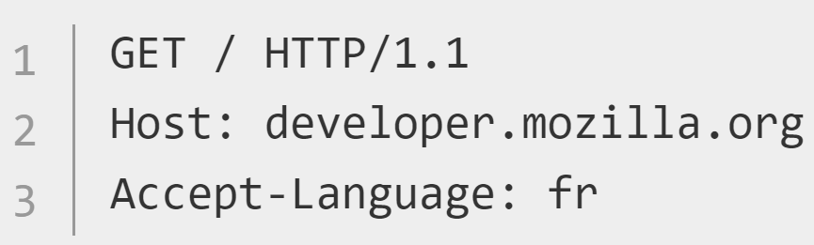
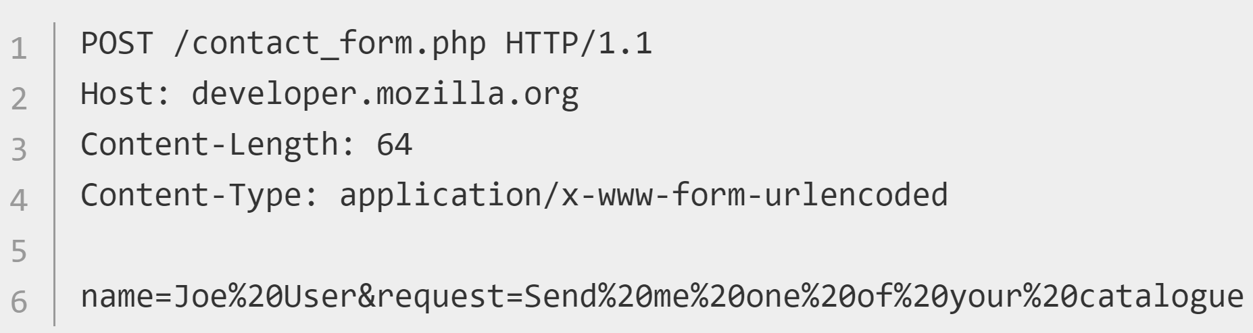
Request Methods (verbs) https://developer.mozilla.org/en-US/docs/Web/HTTP/Methods https://developer.mozilla.org/en-US/docs/Web/HTTP/Session
Request methods (HTTP verbs) indicate the desired action to be performed on a resource. HTTP verbs are GET, POST, PUT, DELETE, TRACE, HEAD, CONNECT, and OPTIONS.
The POST method sends data to a server. POST is used mainly for HTML Forms.
The GET method requests/retrieves data.

Slide 4
Request Methods (verbs) https://developer.mozilla.org/en-US/docs/Web/HTTP/Methods
HTTP Verb | Description
*GET | Requests the specified resource. GET should only retrieve data.
HEAD | Just like a GET request, but without the response body.
*POST | Used to submit an entity to the specified resource.
*PUT | Replaces all current representations of the target resource with the payload.
*DELETE | Deletes the specified resource.
CONNECT | Establishes a tunnel to the server identified by the target resource.
OPTIONS | Describes the communication options for the target resource.
TRACE | Performs a message loop-back test along the path to the target resource.
PATCH | Applies partial modifications to a resource.
*most common

Slide 5
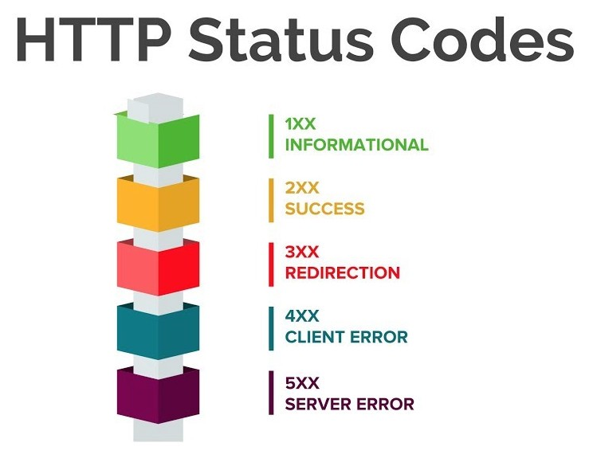
Response Status Codes https://developer.mozilla.org/en-US/docs/Web/HTTP/Session https://developer.mozilla.org/en-US/docs/Web/HTTP/Status https://tools.ietf.org/html/rfc2616#section-10
HTTP response status codes give the result of an HTTP request. Responses are grouped in five general categories:
Informational responses (100–199),
Successful responses (200–299),
Redirects (300–399),
Client errors (400–499),
and Server errors (500–599).
Cheat Sheet

Slide 6
Common Response Status Codes https://www.smartlabsoftware.com/ref/http-status-codes.htm https://developer.mozilla.org/en-US/docs/Web/HTTP/Status
Code number | Code Meaning
200 OK, 201 | The request succeeded. Request has been fulfilled resulting in new resource(s) created.
300 Multiple Choices | The requested resource has different choices and cannot be resolved into one.
301 Moved Permanently | The requested resource has been assigned a new permanent URI
304 Not Modified | Client performed a conditional GET request. Access is allowed. The document is unmodified
307 Temporary Redirect | The requested resource resides temporarily under a different URI.
400 Bad Request | The request could not be understood by the server due to malformed syntax.
401 Unauthorized | The request requires user authentication.
403 Forbidden | The server understood the request but is refusing to fulfill it.
404 Not Found | The server has not found anything matching the Request-URI.
410 Gone | The requested resource is no longer available at the server and no forwarding address is known.
500 Internal Server Error | The server encountered an unexpected condition which prevented it from fulfilling the request.
501 Not Implemented | The server does not support the functionality required to fulfill the request.
503 Service Unavailable | Your web server is unable to handle your HTTP request at the time.
550 Permission Denied | Your account does not have permission to perform the action you are attempting.
Some of the most useful Status Codes.

Slide 7

‘Safe’ and ‘Idempotent’ https://developer.mozilla.org/en-US/docs/Glossary/safe https://developer.mozilla.org/en-US/docs/Glossary/Idempotent
Safe – An HTTP method that doesn't alter the state of the resource, meaning it leads to a read-only operation. GET, HEAD, and OPTIONS are safe. All safe methods are also idempotent.
Idempotent – An identical request can be made once or several times in a row with the same effect while leaving the server in the same state. Implemented correctly, the GET, HEAD, PUT, and DELETE method are idempotent, but not the POST method. Not all idempotent methods are safe. For example, PUT and DELETE are both idempotent but unsafe.

Slide 8
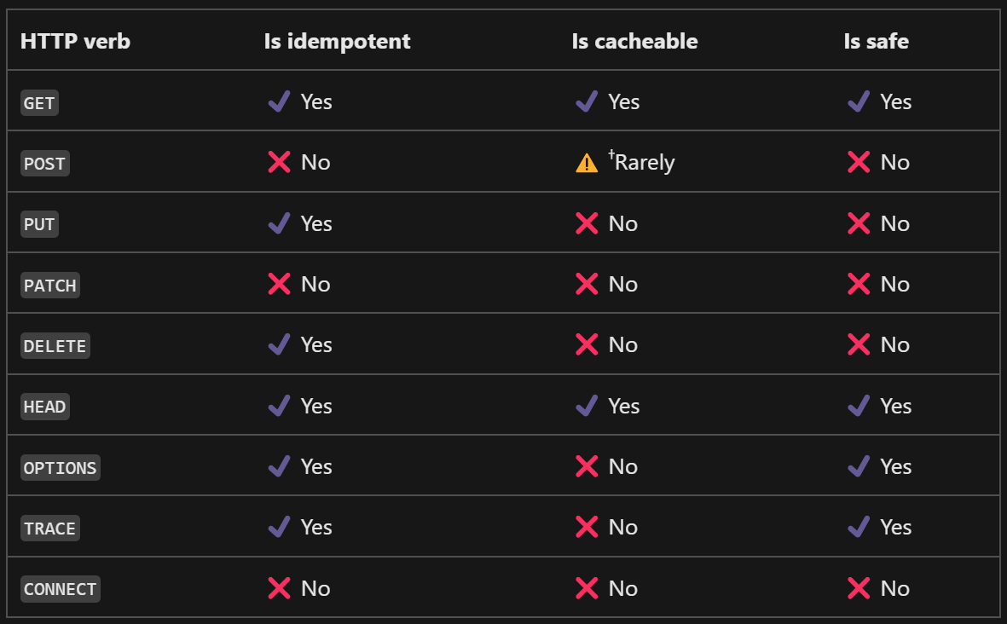
Is my request Idempotent? https://learn.microsoft.com/en-us/dotnet/fundamentals/networking/http/http-overview#:~:text=methods%20are%20differentiated https://learn.microsoft.com/en-us/dotnet/fundamentals/networking/http/http-overview#:~:text=the%20request
Safe – The request doesn't alter the state of the resource, meaning it leads to a read-only operation. All safe methods are idempotent.
Idempotent – An identical request can be made once or several times in a row with the same overall effect.

Slide 9
Additional Resources
https://developer.mozilla.org/en-US/docs/Web/HTTP/Overview#HTTP_Messages
https://docs.microsoft.com/en-us/azure/architecture/best-practices/api-design

