Slide 1

Azure DevOps Code Analysis
.NET

Slide 2
DevOps technologies, combined with people and processes, enable teams to implement CI/CD and continually provide value to customers.
https://azure.microsoft.com/en-us/solutions/devops/

Slide 3
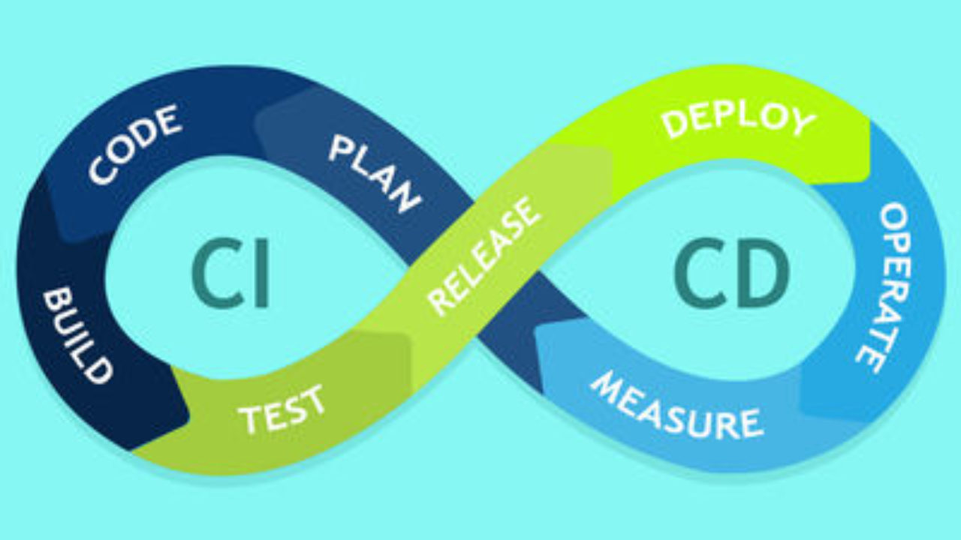
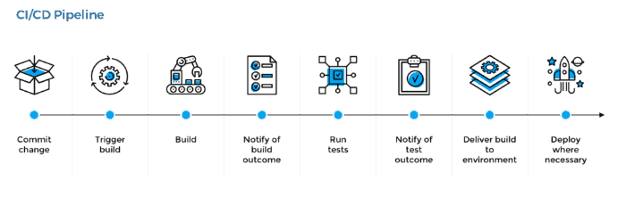
CI/CD and Continuous Testing (CT) https://docs.microsoft.com/en-us/azure/devops/pipelines/overview?view=azure-devops-2019
Continuous Integration (CI) is the practice of automating the merging and testing of code. Implementing CI helps catch bugs early, which makes them less expensive to fix. Automated tests execute as part of the CI process.
Continuous Delivery (Deployment) (CD) is a process by which code is built, tested, and deployed to one or more test and production environments to help improve product quality.
Continuous Testing (CT) is the use of automated build-deploy-test workflows that test your changes continuously in a fast, scalable manner.

Slide 4
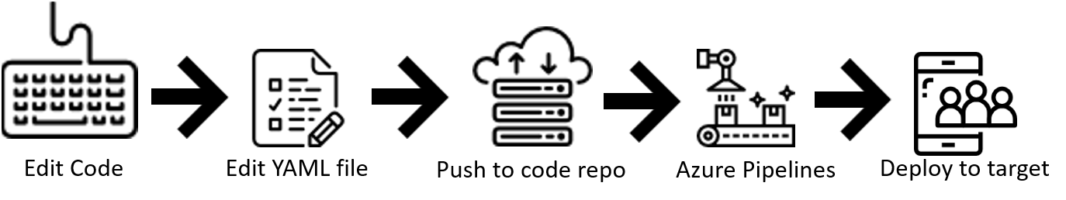
Azure DevOps - Introduction https://docs.microsoft.com/en-us/azure/devops/pipelines/ecosystems/dotnet-core?view=azure-devops https://docs.microsoft.com/en-us/azure/devops/pipelines/get-started/pipelines-get-started?view=azure-devops https://docs.microsoft.com/en-us/azure/devops/pipelines/?view=azure-devops
Azure Pipelines is a cloud service that you can use to automatically build and test your code and make it available to other users. Azure Pipelines works with many language or project types.
Azure Pipelines combines Continuous Integration (CI) and Continuous Delivery (CD) to constantly test and build your code to be shipped to any target.

Slide 5
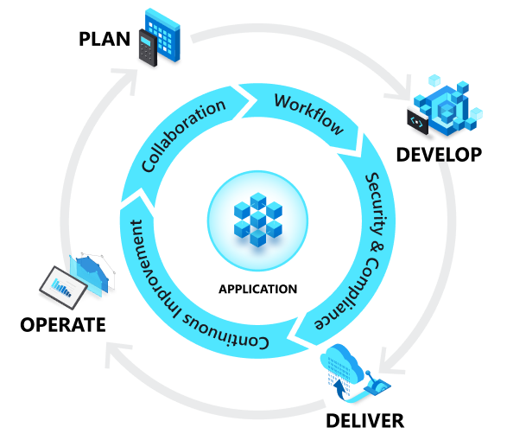
Build Definition https://docs.microsoft.com/en-us/aspnet/web-forms/overview/deployment/configuring-team-foundation-server-for-web-deployment/creating-a-build-definition-that-supports-deployment#task-overview
A build definition is the mechanism that controls how and when builds occur. Azure DevOps uses a .yml file to define a build. Each build definition specifies:
The things you want to build.
The criteria that determine when a build should take place
The location to which the Build should send build outputs.
The amount of time that each build should be retained.
Various other parameters of the build process.

Slide 6
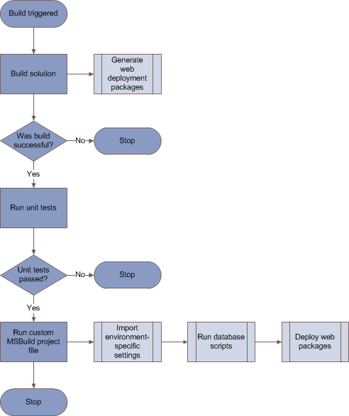
Release Pipeline https://docs.microsoft.com/en-us/azure/devops/pipelines/release/?view=azure-devops
Release pipelines in Azure Pipelines help your team implement CI/CD and deliver software to your clients faster and with lower risk.
You can fully automate the testing, delivery, and analysis of your software all the way to production or set up semi-automated processes with required approvals and on-demand deployments.
This flow chart illustrates a typical build/test/deploy workflow.

Slide 7
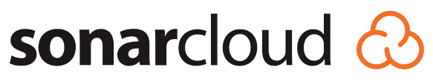
What is Code Analysis? https://en.wikipedia.org/wiki/Static_program_analysis
Code analysis is performed on the code of an application as a tangent from the direct pipeline. For example, the pipeline will create documentation of how the unit and integration tests performed and make that documentation along with the base code available to another application. A 3rd party application or website like SonarCloud.io can then analyze the code and display useful information to the developer. Click to learn: SonarQube vs SonarCloud.
Produce Documentation
Provide to Analysis Application
Analyze and display to Developer

Slide 8
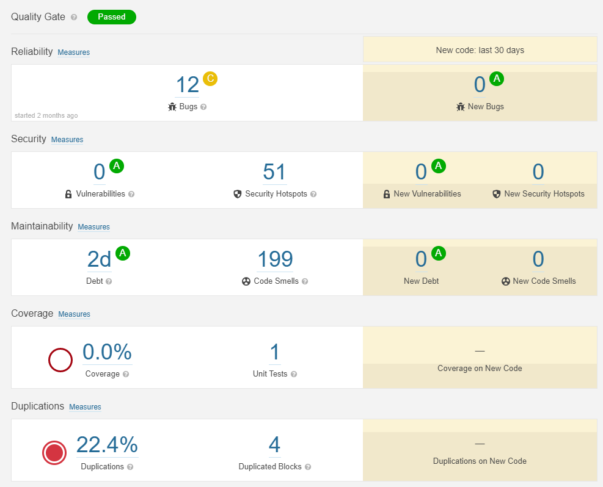
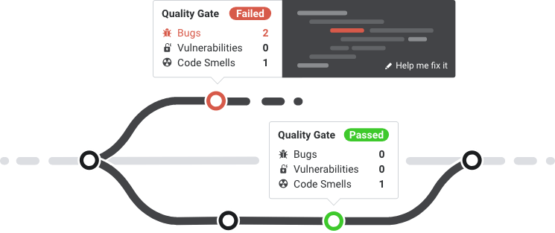
What is Static Code Analysis? https://en.wikipedia.org/wiki/Static_program_analysis
Static code analysis is the analysis of computer software performed without executing the program. Static code analysis is usually performed on the source code.
The term is usually applied to the analysis performed by an automated tool. SonarCloud and SonarQube are popular Static Code Analysis tools.
Human analysis is called Code Review.

Slide 9
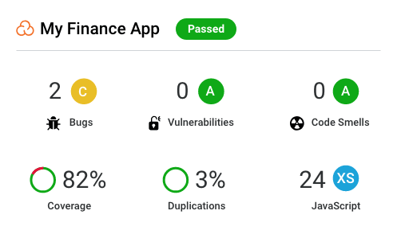
What is a Coverage Review? https://sonarcloud.io/documentation/user-guide/metric-definitions/ https://sonarcloud.io/documentation/user-guide/concepts/
How much of the source code has been covered by the unit tests?
Code Coverage is determined by evaluating what percentage of the total lines of code are covered by unit testing. It is a mix of Line coverage and Condition coverage.
Coverage = (CT + CF + LC) / (2*B + EL)
CT = conditions that have been evaluated to 'true' at least once
CF = conditions that have been evaluated to 'false' at least once
LC = covered lines = lines_to_cover - uncovered_lines
B = total number of conditions
EL = total number of executable lines (lines_to_cover)

Slide 10
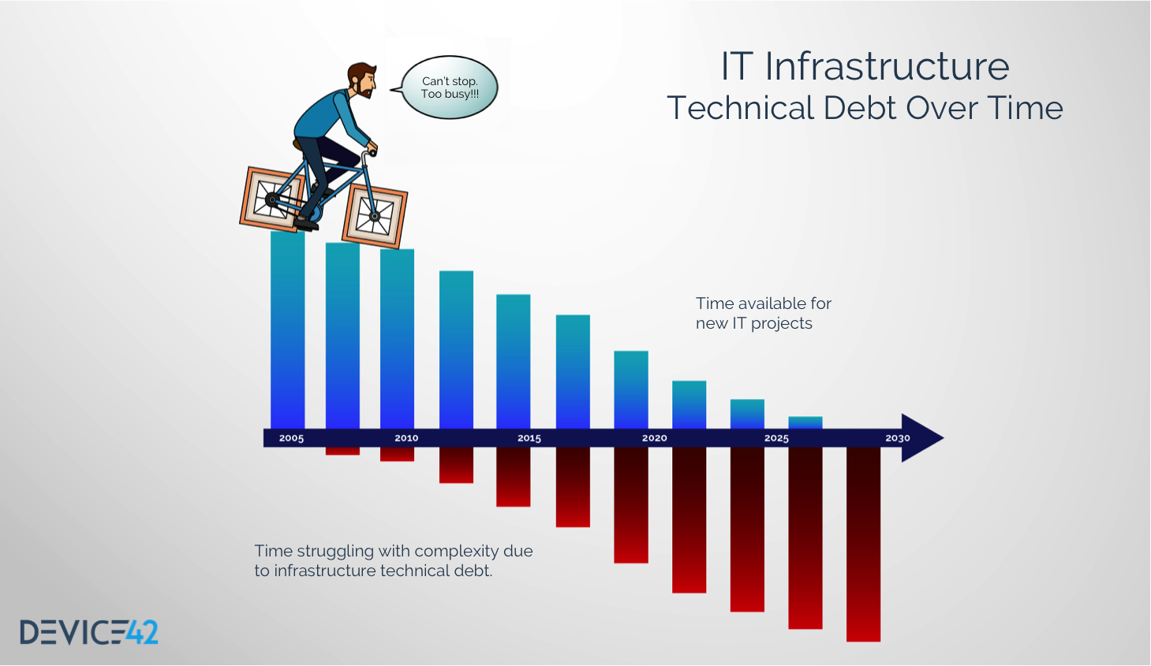
Technical Debt https://sonarcloud.io/documentation/user-guide/concepts/
Technical Debt is the estimated time required to fix all Maintainability Issues/code smells.

Slide 11
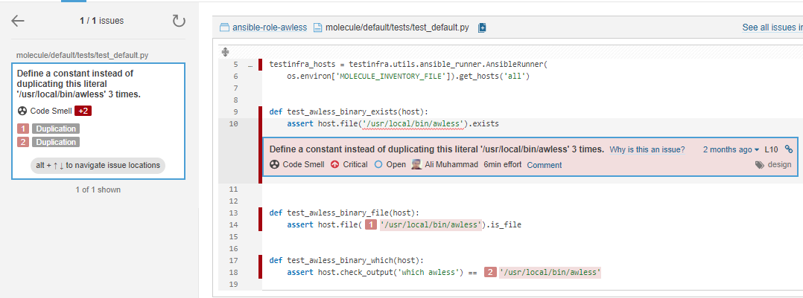
What is a Code Smell? https://sonarcloud.io/documentation/user-guide/concepts/ https://sonarcloud.io/project/issues?id=ansible-role-awless&open=AXEseUF1IRsecPgXK050&resolved=false&types=CODE_SMELL
A Code Smell is any characteristic in the source code of a program that possibly indicates a deeper problem. Determining what is and is not a Code Smell is subjective, and varies by language, developer, and development methodology.
A Code Smell is an issue with long-term maintainability in the code. Leaving it as-is means that it will be more difficult for maintainers to make changes to the code. They’ll risk introducing new errors as they make changes.

Slide 12
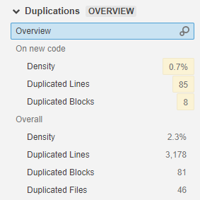
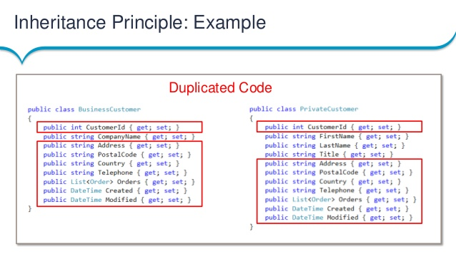
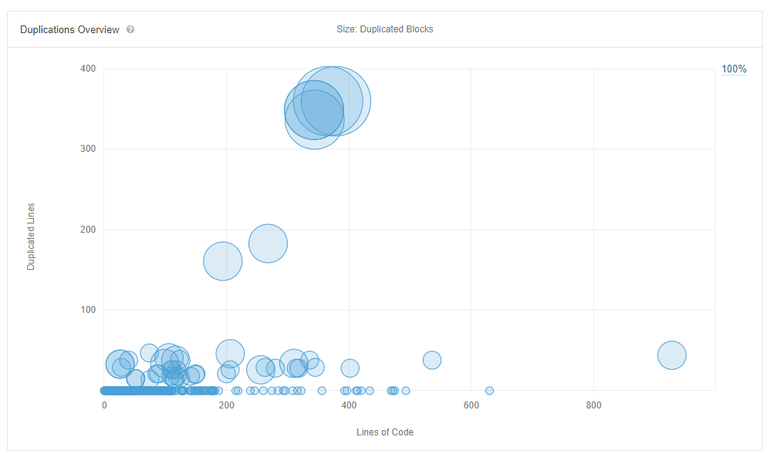
Duplication https://sonarcloud.io/component_measures?id=microsoft_vscode-python&metric=Duplications
Duplication in code analysis indicates lines of code that are identical and could theoretically be separated into a method to be called or resolved using SOLID or DRY principles.

Slide 13
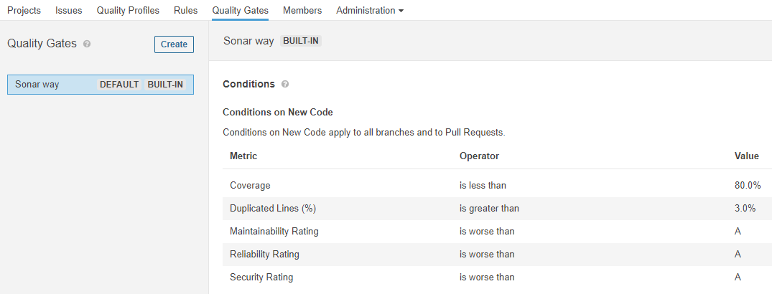
Quality Gate https://sonarcloud.io/documentation/user-guide/quality-gates/
A Quality Gate is the best way to Fix the Water Leak and enforce policies ensuring high quality code in your organization.
You can define as many quality gates as you wish. SonarCloud, by default, provides a built-in Quality Gate that is recommended for most projects. You can receive a notification when the Quality Gate fails.
To create a Quality Gate, define a set of Boolean conditions based on measure thresholds. Projects are then measured against them.
For example:
No new blocker issues
Code coverage on new code greater than 80%

Slide 14
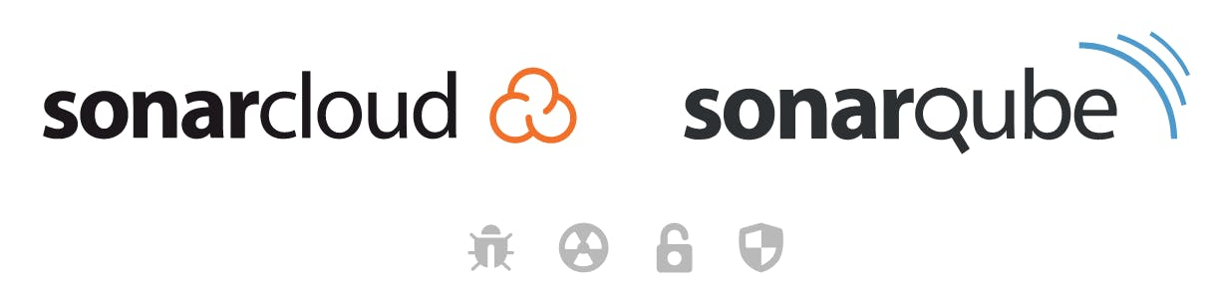
Sonarcloud vs. Sonarqube https://community.sonarsource.com/t/sonarcloud-vs-sonarqube/9557 https://blog.sonarsource.com/sq-sc_guidance
SonarQube is meant to be integrated with on-premise solutions like GitHub Enterprise or BitBucket Server.
SonarCloud is meant to be integrated with cloud solutions like GitHub.com or BitBucketCloud.

Slide 15
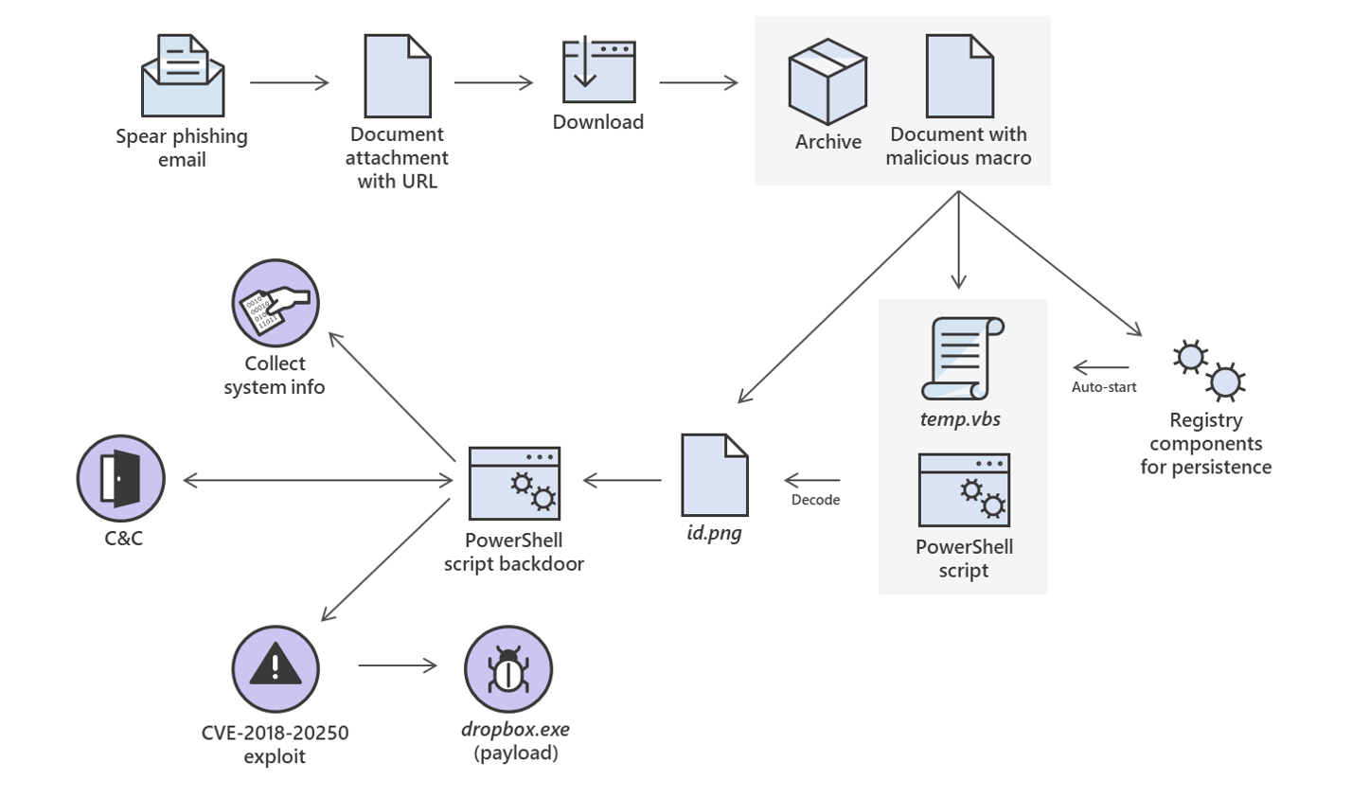
Monitoring Security and Vulnerability https://sonarcloud.io/documentation/user-guide/concepts/ https://sonarcloud.io/documentation/user-guide/metric-definitions/#security
Security-related issues represent a place in your code that attackers could exploit. Security hotspots are areas of the code that may cause security issues and therefore need to be reviewed.
The SonarCloud Quality Model has three different types of rules: Reliability (bug), Vulnerability (security), and Maintainability (code smell).
One of these rules will usually find and flag anything suspicious.
Then a human security auditor can manually review the report, delete the false positives, and send the appropriate issues for remediation.

Slide 16
“Clean as you Code” Methodology https://www.sonarqube.org/features/clean-as-you-code/#:~:text=With%20the%20Clean%20as%20You,clean%20up%20after%20someone%20else.
The act of sorting out new code smells, etc, each time you build the pipeline.

