Slide 1

YAML Yet Another Markup Language
.net

Slide 2
YAML is a human-readable data serialization standard for all programming languages. It’s a strict superset of JSON, with the addition of syntactically significant newlines and indentation.
https://yaml.org/

Slide 3
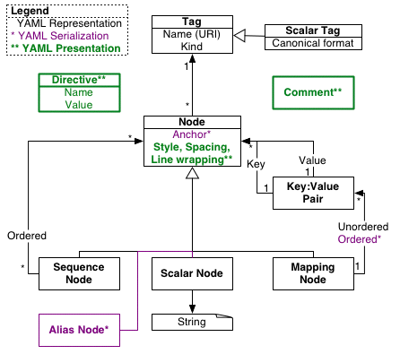
What is YAML? https://yaml.org/spec/1.2/spec.html http://www.yamllint.com/
YAML is a Unicode-based data serialization language. It’s designed around the common native data types of Agile programming languages.
YAML is useful for configuration, messaging, object persistence, and data auditing.
The design goals for YAML, in decreasing priority, are:
Be easily readable by humans.
Be portable between programming languages.
Match the native data structures of Agile languages.
Have a consistent model to support generic tools.
Support one-pass processing.
Be expressive and extensible.
Be easy to implement and use.

Slide 4
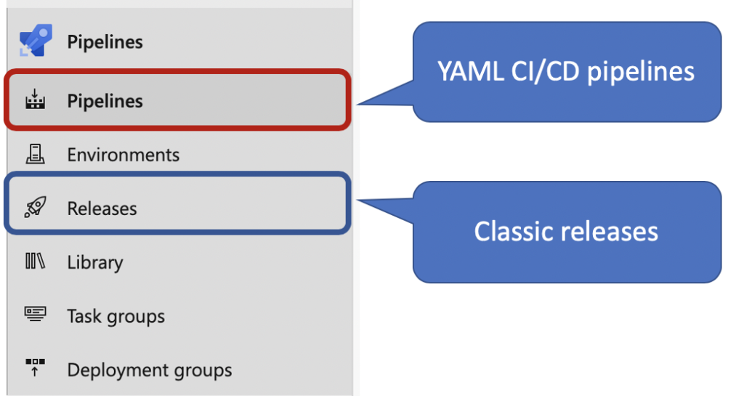
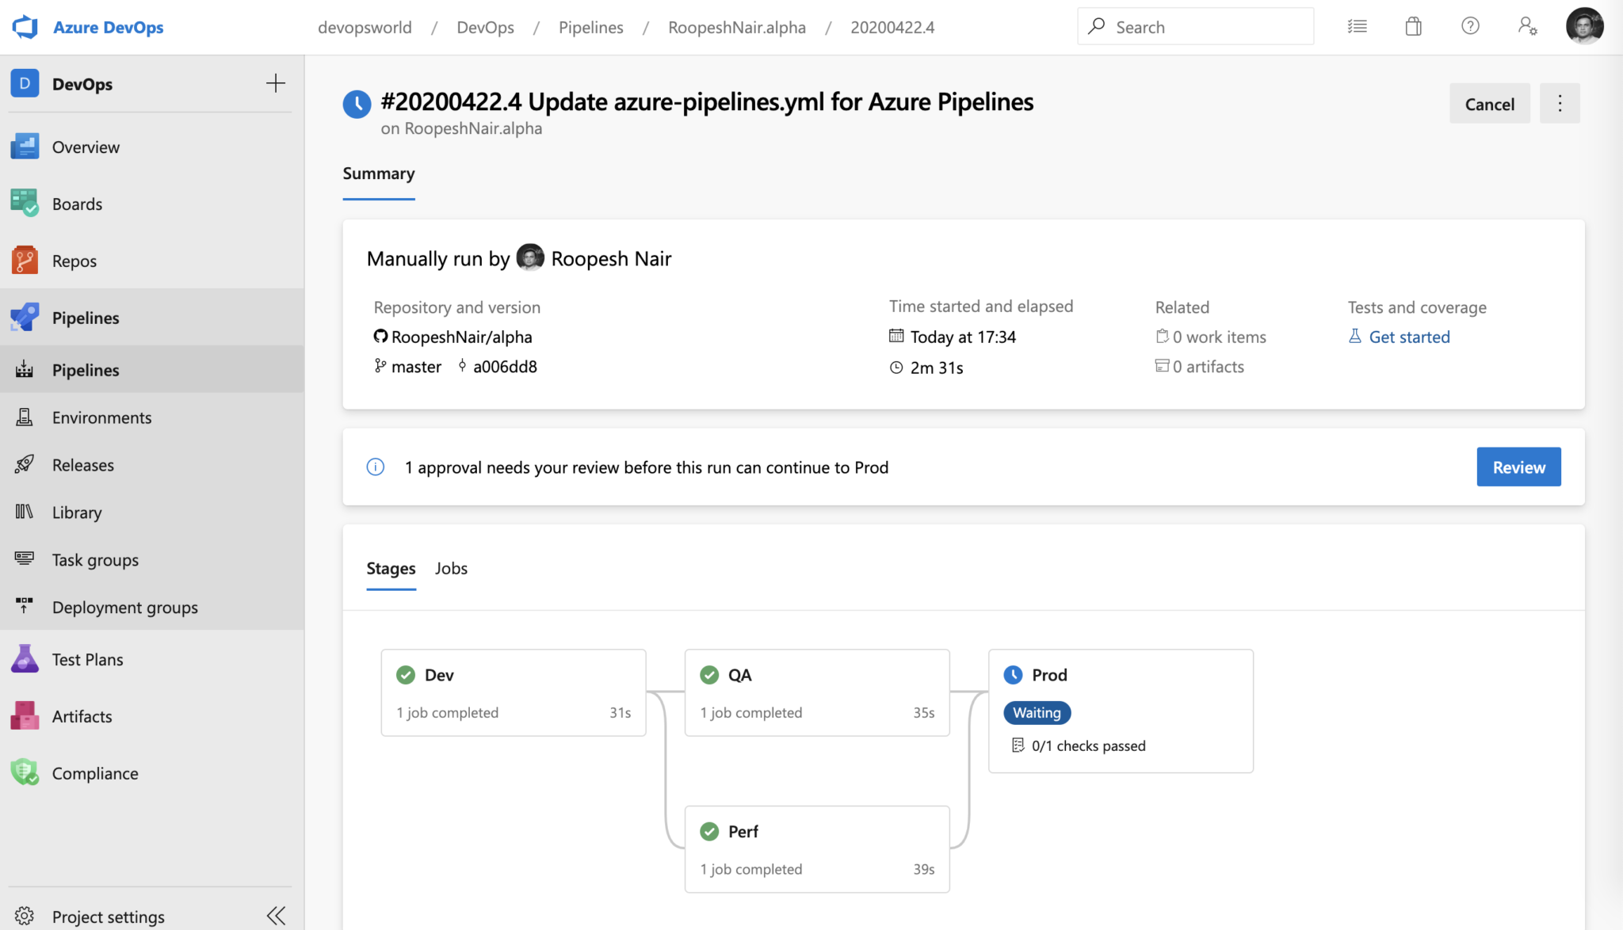
Azure Pipelines and YAML https://devblogs.microsoft.com/devops/announcing-general-availability-of-azure-pipelines-yaml-cd/ https://azure.microsoft.com/en-us/services/devops/logout/?nav=min
Microsoft’s Azure Pipelines offers a way to use .yml files to configure CI/CD Pipelines.
A pipeline is defined using a YAML file. This .yml file is placed at the root of your project when you set up your Azure Pipeline.
The YAML file controls the build, test, and deploy stages of your application. It is started by a trigger activated when certain conditions are met in your repository.
The trigger knows about a push, PR, etc, to the repository because of a Web Hook on the repository.

Slide 5
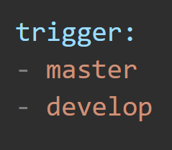
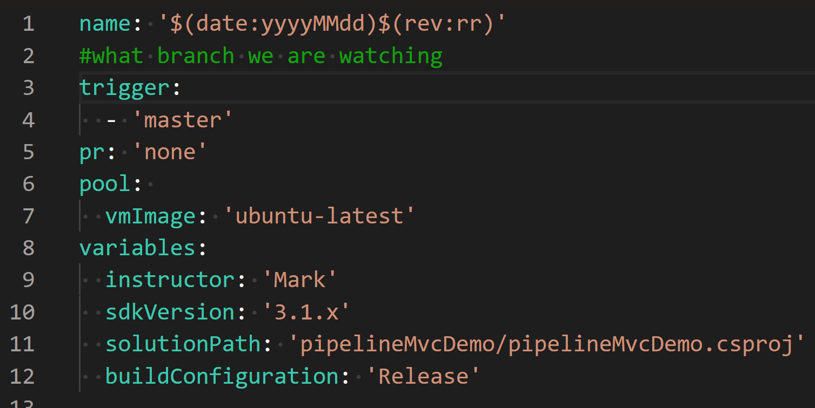
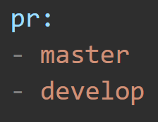

YAML Triggers https://docs.microsoft.com/en-us/azure/devops/pipelines/yaml-schema?view=azure-devops&tabs=example%2Cyaml-example#push-trigger https://docs.microsoft.com/en-us/azure/devops/pipelines/build/triggers?tabs=yaml&view=azure-devops#pr-triggers https://docs.microsoft.com/en-us/azure/devops/pipelines/repos/github?view=azure-devops&tabs=yaml#ci-triggers
Triggers are how you automatically build your application. They are placed at the top of your YAML file. Azure Pipelines watches for your designated trigger and will automatically start running your YAML instructions when the trigger event is detected.
A push trigger specifies that a ‘git push’ to a particular branch will cause a build to run. If you specify a “no push” trigger, pushes to any branch trigger a build.
A Pull Request Trigger will start a build when a PR is made to the specified branch. You can also specify ‘none’, which will disable PR triggers.
If you don’t specify pr: none, every pr creation will trigger a build!!

Slide 6
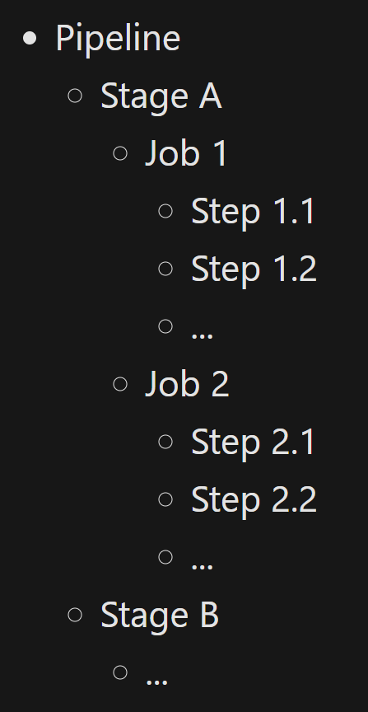
YAML and Pipeline Structure https://docs.microsoft.com/en-us/azure/devops/pipelines/yaml-schema?view=azure-devops&tabs=schema%2Cparameter-schema https://docs.microsoft.com/en-us/azure/devops/pipelines/get-started/pipelines-get-started?view=azure-devops
Azure Pipelines supports CI/CD using a .yml file. The .yml file (YAML) is written in YAML Syntax and contains instructions that Azure Pipelines uses to build, test, report, publish, and deploy an application.
A pipeline is made up of one or more “stages” that describe processes.
Stages are the major divisions in the deployment process (building, testing and deployment).
Each Stage is divided into Jobs.
A Job is a unit of work assignable to one machine and is divided into Steps
Each Step is a series of Tasks, scripts, or references to external templates.
Tasks are the smallest units of work (executable operation) in the pipeline.
Simple pipelines can omit multiple stages and jobs as needed. Azure Pipelines does not support all YAML features.

Slide 7
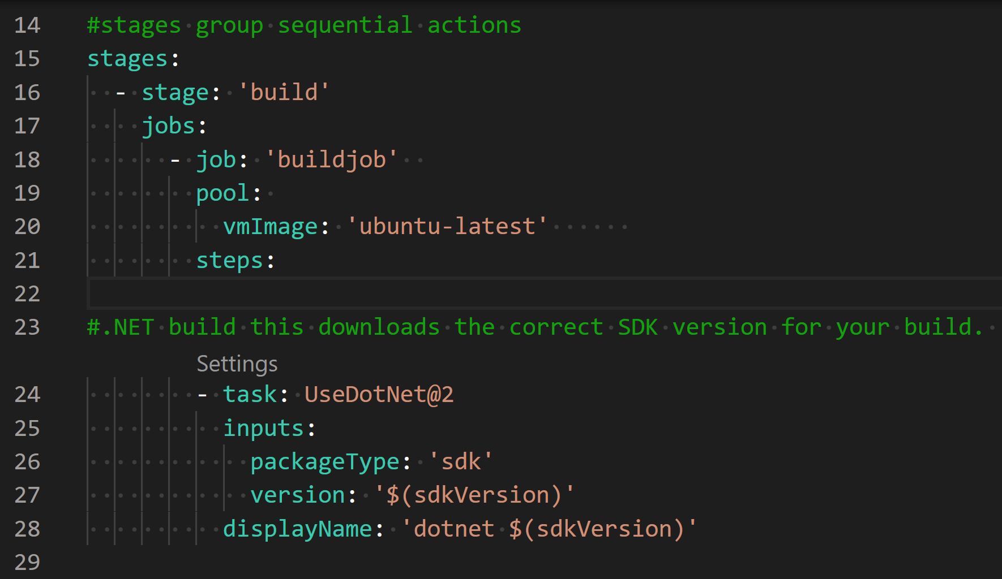
YAML and Pipeline Structure https://docs.microsoft.com/en-us/azure/devops/pipelines/yaml-schema?view=azure-devops&tabs=schema%2Cparameter-schema https://docs.microsoft.com/en-us/azure/devops/pipelines/get-started/pipelines-get-started?view=azure-devops
A pipeline is made up of one or more “stages” that describe processes.
Stages are the major divisions in the deployment build, test and deploy process.
Each Stage is divided into Jobs.
A Job is a unit of work assignable to one machine.
Each job is divided into steps
Each Step is divided into Tasks. The Task is the smallest unit of work in the pipeline.
If you have more than one Stage to list, they can be listed inside a “Stages” section. The same is for Jobs.

Slide 8
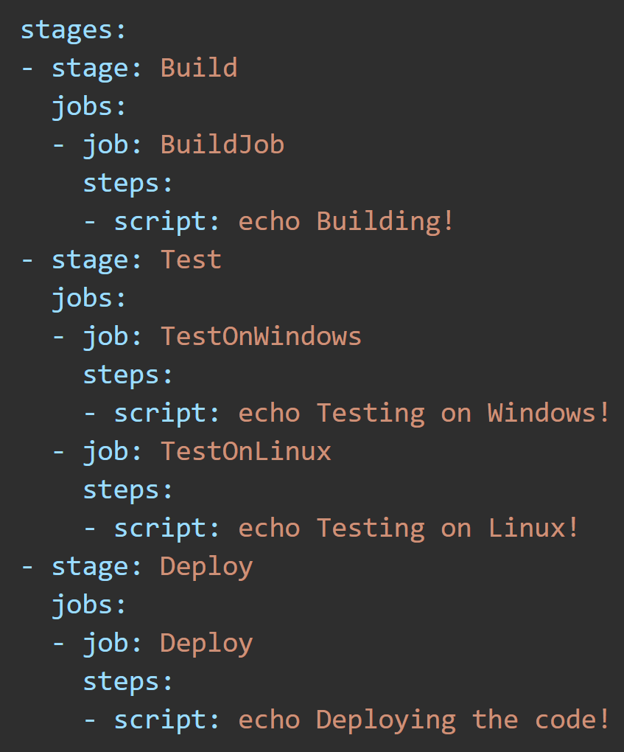
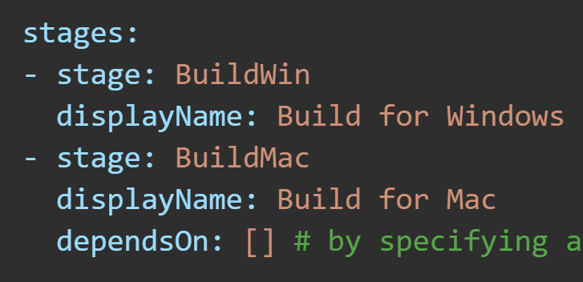
YAML Stage https://docs.microsoft.com/en-us/azure/devops/pipelines/yaml-schema?view=azure-devops&tabs=example%2Cparameter-schema#stage
A Stage is a collection of related Jobs. By default, Stages run sequentially.
In this example:
A region of Stages is declared then given a name.
Each stage has a Jobs region where one or more Jobs are listed and named.
Each Job has a Steps region where one or more Tasks can be listed.
A script is a type of Task and represents what you could type in the command line.
This example shows how to run two stages in parallel (async).
Specify an empty array with ‘dependsOn:’ to run a stage without waiting for the preceding stage to complete.

Slide 9
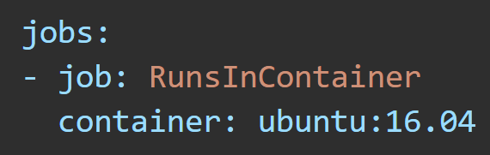
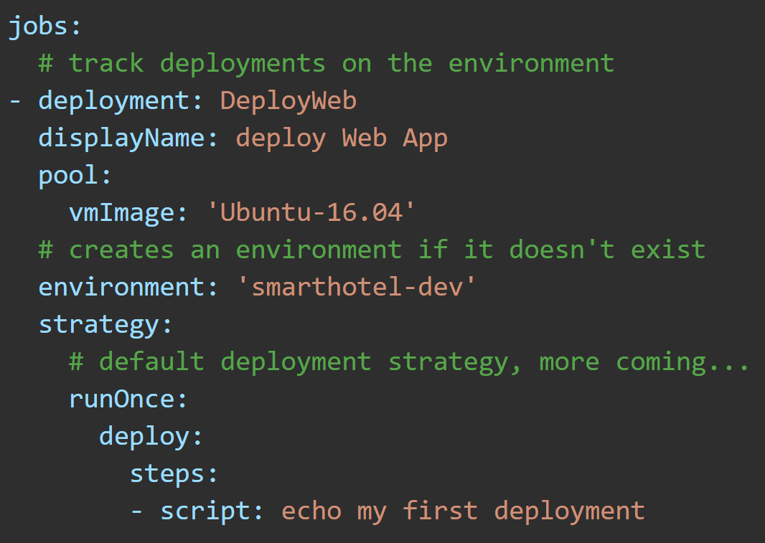
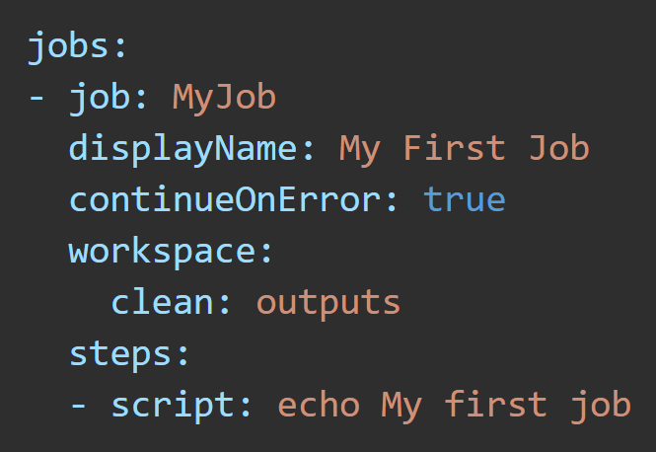

YAML Job https://docs.microsoft.com/en-us/azure/devops/pipelines/yaml-schema?view=azure-devops&tabs=example%2Cparameter-schema#job
A Job is where you can add a reference to a container.
A Job is a collection of Steps run by an agent or on a server. Jobs can run conditionally and might depend on earlier Jobs.
A deployment job is a special type of job. It is a collection of steps to run sequentially against the environment.

Slide 10
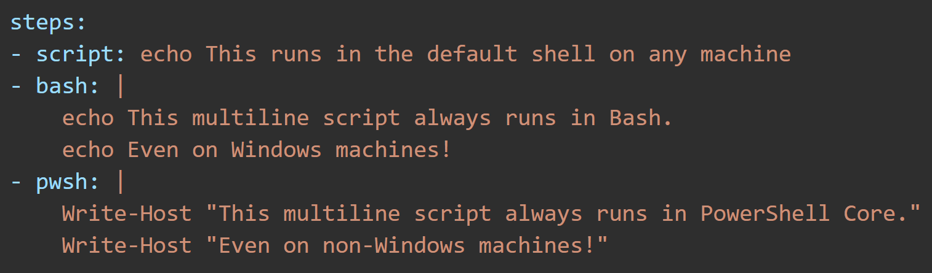
YAML Steps https://docs.microsoft.com/en-us/azure/devops/pipelines/yaml-schema?view=azure-devops&tabs=example%2Cparameter-schema#steps
A job is made up of one or more steps. Each step runs in its own process and has access to the pipeline workspace. Environment variables aren't preserved between steps, but file system changes are. Supported Tasks in Azure Pipelines are script, bash, pwsh, PowerShell, Checkout, task, and step templates.

Slide 11
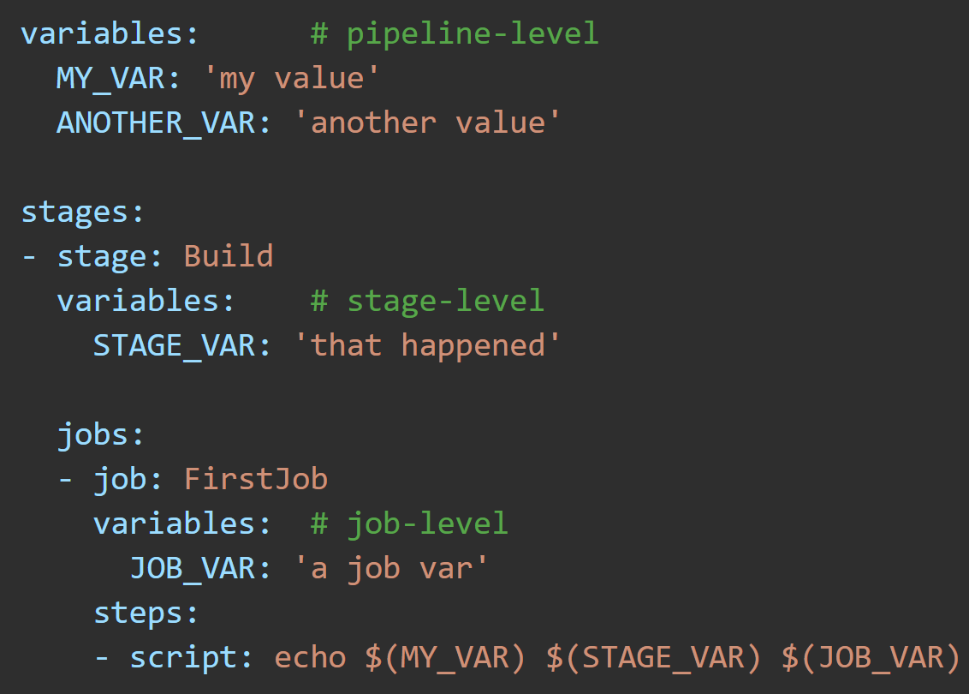
YAML Variables https://docs.microsoft.com/en-us/azure/devops/pipelines/yaml-schema?view=azure-devops&tabs=example%2Cparameter-schema#variables
You can add hard-coded values directly or reference a variable group.
You can specify variables at the pipeline, stage, or job level by using the ‘variables:’ keyword followed by the name and value of the variable in single quotes.

Slide 12
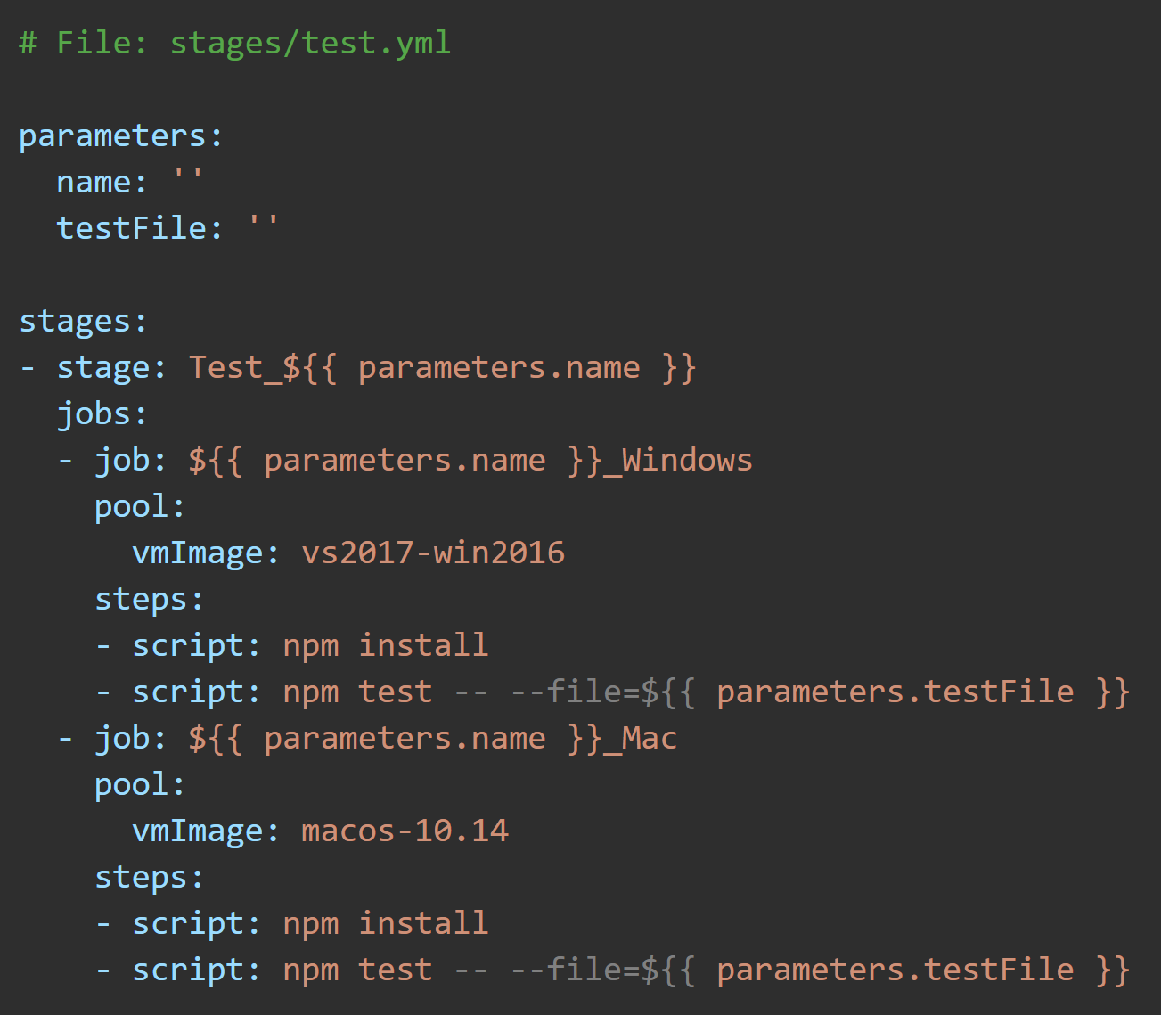
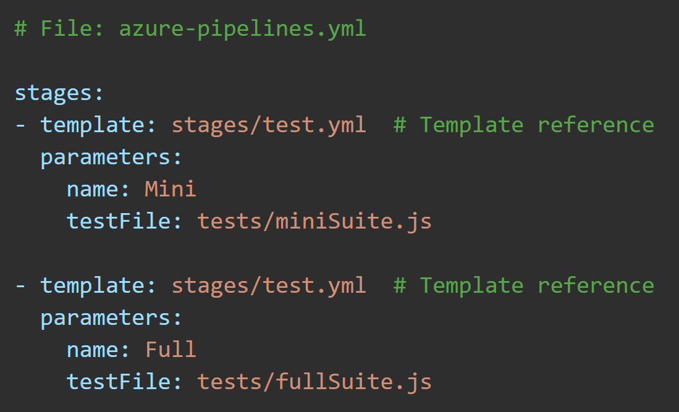
Template References https://docs.microsoft.com/en-us/azure/devops/pipelines/yaml-schema?view=azure-devops&tabs=example%2Cparameter-schema#template-references
Template that accepts parameters
You can import reusable sections of your pipeline from a separate (template) file. These separate files are known as templates. Templates can include other templates.
Azure Pipelines supports four kinds of templates:
Stage
Job
Step
Variable
.yml file which calls the template using parameters

Slide 13
Template References https://docs.microsoft.com/en-us/azure/devops/pipelines/yaml-schema?view=azure-devops&tabs=example%2Cparameter-schema#template-references
Template that accepts parameters
In this example:
The upper image shows the template .yml file.
The lower image is the .yml file that called the template with arguments.
The lower YAML file calls the template two times.
The Template instantiates an object at the top with the keyword ‘parameters’ to accept arguments passed in.
It then references the values of the object while creating jobs and using npm commands.
.yml file which calls the template using parameters

Slide 14
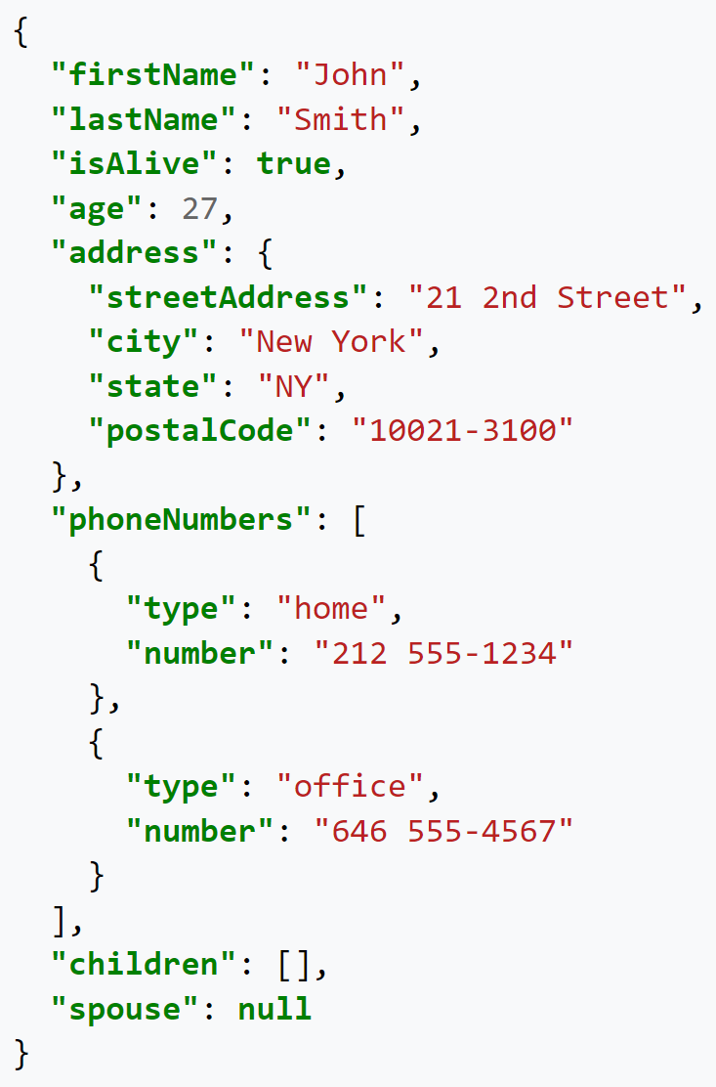
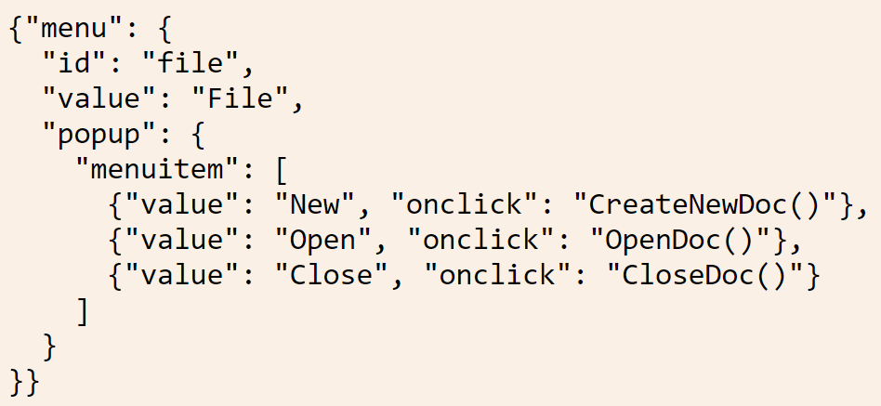
Assignment: Convert these .json files to .yml https://onlineyamltools.com/convert-yaml-to-json

Slide 15
Pipeline Deployment Workflow
1. Your Local changes. Add, Commit, Push
3. Pipeline (triggered)
4. build stage
5. deploy stage
2. Github
(source code)
4.1
build
jobs
- job
- steps
“app”
4.2
test jobs
- Job
- coverage
5.1 deploy job
Steps
Step
Jobs
job
6. Azure Website
The results of ‘dotnet publish’ in .zip form
7. Code Coverage Website
4.3 artifacts created

Slide 16
Additional Resources
Build your first Azure Pipeline
https://docs.microsoft.com/en-us/azure/devops/pipelines/ecosystems/dotnet-core?view=azure-devops
See code coverage in Azure Pipeline
https://docs.microsoft.com/en-us/azure/devops/pipelines/test/review-code-coverage-results?view=azure-devops
Deploy to Azure App Service using Visual Studio Code
https://docs.microsoft.com/en-us/azure/devops/pipelines/targets/deploy-to-azure-vscode?view=azure-devops

