Slide 1

Cloud Computing
.NET

Slide 2
Cloud computing is the delivery of computing services over the Internet from a remote location (“the cloud”) to offer faster innovation, flexible resources, and scalability.
https://azure.microsoft.com/en-us/overview/what-is-cloud-computing/

Slide 3
Cloud Computing – Benefits https://azure.microsoft.com/en-us/overview/what-is-cloud-computing/#benefits
Three reasons why Cloud Computing is beneficial for businesses.
Cost - Eliminate the expense of hardware and software, the inefficiencies of setting up data centers, electricity payments for power and cooling, and the hiring of additional IT experts for managing infrastructure. IT teams can be more productive while achieving more important business goals.
Global Scaling and Speed – Reduce latency by running on a network of secure, updated datacenters that can be scaled elastically. This means applying more (or less) computing power, storage, or bandwidth right when it’s needed, with just a few mouse clicks or even automatically.
Security – Gain access to the most robust security possible, helping protect your data, apps, and infrastructure from threats.

Slide 4
Scaling – Types https://simplicable.com/new/cloud-scaling
Category | Explanation
Cloud Scaling | Allocating cloud computing resources (and paying for them) as you need them.
Vertical Scaling (Up or Down) | Moving to a larger or smaller instance or upgrading/downgrading your resources.
Horizontal Scaling (In or Out) | Adding or removing instances to a service, system, or application

Slide 5
Important Terms https://en.wikipedia.org/wiki/Service-level_agreement https://cloud.google.com/docs/geography-and-regions
Term | Definition
SLA (Service Level Agreement) | A commitment between a service provider and a client about the quality and availability of service and the responsibilities of each party.
Regions | Independent geographic areas that consist of Accessibility Zones. Locations within regions usually have minimum round-trip network latencies.
Accessibility Zone | A deployment area for cloud resources within a region. Zones should be considered a single failure domain within a region. Applications should be deployed across multiple zones in a region to have higher availability.

Slide 6
Cloud Computing – Types https://azure.microsoft.com/en-us/overview/what-is-cloud-computing/#cloud-deployment-types
Public Cloud | Private Cloud | Hybrid Cloud
Owned and operated by third-party cloud service providers. Microsoft Azure, AWS*, and GCP** are public cloud services. All hardware, software, etc, is owned and managed by the cloud provider. Clients access these services and manage their accounts using a web browser. | Used exclusively by a single organization. Can be physically located at the company’s on-site datacenter. Some companies also contract to third-party service providers to host their private cloud off-site. Services and infrastructure are maintained on a private network. | Public, private and/or on-site clouds combined. Bound together by technology that allows data and applications to be shared between them. Gives businesses greater flexibility, more deployment options, and helps optimize existing infrastructure, security, and compliance.
*Amazon Web Services
**Google Cloud Platform

Slide 7
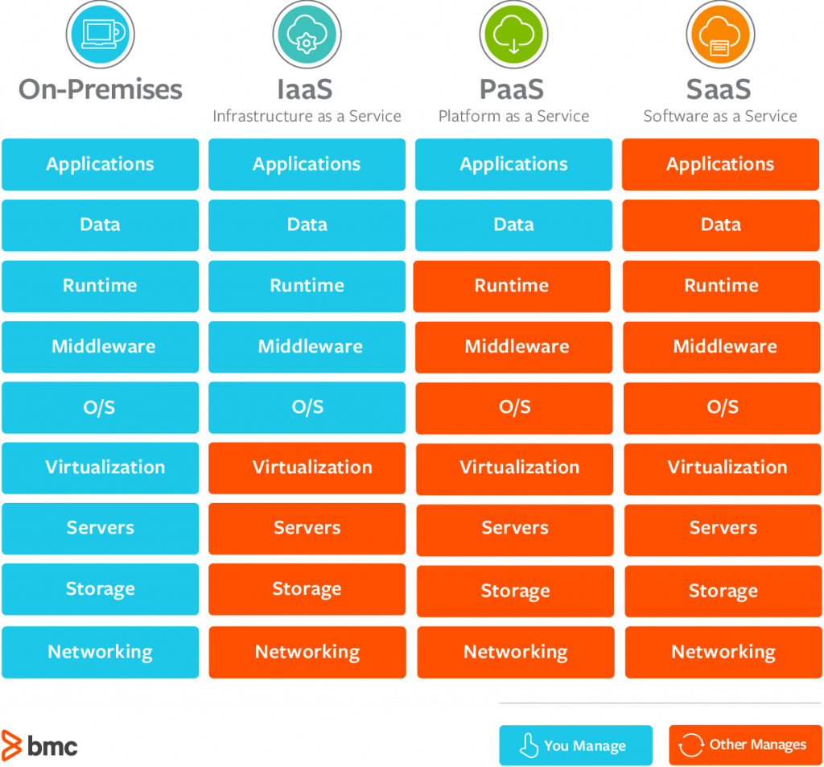
Cloud Computing Services – Models https://azure.microsoft.com/en-us/overview/what-is-cloud-computing/#cloud-computing-models https://www.bmc.com/blogs/saas-vs-paas-vs-iaas-whats-the-difference-and-how-to-choose/
Most cloud computing services fall into three broad categories:
Infrastructure as a Service (IaaS)
Platform as a Service (PaaS)
Software as a Service (SaaS)
These are sometimes called the cloud computing "stack" because they build on top of one another.

Slide 8
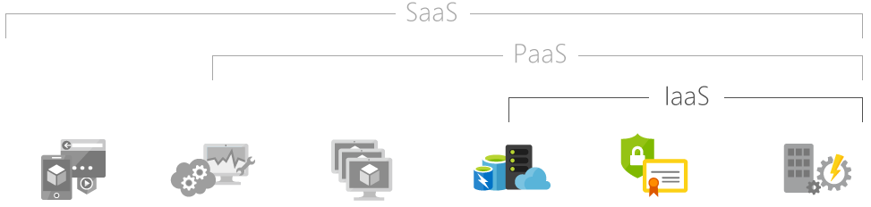
IaaS (Infrastructure as a Service) https://azure.microsoft.com/en-us/overview/what-is-iaas/
With IaaS, IT infrastructure (servers and virtual machines, storage, networks, operating systems) is rented from a cloud provider on a pay-as-you-go basis. IaaS quickly scales up and down with demand to avoid the expense and complexity of buying and managing your own physical servers and other datacenter infrastructure. Each resource is offered as a separate service component. You only rent one for as long as you need it. (Azure, OpenShift, Heroku)

Slide 9
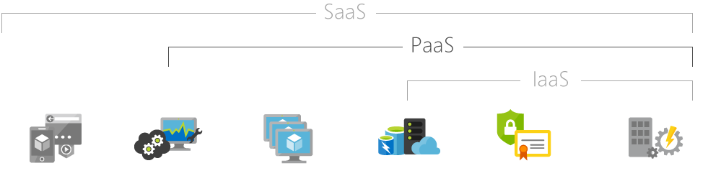
PaaS (Platform as a Service) https://azure.microsoft.com/en-us/overview/what-is-paas/
PaaS refers to cloud computing services that supply an on-demand environment for developing, testing, delivering, and managing software applications. PaaS is a complete development and deployment environment in the cloud. It’s designed to make it easier for developers to quickly create web or mobile apps without worrying about setting up or managing the underlying infrastructure of servers, storage, network, and databases needed for development. (Digital Ocean, AWS, Microsoft Azure)

Slide 10
A [X]AAS real world analogy https://www.optimizely.com/insights/blog/pizza-as-a-service/
Pizza!

Slide 11
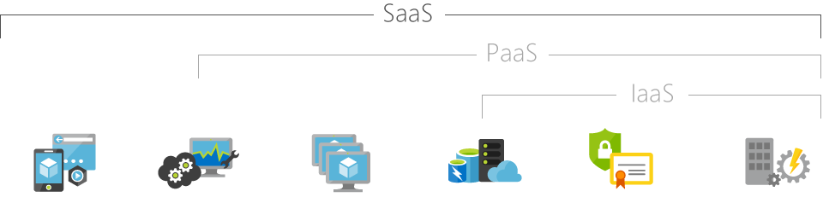
SaaS (Software as a Service) https://azure.microsoft.com/en-us/overview/what-is-saas/
SaaS is a method for delivering complete software applications on demand over the Internet (typically as a subscription). Cloud providers host and manage the software application and underlying infrastructure and handle any maintenance (software upgrades and security patching). Users simply connect to the application over the Internet. (Google Workspace, Office Online, Salesorce)

Slide 12
Activity (Groups) https://docs.google.com/presentation
Create a Google Slides or PPT presentation.
Create a Google Slides or PPT presentation that will take about 5 minutes to present as a group.
In your own words, explain the three different types of Services; IaaS, Paas, Saas.
Describe with detail one hypothetical yet realistic situation for each type of service.
“In what situation would a person or business use this type of service?”
Explain WHY that particular service would be best for that situation.
Explain which type of cloud (private, public, hybrid) would be best for that situation.
Identify a suite of products offered by Azure, AWS, GCP, etc., that would fall under the service and cloud type of each of your three use cases.
Group members must present equal numbers of slides each.
The above requirements need to be mentioned in the ppts so that I can review if needed.

