Slide 1

Software Development Life Cycle
.NET

Slide 2
The Software Development Life Cycle is the process of dividing software development work into distinct, repeatable phases to improve design and product management.
https://en.wikipedia.org/wiki/Software_development_process

Slide 3
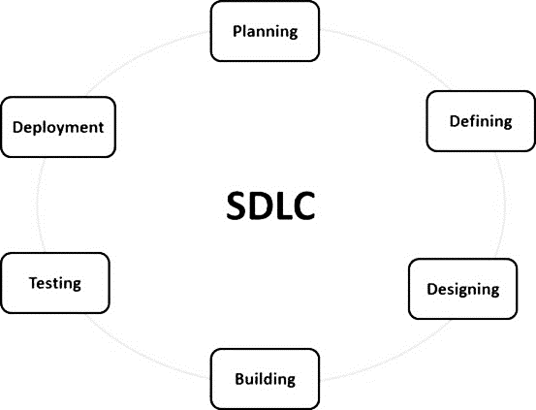
SDLC – Software Development Lifecycle https://www.tutorialspoint.com/sdlc/sdlc_overview.htm
The Software Development Life Cycle (SDLC) is a process used to design, develop, and test software.
The phases of the SDLC are:
Planning and Requirement Analysis.
Define the project requirements.
Design the Product Architecture
Build the product
Test
Deployment

Slide 4
SDLC – Stages Details https://www.tutorialspoint.com/sdlc/sdlc_overview.htm
Stage | Purpose
Planning and Requirement Analysis | All involved parties (Stakeholders) give input to plan the project and decide on the feasibility the various aspects of the project. Different approaches to solving various problems are explored.
Define Project Requirements | Stakeholders define and document the product requirements and get them approved by the customer. A final design approach is decided upon.
Design Product Architecture | Stakeholders decide on the best approach to implementing the design plan.
Build and Develop the Product | A specific programming language is chosen, and code is written following guidelines established by stakeholders.
Test the Product | Extensive testing and refactoring the product is conducted mostly after the product is complete.
Deployment and Maintenance | User Acceptance Testing. Formal (sometimes limited) release with continued evaluation. The code may be refactored based on user feedback.

Slide 5
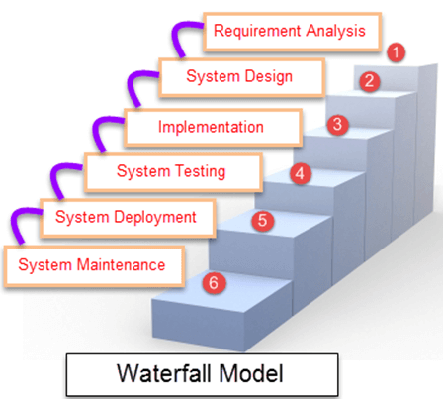
SDLC – Waterfall Model https://en.wikipedia.org/wiki/Waterfall_model
The Waterfall Model breaks down project activities into phases. Each depends on the deliverables of the previous phase.
Progress flows downward through each phase only when the preceding phase is verified to be complete.
Waterfall is less iterative and less flexible than other models and has high accountability and documentation requirements.
The Waterfall Model is too rigid for most situations.

Slide 6
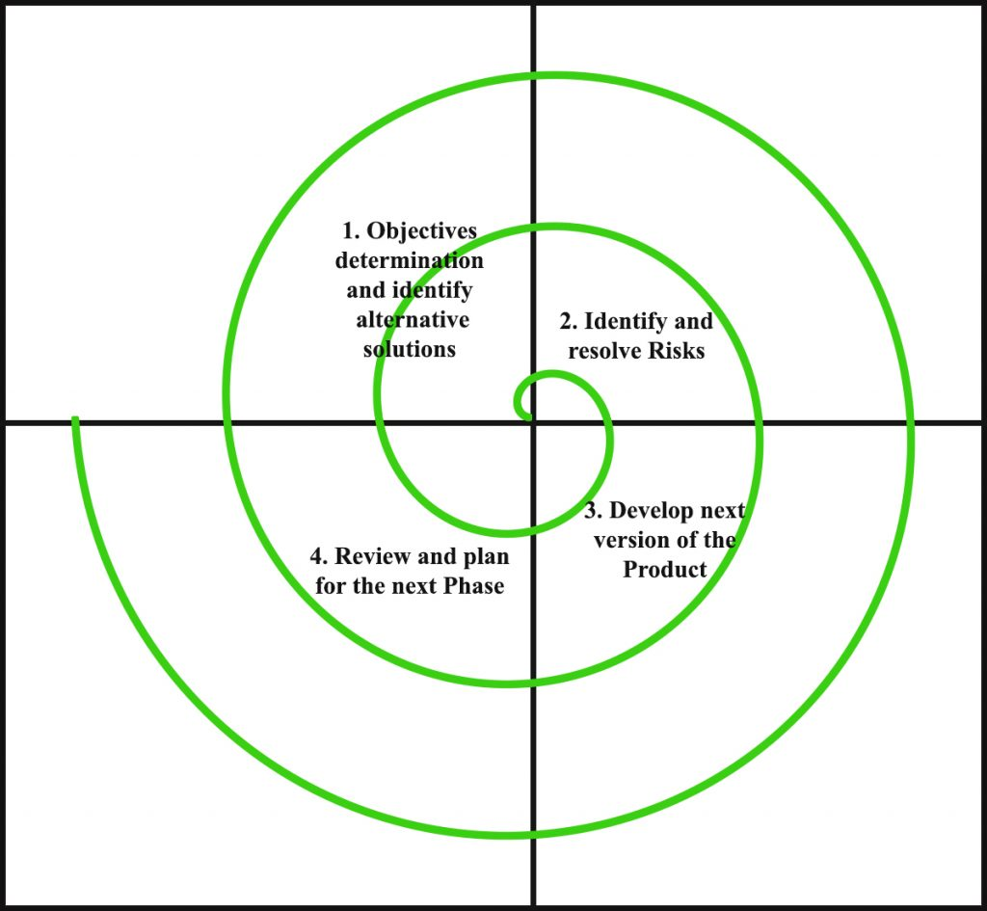
SDLC – Spiral Model https://en.wikipedia.org/wiki/Spiral_model#The_six_invariants_of_spiral_model https://www.geeksforgeeks.org/software-engineering-spiral-model/
The Spiral Model bases its processes on the unique risk patterns of the project. This approach guides a team to adopt elements of other models while implementing the Spiral Model design pattern.
Spiral often results in a series of mini-Waterfalls. A single loop of the Spiral represents one full Waterfall Model cycle.
The exact number of loops of the Spiral depends on the requirements of the project
Each loop of the Spiral is called a “phase” and each phase is divided into quadrants.

Slide 7
SDLC – Spiral Model – Pros and Cons https://en.wikipedia.org/wiki/Spiral_model#The_six_invariants_of_spiral_model https://www.geeksforgeeks.org/software-engineering-spiral-model/
Advantages | Disadvantages
Risk Handling. You can deal with new requirements/fixes during the next cycle. | Complexity
Good for large and complex projects. | Expense
Flexibility. Each cycle adjusts requirements based on the state of the project. | Requires expertise to determine the risk factors before each cycle.
Customer Satisfaction. Clients can see the results of each cycle immediately. | An unknown number of cycles in the completed project.

Slide 8
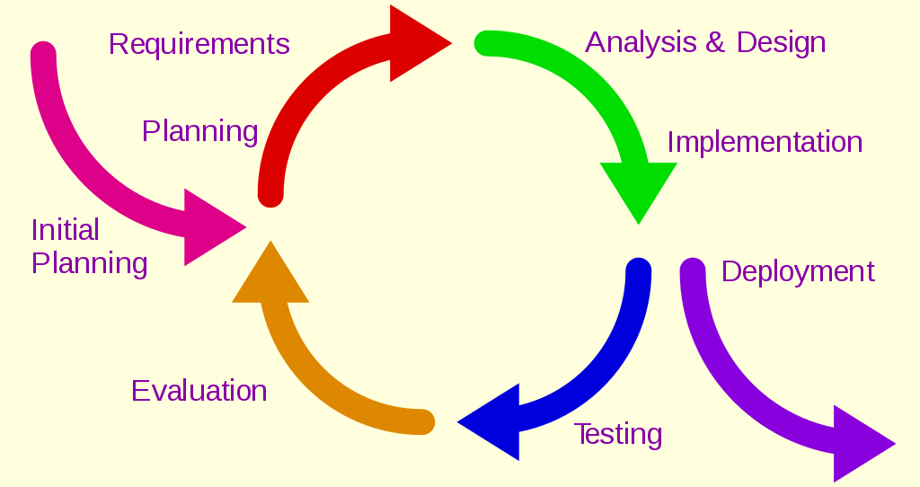
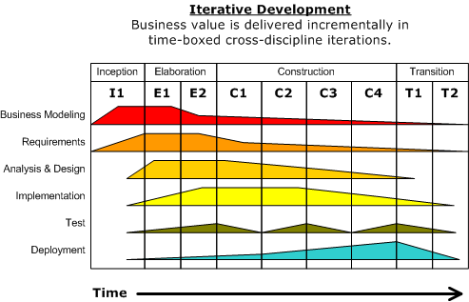
SDLC – Iterative Model https://en.wikipedia.org/wiki/Iterative_and_incremental_development
The Iterative Model develops a project through small, iterative development cycles.
This allows developers to learn from earlier versions of the project. Each iteration adds features until the full application is implemented.
A Project Control List is updated after each iteration to focus developers on the specific functionality to implement in that iteration.
Analysis of each iteration is based on client and user feedback. The next round of changes are implemented in the next iteration.
Unlike with the Waterfall Model, the Iterative Model allows backtracking.

Slide 9
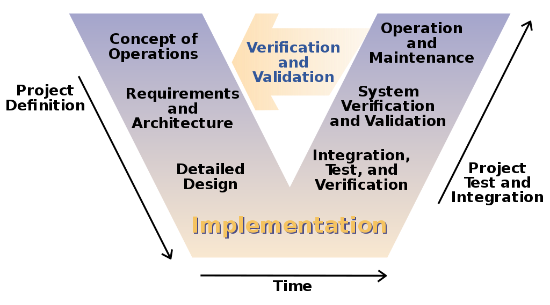
SDLC – V Model https://en.wikipedia.org/wiki/V-Model_(software_development)
In the V Model, the process steps flow downward during the development phase and back upwards during the testing phase in the shape of a ‘V’.
The relationships between each SDLC phase and testing phase is represented by the horizontal pairs of actions.
The horizontal and vertical axes represent time, project completeness, and level of abstraction.

Slide 10
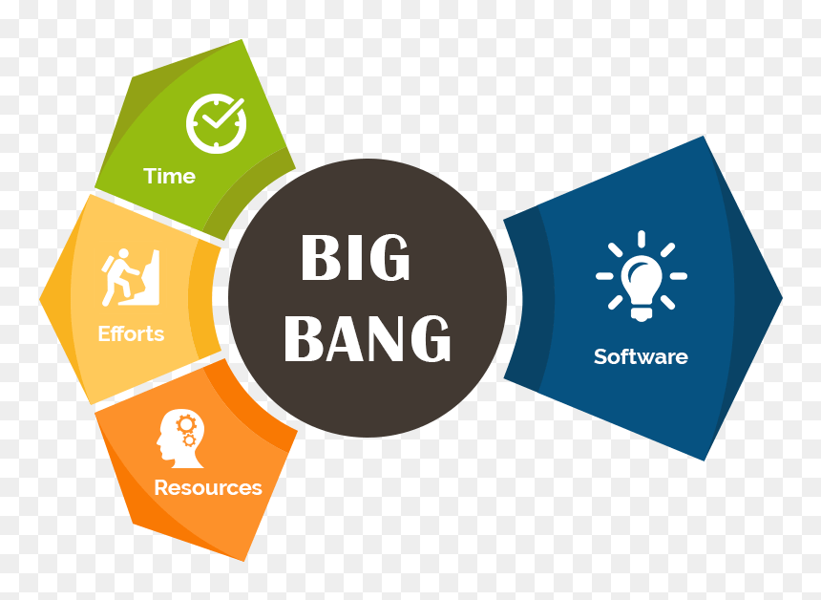
SDLC - Big Bang Model https://www.tutorialspoint.com/sdlc/sdlc_bigbang_model.htm
The Big Bang Model does not follow any specific process. Requirements are implemented without much analysis.
Development starts as soon as the required funds are acquired and developers are ready.
The Big Bang Model is meant for small projects with small teams. It’s higher risk than other models with misunderstandings and failure a likely outcome.
For small projects, the Big Bang Model offers easy management, rapid prototyping, more flexibility, and requires few resources.

Slide 11
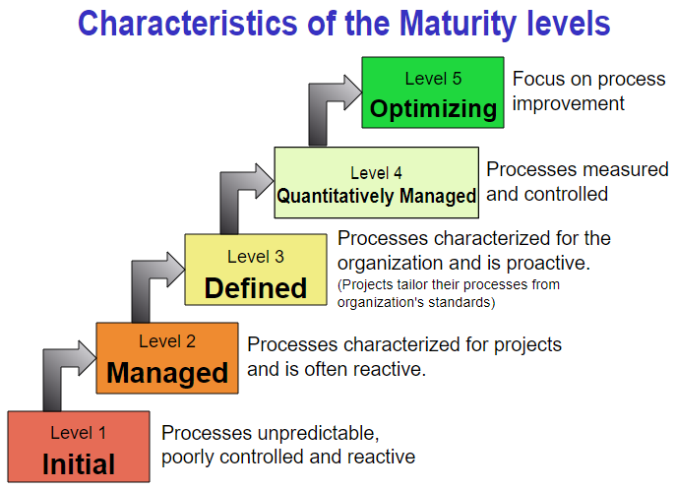
Agile – CMMI (Capability Maturity Model Integration) https://en.wikipedia.org/wiki/Capability_Maturity_Model_Integration http://dthomas-software.co.uk/resources/frequently-asked-questions/what-is-cmmi-2/
CMMI is a process level improvement, training, and appraisal program. Its main sponsors originally included the Office of the Secretary of Defense (OSD) and the National Defense Industrial Association.
CMMI was developed by Carnegie Mellon University and The CMMI Project. The aim was to improve existing software development processes.
The CMMI principal is “The quality of a system or product is highly influenced by the process used to develop and maintain it.”. CMMI can be used to guide process improvement across a project, a division, or an entire organization.

Slide 12
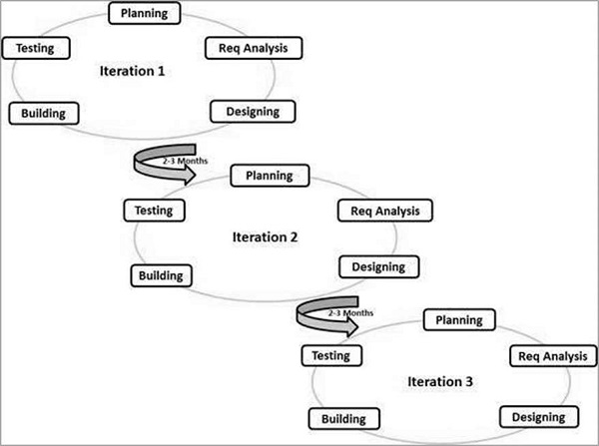
Agile – Overview https://agilemanifesto.org/principles.html
There are multiple Agile styles. Together, they are referred to as Agile Methodologies.
In Agile:
Interactions are prioritized over processes.
Working software is more important than extensive documentation.
Collaboration with the client is prioritized above negotiation.
Quick response to new requirements is the most important aspect of the whole process.

Slide 13
Agile – Overview https://agilemanifesto.org/principles.html
Agile Priorities:
Early and continuous delivery (CI/CD).
Quick acceptance of and adjustment to changing requirements.
Quick delivery of a working product.
Sustainable development process.
Regularly scheduled sessions of introspection (Daily Stand-up’s)
Constant adjustment to a dynamic development environment.

Slide 14
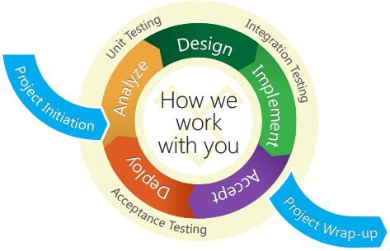
Agile - Characteristics https://en.wikipedia.org/wiki/Agile_software_development https://www.agilealliance.org/glossary/daily-meeting https://www.tutorialspoint.com/sdlc/sdlc_agile_model.htm
The Agile Process is a series of Sprints where each team has a specific User Story. A Sprint has a predetermined start and stop date and lasts 2-4 weeks. After each Sprint, teams demonstrate what they’ve accomplished to each other and to the client. Feedback is then taken to inform the next Sprint. A Sprint also includes short, daily “Standup” meetings.
Daily Standup – Each member reports:
What I did yesterday.
What I intend to do today.
What “blockers” I have.
Information Radiator (Kanban) - A board presenting an up-to-date summary of the status of the product.
Continuous Integration – The practice of merging all developers' working copies to a shared master. This is done several times a day.
Test Driven Development – Relies on the repetition of a very short development cycle: requirements are turned into very specific test cases. Then the code is improved until the tests pass.

Slide 15
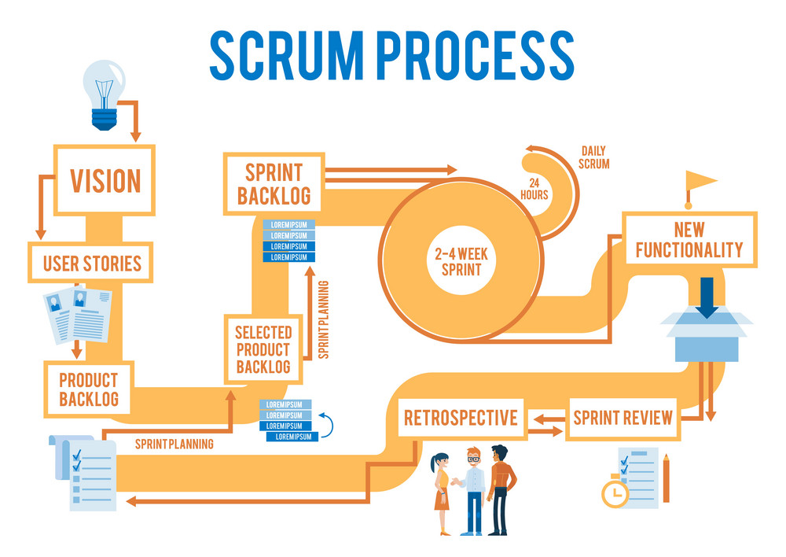
Agile – Scrum https://www.agilealliance.org/glossary/scrum https://www.scrum.org/resources/what-is-scrum
Scrum is a framework that facilitates addressing complex problems while delivering products of the highest possible value.
In a Scrum, teams work iteratively to:
hypothesize about how the final project should work,
try to implement the idea,
reflect on the experience,
Make necessary adjustments,
repeat the cycle.
Scrum is best used when the amount of work required can be split in to more than one Sprint.
Daily Stand-ups allow each person to transparently share the difficulties (Blockers) they are having. Adjustments are made to focus the following days efforts, based on the Stand-up.

Slide 16
Agile – Scrum Details https://www.agilealliance.org/glossary/scrum
A Scrum starts with a Sprint Planning Meeting with the client. In a Sprint Planning Meeting, User Stories that form the Sprint Backlog are created. Backlog items are added to the Scrum Board (Kanban).
Teams then decide how they will successfully deliver a working iteration at the end of the first Sprint. The Sprint Backlog is then locked and no more User Stories can be added.
During the Sprint, the Scrum Master conducts a short (15-minute) Daily Standup in which members discuss blockers and coordinate efforts for the day.

Slide 17
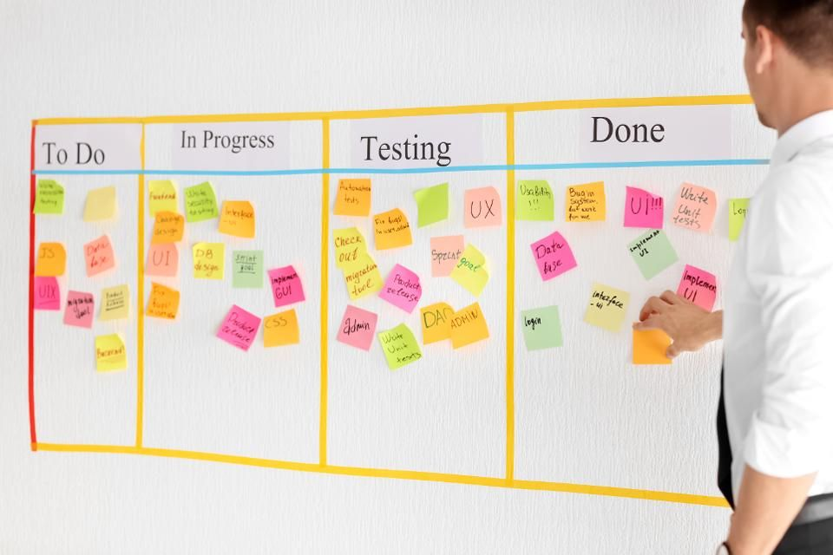
Agile – Kanban https://www.atlassian.com/agile/kanban/wip-limits https://www.agilealliance.org/glossary/kanban
The Kanban Method gets its name from the use of “Kanban”, a Japanese word for visual signaling mechanisms representing work-in-progress.
A general term for systems using the Kanban Method is “flow”. Flow shows that work flows continuously through the system instead of being constrained to distinct timeboxes.

Slide 18
Agile – Kanban Board https://www.atlassian.com/agile/kanban/wip-limits https://www.agilealliance.org/glossary/kanban
Kanban systems use a Kanban Board to visualize work and the process it goes through. In the Kanban system,
programmers are aided in maintaining a narrow focus on tasks.
Bottlenecks and blockers are identified and addressed.
Feedback loops are used to make small changes to increase efficiency.
Balance of effort across services and response to risks and inefficiencies is emphasized.
Kanban starts with the process as it currently exists and applies continuous and incremental improvement.

Slide 19
Agile – Sprint https://www.agilealliance.org/glossary/user-story-template/
A Sprint is a designated period of time in which teams work to complete a User Story. All User Stories for a project form what’s called the Backlog. The Backlog is a record of all the User Stories.
Each User Story is assigned points representing the expected effort needed to complete it.
After the Sprint, Team members add up effort points for User Stories completed during the Sprint.
Points completed represent the Velocity.
Knowing their Velocity, the team can estimate how many Sprints will be required to complete the project. Teams can use their Velocity to modulate how much work they take on in each Sprint.

Slide 20
Agile – Sprint Review https://www.agilealliance.org/glossary/scrum
Sprint Review - After the Sprint, teams, client, and stakeholders meet to:
demonstrate the in-progress product,
review the results of the Sprint,
place feedback into the Product Backlog for future iterations.
Sprint Retrospective – After the Sprint Review, the team meets to make adjustments going forward and decide on which User Stories will be included in the next Sprint.

Slide 21
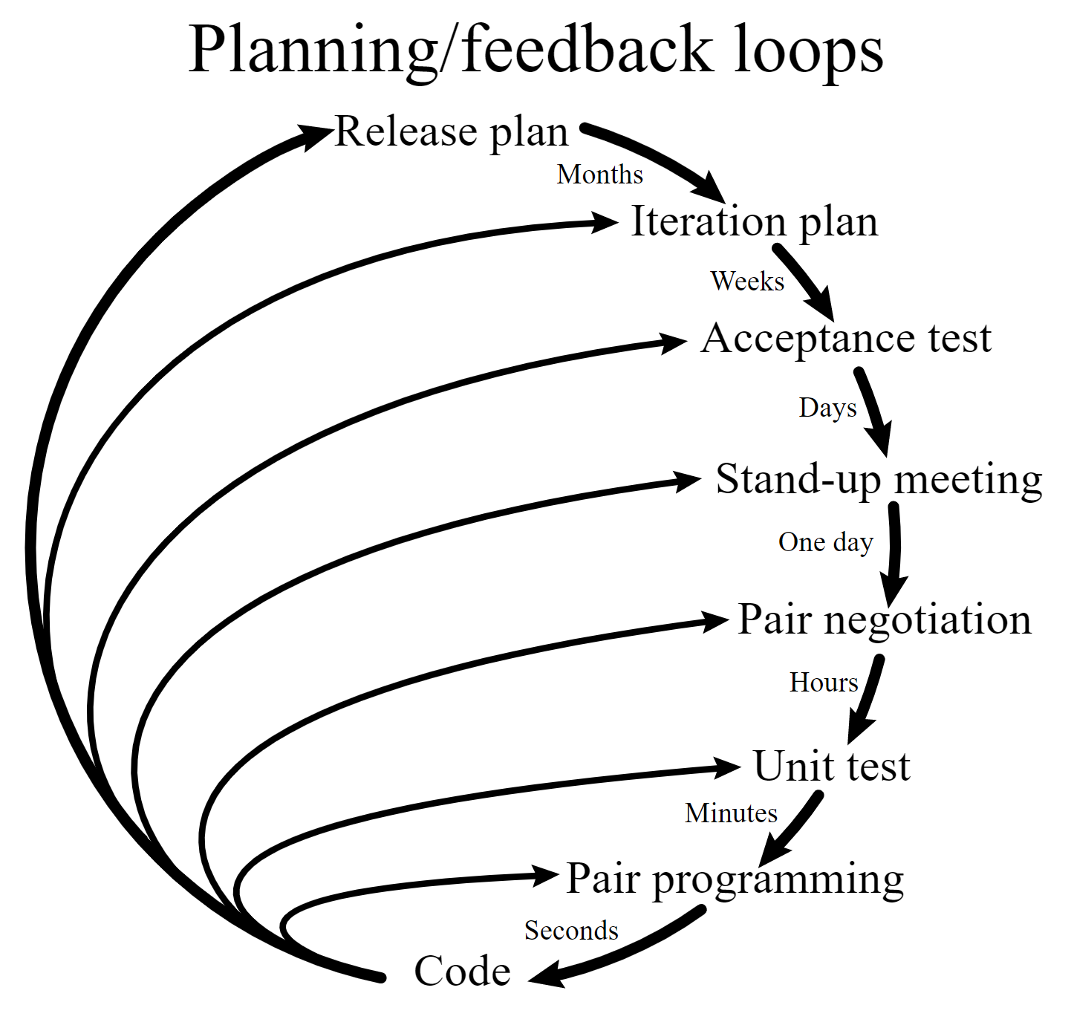
Agile – Extreme Programming https://en.wikipedia.org/wiki/Extreme_programming https://www.agilealliance.org/glossary http://www.extremeprogramming.org/when.html
Extreme Programming (XP) is an Agile software development framework that aims to produce higher quality software, and higher quality of life for the development team in programming environments where the requirements constantly change.
XP is the most specific of the Agile frameworks regarding appropriate engineering practices for software development.
XP is set up for small groups of between 2 and 12 programmers including developers, managers, and customers.
Automated unit and functional tests must be created for the project using TDD.
XP advocates frequent "releases" in short development cycles, which is intended to improve productivity and introduce checkpoints at which new customer requirements can be adopted.

Slide 22
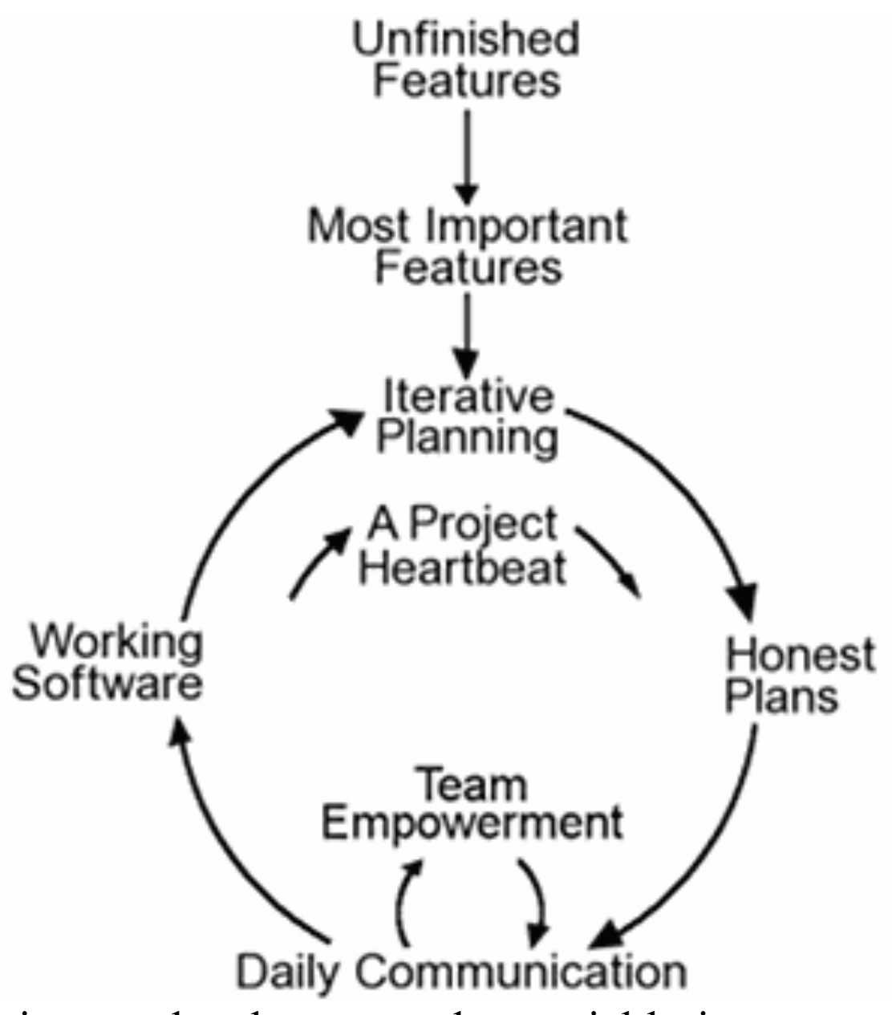
Agile – EP Best Practices (1/2) https://en.wikipedia.org/wiki/Extreme_programming https://www.agilealliance.org/glossary http://www.extremeprogramming.org/when.html
The defining practices of XP are:
Sit Together – The team sits together in the same place to better allow efficient, effective communication
Whole Team – Client and all people who play any part in the development work together daily.
Informative Workspace – The workspace is set up to allow face-to-face communication. Information Radiators are used to clearly and quickly communicate information.
Energized Work - Make sure SE’s are able physically and mentally focus on the work.
Pair Programming – This provides a continuous code review as one SE codes while another monitors and provides input.
Stories - Short descriptions of things users want to be able to do with the product and that can be used for planning.

Slide 23
Agile – EP Best Practices (2/2) https://en.wikipedia.org/wiki/Extreme_programming https://www.agilealliance.org/glossary http://www.extremeprogramming.org/when.html
The defining practices of XP are:
Weekly Cycle – An Iteration that starts with a Scrum Meeting where the client picks stories to focus on during that week and SE’s decide how to accomplish them. It ends with unit tested functionality.
Quarterly Cycle – A release of the product. The purpose is to keep the detailed work of each weekly cycle in context of the overall project.
Slack – Include some stories in the weekly cycle that can be postponed if unexpected delays arise.
10-minute Build – Keep the overall build time under 10 minutes. This promotes more frequent build triggers.
Continuous Integration – Immediately include tested code changes when they are merged to the primary code.
Test-Driven Development – TDD is required so that bugs are found and fixed earlier.
Incremental Design – Create the framework of the project first, then dive into more detailed work later.

