Slide 1

Publish Code Coverage to SonarCloud
.NET

Slide 2
SonarCloud is a cloud-based code analysis service designed to detect code quality issues in 25 different programming languages, continuously ensuring the maintainability, reliability and security of your code.
https://sonarcloud.io/documentation

Slide 3
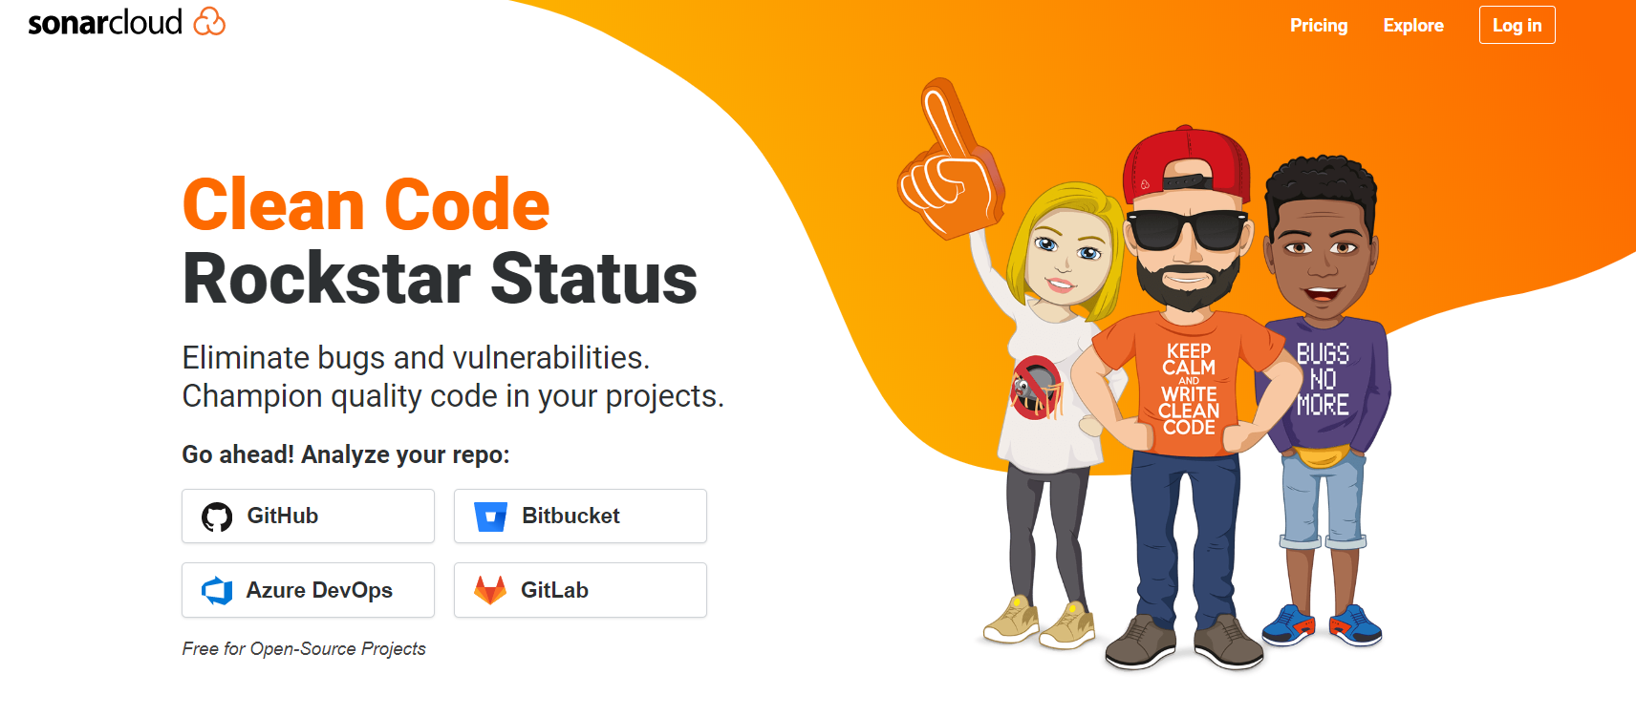
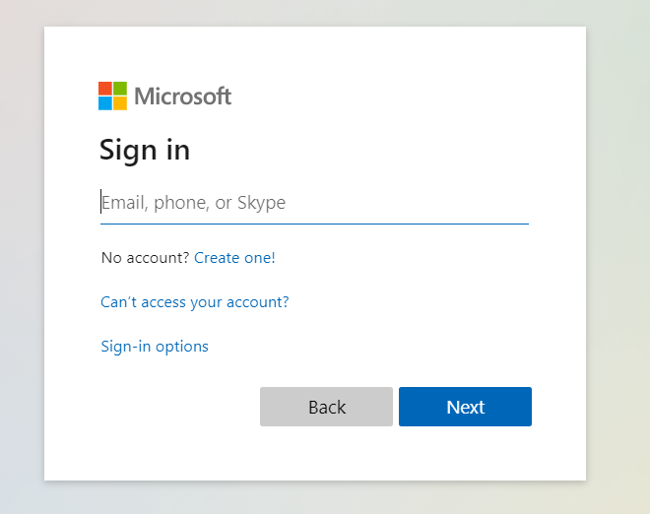
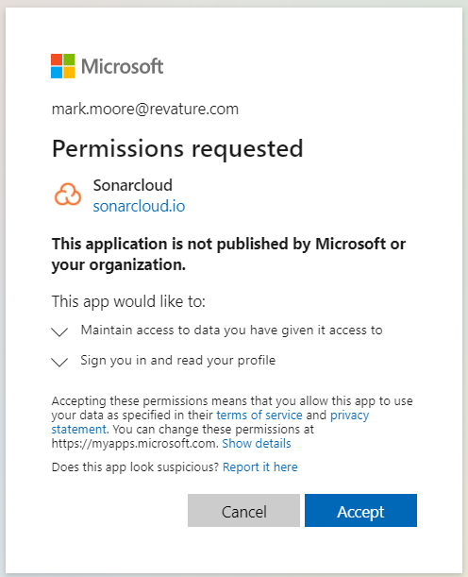
First Steps https://sonarcloud.io/
First, create a pipeline that successfully builds and deploys to your Website.
Next, log in to www.sonarcloud.io.
(Important) Use your Azure DevOps credentials.
If asked, accept any request for permission or access by Sonarcloud.

Slide 4
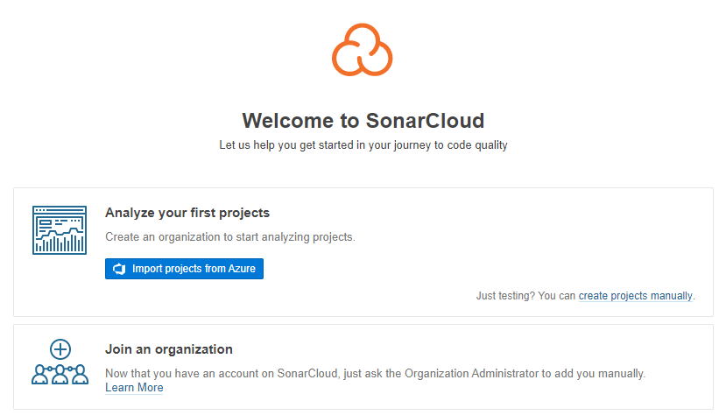
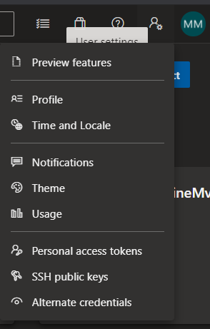
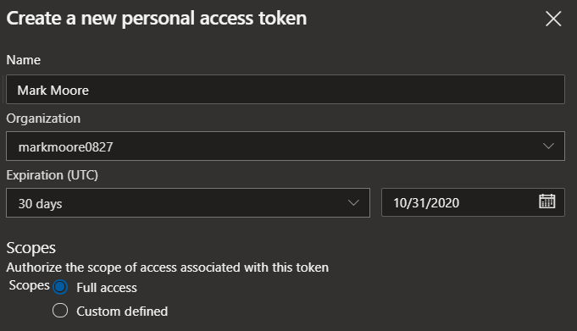
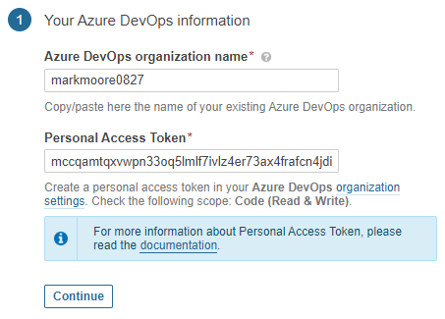
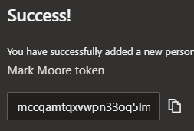
Create SonarCloud Organization
Create an organization
Enter the correct name of your Azure Devops Organization and a Personal Access Token (P.A.T.).
Log into your Azure Account.
In the upper right, click on User Settings>Personal Access tokens.
Click ‘New Token’.
Enter your name and select ‘Full Access’
Select ‘Create’
Copy your P.A.T.
Enter the P.A.T.
Click ‘Continue’

Slide 5
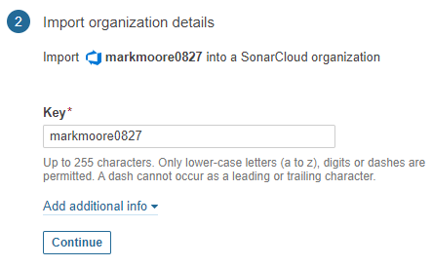
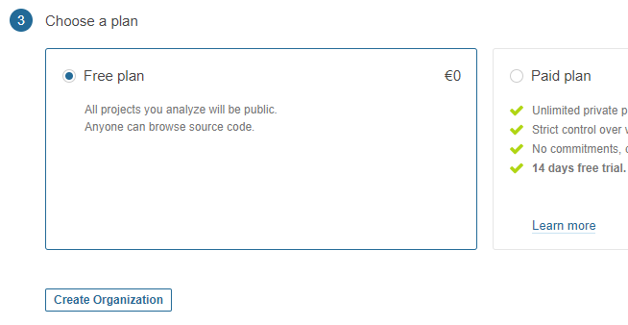
Create SonarCloud Organization
Click ‘Continue’ to Import your organization details
Select ‘Free plan’
Click “Create Organization”

Slide 6
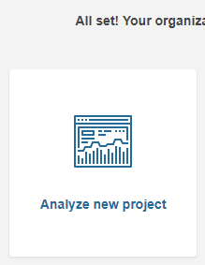
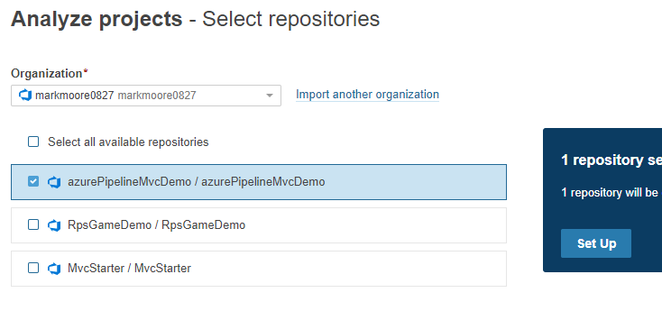
Analyse a New Project
Click ‘analyse new project’.
Choose the pipeline you want to analyse.
Click ‘Set Up’.

Slide 7
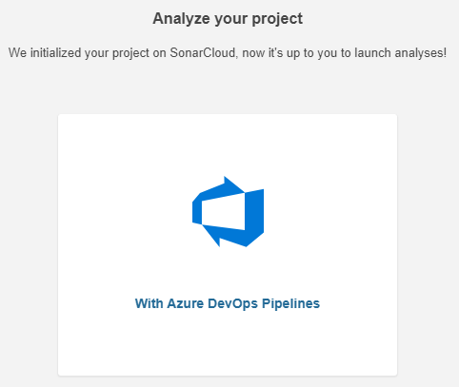
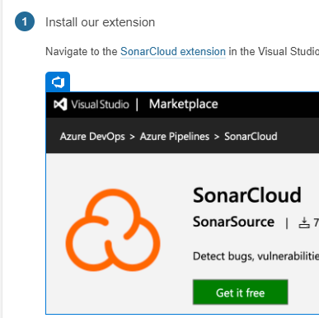
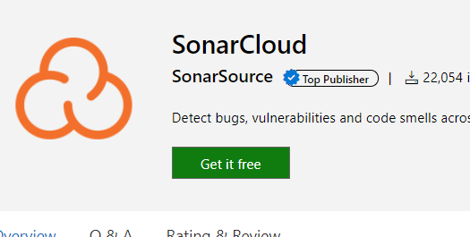
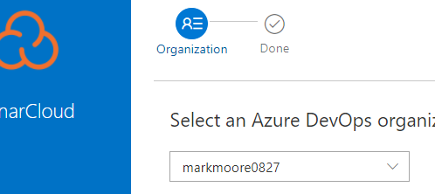
Configure Code Analysis
Click on ‘With Azure DevOps Pipelines’
Click to download the SonarCloud Extension from the from the Visual Studio Marketplace.
Make sure to choose the correct organization when installing in the Marketplace.

Slide 8
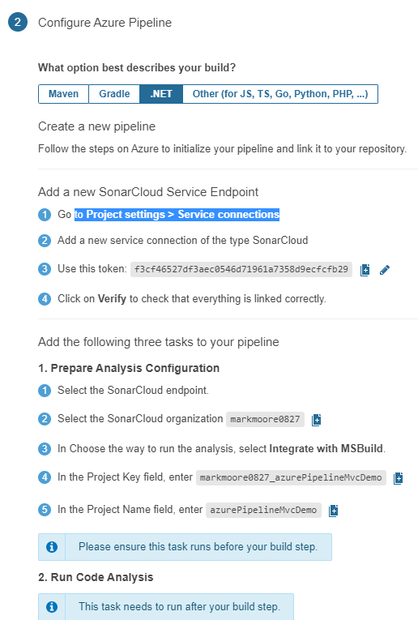
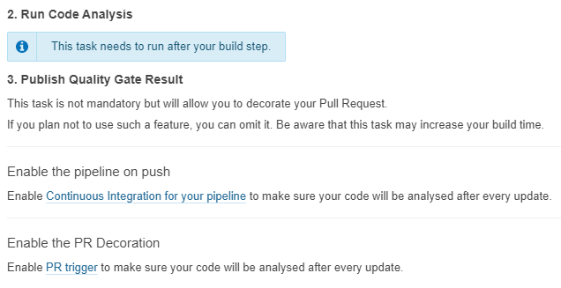
Configure Azure Pipeline
The steps on the following pages will guide you through setup on the Azure DevOps side.
See the Step-By-Step on the following slides.

Slide 9
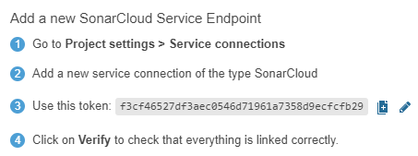
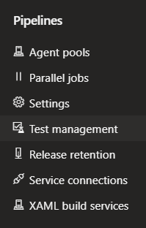
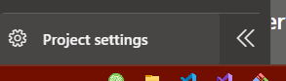
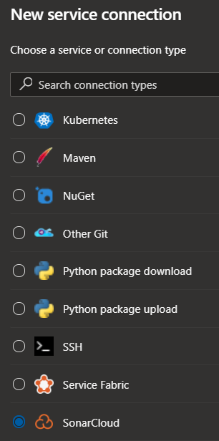


Add a new SonarCloud Service Endpoint
In your Azure DevOps account, click on the project you will be adding the Code Analysis to.
Click Project settings at the bottom left of your project home page.
Click the ‘back’ arrow next to Project details.
Click Service Connections under Pipelines.
Click ‘New service connection’ in the upper right.
Select ‘SonarCloud’ in the ‘New Service Connection’ List
Click Next.

Slide 10
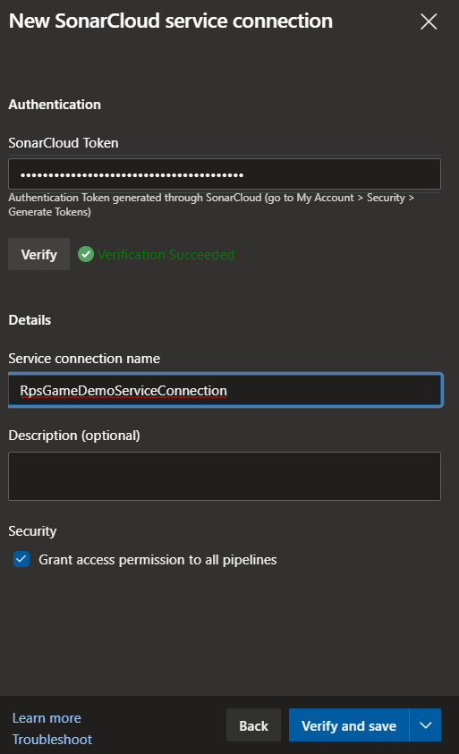
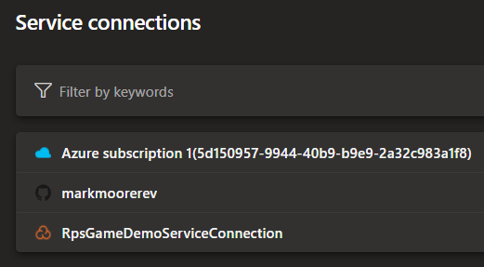
New SonarCloud Connection
Paste in the Personal Access Token under ‘SonarCloud Token’.
Create a name for your connection under ‘Service connection name’.
Click ‘Verify and Save’.
Verify the connection was successful.

Slide 11
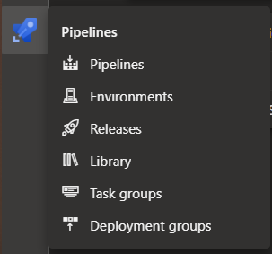
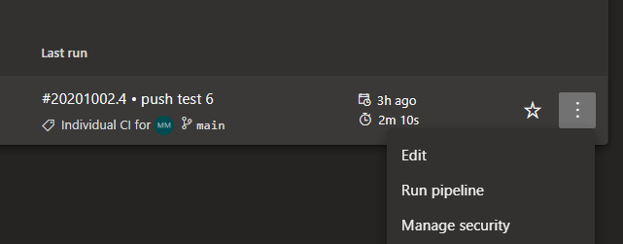
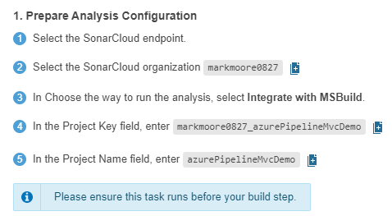
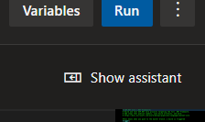
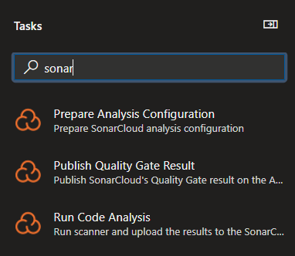
Add publish task to your pipeline YAML
Add the following three tasks to your pipeline.
Click Pipelines under the Rocket (Pipelines) avatar in the left column.
Click Edit under the pipeline you want to add code analysis to.
Click ‘Show Assistant’ in the upper left.
Select ‘Prepare Analysis Configuration’.

Slide 12
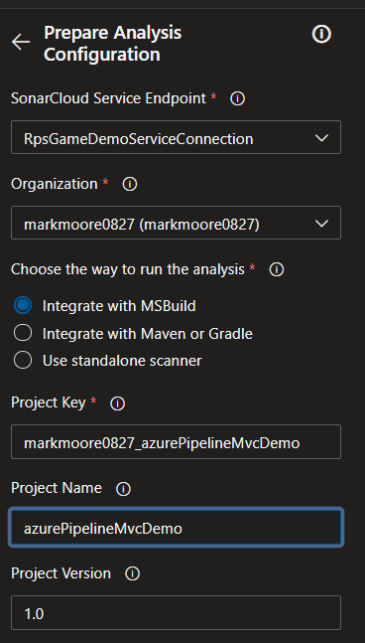
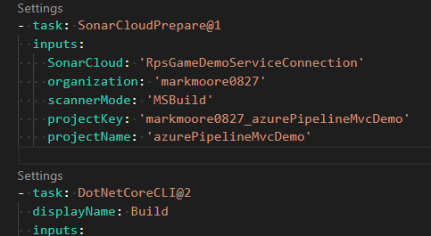
Add Code Analysis configuration task to your pipeline YAML
You don’t have to change anything under ‘Advanced’.
Place the curser on the line above your ‘build’ Task.
Click ‘Add’

Slide 13
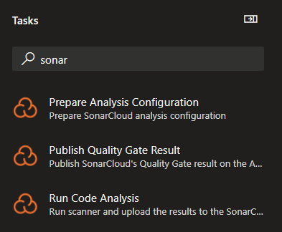

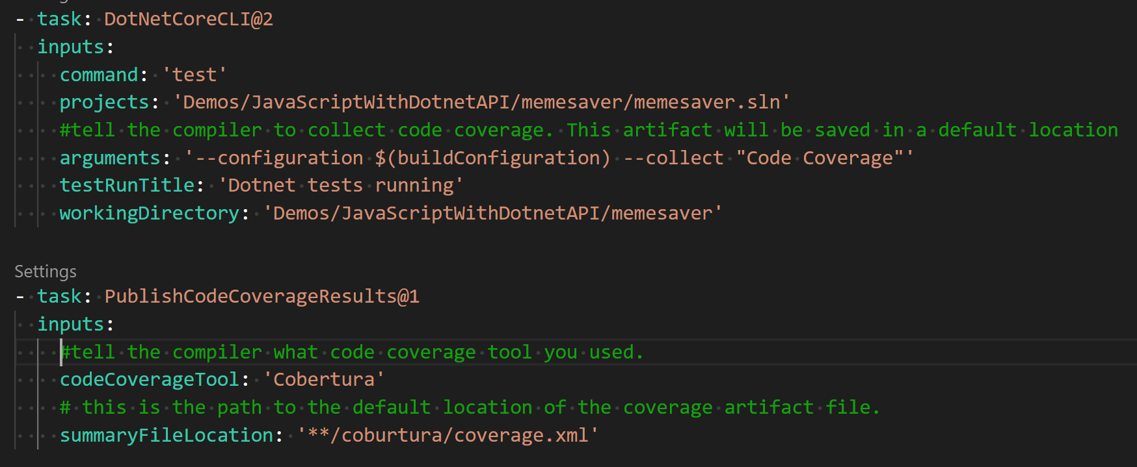
Add Code Analysis to your YAML
Click ‘Show Assistant’ to return to the Assistant.
Make sure the curser is immediately below the ‘build’ task.
Click ‘Run Code Analysis’.

Slide 14
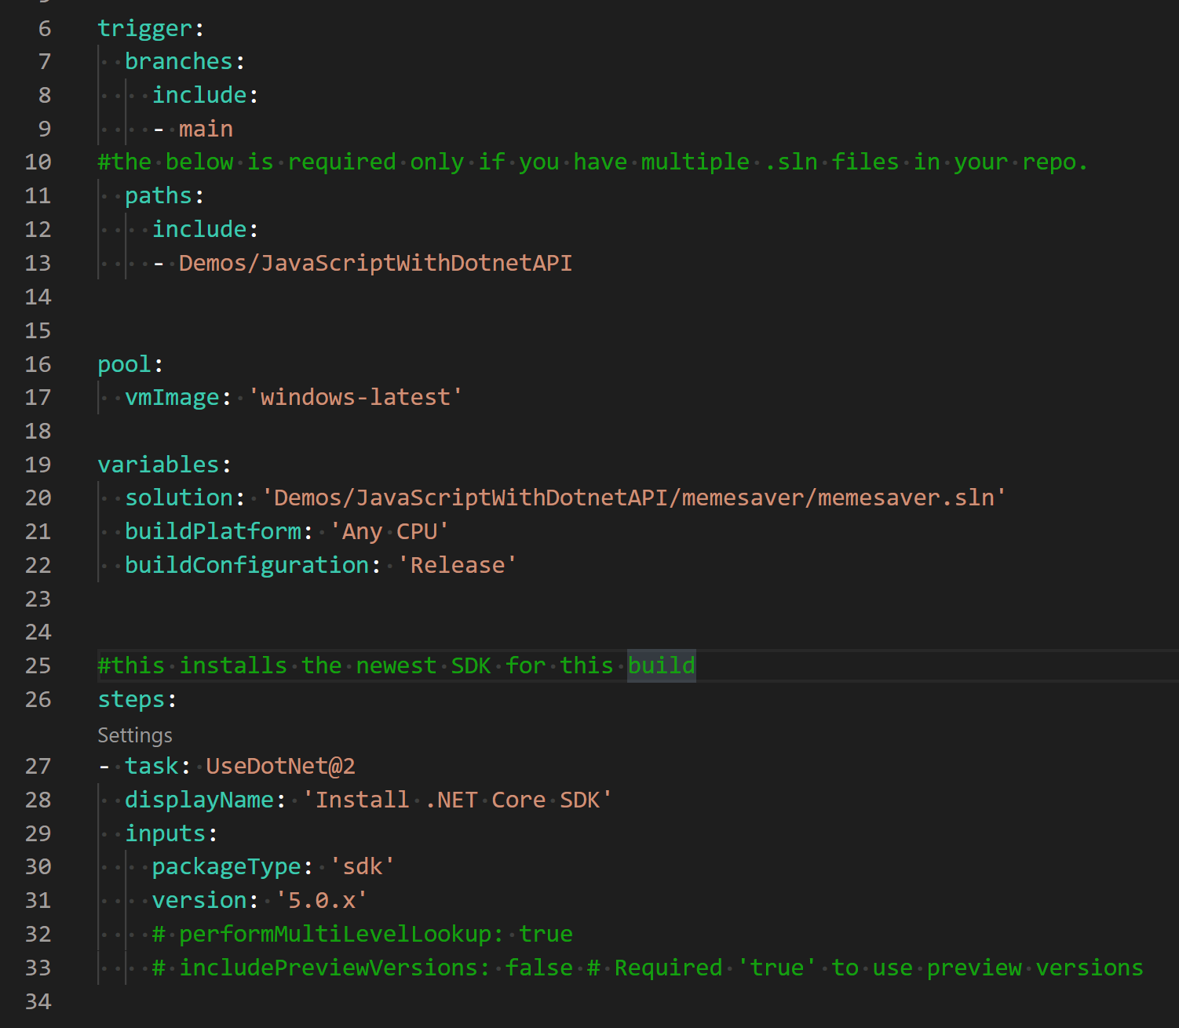
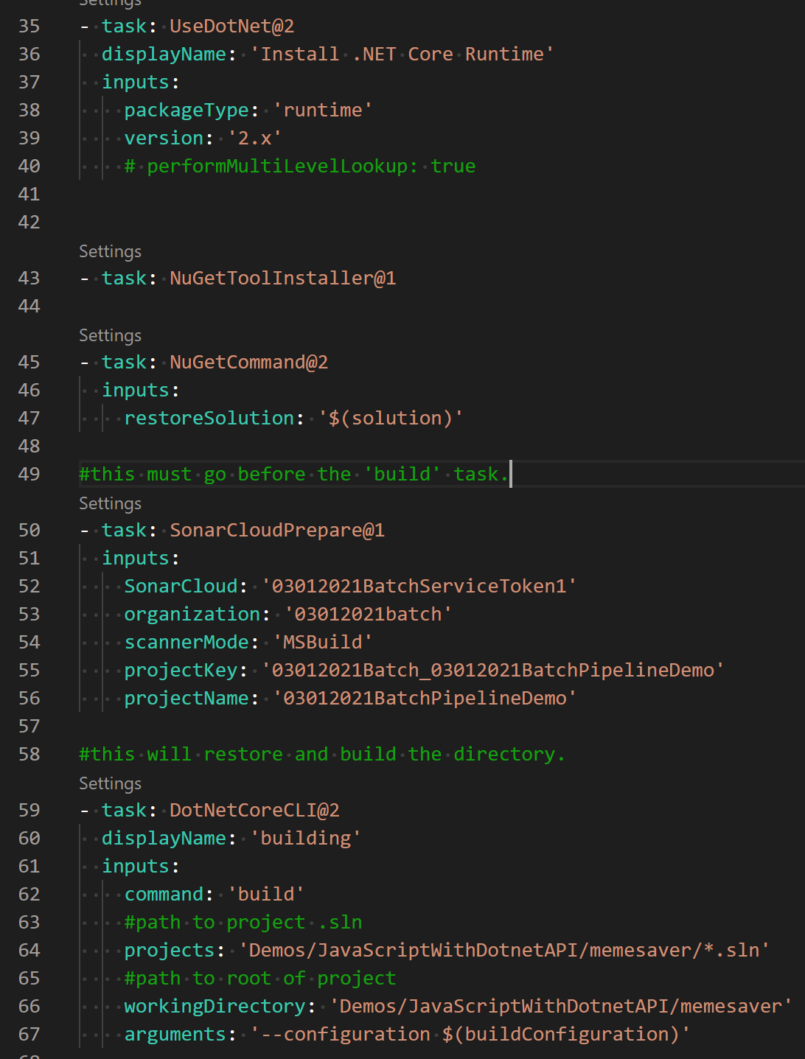
Complete Pipeline YAML file (1/2)

Slide 15
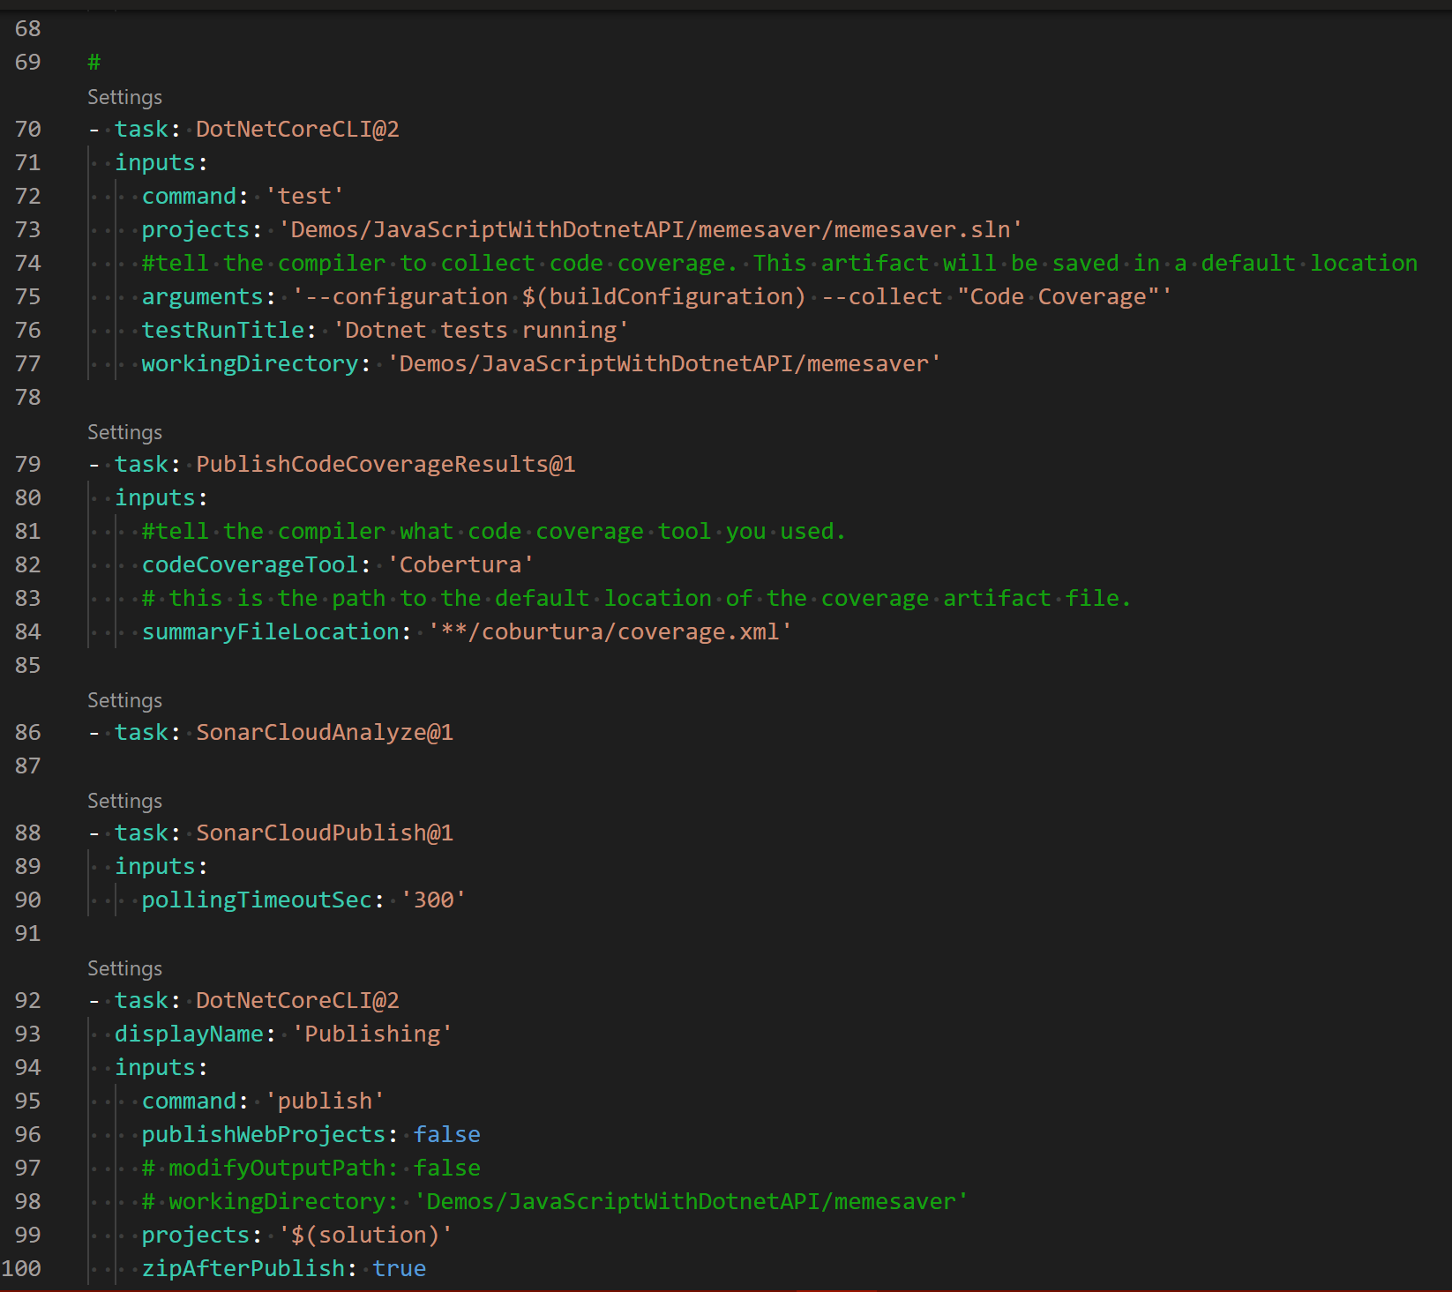
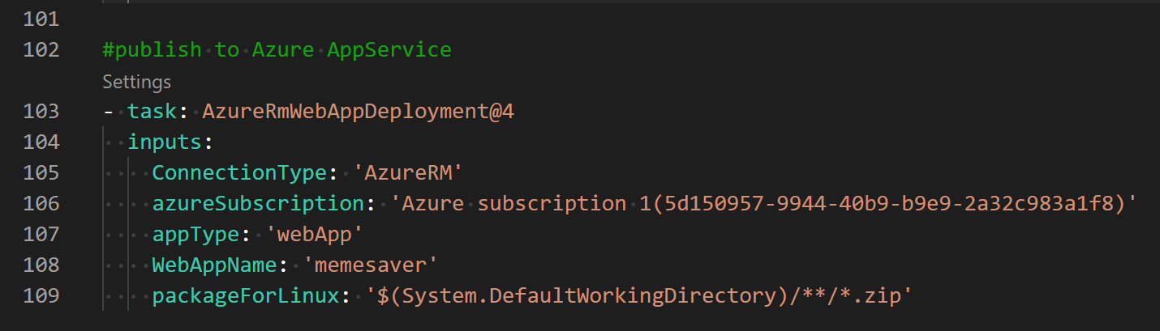
Complete Pipeline YAML file (2/2)

Slide 16
A Microsoft Docs Lab Tutorial
https://azuredevopslabs.com/labs/vstsextend/sonarcloud//

