Slide 1

Containerization and Virtualization
.NET

Slide 2
Containerization is the packaging of software along with the libraries and dependencies required to run the code. The lightweight executable (a container) runs on any infrastructure.
https://www.ibm.com/cloud/learn/containerization

Slide 3
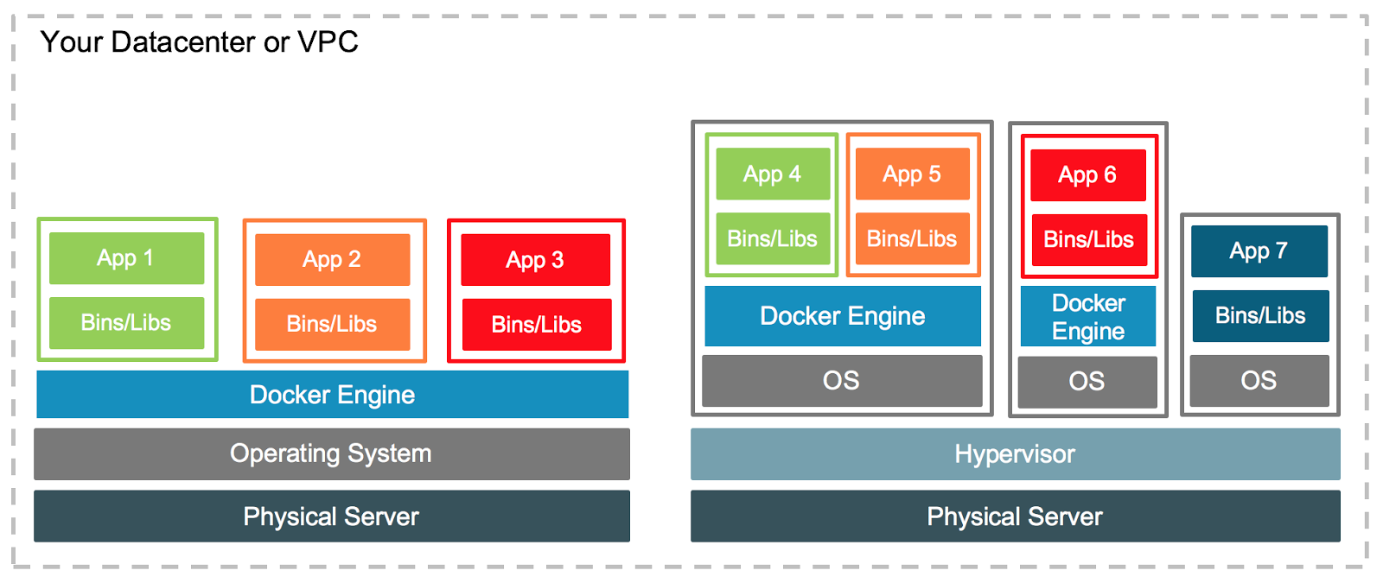
Containerization is not Virtualization https://en.wikipedia.org/wiki/Virtualization#Hardware_virtualization https://www.docker.com/blog/containers-and-vms-together/
Virtualization refers to the creation of a Virtual Machine. A virtual machine is an application that simulates a computer within an existing operating system and hardware.
Software executed on a Virtual Machine is isolated from the underlying hardware resources.

Slide 4
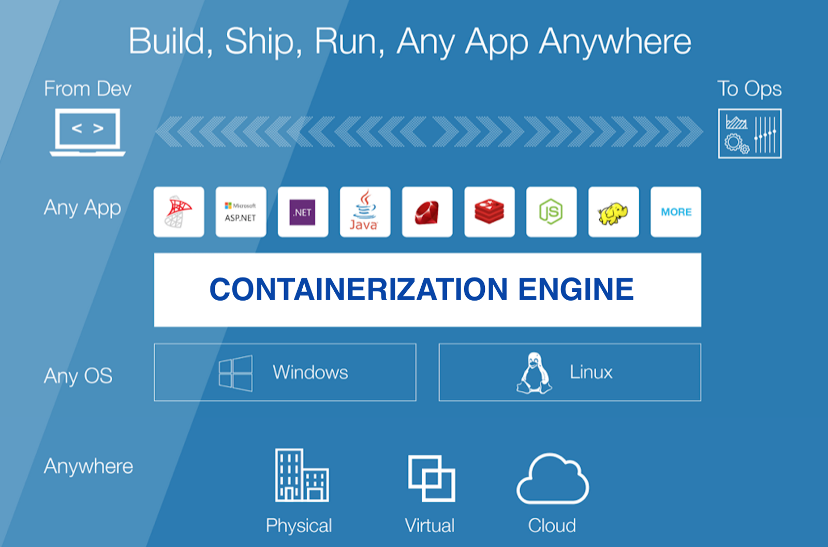
What is Containerization? https://hackernoon.com/what-is-containerization-83ae53a709a6 https://www.ibm.com/cloud/learn/containerization
Containerization is the bundling of everything an application needs to run inside a single package.
When the needed configuration files, libraries, and dependencies an application requires are included in one package, it can be run in any environment.
Containers are more portable and resource-efficient than virtual machines (VMs). Containers are the de facto compute units of modern cloud-native applications.
The most popular containerization ecosystems are Docker and Kubernetes.

Slide 5
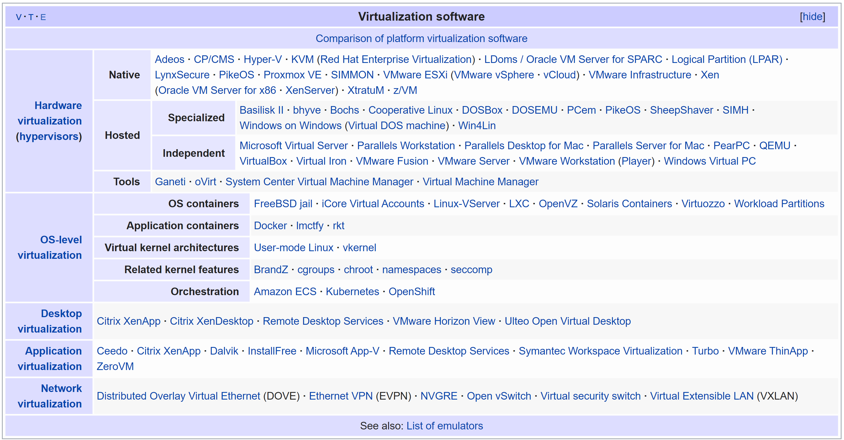
Virtualization Software Examples https://en.wikipedia.org/wiki/Virtualization

