Slide 1

Docker Compose
.NET

Slide 2
docker compose is a tool for defining and running multi-container Dockerized applications. docker compose uses a YAML file to configure an application’s services.
https://docs.docker.com/compose/

Slide 3
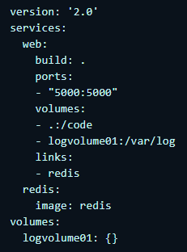
docker compose – Overview https://docs.docker.com/compose/
docker-compose up allows you to create and start all the services composing your application at once. docker-compose works in all environments: production, staging, development, testing, and CI/CD workflows.
Using docker compose is a three-step process:
Define your app’s environment (‘Dockerize’ it) with a Dockerfile
Define the app’s services including their docker run arguments in docker-compose.yml so they can be run together in an isolated environment.
Run docker-compose up and the Compose app builds and runs all your containers using the configuration you provide it the docker-compose.yml.

Slide 4
Docker Compose - Features https://docs.docker.com/compose/#features
Have many isolated environments on one host | Preserve volume data when containers are created | Recreate containers that have changed | A composition is portable between environments
Because Compose uses unique names for each project, the projects run independently of each other. Use –p to give your project a unique name. | When docker-compose up runs, it copies the volumes from the old container to the new container. This ensures that any data you’ve created in volumes isn’t lost. | Compose re-uses existing containers if they haven’t been changed. | You can use variables in the Compose file to customize your composition for different environments or different users.

Slide 5
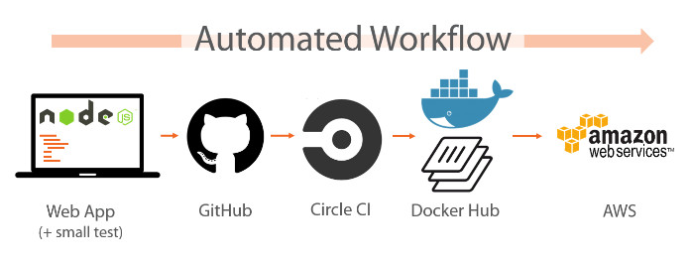
Docker Compose – Use Cases https://docs.docker.com/compose/#common-use-cases
A docker-compose.yml file is used to automate testing configurations and dependencies so that workflows are automated and end-to-end testing is faster and easier.
Compose provides a convenient way to create and destroy isolated testing environments for your test suite.

Slide 6
Docker Context
https://www.docker.com/blog/how-to-deploy-on-remote-docker-hosts-with-docker-compose/
Use docker-compose to deploy to a remote server.
Normally, Docker is used in development or testing, but it’s becoming more popular to use in deployment.

Slide 7
Multi container apps https://docs.docker.com/get-started/07_multi_container
The question often arises - “Where will MySQL run? Install it in the same container or run it separately?” Each container should do one thing…very well. The following are a few reasons to run the container separately:
There’s a good chance you’d have to scale APIs and front-ends differently than databases.
Separate containers let you version and update versions in isolation.
While you may use a container for the database locally, you may want to use a managed service for the database in production. You don’t want to ship your database engine with your app then.
Running multiple processes will require a process manager (the container only starts one process), which adds complexity to container startup/shutdown.
How do you allow one container to talk to another? The answer is networking.

Slide 8
Networking
docker network create todo-app

