Slide 1

Dockerfile
.NET

Slide 2
Docker builds images by reading instructions in a Dockerfile. A Dockerfile is a text document that contains all the actions needed to assemble an image.
https://docs.docker.com/engine/reference/builder/

Slide 3
Dockerfile https://docs.docker.com/engine/reference/builder/ https://docs.docker.com/develop/develop-images/dockerfile_best-practices/
A Dockerfile is a text document that contains all the commands a user would call on the command line to assemble a Docker image.
The Dockerfile is used by the docker build command to create a container image.
docker build executes the instructions from the dockerfile in order.
$ docker build -t svendowideit/ambassador .
Sending build context to Docker daemon 15.36 kB
Step 1/4 : FROM alpine:3.2
---> 31f630c65071
Step 2/4 : MAINTAINER SvenDowideit@home.org.au
---> Using cache
---> 2a1c91448f5f
Step 3/4 : RUN apk update && apk add socat && rm -r /var/cache/
---> Using cache
---> 21ed6e7fbb73
Step 4/4 : CMD env | grep _TCP= | (sed 's/.*_PORT_\([0-9]*\)_TCP=tcp:\/\/\(.*\):\(.*\)/socat -t 100000000 TCP4-LISTEN:\1,fork,reuseaddr TCP4:\2:\3 \&/' && echo wait) | sh
---> Using cache
---> 7ea8aef582cc
Successfully built 7ea8aef582cc

Slide 4
Dockerfile Format https://docs.docker.com/engine/reference/builder/#format https://docs.docker.com/engine/reference/builder/#official-releases
The Dockerfile follows a format very similar to a bash script. Instructions are run sequentially. Comments begin with # and must be on their own line. By convention, keywords are uppercase.
A Dockerfile must begin with a FROM instruction. FROM specifies the Parent image from which the container will be built.
FROM alpine:3.2
#this is a comment
RUN apk update && apk add socat && rm –r /var/cache/
CMD env | grep _TCP= | (sed 's/.*_PORT_\([0-9]*\)_TCP=tcp:\/\/\(.*\):\(.*\)/socat -t 100000000 TCP4-LISTEN:\1,fork,reuseaddr TCP4:\2:\3 \&/' && echo wait) | sh
FROM may only be preceded by ARG instructions which declare arguments that are used in FROM lines in the Dockerfile.
Pre-made images for building Dockerfiles are available in the docker/dockerfile repo on Docker Hub (https://hub.docker.com/).

Slide 5
Docker Multi-stage Build https://docs.docker.com/build/building/multi-stage

Slide 6
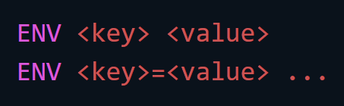
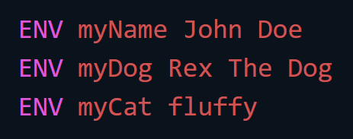
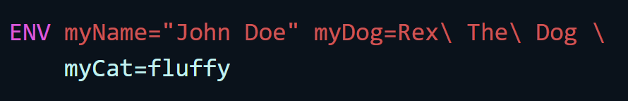
ENV(ironment) variables https://docs.docker.com/engine/reference/builder/#environment-replacement
The ENV instruction sets an environment variable <key> to <value>. The value will be in the environment for all subsequent instructions.
ENV variables will persist when a container is run from the resulting image. docker inspect allows you to view them. You can change them with docker run --env <key>=<value>.
The ENV instruction has two forms.
ENV <key> <value> sets a single variable to a value.
ENV <key>=<value> ..., allows for multiple variables to be set at one time. Quotes and backslashes can be used to “escape” spaces within values.
yields the same results as

Slide 7
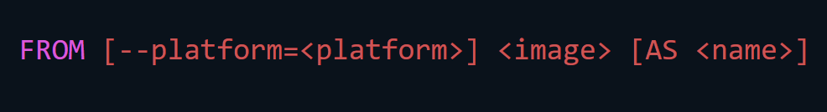
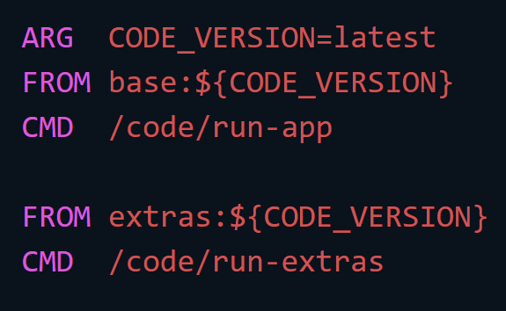
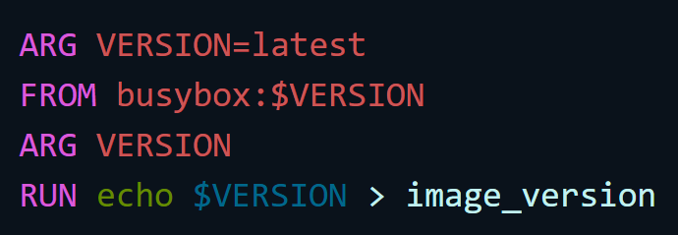
Dockerfile commands – FROM https://docs.docker.com/engine/reference/builder/#from
A Dockerfile must start with FROM. FROM initializes a new build stage and sets the Base Image for subsequent instructions. ARG is the only instruction that may precede FROM in the Dockerfile.
FROM can appear multiple times within a single Dockerfile to create multiple images or use one build stage as a dependency for another.
Give an alias to a new build stage by adding AS to the FROM instruction. The alias can be used in subsequent FROM commands. COPY --from=<alias> instructions refer to the image built in the previous alias stage.
FROM can use variables that are declared by any ARGs occurring before the first FROM.
An ARG declared before FROM is outside of a build stage, so it can’t be used in any instruction after a FROM. Only the FROM itself can use it.

Slide 8

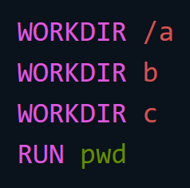
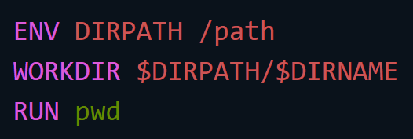
Dockerfile commands – WORKDIR https://docs.docker.com/engine/reference/builder/#workdir
WORKDIR sets the working directory for any RUN, CMD, ENTRYPOINT, COPY, and ADD instructions that follow it in the Dockerfile. If a WORKDIR doesn’t exist, it will be automatically assigned.
WORKDIR can be used multiple times in a Dockerfile. Each new WORKDIR command must be relative to the path of the previous WORKDIR.
WORKDIR can use environment variables previously set using ENV. Only environment variables explicitly set in the Dockerfile can be used.
The output of pwd (path to working directory) in this Dockerfile will be /a/b/c
The output of pwd will be /path/$DIRNAME

Slide 9
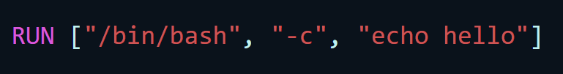
Dockerfile commands – RUN https://docs.docker.com/engine/reference/builder/#run
RUN has 2 forms:
RUN <command> (shell form, the command is run in a shell)
RUN ["executable", "param1", "param2"] (exec form)
RUN will execute commands in a new layer on top of the current image and then commit the results. The resulting committed image will be used for the next Dockerfile step.
Layering RUN instructions and generating commits conforms to the core concepts of Docker where containers can be created from any point in an image’s history.
‘exec’ form syntax makes it possible to RUN commands using a base image that does not contain the specified shell executable.
Exec form syntax

Slide 10
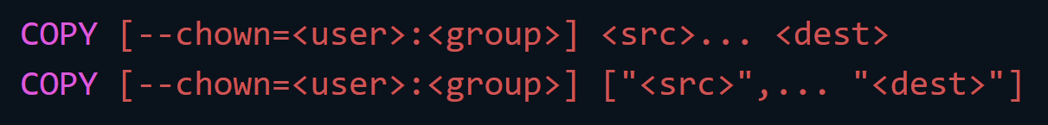
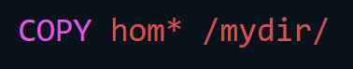

Dockerfile commands – COPY https://docs.docker.com/engine/reference/builder/#copy
The COPY instruction copies new files or directories from <src> and adds them to the filesystem of the Container at the path <dest>.
Multiple <src> resources may be specified. Paths are interpreted relative to the context. <src> may also contain wildcards.
COPY has two forms:
COPY [--chown=<user>:<group>] <src>... <dest>
COPY [--chown=<user>:<group>] ["<src>",... "<dest>"] (used for whitespace)
The (optional) --chown flag specifies a given userName, groupName, or UID/GID combination to request specific ownership of the copied content.
adds all files starting with “hom…”.
adds “test.txt” to <WORKDIR>/relativeDir/
If the user or group are invalid, the build fails on COPY.

Slide 11
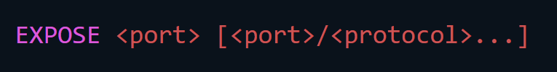


Dockerfile commands – EXPOSE https://docs.docker.com/engine/reference/builder/#expose
EXPOSE informs Docker that the container listens on the specified ports. By default, the port listens on TCP.
EXPOSE does not actually publish the port. It functions as documentation between those who build the image and those who run the container.
You can override Dockerfile EXPOSE settings at runtime with the -p flag.
To publish the port when running the container, use the -p flag on docker run to publish and map one or more ports, or the -P flag to publish all exposed ports and map them to high-order ports.
To override EXPOSE settings

Slide 12
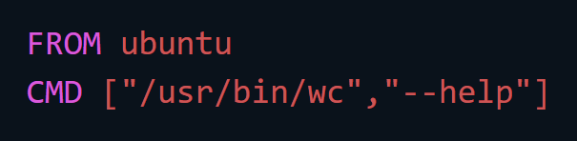
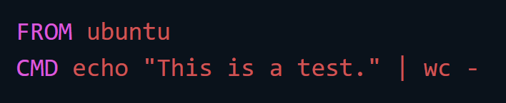
Dockerfile commands – CMD https://docs.docker.com/engine/reference/builder/#cmd
CMD and ENTRYPOINT are very similar. They both provide startup commands.
CMD provides default startup commands for a container. These defaults can include an executable.
CMD does not execute anything at build time but specifies the intended command for the image. If different commands are entered at time of docker run, CMD commands are overridden.
The CMD instruction has three forms:
CMD ["executable",“arg1",“arg2"] (exec form. Preferred)
CMD [“arg1",“arg2"] (default params to ENTRYPOINT)
CMD command arg1 arg2 (shell form)
There can only be one CMD instruction in a Dockerfile.
This exec form is the preferred format of CMD. Params must be expressed as strings in the array.
Shell form. The <command> will execute in /bin/sh -c

Slide 13
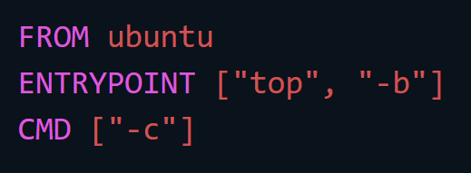

Dockerfile commands – ENTRYPOINT (1/2) https://docs.docker.com/engine/reference/builder/#entrypoint
ENTRYPOINT allows configuration of a container to run as an executable. It has two forms:
ENTRYPOINT ["executable", “arg1", “arg2"] (exec form is recommended)
ENTRYPOINT command arg1 arg2 (shell form*)
ENTRYPOINT must be specified when CMD omits the executable.
If CMD is used to provide default arguments for ENTRYPOINT. Both the CMD and ENTRYPOINT instructions should use the JSON array format.
This command starts nginx with its default content, listening on port 80:
*Click the link above for more specifics on the shell form of ENTRYPOINT instruction.

Slide 14
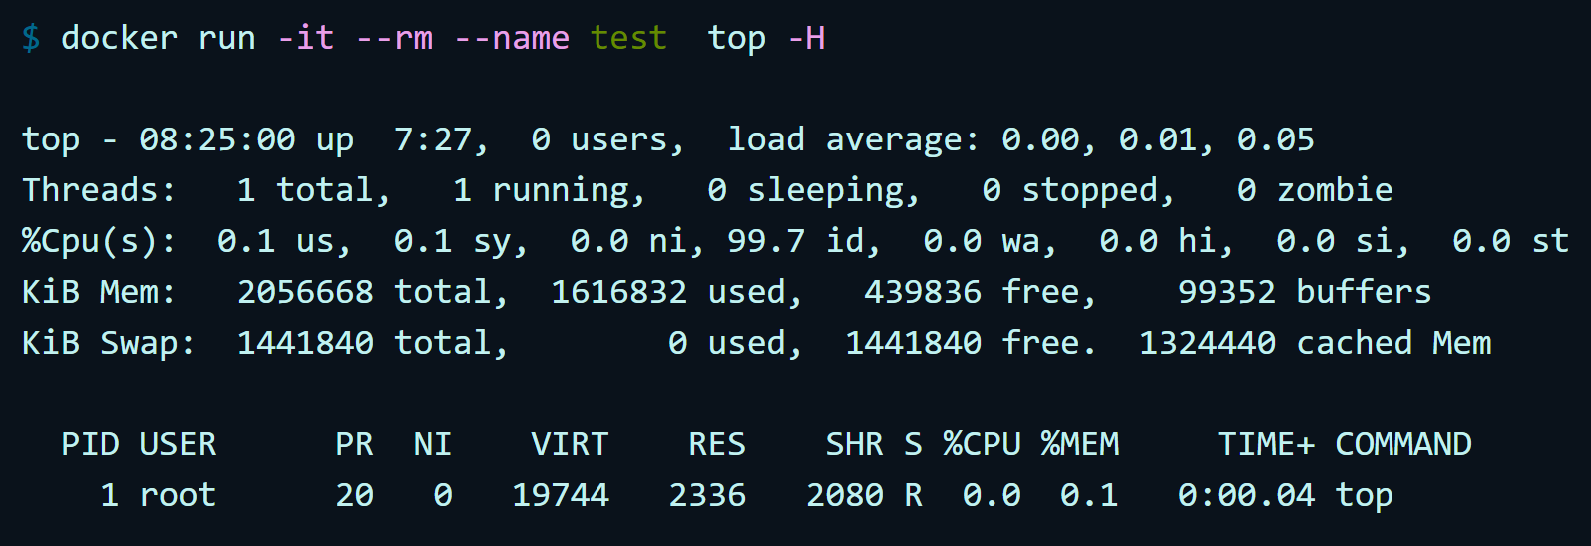
Dockerfile commands – ENTRYPOINT(2/2) https://docs.docker.com/engine/reference/builder/#exec-form-entrypoint-example
Command line arguments to docker run <image> will be appended after all elements in an exec form ENTRYPOINT. They override all elements specified using CMD. This allows docker run <image> -d to pass the -d argument to the entry point. ENTRYPOINT can be overridden by using the --entrypoint flag at docker run time.
Use the exec form of ENTRYPOINT to set default commands or arguments and then use CMD to set additional defaults that are more likely to be changed on execution.
Configure the above, then run the container to see that ‘top’ is the only process.
*Click the link above for more specifics on the shell form of ENTRYPOINT instruction.

Slide 15
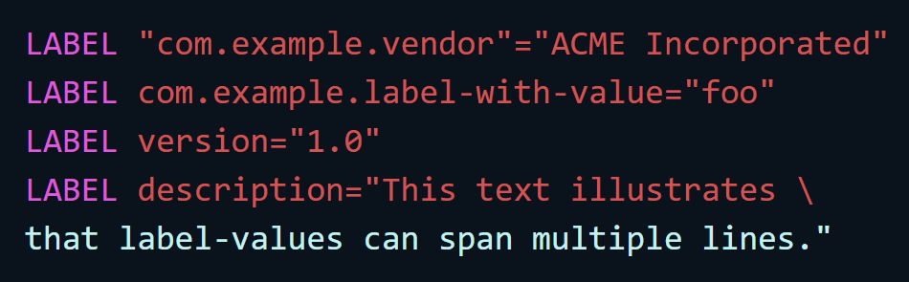

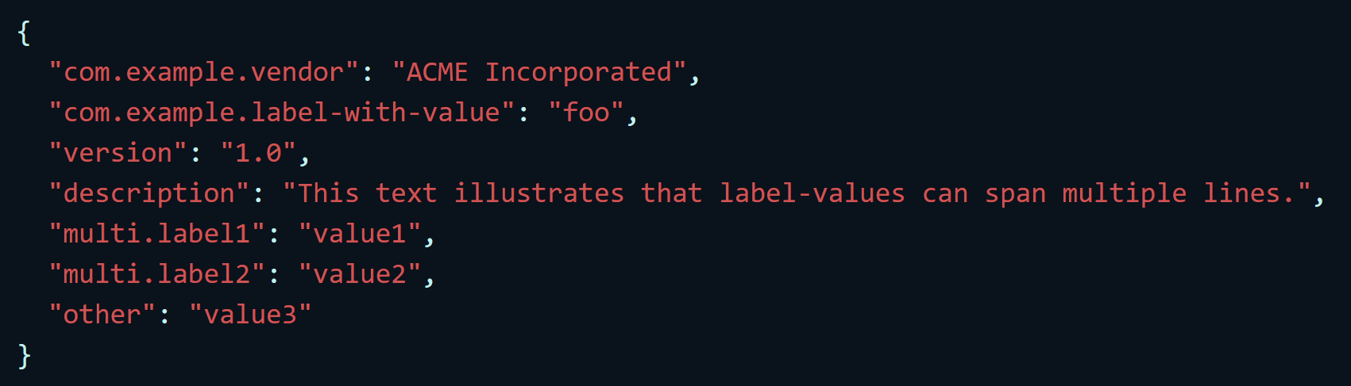
Dockerfile commands – LABEL https://docs.docker.com/engine/reference/builder/#label
LABEL adds metadata to an image as a key-value pair.
Include spaces by using quotes (or backslashes) as in command-line parsing.
You can specify multiple labels on a single line.
Labels included in parent images (images in the FROM line) are inherited.
If a LABEL already exists with a different value, it’s overwritten
To view an image’s labels, use docker image inspect command.

Slide 16



Dockerfile commands – ADD https://docs.docker.com/engine/reference/builder/#add
ADD <src> <dest> copies new files, directories or remote file URLs from <src> and adds them to the filesystem of the image at the path <dest>.
Multiple <src> resources may be specified.
File or directory paths are written relative to the source of the build context.
Each <src> may contain wildcards. Matching is done using Go’s filepath.Match rules.
There are many more options and configurations for ADD in the docs linked above.
use a relative path to add “test.txt” to <WORKDIR>/relativeDir/
use an absolute path to add “test.txt” to /absoluteDir/
Escaping special chars. Adds “test.txt” to <WORKDIR>/relativeDir/

Slide 17
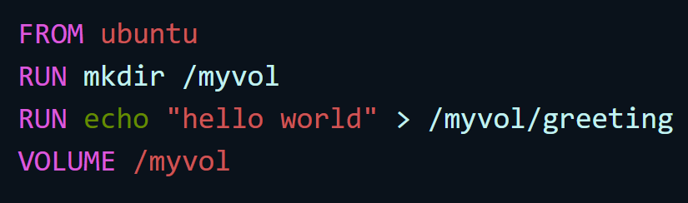
Dockerfile commands – VOLUME https://docs.docker.com/engine/reference/builder/#volume
VOLUME creates a mount point with the specified name and marks it as holding externally mounted volumes from native host or other containers.
The exact location of the volume on the host machine is decided by the docker engine. The volume is accessed by the docker engine using the specified name given at creation.
The value can be a JSON array,
VOLUME ["/var/log/"]
a plain string,
VOLUME /var/log
or have multiple arguments
VOLUME /var/log /var/db
docker run initializes the newly created volume with any data that exists at the specified location within the base image.
The Dockerfile example above results in an image that causes docker run to create a new mount point at /myvol and copy the greeting file into the newly created volume.

Slide 18


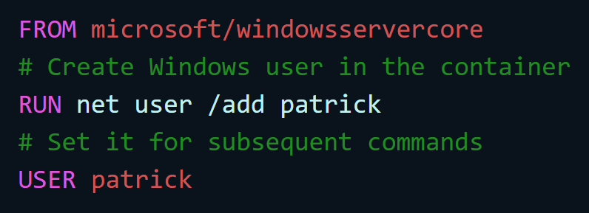
Dockerfile commands – USER https://docs.docker.com/engine/reference/builder/#user
USER sets the user’s name or UID and the user group or GID to use when running the image for any RUN, CMD and ENTRYPOINT instructions that follow it in the Dockerfile.
The user will have only the specified group membership. Any other configured group memberships will be ignored.
On Windows, the user must be created first if it’s not a built-in account. This is done with net user called as part of a Dockerfile.

Slide 19
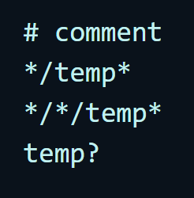
.dockerignore file https://docs.docker.com/engine/reference/builder/#dockerignore-file
a .dockerignore file allows you to exclude files and directories from docker build.
The .dockerignore file is a newline-separated list of filenames relative to the root directory of the context. The root of the context is also the working directory.
Comment. This is ignored.
Exclude files/directories whose names start with temp in any immediate subdirectory of the root.
Exclude files/directories starting with temp in any subdirectory two levels below the root.
Exclude files and directories in the root directory whose names are a one-character extension of temp. (For example, /tempa)

Slide 20
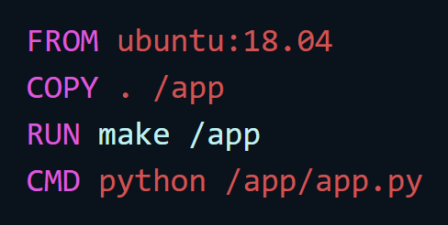
Docker build https://docs.docker.com/engine/reference/builder/#usage
Docker builds images by reading the instructions from a Dockerfile. A Dockerfile adheres to a specific format and set of instructions.
Each instruction creates one layer:
FROM creates a layer from the image ubuntu:18.04.
COPY adds files from your Docker client’s current directory.
RUN builds your application with make.
CMD specifies what command to run within the container.

Slide 21
Sample ASP.NET Core App with SQL Server – Step-by-Step
Install Docker Desktop (includes Docker Engine, Docker CLI client, Docker Compose, Notary, Kubernetes, and Credential Helper.)
Create a new directory for your application. This is the ‘context’ of the project.
Docker doesn’t work on versions earlier that Windows 10.
Virtual box won’t work on Windows. (9 min mark in Edureka video)
Run windows powershell as administrator
Use docker –version to see what you have.
docker run hello-world => downloads the image automatically.
Docker pull ubuntu – to pull the official ubuntu image.
Docker run –it –d ubuntu => run the ubuntu image “detached” and create a container
EXIT to exit the container
Docker commit [containerNum] accountName/imageName

Slide 22
https://docs.microsoft.com/en-us/dotnet/core/docker/build-container
Tutorial: Containerize a .NET Core app
https://docs.microsoft.com/en-us/dotnet/core/docker/build-container?tabs=windows
Create a .NET app with Docker integration
https://docs.microsoft.com/en-us/visualstudio/containers/overview?view=vs-2022
Make and containerize a .NET Core App with SQL Server (below).
https://docs.docker.com/compose/aspnet-mssql-compose/
https://docs.docker.com/compose/gettingstarted/

