Slide 1

Docker Fundamentals
.NET

Slide 2
Docker is a Containerization application that provides the ability to run one or more applications in an isolated environment called a Container, without a hypervisor, on any computer.
https://docs.docker.com/engine/docker-overview/

Slide 3
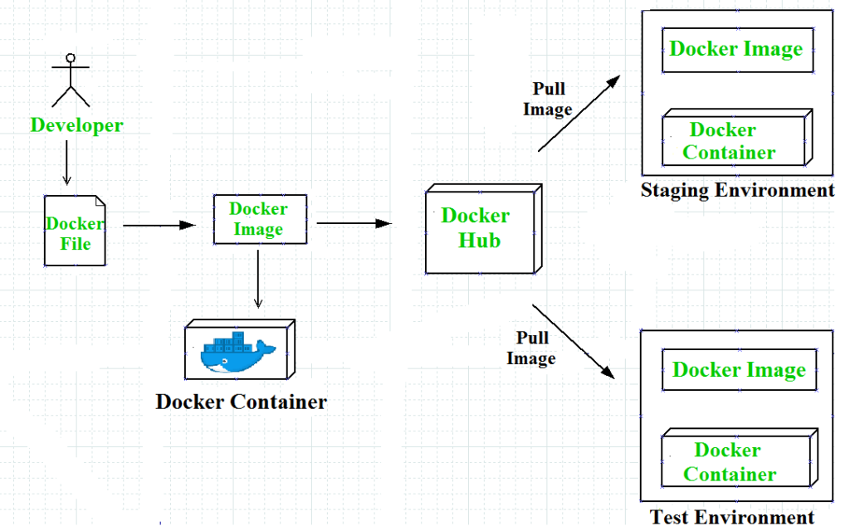
Docker – Purpose https://docs.docker.com/engine/docker-overview/#what-can-i-use-docker-for
Docker allows developers to continue working in standardized environments while using Containers. Containers provide everything needed to run applications and services and are perfect for CI/CD workflows.
Developers write code locally in a development environment and share their work using Docker images.
They can use Docker to push their applications into a test environment to execute automated and manual tests.
Bugs can be fixed in the development environment and redeployed to the test environment for re-testing and validation.
When testing is complete, developers push the updated image to the production environment.

Slide 4
Docker – Benefits https://docs.docker.com/engine/docker-overview/#what-can-i-use-docker-for
Responsive deployment and scaling:
Docker Images are portable. They can run on a local laptop, on physical and virtual machines, in a data center, or on cloud providers.
You can scale up or tear down applications and services as needed.
Run more workloads on the same hardware:
Docker is lightweight and fast.
Docker is NOT a Virtual Machine.
a virtual machine (VM) runs a full-blown “guest” operating system with virtual access to host resources through a hypervisor. VMs incur a lot of overhead.

Slide 5
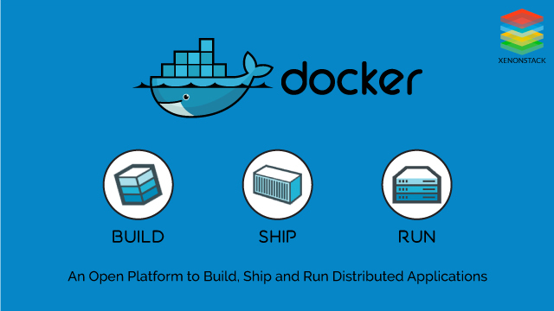
The Docker Platform https://www.docker.com/resources/what-container
Docker provides a platform to manage the entire lifecycle of containers:
You develop an application along with its supporting components using a Container.
The Container becomes the unit for distribution and testing your application.
Deploy your application into your production environment as a Container.
This process is identical for all production environments:
in a local data center,
a cloud provider,
or a hybrid.

Slide 6
Docker Install
Windows:
Windows Home has additional requirements.
https://docs.docker.com/docker-for-windows/install/
Mac:
https://docs.docker.com/docker-for-mac/install/

Slide 7
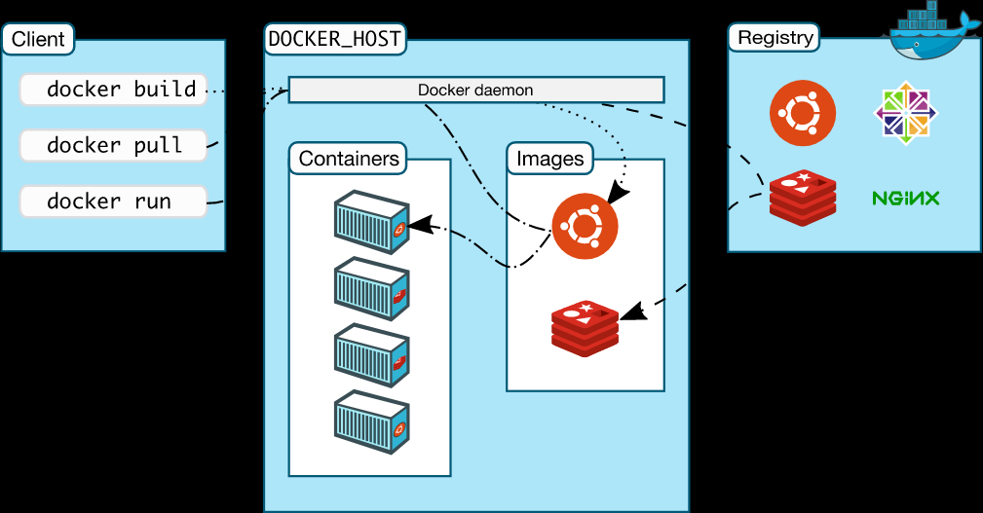
Docker Architecture https://docs.docker.com/engine/docker-overview/#docker-architecture
Docker uses a client-server architecture. The Docker client talks to the Docker daemon (server, dockerd), which builds, runs, and distributes Docker containers.
The Docker client and daemon can run on the same system, or you can connect a Docker client to a remote Docker daemon.
The Docker client and daemon communicate using a REST API.
Docker API
DockerHub

Slide 8
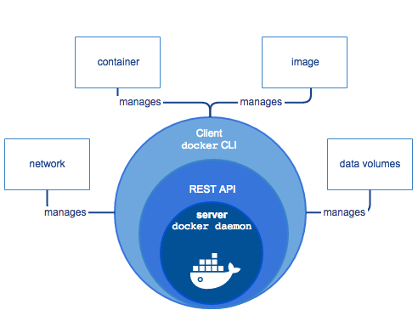
Docker Engine https://docs.docker.com/engine/docker-overview/#docker-engine
Docker Engine is a client-server application with three major components:
A server, which is a long-running program called a daemon. The daemon is also known as ‘dockerd’;
A REST API specifies interfaces used to talk to the daemon and instruct it in what to do. You interact with the daemon with the docker command.
A command line interface (CLI) client (docker <command>).
Docker Engine

Slide 9
Docker Engine https://docs.docker.com/engine/docker-overview/#docker-engine
The Docker CLI uses the Docker REST API to interact with the Docker daemon through scripting and/or CLI commands. Many Docker applications use the underlying API and CLI.
The daemon creates and manages Docker objects, such as images, Containers, networks, and volumes.
Docker Engine

Slide 10
Docker Client | Docker daemon | Docker registries
The Docker client is the primary way that most Docker users interact with Docker. With docker run, the client sends commands to dockerd, which carries them out. docker specifies the Docker API. | The Docker daemon (dockerd) listens for Docker API requests and manages Docker objects such as images, networks, containers, and volumes. | A Docker registry stores Docker images. hub.docker.com is a public registry. With the docker pull or docker run commands, images can be pulled from a DockerHub registry. When you use docker push, an image is pushed to the configured registry.
Docker API

Slide 11
Docker Image and Docker Container https://docs.docker.com/engine/docker-overview/#docker-architecture
A container is a runnable instance of an image. You can create, start, stop, move, or delete a Container using the Docker API.
A Container is defined by an image as well as any configuration options you provide to it when you create or start it.
You can connect a Container to one or more networks, attach storage to it, or even create a new image based on its current state.
An image is a read-only template with instructions for creating a Docker container.
An image often is based on another image. An image could be based on another image, then install a different web server, an application, and the configuration details needed to make the application run.
To build an image, create a Dockerfile which defines the steps to create an image and run it.
When you change a Dockerfile and rebuild the image, only those layers which have changed are rebuilt.

Slide 12
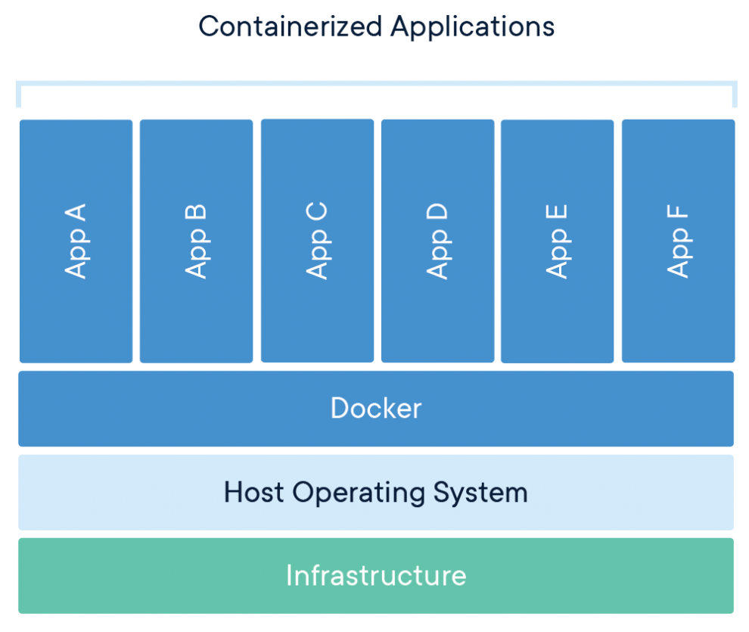
Docker Image and Docker Container https://www.docker.com/resources/what-container https://docs.docker.com/get-started/
A Docker Image is a standalone executable package that includes everything needed to run an application: code, runtime, system tools and libraries, and settings.
A Docker Container is created from a Docker Image when you use docker run <imageName> command. Containers run identically on Linux or PC machines.
A Container is a running application with encapsulation features applied to it to keep it isolated from the host.
A Container interacts with its own private filesystem.

Slide 13
List of Basic Docker commands
Command | Purpose
docker start <containername> | Start a container.
docker stop <containername> | Stop a running container
docker container <command> | Manage containers
docker image ls | list the images on your machine.
docker ps –a | Lists all containers, running or stopped
docker ps | Lists the running containers
docker run <containername> | Re-run a container
docker build –t myimage . | Build an image to be tagged “myimage” from a Dockerfile at ‘.’ (in the same directory).
docker rm <containername> | Delete a stopped container
docker push username/reponame:<tagname> | Push an image to a repo in the Docker Registry
docker create myimage | Create a Container from an image, but don’t start it.
docker attach <containername> | Connect to a running container

Slide 14
Docker – Setup and Test a Container https://docs.docker.com/get-started/
Download Docker Desktop.
Go to Docker.com and create an account
Run docker –version in the Command Line to see what Docker version you have.
Run docker run hello-world to test that docker is running correctly. You don’t have this image so it will get downloaded automatically and run.
Run docker image ls to list the downloaded hello-world image on your machine.
Run docker ps -a to see the container created from the hello-world image.
Do the Docker tutorial here.
Then complete the Getting Started Walk-through for Developers tutorial.

Slide 15
Docker in action
The following command runs an ubuntu container, attaches interactively to your local command-line session, and runs the /bin/bash script.
$ docker run -i -t ubuntu /bin/bash
The following happens (assuming default registry configuration):
If you do not have the ubuntu image locally, Docker pulls it from your configured registry, as though you had run docker pull ubuntu manually.
Docker creates a new container, as though you had run a docker container create command manually.
Docker allocates a read-write filesystem to the container, as its final layer.
This allows a running container to create or modify files and directories in its local filesystem.
Docker creates a network interface to connect the container to the default network,
because you did not specify any networking options.
This includes assigning an IP address to the container.
By default, containers can connect to external networks using the host machine’s network connection.
Docker starts the container and executes /bin/bash.
Because the container is running interactively and attached to your terminal (due to the -i and -t flags), you can provide input using your keyboard while the output is logged to your terminal.
When you type exit to terminate the /bin/bash command, the container stops but is not removed.
You can start it again or remove it.

Slide 16
Assignment
After finishing the tutorials, redo this tutorial with modifications. The modifications are:
you will run it on your local machine and
make the necessary changes to get it to work.
You don't have the .html and .png files that are COPY'd into the container in the Dockerfile. There are certainly other things missing and it is your task to find out what must be changed and change them.
The first person who finishes and presents to the class tomorrow morning will get 5 points added to their quiz on Monday.
You must be the first to contact me with a working site and explanation of exactly what had to be changed.

