Slide 1

DOM (Document Object Model)
.NET

Slide 2
The Document Object Model (DOM) is the data representation of the objects that comprise the structure and content of a document on the web. The DOM represents an HTML (or XML) document in memory.
https://developer.mozilla.org/en-US/docs/Web/API/Document_Object_Model/Introduction

Slide 3
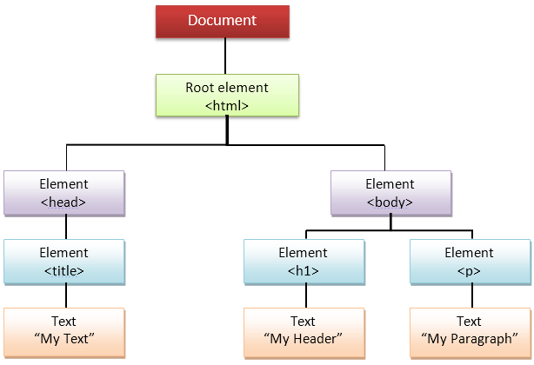
DOM (Document Object Model) https://developer.mozilla.org/en-US/docs/Web/API/Document_Object_Model/Introduction
The Document Object Model (DOM) is a programming interface for HTML and XML documents. It represents the page as nodes and objects. The DOM allows programs to change the documents' structure, style, and content.
A Web page is a document that can be
displayed in the browser window,
viewed as HTML, and
represented by the DOM.
The DOM can be manipulated by scripting languages like JavaScript.

Slide 4
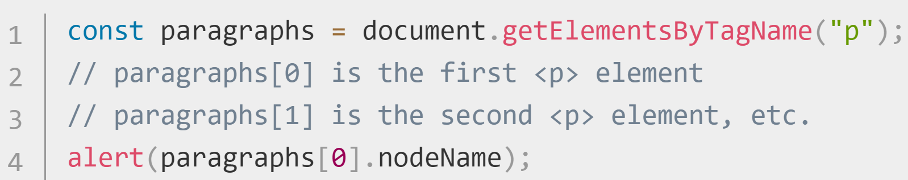
DOM in action https://javascript.info/
All the properties, methods, and events available for manipulating and creating web pages are organized into objects.
For example:
the “document” object represents the document itself
the <table> object implements the HTMLTableElement DOM interface. It is used to access HTML tables.
document.getElementsByTagName(“p”) returns a array of all the <p> elements in the document.

Slide 5
DOM – How to Access the DOM
Within the <head> of your .html file or at the bottom of the <body>, include a <script> tag which contains the .js file you want to use for the .html page. You can then access the document in the .js file using dot-notation on the keyword document:
document.getElementById(“IdName”)
<head>
<!--metadata tags….-->
</head>
<body>
<!—body content-->
<script type="text/javascript" src="jsfile. js"></script>
</body>

Slide 6
DOM – Selectors https://blog.bitsrc.io/dom-selectors-explained-70260049aaf0
JS DOM Selectors are used to select HTML elements within a document. There are 5 selectors.
Selector Name | Purpose
let myLi = document.getElementsByTagName(“li”) | Returns an HTMLCollection (array) of items matching the tag name.
document.getElementsByClassName(“myClass”) | Returns an HTMLCollection (array) of items matching the class name.
document.getElementById(“myId”) | Returns the first matched id name. Id’s are supposed to be unique in the .HTML file.
document.querySelector(“#myId”) document.querySelector(“.myClass”) document.querySelector(“p”) | Returns the first element that matches the specified selector. The ‘.’ is needed for classes. The ‘#’ is needed for id’s.
document.querySelectorAll(“.myClass”) | Returns an HTMLCollection of the elements that match the specified selector.

Slide 7
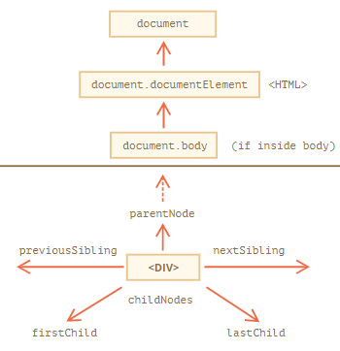
Walking the DOM - Basics https://javascript.info/dom-navigation
We can perform many actions on elements and their contents after accessing them.
The topmost tree nodes are available directly as document properties:
To get the <html> element, use:
let html = document.documentElement;
To get the <body> element, use:
let body = document.body;
To get the <head> element, use
let head = document.head;

Slide 8
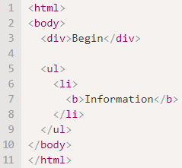
Walking the DOM - Basics https://javascript.info/dom-navigation
Child nodes – Elements that are nested in the given element. <head> and <body> are both children of <html>.
Siblings - nodes that are children of the same parent.
Descendants – all elements nested in the given element. This includes children, their children, etc.
In this example, <body> has two children, <div> and <ul>. <div> and <ul> are siblings
Among the descendants of <body> are the direct children <div> and <ul> and more deeply nested elements, like <li> (child of <ul>) and <b> (child of <li>).
<div> is the first child of the <body>. <ul> is the 2nd child of the <body>.
<li> is the first child of the <ul>. <li> is a descendent of the <body>.

Slide 9
Walking the nodes of the DOM https://javascript.info/dom-navigation https://developer.mozilla.org/en-US/docs/Web/API/Node/nodeType
Method | Explanation/Example
document.body.childNodes | document.body.childNodes lists all child nodes as an HTMLCollection, includes text and comments.
.firstChild | elem.firstChild gives access to the first child. Also returns non-element nodes like plain text and <!—comments-->.
.lastChild | elem.lastChild gives access to the last child.
.nextSibling | Access the following or “right” sibling going down the page.
.previousSibling | Access the prior or “left” sibling going up the page.
.parentNode | Access the parent of the current node.
.createElement(‘div’); | Create a new element in the document object.

Slide 10
Walking the elements of the DOM https://javascript.info/dom-navigation#children-childnodes-firstchild-lastchild
Method | Explanation/Example
.firstElementChild | Gives access to the first child element.
.lastElementChild | Gives access to the last child element.
.nextElementSibling | Access the next (“right”) sibling element going down the page.
.previousElementSibling | Access the prior (“left”) sibling element going up the page.
.parentElement | Access the parent of the current node if it’s an element. Returns null if not an element
.children | Returns an HTMLCollection of all children elements.

Slide 11
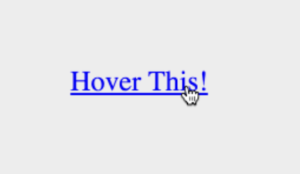
DOM – Events Overview https://developer.mozilla.org/en-US/docs/Web/Events https://developer.mozilla.org/en-US/docs/Web/API/GlobalEventHandlers/onclick
DOM Events are emitted when something happens on the HTML page, such as when a button is clicked, or an object is ‘moused’ over.
Each event is represented by an event object which is based on the Event interface that can have fields and/or functions used to get additional information about what happened.
The two most common events are ‘click’ and ‘submit’ form submissions.

Slide 12
Event Listeners and Event Handlers https://developer.mozilla.org/en-US/docs/Learn/JavaScript/First_steps/A_first_splash
event listener - The “construct” that listens for an event to happen.
event handler - The block of code that runs when the event fires.
This code creates an object that represents an HTML element with id=‘button’. The button variable holds all the data from an element.
A built-in JS helper function called .addEventListener() is used. It takes two arguments.
The type of event we are listening for (click), and
A callback function to the code we want to run when the event occurs.
const button = document.getElementById(“button”);
button.addEventListener(‘click’, (e) => {do some stuff});
// another event listener can use the same callback function
otherButton.addEventListener(‘mouseover’, callbackFunction);

Slide 13
Bubbling and Capture https://developer.mozilla.org/en-US/docs/Web/API/Document_Object_Model/Examples#Example_5:_Event_Propagation https://developer.mozilla.org/en-US/docs/Learn/JavaScript/Building_blocks/Events https://javascript.info/bubbling-and-capturing
Event bubbling and event capture are two mechanisms that describe what happens when two event handlers are triggered on one element.
When an event (‘click’) is fired on an element that has parent elements, browsers run two different event phases — the capturing phase and the bubbling phase. Almost all events bubble.
Capture Phase | Bubble Phase
The browser checks to see if the element's outer-most ancestor (<html>) has an ‘onclick’ event handler registered on it and, if so, runs it. This continues until it reaches the element that was actually clicked. Capture is rarely used, but sometimes can be useful. | The browser checks to see if the element that was actually clicked on has an ‘onclick’ event handler registered on it for the bubbling phase and runs it if so. Then it moves on to the next immediate ancestor element and does the same thing until it reaches the <html> element.

Slide 14
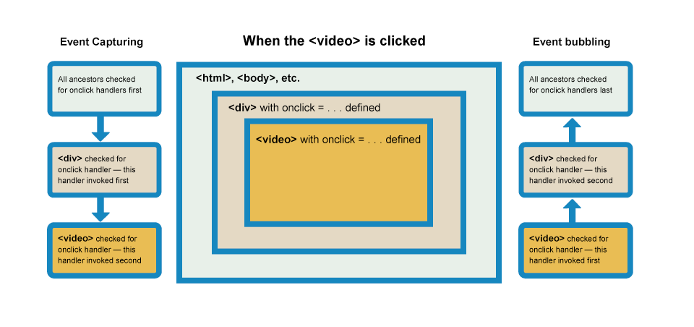
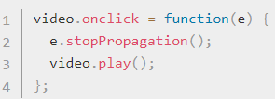
Bubbling (1/2) https://developer.mozilla.org/en-US/docs/Web/API/Document_Object_Model/Examples#Example_5:_Event_Propagation https://developer.mozilla.org/en-US/docs/Learn/JavaScript/Building_blocks/Events https://www.carlrippon.com/stoppropagation-v-stopimmediatepropagation/
Browsers automatically register event handlers for the bubbling phase.
When the video is clicked, the ‘click’ event bubbles outward from the <video> element outwards to its parent <div>, to the <html>. If any of these elements has an ‘on-click’ event handler, they will fire.
.stopPropagation() and .stopImmediatePropagation() are used to stop further bubbling propagation.

Slide 15
Bubbling (2/2) https://developer.mozilla.org/en-US/docs/Web/API/Document_Object_Model/Examples#Example_5:_Event_Propagation https://developer.mozilla.org/en-US/docs/Learn/JavaScript/Building_blocks/Events https://www.carlrippon.com/stoppropagation-v-stopimmediatepropagation/
Browsers automatically register event handlers for the bubbling phase.
stopPropagation() prevents other listeners above the triggered listener from being triggered.
If several listeners are on the same element for the same event type, they are called in sequential order.
stopImmediatePropagation() prevents remaining listeners from being called on the same element.

Slide 16
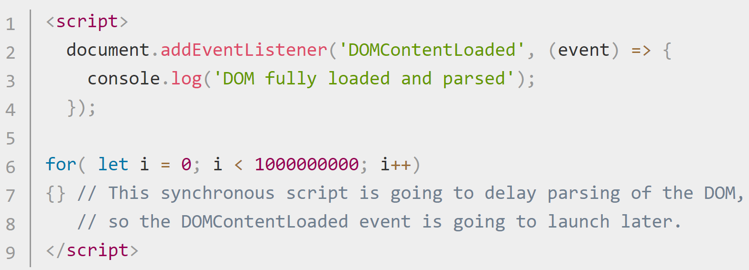
DOM Events Order https://developer.mozilla.org/en-US/docs/Web/API/Document/DOMContentLoaded_event
The DOMContentLoaded event fires when the initial HTML document has been completely loaded and parsed, without waiting for stylesheets, images, and subframes to finish loading.
A different event, load, should be used only to detect a fully-loaded page with images, etc.
Often, developers use load where DOMContentLoaded would be faster and more appropriate.
Synchronous JavaScript pauses when parsing the DOM. To parse the DOM as fast as possible after the user has requested the page, make your JavaScript asynchronous to optimize the loading of stylesheets.
If loaded as usual, stylesheets slow down DOM parsing as they're loaded in parallel. This "steals" traffic from the main HTML document.

Slide 17
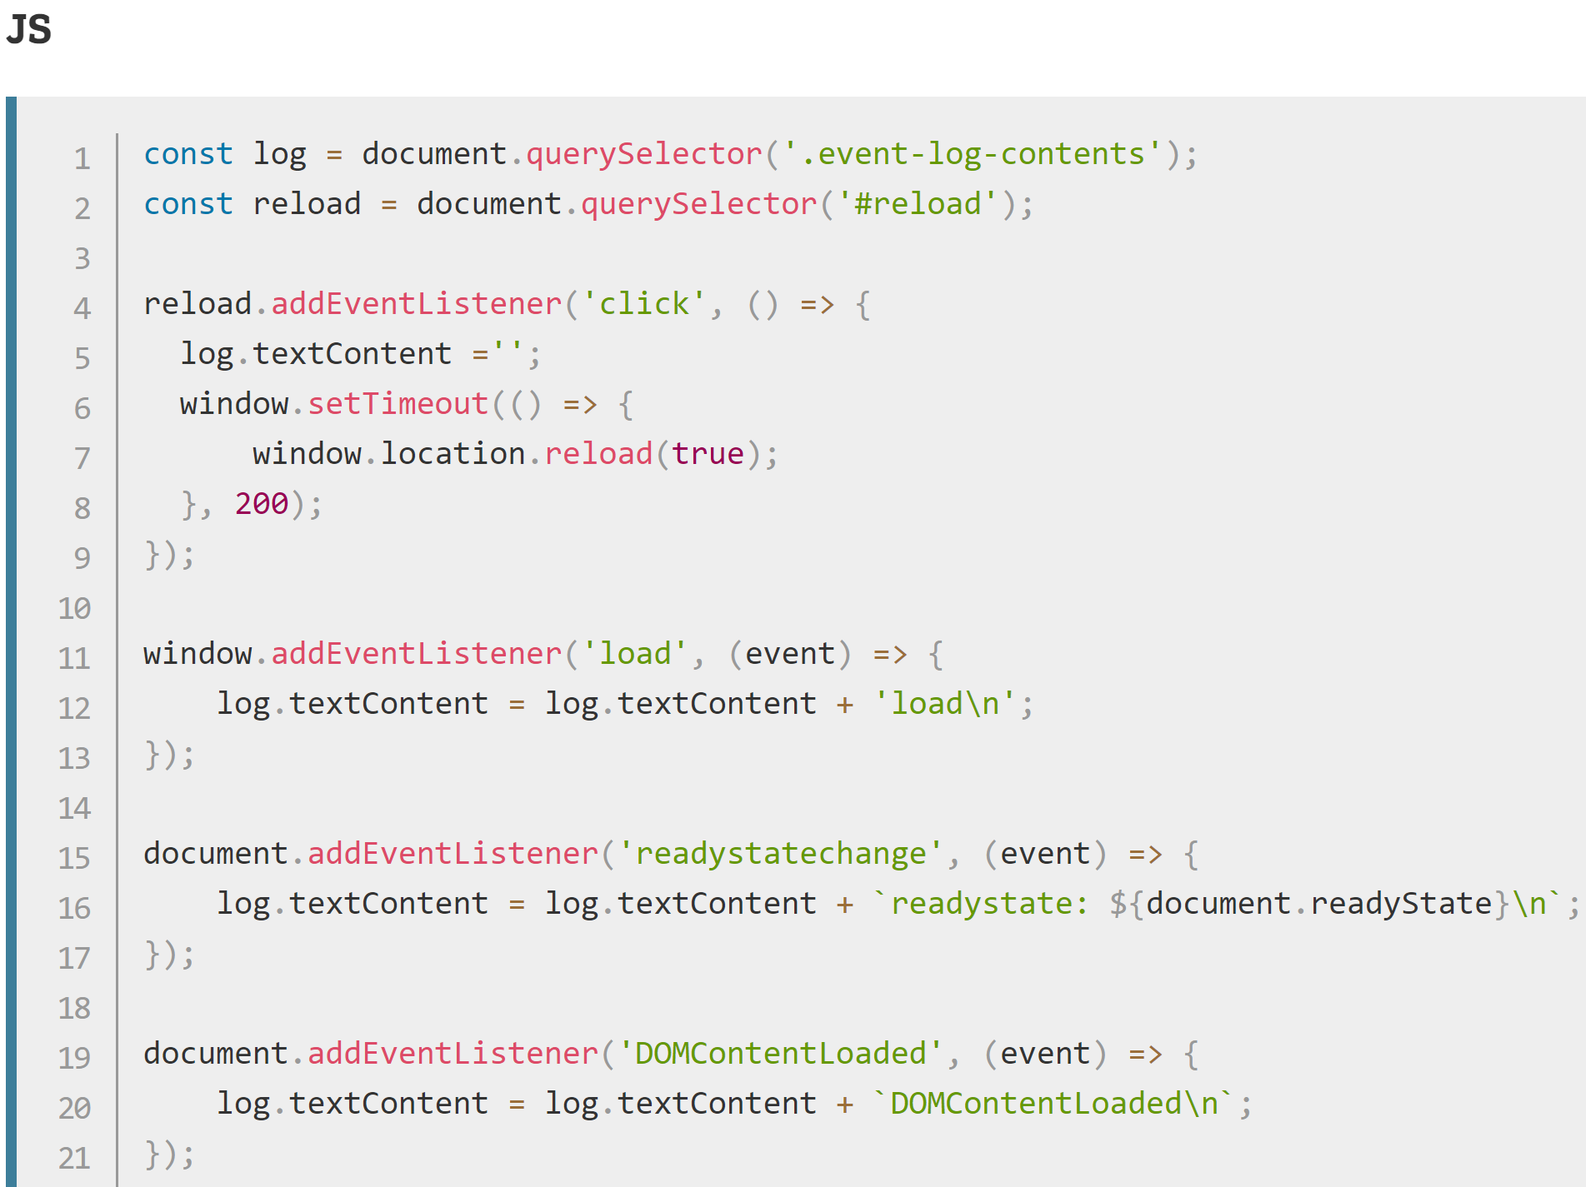
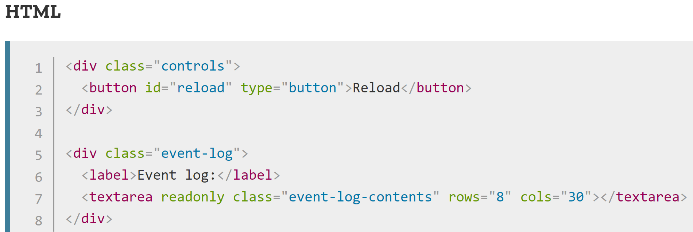
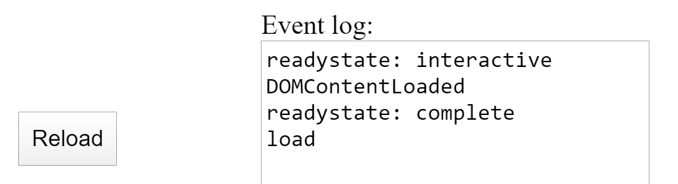
DOM Events Order https://developer.mozilla.org/en-US/docs/Web/API/Document/DOMContentLoaded_event
DOMContentLoaded may fire before your JS script has a chance to run, so it is wise to check before adding a listener.
Result of the above

Slide 18
Commonly used HTML Events https://www.w3schools.com/tags/ref_eventattributes.asp
Event | Purpose
blur / focus | Fires when an element loses/gets focus
change | Fires when the value of the element is changed
input | Fires when an element gets user input
invalid | Fires when an element is invalid
reset / submit | Fires when the Reset/submit button in a form is clicked
keyup / keydown | Fires when a user presses or releases a key
mouseover /mouseout | Fires when the mouse pointer moves over/out of an element
click / dblclick / mouseup | Fires on a mouse click/double-click/button-release on the element

Slide 19
Function DOM manipulation
Like .after(), .appendChild() , etc…
https://developer.mozilla.org/en-US/docs/Web/API/Element/after

Slide 20
GuessingGame Tutorial https://developer.mozilla.org/en-US/docs/Learn/JavaScript/First_steps/A_first_splash
Complete the guessingGame Tutorial.
Change guessingGame from using events to using a form to get the number.
Use https://javascript.info/ui for independent study.

