Slide 1

FetchAPI
.NET

Slide 2
The Fetch API provides an interface for fetching resources that has a more powerful and flexible feature set than XMLHttpRequest.
https://developer.mozilla.org/en-US/docs/Web/API/Fetch_API

Slide 3
FetchAPI - Overview https://developer.mozilla.org/en-US/docs/Web/API/Fetch_API https://developer.mozilla.org/en-US/docs/Web/API/Fetch_API/using_fetch
Fetch() is an async method of the WindowOrWorkerGlobalScope ‘mixin’ (not an Interface). It provides Request and Response objects involved with network requests. Fetch() has built-in functions and properties that can be used when needed.
Fetch() includes CORS and HTTP headers.
Fetch() requires at least one argument (the URL).
Fetch() It returns a Promise that represents the response to the request.
Fetch() never fails, even if the HTTP Response Code is 404 or 500. It will reject only if the request itself fails (in the case of a network failure).
Fetch() can send and receive cross-site cookies (Sessions)
fetch(‘http://revature.com/assoc’)
.then(res => res.json())
.then(data => console.log(data));

Slide 4
Fetch API Example https://developer.mozilla.org/en-US/docs/Web/API/Fetch_API/using_fetch
fetch('http://revature.com/associates’)
.then(response => response.json())
.then(data => console.log(data.joke));
In this example, a URL is Fetch’ed and the response is printed to the console. fetch() takes one or two arguments and returns a Promise containing the Response object.
When fetch() returns, the Promise response becomes the parameter for the following .then() statement. The .json() method is used to extract the JSON Body content from the response.
The .then() statement is also used to handle whatever HTTP response codes are returned, even if 404 or 500.

Slide 5
Fetch() – Arguments https://developer.mozilla.org/en-US/docs/Web/API/WindowOrWorkerGlobalScope/fetch
Fetch() has two possible arguments.
The URL path to the desired resource.
An (optional) object called an init object. This allows custom settings to be set with the Request. (see next slide)
Below are the most frequently used init object properties.
Option | Usage
Method | The HTTP verb of the request. GET, POST, etc.
Headers | A Headers object containing the headers desired.
Body | An object containing what you want to POST, Delete, INSERT, etc.
Mode | The mode desired. ‘cors’, ‘no-cors’, ‘same-origin’

Slide 6
Fetch() – example https://developer.mozilla.org/en-US/docs/Web/API/Fetch_API/using_fetch
fetch(‘https://revature.com/associates’,
{
method: 'POST',
mode: 'cors’,
cache: 'no-cache',
credentials: 'same-origin’,
headers:
{‘Content-Type': 'application/json’},
redirect: 'follow’,
referrerPolicy: 'no-referrer’,
body: JSON.stringify(
{ name: ‘Mark’, id: 42 })
})
.then(response => response.json())
.then(data => console.log(data.joke));
Below are the options available for each property.
* == default
The path to the resource –
The init object –
*GET, POST, PUT, DELETE, etc –
‘no-cors’, *’cors’, ‘same-origin’ –
*default, no-cache, reload, force-cache, only-if-cached –
include, *same-origin, omit –
‘application/json’,‘application/x-www-form-urlencoded’ –
manual, *follow, error –
‘no-referrer’, *’no-referrer-when-downgrade’, ‘origin’,
‘origin-when-cross-origin’, ‘same-origin’, ‘strict-origin’, ‘strict-origin-when-cross-origin’, ‘unsafe-url’ –
Use JSON.stringify() to serialize the body. –
Body data type must match "Content-Type" header –
Use `response.json()` to parse JSON data. –

Slide 7
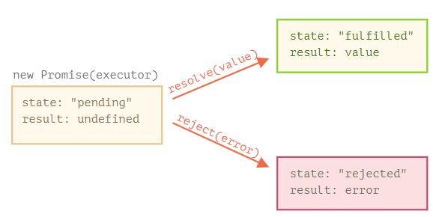
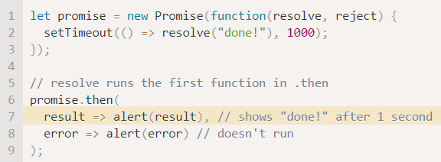
Promises https://javascript.info/promise-basics https://javascript.info/promise-basics#consumers-then-catch-finally https://web.dev/promises/
Fetch() returns a Promise. A Promise is the async result of the Fetch HTTP Request. It contains the Fetch() Response.
The Fetch() Response has either been ‘resolved’ or ‘rejected’.
Resolve and Reject are internal JS functions, so you don’t have to implement them.
The ‘resolved’ or ‘rejected’ status of a response can be checked and acted upon with the .then(), .catch(). and/or .finally() blocks.

Slide 8
Promises - .then(), .catch(), .finally() (1/3) https://javascript.info/promise-basics https://javascript.info/promise-basics#consumers-then-catch-finally
.then() has two arguments (.then(a, b)).
a - A function for a Resolved Request that contains a value.
b - A function for a Rejected/failed Request that contains an error.

Slide 9
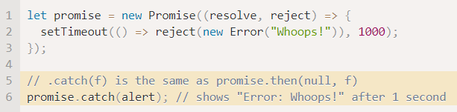
Promises - .then(), .catch(), .finally() (1/3) https://javascript.info/promise-basics https://javascript.info/promise-basics#consumers-then-catch-finally
.catch() is the equivalent of .then(null, b). It will catch any errors returned in the response. It only runs if there is an error.

Slide 10
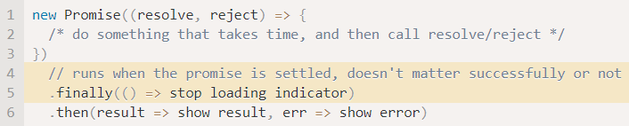
Promises - .then(), .catch(), .finally() (1/3) https://javascript.info/promise-basics https://javascript.info/promise-basics#consumers-then-catch-finally
.finally() is equivalent to .then(c, c) because it always runs whether the result is successful or an error. It can be placed before or after .then().

Slide 11
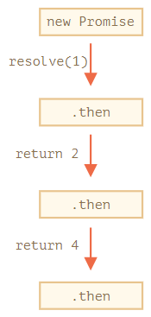
Promise Chaining https://javascript.info/promise-chaining
fetch(‘https://revature.com/associates’)
.then(response1 => response.json())
.finally(response2 => console.log(‘This is
the finally block. It always runs.’)
.then(response3 => console.log(‘This is
the second .then() block’))
.then(response4 => {
console.log(‘This is the third .then()
block’);
resolve();
})
.catch(response5 => console.log(‘The catch block won’t run unless
there’s an error’));
Promise Chaining is a way to run multiple actions on the returns of sequential asynchronous functions.
The result of each function is passed through the chain of .then() handlers.

Slide 12
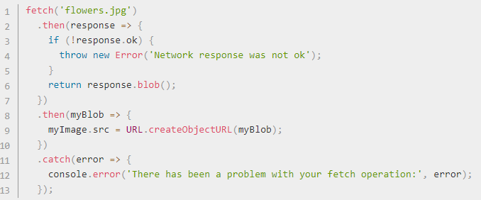
Fetch() – Response Object https://developer.mozilla.org/en-US/docs/Web/API/Fetch_API/using_fetch
A Response object is returned when a fetch() Promise is resolved.
The three most commonly used response properties are:
Response.status — is an integer (default 200) holding the response status code.
Response.statusText — is a string (default "OK"), which corresponds to the HTTP status code message.
Response.ok — is a shorthand for checking that status is in the range 200-299 inclusive. This returns a Boolean.

Slide 13
Fetch() – checking Response success https://developer.mozilla.org/en-US/docs/Web/API/Fetch_API/using_fetch
A fetch() promise will reject with a TypeError when a network error is encountered, or CORS is misconfigured on the server-side.
A check for a successful fetch() includes checking that the Promise ‘resolved’. This means checking that the Response.ok property has a value of true.
With response.ok, check that the Response was completed and take action based on the data received.
Use .catch() to handle any errors that could have been thrown.

Slide 14
Fetch() – Body https://developer.mozilla.org/en-US/docs/Web/API/Fetch_API/Using_Fetch
Both requests and responses may contain body data. A body is an instance of any of the following types.
Data Type | Function used to access data
ArrayBuffer | .arrayBuffer() - This object is used to represent a generic, fixed-length binary data buffer.
ArrayBufferView
Blob/File | .blob() - returns a promise that resolves with a Blob.
String | .text() - returns a promise that resolves with a USVString object (text). The response is always decoded using UTF-8.
FormData | .formData() - returns a promise that resolves with a FormData object.

