Slide 1

Kubernetes
Deploying your MSA app

Slide 2
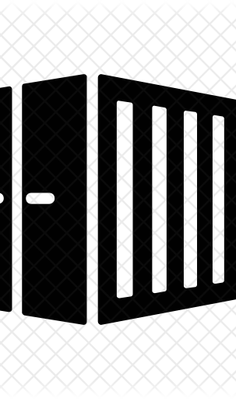
So, you’ve containerized your app
Give yourself a pat on the back. Congratulations! You have successfully deployed your application. Now what?
You want to transition to an MSA way of doing things since you want to easily scale your app
The deployment problem comes up again, how would you deploy an MSA app?
Through multiple containers of course!
How will you manage those containers?

Slide 3

Let’s draw out what we want to happen

Slide 4

Container Orchestration
A container orchestration tool helps in deployment, scaling, networking, and monitoring of your containers.
It provides a framework for managing containers and the microservices they contain at scale.
As developers we focus on the code being deployed, container orchestration tools help by abstracting the deployment details

Slide 5
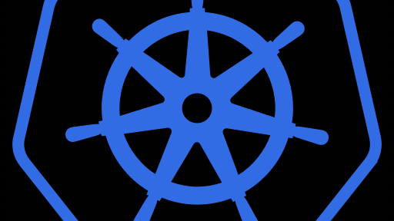
K8s
Kubernetes is a container orchestration tool.
It provides tools that help deploy and manage containers that run over a network.
It lets us build application services that span multiple containers, schedule containers across a cluster, scale those containers, and manage their health over time.
Similar tools are Docker Swarm and Apache Mesos
Based on the Greek word for helmsman or pilot (do what you will with this info)

Slide 6
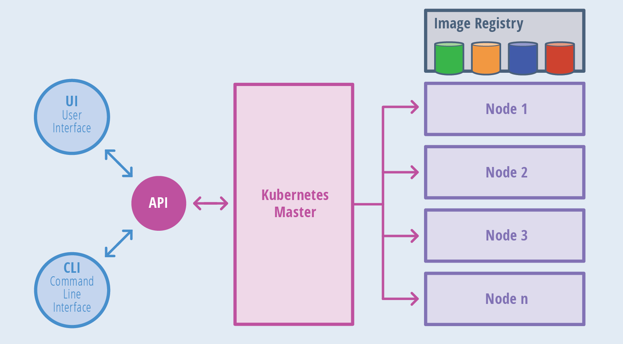

Slide 7
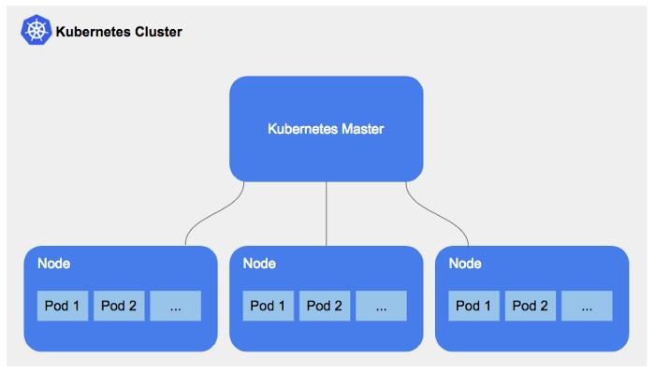
K8s Architecture
Cluster
Node
Pod
Containers

Slide 8
Worker Node Architecture
Kubelet
Primary node agent
Interacts with master node
Container Runtime
Software that runs containers
Ex: Docker
Kube-proxy
Network proxy
Maintains network rules on nodes

Slide 9
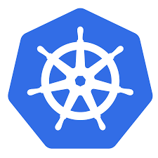
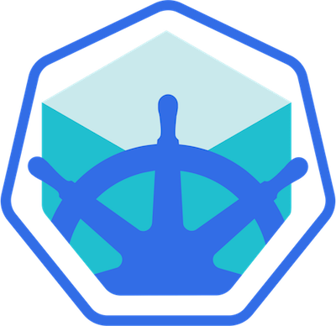
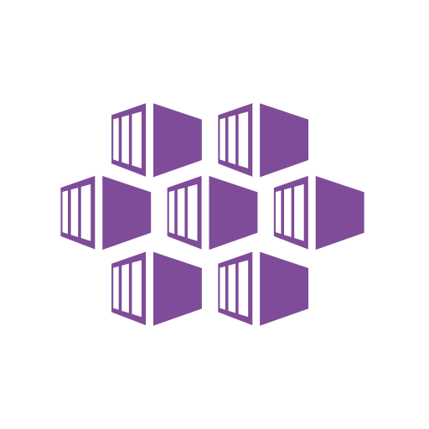
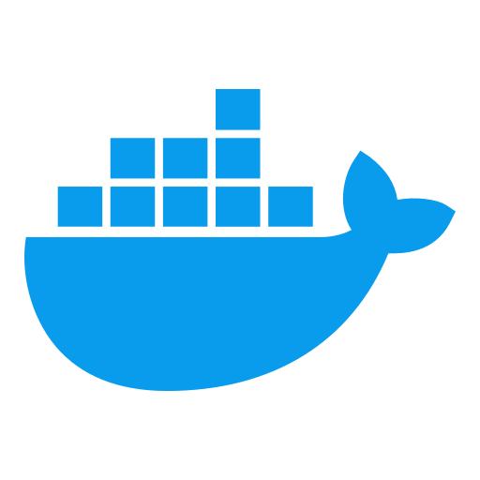
K8s tooling
Kubectl
Cmd line tool for k8s
Allows you to interact with the API in the master node to deploy and manage your cluster
API
Lets you query and manipulate the state of objects in K8s
Minikube
Local k8s
AKS
Azure K8s Service
Docker
Container runtime

Slide 10
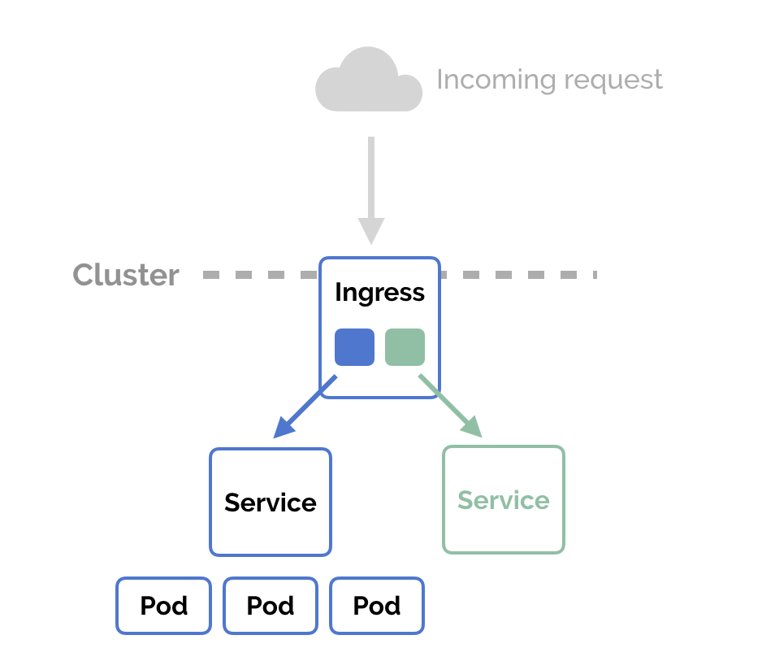
Deploying with k8s
Object config file
Pods
Deployments
Services
Ingress

Slide 11

Questions?
Comments? Concerns? Violent Reactions?

Slide 12

Discussion Q’s
What is container orchestration?
What is k8s?
What is a cluster? Node? Pod?
Explain the k8s architecture
What is the object config file?
What is a deployment?
What are services?

