Slide 1

Kubernetes Fundamentals
.net

Slide 2
Kubernetes is a portable, extensible, open-source, cloud-native platform for managing containerized workloads and services.
https://kubernetes.io/docs/concepts/overview/what-is-kubernetes/

Slide 3
Nicks lecture.. Things to add?
K8s is controlled through HTTP when using kubeCTL.
Make sure to show them the docs for definition to each part. ‘Kubernetes api reference’
Show the kube/.config file. This is the one you use when merging the context with az aks get-credentials --resource-group <ResourceGroupName> --name testcluster.
Mention and show that every object has metadata.
A ‘namespace’ is a logical grouping of things that belong together. You get a default namespace but a microservice COULD be distributed across multiple namespaces.

Slide 4
Things to add.
Go over the K8s Quiz and answer these questions in the demo.
.NET Microservices Kubernetes July2019

Slide 5
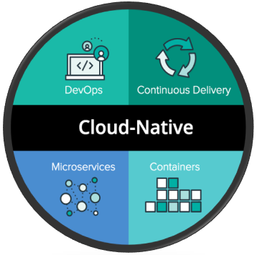
Cloud Native Applications https://www.redhat.com/en/topics/cloud-native-apps https://medium.com/velotio-perspectives/cloud-native-applications-the-why-the-what-the-how-9b2d31897496
Cloud-native applications are small, independent, loosely coupled services, that are designed to deliver business value. They rapidly incorporate user feedback, maintain higher up-time, and are optimized CI/CD.
Cloud-native app development is a way to speed up how applications are built, how they optimize existing applications, and how services are interconnected.
A "cloud-native," app is specifically designed to provide consistent development, automated management, and greater fault-tolerance experience across all cloud types (private, public, hybrid). Cloud computing increases the scalability and availability of apps through self-service and on-demand provisioning of resources, as well as automating the application life cycle from development to production.
Kubernetes is one of the first and most popular cloud native applications.

Slide 6
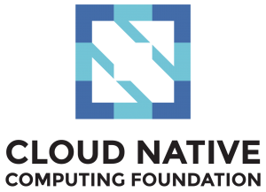
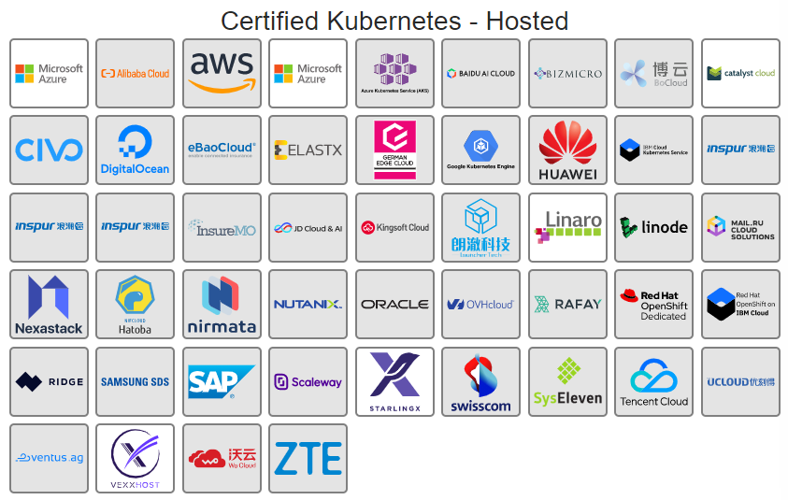
Cloud Native Computing Foundation https://landscape.cncf.io/ https://www.cncf.io/blog/2018/03/08/introducing-the-cloud-native-landscape-2-0-interactive-edition/ https://github.com/cncf/foundation/blob/master/charter.md
Kubernetes is part of what is called the Cloud Native Interactive Landscape. This landscape is a category of “Cloud Native” services. These are loosely coupled services solely located in the cloud and whose intent is to enhance the ability of applications to be managed and scaled as needed.
The Cloud Native Computing Foundation (CNCF) hosts critical components of the global technology infrastructure.
The CNCF mission is to:
make cloud native computing ubiquitous,
steward new projects,
foster the growth and evolution of the cloud ecosystem,
promote underlying technologies, and
make the technology accessible and reliable.

Slide 7
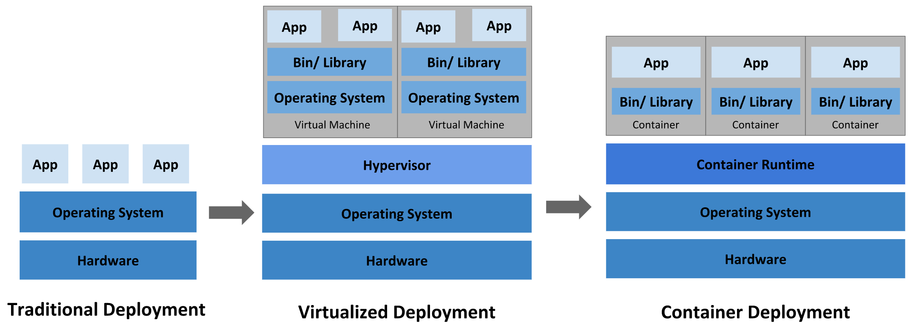
What is Kubernetes? https://developer.ibm.com/technologies/microservices/articles/why-should-we-use-microservices-and-containers/ https://kubernetes.io/docs/concepts/overview/what-is-kubernetes/
Kubernetes is a production-grade, open-source infrastructure for the deployment, scaling, management, and composition of application containers across clusters of hosts. It was inspired Google Kubernetes Project. The name Kubernetes originates from Greek for helmsman or pilot.

Slide 8
What is Kubernetes? https://developer.ibm.com/technologies/microservices/articles/why-should-we-use-microservices-and-containers/ https://kubernetes.io/docs/concepts/overview/what-is-kubernetes/
Kubernetes provides a framework to run distributed systems with redundancy build in. It manages scaling and failover and provides deployment patterns. Kubernetes allows you to automate the deployment of containerized microservices. This makes it easier to manage the components and microservices in your application.

Slide 9
What is Kubernetes? https://developer.ibm.com/technologies/microservices/articles/why-should-we-use-microservices-and-containers/ https://kubernetes.io/docs/concepts/overview/what-is-kubernetes/ https://github.com/kubernetes/community/blob/master/contributors/design-proposals/architecture/architecture.md#kubernetes-design-and-architecture
Kubernetes allow you to:
Deploy images quickly | Maintain CI/CD | Enhance Separation of Concerns | Run applications anywhere
Have an elastic, scalable MSA | Isolate resources | Use resources effectively | Run an application on any platform

Slide 10
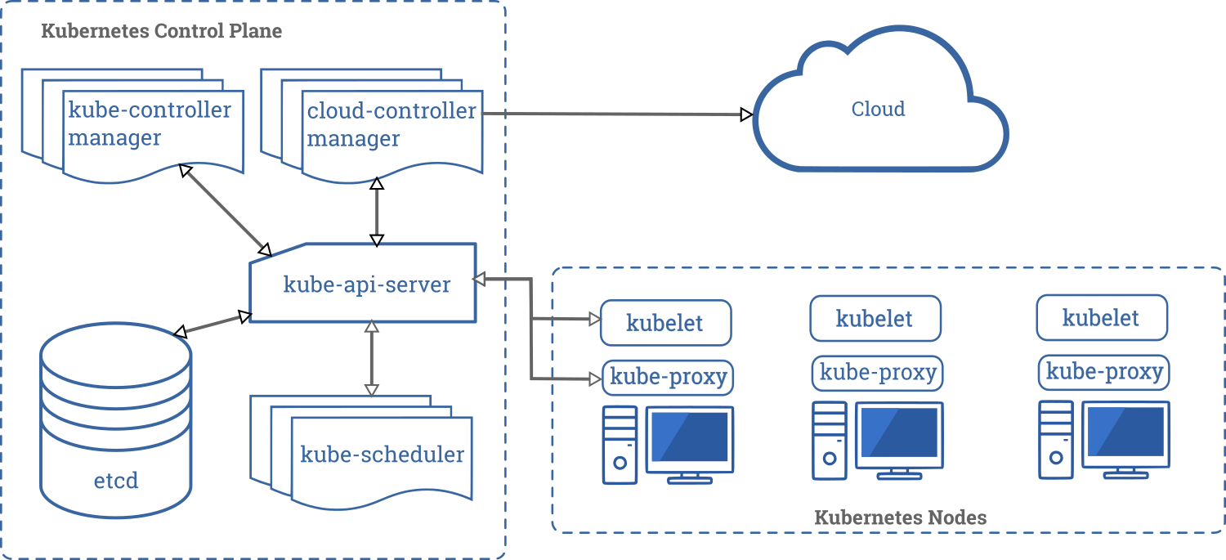
Kubernetes Architecture – Overview (1/2) https://kubernetes.io/docs/concepts/overview/components/
Kubernetes is not a traditional, all-inclusive PaaS (Platform as a Service).
Kubernetes operates at the container level rather than at the hardware level.
When you deploy Kubernetes, you get a Cluster.
A Cluster consists of worker machines (Nodes), that run containerized applications.

Slide 11
Kubernetes Architecture – Overview (2/2) https://kubernetes.io/docs/concepts/overview/components/
The worker node(s) host the Pods that are the components of the application.
The control plane manages the worker nodes and the Pods in the cluster.
In production, the control plane usually operates across multiple servers and a cluster usually runs multiple nodes. This enhances fault-tolerance and keeps your microservices running.

Slide 12
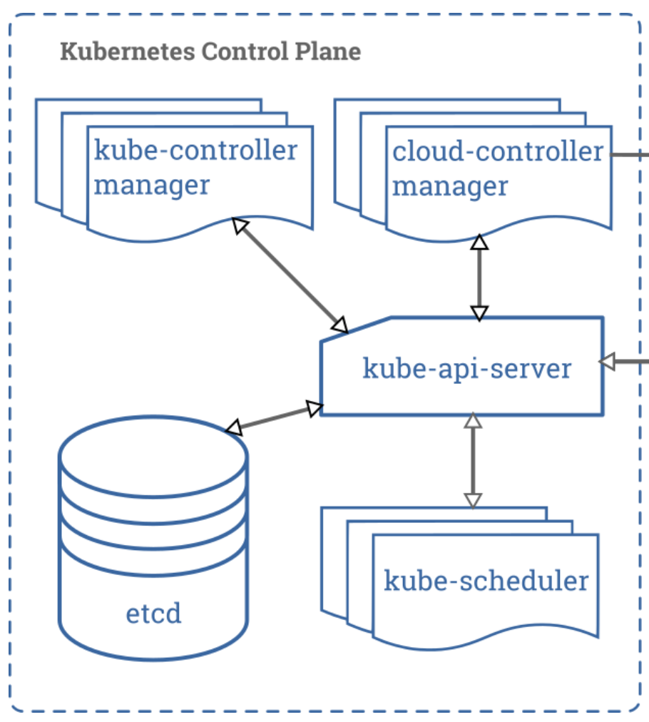
Kubernetes Control Plane (Master) https://kubernetes.io/docs/concepts/overview/components/#control-plane-components
The control plane’s components make decisions about the cluster and detect and respond to cluster events,
These components start or tear down a new pod when a deployment .yml files ‘replicas’ field is unsatisfied.
Control plane components can be run on any machine in the cluster, set-up scripts usually start all control plane components on the same machine and run user containers on a different machine.

Slide 13
Control Plane – kube-api-server https://kubernetes.io/docs/concepts/overview/components/#kube-apiserver
The API server exposes the Kubernetes API. The API server is the HTTP endpoint for the Kubernetes control plane.
The main implementation of a Kubernetes API server is kube-api-server.
kube-api-server is designed to scale horizontally (deploy more instances).
You can run several instances of kube-api-server.
A LoadBalancer balances traffic between the instances.

Slide 14
Control Plane – etcd and kube-scheduler https://kubernetes.io/docs/concepts/overview/components/#etcd https://kubernetes.io/docs/concepts/overview/components/#kube-scheduler https://github.com/kubernetes/community/blob/master/contributors/design-proposals/architecture/architecture.md#scheduler
Etcd is a key-value storage. It maintains the clusters’ metadata.
kube-scheduler watches for new Pods and assigns a node to them to run on based on predetermined requirements like:
hardware constraints,
affinity/anti-affinity specifications (when and where to start/delete pods),
deadlines,
and many more.

Slide 15
Control Plane – kube-controller manager https://kubernetes.io/docs/concepts/overview/components/#kube-controller-manager
Kube-manager-controller runs the four controller processes.
There are 4 controller process types:
Node controller: notices and responds when nodes go down.
Replication controller: maintains the correct number of pods for every replication controller object in the system.
Endpoints controller: Populates the Endpoints object (joins Services & Pods).
Service Account & Token controllers: Create default accounts and API access tokens for new namespaces.

Slide 16
Control Plane – cloud-controller manager (1/2) https://kubernetes.io/docs/concepts/overview/components/#cloud-controller-manager
The cloud-controller-manager allows linking a cluster into the cloud providers’ (AKS) API. It will separate the components that interact with the cloud platform from components that only interact with the cluster.
cloud-controller-manager combines several logically independent control loops into a single binary that is run as a single process. Horizontal scaling (running more instances) allows for improved performance or help with failure tolerance.

Slide 17
Control Plane – cloud-controller manager (2/2) https://kubernetes.io/docs/concepts/overview/components/#cloud-controller-manager
These three controllers can have cloud provider dependencies:
Node controller: For checking the cloud provider to determine if a node has been deleted in the cloud after it stops responding.
Route controller: For setting up routes in the underlying cloud infrastructure.
Service controller: For creating, updating, and deleting cloud provider load balancers.

Slide 18
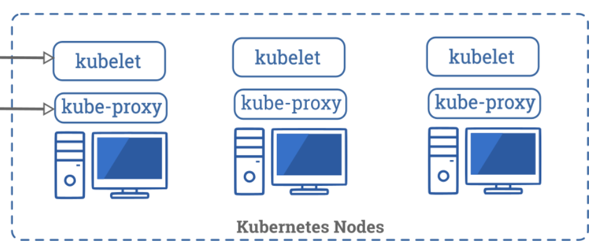
Node Components - Kubelet https://kubernetes.io/docs/concepts/overview/components/#node-components https://github.com/kubernetes/community/blob/master/contributors/design-proposals/architecture/architecture.md#kubelet https://github.com/kubernetes/community/blob/master/contributors/design-proposals/architecture/architecture.md#kube-proxy
A Kubelet agent runs on each node in the cluster.
Kubelet agent is the primary implementer of the Pod and Node APIs that drive the container execution layer. The Kubelet uses PodSpecs to verify that containers described in those PodSpecs are running in the Pods.
The kubelet doesn’t manage containers which were not created by Kubernetes.
Node components run on every node, maintain running pods, and providing the Kubernetes runtime environment.

Slide 19
Node Components – kube-proxy https://kubernetes.io/docs/concepts/overview/components/#node-components https://github.com/kubernetes/community/blob/master/contributors/design-proposals/architecture/architecture.md#kubelet https://github.com/kubernetes/community/blob/master/contributors/design-proposals/architecture/architecture.md#kube-proxy
A kube-proxy is a network proxy that runs on each node in your cluster. kube-proxy provides a way to group pods under a common access policy (e.g., load-balanced).
This creates a virtual IP that clients can access which is transparently proxied (forwarded) to the pods in a Service.
Every node runs a kube-proxy process. Kube-proxy programs IpTables rules to trap access to service IPs and redirect them to the correct backend.
Node components run on every node, maintain running pods, and providing the Kubernetes runtime environment.

Slide 20
Node – Components https://kubernetes.io/docs/concepts/overview/components/#node-components https://kubernetes.io/docs/concepts/architecture/nodes/#management
The container runtime is the containerization software that is responsible for running your containers.
Kubernetes supports several container runtimes.
Kubernetes Container Runtime Interface (CRI
Docker
containerd
CRI-O

Slide 21
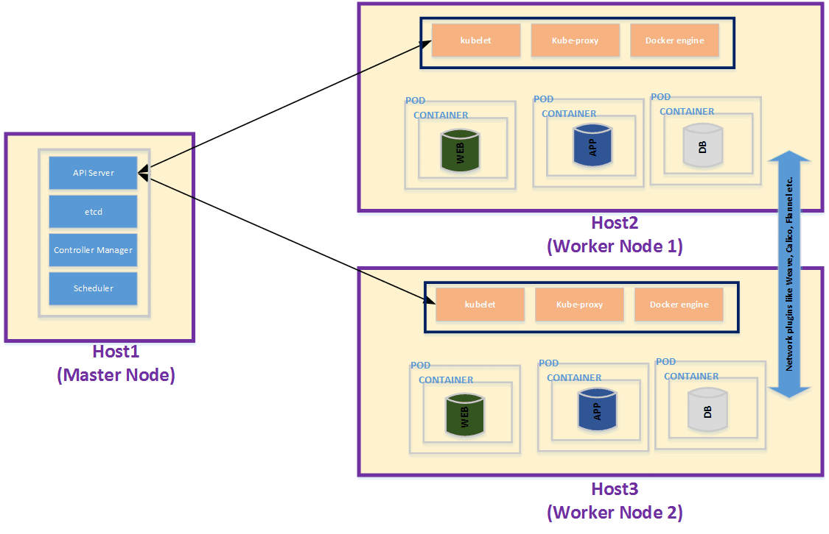
Node Structure https://kubernetes.io/docs/concepts/architecture/nodes/
Each node contains the services necessary to run the Pods on it, which are managed by the control plane.
A node may be a VM or a physical machine.

Slide 22
Node Structure https://kubernetes.io/docs/concepts/architecture/nodes/
A container represents a containerized application
The container is placed into a Pod.
A Pod runs on a Node.
One or more Nodes make up a Cluster.
The Cluster is the Kubernetes Workload.

Slide 23
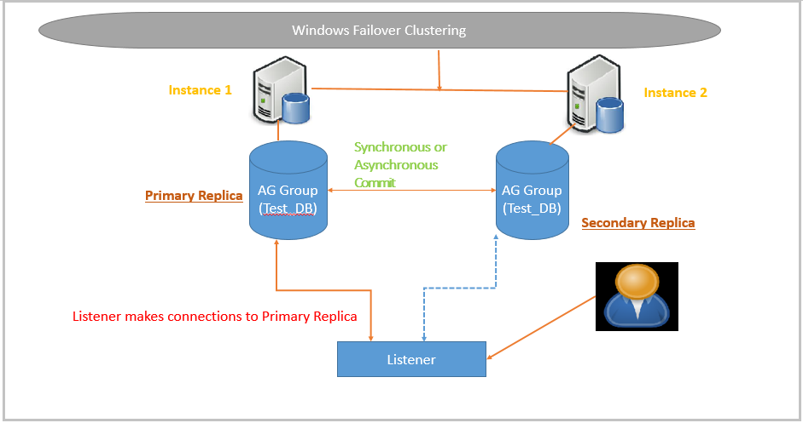
failover explained https://en.wikipedia.org/wiki/Failover https://devopsprodigy.com/blog/failover-in-kubernetes/
In computing and related technologies such as networking, failover is switching to a redundant or standby server, system, hardware component, or network upon the failure or abnormal termination of the previously active application, server, system, hardware component, or network.
In Kubernetes, failover is avoided by creating self-balanced, self-scaled, and self-restored pods and containers.
A major issue can create circumstances where an entire region or service goes down and there needs to be a backup cluster ready to handle such instances.

Slide 24
AzureCLI https://docs.microsoft.com/en-us/cli/azure/install-azure-cli
az --version

