Slide 1

Kubernetes kubectl and Deployment
.net

Slide 2
The kubectl CLI tool allows for control of Kubernetes clusters.
https://kubernetes.io/docs/reference/kubectl/overview/

Slide 3
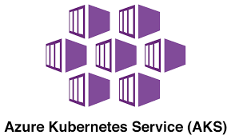
Azure Kubernetes Service (AKS) https://kubernetes.io/docs/setup/production-environment/turnkey/azure/#azure-kubernetes-service-aks https://github.com/Azure/aks-engine/blob/master/docs/tutorials/README.md https://docs.microsoft.com/en-us/azure/aks/intro-kubernetes
The Azure Kubernetes Service (AKS) offers simple deployments for Kubernetes clusters.
AKS makes it simple to deploy a managed Kubernetes cluster in Azure.
AKS handles much of the complexity and operational overhead of managing Kubernetes.
Azure handles critical tasks like health monitoring.
The Kubernetes masters are managed by Azure. You only manage and maintain the agent nodes.
AKS lets you integrate with Azure Active Directory and use Kubernetes role-based access controls.

Slide 4
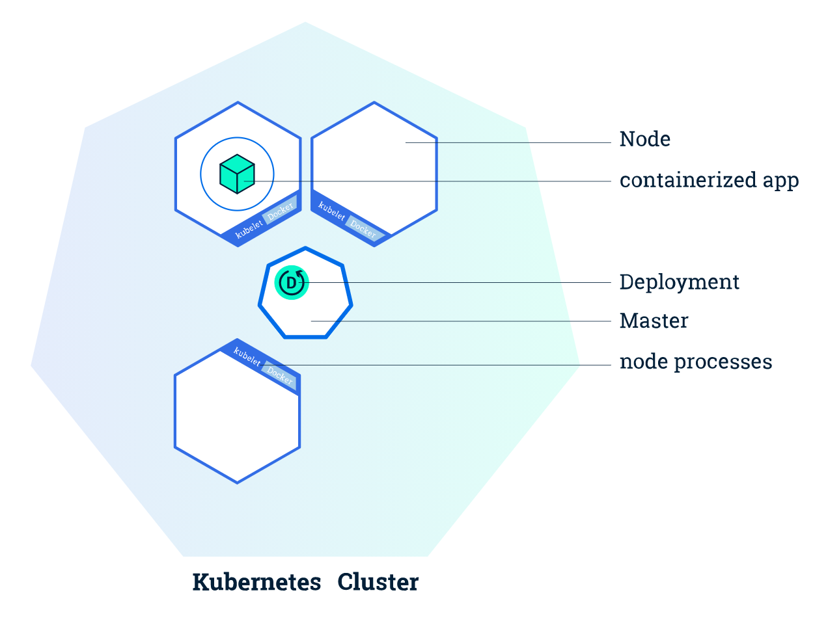
Kubectl (“Cube CTL”) https://kubernetes.io/docs/reference/kubectl/overview/
Kubectl is the command line tool used to control Kubernetes clusters. Kubectl looks for a file named config in the $HOME/.kube directory. You can specify other kubeconfig files by setting the KUBECONFIG environment variable or by setting the --kubeconfig flag.
Kubectl uses the Kubernetes API to interact with the cluster. The following syntax is used in command line to communicate through kubectl:
kubectl <command> <TYPE> <NAME> [flags]

Slide 5
Kubectl https://kubernetes.io/docs/tasks/kubectl/install/ https://kubernetes.io/docs/reference/kubectl/cheatsheet/
Kubectl uses the Kubernetes API to interact with the cluster. The following syntax is used in command line to communicate through kubectl:
kubectl <command> <TYPE> <NAME> [flags]
Command | Usage
command | Specifies the operation to perform on resources (create, get, describe, delete.)
type | Specifies the (case-insensitive) resource type.
--name | Specifies the case-sensitive name of the resource. If the name is omitted, details for all resources are displayed.
--flags, -f | Specifies optional flags.

Slide 6
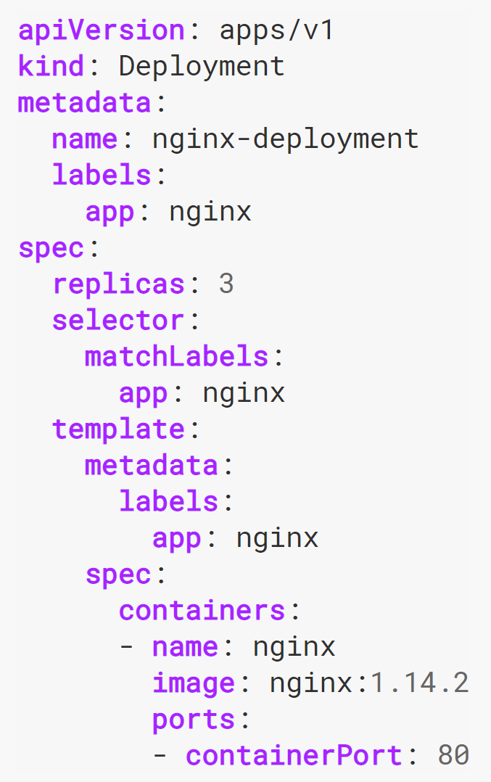
Deployment (1/2) https://kubernetes.io/docs/tutorials/hello-minikube/
A Deployment is the recommended way to manage the creation and scaling of Pods.
The Deployment Controller:
uses a Deployment .yml to change an unacceptable state to a desired state at a controlled rate.
manages ReplicaSets,
provides declarative updates to Pods,
checks on pod health
restarts terminated pods.
Deployments should be used instead of directly using ReplicaSets unless custom update orchestration is not required or updates themselves are not required.

Slide 7
Deployment Example (2/2) https://kubernetes.io/docs/tutorials/hello-minikube/
Deployment named nginx-deployment is created
The Deployment will create three identical pods in the cluster.
-
Defines how the Deployment finds which Pods to manage later on.
Create one container and name it ‘nginx’ using the field, .spec.template.spec.containers[0].name
Pods run one cluster, nginx, on the nginx Docker Hub image, version 1.14.2

Slide 8
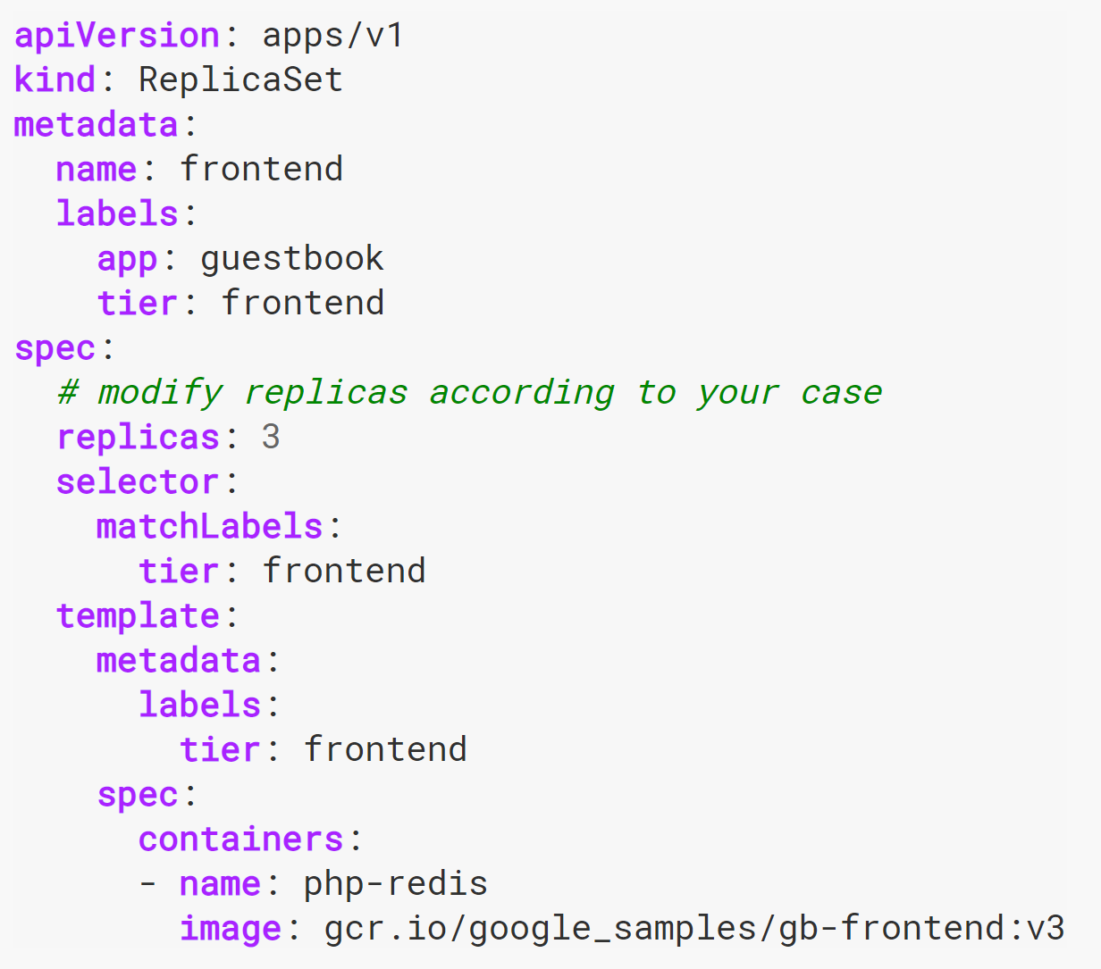
ReplicaSet https://kubernetes.io/docs/concepts/workloads/controllers/replicaset/
The purpose of a ReplicaSet is to maintain a stable set of replica Pods running at a all times. It is often used to guarantee the availability of a specified number of identical Pods.
A ReplicaSet will dynamically drive the cluster back to the predetermined desired state via creation of new Pods to keep an application running.
Use kubectl apply -f <URL> to apply a template.
Pods can also be added without a template.
A ReplicaSet is defined with fields, including:
replicas indicate how many Pods should be maintained.
selector specifies how to identify Pods it can acquire.
template specifies the data of the new Pods that should be created.

Slide 9
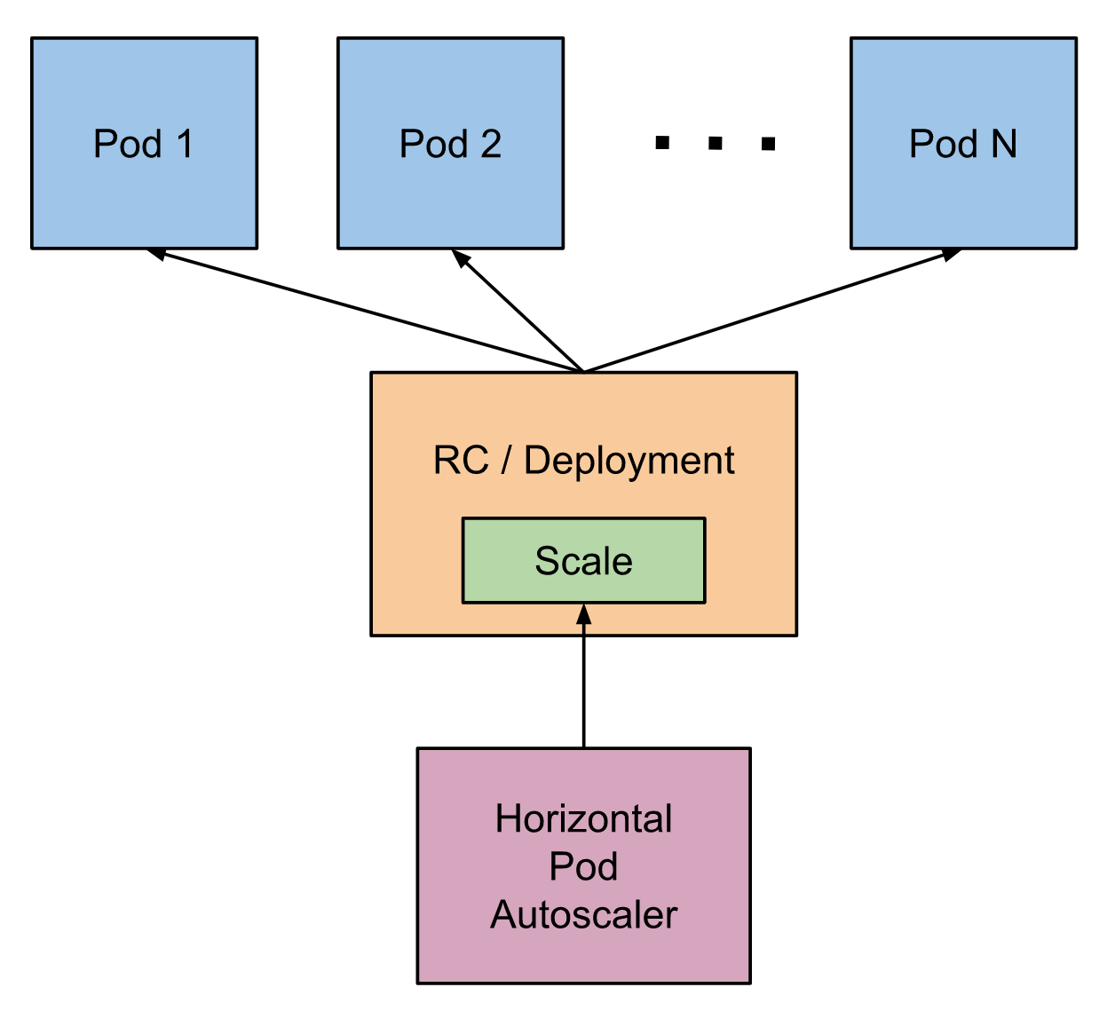
AutoScaling https://kubernetes.io/docs/tasks/run-application/horizontal-pod-autoscale/
The Horizontal Pod Autoscaler is an API resource in the Kubernetes autoscaling API group which automatically scales the number of pods in a replication controller, deployment, replica set, or stateful set based on CPU utilization.
The Horizontal Pod Autoscaler is implemented as a Kubernetes API resource and a controller in a control loop, with a period maintained by the controller manager. The Kubernetes API resource determines the behavior of the controller.

Slide 10
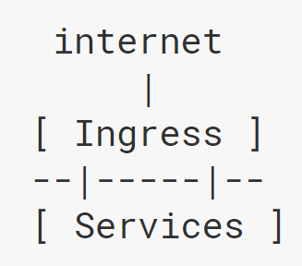
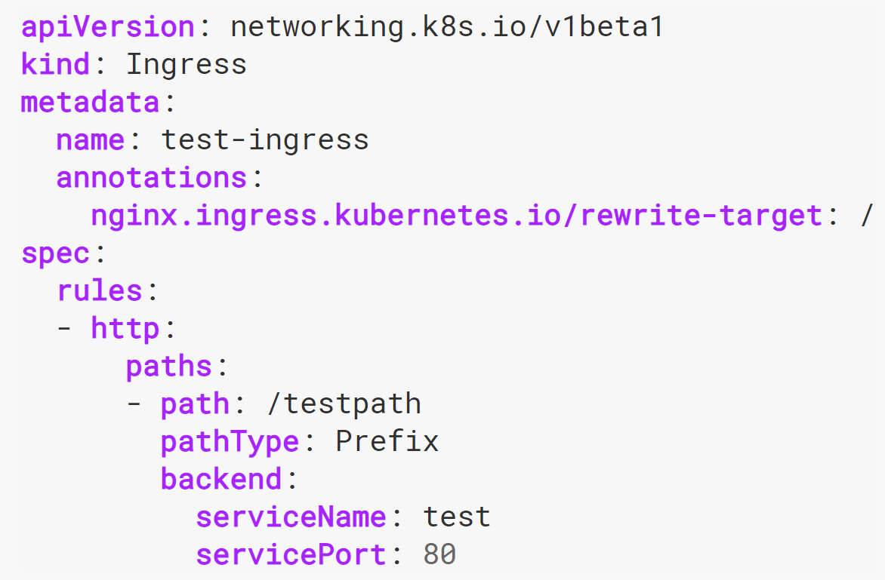
Ingress (1/2) https://kubernetes.io/docs/concepts/services-networking/ingress/
In Kubernetes, ‘Ingress’ exposes HTTP routes from outside the cluster to services within the cluster. It can give Services externally-reachable URLs, load balance traffic, terminate SSL/TLS, and offers name-based virtual hosting.
Traffic routing is controlled by rules defined on the Ingress resource. An Ingress Resource is (usually) a .yml file defining the rules for accessing structures in a cluster.

Slide 11
Ingress (2/2) https://kubernetes.io/docs/concepts/services-networking/ingress/
The name of an Ingress object must be a valid DNS subdomain name
As with all other Kubernetes resources, an Ingress needs apiVersion, kind, and metadata fields.
Ingress frequently uses annotations to configure some options depending on the Ingress controller
Each HTTP rule contains:
An optional host. If no host is specified, the rule applies to all inbound HTTP traffic through the IP address specified.
A list of paths.
A backend defines a serviceName and servicePort for each path. It is a combination of Service and port names.
The Ingress spec has all the information needed to configure a load balancer or proxy server.

Slide 12
Details on Ingress / Step-by-Step? https://www.udemy.com/course/azure-kubernetes-service-with-azure-devops-and-terraform/learn/lecture/21994362#overview
You need the Ingress Controller AND the Ingress Resource(Service).
Ingress Controller and an app that configures the load balancer according to the YAML. It is deployed as a container in a pod.
Ingress Resourcehere you define the routing rules for how to get to the klusterIP resources (the Microservices)

Slide 13
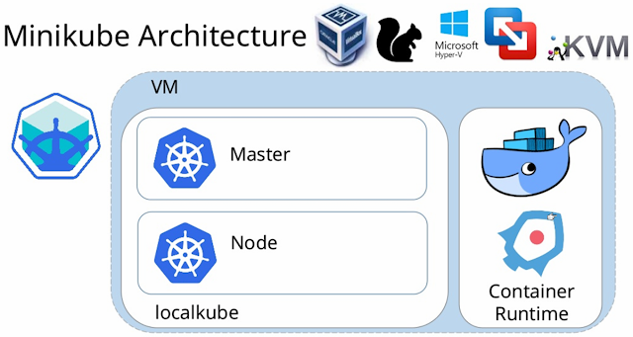
MiniKube https://kubernetes.io/docs/setup/learning-environment/minikube/ https://kubernetes.io/docs/tasks/tools/install-minikube/ https://kubernetes.io/docs/tasks/tools/#minikube
The Minikube CLI provides basic bootstrapping operations for working with your cluster, including start, stop, status, and delete.
Minikube:
is a tool that lets you run Kubernetes locally.
runs a N-node Kubernetes cluster
runs on your personal machine (Windows, macOS, Linux PC).
is great for trying out Kubernetes, or for daily development work.

Slide 14
Hello-Node Tutorial Step-By-Step(1/2) https://kubernetes.io/docs/tutorials/hello-minikube/
Create a Deployment that manages a Pod which will run a container based on the provided Docker Image with:
kubectl create deployment hello-node –image=k8s.gcr.io/echoserver:1.4
See the deployment with:
kubectl get deployments.
See the Pod with:
kubectl get pods.
See cluster events with a:
kubectl get events.
See the kubectl configuration with:
kubectl config view.
Expose the Pod as a Kubernetes Service to make it visible from outside the Cluster with type=LoadBalancer as the expose keyword.
kubectl expose deployment hello-node --type=LoadBalancer --port=8080

Slide 15
Hello-Node Tutorial Step-By-Step(2/2) https://kubernetes.io/docs/tutorials/hello-minikube/
View the service you just created with:
kubectl get services.
External cloud providers get an external IP to access the service.
Select + → Select Port to View on Host 1 → Enter the 5 digit port # after the :
Take a look at available Add-Ons with:
minikube addons list.
Enable the metrics-server add-on with:
minikube addons enable metrics-server.
View the Pod with the service you just created with:
kubectl get pod, svc –n kube-system.

Slide 16
Hello-Node Tutorial Step-By-Step(3/3) https://kubernetes.io/docs/tutorials/hello-minikube/
Disable the metrics-server with:
minikube addons disable metrics-server.
Delete the service with:
kubectl delete service hello-node
Delete the deployment with:
kubectl delete deployment hello-node
Stop Minikube with:
minikube stop
Delete the Minikube VM with:
minikube delete

Slide 17
More Tutorials https://kubernetes.io/docs/tutorials/
https://docs.microsoft.com/en-us/azure/aks/tutorial-kubernetes-prepare-app
https://kubernetes.io/docs/tutorials/stateful-application/mysql-wordpress-persistent-volume/
https://www.digitalocean.com/community/curriculums/kubernetes-for-full-stack-developers
https://cloud.google.com/kubernetes-engine/kubernetes-comic/

Slide 18
Assignment (1/2) https://kubernetes.io/docs/tutorials/kubernetes-basics/
Create 8 quiz questions along with four plausible answers each.
These 8 questions will coincide with the 6 chapters of the above tutorial and the 2 lecture pdf’s.
That means one question will be from each chapter and 1 from each pdf.
Turn these questions in to your original (first) Batch GitHub repo in a file found at the root of your repo titled ‘KubernetesQuiz_FnameLname.txt’
These questions will be included in a quiz that you will be given tomorrow and will serve as a primer for the next QC.
Make sure to include a full range of questions from definitions of elements of Kubernetes structural questions to process to data flow to specific commands in the CTL, etc.
Also include a link to the docs page where the answer to your question is found.

Slide 19
Assignment (2/2) https://kubernetes.io/docs/tutorials/kubernetes-basics/
Questions format example.
2. This is a DB that stores info about all nodes and clusters in Key:Value pairs.
https://kubernetes.io/docs/concepts/overview/components/#etcd
a. ETCD Cluster (correct)
b. Worker nodes
c. Kube-ApiServer
d. Kuberlet

