Slide 1

REST Fundamentals
.NET

Slide 2
REST is an architectural framework in which data and functionality are considered resources. Clients and servers exchange representations of resources using a standardized interface and protocol like JSON and serialized HTTP.
https://restfulapi.net/

Slide 3
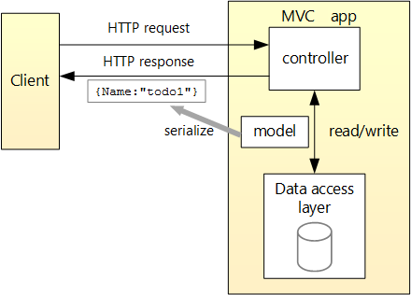
REST API Tutorial https://docs.microsoft.com/en-us/aspnet/core/tutorials/first-web-api?view=aspnetcore-3.1&tabs=visual-studio
An API (maybe yours?)
3rd-Party API offering additional functionality.
Angular
Business Layer
Database
Database

Slide 4
REST API Tutorial https://docs.microsoft.com/en-us/aspnet/core/tutorials/first-web-api?view=aspnetcore-3.1&tabs=visual-studio
Angular
An API. Login.
Database
An API.
Create a reimbursement.
An API. Register.
Database
3rd-Party API offering additional functionality.

Slide 5
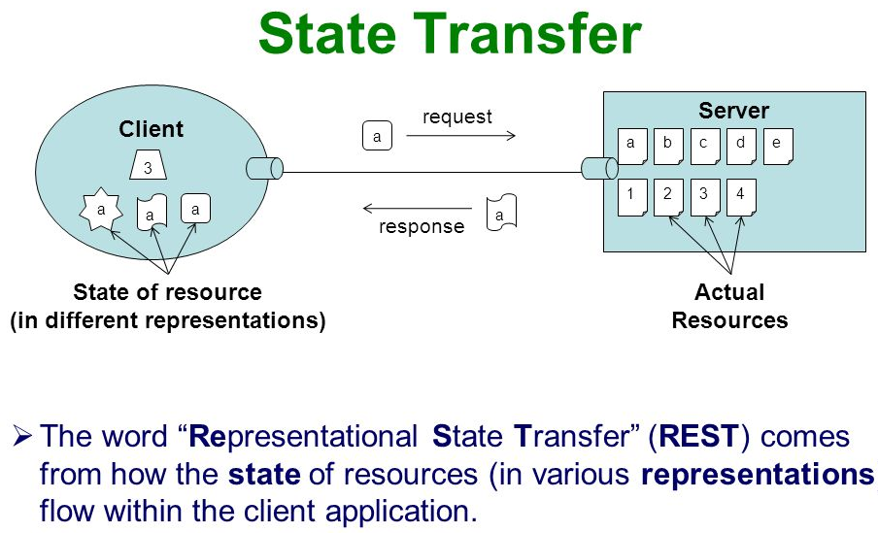
Rest – Overview https://docs.microsoft.com/en-us/azure/architecture/best-practices/api-design#introduction-to-rest
Roy Fielding proposed REpresentational State Transfer (REST) as an architectural approach to designing web services in 2000. REST uses open standards. A REST web service can use any language or toolset that can generate HTTP requests and parse HTTP responses. REST APIs are designed around resources.
Resources are any kind of data or service that can be accessed by a client.
Resources have identifiers.
EX. http://www.Revature.com/ employees/associates/23.
Routing is used to direct a request to the correct resource.
Clients interact with a service by exchanging representations of resources.

Slide 6
Rest – Overview https://docs.microsoft.com/en-us/azure/architecture/best-practices/api-design#introduction-to-rest
REST APIs implement an interface that allows decoupling of client and service applications. They use a data transfer format like XML, JSON, or JPG and standard HTTP verbs to facilitate communication. The state of an application is not remembered between requests in REST.
The only place where data is stored is in the DataBase for the application.
This means that any request can be made through any server by any client.
Each request must be atomic: It can’t depend on any other request.

Slide 7
REST – Guiding Principles https://restfulapi.net/ https://restfulapi.net/rest-architectural-constraints/
Client-Server | Stateless | Cacheable | Uniform Interface | Layered System | Code on Demand
Loose Coupling allows portability of the UI and scaling of the application. | Requests must be atomic. This means they cannot be dependent on any other call. | Responses are labeled as Cacheable or non-cacheable. If Cacheable, the client (browser) can reuse the data. | All API Interfaces have 4 constraints: ID of resources, manipulation of resources through representations, self-descriptive messages, HATEOAS. | Hierarchical architecture. Each component can’t see beyond the layer with which it is interacting. | REST allows extension of functionality by the downloading of scripts.
If you are honoring the 6 guiding principles of REST, you can call your app ‘RESTful’.

Slide 8
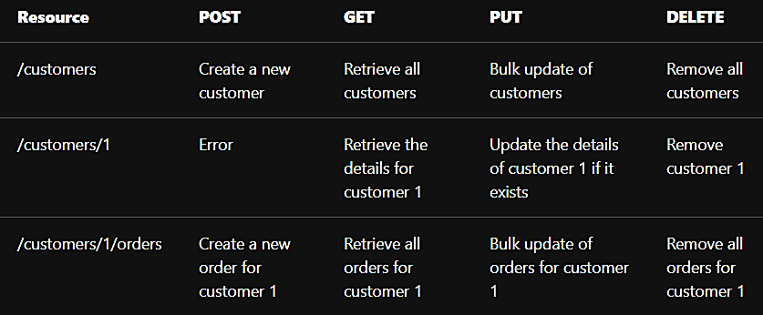
REST – HTTP Methods https://learn.microsoft.com/en-us/azure/architecture/best-practices/api-design https://developer.mozilla.org/en-US/docs/Web/HTTP/Methods https://restfulapi.net/
HTTP Methods assign semantic meaning to a request. The effect of a specific HTTP Method (Verb) used in a request should depend on whether the resource is a collection or an individual item.
Roy Fielding never defined any rules around which HTTP method must be used in which condition.
The only requirement is that the interface be uniform and internally consistent.

Slide 9
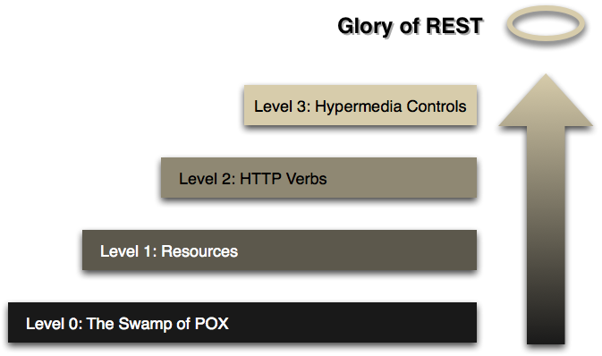
Richardson Maturity Model https://docs.microsoft.com/en-us/azure/architecture/best-practices/api-design https://martinfowler.com/articles/richardsonMaturityModel.html
In 2008, Leonard Richardson proposed the following maturity model for web APIs:
Level 0: Define one URI. All operations are POST requests to this URI. POX (Plain Ol’ Xml)
Level 1: Create many URIs for differnet resources.
Level 2: Use HTTP methods to define operations on resources.*
Level 3: Use hypermedia (HATEOAS).
*Most websites are at Level 2.

Slide 10
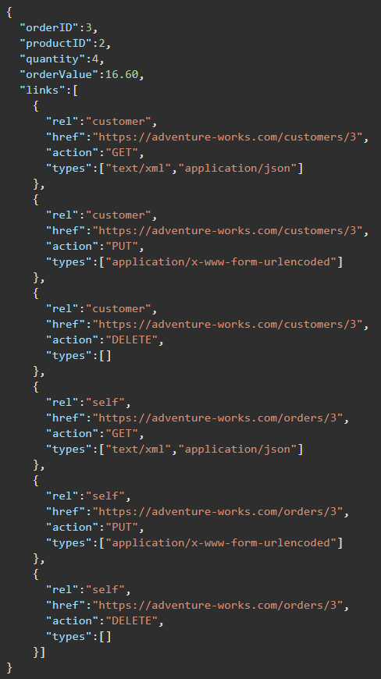
HATEOAS – Hypertext as the Engine of Application State https://docs.microsoft.com/en-us/azure/architecture/best-practices/api-design#use-hateoas-to-enable-navigation-to-related-resources
Each HTTP GET request should return the information necessary to find the resources related directly to the requested object through hyperlinks included in the response. It should also be provided with information that describes the operations available on each of these resources.
HATEOAS creates a ‘Finite State Machine’. The response to a request contains the information necessary to move between states.
Currently there are no standards or specifications that define how to model the HATEOAS principle.

Slide 11
REST Best Practices (1/2) https://docs.microsoft.com/en-us/azure/architecture/best-practices/api-design#organize-the-api-around-resources
Resource URIs should be based on nouns (the resource) and not verbs (the operations on the resource).
Https://adventure-works.com/Orders (NOT ”GetOrders”)
Avoid creating APIs that simply mirror the internal structure of a database. This gets easier when using Microservices.
A collection is a separate resource from the item within the collection and should have its own URI.
Collection => Revature.com/accounts/associates.
Item => Revature.com/accounts/associates/45
Use plural nouns for URIs that reference collections.
Collection => Revature.com/accounts/associates.
Organize URIs for collections and items into a hierarchy.

Slide 12
REST Best Practices (2/2) https://docs.microsoft.com/en-us/azure/architecture/best-practices/api-design#organize-the-api-around-resources
Consider the relationships between different types of resources and how you might expose these associations:
/customer/{id}/{resource} => /customers/5/orders might retrieve all the orders for customer 5.
Provide navigable links to associated resources in the body of the HTTP response message.(HATEOAS)
Avoid "chatty" web APIs that expose many small resources.
Balance exposing many resources against the overhead of fetching data that the client doesn't need. Retrieving large objects can increase latency.
Avoid introducing dependencies between the web API and the underlying data sources.
Introduce a mapping layer between the database and the web API so that only requested data is returned. Use Data Transfer Objects (DTO) to minimize payloads.

Slide 13

Filtering and Pagination https://docs.microsoft.com/en-us/azure/architecture/best-practices/api-design#filter-and-paginate-data
Filtering - Allow for passing a filter in the query string of the URI, such as /orders?minCost=n instead of retrieving all orders. The API should create a query specifying the search parameter to retrieve just what is needed.
Pagination – You can specify a certain number of items to return with a request at a time and only retrieve the next set when the user requests the next page. /orders?limit=25&offset=50
Avoid fetching large amounts of data when only a subset of the information is required.
Set an upper limit on the number of items returned. This helps prevent Denial of Service (DoS) attacks.
GET requests that return paginated data should also include some form of metadata that indicate the total number of resources available in the collection.

Slide 14

Open API Initiative https://docs.microsoft.com/en-us/azure/architecture/best-practices/api-design#open-api-initiative https://www.openapis.org/ https://docs.microsoft.com/en-us/aspnet/core/tutorials/web-api-help-pages-using-swagger?view=aspnetcore-5.0
The Open API Initiative was created to standardize REST API descriptions across vendors.
Swagger 2.0 specification was renamed to The OpenAPI Specification (OAS) and brought under the Open API Initiative.
The OpenAPI Specification offers a set of guidelines on how a REST API should be designed. This has advantages for interoperability but requires more care when designing an API.
OAS promotes a contract-first approach, rather than an implementation-first approach. Contract-first means you design the API contract (the interface) first and then write code that implements the contract.(i.e. “What I want to offer. Then, “How will I get that.”)
Tools like Swagger can generate client libraries or documentation from API contracts.

Slide 15
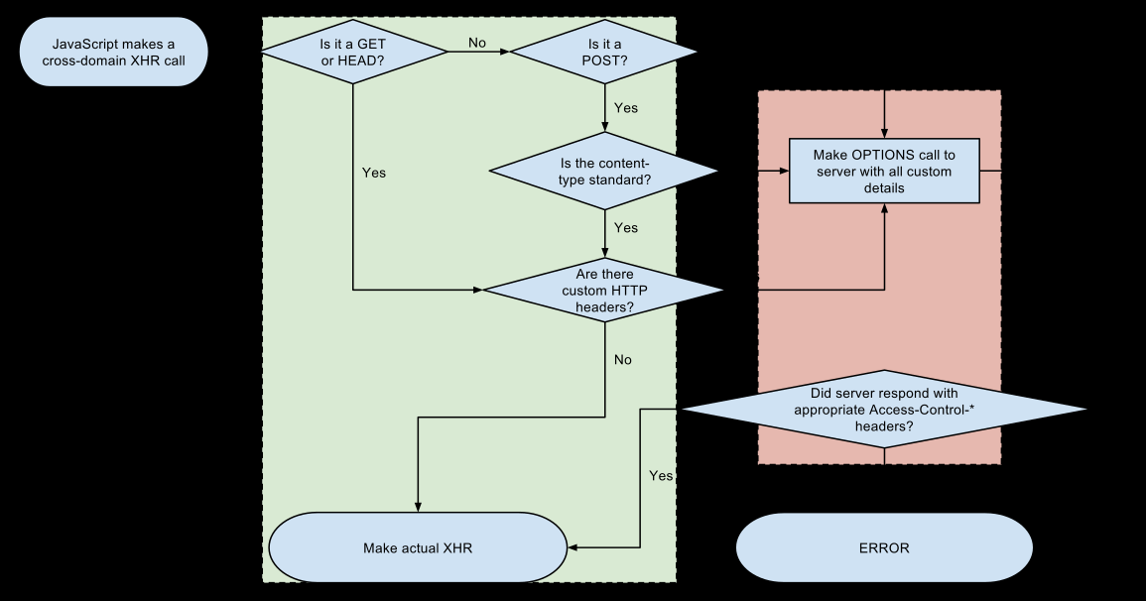
CORS https://en.wikipedia.org/wiki/Cross-origin_resource_sharing https://www.w3.org/TR/cors/#resource-requests
Cross-origin resource sharing (CORS) allows restricted resources on a web page to be requested from another domain outside the domain from which the first resource was served.
A web page might embed cross-origin images, stylesheets, scripts, iframes, and videos.
Certain "cross-domain" requests (AJAX requests) are forbidden by the same-origin security policy.
CORS defines how a browser and server can interact in a safe way allowing the cross-origin request.

Slide 16
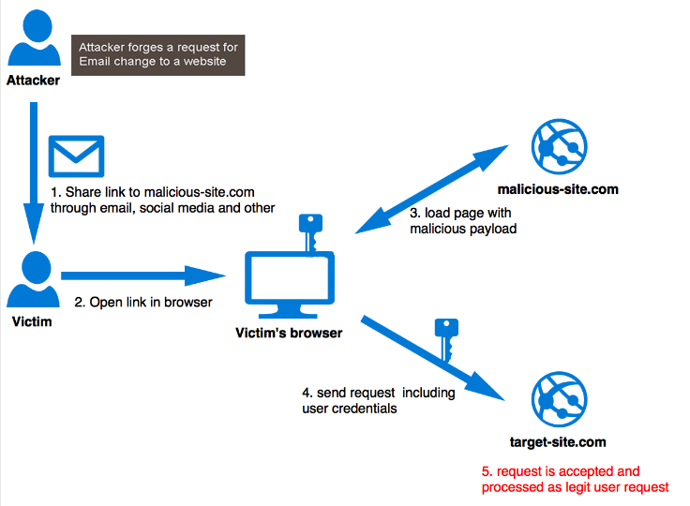
Cross-Site Request Forgery(CSRF) https://en.wikipedia.org/wiki/Cross-site_request_forgery
CSRF is a type of attack where unauthorized commands are transmitted from a user that the web application trusts.
A malicious website can transmit commands by using:
specially-crafted image tags,
hidden forms,
JavaScript XMLHttpRequest objects.
All the above can work without the user's interaction or even knowledge. CSRF exploits the trust that a site has in a user's browser.
In a CSRF attack actions can be performed on the website that can include inadvertent client or server data leakage, change of session state, or manipulation of an end user's account.

Slide 17
How to implement a REST API on ASP.NET Core https://docs.microsoft.com/en-us/aspnet/core/web-api/?view=aspnetcore-5.0 https://docs.microsoft.com/en-us/aspnet/core/web-api/action-return-types
API Tutorial
ASP.NET Core Mvc has views.. In REST, views are eliminated, and HTTP endpoints now must be queried.
In VS create a asp.net web api using C#. dotnet new webapi -o <appName>
Choose api as the app type and create the template app.
Go to program.cs and add services.AddControllers(); in the services section.
In the configure method you see endpoints.MapControllers();.
The ControllerBase Class allows for “attribute routing”. This is the parent class of Controller class and doesn’t support views.
With MVC you use IActionResult for the return type. IActionResult also works with web API’s
You can write action methods specific to a different state of the source but usually you write them more generally.
Download PostMan – you don’t have to sign in to use it.

Slide 18
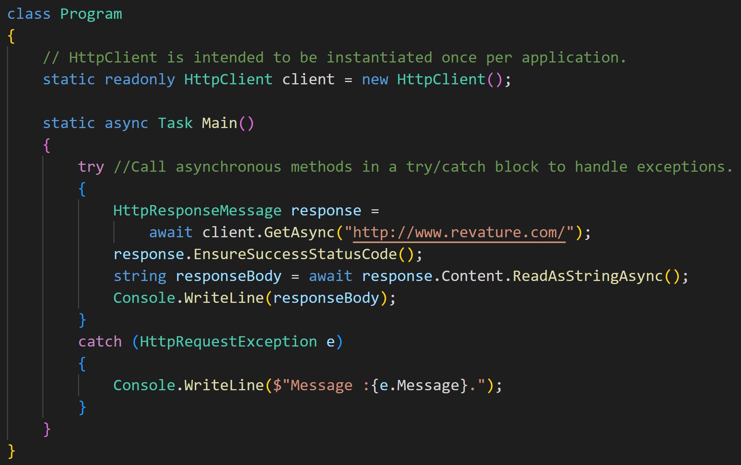
.NET HttpClient https://docs.microsoft.com/en-us/dotnet/api/system.net.http.httpclient?view=net-6.0
The HttpClient class instance acts as a session to send HTTP requests. It provides a base class for HTTP requests and responses for a resources URI.

Slide 19
In PostMan… https://learning.postman.com/docs/postman/sending-api-requests/requests/
Use the generic app provided to you…
Send the first GET and it fails. In the details it tells you why. The SSL cert isn’t trusted so you have to go to the settings(upper right. Looks like a wrench or cog) Turn OFF SSL Cert Verification.
NOW you can send the GET and see the JSON in ‘pretty print’ format.
NOW add a scaffolded Item → API Controller with read/write actions . This will install whatever NuGet packages you need.
Looking at the template API Controller. attributes;:
[Route(“api/[controller]”)] gives a prefix for all the action methods of this controller
[ApiController] makes this class an attribute router with automatic checking for some return status codes (like 400 Bad Request)
[HttpGet(“{id}”, Name=“Get”)] the methods route will append to this. ID to the controllers overall route. Id is the route parameter or a variable for the method parameter. This is a Get method so only GET requests will be routed here.

Slide 20
Interesting Reads and Resources
The N+1 Problem
SOAP vs REST
How to design a REST API.
Authentication/authorization should not depend on cookies or sessions.
The Halting Problem.

Slide 21
REST Documentation https://blog.newrelic.com/engineering/documenting-restful-apis/
How to document REST services.

