Slide 1

Service Oriented Architecture
.NET

Slide 2
Service-oriented architecture (SOA) is a software design pattern where functionalities are provided by one API to another API through a predetermined communication protocol (HTTP).
https://en.wikipedia.org/wiki/Service-oriented_architecture

Slide 3
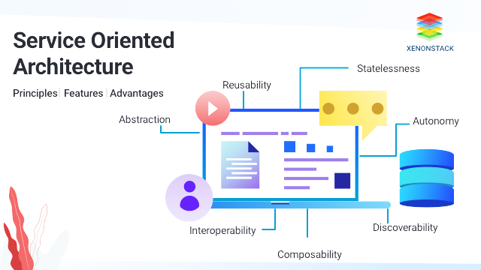
SOA – Overview https://www.ibm.com/support/knowledgecenter/SSMQ79_9.5.1/com.ibm.egl.pg.doc/topics/pegl_serv_overview.html#pegl_serv_overview__introsoa https://en.wikipedia.org/wiki/Service-oriented_architecture#Patterns https://docs.microsoft.com/en-us/dotnet/framework/wcf/whats-wcf#features-of-wcf
Service-oriented architecture (SOA) is defined by a reliance on “services” to send and receive data. SOA involves the deployment of services (API’s).
A REST service has the following characteristics:
Handles business processes with a deterministic outcome.
Accesses a database.
Is self-contained and independent.
It can access other services (other APIs).
It is a black box for users.
The independence of the service from other software is called loose coupling.
Services are deployed independently and function independently of platforms and programming languages.

Slide 4
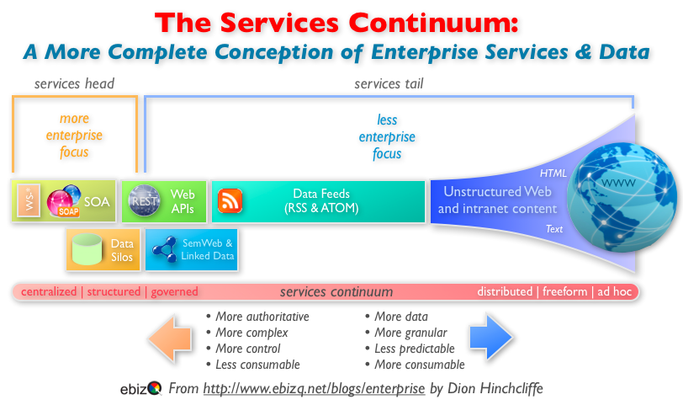
SOA – Overview https://en.wikipedia.org/wiki/Service-oriented_architecture#Patterns
SOA is part of an organizational continuum.
This continuum:
Begins at the (older) concepts of distributed computing and modular programming.
Then moves to SOA.
Then moves on to the offspring of SOA, such as:
Mashups,
SaaS, and
cloud computing.

Slide 5
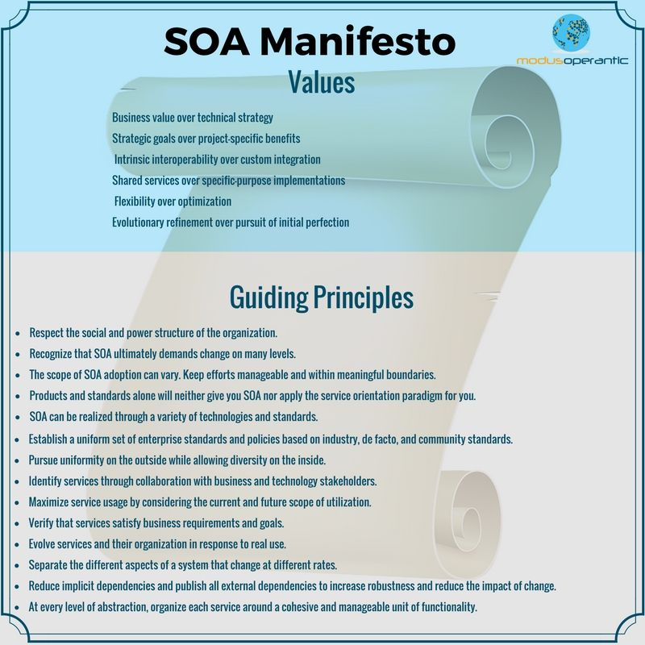
SOA – Principles https://en.wikipedia.org/wiki/Service-oriented_architecture#Patterns https://www.modusoperantic.com/en/the-soa-manifesto/
The six core values of Service-Oriented Architecture are:
Business value is given more importance than technical strategy.
Strategic goals are given more importance than project-specific benefits.
Intrinsic interoperability is given more importance than custom integration.
Shared services are given more importance than specific-purpose implementations.
Flexibility is given more importance than optimization.
Evolutionary refinement is given more importance than pursuit of initial perfection.
“Perfect” is the enemy of “DONE”.

Slide 6

Client/Server Model https://en.wikipedia.org/wiki/Client%E2%80%93server_model
The client–server model is a distributed application structure that separates work between the providers of a resource or service (server) and service requesters (client).
A client does not share its resources.
A client requests content or service from a server.
Clients must initiate all communication with servers.
Servers await incoming requests.
A client does not have to be concerned with how the server fulfills the request.
The client only has to understand the response.
The response is delivered over HTTP almost exclusively.
Clients and servers exchange messages in a request–response messaging pattern.
The client sends a request, and the server returns a response.
Email, network printing, and the World Wide Web all use the client-server model.

Slide 7
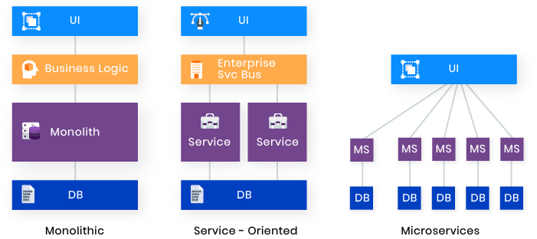
SOA – Uses https://www.ibm.com/support/knowledgecenter/SSMQ79_9.5.1/com.ibm.egl.pg.doc/topics/pegl_serv_overview.html#pegl_serv_overview__introsoa
SOA is mainly implemented from the ground up on new services. Justifications for when old code might be converted to SOA architecture are if the application:
has UI logic, business processing, and data access tightly coupled making the code difficult to test.
is hard to understand due to repeated patching rather than being rewritten when needed.
Updates are time consuming and complex, resulting in additional errors.
inventory has duplicate logic, requiring changes in several places.

Slide 8
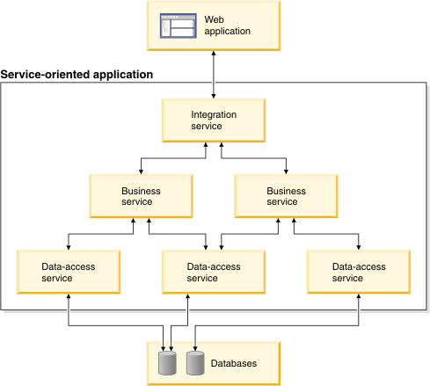
SOA – Design Patterns ibm.com/support/knowledgecenter/SSMQ79_9.5.1/com.ibm.egl.pg.doc/topics/pegl_serv_overview.html#pegl_serv_overview__introsoa
A Service-Oriented Application is a collection of independent services organized into a hierarchy.
The topmost level of the SOA receives data from the UI (the user) and sends requests via HTTP to the appropriate Business service API.
The Business Service may manipulate the data or send another request to a Data Access Services, or access a Database, depending on what is needed.

Slide 9
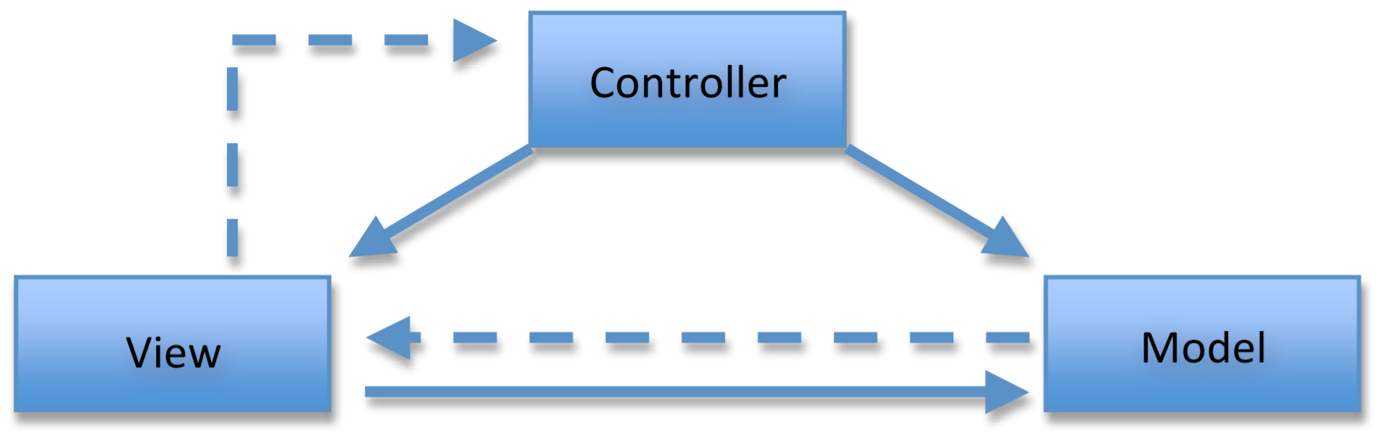
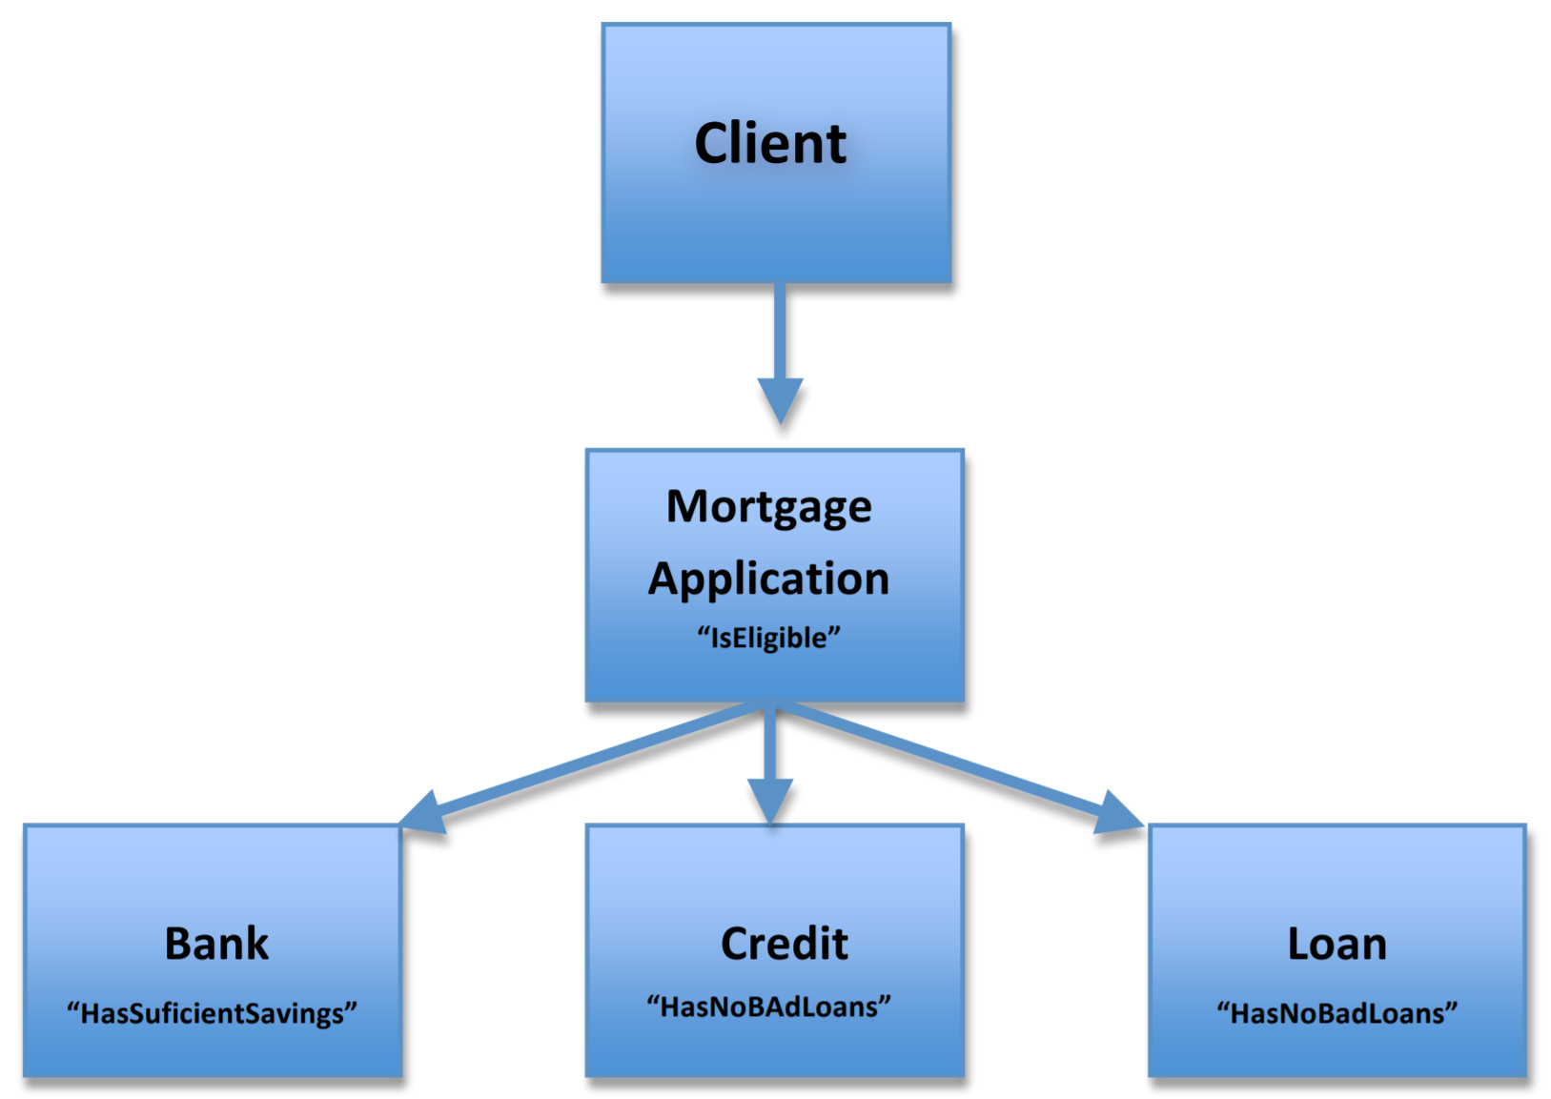
SOA – Web Service Design Patterns https://www.mercurymagazines.com/pdf/Bst_Prctcs_Dsgn_Ptrns.pdf
Controller - A Controller can be used in SOA architectures to encapsulate the Business Logic of the target service. Controller is a key component of “MVC” architecture.
Façade: Placed between the client and the services used. It Loosens the coupling between client and server components.

Slide 10
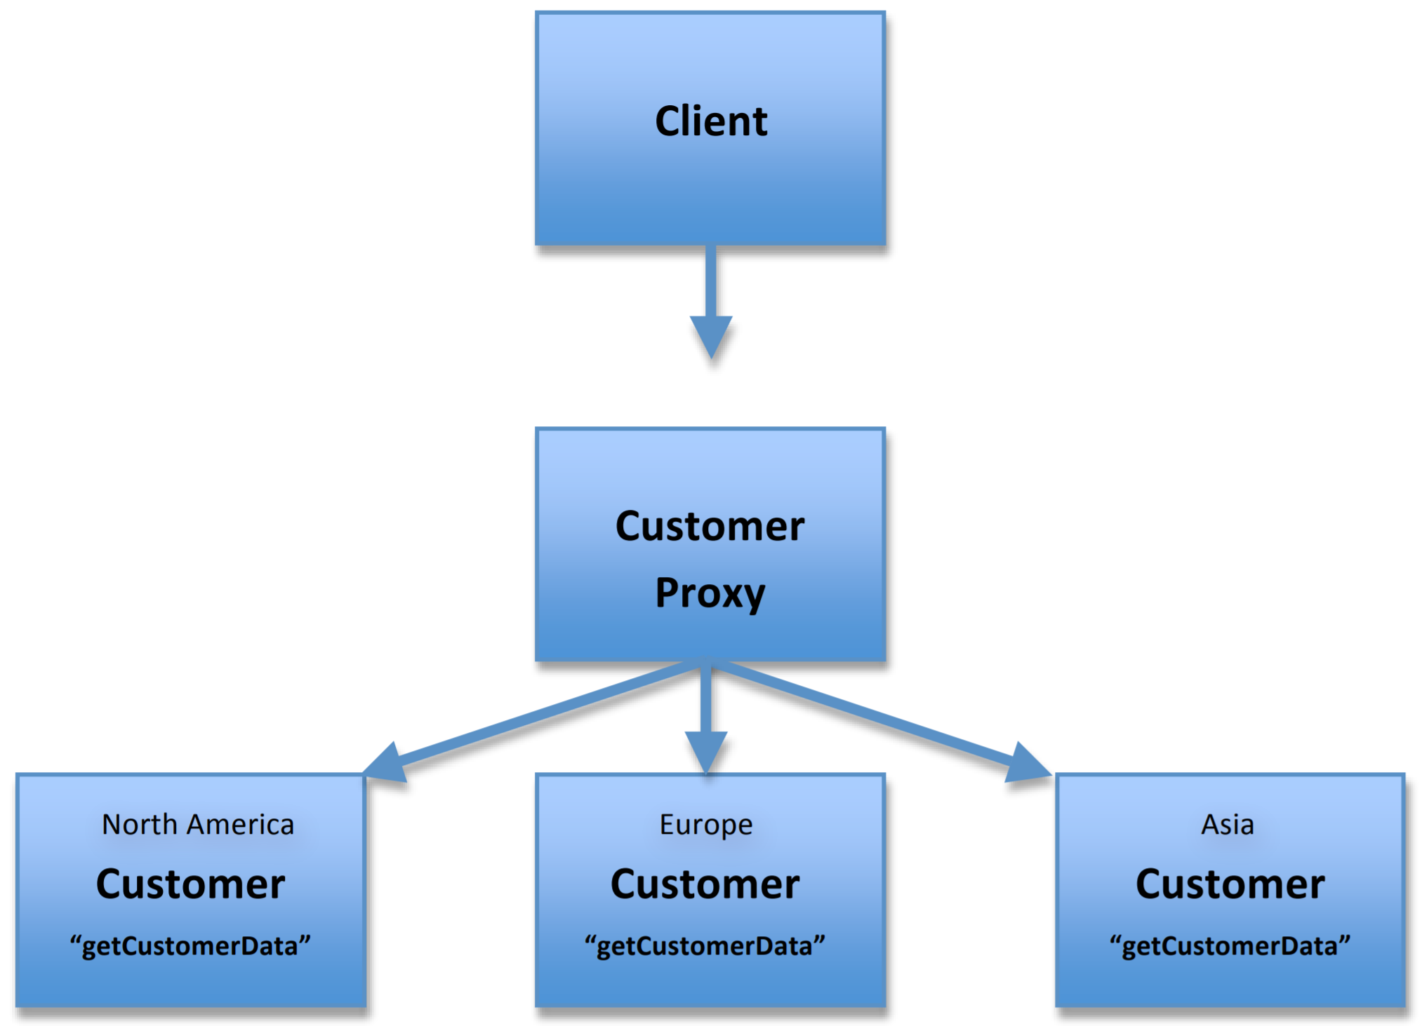
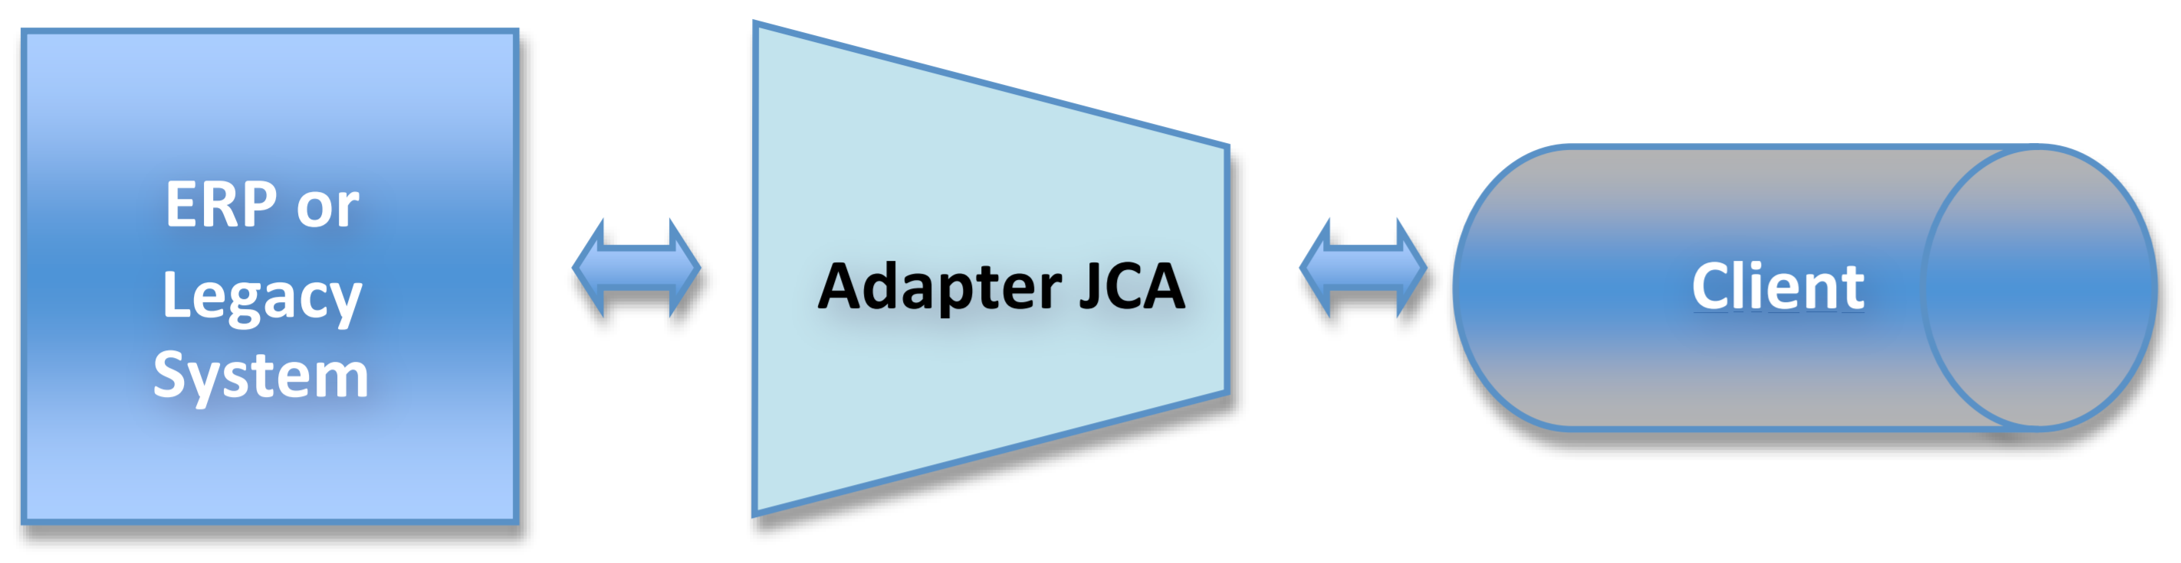
SOA – Web Service Design Patterns https://www.mercurymagazines.com/pdf/Bst_Prctcs_Dsgn_Ptrns.pdf
Proxy - Used to consolidate the messages sent to separate services into a single service. The Proxy dispatches the request to the appropriate back‐end service. This simplifies interactions with multiple services.
Adapter - Allows the continued use of existing applications by implementing a wrapper around them to modify output to what the modern client expects.

Slide 11
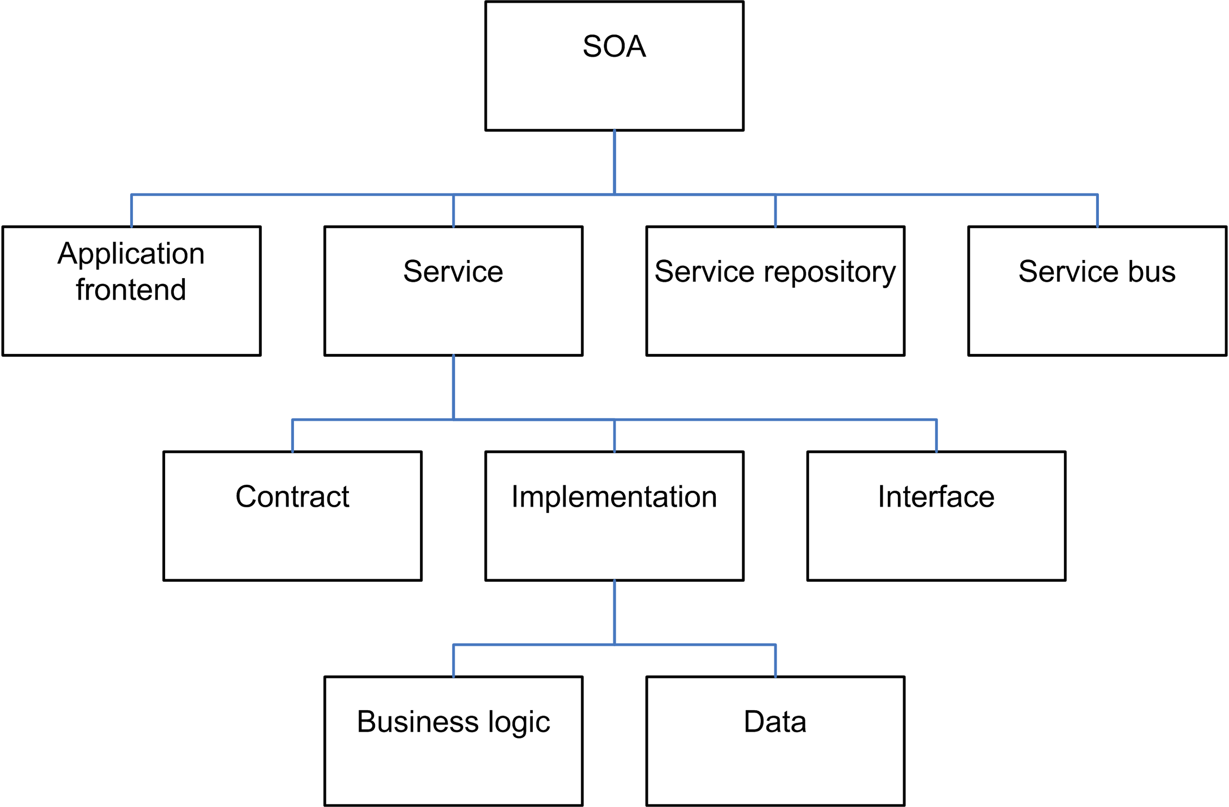
SOA - Implementations https://en.wikipedia.org/wiki/Service-oriented_architecture#Patterns:~:text=20%5D%5B21%5D-,Implementation%20approaches,-%5Bedit%5D
SOA’s are often implemented using Web Services. The most common Web Service SOA implementations use REST but there are many others.
SOA’s can make use of many different technologies due to their loosely coupled nature. The various services comprising a SOA must only decide on a protocol for communication.
This is often done (especially with SOAP) with a formal document called a Web Services Description Language (WSDL) Document.
When using a WSDL, no responding service needs to know anything about a calling service. Each service is a black box to the others.

Slide 12
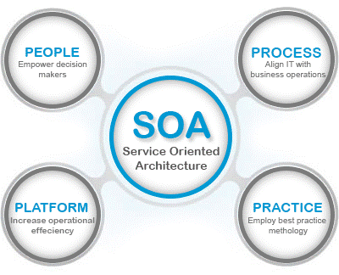
SOA – Benefits https://www.mercurymagazines.com/pdf/Bst_Prctcs_Dsgn_Ptrns.pdf
With Service-Oriented Architecture, you can integrate legacy code with new technologies to reuse existing applications. This reduces development costs.
Decoupling a service from its presentation reduces expenses and decreases development time.
SOA makes applications more dynamic by exposing information and data sharing across the organization and focusing development strategies to improve overall operations.

Slide 13
SOA – Difficulties https://www.mercurymagazines.com/pdf/Bst_Prctcs_Dsgn_Ptrns.pdf https://martinfowler.com/bliki/ServiceOrientedAmbiguity.html
SOA services are loosely coupled. Due to this loose coupling, they have more latency than tightly coupled implementations.
This can present challenges when implementing dynamic requirements.
SOA is meant to create an environment where legacy systems can work with new systems, but new business practices like the standardization of naming, definitions, and identification can present implementation challenges.
To overcome the challenge of blending legacy applications with new standards, services can be implemented to handle certain tasks on behalf of the legacy application.

