Slide 1

SOAP Fundamentals
.net

Slide 2
Simple Object Access Protocol is based on transferring XML data as SOAP Messages. Each message is an XML document. The structure of the XML document follows a specific pattern, but not the content. In SOAP, messages are all sent via HTTP.
https://www.guru99.com/web-service-architecture.html#1

Slide 3
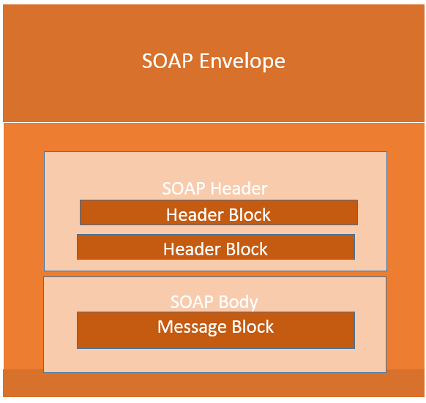
SOAP – Overview https://en.wikipedia.org/wiki/SOAP
SOAP (Simple Object Access Protocol) is a messaging protocol specification for exchanging structured information in the implementation of web services.
SOAP has three major characteristics:
extensibility (security and WS-Addressing are under development)
neutrality (SOAP can operate over any protocol such as HTTP, SMTP, TCP, UDP)
independence (SOAP allows for any programming model)

Slide 4
SOAP Web Services – Overview https://www.guru99.com/soap-simple-object-access-protocol.html
SOAP (Simple Object Access Protocol) is a protocol that defines how Web Services communicate with each other or with client applications that invoke them.
Every programming language can understand the XML markup language. SOAP uses XML for data exchange.
Because there are no standard specifications on use of XML across all programming languages for data exchange, SOAP was designed to work with XML over HTTP and have some sort of specification which could be used across all applications. W3C recommends SOAP as the medium of exchange between client and Web Service.
The SOAP specification defines something known as a "SOAP message" which is an XML document sent between the Web Service and the client application.

Slide 5
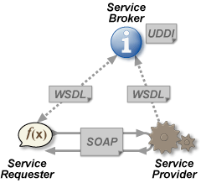
SOAP Web Service Requirements https://en.wikipedia.org/wiki/Web_service https://www.guru99.com/web-service-architecture.html#1 https://www.oasis-open.org/
Every SOAP Web Service must have certain foundational characteristics to function.
SOAP messaging – Simple Object Access Protocol messages contain an XML document with a standardized structure. SOAP messages are most often sent over HTTP but can use any protocol.
WSDL (say, “wizdle”)– Web Services Description Language is an XML file which tells the client what a SOAP Web Service does and how to communicate with it.
UDDI – Universal Description, Discover, and Integration is a repository where WSDL files can be published by a SOAP Web Service provider. Any client has access to the UDDI. UDDI was created by OASIS.

Slide 6
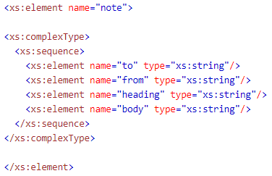
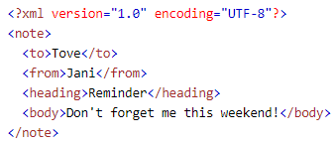
XML and XML Schema https://www.w3schools.com/xml/xml_whatis.asp https://www.w3schools.com/xml/xml_schema.asp
XML (the house) | XML Schema (blueprint)
Software and Hardware independent. | Describes the structure of an accompanying XML doc.
Stores and transports data in plain text format. | Supports Namespaces and Datatypes.
Is self-descriptive. | Written in XML.
Is recommended by W3C. | Can serve as a contract for how client and provider communicate.
XML tags are not predefined. The tag is the Key of the key-value pair.

Slide 7
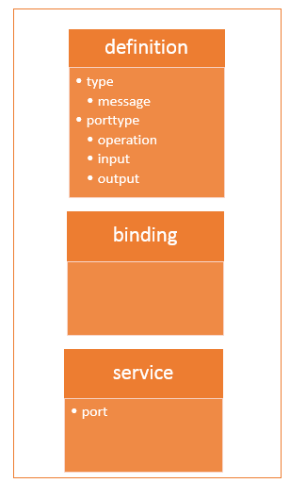
WSDL – Example and Explanation https://www.guru99.com/wsdl-web-services-description-language.html
The WSDL describes what the Web Service does, what it requires from the client, and what it provides to the client. A WSDL contains:
the location of the Web Service,
all the information required to connect to the Web Service
all the methods and functionality provided the Web Service.
The definitions and types of SOAP messages passed by the SOAP protocol is defined in the WSDL document.
A WSDL contains these elements:
Definition, TargetNamespace, DataType, Message, PortType, Binding, Service

Slide 8
WSDL Tag Elements https://www.guru99.com/wsdl-web-services-description-language.html
Tag Name | Purpose
<types> | Defines all complex data types in the messages
<message> | Defines the message which to be exchanged between the client application and the web server. There are two <message> tags in each WSDL. One for input parameters and one for output parameters.
<portType> | Used to define a complete input/output operation provided by the Web Service. Gives the names of the input and output <message>.
<binding> | Used to define how the messages will be transferred (HTTP or other). Port types act like interfaces, so the client must call the relevant port to ask for a particular functionality.
<service> | Declares the name given to the Web Service itself. This is a web address used for confirmation that the service exists.

Slide 9
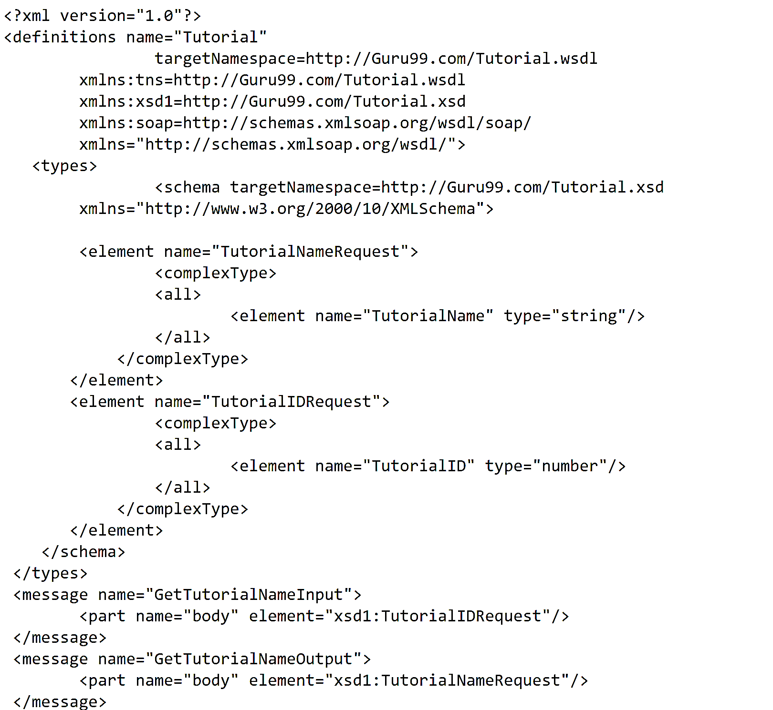
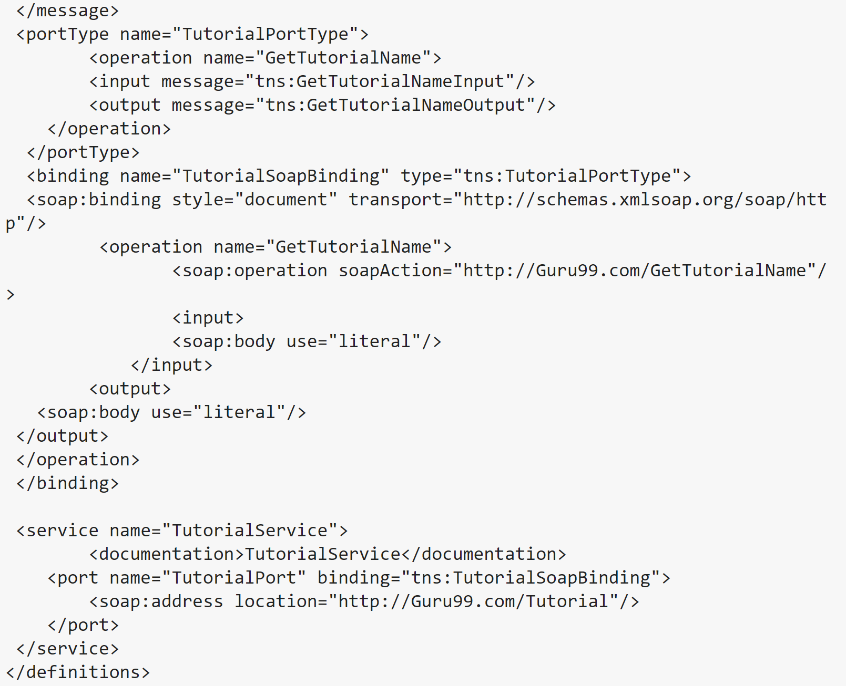
WSDL File Example https://www.guru99.com/wsdl-web-services-description-language.html
Tag Name | Purpose
<types> | Defines all complex data types in the messages
<message> | Defines the message which is exchanged between the client application and the web server. There are two <message> tags in each WSDL. One for input parameters and one for output parameters.
<portType> | Used to define a complete input/output operation provided by the Web Service. Gives the names of the input and output <message>.
<binding> | Used to define how the messages will be transferred (HTTP or other). Port types act like interfaces, so the client must call the relevant port to ask for a particular functionality.
<service> | The name given to the Web Service itself. This is a web address used for confirmation that the service exists.

Slide 10
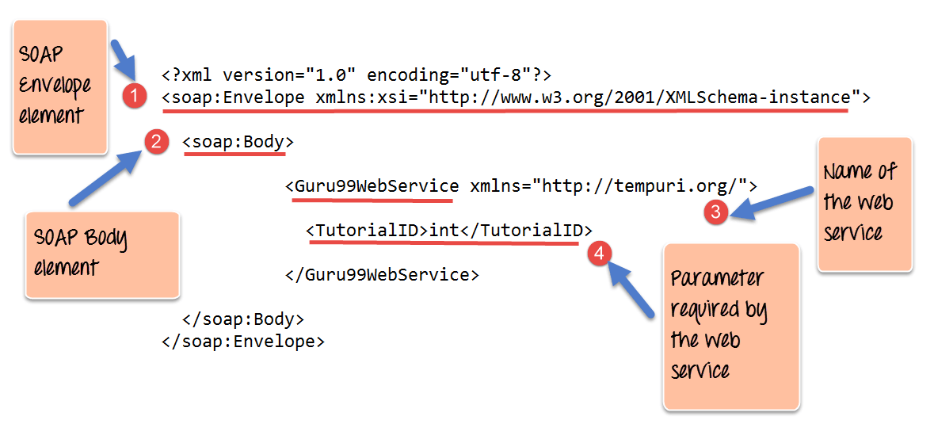
SOAP Message Elements https://www.guru99.com/soap-simple-object-access-protocol.html
Envelope – This element is mandatory and identifies the message as a SOAP message. The Envelope is the Root element and contains all other parts.
Header – This optional element can contain authentication credentials and complex data type definitions.
Body – There is one Body. It is mandatory and it contains the data being sent.
This message contains a Web Service which has the name of "Guru99WebService".
The "Guru99Webservice" accepts a parameter of the type 'int' and has the name TutorialID.

Slide 11
SOAP Message – Envelope https://www.guru99.com/soap-simple-object-access-protocol.html https://www.ibm.com/support/knowledgecenter/SSGMCP_5.4.0/fundamentals/web-services/dfhws_header.html
<?xml version='1.0' ?>
<env:Envelope xmlns:env="http://www.w3.org/2003/05/soap-envelope">
<env:Header>
<m:reservation xmlns:m="http://travelcompany.example.org/reservation"
env:role="http://www.w3.org/2003/05/soap-envelope/role/next"
env:mustUnderstand="true">
<m:reference>uuid:093a2da1-q345-739r-ba5d-pqff98fe8j7d</m:reference>
<m:dateAndTime>2001-11-29T13:20:00.000-05:00</m:dateAndTime>
</m:reservation>
<n:passenger xmlns:n="http://mycompany.example.com/employees"
env:role="http://www.w3.org/2003/05/soap-envelope/role/next"
env:mustUnderstand="true">
<n:name>Åke Jógvan Øyvind</n:name>
</n:passenger>
</env:Header>
<env:Body>
<p:itinerary
xmlns:p="http://travelcompany.example.org/reservation/travel">
<p:departure>
<p:departing>New York</p:departing>
<p:arriving>Los Angeles</p:arriving>
<p:departureDate>2001-12-14</p:departureDate>
<p:departureTime>late afternoon</p:departureTime>
<p:seatPreference>aisle</p:seatPreference>
</p:departure>
<p:return>
<p:departing>Los Angeles</p:departing>
<p:arriving>New York</p:arriving>
<p:departureDate>2001-12-20</p:departureDate>
<p:departureTime>mid-morning</p:departureTime>
<p:seatPreference/>
</p:return>
</p:itinerary>
<q:lodging
xmlns:q="http://travelcompany.example.org/reservation/hotels">
<q:preference>none</q:preference>
</q:lodging>
</env:Body>
</env:Envelope>
The SOAP Envelope is mandatory
The SOAP Envelope encapsulates all the other elements.
The Envelope header is optional.
The Envelope may only contain one header element.
The SOAP Envelope must have exactly one Body element.
The SOAP Envelope Header must the first child of the Envelope.
The SOAP Envelope changes when versions change. A Fault is generated when Envelope versions are mismatched.

Slide 12
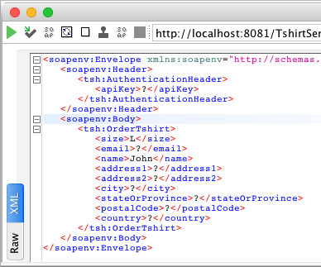
SOAP Message - Header https://www.ibm.com/support/knowledgecenter/SSGMCP_5.4.0/fundamentals/web-services/dfhws_header.html https://docs.mulesoft.com/apikit/4.x/apikit-4-get-header-task
The SOAP <Header> element is optional in a SOAP message. It is used to pass application-related information that is to be processed by SOAP nodes along the message path.
The immediate child elements of the <Header> element are called header blocks. A header block is an application-defined XML element. Header Blocks can be targeted by child elements in the body of the SOAP message.

Slide 13
SOAP Message - Header https://www.ibm.com/support/knowledgecenter/SSGMCP_5.4.0/fundamentals/web-services/dfhws_header.html
Header blocks are application-defined. SOAP-defined attributes on the header blocks indicate how the header blocks are to be processed by the SOAP nodes.
encodingStyle - Indicates the rules used to encode the parts of a SOAP message.
role/actor – <role> and <actor> can be assigned to a message in the header. If a <body> node has a matching assignment, the node is processed.
mustUnderstand – Used to ensure that SOAP nodes do not ignore important <header> blocks
Relay - when <relay> is specified with a value of true, the node retains the unprocessed <header> block in the message if it otherwise would have discarded it.

Slide 14
SOAP Message - Fault https://www.guru99.com/soap-simple-object-access-protocol.html
A SOAP response can be either “successful” or “error”. “Success” means a SOAP message will be returned. Failure means a “HTTP 500” is sent.
The Fault message contains the following elements.
Fault Element | Meaning
<faultCode> | Gives the code of the error. Possible values are ‘VersionMismatch’, ‘MustUnderstand’, ‘Client’, ‘Server’
<faultString> | A text message which gives a detailed description of the error.
<faultActor> | (Optional)A text string telling who caused the fault
<detail> | (Optional) Gives application-specific error messages.

Slide 15
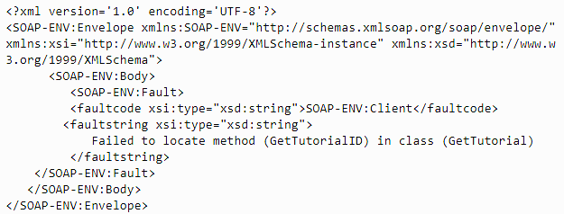
SOAP Fault Message https://www.guru99.com/soap-simple-object-access-protocol.html

Slide 16
SOAP in the .NET World https://docs.microsoft.com/en-us/dotnet/framework/wcf/whats-wcf
In .NET Framework, you use WCF (Windows Communication Foundation) when you want to use SOAP.
WCF is a framework for building service-oriented applications with a Service Oriented Access Protocol (another meaning of SOAP). Using WCF, you can send data as asynchronous messages from one service endpoint (a URL) to another.
These service endpoints can:
Process transactions
Send chat messages
Supply data like Star Wars character data or Chuck Norris Jokes.
WCF is designed to offer a manageable, easy approach to creating Web services and Web service clients (with SOAP).

Slide 17
WCF Features https://docs.microsoft.com/en-us/dotnet/framework/wcf/whats-wcf#features-of-wcf
Service | Details
Service Orientation | Create loosely-coupled services so that any client can connect to any service.
Service Metadata | WCF supports publishing service metadata (like WSDL*).
Data Contracts | You can use C# classes to represent data. The .NET Framework automatically creates the metadata that allows clients to comply with the data types you designed.
Durable Messages | Messages are saved to a DB.
AJAX and REST support | WCF can be configured to process "plain" XML data that is not wrapped in a SOAP envelope and also be extended to support specific XML formats
*And many others

Slide 18
A Practical SOAP Example https://docs.microsoft.com/en-us/dotnet/framework/wcf/how-to-define-a-wcf-service-contract https://docs.microsoft.com/en-us/dotnet/framework/wcf/getting-started-tutorial
Make sure you have WCF installed. => VS Installer =>Modify => Install Windows Communication Foundation
Open VS as an admin => new Project => C# => search WCF => WCF Service Library
Tutorial here.
The next task for creating a WCF application is to create a client by retrieving metadata from a WCF service. You use Visual Studio to add a service reference, which gets the metadata from the service’s MEX endpoint. Visual Studio then generates a managed source code file for a client proxy in the language you've chosen. It also creates a client configuration file (App.config). This file enables the client application to connect to the service at an endpoint. Tutorial: Use A Client
https://docs.microsoft.com/en-us/dotnet/framework/wcf/how-to-use-a-wcf-client
Q/A - The service keeps data as long as it is still running. So a List<> will persist till you shut the service down.

Slide 19
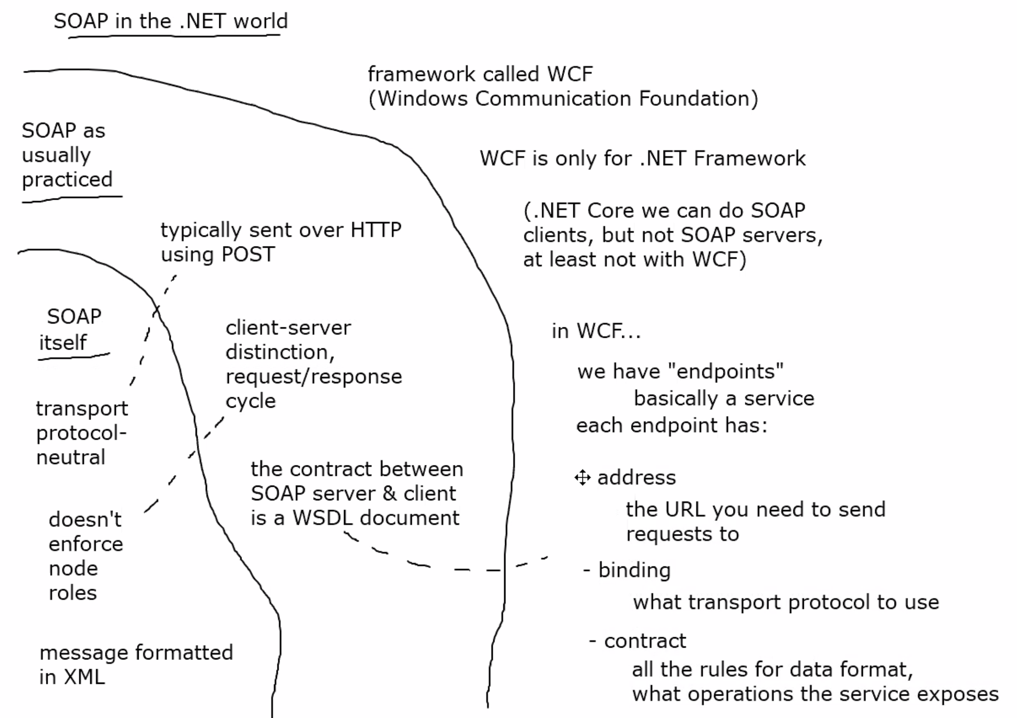
SOAP extra. https://www.ibm.com/support/knowledgecenter/SSMQ79_9.5.1/com.ibm.egl.pg.doc/topics/pegl_serv_overview.html https://www.ibm.com/support/knowledgecenter/SSAW57_9.0.5/com.ibm.websphere.nd.multiplatform.doc/ae/cwbs_soap.html
SOAP is protocol neutral. SOAP doesn’t care how you send SOAP messages.
Messages are always formatted in XML.
SOAP uses HTTP in practice.
Typically sent over HTTP using POST.
Client-server, distinction, request/response cycle
The contract between the SOAP server and the client is the WSDL doc(contract).
SOAP in the .NET world:
.NET uses WCF(Windows Communication Foundation)
WCF is Microsoft proprietary

