Slide 1

Object/Relational Mapper Entity Framework DbContext
.NET

Slide 2
Entity Framework Core is a modern object-database mapper for .NET. It supports LINQ queries, change tracking, updates, and schema migrations. EF Core works with SQL Database, SQLite, MySQL, PostgreSQL, and Azure Cosmos DB.
https://docs.microsoft.com/en-us/ef/core/

Slide 3

Entity Framework(an O/RM) https://docs.microsoft.com/en-us/ef/core/ https://www.entityframeworktutorial.net/what-is-entityframework.aspx
Entity Framework (EF) Core is a lightweight, extensible, open source and cross-platform version of the Entity Framework data access technology.
EF Core can serve as an object-relational mapper (O/RM). It enables .NET developers to work with a database using .NET objects and eliminates the need for most of the data-access code they usually need to write.
With EF Core, data access is performed using a Model. Models are made up of entity classes and a context object that represents a session with the database, allowing you to query and save data (for example, using LINQ). EF Core supports many database engines.

Slide 4
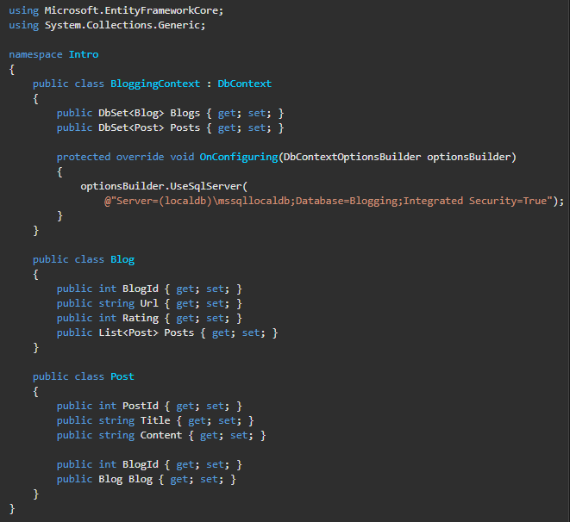
Entity Framework - Overview https://docs.microsoft.com/en-us/ef/core/#the-model
With Entity Framework Core, you can:
generate a Model from an existing database (Db-First Approach)
use EF Migrations to create a new database from an existing Model (Code-First Approach)
hand-code a Model to match your existing database.

Slide 5
Fluent API https://www.entityframeworktutorial.net/efcore/fluent-api-in-entity-framework-core.aspx https://www.tutorialspoint.com/entity_framework/entity_framework_fluent_api.htm
Entity Framework Fluent API is used to configure domain classes to override conventions. The ModelBuilder class acts as a Fluent API.
Entity Framework Core Fluent API configures the following aspects of a model:
Model Configuration: Configures an EF model to database mappings. Configures the default Schema, DB functions, additional data annotation attributes and entities to be excluded from mapping.
Entity Configuration: Configures entity to table and relationships mapping e.g. PrimaryKey, AlternateKey, Index, table name, one-to-one, one-to-many, many-to-many relationships etc.
Property Configuration: Configures property to column mapping e.g. column name, default value, nullability, Foreignkey, data type, concurrency column etc.
public class SchoolDBContext: DbContext
{
public DbSet<Student> Students { get; set; }
protected override void OnModelCreating(ModelBuilder modelBuilder)
{
//Property Configurations
modelBuilder.Entity<Student>()
.Property(s => s.StudentId)
.HasColumnName("Id")
.HasDefaultValue(0)
.IsRequired();
}
}

Slide 6
Loading Data from the DB https://docs.microsoft.com/en-us/ef/core/querying/related-data https://www.c-sharpcorner.com/article/eager-loading-lazy-loading-and-explicit-loading-in-entity-framework/
Entity Framework Core allows you to use the navigation properties in your model to load related entities.
There are three common O/RM patterns used to load data.
Eager loading - data is loaded from the database as part of the initial query.
Explicit loading - data is explicitly loaded from the database at a later time.
Lazy loading - data is loaded from the database when the navigation property is accessed. By default, LINQ to SQL load related entities using Lazy Loading.
We’ll focus on Eager and Lazy Loading only

Slide 7
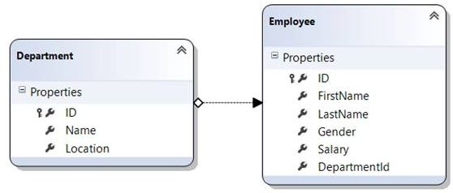
Lazy and Eager Loading Explained https://www.c-sharpcorner.com/article/lazy-loading-and-eager-loading-in-linq-to-sql/ https://www.c-sharpcorner.com/article/eager-loading-lazy-loading-and-explicit-loading-in-entity-framework/
Lazy Loading - The default behavior of Entity Framework Core. An entity is loaded only when it is accessed for the first time. This delays the loading of the related data until you ask for it.
Ex. When the departments are loaded, the related entities (Employee) are not loaded.
var dept = dbContext.Employee.Where(a => a.UserId == userId).FirstOrDefault();
Eager Loading – All entities are loaded at once as a part of the initial query. A large amount of data may be loaded at once.
Ex. Load the first found employee with DepartmentId == ID along with the employee details.
var dept = dbContext.Department.Include(a => a.Employee).Where(a => a.DepartmentId == ID);

Slide 8
Migrations https://learn.microsoft.com/en-us/aspnet/core/data/ef-rp/migrations?view=aspnetcore-7.0&tabs=visual-studio
Mention aaalll
about [attributes]

Slide 9
Model Attributes

Slide 10
Complex Data Models

Slide 11
Loading Related Data https://learn.microsoft.com/en-us/aspnet/core/data/ef-rp/read-related-data?view=aspnetcore-7.0&tabs=visual-studio

Slide 12
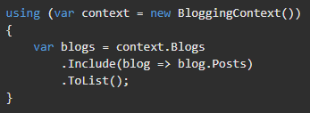

Eager Loading - Example https://docs.microsoft.com/en-us/ef/core/querying/related-data#eager-loading
Use the .Include() method to specify related data from one or multiple relationships to be included in a single query result (Eager Loading). Here, the blogs that are returned in the results will have their Posts property populated with the related posts automatically.
You can drill down through relationships to include multiple levels of related data using the .ThenInclude() method. The following example loads all blogs, their related posts, and the author of each post.

Slide 13
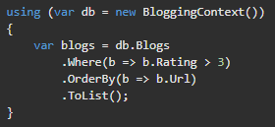
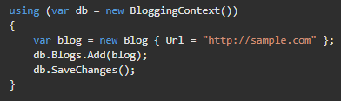
Querying DbContext / .SaveChanges(); https://docs.microsoft.com/en-us/ef/core/#querying https://www.entityframeworktutorial.net/efcore/entity-framework-core-dbcontext.aspx
With a DbContext, instances of your entity classes are retrieved from the database using Language Integrated Query (LINQ).
Data is created, deleted, and modified in the database using instances of your entity classes. .SaveChanges() is used to persist (save) those changes to the Db.

Slide 14
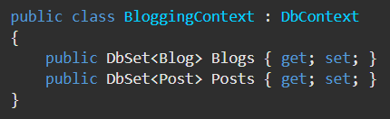
Code First Approach - DbSet<> https://docs.microsoft.com/en-us/ef/ef6/modeling/code-first/dbsets
When using an EF Core Code First approach, you define a DbContext that represents your session with the database and exposes (creates) a DbSet<modelType> for each Model type in your application.
This will configure the Classes sent as type arguments to the DbSet<> Class as entity types in your DB, as well as automatically configuring other needed types reachable from those types.

Slide 15

Tracking Queries https://docs.microsoft.com/en-us/ef/core/querying/tracking
By default, queries that return entity types are tracked. Tracking behavior controls whether Entity Framework Core will keep information about an entity instance in its “change tracker”.
If an entity is tracked, any changes detected in the entity will be persisted to the database during .SaveChanges().

Slide 16


No-Tracking Queries https://docs.microsoft.com/en-us/ef/core/querying/tracking#no-tracking-queries
If you don't need to update the entities (a read-only scenario) retrieved from the database, then a ‘no-tracking’ query should be used. They are quicker to execute because there's no need to set up the change tracking information.
You can also change the default tracking behavior at the context instance level

Slide 17


Raw SQL Queries https://docs.microsoft.com/en-us/ef/core/querying/raw-sql
Entity Framework Core allows you to use raw SQL queries. Raw SQL queries are useful if the query you want can't be expressed using LINQ or if using a LINQ query is resulting in an inefficient SQL query.
Use the .FromSqlRaw() extension method to begin a LINQ query based on a raw SQL query. .FromSqlRaw() can only be used on query roots, that is directly on the DbSet<>.
Raw SQL queries can be used to execute a stored procedure.

Slide 18
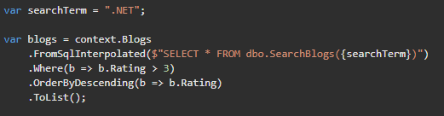
Raw SQL Queries https://docs.microsoft.com/en-us/ef/core/querying/raw-sql
You can compose on top of the initial raw SQL query using LINQ operators. Composing with LINQ requires your raw SQL query to be composable since EF Core will treat the supplied SQL as a subquery. SQL queries that can be composed on begin with the SELECT keyword.

Slide 19
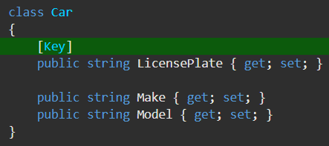
Database - Entity Framework [key] https://docs.microsoft.com/en-us/ef/core/modeling/keys?tabs=data-annotations
A key serves as a unique identifier for each entity instance.
Most entities in EF have one key which maps to the concept of a Primary Key in relational databases.
It is possible for an entity to have no keys.
Entities can also have additional keys (Alternate Keys) beyond the Primary Key.
By default, any property named Id or <type name>Id will be automatically configured by EF as the Primary Key of an entity.
You can configure any single property to be the Primary Key of an entity.

Slide 20
Migrations – Code First Approach Create and Update the DB https://docs.microsoft.com/en-us/ef/core/managing-schemas/migrations/?tabs=dotnet-core-cli
The migrations feature in EF Core provides a way to incrementally update the database schema to keep it in sync with the application's data model while preserving existing data in the database.
Migrations includes command-line tools and APIs that help with the following tasks:
Create a migration. - Generate code that can update the database to sync it with a set of model changes.
Update the database. - Apply pending migrations to update the database schema.
Customize migration code. Sometimes the generated code needs to be modified or supplemented.
Remove a migration. - Delete the generated code.
Revert a migration. Undo the database changes.
Generate SQL scripts. - You might need a script to update a production database or to troubleshoot migration code.
Apply migrations at runtime. - When design-time updates and running scripts aren't the best options, call the Migrate() method.

Slide 21
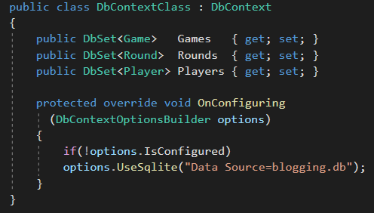
EF Code-First with Sqlite (1/2) https://docs.microsoft.com/en-us/ef/core/get-started/?tabs=netcore-cli
Create your console project with dotnet CLI
dotnet new console –o [projectName]
With Package Manager Console (in VS), install the correct package for the EF Core DB Provider you want. (Here is for SQL-Lite).
Install-Package Microsoft.EntityFrameworkCore.Sqlite
Create Class models that represent the entities in your application.
Create a class that inherits DbContext, add DbSet<>’s, and make it match the image to the right.
In Package Manager Console, install EF Tools
Install-Package Microsoft.EntityFrameworkCore.Tools

Slide 22
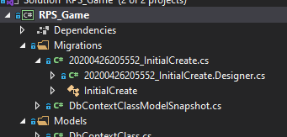
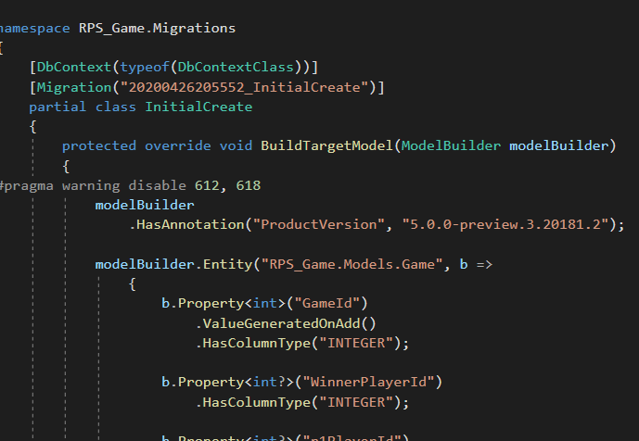
EF Code-First with Sqlite (2/2) https://docs.microsoft.com/en-us/ef/core/get-started/?tabs=netcore-cli
Create the initial set of migration instructions files for Db creation.
Add-Migration InitialCreate
Create the DB and apply the new migration to it.
Update-database
Look at the files created to verify that EFCore has correctly interpreted your models.
Create a context to use in whichever class you need the DbContext.
var db = new BloggingContext();

Slide 23
EF Data-First Approach https://www.entityframeworktutorial.net/efcore/create-model-for-existing-database-in-ef-core.aspx
Download the required packages.
Microsoft.EntityFrameWorkCore.SqlServer
Microsoft.EntityFrameWorkCore.Design
Microsoft.EntityFrameWorkCore.Tools
In VS, go to the Package Manager Console and enter:
Scaffold-DbContext "Server=.\SQLExpress;Database=YourDbNameHere;Trusted_Connection=True;" Microsoft.EntityFrameworkCore.SqlServer -OutputDir Models
/

Slide 24
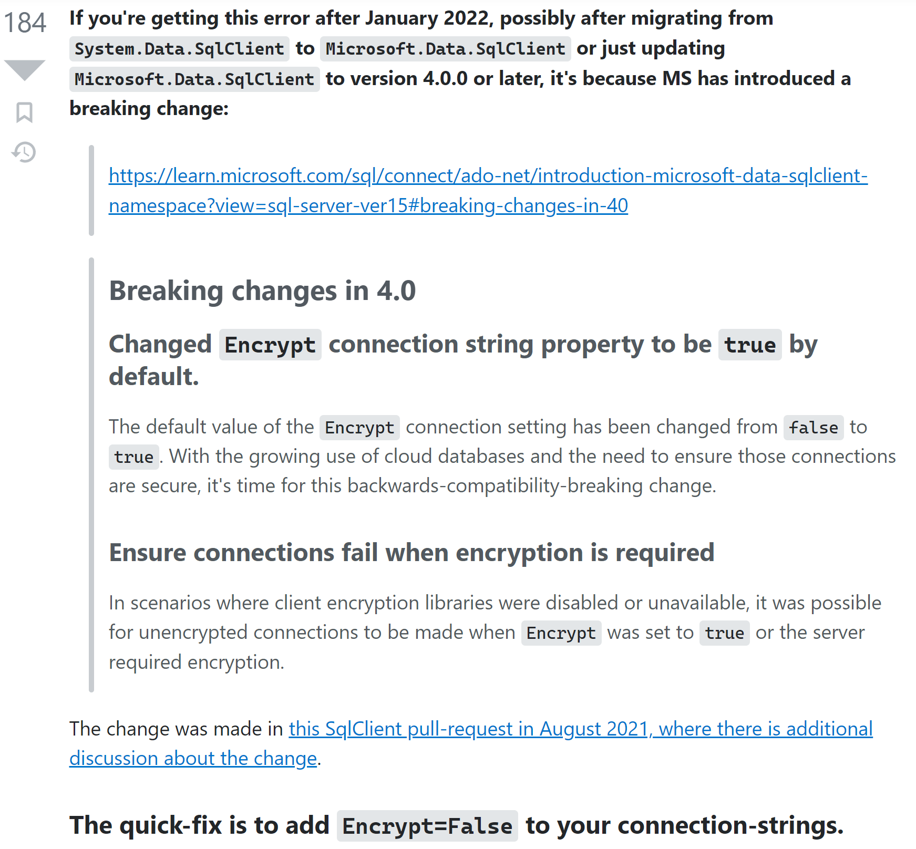
Failure to connect error solution https://stackoverflow.com/questions/17615260/the-certificate-chain-was-issued-by-an-authority-that-is-not-trusted-when-conn/70850834#70850834:~:text=The%20quick%2Dfix%20is%20to%20add%20Encrypt%3DFalse%20to%20your%20connection%2Dstrings.

