Slide 1

Object/Relational Mapper
.NET

Slide 2
An object-relational mapper (O/RM) enables developers to work with a database using objects that represent the state of the database. This eliminates the need for most of the data-access code they usually need to write.
https://docs.microsoft.com/en-us/ef/core/

Slide 3
Object-Relational Mapping https://en.wikipedia.org/wiki/Object-relational_mapping
Object-relational mapping (aka, ORM, O/RM, or O/R mapping tool) is a programming technique for converting data between incompatible type systems using OOP languages.
In OOP, data management acts on objects which have non-scalar values. (A scalar value is a single number or string value.) For example, an address book contains objects. Each object represents a single person. Each person has attributes like their name, phone number, or address.
The address book entry is treated as a single object by the OOP language, and it is accessed through a variable containing a reference to the object.
fName | lName | Age | Pnum | Address
Dennis | Rader | 82 | 817-364-1234 | 6220 Independence St.
Joseph | Otero | 72 | 648-214-2345 | 803 N. Edgemoore St.

Slide 4
Object-Relational Mapping https://en.wikipedia.org/wiki/Object-relational_mapping
Most DB’s can only store and manipulate scalar (individual/atomic) values such as integers and strings organized within tables. Object-Relational Mapping implements a system in which the object values are converted into groups of simpler values for storage in the database and converted back when retrieved by the application.
The object values must be atomic (indivisible) to be stored in the database and preserve the properties of the objects and their relationships so that they can be reloaded as objects when needed.
fName | lName | Age | Pnum | Address
Dennis | Rader | 82 | 817-364-1234 | 6220 Independence St.
Joseph | Otero | 72 | 648-214-2345 | 803 N. Edgemoore St.
When this functionality is implemented, data doesn’t change between transactions. The objects are “persisted” to the DB.

Slide 5
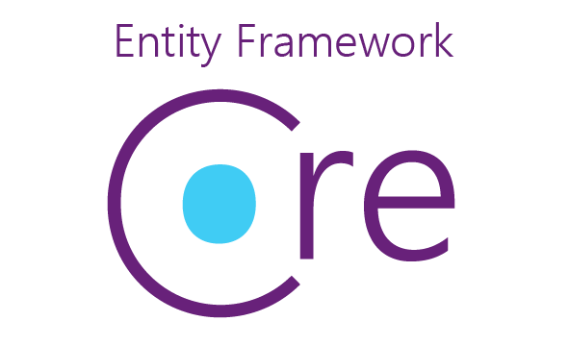
Entity Framework(an O/RM) https://docs.microsoft.com/en-us/ef/core/ https://www.entityframeworktutorial.net/what-is-entityframework.aspx
Entity Framework (EF) Core is a lightweight, extensible, open source and cross-platform version of the Entity Framework data access technology.
EF Core can serve as an object-relational mapper (O/RM). It enables .NET developers to work with a database using .NET objects and eliminates the need for most of the data-access code they usually need to write.
With EF Core, data access is performed using a Model. Models are made up of entity classes and a context object that represents a session with the database, allowing you to query and save data (for example, using LINQ). EF Core supports many database engines.

