Slide 1

Relational Database Management System, DML/ DQL
.NET

Slide 2
Software used to maintain relational databases is a Relational Database Management System (RDBMS). Many relational database systems use Structured Query Language (SQL) for querying and maintaining the database.
https://docs.microsoft.com/en-us/sql/t-sql/language-reference?

Slide 3

(RDBMS) Relational Database Management System – History https://en.wikipedia.org/wiki/Relational_database
Relational databases are based on the relational model of data, as proposed by E. F. Codd in 1970.
Edgar Frank "Ted" Codd (August 23, 1923 – April 18, 2003) was a British computer scientist and winner of the 1981 Turing Award.

Slide 4
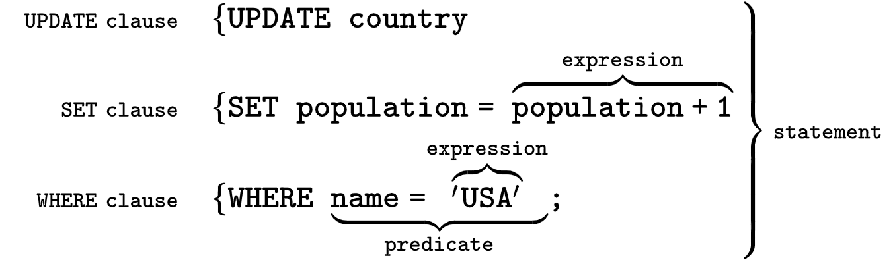
SQL (Structured Query Language) https://en.wikipedia.org/wiki/SQL
SQL was originally based upon relational algebra and tuple relational calculus. SQL is a declarative language. We say what data we want, not how to get it. We cannot manage how SQL obtains the data.
The scope of SQL includes data query, data manipulation (insert, update and delete), data definition (schema creation and modification), and data access control.
SQL consists of two MAIN types of statements:
Data Definition Language (DDL)
Data Manipulation Language (DML).

Slide 5
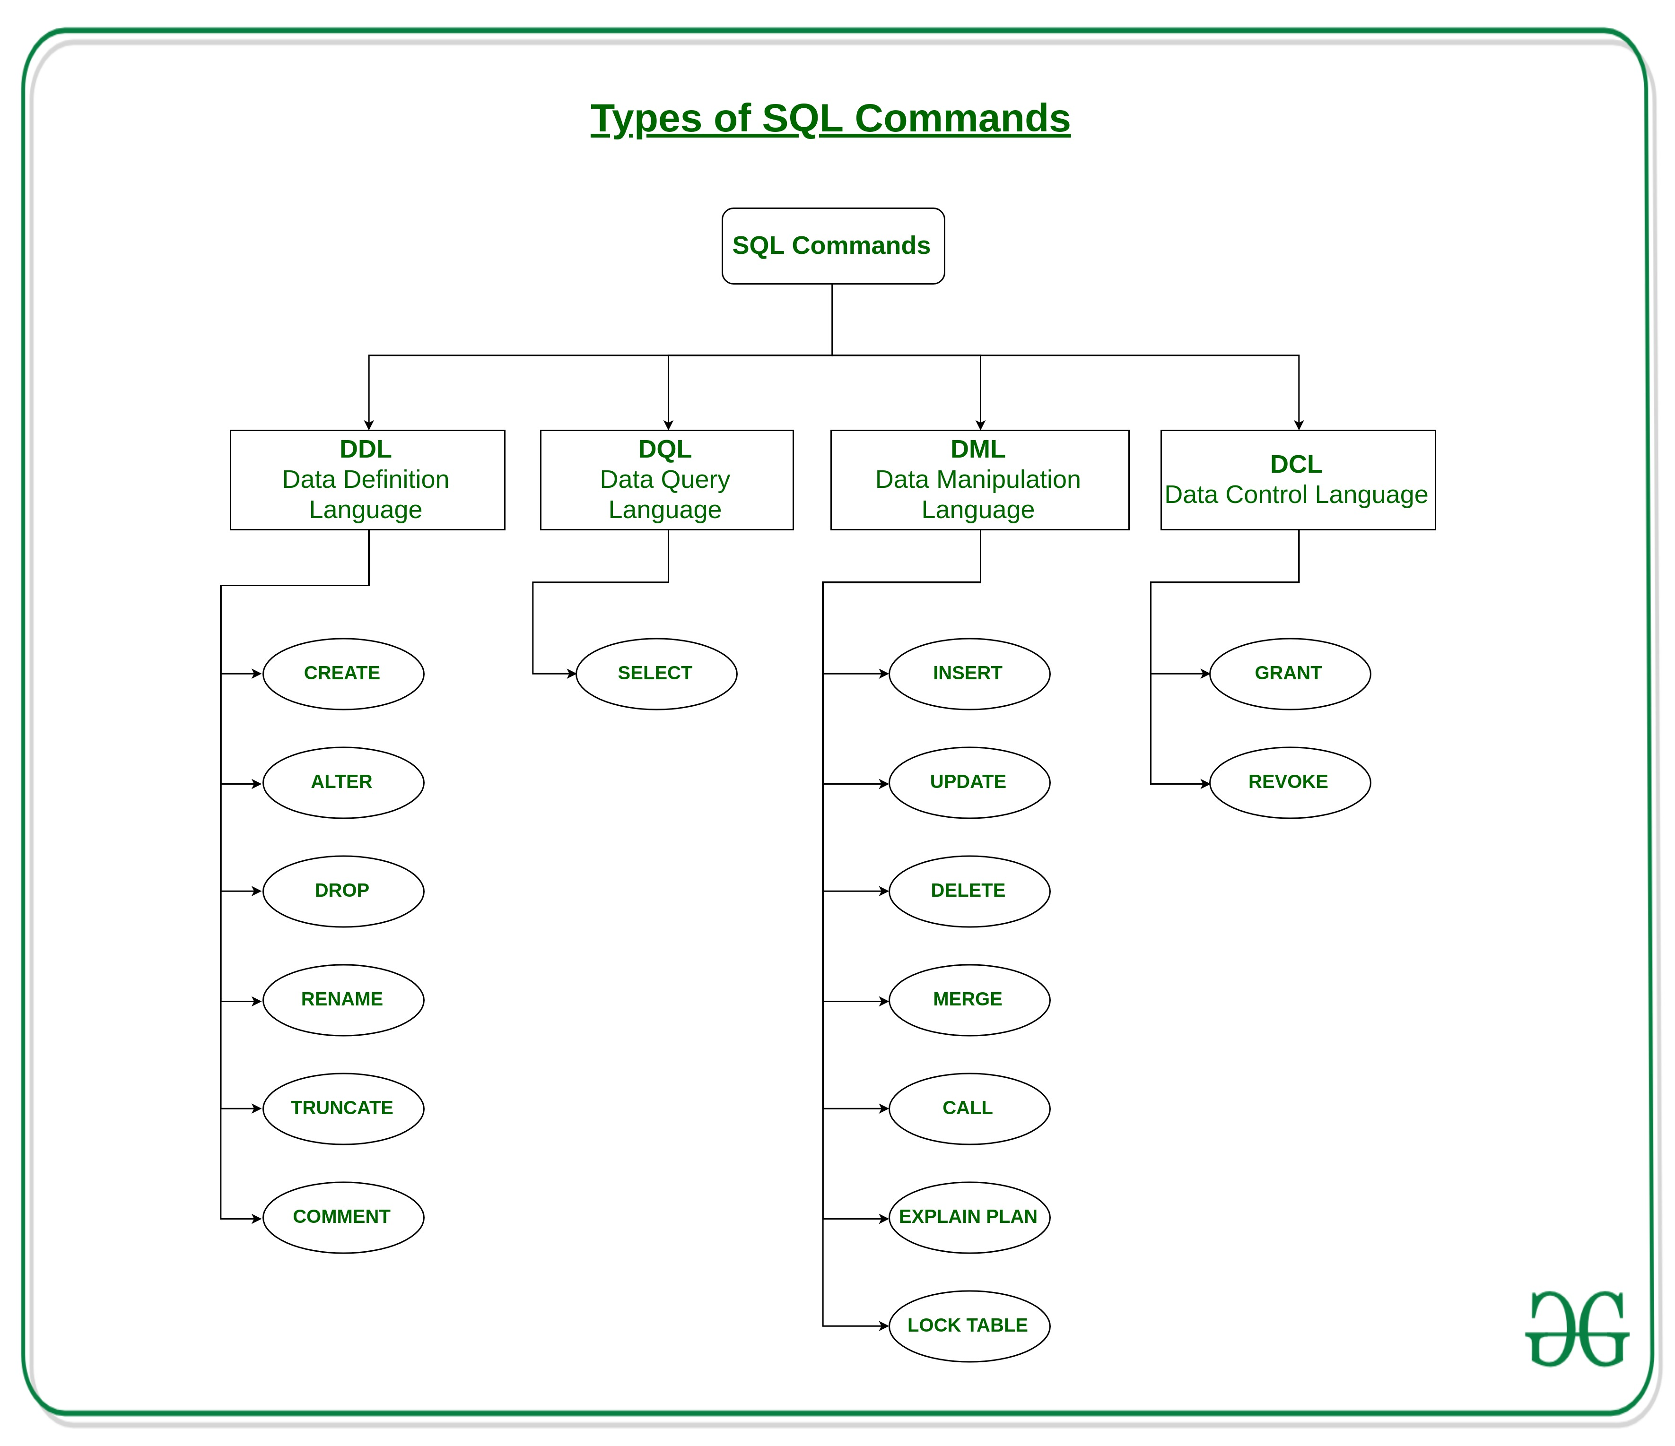

Slide 6
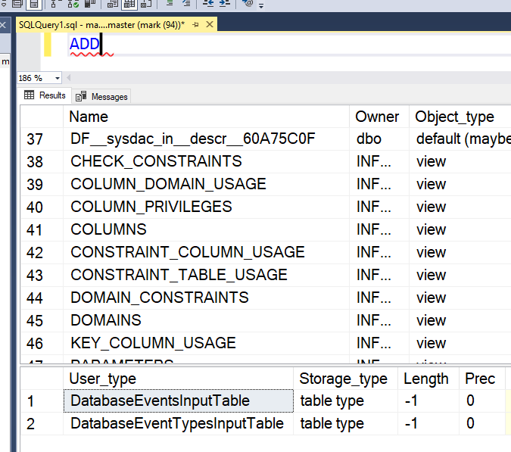
Microsoft and T-SQL https://docs.microsoft.com/en-us/sql/t-sql/language-reference?view=sql-server-ver15#tools-that-use-t-sql
T-SQL is central to using Microsoft SQL products and services. All tools that communicate with a SQL database send T-SQL commands. SQL works on top of T-SQL.
Some of the Microsoft tools that issue T-SQL commands are:
SQL Server Management Studio (SSMS)
SQL Server Data Tools (SSDT)
Azure Data Studio
Dataverse (formerly Common Data Service)
SharePoint
*You can type a T-SQL keyword in the SSMS Query Editor window and press F1 to get data about any T-SQL Keyword.

Slide 7
Data Manipulation Language (DML) https://docs.microsoft.com/en-us/sql/t-sql/statements/statements?view=sql-server-ver15#data-manipulation-language
Data Manipulation Language (DML) is used to query a Database, to retrieve data, and to modify data from an SQL Database. Use Data Manipulation Language statements to query the rows in the database and:
INSERT – Add one or more rows to a table or a view.
DELETE – Remove one or more rows from a table or view in SQL Server.
UPDATE – Change existing data in a table.
TRUNCATE - Remove all rows from a table without deleting the table.
Similar to the DELETE statement with no WHERE clause, but faster.

Slide 8
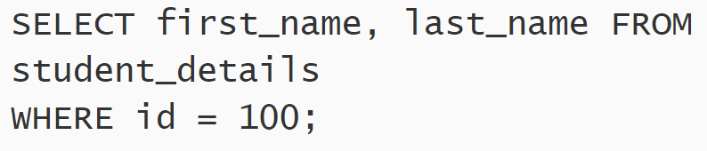
SQL - SELECT, FROM, WHERE https://docs.microsoft.com/en-us/sql/t-sql/queries/select-transact-sql?view=sql-server-ver15#logical-processing-order-of-the-select-statement
The three most common keywords in SQL Queries are SELECT, FROM, and WHERE.
SELECT - Retrieves rows from the database
FROM – Usually required on the SELECT statement. Specifies from which table(s) the results will come.
WHERE - Specifies the search conditions for the rows returned by the query.

Slide 9
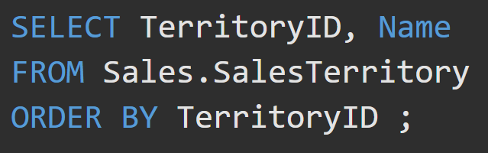
SQL – Queries https://www.ibm.com/support/knowledgecenter/SSGU8G_12.1.0/com.ibm.dbdk.doc/ids_dbdk_028.htm
SQL Queries have a specific syntax and structure.
Start the query with the SELECT keyword,
State the names of the columns you want in the result,
State FROM which table to get the data,
Followed by conditions.
This query returns the TerritoryID and Name columns from the Sales.SalesDirectory table and orders the result by TerritoryID. Default order is ascending (asc). If you want Descending, use DESC.

Slide 10
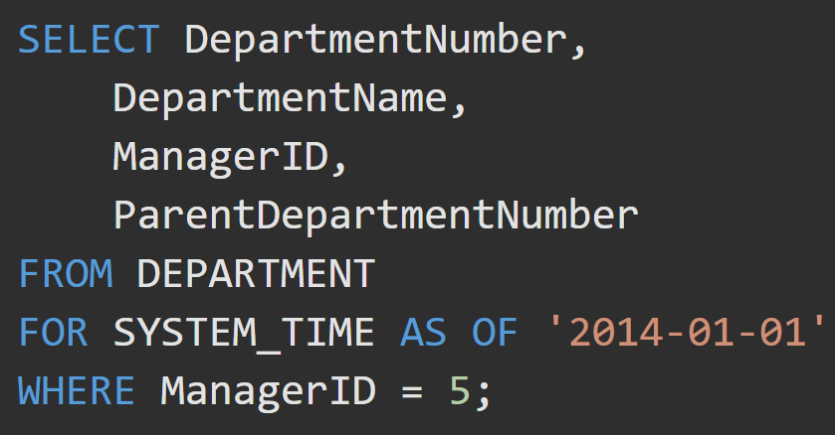
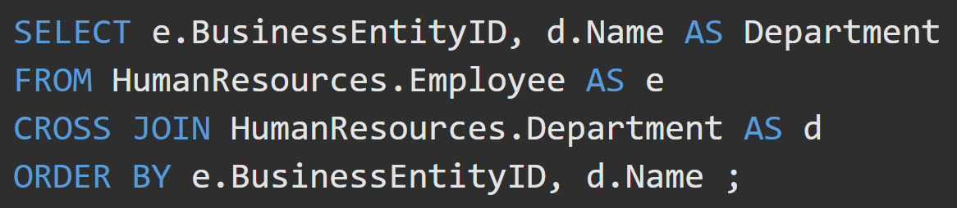
SQL - Queries
Queries are used to INSERT, retrieve, modify, and DELETE data in a SQL Database.

Slide 11
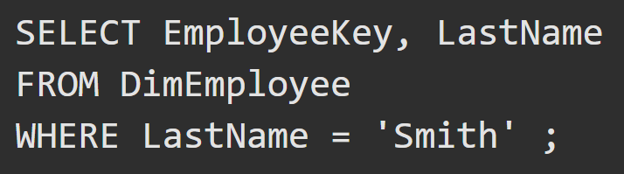
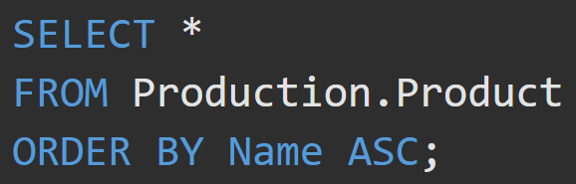
Query Examples
This query SELECTs the EmployeeKey and LastName columns from the DimEmployee table, but only if the last name is “Smith”
This query SELECTs all the columns from the Production.Product table and orders the result by the Name column in ascending order.

Slide 12
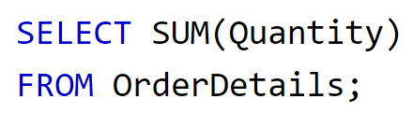
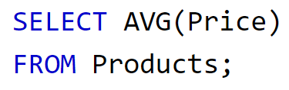
Aggregate Functions (1/2)
This query returns the amount of items in the Quantity column from the table OrderDetails.
This query returns the average of all the numbers in the Price column from the Products table.

Slide 13
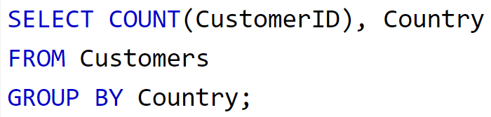
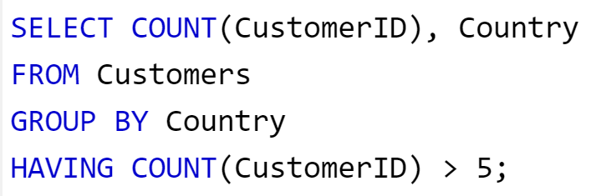
Aggregate Functions (2/2)
This query returns the CustomerID and Country columns from the Customers table. It will GROUP all the like countries and tell how many customers from each country there are.
This query returns the CustomerID and Country columns from the Customers table. It will GROUP all the like countries and tell how many customers from each country there are if the count total is over 5.

Slide 14
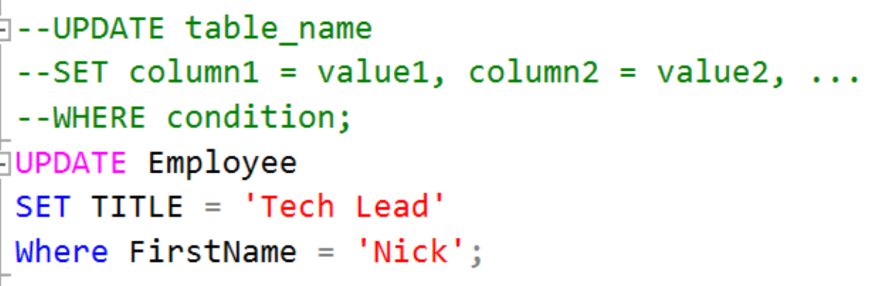

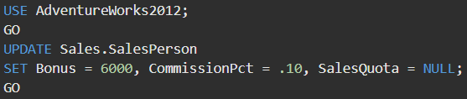
SQL – UPDATE the data in a table https://docs.microsoft.com/en-us/sql/t-sql/queries/update-transact-sql?view=sql-server-ver15 https://docs.microsoft.com/en-us/sql/t-sql/queries/update-transact-sql?view=sql-server-ver15#a-using-a-simple-update-statement
UPDATE changes existing data in a table or view. There are many variations to UPDATE.
UPDATE multiple rows simultaneously.

Slide 15
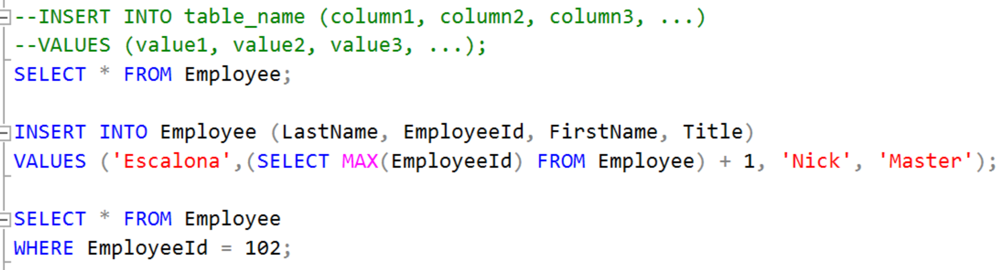
SQL – INSERT into a table https://docs.microsoft.com/en-us/sql/t-sql/statements/insert-transact-sql?view=sql-server-ver15#BasicSyntax https://docs.microsoft.com/en-us/sql/t-sql/statements/insert-transact-sql?view=sql-server-ver15#BasicSyntax
INSERT adds one or more rows to a table or a view in SQL Server.

Slide 16
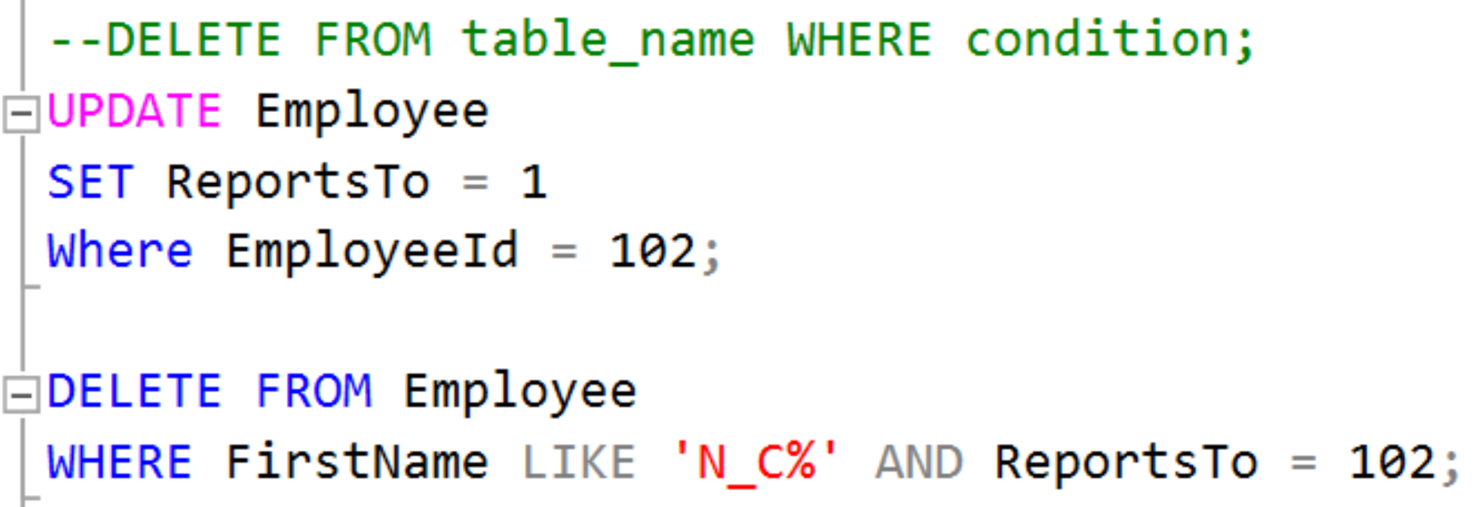
SQL – DELETE from a table https://docs.microsoft.com/en-us/sql/t-sql/statements/delete-transact-sql?view=sql-server-ver15 https://docs.microsoft.com/en-us/sql/t-sql/statements/delete-transact-sql?view=sql-server-ver15#BasicSyntax
DELETE removes one or more rows from a table or view in SQL Server.

Slide 17
SQL Subquery https://docs.microsoft.com/en-us/sql/relational-databases/performance/subqueries?view=sql-server-ver15
A subquery is a query that is nested inside a SELECT, INSERT, UPDATE, or DELETE statement, or inside another subquery. A subquery can be used anywhere an expression is allowed. The subquery is evaluated then the outer query is evaluated against it.
Many SQL statements that include subqueries can be formulated as JOINs. There is usually no performance difference between a statement with a subquery and an equivalent JOIN.
SELECT Ord.SalesOrderID, Ord.OrderDate,
(SELECT MAX(OrdDet.UnitPrice)
FROM Sales.SalesOrderDetail AS OrdDet
WHERE Ord.SalesOrderID = OrdDet.SalesOrderID) AS MaxUnitPrice
FROM Sales.SalesOrderHeader AS Ord;
In this example, a subquery is used as a column expression named MaxUnitPrice in a SELECT statement. The subquery obtains the maximum price for each unit and them becomes a column in the outer query result.

Slide 18
Subquery https://docs.microsoft.com/en-us/sql/relational-databases/performance/subqueries?view=sql-server-ver15
A subquery nested in an outer SELECT statement has the following components:
A regular SELECT query including the regular select list components.
A regular FROM clause including one or more table or view names.
An optional WHERE clause.
An optional GROUP BY clause.
An optional HAVING clause.
This example shows two queries obtaining an identical result. One uses a subquery and the other uses a JOIN.
SELECT Name
FROM Production.Product
WHERE ListPrice =
(SELECT ListPrice
FROM Production.Product
WHERE Name = 'Chainring Bolts' );
SELECT Prd1.Name
FROM Production.Product AS Prd1
JOIN Production.Product AS Prd2
ON (Prd1.ListPrice = Prd2.ListPrice)
WHERE Prd2.Name = 'Chainring Bolts';

Slide 19
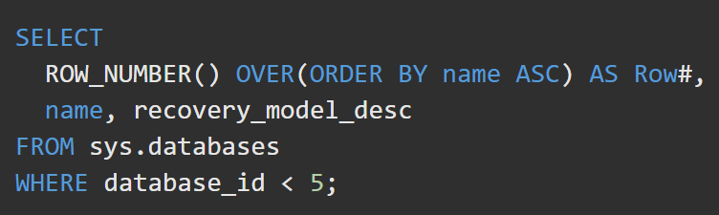
ROW_NUMBER https://docs.microsoft.com/en-us/sql/t-sql/functions/row-number-transact-sql?view=sql-server-ver15
ROW_NUMBER inserts a row number to every tuple.

Slide 20
CASE Statements https://www.w3schools.com/sql/sql_case.asp
SELECT OrderID, Quantity,
CASE
WHEN Quantity > 30 THEN 'The quantity is greater than 30'
WHEN Quantity = 30 THEN 'The quantity is 30'
ELSE 'The quantity is under 30'
END AS QuantityText
FROM OrderDetails;

Slide 21
IN(), NOT IN()
Supply a list of options to return if true.
SELECT * FROM Customers WHERE name IN(‘Moore’, ‘Smith’, ‘Hunter’);

Slide 22
Between
BETWEEN is inclusive of the two bounding values.
Select productid from orders where productid BETWEEN 5 and 10;
Select productid from orders where productName BETWEEN ‘B’ and ‘L’;

Slide 23
LIKE
_ means a single char.
% means any number of chars.
SELECT productName FROM orders WHERE productName LIKE ‘Comp%’;
SELECT productPrice FROM orders WHERE productPrice LIKE ‘3.%’;

Slide 24
Ordering Data
SELECT * FROM orders WHERE productName LIKE ‘Comp%’ ORDER BY price ASC;
SELECT * FROM orders WHERE productName LIKE ‘Comp%’ ORDER BY price DESC;

Slide 25
Distinct
SELECT DISTINCT productName FROM orders WHERE productName LIKE ‘Comp%’;
SELECT DISTINCT productName, productId FROM orders WHERE productName LIKE ‘Comp%’;

Slide 26
LIMIT and OFFSET
SELECT productName FROM orders WHERE productName LIKE ‘Comp%’ LIMIT 5;
Returns only the first 5.
SELECT productName FROM orders WHERE productName LIKE ‘Comp%’ LIMIT 5 OFFSET 6;
Returns 5 but starting with the… 7th …so… 7th, 8th, 9th, 10th, and 11th, etc.

Slide 27
Aliases
SELECT productName AS JimmyJohn FROM orders WHERE productName LIKE ‘Comp%’ LIMIT 5;

Slide 28
EXTRACT()
Extract a subcomponent of a date value. Like the YEAR, MONTH, DAY, WEEK, QUARTER
EXTRACT(YEAR FROM <dateTime Type Column>);

Slide 29
AGE()
Calculates and returns the current age of a given timestamp.

Slide 30
ROUND()
SELECT ROUND(rental_rate/replacement_cost,2) AS “Rental Over Replacement” FROM film;

Slide 31
Math functions
SELECT * FROM film;
SELECT rental_rate/replacement_cost FROM film;
SELECT film_id*10 AS "multiplied!" FROM film;

Slide 32
String functions https://www.postgresql.org/docs/current/functions-string.html
You can concatenate columns or data to a string for custom output!

Slide 33
COALESCE()
SELECT item,(price – COALESCE(discount,0) AS final FROM tableName
COALESCE() replaces a null value with the given value. It is valuable when doing calculations on a column that might have null values.

Slide 34
CAST()
To cast one data type to another type.
SELECT CAST(‘5’ AS INTEGER)
SELECT CAST(dateColumn AS TIMESTAMP)
You can cast an integer as a string to coundt how many digits it is.
SELECT CHAR_LENGTH(CAST(inventory_id AS VARCHAR)) FROM rental
.

Slide 35
NULLIF()
NULLIF(arg1, arg2) takes 2 args and returns null if they are equal. Otherwise, returns the first arg.
NULLIF(1,2) returns 1.
NULLIF(2,2) returns null.

Slide 36
Chinook DB Seeder Code https://raw.githubusercontent.com/2002-feb24-net/trainer-code/master/2-sql/Chinook_SqlServer.sql
Download and set up SQL Server Management Studio – https://aka.ms/ssmsfullsetup
Download & Install SQL Server Express
To download SQL Server Express, click on the following link:
https://www.microsoft.com/en-us/download/details.aspx?id=101064

Slide 37
DML Activity
Basic exercises in groups of 3 (Chinook database):
-- 1. List all customers (full names, customer ID, and country) who are not in the US
-- 2. List all customers from brazil
-- 3. List all sales agents
-- 4. Show a list of all countries in billing addresses on invoices.
-- 5. How many invoices were there in 2009, and what was the sales total for that year?
-- 6. How many line items were there for invoice #37?
-- 7. How many invoices per country?
-- 8. Show total sales per country, ordered by highest sales first.

Slide 38
DML Activity - Answers
SELECT * FROM Customer;
1. list all customers (full names, customer ID, and country) who are not in the US
SELECT CustomerId, FirstName, LastName, Country FROM Customer
WHERE Country != 'USA’; (also acceptable “Country NOT ‘USA’;”)
2. list all customers from brazil
3. list all sales agents
SELECT * FROM Employee WHERE Title LIKE '%Sales%Agent%';
-- pattern matching with the LIKE operator
-- % - 0 to n number of any characters
-- [abc] - one of a, b, or c
-- _ - one of any character

Slide 39
DML Activity - Answers
4. show a list of all countries in billing addresses on invoices.
SELECT DISTINCT BillingCountry FROM Invoice;
-- SELECT DISTINCT means, after you get all the result rows,
SELECT BillingCountry FROM Invoice GROUP BY BillingCountry;
remove duplicate rows (where ALL column values match)
5. How many invoices were there in 2009,
SELECT count(InvoiceDate) FROM Invoice;
What was the sales total for 2009?
(extra challenge: find the invoice count sales total for every year, using one query)
SELECT SUM(Total) AS TotalAmount, COUNT(InvoiceId) AS “Invoices in 2009” FROM Invoice
WHERE InvoiceDate BETWEEN '2009-01-01' AND '2010-01-01’ WHERE YEAR(InvoiceDate) = 2009;
--also
SELECT YEAR(InvoiceDate) AS Year, SUM(Total) AS TotalAmount, COUNT(InvoiceId) AS Invoices FROM Invoice
GROUP BY MONTH (InvoiceDate);
SELECT COUNT(*) As 'How Many Invoices', YEAR(InvoiceDate), SUM(Total) AS 'SUM in 2009’ FROM [dbo].[Invoice] WHERE YEAR(InvoiceDate) = 2009 GROUP BY YEAR(InvoiceDate);

Slide 40
DML Activity - Answers
6. how many line items were there for invoice #37?
SELECT Count(Quantity) As TotalItems FROM InvoiceLine WHERE InvoiceId = ‘37’;
7. How many invoices per country?
SELECT BillingCountry, count(BillingCountry) as “Number of Orders” FROM dbo.Invoice GROUP BY BillingCountry
8. Show total sales per country, ordered by highest sales first.
SELECT BillingCountry, SUM(Total) FROM Invoice GROUP BY BillingCountry ORDER BY SUM(Total) DESC;

