Slide 1

Data Definition Language (DDL)
.NET

Slide 2
A software system used to maintain a relational database is called a Relational Database Management System (RDBMS). Many relational database systems use Structured Query Language (SQL) for querying and maintaining a database.
https://docs.microsoft.com/en-us/sql/t-sql/language-reference?

Slide 3

(RDBMS) Relational Database Management System – History https://en.wikipedia.org/wiki/Relational_database
Relational databases are based on the relational model of data, as proposed by E. F. Codd in 1970.
Edgar Frank "Ted" Codd (August 23, 1923 – April 18, 2003) was a British computer scientist and winner of the 1981 Turing Award.

Slide 4
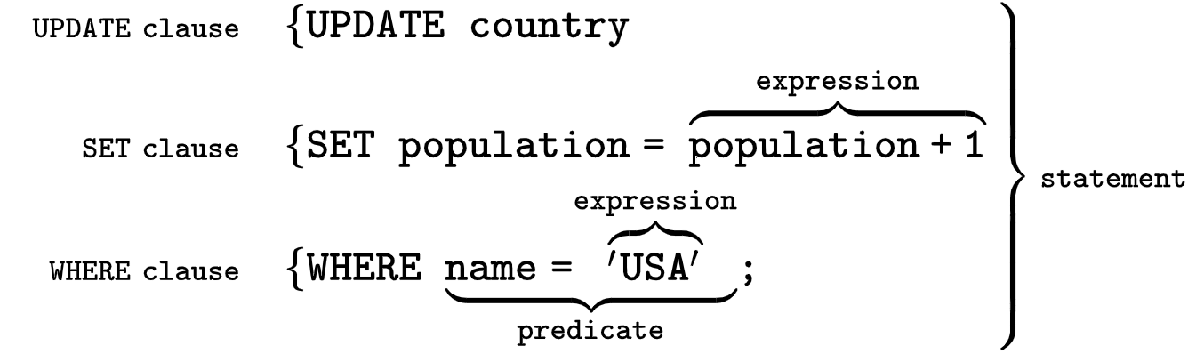
SQL (Structured Query Language) https://en.wikipedia.org/wiki/SQL
SQL was originally based upon relational algebra and tuple relational calculus. SQL is a declarative language. We say what data we want, not how to get it. We cannot manage how SQL obtains the data.
The scope of SQL includes data query, data manipulation (insert, update and delete), data definition (schema creation and modification), and data access control.
SQL consists of two main types of statements:
Data Definition Language (DDL)
Data Manipulation Language (DML).

Slide 5
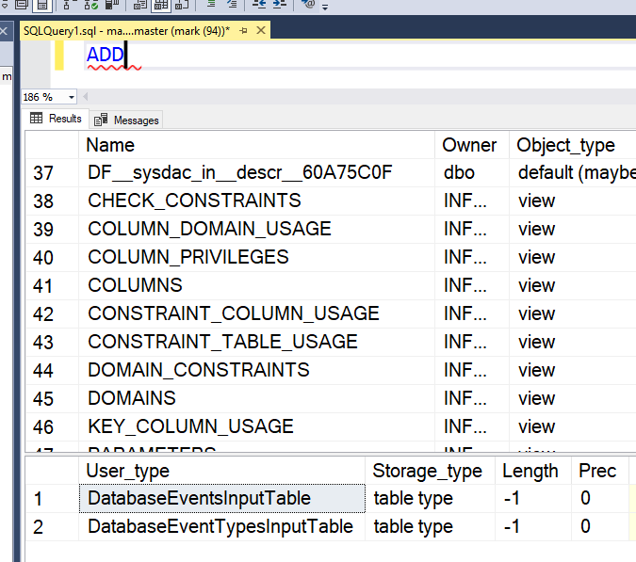
Microsoft and T-SQL https://docs.microsoft.com/en-us/sql/t-sql/language-reference?view=sql-server-ver15#tools-that-use-t-sql
T-SQL is central to using Microsoft SQL products and services. All tools that communicate with a SQL database send T-SQL commands. SQL works on top of T-SQL.
Some of the Microsoft tools that issue T-SQL commands are:
SQL Server Management Studio (SSMS)
SQL Server Data Tools (SSDT)
Azure Data Studio
*You can type a T-SQL keyword in the SSMS Query Editor window and press F1 to get data about any T-SQL Keyword.

Slide 6
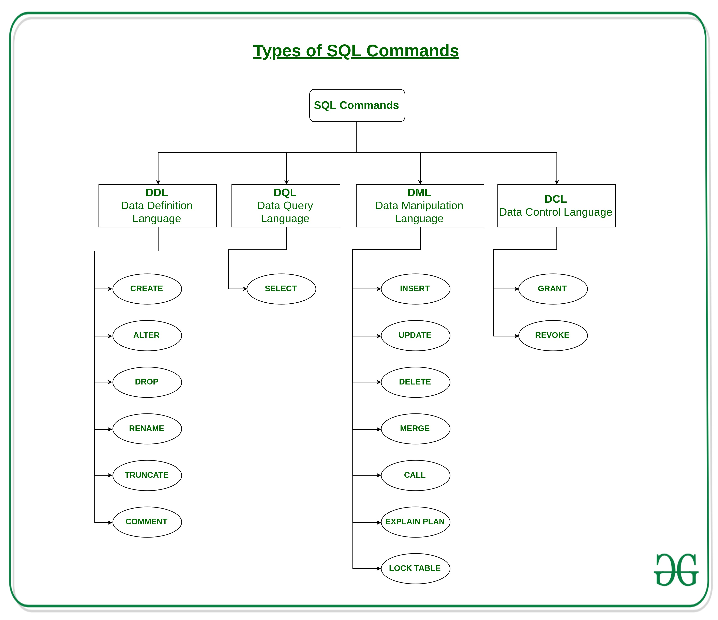

Slide 7

Data Definition Language https://docs.microsoft.com/en-us/sql/t-sql/statements/statements?view=sql-server-ver15#data-definition-language
Data Definition Language (DDL) statements define the structure of the DB. DDL statements create, alter, or drop the data structures (tables) of a database.
ALTER - Modifies a table definition by altering, adding, or dropping columns and constraints.
CREATE - creates a new database
DROP - Removes one or more table definitions and all data, indexes, triggers, constraints, and permission specifications for those tables.

Slide 8
SQL – Create and Drop an empty DB
*Deleting a database will result in complete loss of information stored in the database!

Slide 9
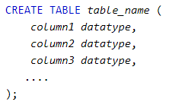
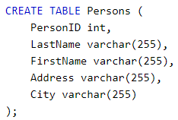
SQL – Create and Drop a table
*Deleting a table will result in complete loss of information stored in the table!

Slide 10
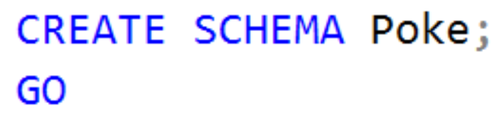
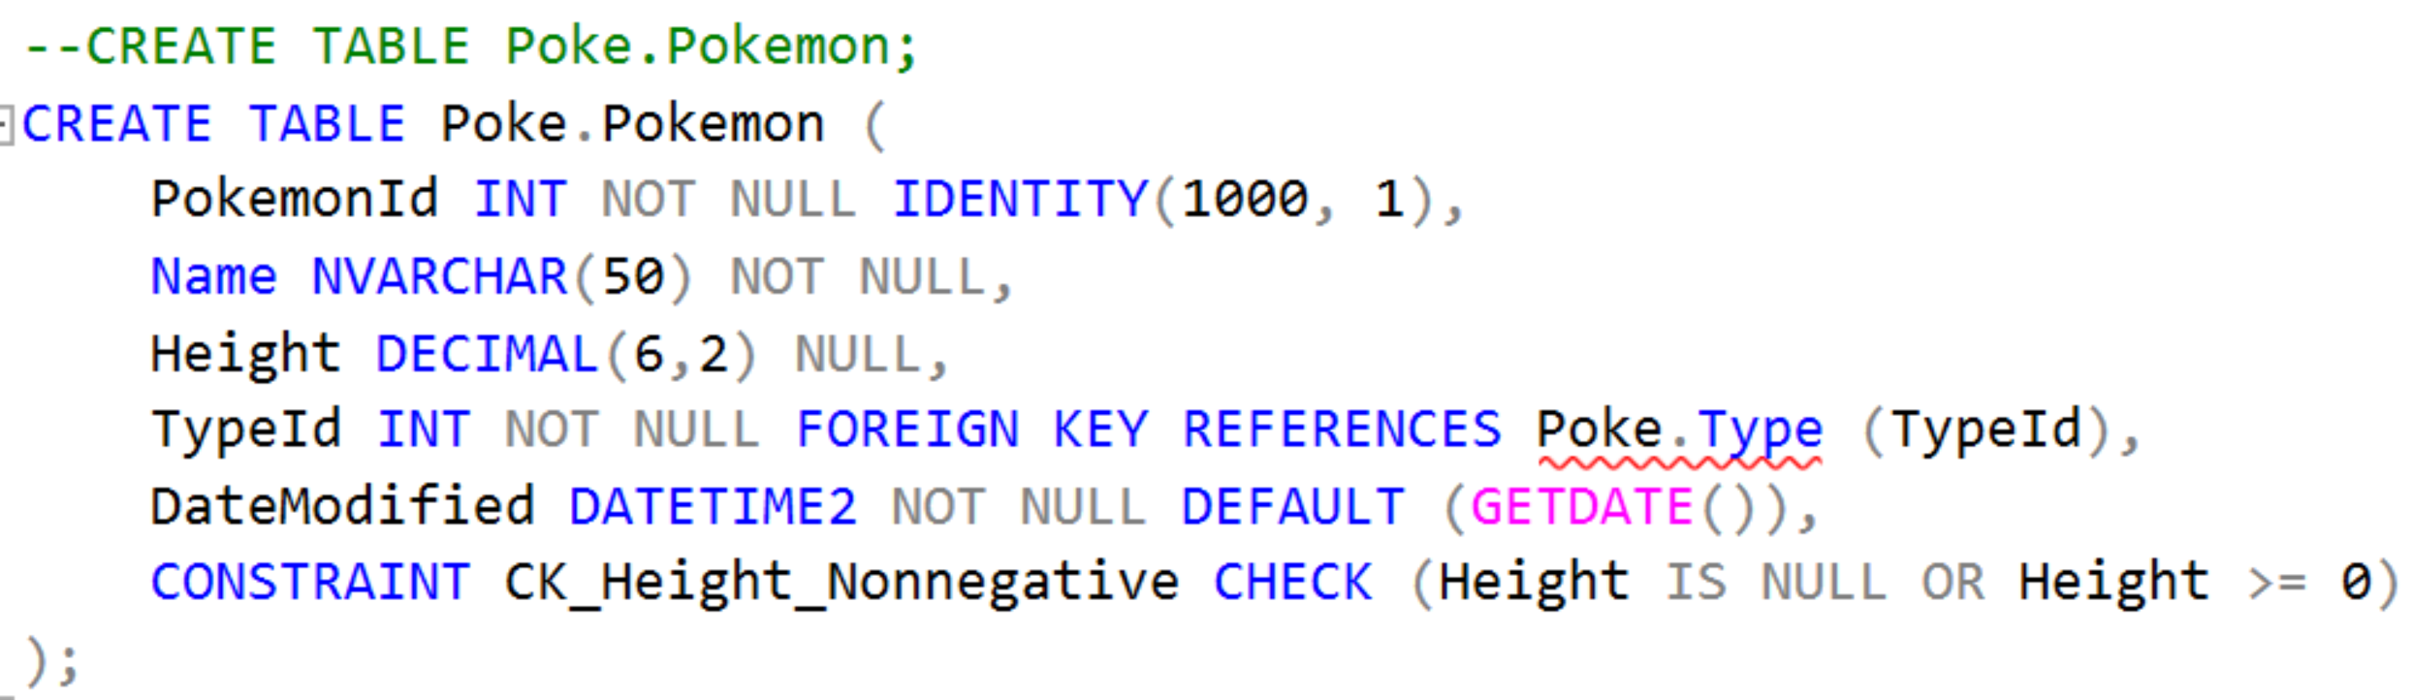
SQL with SQL Server
In SQL Server, every table must be in a schema.

Slide 11
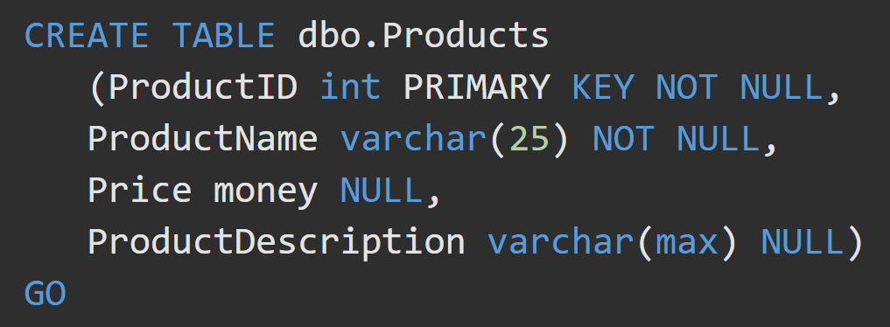
Create a Table in SQL Server https://docs.microsoft.com/en-us/sql/t-sql/lesson-1-creating-database-objects?view=sql-server-ver15#create-a-table
To create a table, you must provide:
a name for the table
name of each column
data type of each column
a unique primary key.
Is the field nullable?

Slide 12
SQL – Table Constraints https://docs.microsoft.com/en-us/sql/t-sql/statements/alter-table-table-constraint-transact-sql?view=sql-server-ver15
UNIQUE(columns) | Makes sure all the values in a column are unique.
REFERENCES tablename(colName) | Denotes the Primary Key that a Foreign Key column references. This is checked to maintain referential integrity when changing values.
CHECK(condition) | Enforces that some expression is true for every row in a column.
PRIMARY KEY(columns) | Allows you to define a primary key made up of multiple columns.

Slide 13
SQL – Column Constraints https://docs.microsoft.com/en-us/sql/t-sql/statements/alter-table-table-constraint-transact-sql?view=sql-server-ver15
NOT NULL | Column does not accept NULL as a value
NULL | Column accepts NULL as a value. NULL will be the default value.
PRIMARY KEY | Value must be unique within this column default sets a CLUSTERED INDEX.
UNIQUE | NOT NULL, UNIQUE, and by default sets a CLUSTERED INDEX.
FOREIGN KEY | By default, sets a NONCLUSTERED INDEX
DEFAULT(value) | Configures a default value for that column
IDENTITY(start, inc) | Sets up an auto-incrementing column and prevents insertion of a value. Default Clustered but not unique. You must also use PRIMARY KEY to ensure uniqueness.
EXCLUSION | Ensures that if any two rows are compared on the specified column, not all comparisons return TRUE. This is dependent on other constraints.

Slide 14
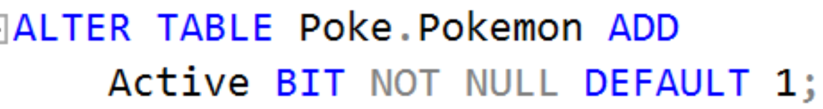
ALTER Table https://docs.microsoft.com/en-us/sql/t-sql/statements/alter-table-transact-sql?view=sql-server-ver15
ALTER TABLE
modifies a table definition by altering, adding, or dropping columns and constraints.
reassigns and rebuilds partitions or disables and enables constraints and triggers.
ALTER TABLE Addresses
DROP COLUMN ZipCode;

Slide 15
ON DELETE CASCADE https://learn.microsoft.com/en-us/sql/relational-databases/tables/primary-and-foreign-key-constraints?view=sql-server-ver16
The ON DELETE CASCADE and ON UPDATE CASCADE clauses are used to ensure that changes made to one table are automatically propagated to the tables that reference that table.
Corresponding rows are updated or deleted in the referencing table when that row is updated or deleted in the parent table. CASCADE cannot be specified if a timestamp column is part of either the foreign key or the referenced key.
ON DELETE CASCADE cannot be specified for a table that has an INSTEAD OF DELETE trigger. ON UPDATE CASCADE cannot be specified for tables that have INSTEAD OF UPDATE triggers.

Slide 16
Definitions
Clustered / NonClustered Index - A clustered index defines the order in which data is physically stored in a table. Table data can be sorted in only one way, therefore, there can be only one clustered index per table. In SQL Server, the primary key constraint automatically creates a clustered index on that particular column.

Slide 17
T-SQL Syntax Conventions https://docs.microsoft.com/en-us/sql/t-sql/language-elements/transact-sql-syntax-conventions-transact-sql?view=sql-server-ver15
Helps to read the docs

