Slide 1

SQL Data Types
.NET

Slide 2
A software system used to maintain a relational database is called a Relational Database Management System (RDBMS). Many relational database systems use Structured Query Language (SQL) for querying and maintaining a database.
https://docs.microsoft.com/en-us/sql/t-sql/language-reference?

Slide 3
SQL – String Data Types https://docs.microsoft.com/en-us/sql/t-sql/data-types/char-and-varchar-transact-sql?view=sql-server-ver15
Data Type | Description
CHAR(n) | Fixed-length up to “n”, 0 to 255, Default 1
VARCHAR(n) | Variable length up to “n”. 0 to 65535
NCHAR(7) | Fixed-length, Unicode string
NVARCHAR(n) | variable-length Unicode string up to “n”. *Use this unless you specifically need to use something else.
There are a many built-in functions to deal with strings:
LEN(), SUBSTRING(), CHARINDEX(), REPLACE(), LOWER(), UPPER()

Slide 4
SQL – Integer Data Types https://docs.microsoft.com/en-us/sql/t-sql/data-types/data-types-transact-sql?view=sql-server-ver15#exact-numerics
Data Type | Description
BIT | It’s a bit. Values 1 to 64. Default 1
TINYINT | Signed = -128 to 127. unsigned = 0 to 255
BOOL | Max 255 bytes. 0 = false, 1 = true
SMALLINT | Max 65535 bytes
INT | signed = -2147483648 to 2147483647. (Use this unless you need something else) unsigned = 0 to 4294967295
BIGINT | -2^63 (-9,223,372,036,854,775,808) to 2^63-1 (9,223,372,036,854,775,807)

Slide 5
SQL –Data Types with decimals https://docs.microsoft.com/en-us/sql/t-sql/data-types/data-types-transact-sql?view=sql-server-ver15#approximate-numerics
Data Type | Description
FLOAT(n) | n is the number of bits that are used to store the floats mantissa and dictates the precision and storage size. If n is specified, it must be a value between 1 and 53. Default is 53.
DECIMAL(size, d) | An exact fixed-point number. size = total digits(default 10, max 65). d = number of digits after the decimal point(default 0, max 30).
FLOAT stores an approximate value and DECIMAL stores an exact value. Exact values like money should use decimal, and approximate values like scientific measurements should use float.

Slide 6
SQL – Date and Time Data Types https://docs.microsoft.com/en-us/sql/t-sql/data-types/date-and-time-types?view=sql-server-ver15
Data Type | Description
DATE | Format: YYYY-MM-DD. From '1000-01-01' to '9999-12-31'
DATETIME2(fsp) | Format: YYYY-MM-DD hh:mm:ss. Add DEFAULT and ON UPDATE in the column definition to get automatic initialization and updating to the current date and time. Microsoft recommends use of DATETIME2 for more precision.
TIMESTAMP(fsp) | The number of seconds since the Unix “epoch”. Format: YYYY-MM-DD hh:mm:ss. Automatic initialization and updating with DEFAULT CURRENT_TIMESTAMP and ON UPDATE CURRENT_TIMESTAMP in the column definition.
TIME(fsp) | hh:mm:ss. Range: '-838:59:59' to '838:59:59’
YEAR | 1901 to 2155, and 0000. MySQL 8.0 does not support year in two-digit format.
DATETIMEOFFSET | For storing intervals of time. Use YEAR() to extract parts of the dates/times, DATEPART(YEAR FROM '2019-01-01') or DATEPART(YEAR, '2019-01-01')
*fsp = fractional seconds precision

Slide 7
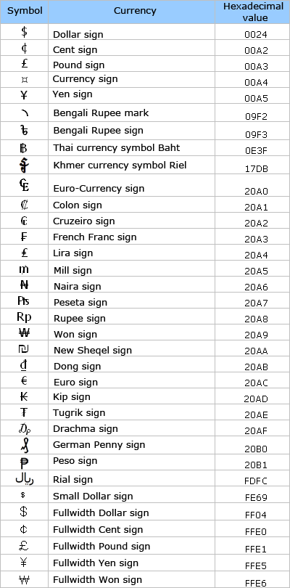
SQL – Currency Data Types https://docs.microsoft.com/en-us/sql/t-sql/data-types/data-types-transact-sql?view=sql-server-ver15#exact-numerics https://learn.microsoft.com/en-us/sql/t-sql/data-types/money-and-smallmoney-transact-sql?view=sql-server-ver15
MONEY and SMALLMONEY are accurate to a ten-thousandth of the monetary units that they represent.
Both MONEY and SMALLMONEY support the monetary symbols to the right.
Data Type | Description
MONEY | From -922,337,203,685,477.5808 to 922,337,203,685,477.5807 prints with ‘$’
SMALLMONEY | From -214,748.3648 to 214,748.3647 prints with ‘$’

