Slide 1

SQL Functions
.net

Slide 2
SQL functions help simplify code by encapsulating complex calculations and reusing the same execution plan in each query.
https://www.sqlservertutorial.net/sql-server-user-defined-functions/sql-server-scalar-functions/

Slide 3
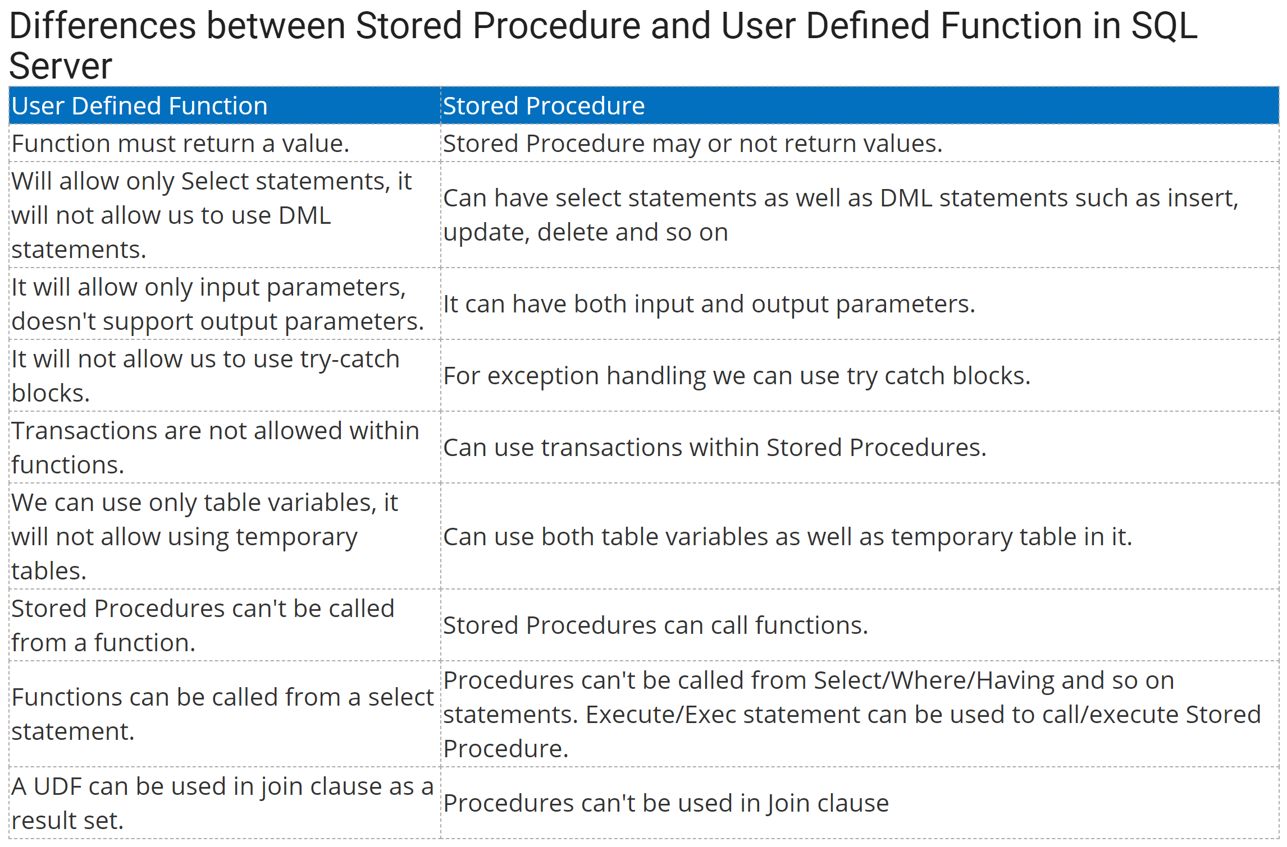
Function vs. Stored Procedure https://www.c-sharpcorner.com/UploadFile/996353/difference-between-stored-procedure-and-user-defined-function/

Slide 4
AGGREGATE Functions https://learn.microsoft.com/en-us/sql/t-sql/functions/aggregate-functions-transact-sql?view=sql-server-ver16
Aggregate functions:
perform a calculation on a set of values and returns a single (scalar) value.
ignore null values (except for COUNT() ).
are often used with the GROUP BY clause of the SELECT statement.
These are Aggregate functions
APPROX_COUNT_DISTINCT | MIN
AVG | STDEV
CHECKSUM_AGG | STDEVP
COUNT | STRING_AGG
COUNT_BIG | SUM
GROUPING | VAR
GROUPING_ID | VARP
MAX

Slide 5

AVG( ) - Average https://docs.microsoft.com/en-us/sql/t-sql/functions/avg-transact-sql?view=sql-server-ver15
AVG() is a Scalar Function that computes the average of a set of values by dividing the sum of those values by the count of non-null values. If the sum exceeds the maximum value for the data type of the return value, AVG() will return an error. AVG() can have 1 or 2 arguments.
ALL – (default) Applies the aggregate function to all values.
DISTINCT - Specifies that AVG() operates only on one unique instance of each value, regardless of how many times that value occurs.
EX. SELECT AVG(ALL NumbersColumn) FROM TableName;
The above example returns the average of all numbers. Even duplicates.
This example returns the average vacation hours each Vice President has and how many total sick leave hours all Vice Presidents have together.

Slide 6

COUNT( ) https://docs.microsoft.com/en-us/sql/t-sql/functions/count-transact-sql?view=sql-server-ver15
COUNT( ) is a Scalar Function that returns the number of items found in a group. COUNT( ) always returns an int.
COUNT( ) has two possible arguments:
ALL - Applies the aggregate function to all values. ALL serves as the default.
DISTINCT - Specifies that COUNT returns the number of unique nonnull values.
This example returns the number of unique job titles there are in all.

Slide 7
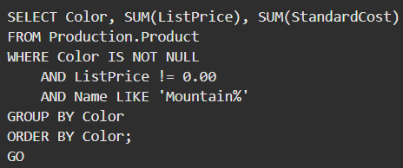
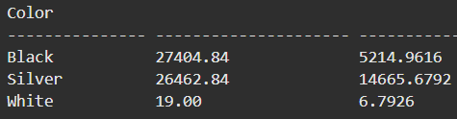
SUM( ) https://docs.microsoft.com/en-us/sql/t-sql/functions/sum-transact-sql?view=sql-server-ver15
SUM() is a Scalar Function can be used with numeric columns only. Null values are ignored.
SUM( ) has two possible arguments:
ALL – Default. Applies the aggregate function to all values.
DISTINCT - Specifies that SUM returns the sum of unique values.

Slide 8
SQL Scalar Function (1/3) https://docs.microsoft.com/en-us/sql/t-sql/statements/create-function-transact-sql?view=sql-server-ver15 https://docs.microsoft.com/en-us/sql/relational-databases/user-defined-functions/create-user-defined-functions-database-engine? https://www.sqlservertutorial.net/sql-server-user-defined-functions/sql-server-scalar-functions/
Scalar Function – A SQL Scalar Function takes one or more parameters and returns a single value.
A Scalar function:
can have parameters,
performs an action such as a complex calculation, and
returns the result of that action as a scalar (single) value.
CREATE FUNCTION dbo.GetNetSale
( @quantity int,
@unitprice decimal(10,2),
@discount decimal(10,2)
)
RETURNS decimal(10,2)
AS
BEGIN
return
@quantity*@unitprice*(1-@discount);
END
-- call the function
SELECT dbo.GetNetSale(10,100.00,0.1)
AS
netSale;

Slide 9
SQL Scalar Function (2/3) https://docs.microsoft.com/en-us/sql/t-sql/statements/create-function-transact-sql?view=sql-server-ver15 https://docs.microsoft.com/en-us/sql/relational-databases/user-defined-functions/create-user-defined-functions-database-engine? https://www.sqlservertutorial.net/sql-server-user-defined-functions/sql-server-scalar-functions/
To create a User-defined Scalar Function:
Use the CREATE FUNCTION keywords to name the function. SQL Server may require dbo. or the schema name.
In parenthesis, specify a list of @<parameterName> <dataType>.
Use the RETURNS keyword and give the data type of the return value.
Use the AS keyword and BEGIN the function body.
RETURN the calculation.
End the body of the function with END.
To call the function,
SELECT <functionName(params)> AS <name>
CREATE FUNCTION dbo.GetNetSale
( @quantity int,
@unitprice decimal(10,2),
@discount decimal(10,2)
)
RETURNS decimal(10,2)
AS
BEGIN
return
@quantity*@unitprice*(1-@discount);
END
-- call the function
SELECT dbo.GetNetSale(10,100.00,0.1)
AS
netSale;

Slide 10
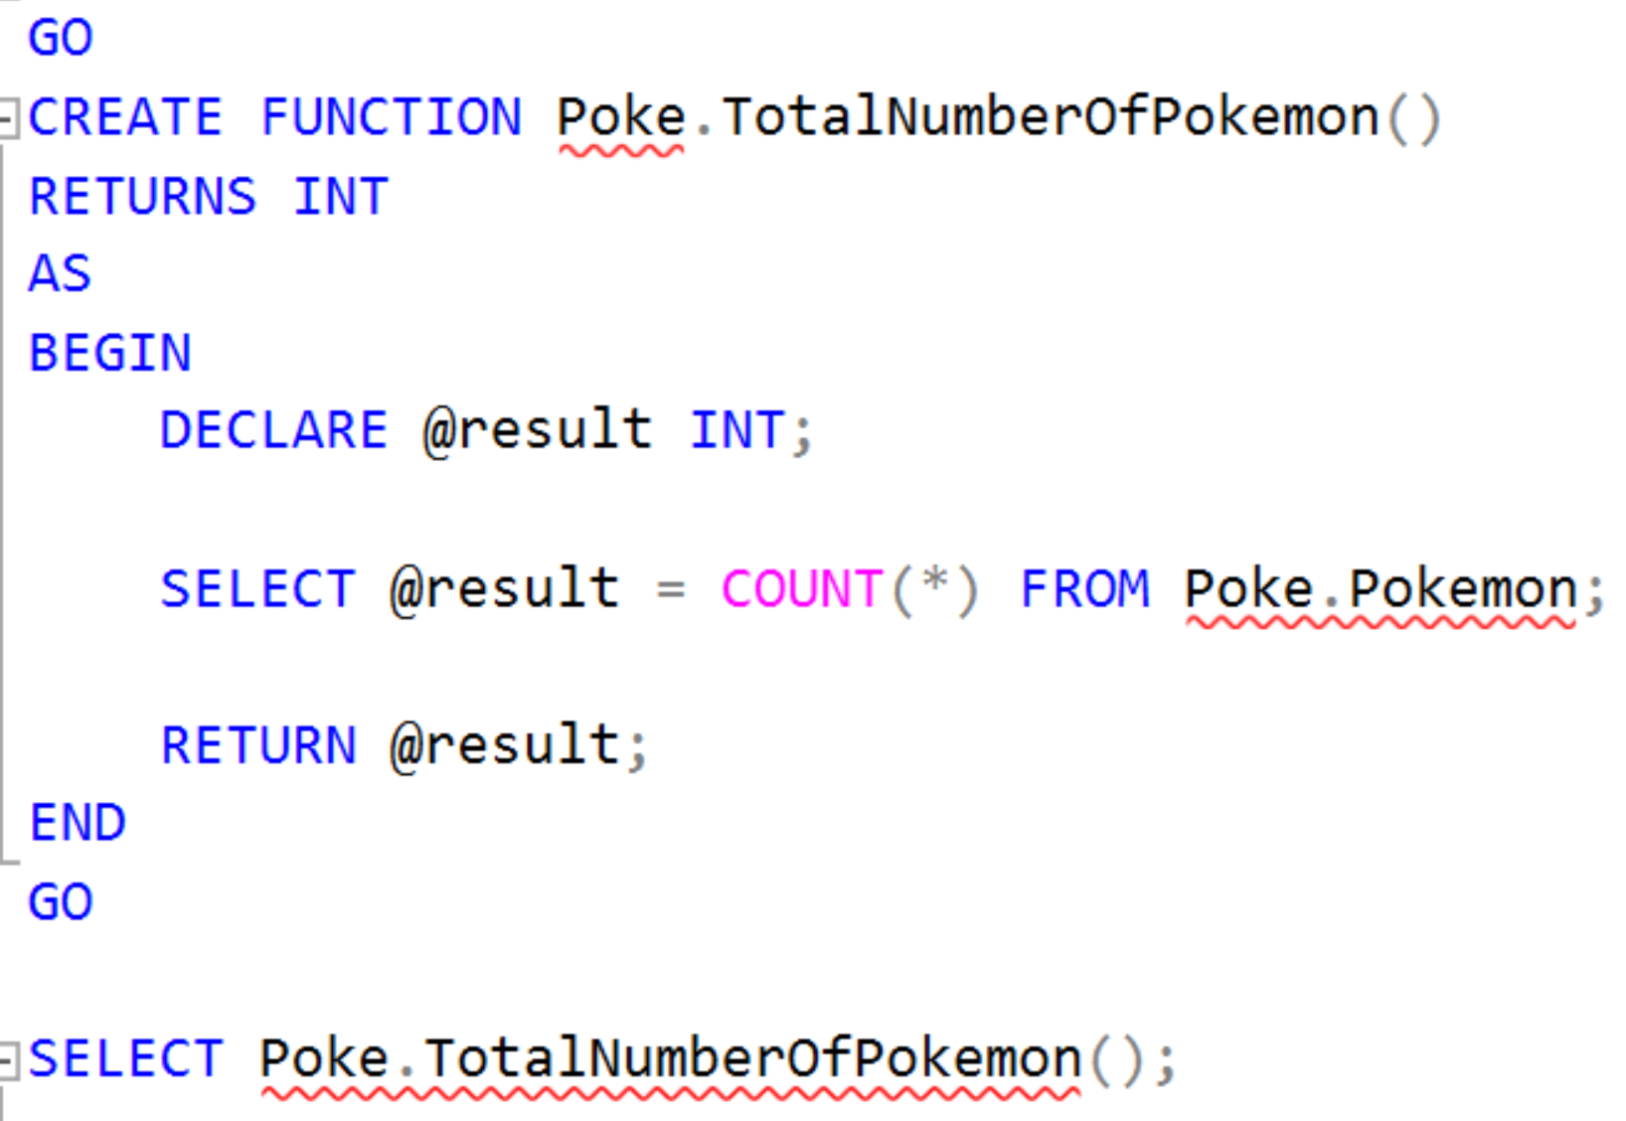
SQL – Scalar Function (3/3)
Scalar Functions operate on a single value and then return a single value.
Scalar functions can be used wherever an expression would be valid.

Slide 11
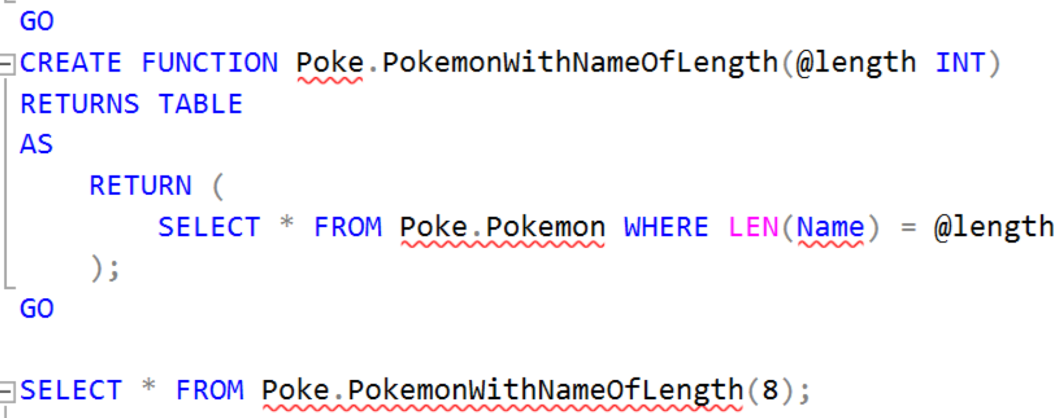
SQL – User-Defined Function
SQL Functions have "read-only" access. Only SELECT statements are allowed. The following is a Table-Value Function (TVF).

Slide 12
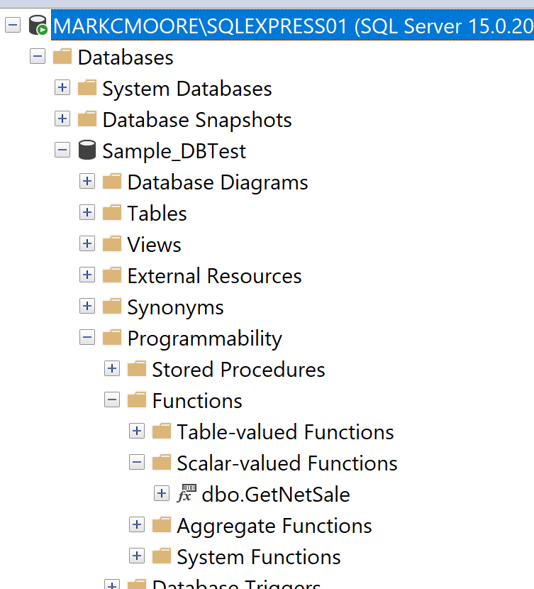
Function access in SSMS
Object Explorer
>>Databases
>>[DbName]
>>Programmability
>>Functions

