Slide 1

Stored Procedures
.NET

Slide 2
SQL Server creates an execution plan for a Procedure and stores it in the cache. In subsequent executions, the plan is reused so that the Stored Procedure can execute faster and with reliable performance.
https://www.sqlservertutorial.net/sql-server-stored-procedures/

Slide 3
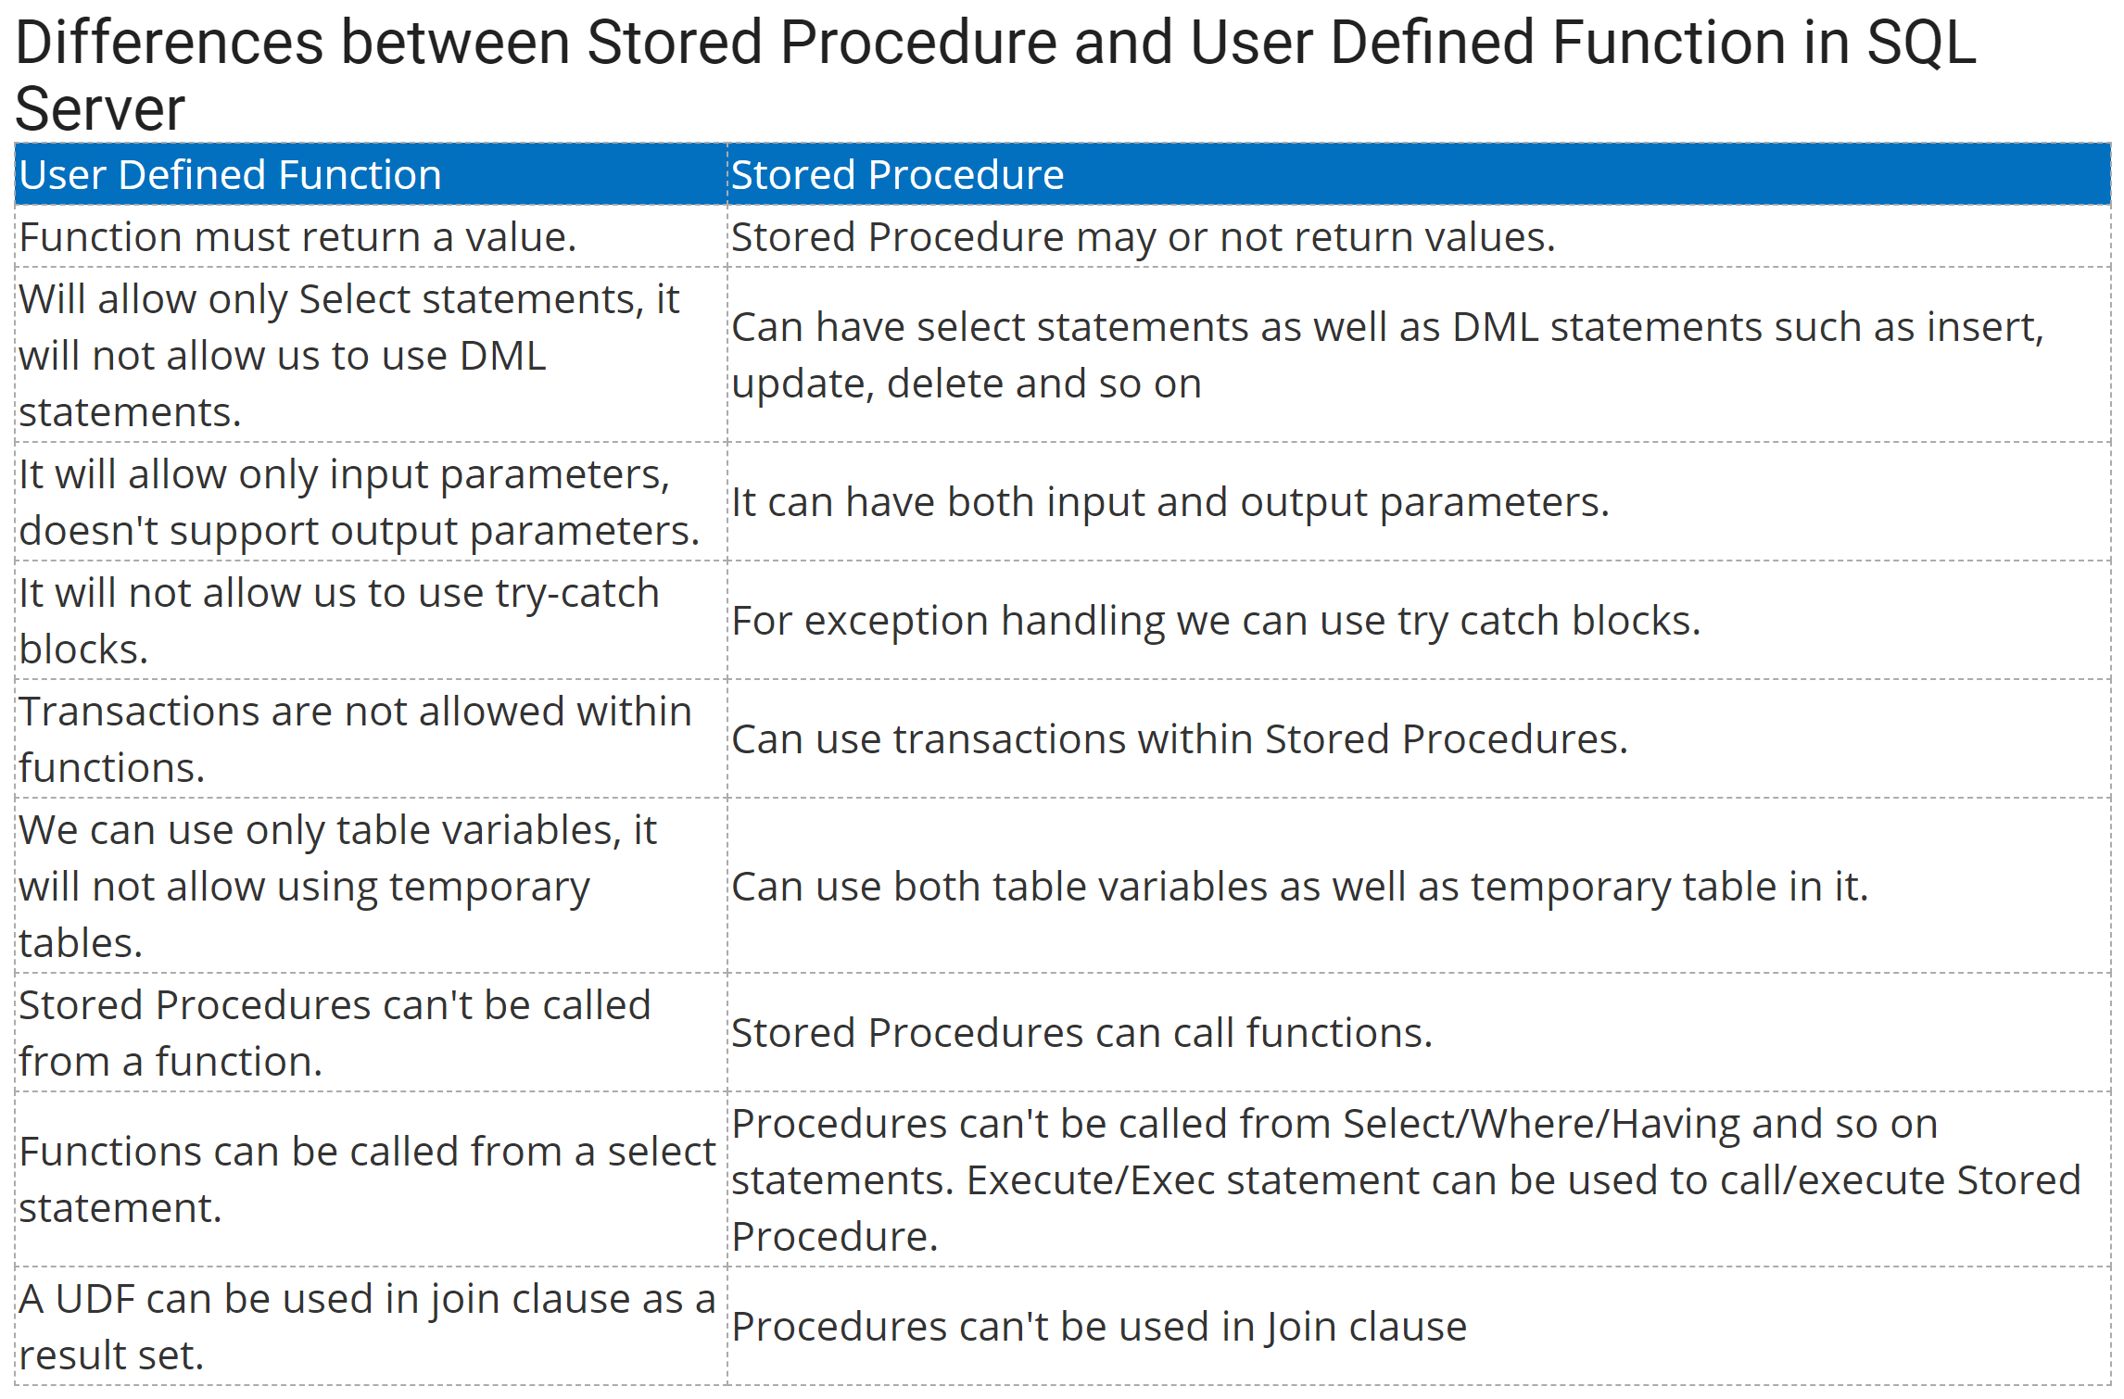
Function vs. Stored Procedure https://www.c-sharpcorner.com/UploadFile/996353/difference-between-stored-procedure-and-user-defined-function/

Slide 4
Stored Procedures – Overview https://www.w3schools.com/sql/sql_stored_procedures.asp https://docs.microsoft.com/en-us/sql/relational-databases/stored-procedures/stored-procedures-database-engine?view=sql-server-ver15
A Stored Procedure is a SQL query that you have saved as a Function so it can be reused. The execution plan is saved so the query runs faster than if it were written new each time it was used.
A commonly used SQL query can be saved as a Stored Procedure, and then called when needed. Stored procedures can have parameters and act based on the parameter values passed.
SSMS has some built-in Stored Procedures.
Use keywords ‘CREATE PROCEDURE’
Give the procedure a name
Use the keyword ‘AS’
Write the query
CREATE PROCEDURE procedure_name
AS
sql_statement

Slide 5
Stored Procedures – Overview https://www.w3schools.com/sql/sql_stored_procedures.asp https://docs.microsoft.com/en-us/sql/relational-databases/stored-procedures/stored-procedures-database-engine?view=sql-server-ver15
Stored Procedures:
Accept INPUT parameters
Can return multiple values in the form of OUTPUT parameters.
Contain programming statements that perform operations on the database, include calling other procedures.
Return a status value to a calling program to indicate success, failure, and the reason for failure.
Allow easy reuse and code maintenance
Improve performance
Reduce network traffic.

Slide 6
Stored Procedures – Types https://docs.microsoft.com/en-us/sql/relational-databases/stored-procedures/stored-procedures-database-engine?view=sql-server-ver15#types-of-stored-procedures
There are four types of Stored Procedures
Type | Description
User-Defined | Created in a user-defined database or in any system database except the Resource database. Can be developed in SQL or as a reference to a method.
Temporary | Stored in tempdb. There are two types: local and global. Local temp procedures have # as the first character of their names, are visible only to the current user connection, and are deleted when the connection is closed. Global temporary procedures have ## as the first two characters of their names, are visible to any user after they are created, and are deleted at the end of the last session using the procedure.
System | Included with SQL Server. They are physically stored in the internal, hidden Resource database and logically appear in the sys schema of every system- and user-defined database.
Extended User-Defined | Extended procedures enable creating external routines in a programming language such as C. These procedures are DLLs that an instance of SQL Server can dynamically load and run.

Slide 7
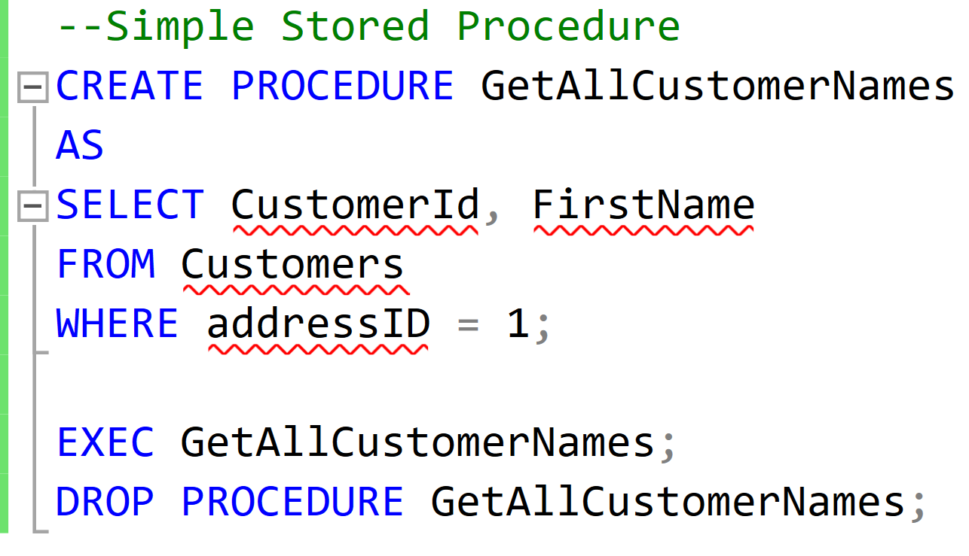
Stored Procedure – Create, Exec, Drop https://www.sqlservertutorial.net/sql-server-stored-procedures/basic-sql-server-stored-procedures/ https://docs.microsoft.com/en-us/sql/relational-databases/stored-procedures/create-a-stored-procedure?view=sql-server-ver15
This Stored Procedure is called GetAllCustomerNames.
It will produce a table with two columns, CustomerId and FirstName, from the Customers table, where the addressId (FK) is 1.
Execute with EXEC.
Drop with DROP PROCEDURE.

Slide 8
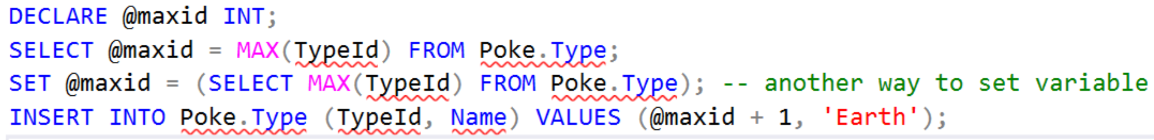
SQL – Scalar Variables
Sometimes we want to store intermediate values.
We can split queries into several parts.
SQL Server supports scalar variables and table-valued variables.
They only exist for the duration of that "batch" of commands

Slide 9
Declaring Scalar Variables https://docs.microsoft.com/en-us/sql/relational-databases/stored-procedures/specify-parameters?view=sql-server-ver15#passing-values-into-parameters
To declare a variable in SQL:
Declare the variable by using the DECLARE keyword.
Follow DECLARE with @<variableName> <datatype>.
Use the Keyword SET.
Use @[variableName] = [value]
The variable can be passes as an argument into a Procedure.
DECLARE @ProductID INT,
@CheckDate datetime;
SET @ProductID = 819;
SET @CheckDate = '20050225';
EXEC dbo.uspGetProductID @ProductID,
@CheckDate;

Slide 10
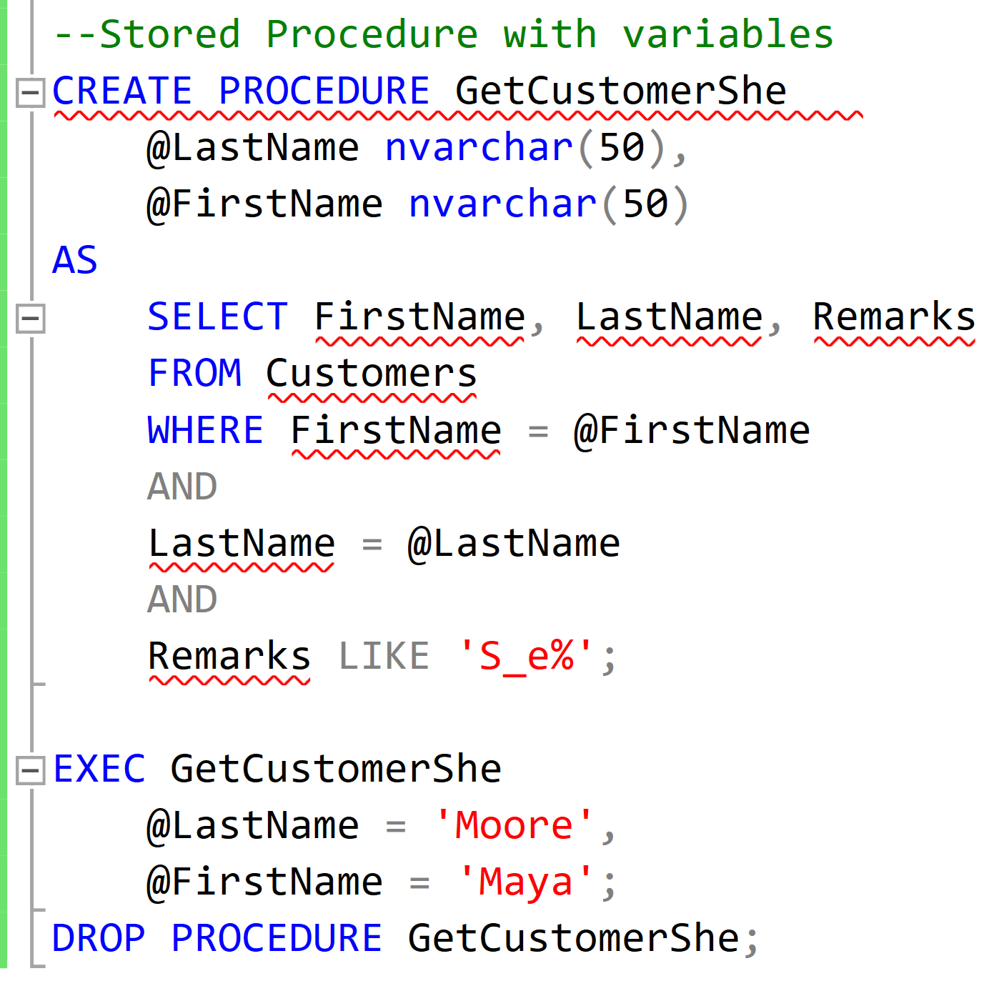
Stored Procedure with Parameters https://docs.microsoft.com/en-us/sql/relational-databases/stored-procedures/specify-parameters?view=sql-server-ver15
The parameter values supplied with a Procedure call must be constants or a variable. A Function name cannot be used as a parameter value.
When creating a Procedure and declaring a parameter name, the parameter name must begin with a single @ and must be unique in the scope of the procedure.
Parameters must also be defined with a data type when they are declared in a CREATE PROCEDURE statement.

Slide 11
Table-Valued Parameter https://docs.microsoft.com/en-us/sql/relational-databases/tables/use-table-valued-parameters-database-engine?view=sql-server-ver15
Table-valued parameters are declared by using user-defined table types. You can use table-valued parameters to send multiple rows of data to a SQL statement or a routine, such as a Stored Procedure or Function, without creating a temporary table or many parameters.
A Table-valued Parameter is scoped to the Stored Procedure or Function, exactly like other parameters.
Table-valued Parameters must be passed as input READONLY parameters to routines. You cannot perform DML operations such as UPDATE, DELETE, or INSERT on a Table-valued Parameter in the body of a routine.
/* Create a table type. */
CREATE TYPE LocationTableType AS TABLE
( LocationName VARCHAR(50), CostRate INT );
/*Create a procedure to receive data for table-valued parameter.*/
CREATE PROCEDURE dbo.usp_InsertProductionLocation
@TVP LocationTableType READONLY
AS
SET NOCOUNT ON
INSERT INTO AdventureWorks2012.Production.Location
( Name, CostRate, Availability, ModifiedDate )
SELECT *, 0, GETDATE()
FROM @TVP;
/* Declare a variable that references the type. */
DECLARE @LocationTVP AS LocationTableType;
/* Add data to the table variable. */
INSERT INTO @LocationTVP (LocationName, CostRate)
SELECT Name, 0.00
FROM AdventureWorks2012.Person.StateProvince;
/* Pass the table variable data to a stored procedure. */
EXEC usp_InsertProductionLocation @LocationTVP;

Slide 12
Stored Procedure – OUT Parameter https://docs.microsoft.com/en-us/sql/relational-databases/stored-procedures/specify-parameters?view=sql-server-ver15#specifying-parameter-direction
The direction of a parameter is either INPUT (default) or OUTPUT, meaning the procedure returns a value to the calling program.
To specify an OUTPUT parameter, the OUTPUT keyword must be specified in the definition of the parameter in the CREATE PROCEDURE statement.
The procedure returns the current value of the OUTPUT parameter to the calling program when the procedure exits.
The calling program must also use the OUTPUT keyword when executing the procedure to save the parameter's value in a variable that can be used in the calling program.
CREATE PROCEDURE HowManyOrdersByCustomer (
@CustomerNumber INT, --customerID
@OrderCount INT OUTPUT
) AS
BEGIN
SELECT
CustomerID AS CustomersID
FROM Orders
WHERE CustomerID = @CustomerNumber;
-- @@ROWCOUNT is a system variable that returns
-- the number of rows read by the previous statement.
SELECT @OrderCount = @@ROWCOUNT;
END;
DECLARE @HowMany INT; -- declare the OUTPUT variable
-- call the method with the 2 parameters
EXEC HowManyOrdersByCustomer 1, @HowMany OUTPUT;
SELECT @HowMany AS 'Ten times the total';

Slide 13
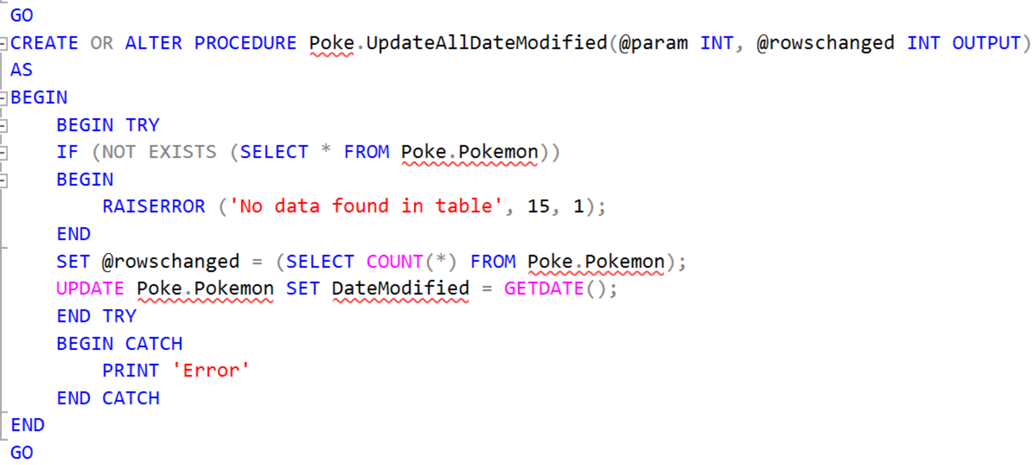
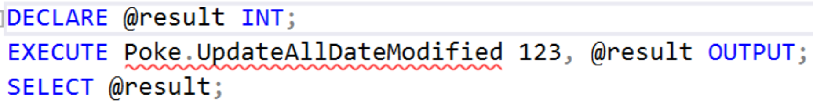
Procedure with Try/Catch
This procedure updates all the DateModified values to the current time and returns the number of rows modified.

Slide 14
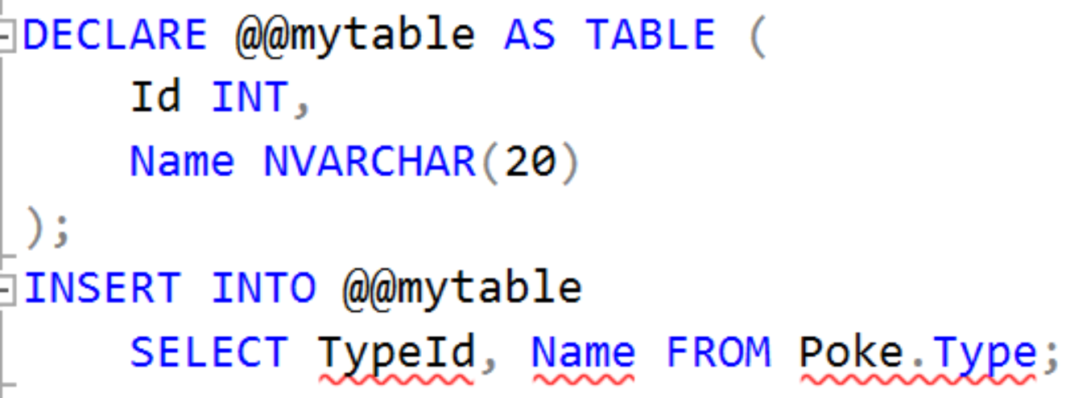
SQL – Value-Typed Variables

