Slide 1

Transactions and Isolation Levels
.NET

Slide 2
Transactions specify an isolation level that defines the degree to which one transaction must be isolated from a resource or from the data modifications of other transactions. Isolation levels indicate which concurrency side effects are allowed.
https://docs.microsoft.com/en-us/sql/connect/jdbc/understanding-isolation-levels

Slide 3
Isolation Level and Read Errors https://www.geeksforgeeks.org/transaction-isolation-levels-dbms/#:~:text=
Isolation levels define the degree to which a transaction must be isolated from other data modifications made by any other transaction.
A transaction isolation level is determined by its permissiveness of:
Dirty Read – When a transaction reads new, uncommitted data of another transaction.
Non-Repeatable read – When a transaction reads the same row twice and gets a different value each time.
Phantom Read – When two identical queries are executed but the rows retrieved by the two are different.

Slide 4
Isolation Levels https://docs.microsoft.com/en-us/sql/connect/jdbc/understanding-isolation-levels?view=sql-server-ver15
Transaction Isolation Levels control:
If locks (and what type of locks) are enacted when data is read.
How long read-locks are held.
If a read operation references rows modified by another transaction:
Block until the exclusive lock on the row is freed.
Retrieve the committed version of the row that existed at the time the statement or transaction started.
Read the uncommitted data modification.
Regardless of Isolation Level, a transaction always gets an exclusive lock on any data it modifies until the transaction completes. Transaction isolation levels primarily define the level of protection from the effects of modifications made by other transactions.

Slide 5

Isolation Levels – Serializable https://sqlperformance.com/2015/04/t-sql-queries/the-read-uncommitted-isolation-level
The only Transaction Isolation Level that provides complete isolation from concurrency effects is Serializable. A transaction will see the latest committed data. The set of data encountered under serializable isolation is guaranteed not to change before the transaction ends.

Slide 6
Isolation Levels – Repeatable-Read https://sqlperformance.com/2015/04/t-sql-queries/the-read-uncommitted-isolation-level
The Repeatable Read isolation level is guaranteed to read only committed data. If two identical queries are enacted simultaneously, they may return different results.

Slide 7
Isolation Levels – Read-Committed https://sqlperformance.com/2015/04/t-sql-queries/the-read-uncommitted-isolation-level
Read committed can see committed data from different points in time – even for a single row if the query plan uses techniques like index intersection.

Slide 8

Isolation Levels – Read-Uncommitted https://sqlperformance.com/2015/04/t-sql-queries/the-read-uncommitted-isolation-level
Read uncommitted is the weakest of the four transaction isolation levels.
It allows all three "concurrency phenomena“; dirty reads, non-repeatable reads, and phantom reads. There's no read locking or versioning, so overhead is minimized.

Slide 9
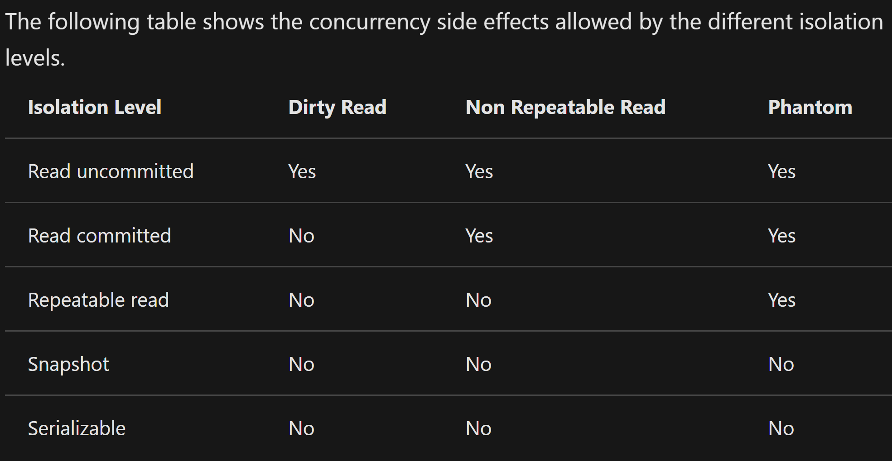
Isolation Levels – In context https://docs.microsoft.com/en-us/sql/connect/jdbc/understanding-isolation-levels?view=sql-server-ver15#remarks

Slide 10
Commit/Rollback/Savepoint https://www.techopedia.com/definition/16/commit#:~:text=
Commit - Refers to the saving of data permanently after a set of tentative changes.
Rollback - An operation which returns the database to some previous state.
Savepoint - A way of implementing nested transactions within a RDBMS by indicating a point within a transaction that can be "rolled back to" without affecting any work done in the transaction before the Savepoint was created. Multiple Savepoints can exist within a single transaction.

